Slide 1
Gamification with the Word wall:
A Movement approach to enhancing literacy skills
Dr. Kristina DeWitt, Liberty University
Mr. Glen DeWitt, Lynchburg City Schools

Slide 2
Today…
Gamification
Background
Where to Start in the Classroom
Literacy Connections
Our Project with Word Walls

Slide 3
What is Gamification Anyway?
By definition
“Gamification” is the use of game design and mechanics to enhance non-game contexts.

Slide 4
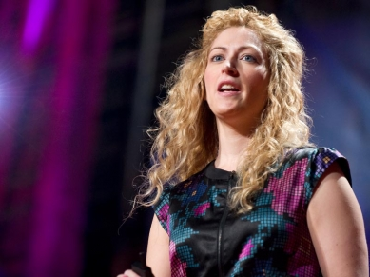
Today's student will spend 10,000 hours playing computer and video games
by the age of 21
- Jane McGonigal
Notes:
TED Talk -- Jane McGonigal: Gaming can make a better world (TED2010)

Slide 5
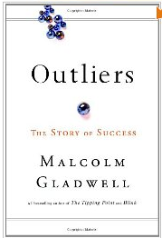
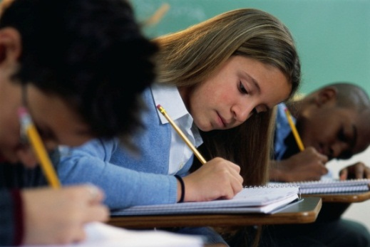
10,000 hours. . .
To mastery…
  Gladwell’s Outliers
Formal instruction in school grades 3 through 12
  997 hours per year
      National Center for Education Statistics

Slide 6
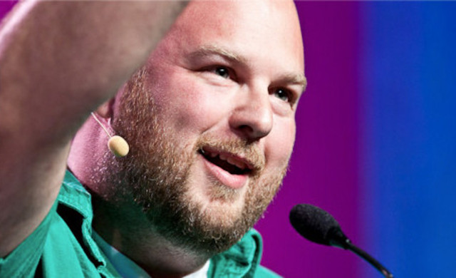
Positively Changing Behavior
Engagement
Motivation
Gamification engages users and changes behavior with the best ideas from games, loyalty programs and behavioral economics
- Gabe Zichermann

Slide 7
Gamification of Education
Games, in any form, increase motivation through engagement.
It’s argued that this is due to current systemic flaws in the way we teach; schools are behind the times.
Level Up - XP

Slide 8
Benefits of Adding
Gamification to Classrooms
Boosts enthusiasm towards the subject
Lessens disruptive behavior
Increases cognitive growth
Incorporates make-believe scenarios which encourages growth and development
Improves attention span through game-centric learning

Slide 9
“Great games require participation and interaction from the players and simultaneously give players immediate and constant feedback on how they're doing.”
Kate Salen, an executive director of the Institute of Play
This was our goal in this project

Slide 10
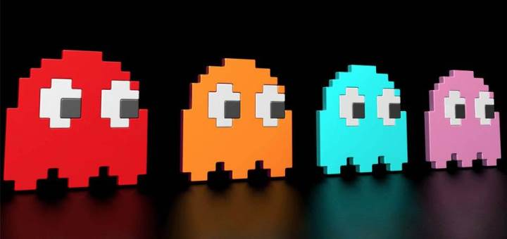
How to Gamify Smart
Rewards
Goal = Engage students’ learning experiences
Fun
Students to take control of their learning
Learn about gamification yourself
"Gamification is not some magic pixie dust that you sprinkle on top of something. You have to understand how to deploy a system that's appropriate to the task at hand and the motivations of the people involved," Werbach says.

Slide 11
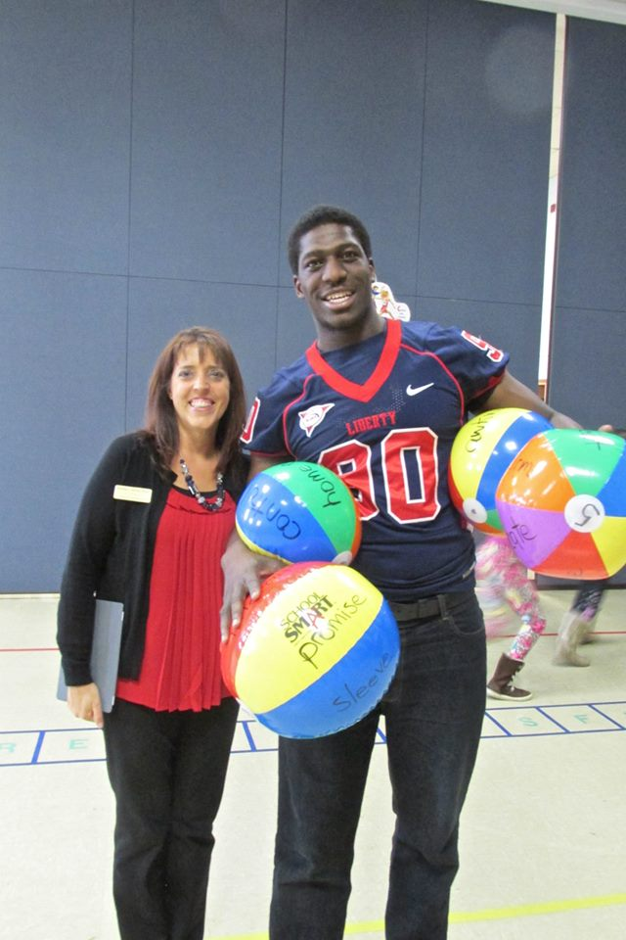
Literacy skills
How we Prepared for
the Gamification Concept

Slide 12
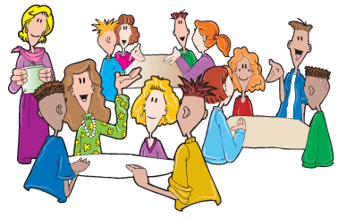
collaboration
Pre Planning
Which Literacy Skills
Grade level discussions
Partnership with University
SOLs
Key topics students were studying
Asked: What would work best?
Sight words
Key vocabulary/concepts
Across Curriculum Thematic topics

Slide 13
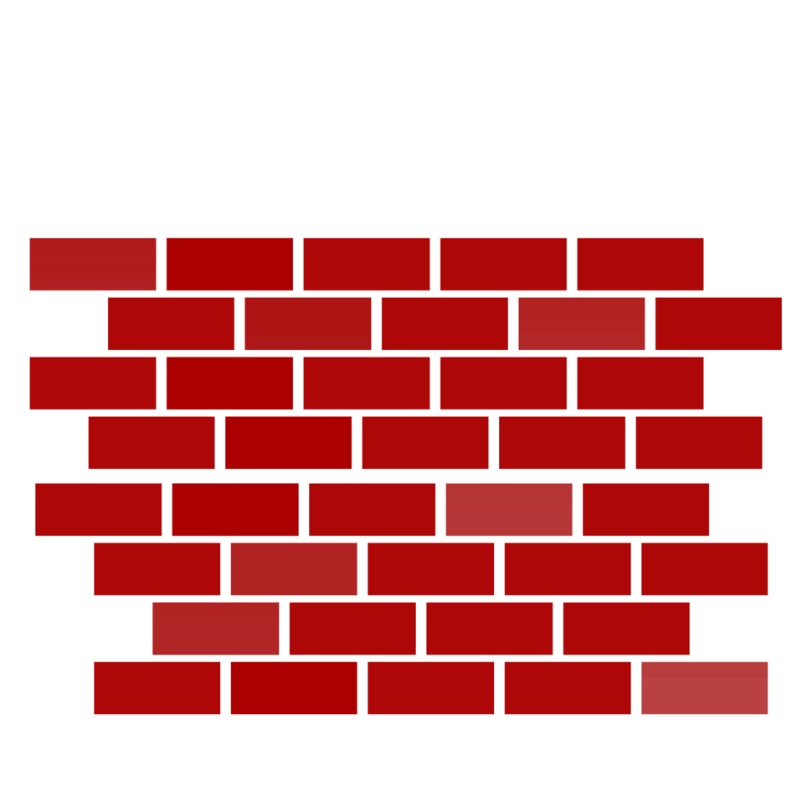
I n t e r a c t I v e w o r d w a l l
Learning on the Move

Slide 14
HOW DO I USE WORD WALLS?
Spelling/Vocabulary Word Recognition
Beginning & Ending Sounds
Story Content Review
4. Order of Story Events
Vowel Recognition

Slide 15
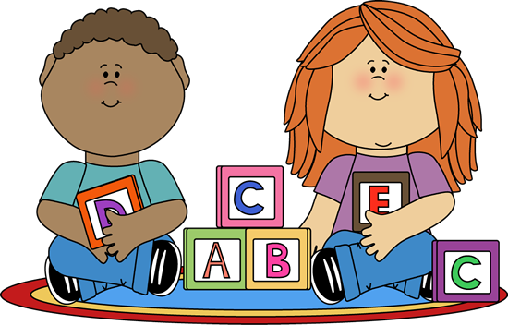
EQUIPMENT FOR YOUR WORD WALL
Open wall space
Construction paper with written words
A soft ball to throw—Yarn balls work the best

Slide 16
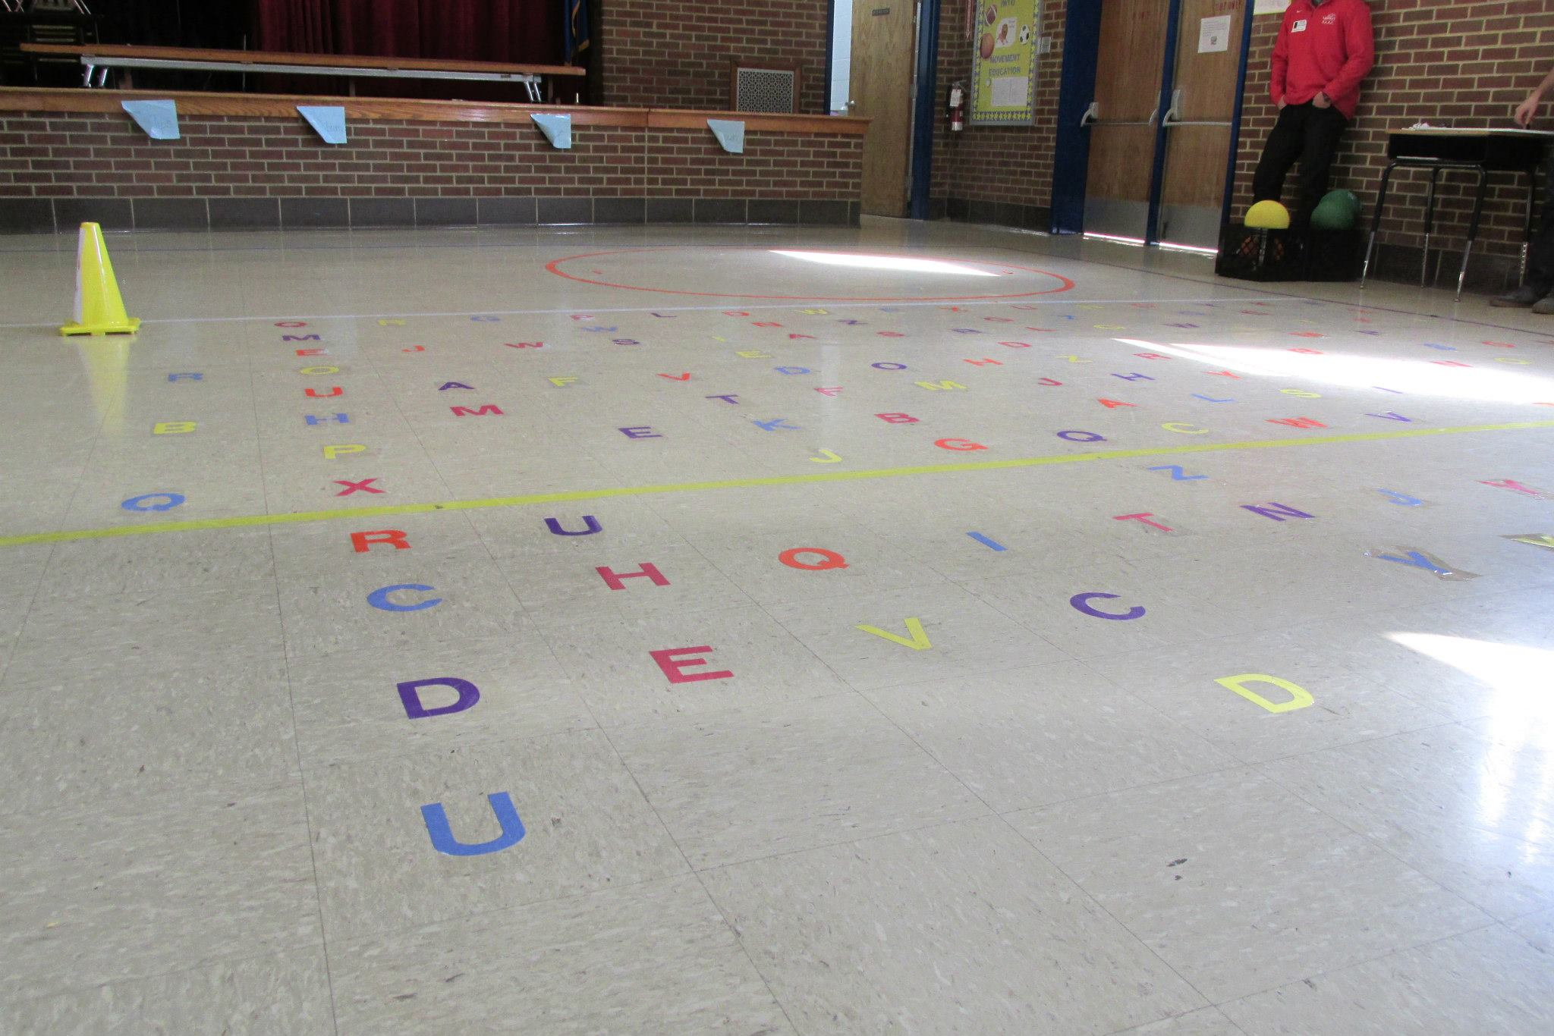
WORD WALL SET UP IN THE CLASSROOM
Grouped together in one space
Scattered around the room
Do not position close to breakable objects

Slide 17

HIT YOUR HOMONYMS
peace know their right
write sale piece no
pair sea two led
lead too sail see
pear there

Slide 18
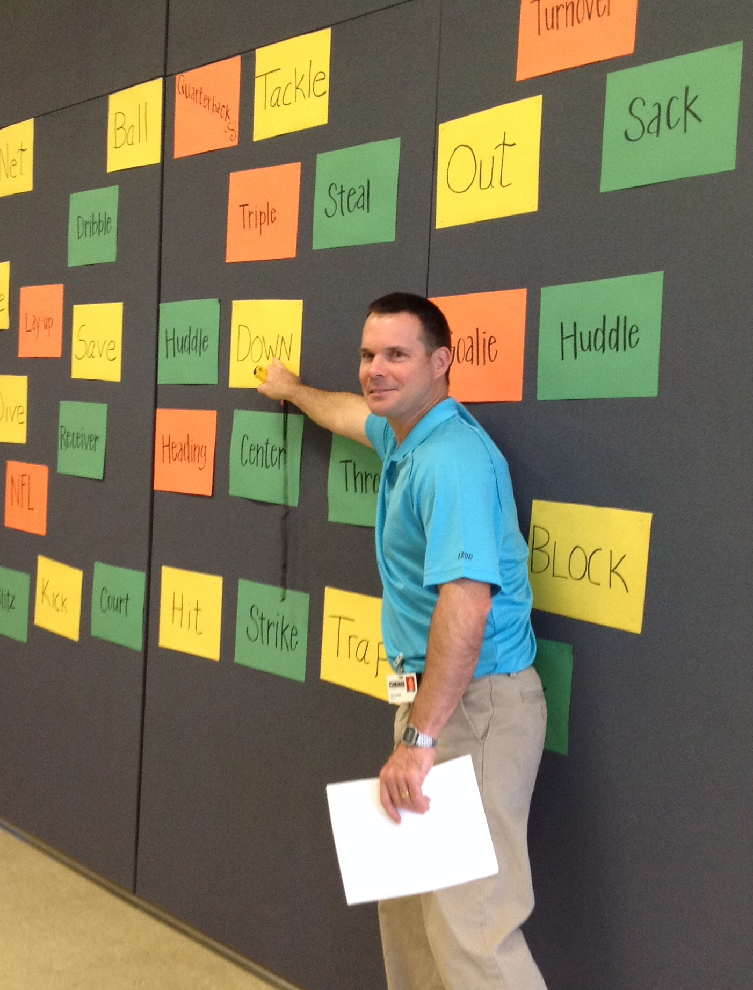
ADVANTAGES OF WORD WALLS
Allows your students to get out of their seat
Reduces restlessness—Boys
Reinforces the lesson
Creates full involvement of all students
It is something different—Adds excitement
Students are throwing the ball to hit the correct answer

Slide 19
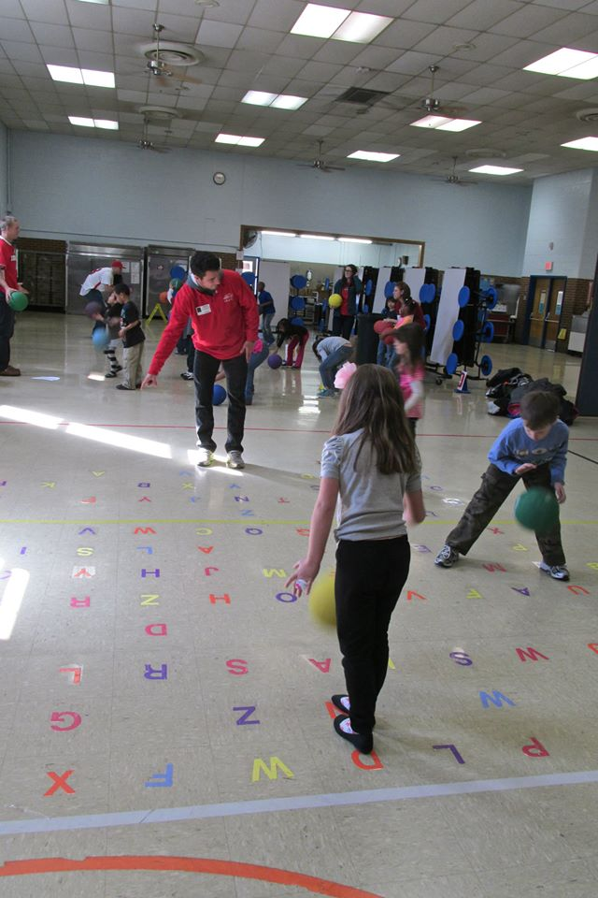
A WORD WALL ON THE FLOOR?
Same concept as the traditional word wall
Great tool for spelling
Student bounces a ball on each letter to spell out the word
3-4 alphabets on the floor
Can have multiple students involved at the same time

Slide 20
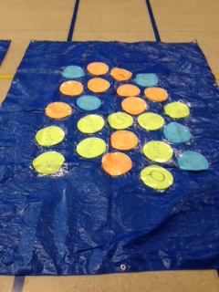
EQUIPMENT FOR THE FLOOR WALL
1-3 playground balls
Packaging tape
Construction paper for letters—Multiple colors
Tarps 4X8—Your choice @ Lowes $5

Slide 21
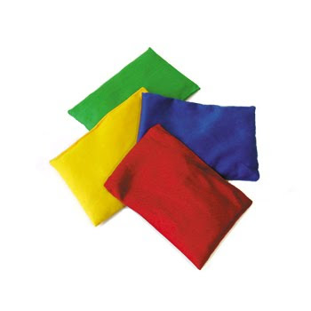
Beanbag Spelling Relay Races
Learning on the Move
3-4 sets of alphabet beanbags
Extra beanbags for a,e,i,o,u & as needed
ex. treat, feet, borrow, apple
2 matching hula hoops for each team
List of grade level words—or higher

Slide 22
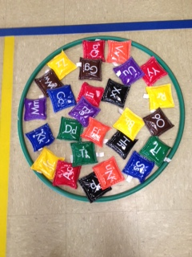
SPELLING RELAYS CONTINUED
How The Relays Are Played
Divide your class into teams
Each team has a set of the entire alphabet
Team members take turns being the runner/speller

Slide 23
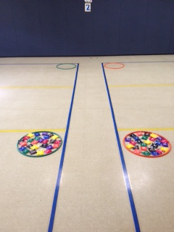
Spelling Relay
Set Up

Slide 24
HOW THE RELAYS ARE PLAYED
Runner/speller stands up beside the first hoop
The teacher says the word—Use in a sentence if needed
The team is sitting around the alphabet hoop finding the letters for the word—Promotes teamwork
The letters are placed on the floor in front of the hoop
The speller picks up one letter at a time and runs it down to the second hoop

Slide 25
HOW THE RELAYS ARE PLAYED
Runner returns to pick up a second letter, runs it down and continues until the word is spelled out completely in the spelling hoop.
When the runner has finished spelling the word, have them sit down beside their word to show that they are finished
First team to successfully spell the word would win that relay race
Have the entire class spell the word together before moving on to the next word. Pick a new runner/speller

Slide 26
SETTING UP YOUR TEAMS
Spread the ability level evenly on all teams
Can do boys against girls if ability levels allow
Differentiate as needed—Have a partner helping the runner/speller spell out the word

Slide 27

Questions
Comments
Where do we go from here?
Contact Information
Kristina DeWitt kdewitt@liberty.edu
Glen DeWitt dewittgc@lcsedu.net

