Slide 1

You’re starting a what?:
Talking to faculty, staff, and students about DigitalCommons@SPU
Kristen Hoffman
Psychology and Scholarly Communications Librarian
Seattle Pacific University

Slide 2
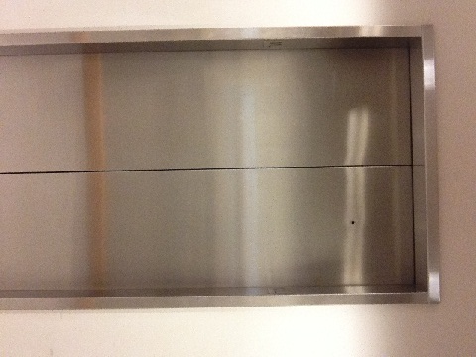
DigitalCommons@SPU
Objectives:
Create elevator speech
Identify faculty, staff, and
  student needs that can
  be met by DC@SPU

Slide 3
DigitalCommons@SPU
Outcome:
Library staff and faculty should be able to explain
  what DC@SPU is,
  how it may help meet a campus need,
  who to contact, and
  where to find more information.

Slide 4
DigitalCommons@SPU
So what is it?
Discover, Create, Share
Digital Commons @ SPU:
Facilitates discovery and sharing of scholarly and creative work associated with SPU

Slide 5

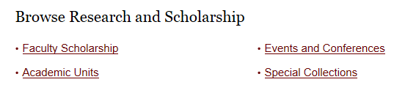
DigitalCommons@SPU
Includes SelectedWorks
Can archive articles, data, media, ETDs, digital archives; publish conference papers, journals and books

Slide 6
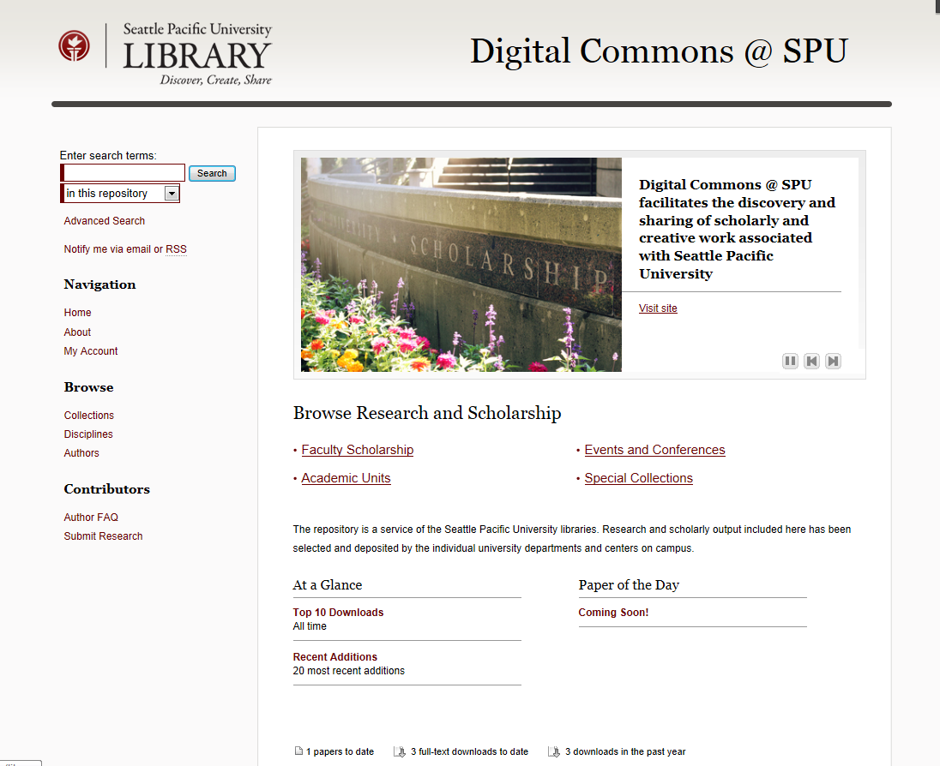
digitalcommons.spu.edu
Notes:
Contributors will submit documents to us for uploading, at least for now. We’ll put them in the appropriate collection and series, or create one if needed.
My Account – current faculty, staff, and students can use SPU username and password (CAS) to log in and see their author dashboard to see what searches people have used to find their contributions, how many times they’ve been downloaded, etc, and to create/manage their SelectedWorks page.

Slide 7
Campus Needs
Faculty, staff, and students will participate if we address their needs and concerns:
tenure and review
research and publication
scholarly reputation
citation counts
grant requirements
collaboration with other colleagues
finding out what their colleagues are doing
dissemination and visibility of their work
teaching
their scholarly legacy
Notes:
From bepress’s Getting Faculty Excited about your IR: Really? Really! at http://vimeo.com/64334080

Slide 8
Campus Needs
Collections in process or planned:
Faculty scholarship: full text articles (published or unpublished), links to books, etc.
Conference proceedings -
Archival materials - Adrienne
Brainstorm blog - UC
iTunesU/YouTube videos - ETM
ETDs – graduate depts.
Notes:
Environmental scan: when I started here, I planned on trying to figure out what the needs on campus were in relation to scholarly communications. That process has begun much easier than expected – just talking with faculty about what they’re currently working on and what we’re doing with Digital Commons brings up ways that we can meet their needs.

Slide 9
Campus Needs
Other possible campus needs:
Dataset storage (Biology, Psychology)
Peer-reviewed journal
Student Research Conferences

Slide 10
What we can do:
Listen: What needs exist on our campus?
  Ask: “What have you been working on lately?”
Share: How can DigitalCommons@SPU help?
Consider: How can we continue to promote DC@SPU?
  Brochures, twitter, library homepage, blog

Slide 11
Questions?
  Kristen Hoffman – main DC@SPU contact
  Adrienne Meier – digital archives
Find out more:
  digitalcommons.spu.edu - FAQ

Slide 12
Practice:
Take turns asking the person next to you, “What is Digital Commons @ SPU?” and give a short (30-second) answer.
Think about what needs you’ve heard around campus lately that DC@SPU may help with. Write down the name or dept. and the need. How would you share about DC@SPU?
  Example: a faculty member wants to start a peer-reviewed journal – DC@SPU offers peer-review capabilities and online journal publication

