Slide 1
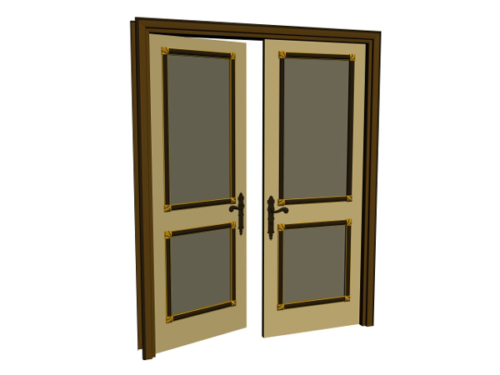







Current Condition of Curriculum Materials Centers & Collections in Academic Institutions in the State of Michigan-2014
Rita Kohrman, Grand Valley State University, kohrmanr@gvsu.edu
Since 2005
6
62% Static
27% Closed
23% Relocated
15% Reduced
4% Merged
New
no major changes
no longer in operation
moved to main library
facility became smaller
two facilities became one
newly discovered
Percentages are based on 26 CMCs contacted in 2014.
Reasons for Changes
80% Budget
80% Space
40% Staffing
20% Low Use
10% Mission Change
Percentages are based on 10 closed /reduced CMCs contacted in 2014.
August 2015

