Slide 1

What a Difference 10 Years Make
Update on the Michigan Curriculum Materials Centers and Collections
Rita Kohrman
Grand Valley State University
Education & Juvenile/YA Literature Librarian
MICHIGAN ACADEMIC LIBRARY ASSOCIATION
Annual Conference 2016
May 12, 2016
(Benscherjon. (n.d.). Track-842483-640.jpg. CC0 Public Domain)
Notes:
Thank you for coming to my presentation on ….
This presentation has its beginnings in 2005 when I had a sabbatical to study the curriculum materials centers and collections located in Michigan colleges and universities. At that time I was able to locate 24 such centers and collections, one in the midst of closing. My 2014 study asked how or if the Michigan centers or collections devoted to preservice education prep. changed due to the economic and academic changes that occurred since 2005.
First though, I need to know how many of you might already know about CMCs, curriculum materials centers and collections?

Slide 2
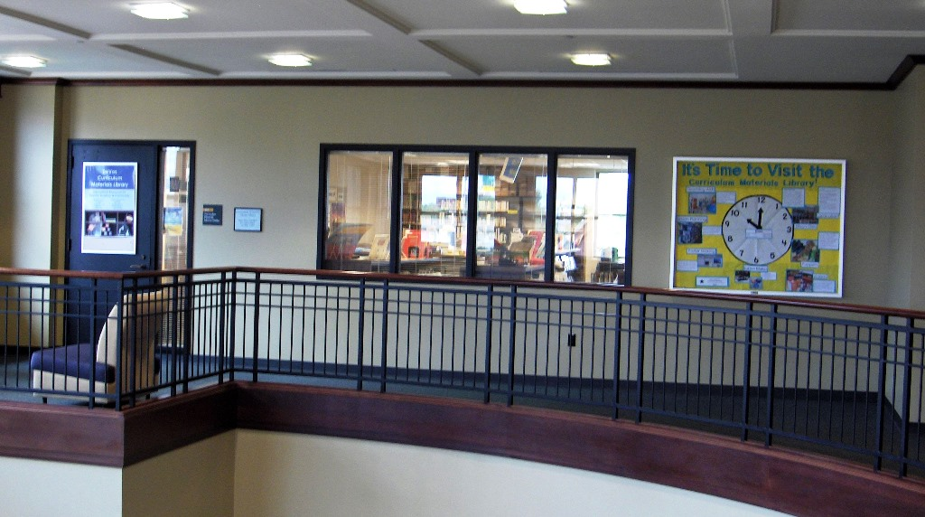
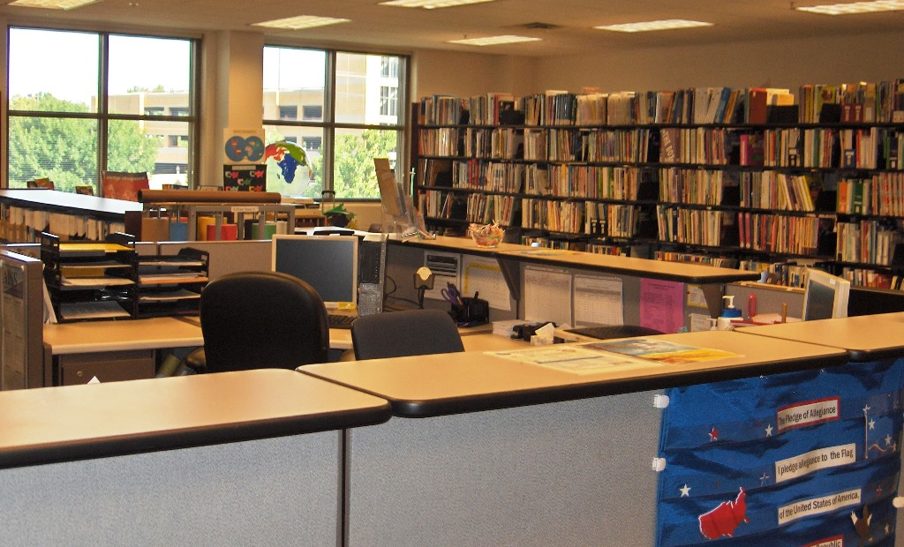
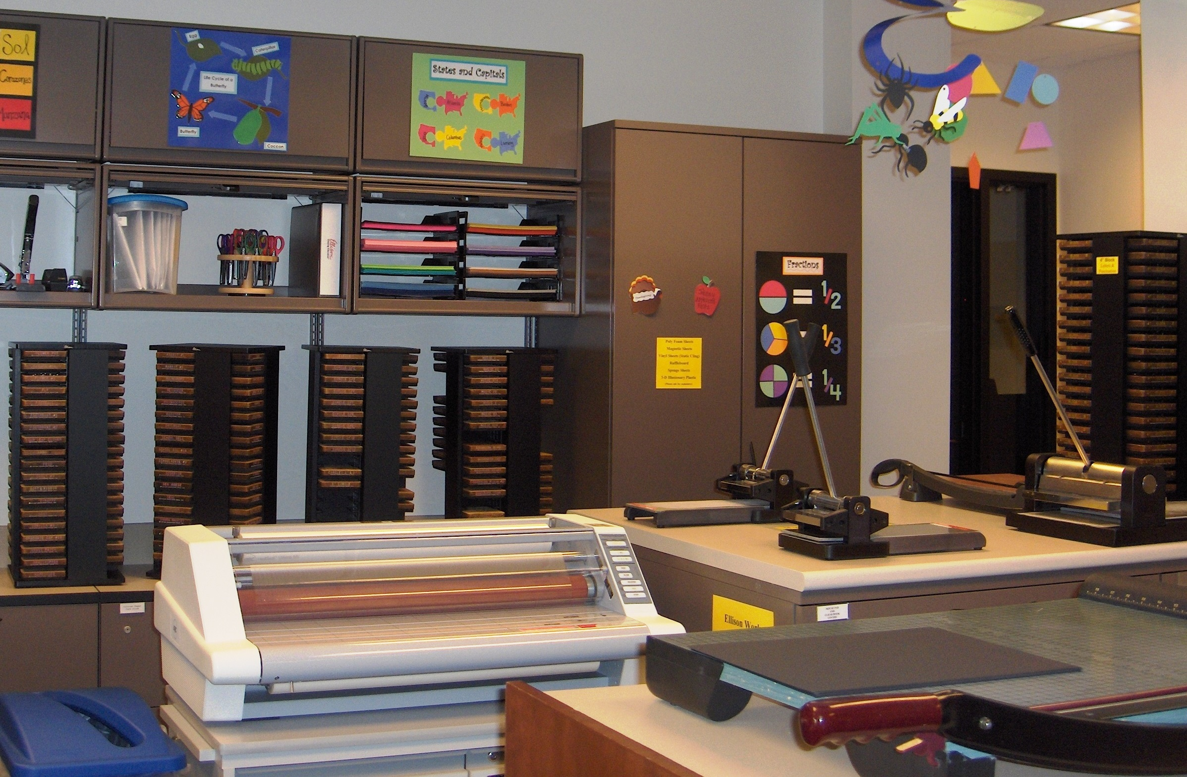
From Collections to Laboratories to Centers/Libraries …
Notes:
CMCs are specialized centers or libraries and collections developed to support teacher education programs within colleges and universities. CMCs are usually located in libraries or education buildings. Historically, K-12 materials were private collections of teachers and faculty. Later, to help save expenses, collections were centralized into laboratories or centers or libraries. (Second image) Instructional materials used in preschool through high school classrooms are found in the collections. (Third image) Many centers also have educational equipment found in school systems such as binding machines, laminators, poster printers, and die cuts.
Henry Harap is credited with coining the term curriculum laboratory in 1932. He is viewed as one of the most influential “curriculum technician”(1) at the time. The term curriculum laboratory was widely used until the 1960s, when center became the preferred designation.
1 Appendix: Fundamental curriculum questions. (2010). In C. Kridel (Ed.), Encyclopedia of curriculum studies (pp. 953-970). Thousand, Oaks, CA: Sage.

Slide 3
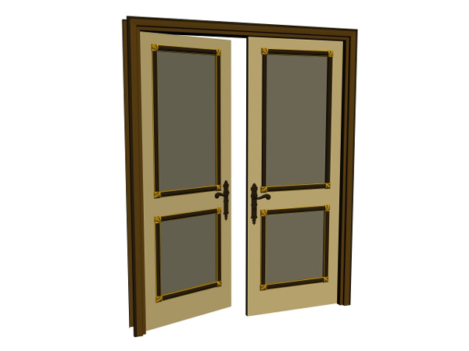







Current Condition of Curriculum Materials Centers & Collections in Academic Institutions in the State of Michigan-2014
Rita Kohrman, Grand Valley State University, kohrmanr@gvsu.edu
Since 2005
6
62% Static
27% Closed
23% Relocated
15% Reduced
4% Merged
New
no major changes
no longer in operation
moved to main library
facility became smaller
two facilities became one
newly discovered
Percentages are based on 26 CMCs contacted in 2014.
Reasons for Changes
80% Budget
80% Space
40% Staffing
20% Low Use
10% Mission Change
Percentages are based on 10 closed /reduced CMCs contacted in 2014.
August 2015
Notes:
Here you can see with a quick visual glance that, yes, a lot of changes has occurred. The following slides provide the detailed information.

Slide 4
No Major Changes to 16 (62%) Since 2005
Adrian College
Albion College
Alma College
Andrews University
Concordia University
Cornerstone University
Ferris State University
Hope College
Oakland University
Spring Arbor University
University of Detroit-Mercy
University of Michigan-Dearborn
University of Michigan-Flint
Wayne State University
*Northern Michigan University
Notes:
Since 2005, 16 centers or collections have continued on with little or no change. The asterisk besides Northern Michigan University represents a CMC that was operational in 2005 but incorrect information was provided as to its existence.

Slide 5

7 (27%) Closed
Calvin College
Eastern Michigan University
Grand Valley State University (1 facility closed)
Kalamazoo College
Marygrove College
Saginaw Valley State University
*Madonna University
Notes:
Seven facilities or collections were closed, with a couple of caveats. At time of my 2005 study, Kalamazoo center was in the process of giving all materials away.
Since 2005, Calvin College, Eastern, and Saginaw Valley centers closed. After major deselection projects, many of the collections were either moved to the main libraries or given to other departments. Marygrove’s collection was moved into the library’s main stacks. An asterisk before Madonna University indicates the existence of a CMC but not found during the 2005 study.
The Grand Valley Zumberge Curriculum Materials Library located on the Allendale campus closed with materials relocated to the Grand Rapids CML. More information regarding the closing of the Zumberge Curriculum Materials Library will be shared in another slide further into the presentation.

Slide 6

6 (23%) Relocated to Library
Aquinas College
Calvin College
Central Michigan University
Eastern Michigan University
Marygrove College
Saginaw Valley State University
Notes:
Collections located at these facilities were reduced greatly and relocated either all or a portion to the main stacks or main libraries.

Slide 7

4 (15%) Reduced in Size
Aquinas College
Central Michigan University
Grand Valley State University
Siena Heights University
Notes:
Four had their collections or centers dramatically reduced in square footage and deselected their resources.

Slide 8

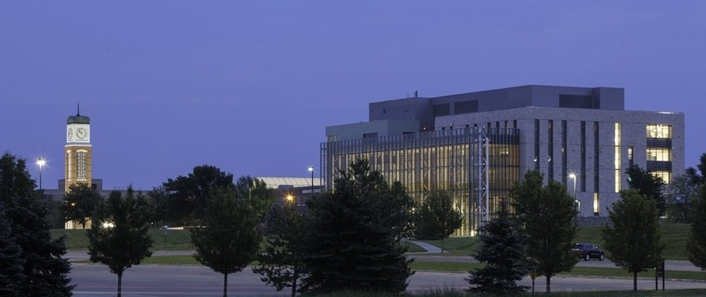
1 (4% )Merged
Zumberge Curriculum Library
Allendale campus
DeVos Curriculum Materials Library
Grand Rapids campus
Mary I. Pew Library Curriculum Collection
DeVos Curriculum Materials Library
Notes:
One facility merged with another center. (CLICK) At GVSU in 2006, the Zumberge Curriculum Library on the GVSU Allendale campus provided services mainly to the content faculty and students. Meanwhile, the DeVos Curriculum Materials Library on the GR campus focused its services to the College of Education faculty and students located downtown. Prior to the 2013 opening of the new Mary I. Pew Library, the Zumberge print collection was weeded of duplicates. (CLICK) It was during this time that the decision was made to close the future Mary I. Pew Curriculum Materials Library. We worked with the content faculty located on the Allendale campus to identify those materials they deemed necessary for the success of their programs. Duplicate equipment was given to either other departments within the library or to other departments located on the Allendale campus. The extra puppets were given to the Children Center for their use.
With the opening in 2013 of the Mary I., (CLICK) the two became one – with a smaller print collection containing only textbooks and lesson planning books at the Mary I. Pew Curriculum Collection.

Slide 9

6 (23%) Newly Discovered
Baker Colleges (Allen Park, Cadillac, Muskegon)
*Madonna University
Miller College/Kellogg Community College
*Northern Michigan University
Notes:
Six new or previously existing CMCs were identified during the 2015 study. Madonna and Northern Michigan University were not a part of the 2005 study due to incorrect information given to me at the time. Baker College has three early childhood print collections. Meanwhile, Miller College and Kellogg Community College have small collections. They share campus grounds and have an agreement where KCC provides library services and resources to Miller College faculty and students. A cooperative venture allows the two colleges to share education curriculum materials and expand the collection for optimum student benefit.

Slide 10
Reasons for Changes
8 (80%)
8 (80%)
3 (40%)
2 (20%)
1 (10%)
Notes:
But what are reasons I found for these sometimes dramatic changes? (CLICK)
Eight CMCs experienced budgetary changes. (CLICK)
Eight found the use or the reallocation of space a focus of their change. (CLICK)
Three CMCs faced a reduction in the staffing. (CLICK)
Two indicated low usage as a reason for either closure or relocation of the collection. (CLICK)
One center, faced with a small enrollment in the education major, had to rethink their mission and closed their facility.

Slide 11


Who and Why
Aquinas
Calvin
CMU
EMU
GVSU
Kalamazoo
Madonna
Marygrove
SVSU
Siena Heights
Reading Clinic
CEHS Centers
Notes:
Aquinas: new library; Budget and space needs
Calvin: Budget and space needs
CMU: Space and staffing needs; went from 9000 square feet to 900 square feet with the building of a new education building. (CLICK) The Kromer Instructional Materials Center is still functional but with a different emphasis: providing appropriate resources and service with manipulative materials, kits, games, puppets, charts, maps, models, and other resources, with access to limited educational equipment. The textbook and juvenile and young adult collections have been moved to the University’s Park Library. (CLICK) The School of Education now has a Reading Clinic, containing many textbooks and children’s reading materials for their K-8 reading workshops. (CLICK) Other centers within the School of Education have opened with provide more of a laboratory learning environment for in-service and pre-service teachers.
Eastern Michigan University: Budget and space needs
GVSU: Budget, space, staffing, low use
SVSU: Budget, space, staffing. As of June 2012, all books that had been housed in the RERC (Regional Educational Resource Center) have been housed with similar material in the Zahnow Library. Curriculum materials are located near the Children's Literature collection on the 4th floor of the library.
Siena Heights: Budget, and space needs

Slide 12
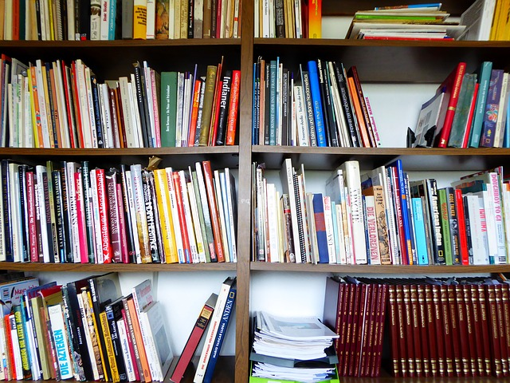
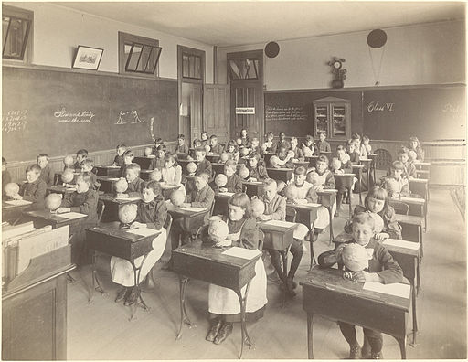
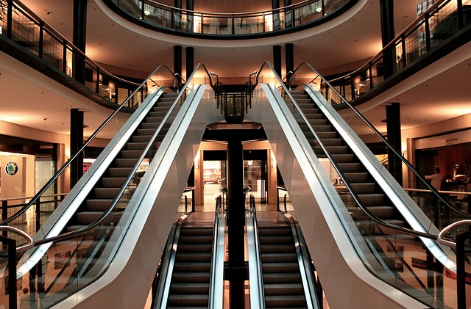
Notes:
Image Credit: EME. (n.d.). Bookshelf. Retrieved from https://pixabay.com/en/books-bookshelf-shelf-reading-797418/ CC0 Domain.
Unknown. (n.d.). Putnam School. Retrieved from https://commons.wikimedia.org/wiki/File%3A1892_PutnamSchool_Boston.jpg
cocoparisienne. (n.d.). Escalator. Retrieved from https://pixabay.com/en/escalator-stairs-metal-segments-283448/ CC0 Domain.
So we have gone from collections (CLICK) to laboratories (CLICK) to centers (or libraries) back . . .

Slide 13
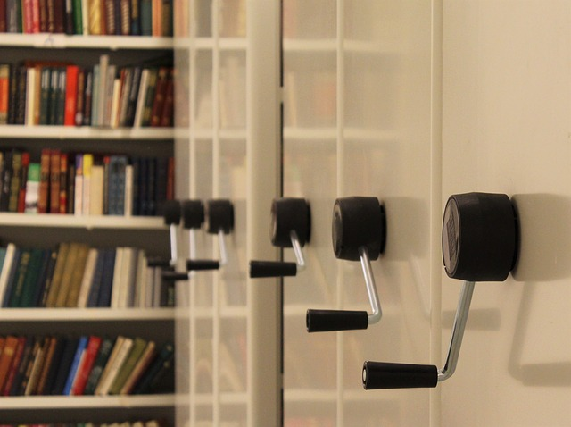
From Collections to Laboratories to Centers/Libraries to Collections
with fewer Centers
Notes:
Image Credit: klimkin. (n.d.). Repository. Retrieved from https://pixabay.com/en/repository-stock-books-shelves-pen-995180/ CC0 Domain.
…to collections.
Centers still exist but are having a time justifying their existence, especially during financial difficulties. Space is what rules in academia and is the tail that moves the dog. There were 35 curriculum libraries located in academia in 1938 according to Beatrice Leary’s 1938 study(2). Frances Drag found 145 centers or collections in 1947(3). In 1981 there were 187 CMCs listed(4) and 204 centers or collections in the 2009 Directory of Curriculum Materials Centers(5). The 2015 Directory of Curriculum Materials Centers and Collections reported a drop to 161 centers/collections, a 21% drop since 2009(6). This decline in centers and collections possibly confirms the anecdotal reports of CMC closures. The decline also is confirmed in my study of Michigan CMCs.

Slide 14
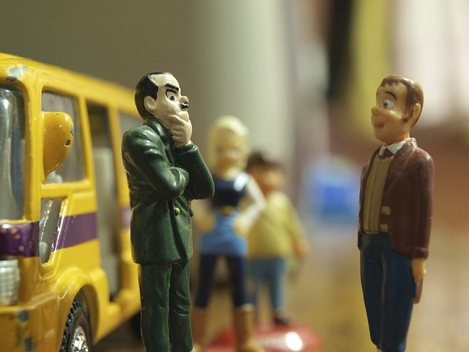
Notes:
Image Credit: ed_davad. (n.d.). Figures. Retrieved from https://pixabay.com/en/figures-toy-bus-talking-men-368751/ CC0 Domain.
There are major changes in Michigan academic CMCs since 2005 due to financial fluctuations within higher education because of the economic downturn. This is no surprise when remembering how much the 2008 economic struggles (stock market loss, Bernard Madoff investment fraud, etc.) affected many individuals and organizations, even Michigan colleges and universities.
Recognizing the escalating costs of curriculum materials, CMC/education librarians and staff should investigate the availability and variety of curriculum e-books, including open education resources. CMC staffs need to stay abreast of the variety and types of educational technology and apps and how to evaluate their usefulness as more K-12 schools venture into virtual learning. A concern is how CMCs, faced with the ever shrinking budgets and staff, are to manage the continual changing nature, upkeep, and costs of technologies. While some CMCs may not be able to include technology with their collections, being aware of the International Society of Technology in Education Standards (ISTE) for teachers and students will enhance and guide the CMC mission, vision, service, relevance, and viability. As Judy Walker from University of North Carolina, Charlotte, stressed one of her many writings, “These services may or may not be available within the confines of the CMC; but, regardless of their location, the CMC staff should be able to promote them to students and faculty” (5, p. 161).
Budgets, space, staffing, usage, and mission must keep up with the changes occurring in education. How CMCs looked in 2005 and in 2015 is guaranteed to change by 2025. Adapting and transforming is the key. This is the transformative nature of education. This is the transformative nature of curriculum materials centers and collections. (6, ¶19).
(5) Walker, J. (2001). Technology and the CMC. In J. A. Carr (Ed.), A guide to the management of curriculum materials centers for the 21st century (pp. 148-163). Chicago, IL: ACRL.
(6) Kohrman, R. (2015). Current condition of Michigan curriculum materials centers and collections in academic institutions. Education Libraries, 38(1). Retrieved from http://educationlibraries.mcgill.ca/article/view/5

Slide 15
???
Rita Kohrman
Education & Juv/YA Librarian
Grand Valley State University
kohrmanr@gvsu.edu
616.331.2622
Article is found at
Kohrman, R. (2015). Current condition of Michigan curriculum materials centers and collections in academic institutions. Education Libraries, 38(1). Retrieved from
http://educationlibraries.mcgill.ca/article/view/5

Slide 16
Complete listing of Michigan Curriculum Materials Libraries
@
https://michigancml.wikispaces.com/

Slide 17
Credits
Slide 2: (1) Appendix: Fundamental curriculum questions. (2010). In C. Kridel (Ed.), Encyclopedia of curriculum studies (Vol. 2, pp. 953-970). Thousand Oaks, CA: Sage.
Slide 12: (2) Leary, B. L. (1938). Curriculum laboratories and divisions: Their organization and function in State Departments of Education. Bulletin 1938, No. 7. Washington, DC: Government Printing Office, Retrieved from ERIC database. (ED542801)
(3) Drag, F. (1947). Curriculum laboratories in the United States. Education Monograph, No. 15. San Diego, CA: Curriculum Laboratory, Office of the Superintendent of Schools, Sand Diego County.
(4) ACRL, EBSS. (2009). Directory of curriculum centers (6th ed.). Chicago, IL: ACRL.
EME. (n.d.). Bookshelf. Retrieved from https://pixabay.com/en/books-bookshelf-shelf-reading-797418/ CC0 Domain.
Unknown. (n.d.). Putnam School. Retrieved from https://commons.wikimedia.org/wiki/File%3A1892_PutnamSchool_Boston.jpg
cocoparisienne. (n.d.). Escalator. Retrieved from https://pixabay.com/en/escalator-stairs-metal-segments-283448/ CC0 Domain.
Slide 13: klimkin. (n.d.). Repository. Retrieved from https://pixabay.com/en/repository-stock-books-shelves-pen-995180/ CC0 Domain.
Slide 14: ed_davad. (n.d.). Figures. Retrieved from https://pixabay.com/en/figures-toy-bus-talking-men-368751/ CC0 Domain.

