Slide 1

Honors in the Major
Formatting Workshop:
STARS
Kerri Bottorff
Digital Projects Librarian
Spring 2016

Slide 2
What is STARS?
UCF’s new Institutional Repository
  publicizes, disseminates, and provides ready access to works by, for, and about UCF
  Provides access to your work as broadly as possible and for as long as possible

Slide 3
Why publish in STARS?
Persistent access to your work
Items indexed in Google and Google Scholar
Authors receive monthly readership reports
Access to author dashboard
Notes:
abstract, keyword being two of the most important fields to include when you upload
Show author dashboard
Readership map

Slide 4
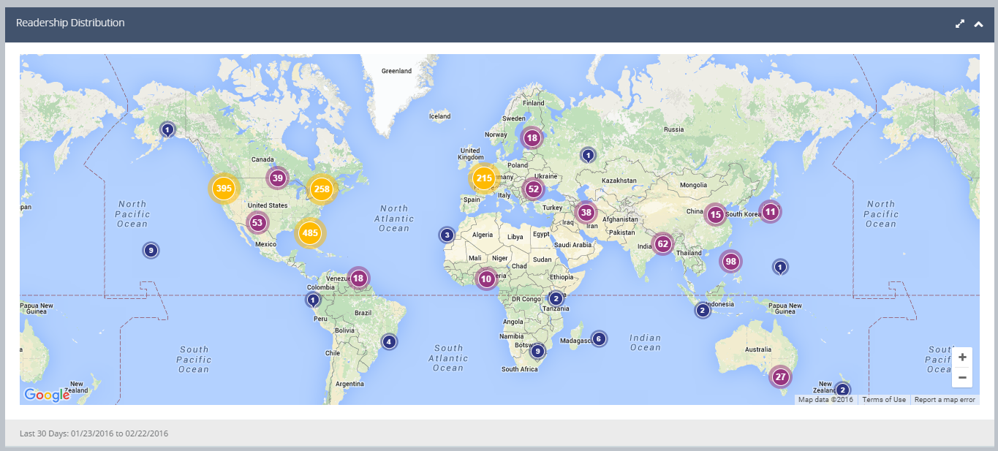
Notes:
Honors in the Major collection, last 30 days, pulled Monday, Feb 22nd

Slide 5
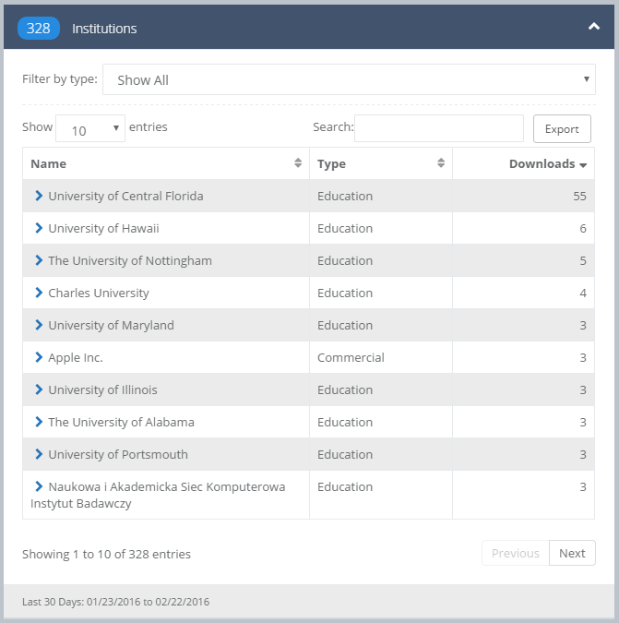
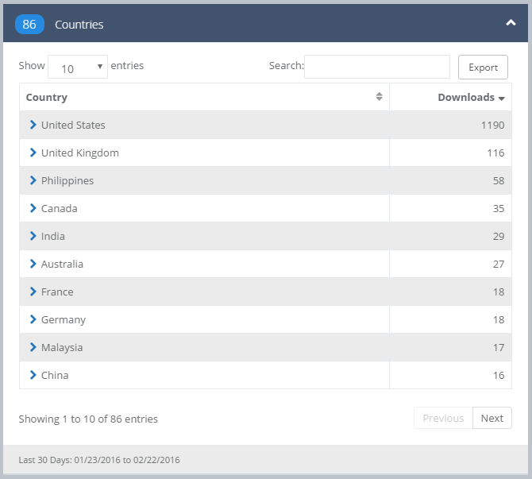
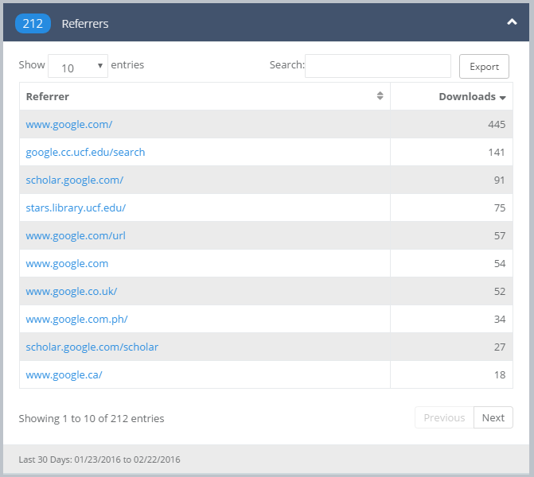
Notes:
Also from dashboard

Slide 6
Submitting to STARS
Create your account
  Name
  Email address
Make sure you have everything ready to submit your document
  You can only submit ONCE
ABSOLUTELY NO CHANGES ONCE YOU SUBMIT
  No, seriously, no changes
  I’m not joking
Notes:
Once you complete format review, you will receive instructions on how to submit, as well as a checklist of what you need to have handy

Slide 7
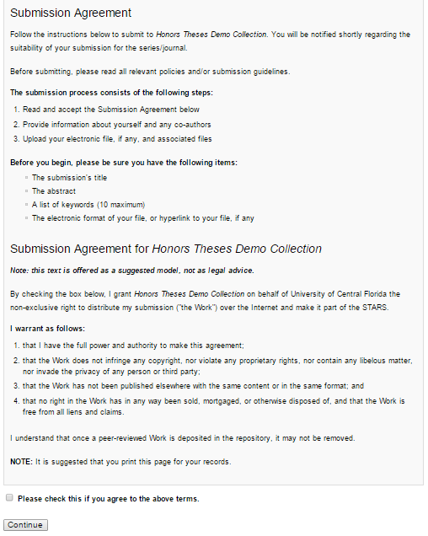
Before you complete the Submission Agreement, have the following ready:
  Approved Title
  Keywords
  Abstract
    As text, not copied and pasted from your pdf
  Advisor(s)
  Embargo/Dissemination choice
  Your thesis and any supplemental files
You will receive notification once your thesis has been added and is available.
Notes:
http://stars.library.ucf.edu/cgi/ir_submit.cgi?context=honorstheses

Slide 8
Questions?
Contact me!
Kerri Bottorff
Digital Project Librarian
kerri.bottorff@ucf.edu
(407) 823-1129

