Slide 1
Cataloging Accessibility Features
Kathryn Lybarger
Third Thursday
June 20, 2019

Slide 2
Accessible Library Materials
Which library materials do you think of as being accessible?
How is this recorded in the catalog record?

Slide 3
Recording Accessibility
300 __ ǂa 1 volume of print/braille : ǂb illustrations ; ǂc 28 cm
347 __ ǂa text file ǂb EPUB3 ǂ2 rda
500 __ ǂa Includes picture-in-picture signing
538 __ ǂa Full audio with structure
546 __ ǂa Closed captioned
655 _7 ǂa Video recordings for the hearing impaired ǂ2 lcgft

Slide 4
Or lack thereof?
(do we ever record when something is NOT accessible?)

Slide 5
Proposal to MARC Advisory Council
Proposal No. 2018-03: Defining New Fields to Record Accessibility Content
"As assistive technologies have evolved, the ability to accommodate accessibility metadata in MARC 21 has not kept pace"
Proposes two new MARC fields:
  341 – machine-actionable field to indicate accessibility features
  532 – a free text field for recording a human-readable summary of the accessibility features or deficiencies

Slide 6
RDA 7.14.1.1 - Accessibility Content
“An indication of content that provides alternative sensory modes to perceive the primary content of a resource. Accessibility content includes accessible labels, audio description, captioning, image description, sign language, and subtitles. Accessibility content does not include subtitles in a language different from the spoken content.”

Slide 7
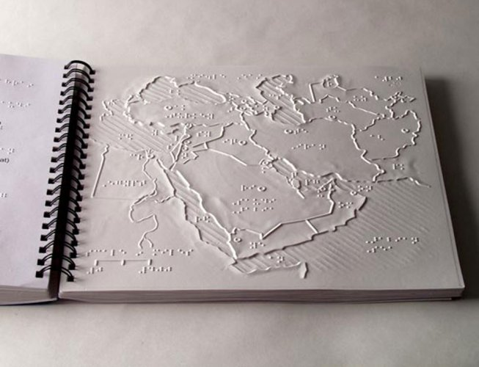
But not...
Not talking about resources where the primary mode of access is inherently accessible or assistive
  Books in braille
  Large print books
  Audiobooks
  Videos of Sign Language
  ( Translations / Subtitles )

Slide 8
341 Accessibility Content (R)
Information about modes of access to the content of a resource, including its primary mode of access and alternative mode(s) of access.
ǂa Content access mode -- Mode required to access the content of the resource without using assistive features (one of textual, visual, auditory, or tactile).
Other subfields describe the assistive features

Slide 9
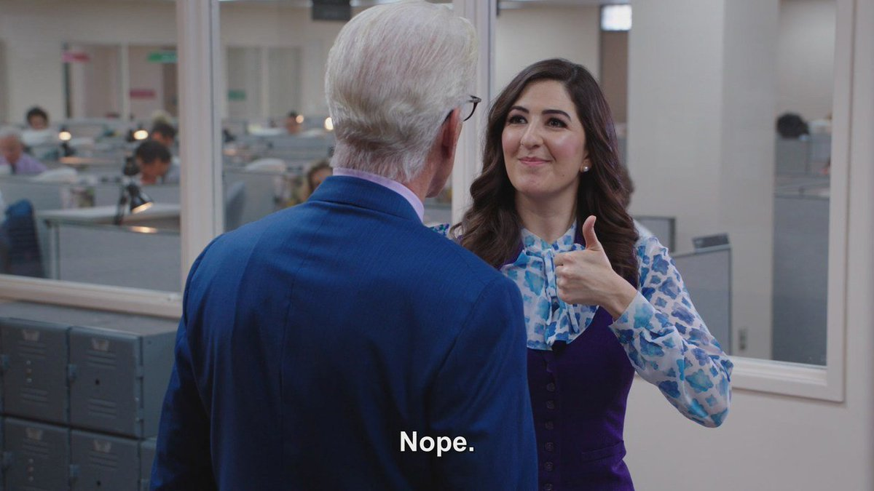
341 ‡b Textual assistive features (R)
341 ǂa auditory ǂb captions
341 ǂa auditory ǂb transcript
341 ǂa visual ǂb alternativeText

Slide 10
WebSchemas / Accessibility vocabulary
(possible vocabulary for this work)
alternativeText
annotations
audioDescription
bookmarks
braille
captions
ChemML
describedMath
displayTransformability
highContrastAudio
highContrastDisplay
index
...

Slide 11


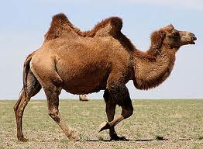

camelCase
Most single words are lowercase
Compound words have each new word starting with Capitals:
  braille
  largePrint
  highContrastDisplay
Some exceptions
  MathML
iOSAccessibility
This Photo by Unknown author is licensed under CC BY.

Slide 12
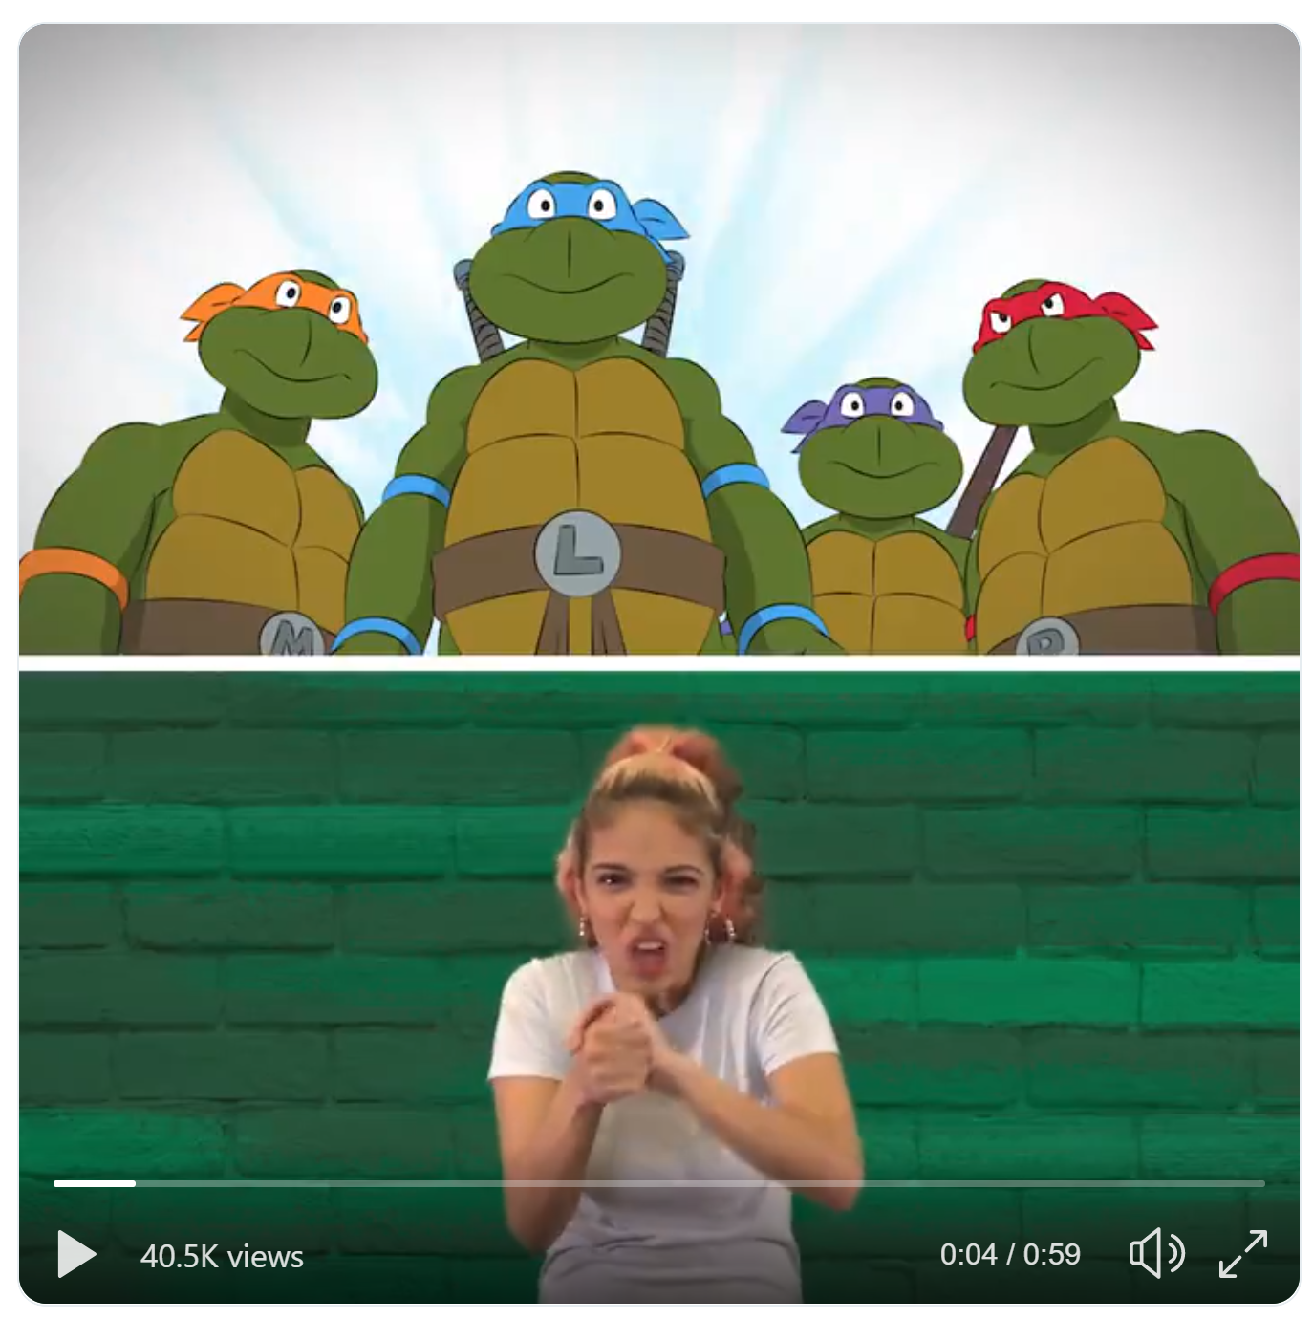
341 ‡c Visual assistive features (R)
341 ǂa auditory ǂc signLanguage
341 ǂa textual ǂc displayTransformability
https://twitter.com/TMNT/status/1088082998208221185

Slide 13
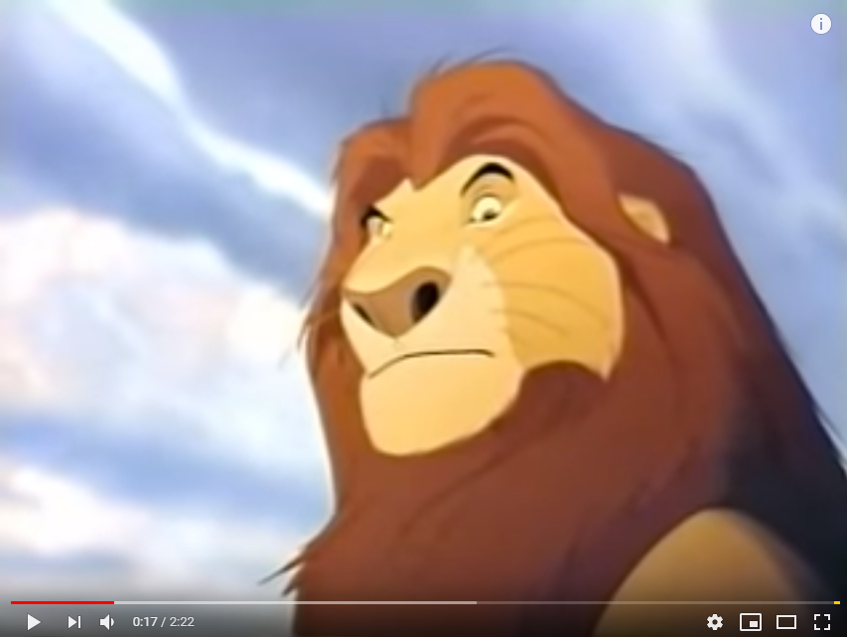
341 ‡d Auditory assistive features (R)
341 ǂa visual ǂd audioDescription
341 ǂa textual ǂd synchronizedAudioText
https://www.youtube.com/watch?v=jT5AsjzgIC4

Slide 14
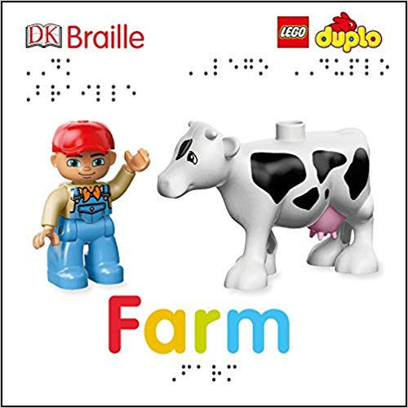
341 ‡e Tactile assistive features (R)
341 ǂa textual ǂe braille
341 ǂa visual ǂe tactileGraphic

Slide 15
532 Accessibility Note (R)
Textual information describing the accessibility features, hazards, and deficiencies of a resource, including technical details relating to accessibility features. This field may be used to expand on or to qualify data in field 341 (Accessibility Content).

Slide 16
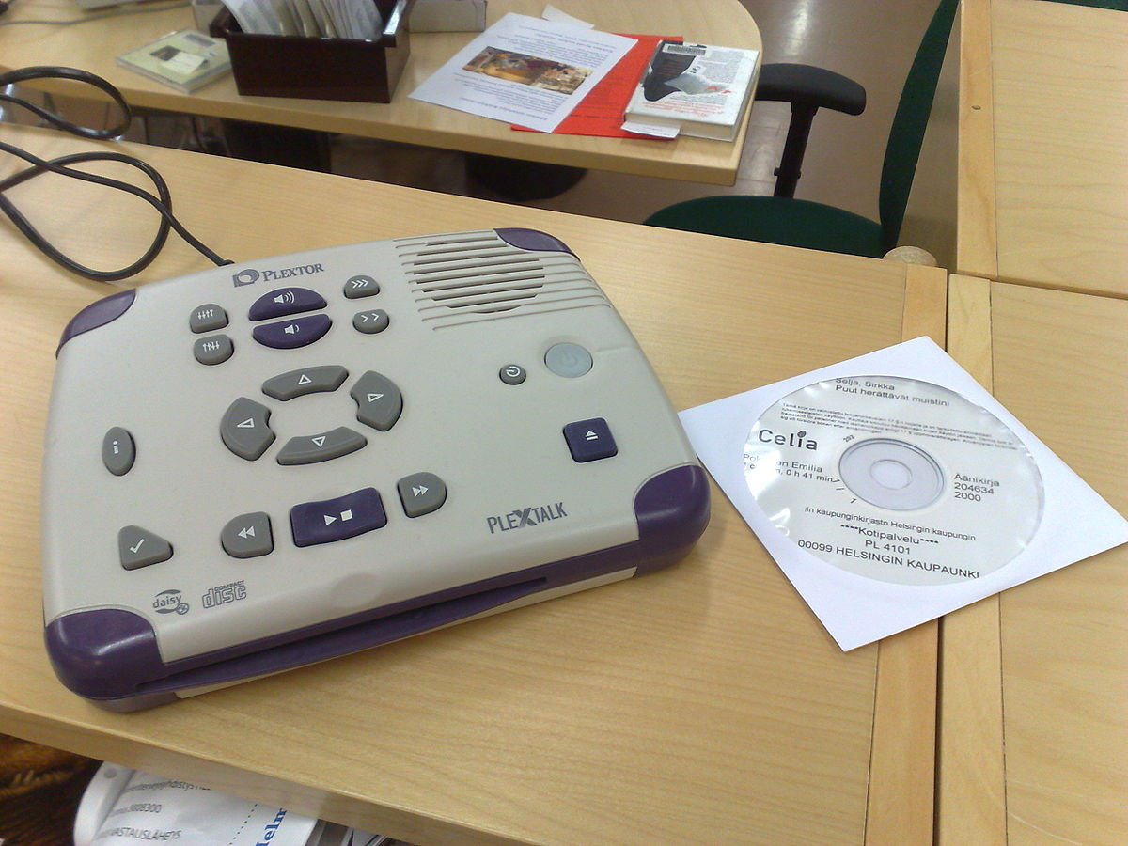
532 0_ Accessibility technical details
532 0_ ǂa Daisy 3
  Should display as:
    Accessibility technical details: Daisy 3
532 0_ ǂa Requires Daisy 3 software for access; Internet connection

Slide 17

532 1_ Accessibility features
532 1_ ǂa Open captioning in French and English
532 1_ ǂa Alternate leaves of text and braille
532 1_ ǂa Described video
532 1_ ǂa Picture-in-picture signing

Slide 18
Captions vs. subtitles
Subtitles provide a text alternative for the dialogue of video footage – the spoken words of characters, narrators and other vocal participants.
Closed captions, on the other hand, not only supplement for dialogue but other relevant parts of the soundtrack – describing background noises, phones ringing and other audio cues that need describing.
Open captions (unlike closed captions) are part of the video, and may not be turned off by the viewer
First two definitions from Matinee Multilingual blog

Slide 19
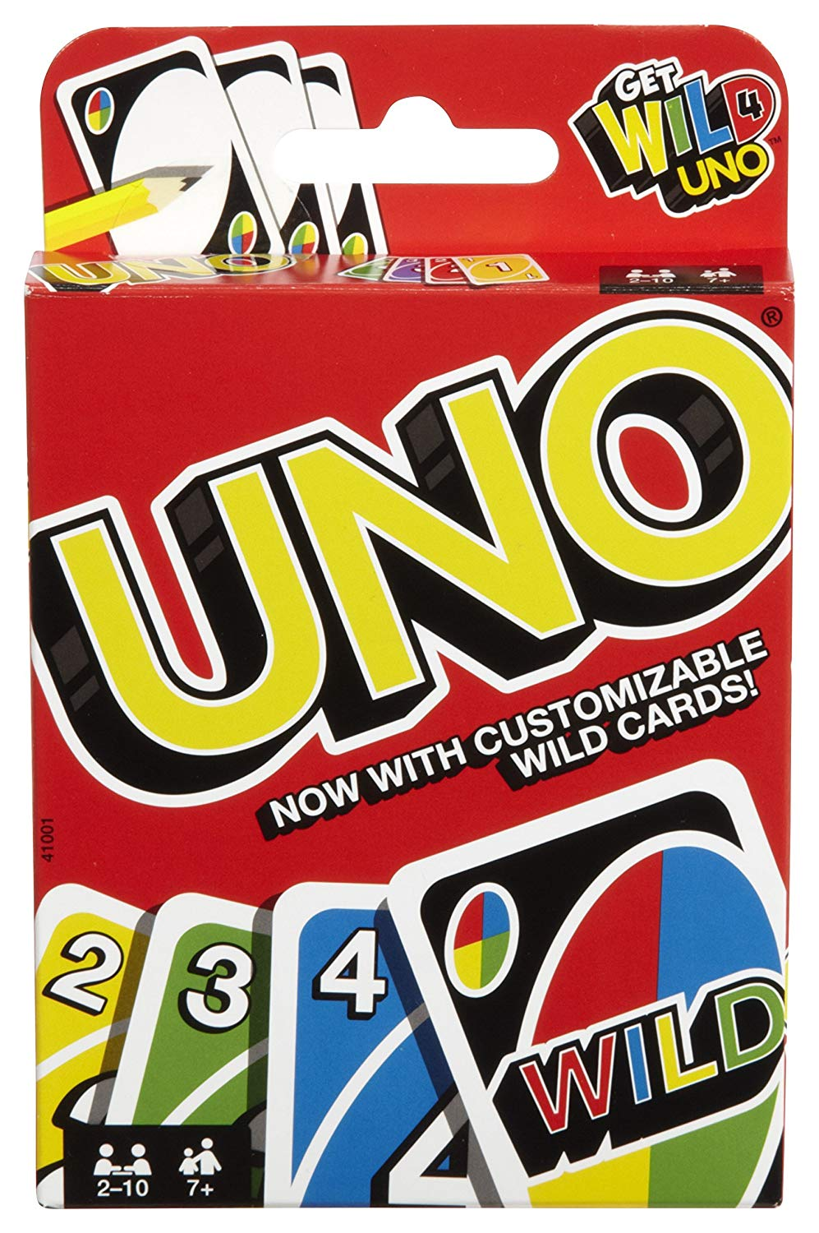
532 2_ Accessibility deficiencies (or "hazards")
532 2_ ǂa Video contains flashing lights which may affect viewers who are susceptible to photosensitive epilepsy or other photo sensitivities.
532 2_ ǂa Game requires player to distinguish between colors.
532 2_ ǂa Menu not navigable
532 2_ ǂa No captions available

Slide 20
Examples

Slide 21

(Accessible) Ebooks
347 __ ǂa text file ǂb EPUB3 ǂ2 rda
341 0_ ǂa textual ǂc displayTransformability ǂd synchronizedAudioText ǂd structuralNavigation ǂ2 w3c
532 1_ ǂa This EPUB3 resource has been optimized to conform to DAISY Consortium specifications for text to speech playback.

Slide 22

DVDs
341 0_ ǂa auditory ǂb captions ǂ2 w3c
532 1_ ǂa Closed captioning
655 _7 ǂa Video recordings for the hearing impaired ǂ2 lcgft

Slide 23
A very accessible DVD
041 __ ǂa sgn ǂa eng
341 0_ ǂa auditory ǂc signLanguage ǂ2 w3c
341 0_ ǂa visual ǂd audioDescription ǂ2 w3c
341 1_ ǂa textual ǂb braille ǂ2 w3c
532 1_ ǂa Described video
532 1_ ǂa Picture-in-picture signing
532 1_ ǂa Container contains text in Braille.
655 _7 ǂa Video recordings for the hearing impaired ǂ2 lcgft
655 _7 ǂa Video recordings for people with visual disabilities ǂ2 lcgft

Slide 24
References
MARC Proposal 2018-03
  https://www.loc.gov/marc/mac/2018/2018-03.html
W3C WebSchemas/Accessibility vocabulary
  https://www.w3.org/wiki/WebSchemas/Accessibility
Accessibility Metadata Best Practices Guide
  http://www.a11ymetadata.org/wp-content/uploads/2013/12/AccessibilityMetadataBestPracticesGuide.pdf

