Slide 1
Grima: Faster Cataloging Using APIs
Kathryn Lybarger ELUNA
University of Kentucky Libraries May 3, 2019
@zemkat #ELUNA2019 #grima

Slide 2

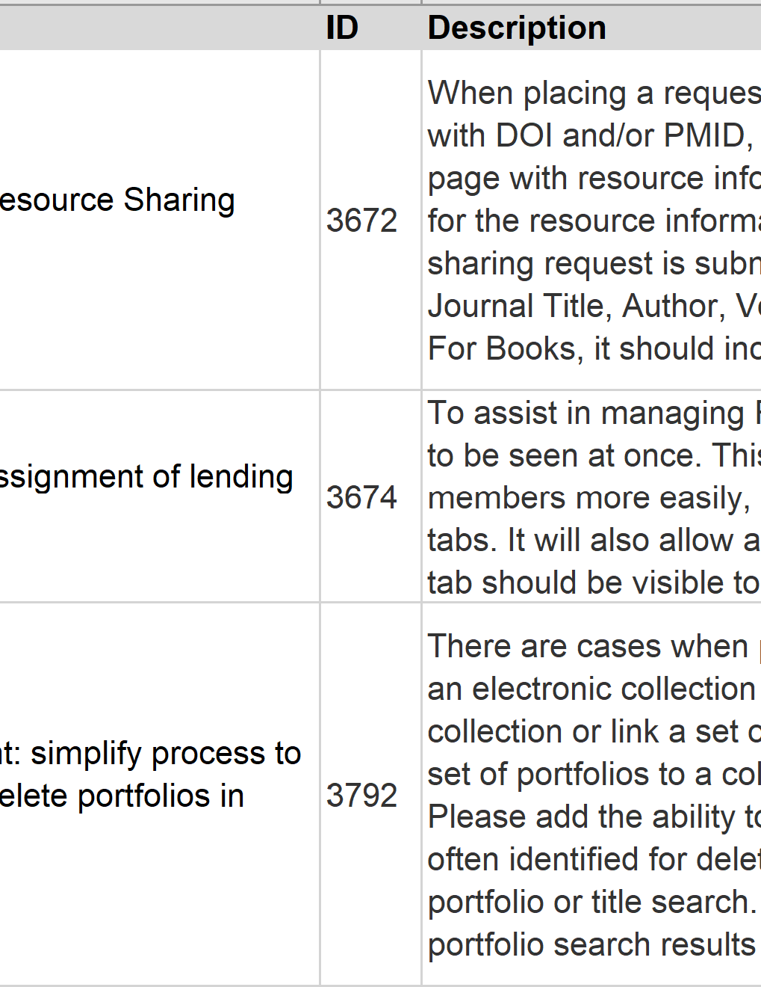
Alma Enhancements
Customers submit requests for enhancements to Alma
Customers vote on the enhancements they would most like to see
Ex Libris implements the top voted enhancements

Slide 3
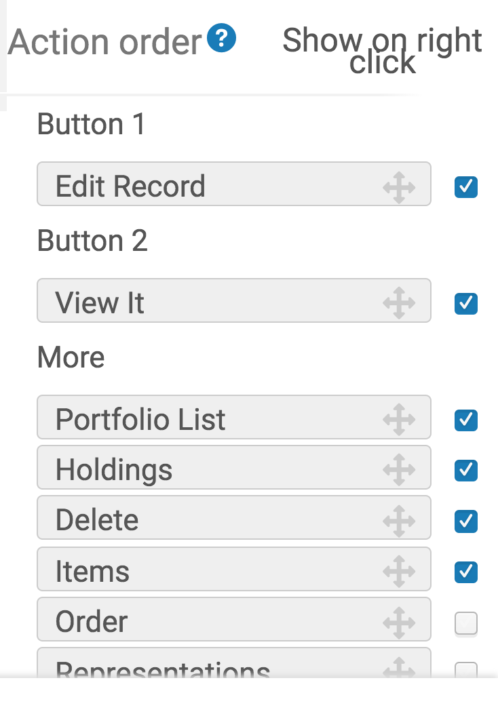
Some types of enhancements
I want to do this action often … why isn't it faster to use?
  I usually choose these options – how can I make them the default?
I want more options
I want to see more of the data

Slide 4
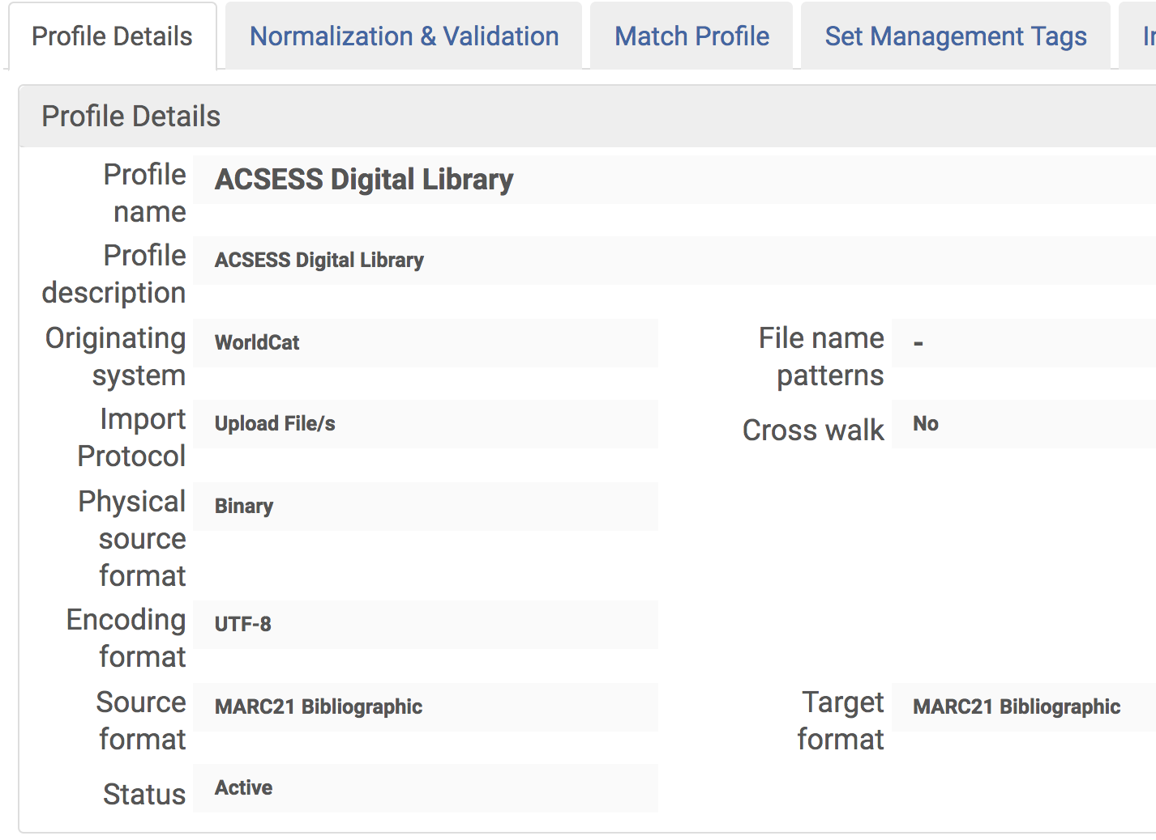
Deciding is hard
Not enough resources to implement all (397) things for all customers
Libraries have conflicting needs
"Less clicky" vs "More flexibility"
"More options" vs "Cleaner design"

Slide 5
Voting on Enhancements
Favors requests that are:
  Popular
  High Priority
  Less complex
… but what about simple features only needed by one library?

Slide 6
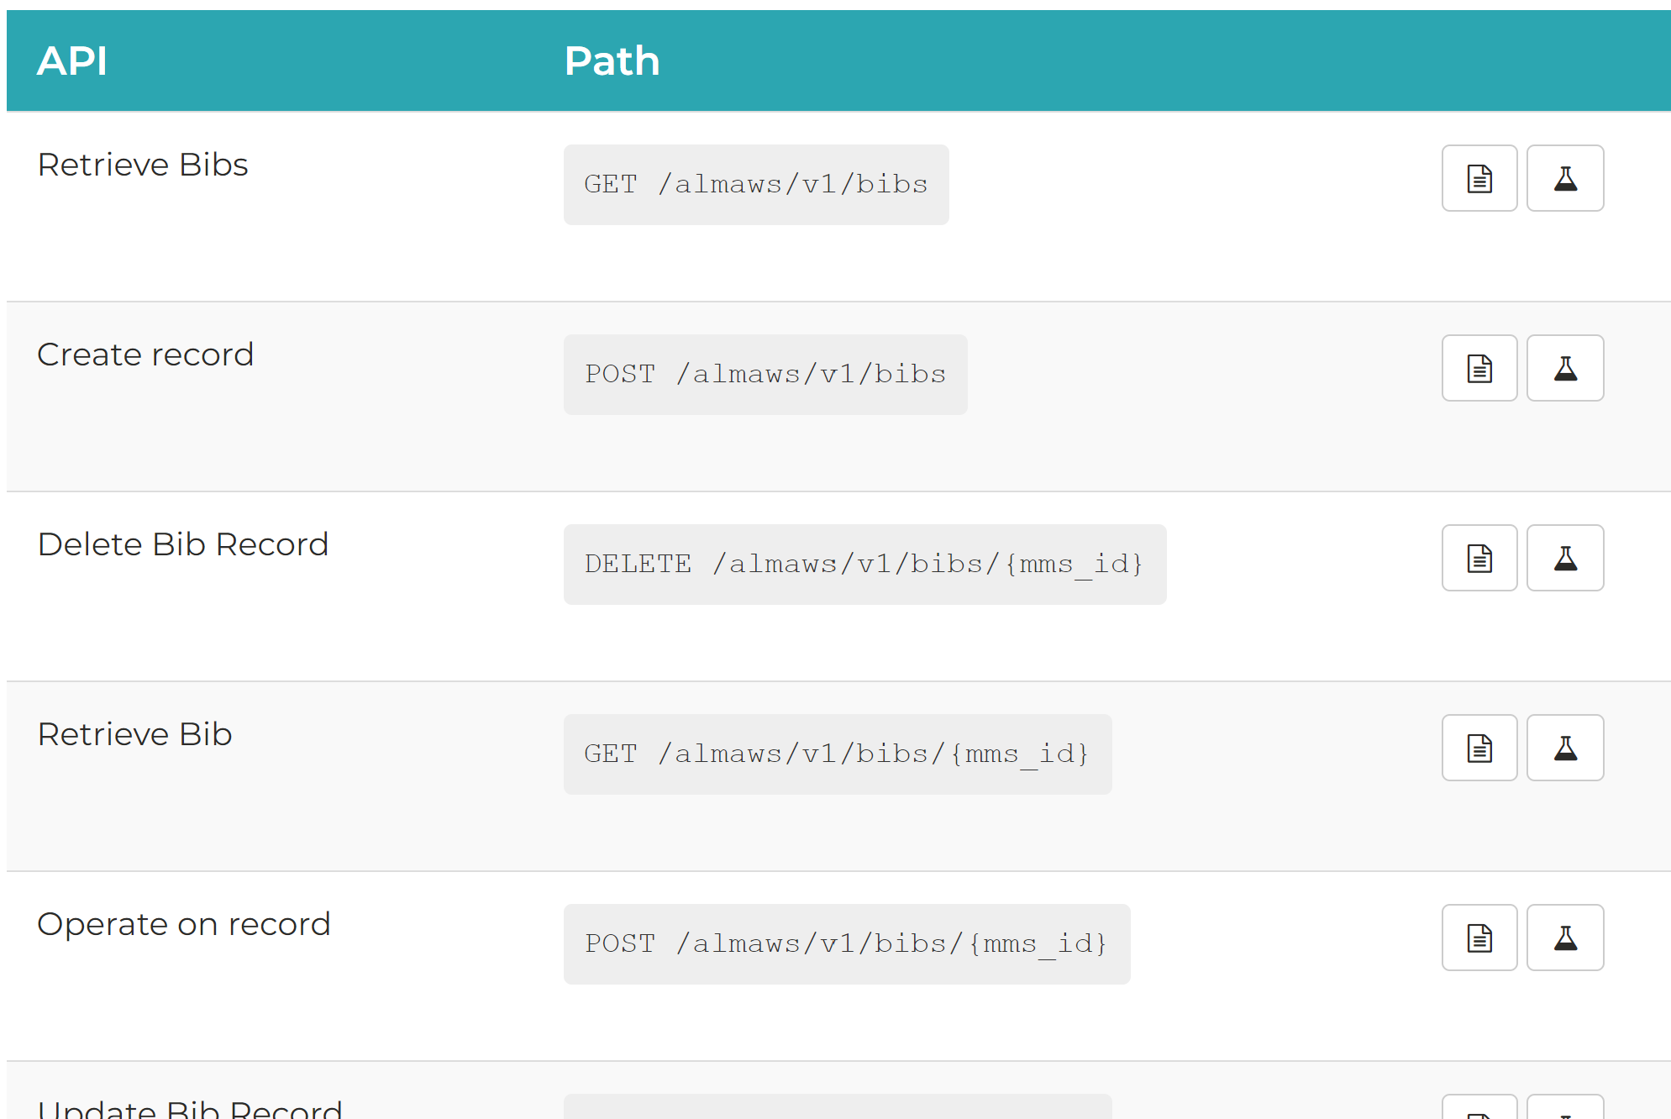
Alma API
Application
Programming
Interface

Slide 7
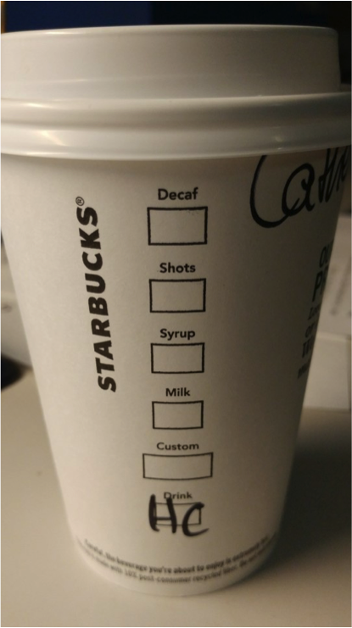
Ordering from Starbucks
Default interface
  Having a nice human conversation with the barista
API
  Giving your order using the cup code, like grande hazelnut soy no-whip hot chocolate

Slide 8
Deleting a Bib Record
Alma UI
Alma API
Search for the record
Open in Metadata Editor
Click the Trash Can
Send the command:
DELETE /almaws/v1/bibs/993524802636

Slide 9
Alma (REST) APIs do simple tasks (CRUD)
POST /almaws/v1/bibs/{mms_id}/holdings/{holding_id}/items
  Create an item record
GET /almaws/v1/bibs/{mms_id}/holdings
  Retrieve the holdings on a bib
PUT /almaws/v1/bibs/{mms_id}/portfolios/{portfolio_id}
  Update a portfolio
DELETE /almaws/v1/bibs/{mms_id}
  Delete a bib record

Slide 10
API Categories
(around 200 APIs across these categories)
Acquisitions
Analytics
Bibliographic Records and Inventory
Configuration and Administration
Courses
Provider Zone
Electronic Resources
Resource Sharing Partners
Task Lists
Users and Fulfillment

Slide 11
Modifying a Portfolio using APIs
(rough outline of a program)
(get the input)
GET /almaws/v1/bibs/{mms_id}/portfolios/{portfolio_id}
(modify the portfolio in some way)
PUT /almaws/v1/bibs/{mms_id}/portfolios/{portfolio_id}
(probably give some output)

Slide 12
Programming can be time-consuming
Look up API calls
Communication with server
Front end interface
Authentication
Input checking
Error handling

Slide 13
Grima: A Framework for Using APIs in Alma
Free and open source (on GitHub)
Written in PHP
Run from web server, or locally
Object-oriented, with classes for Alma objects like "Bib" and "Item"
Consistent member functions
  $bib->loadFromAlma($id)
  $item->deleteFromAlma()
Some array access
  $item['statistics_note_1']

Slide 14
"Grimas": programs using the Grima library
Some parts already in place
  Web interface
  Error handling
You define fields / behavior
Only code the parts you want to change
Directory containing:
  XML file specifying input
  PHP file containing actions
  (Output)
  (Documentation)

Slide 15
Grima XML
<GrimaForm>
<Title>Grima: Delete Bib</Title>
<Field
name="mms_id"
label="MMS ID"
autocomplete="off"
required="yes"
placeholder="Bib record to delete..."
/>
</GrimaForm>

Slide 16
Grima PHP
function do_task() {
$bib = new Bib();
$bib->deleteFromAlma();
$this->addMessage('success',
"deleted bib {$this['mms_id']}");
}
$bib->loadFromAlma($this['mms_id']);

Slide 17
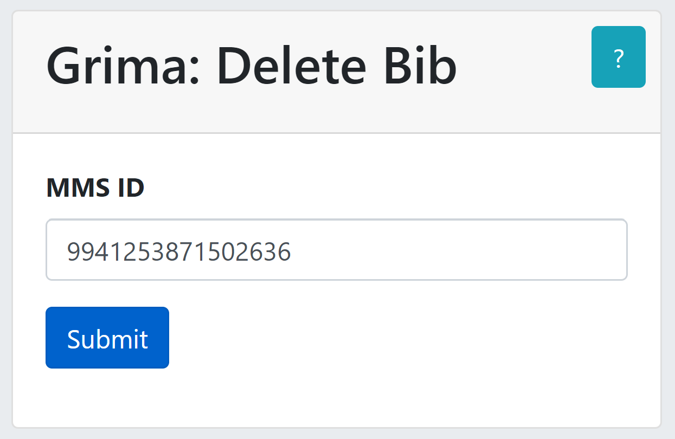
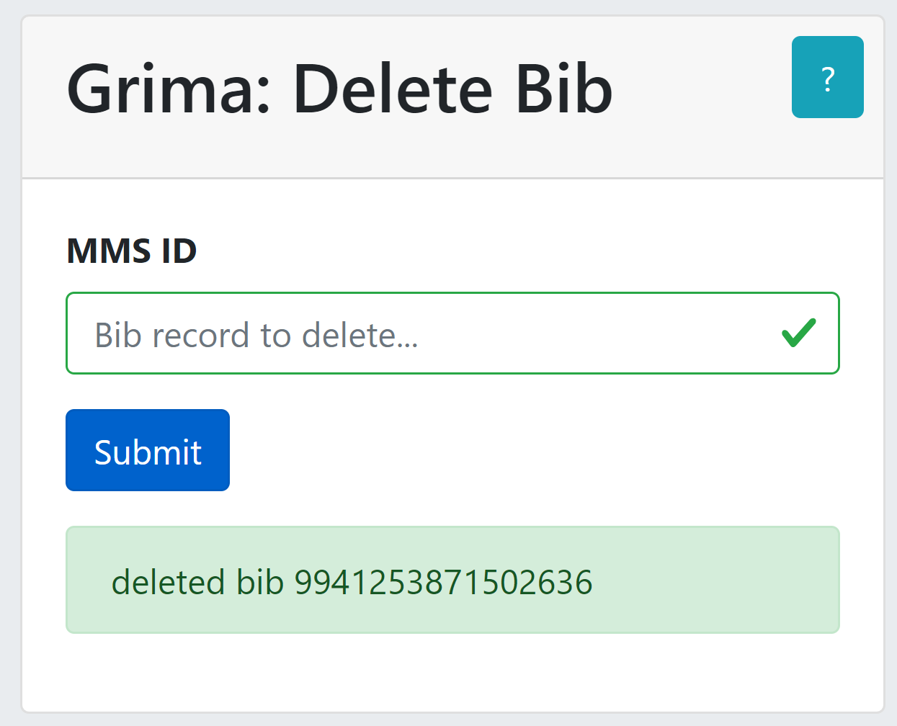
Grima: Delete Bib

Slide 18
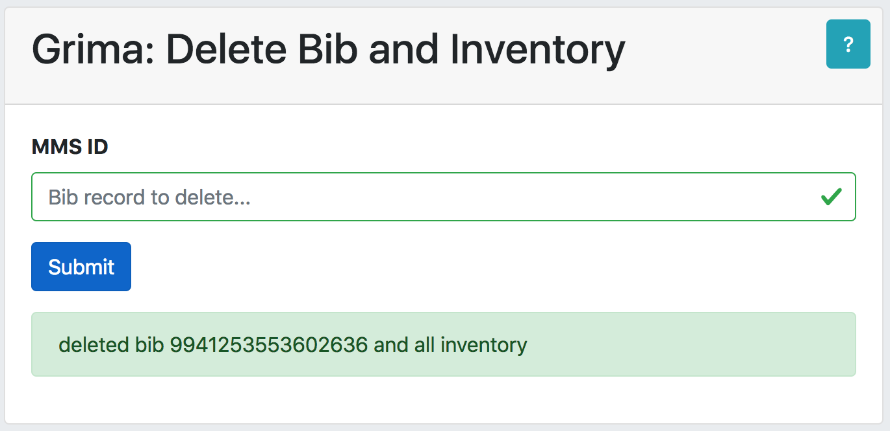
Default Output: Success

Slide 19
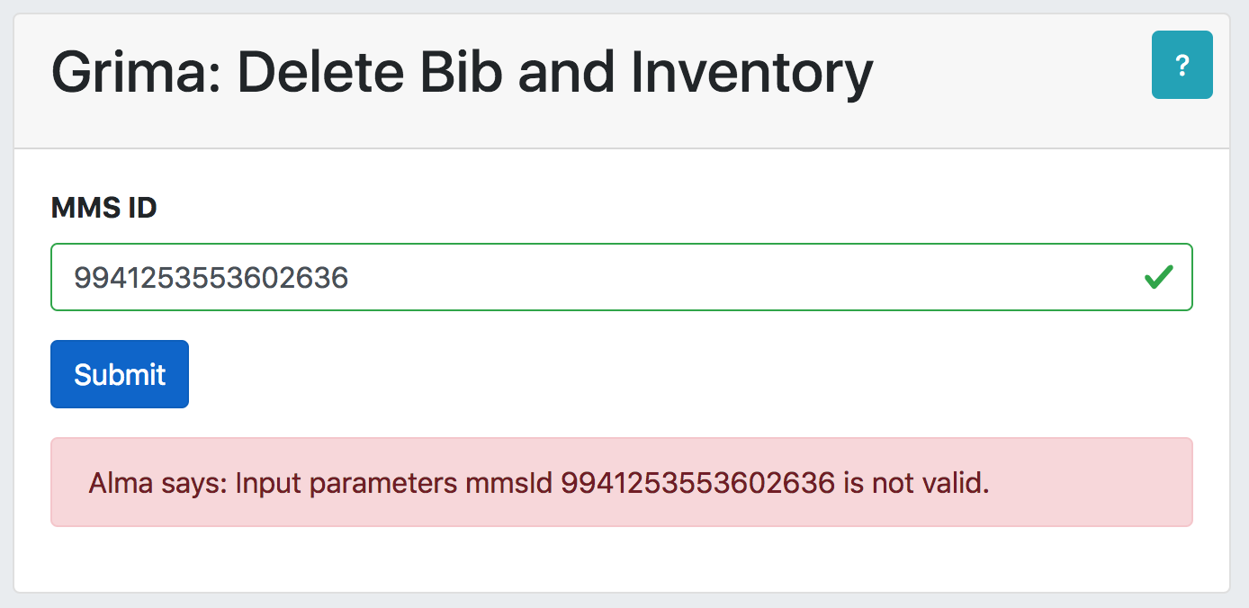
Default Output: Failure

Slide 20
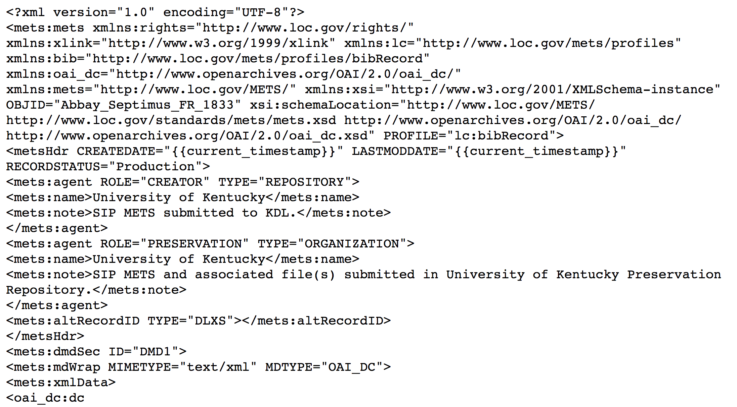
Grima: METS output for ExploreUK

Slide 21
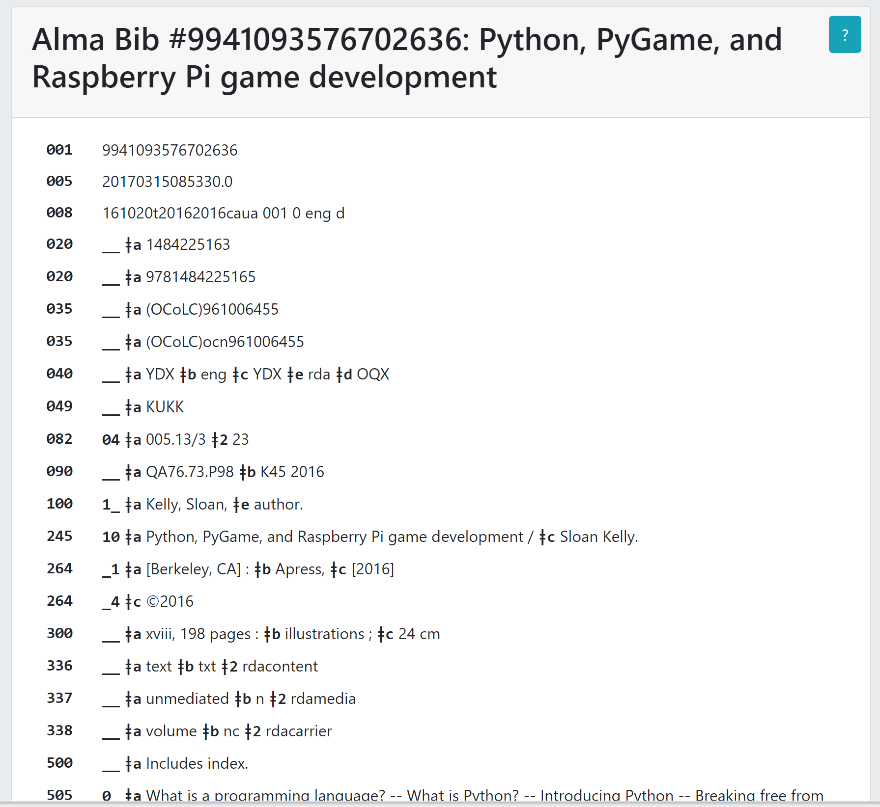
Grima: Display Bib
MARC record display suitable for printing
Can be output for other grimas

Slide 22
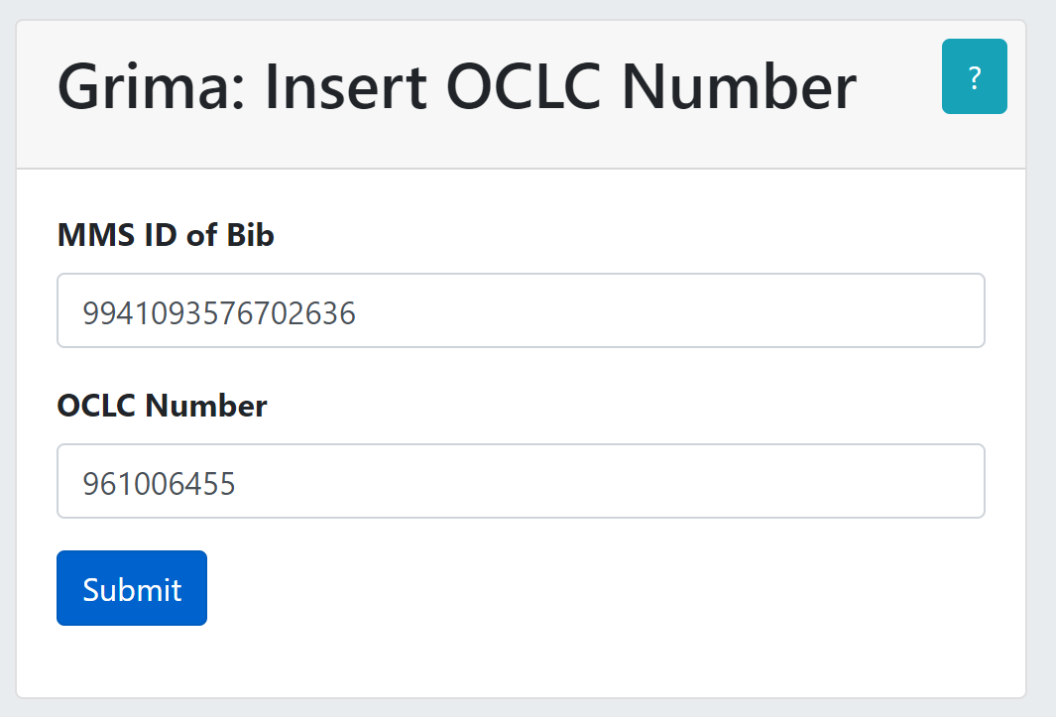
Grima: Insert OCLC Number
To overlay an Alma record from OCLC:
  Enter the MMS ID of bib to overlay
  Enter the OCLC number of the incoming record
  Submit form
    Output: Display Bib
  Export from OCLC

Slide 23
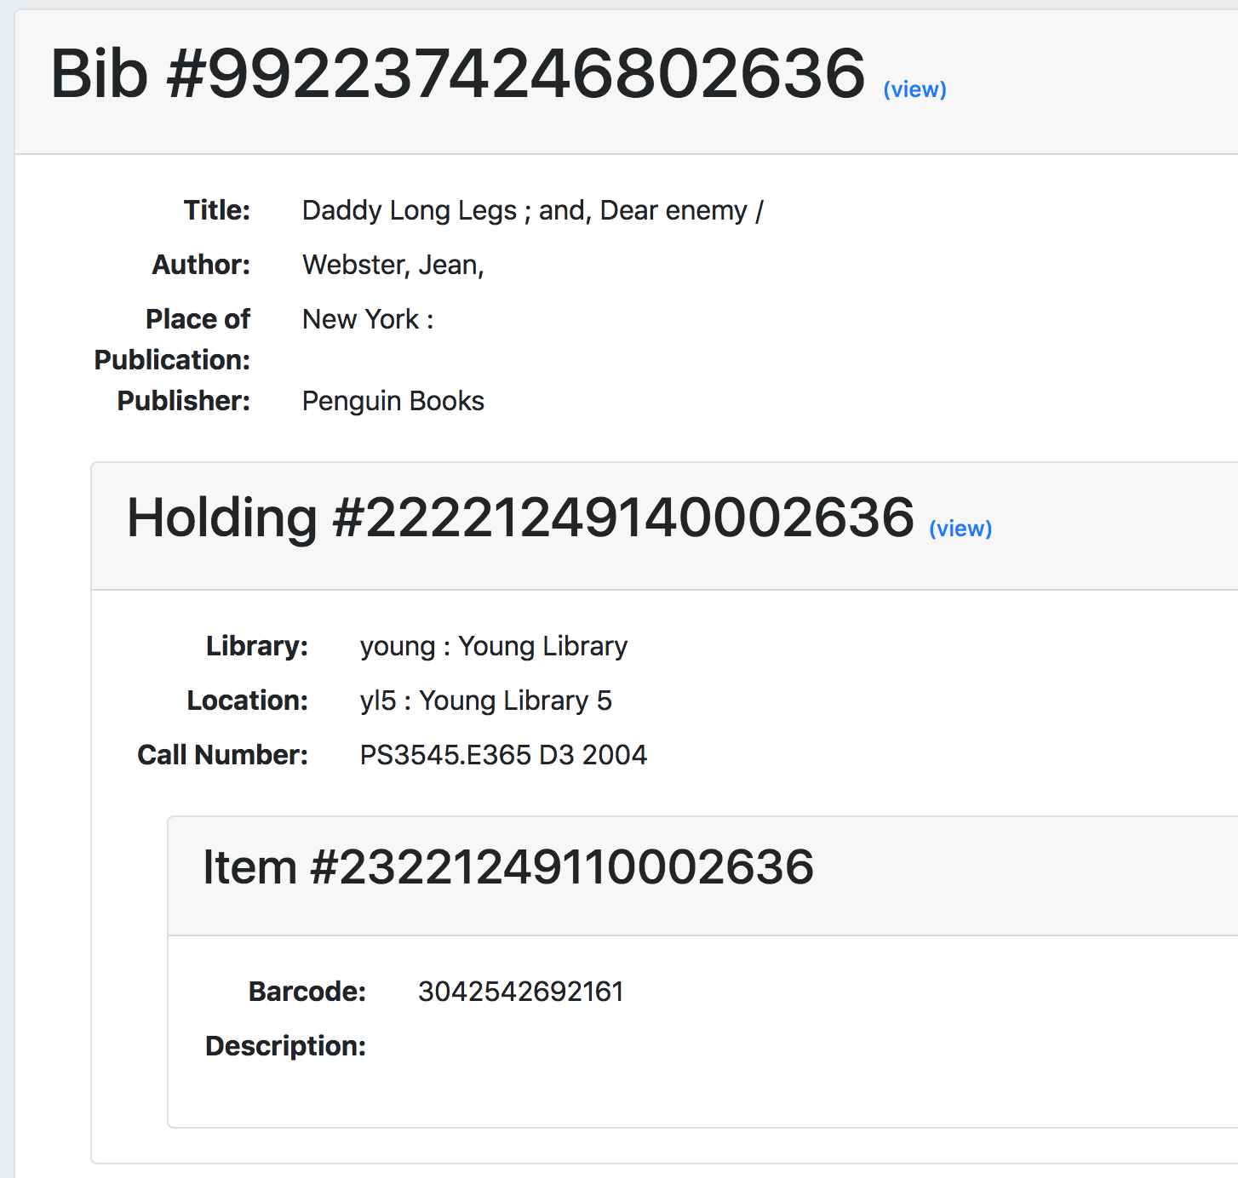
Other Grimas for Output
Display Bib
Display Holding
Display Hierarchy
Display XML

Slide 24
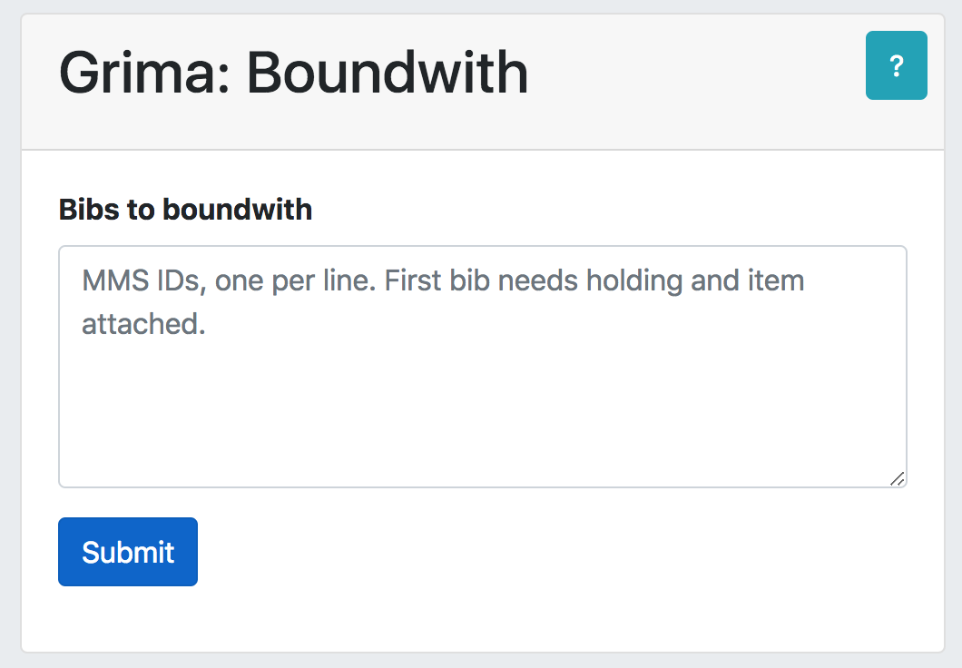
Grima: Boundwith
Enter MMS IDs, one per line
First bib should have holding and item record
Adds 501 note and 774 to all bibs
Adds 014 for all bibs to holding
Script runs overnight to form boundwith

Slide 25
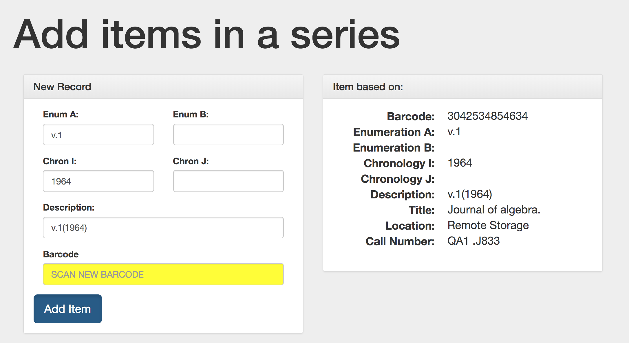

Slide 26

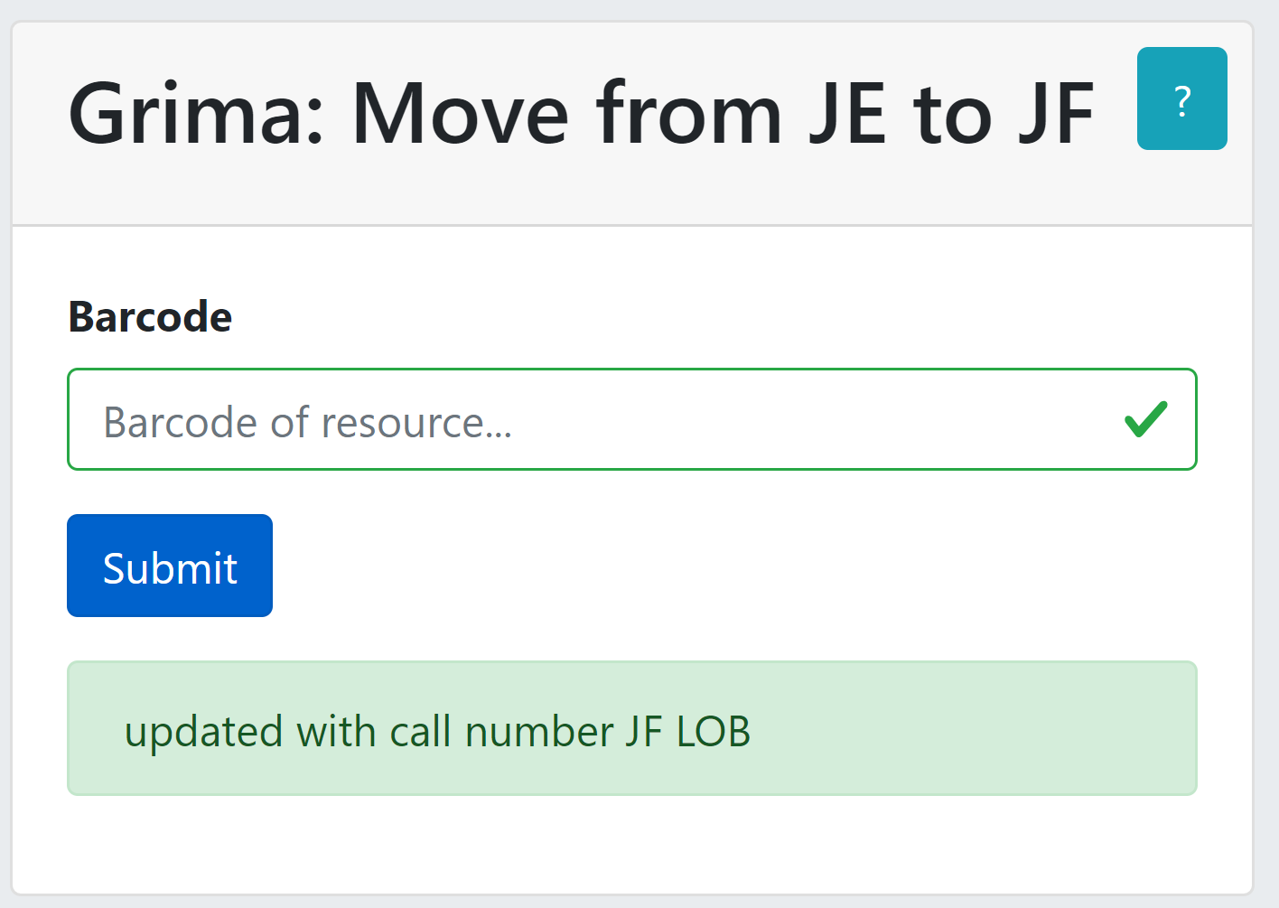
Grima: Change JE to JF
(project-specific)

Slide 27
Grima for
enhancements?

Slide 28
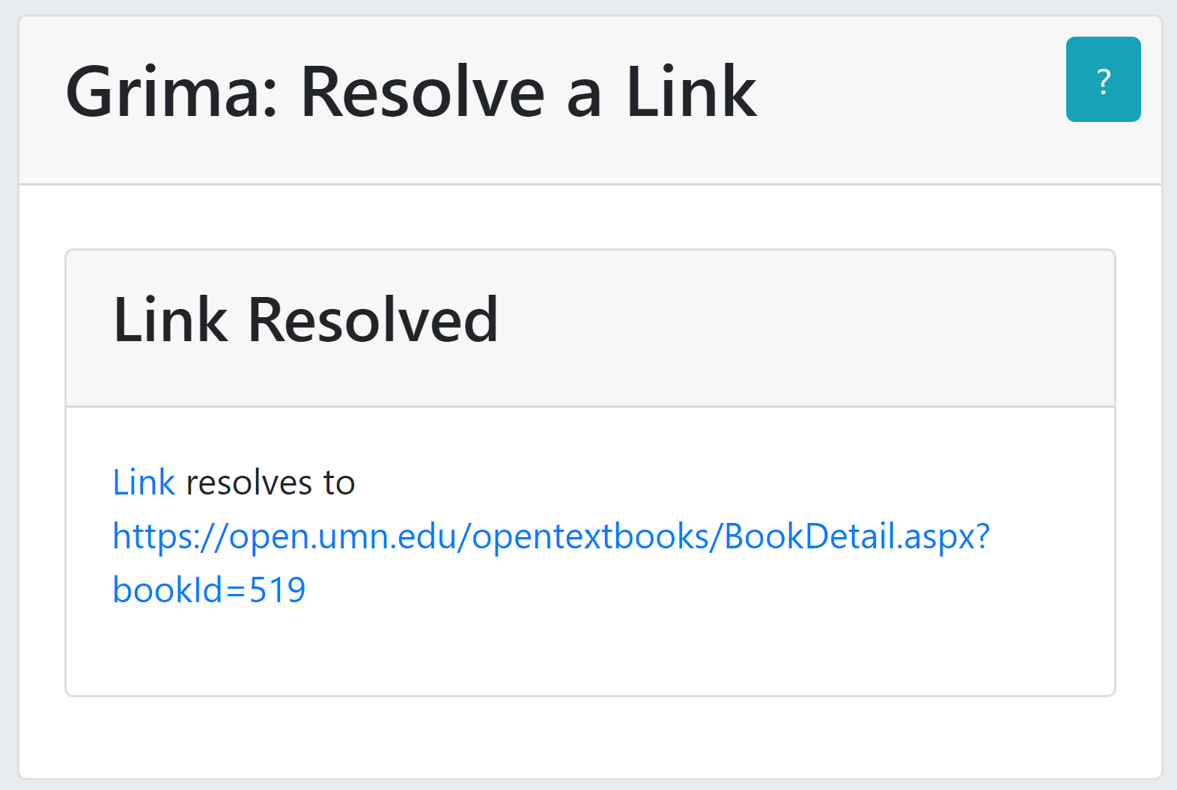
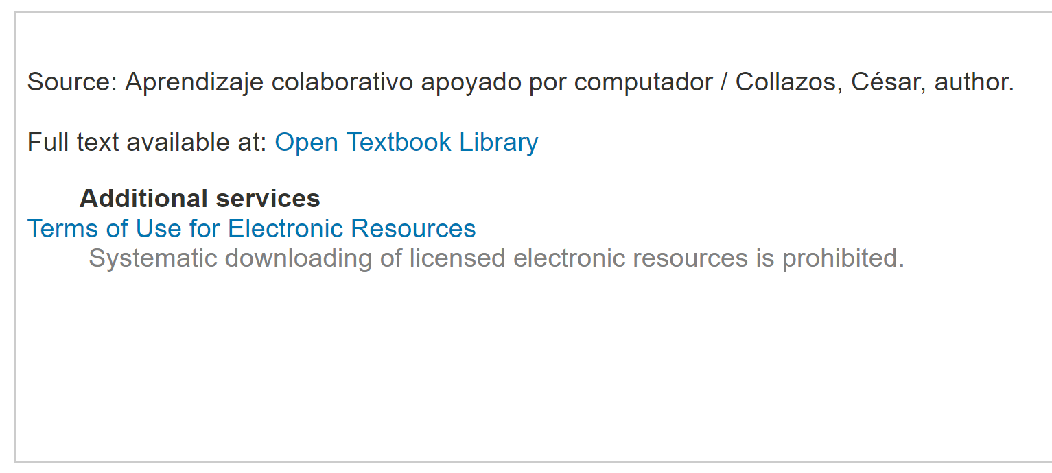
Grima: Resolve Link (#5790)

Slide 29
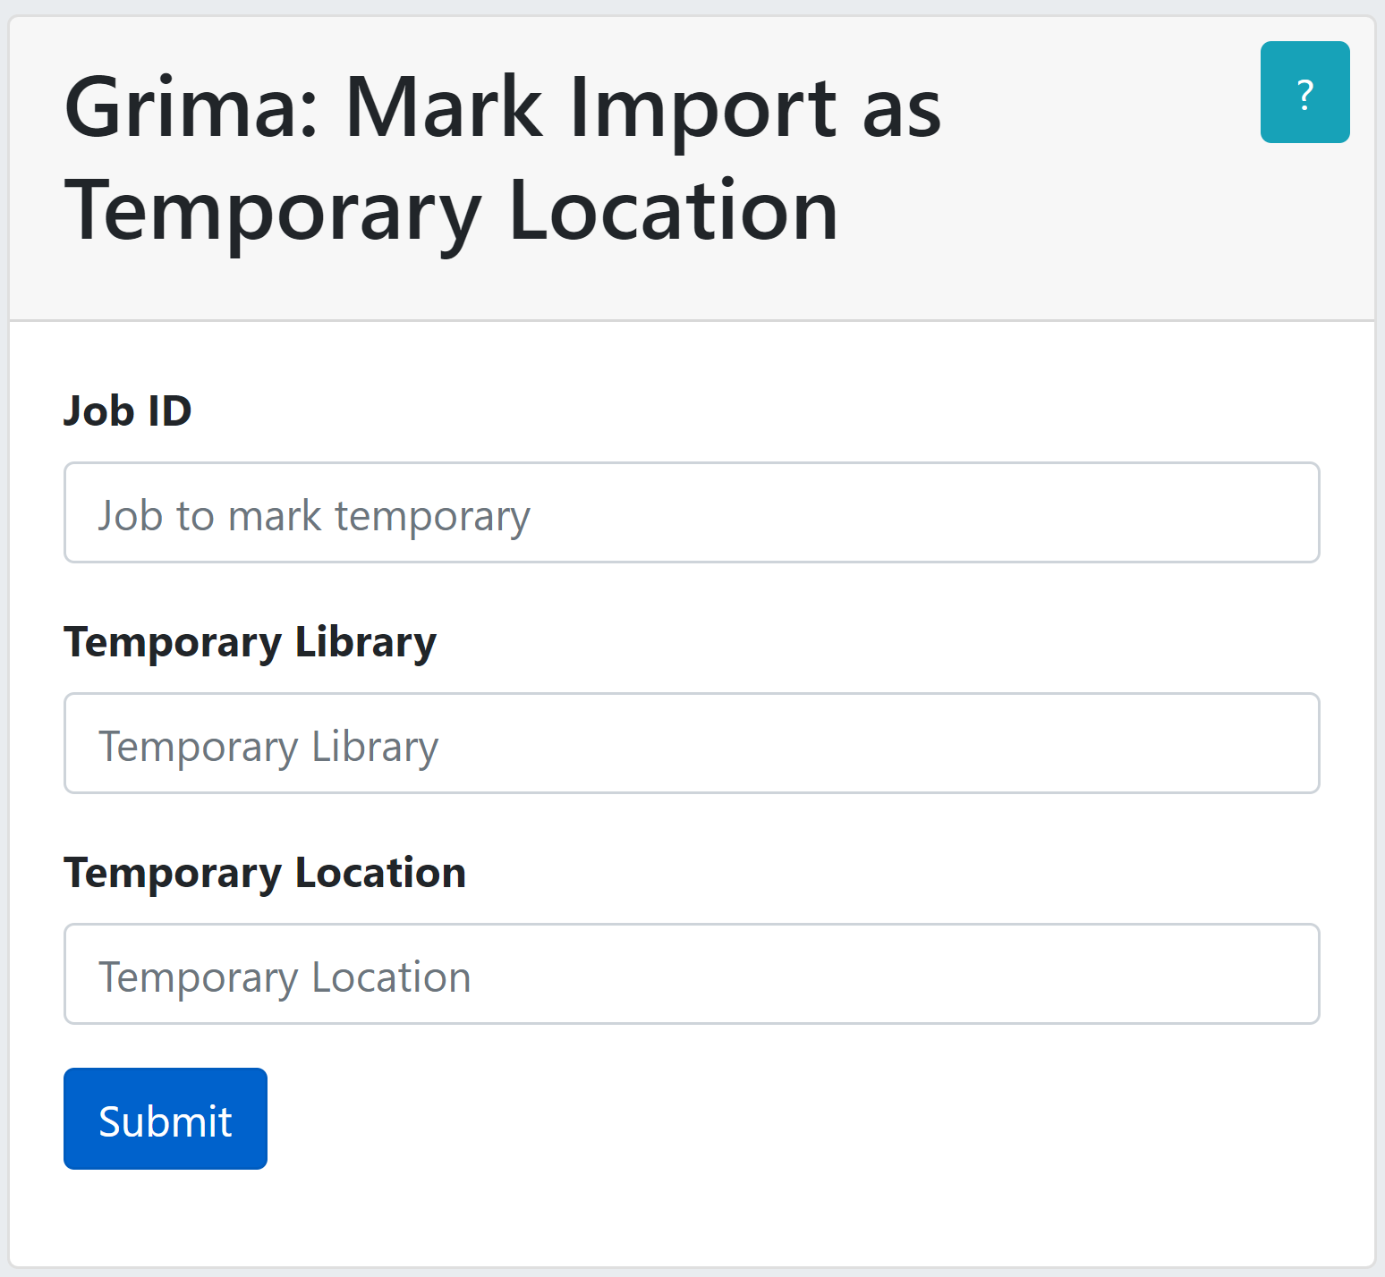
Grima: Mark Imported Items as being in Temporary Location (#5886)
Import Profile has no way to automatically mark items as being in a temporary location
Run the Import as usual, making note of the Job ID
Run this grima, specifying Job ID and temporary location

Slide 30
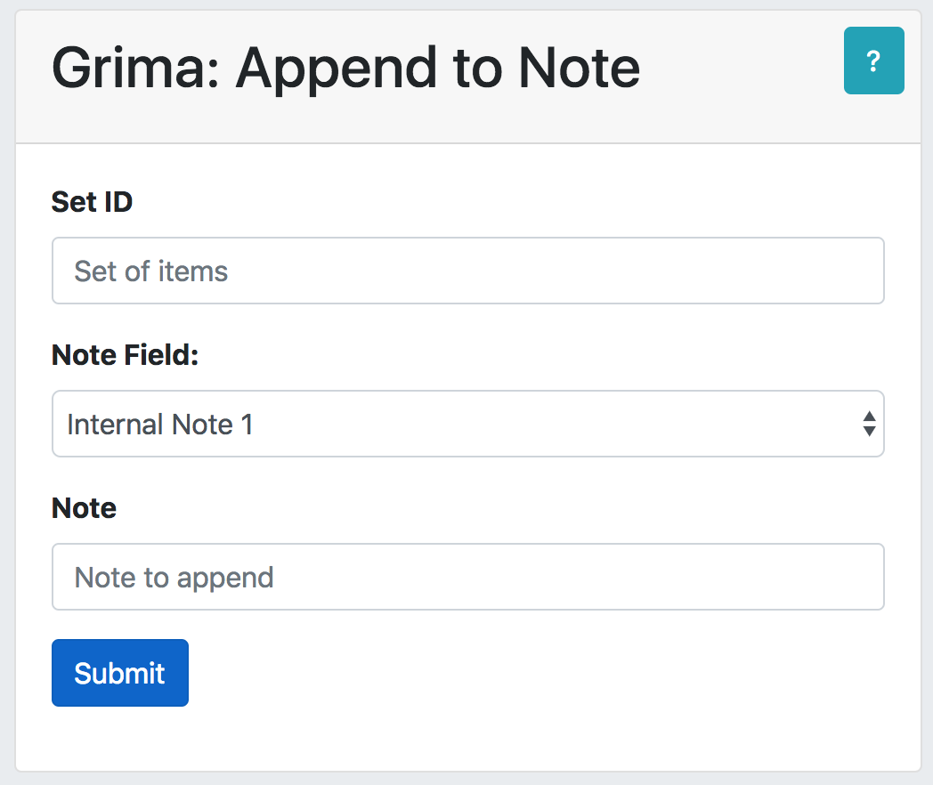
Appending Notes (#4918)
Select which note from a drop-down
If that note is not already set, it becomes the note you specify
If the note IS set, your note is appended, separated by ;
I made some decisions here – should the form let you specify?

Slide 31
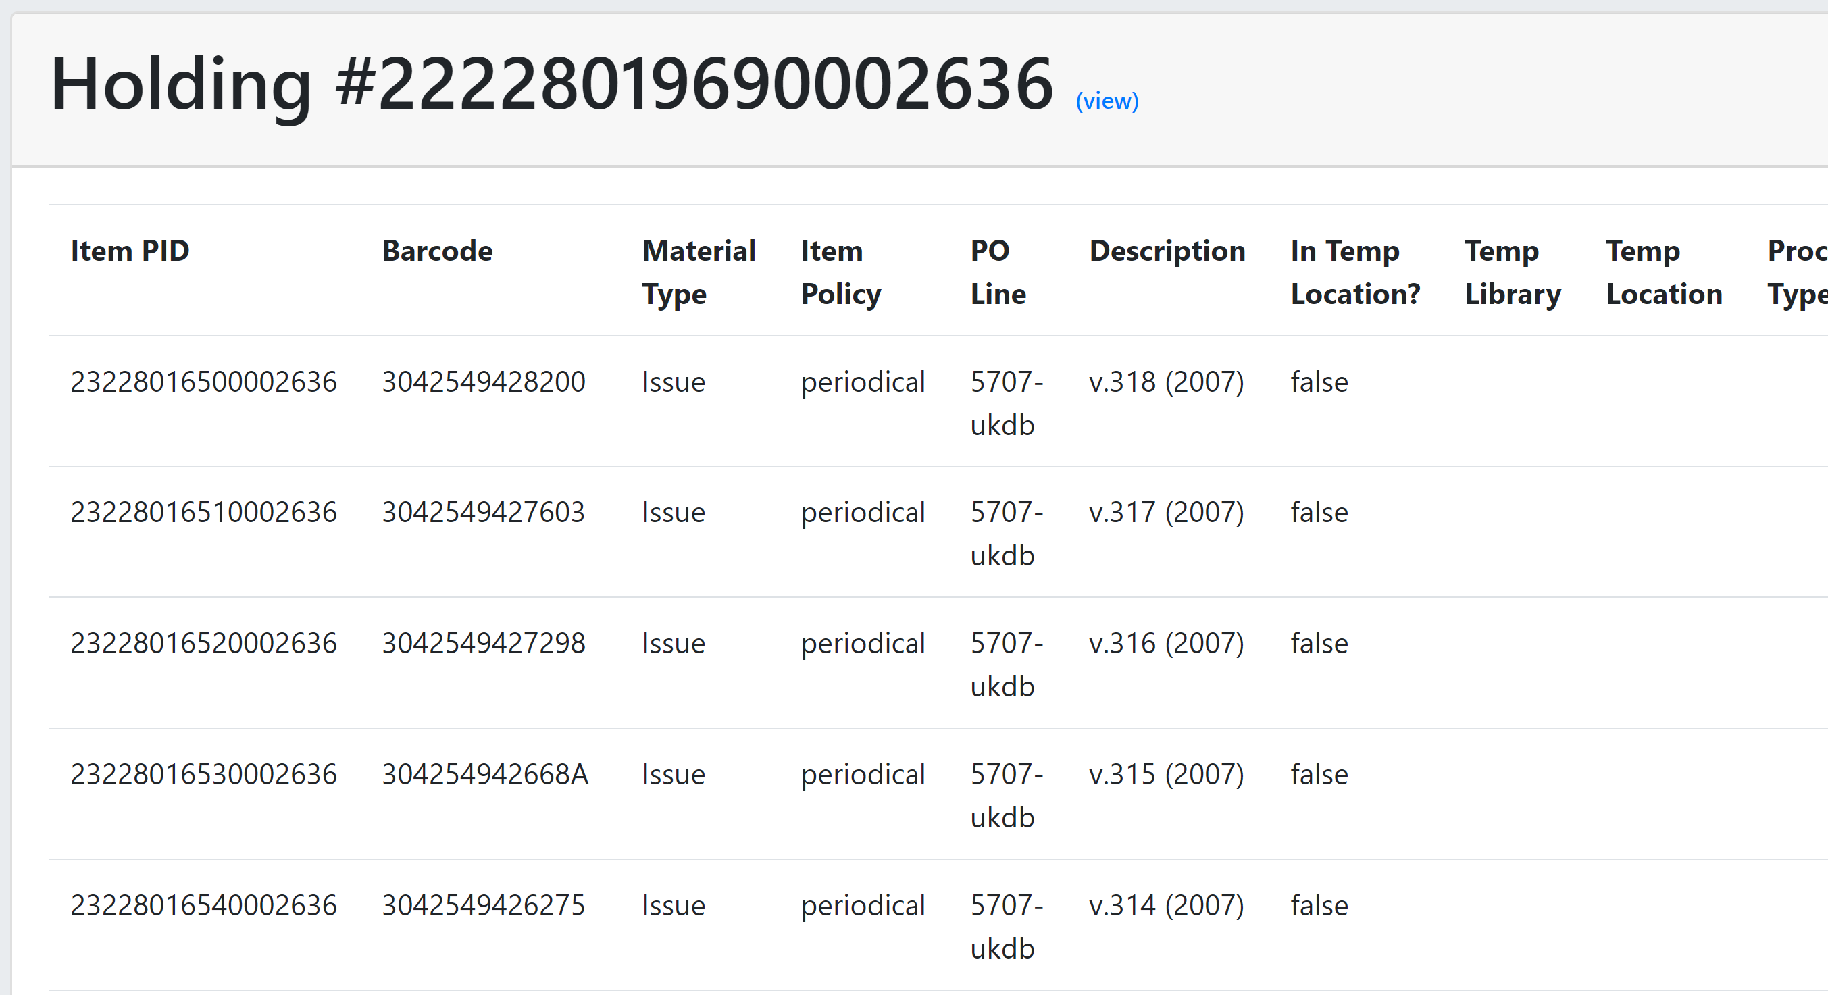
List of Items from Holdings (#5489, #5615)

Slide 32
Scan-in Items in Bulk (#5571)
(not a grima)
Margaret Briand Wolfe (Boston College)
  Perl script presented at ELUNA Developers Day+ 2019
  https://github.com/briandwo/scan_in_items

Slide 33
Grima: Chain from Bib (in progress)
Library
young
Location
yl4
Barcode
304255140920Z
For gift cataloging, we often want to add a holding and an item
OCLC Connexion macro adds fields:
  952 – holdings information
  949 – item information
Export from Connexion
Grima builds holding and item
young
ydd
OK
Cancel
yl4
yd
yd
304255140920Z

Slide 34
Grima Setup!

Slide 35
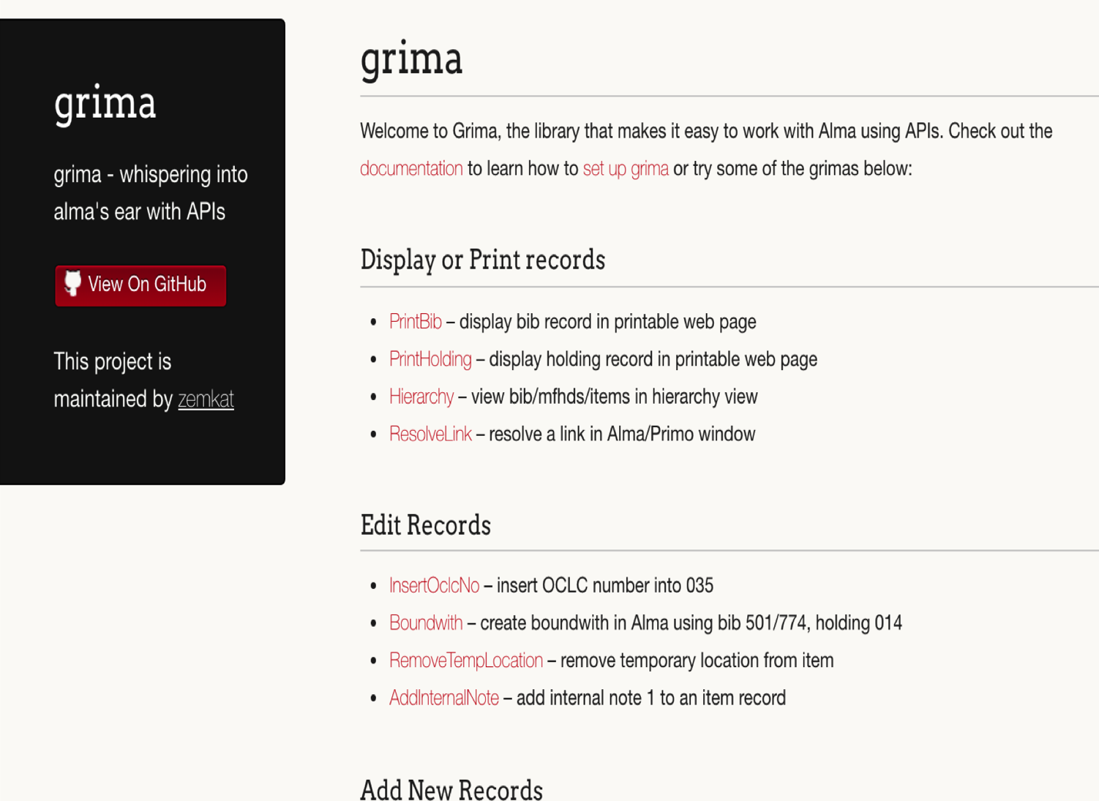
Server Install and Setup
Clone GitHub repository onto a web server
Visit your new web site

Slide 36
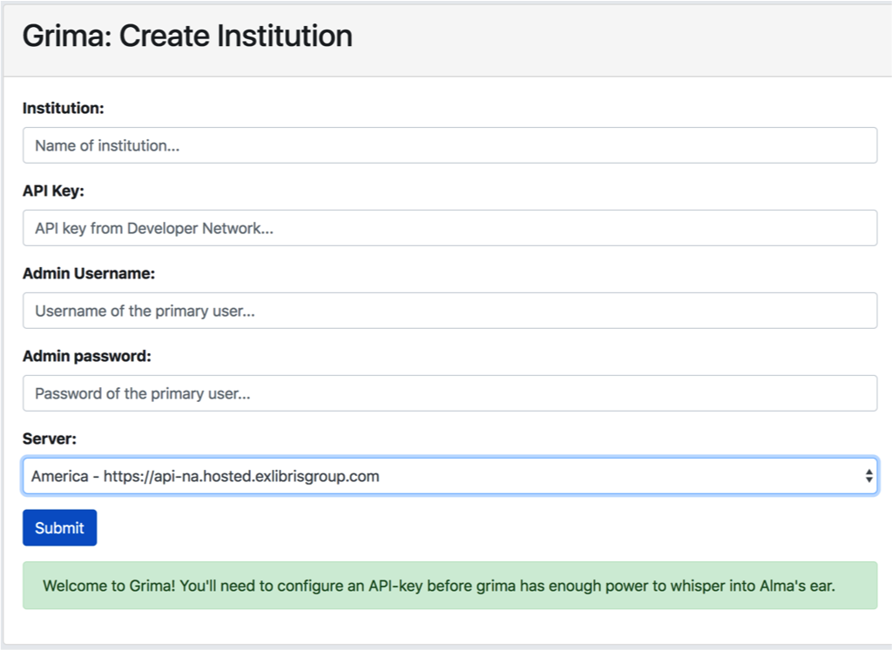
Authentication
Try to run any grima, and you’ll be prompted to:
  Create institution / site admin
  Enter your API key
  Select your server

Slide 37
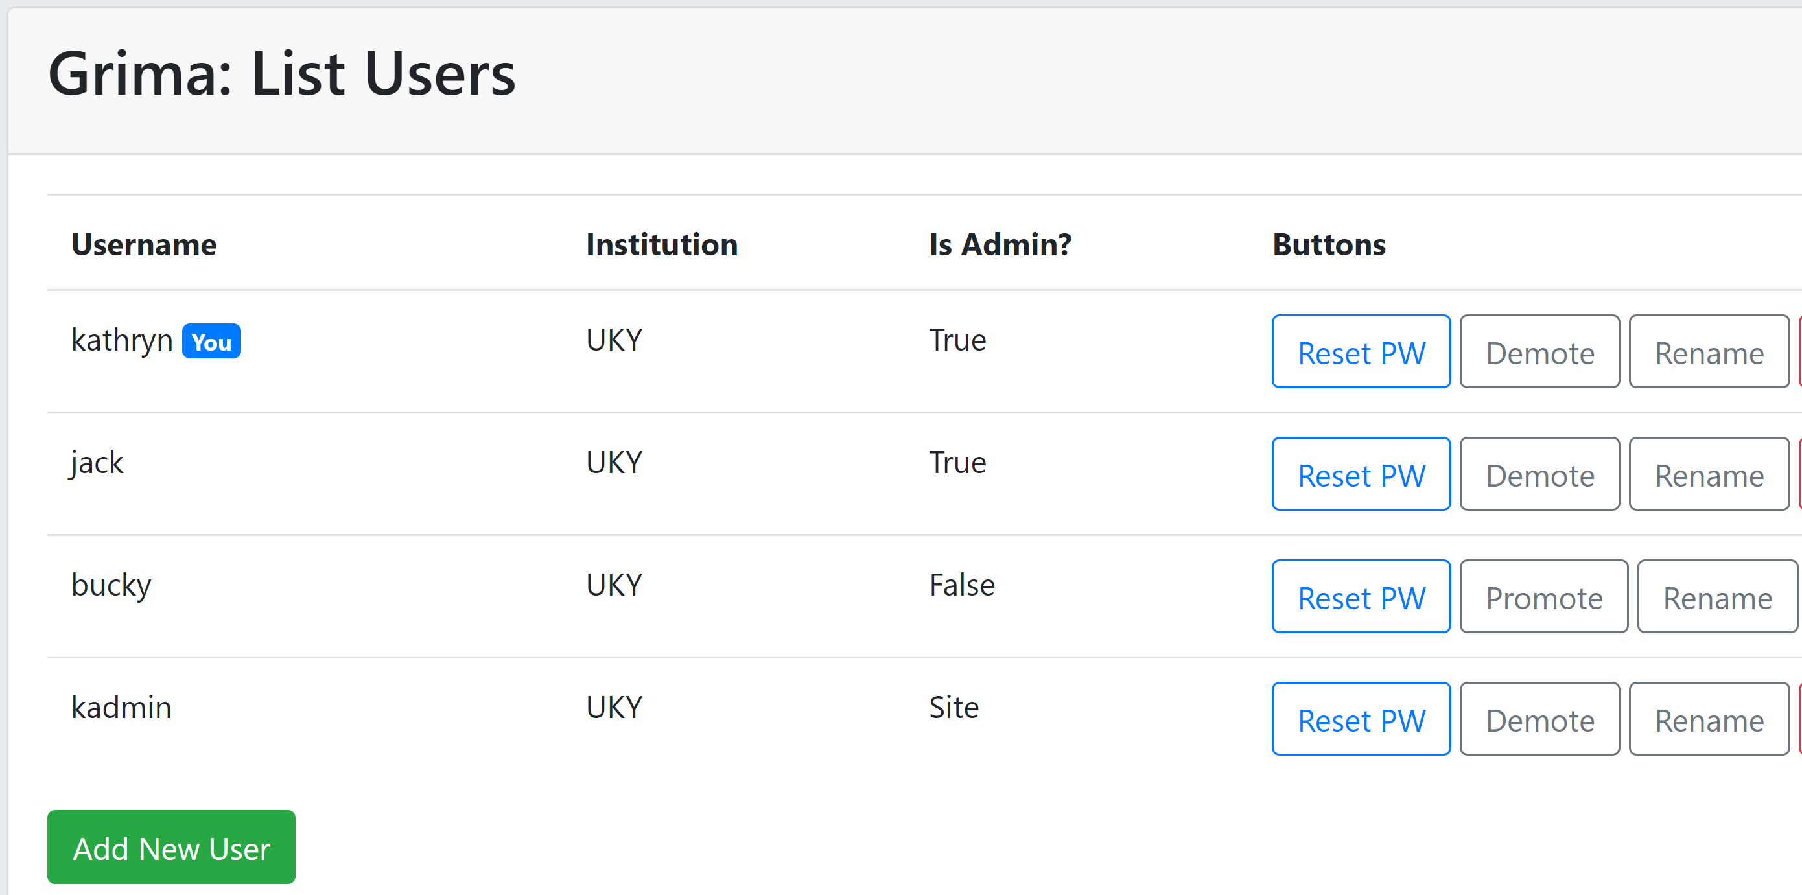
User management dashboard

Slide 38

Local Install
Install Desktop version of Docker
  Windows, Mac, Linux
Download program from GitHub
Program downloads and runs container from DockerHub
API key stored locally
Authentication optional

Slide 39
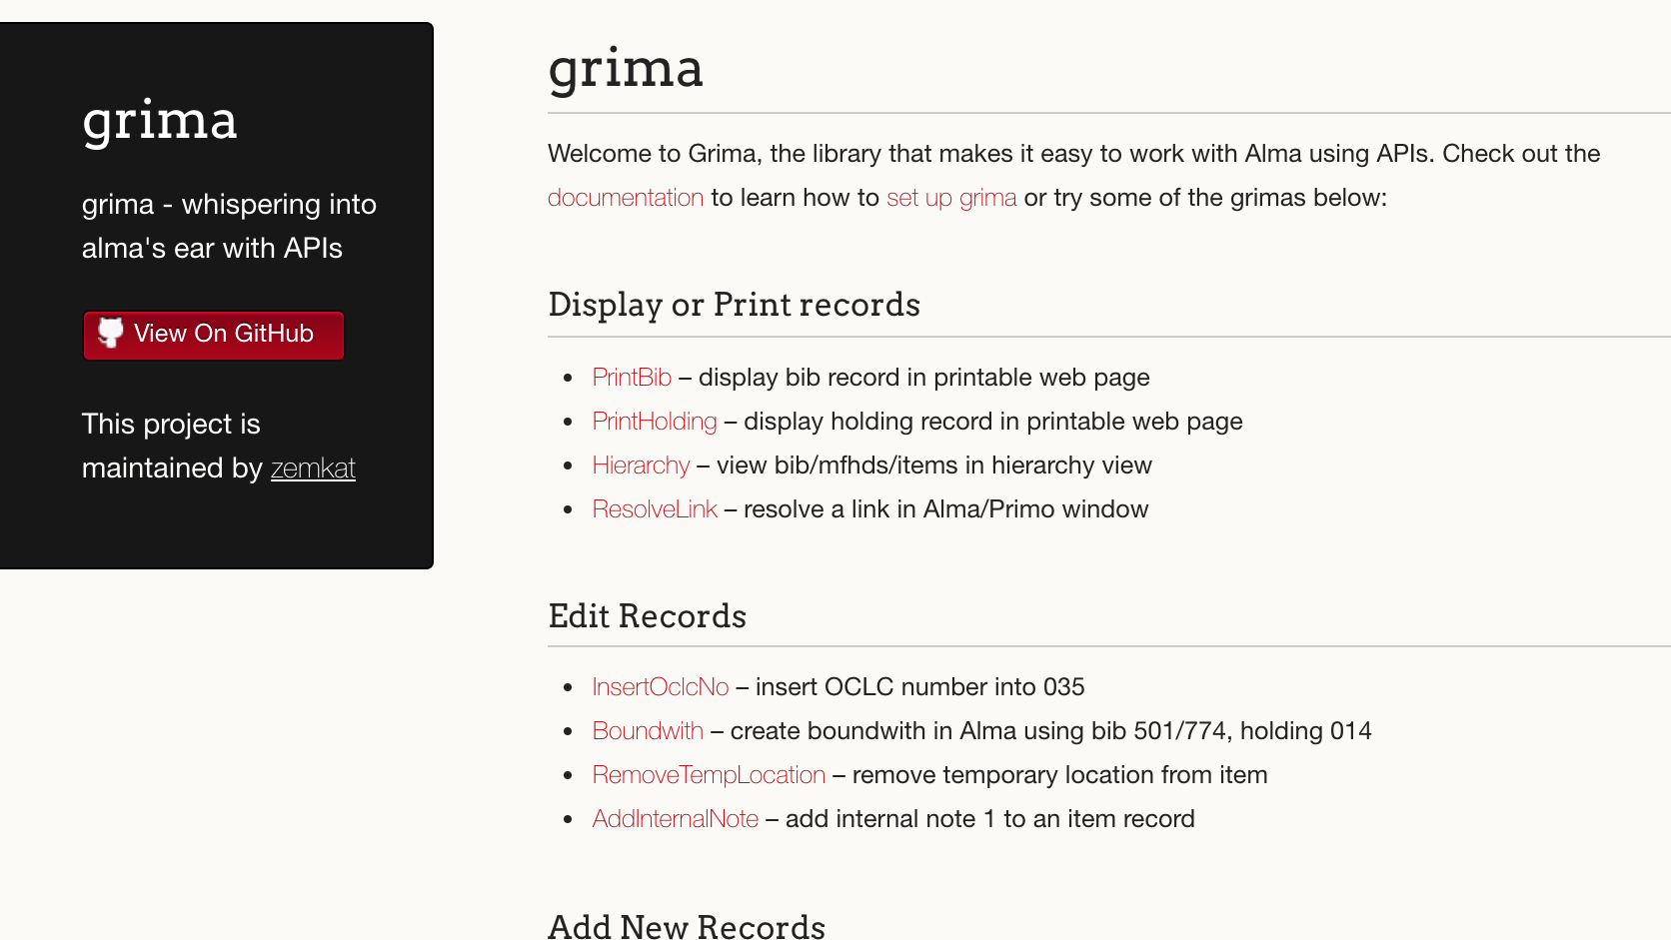

Slide 40
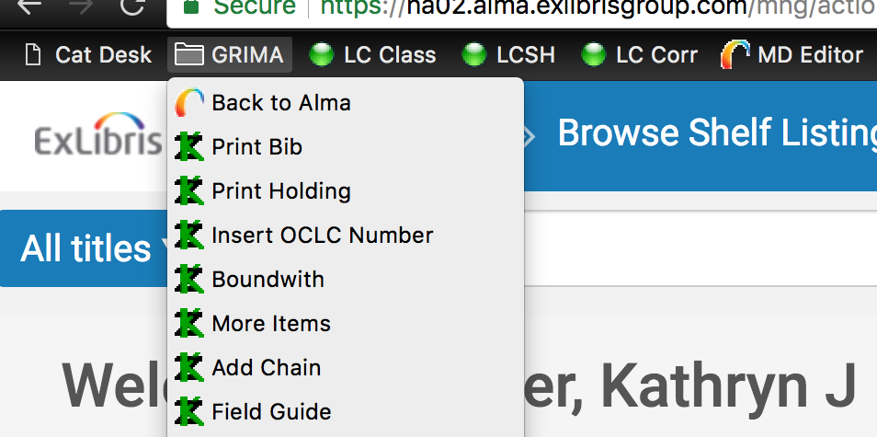
Bookmarks are close to other Alma options

Slide 41
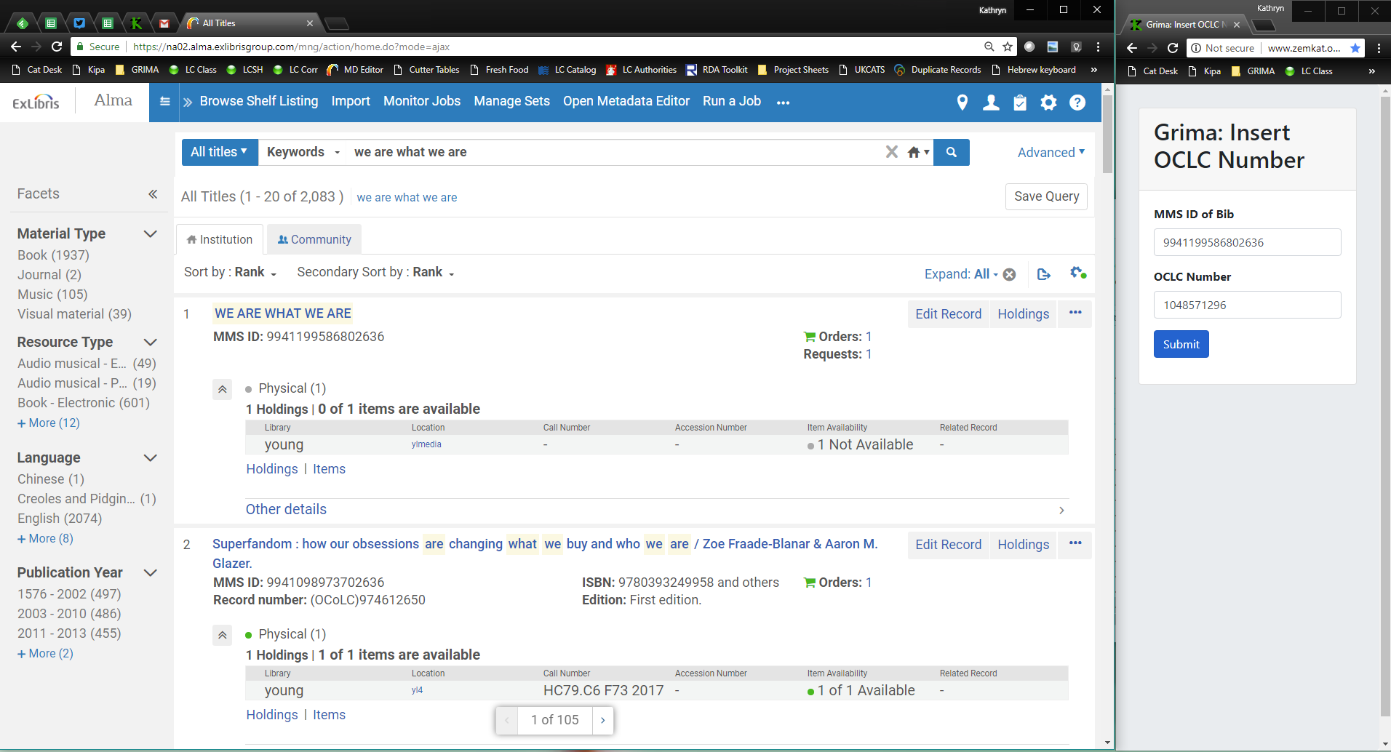
"Skinny Grima"

Slide 42
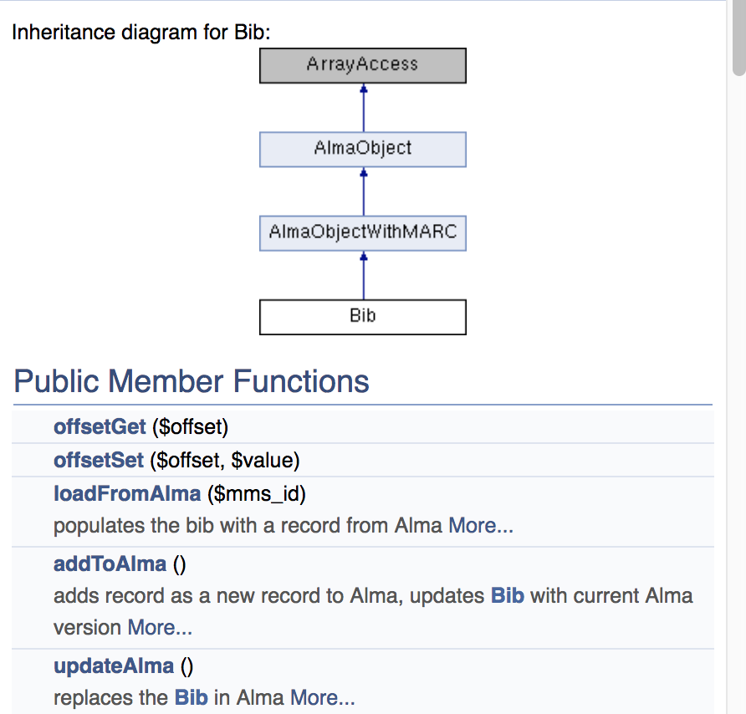
Make your own Grimas
Make a copy of a similar grima
Modify as needed
Check documentation (or read the library code!)
(Ask me!)

Slide 43

Any questions?
Grima - https://github.com/zemkat/grima
Kathryn Lybarger @zemkat
Kathryn.Lybarger@uky.edu
University of Kentucky Libraries

