Slide 1
Regular expressions for tech services
Kathryn Lybarger Nov. 21, 2016
University of Kentucky NOTSL

Slide 2
What are regular expressions? (“regex” or “regexp”)
Powerful search and replace
Rather than just searching for specific things, you can search for kinds of things
Symbols define a search pattern (similar to “wildcards”)
This pattern may match your data
Data may be modified or rearranged based on that matching

Slide 3
Examples:
Regex for finding data
Find all the lines that start with “2016”
Find all 10- or 13-digit numbers
Find all the fields like “Includes biblio … something something ... references.” (but not “bibliographical”)

Slide 4
Use case:
Links per record?
Large MARC file of ebook records
How many links in each record?
Do some have more than one? Or none?
Is having the same number of 001 and 856 enough?
001 eve0483837
856 $u http://www.evender.com/
001 eve0483839
856 $u http://www.evender.com/
856 $u http://www.evender.com/
001 eve0483834
001 eve0483845
856 $u http://www.evender.com/

Slide 5
Examples:
Regex for modifying data
Reformat all phone numbers from ###-###-#### to (###) ###-####
Re-order names from LastName, FirstName -> FirstName LastName
  Handling “Jr.” or “Sr.” correctly

Slide 6
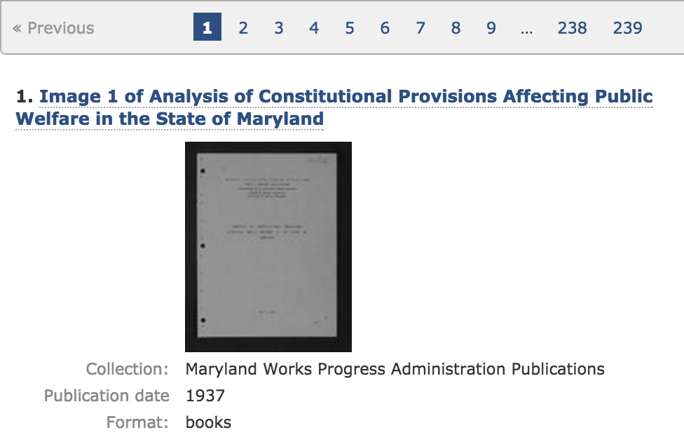
Use Case:
What to catalog?

Slide 7
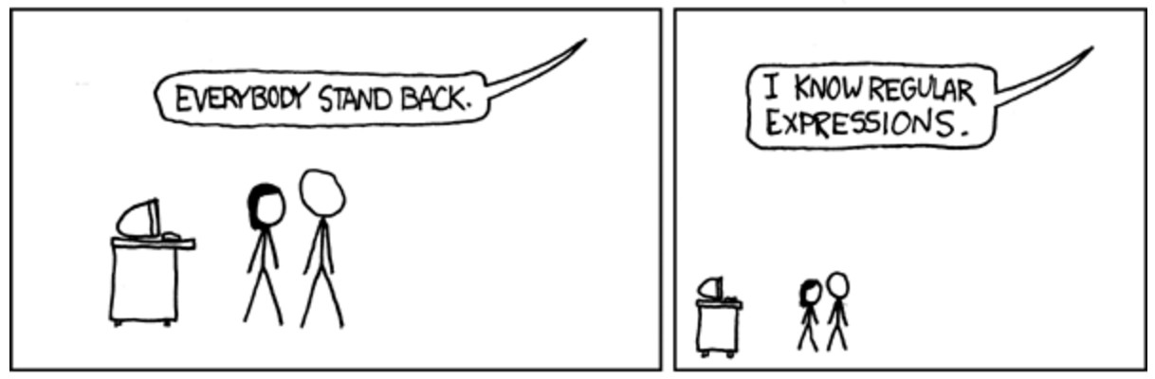
Use Case:
What to catalog?
https://xkcd.com/208/

Slide 8
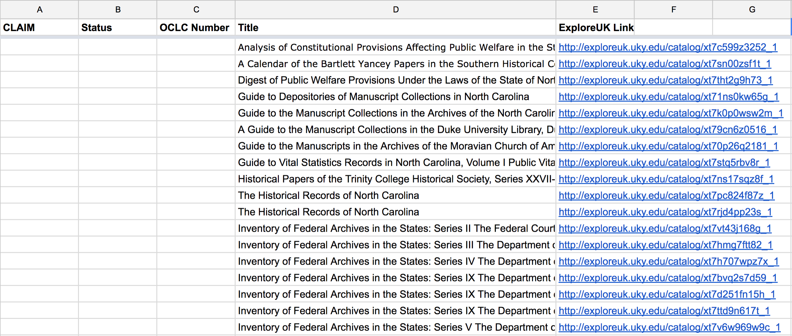
Use Case:
What to catalog?

Slide 9
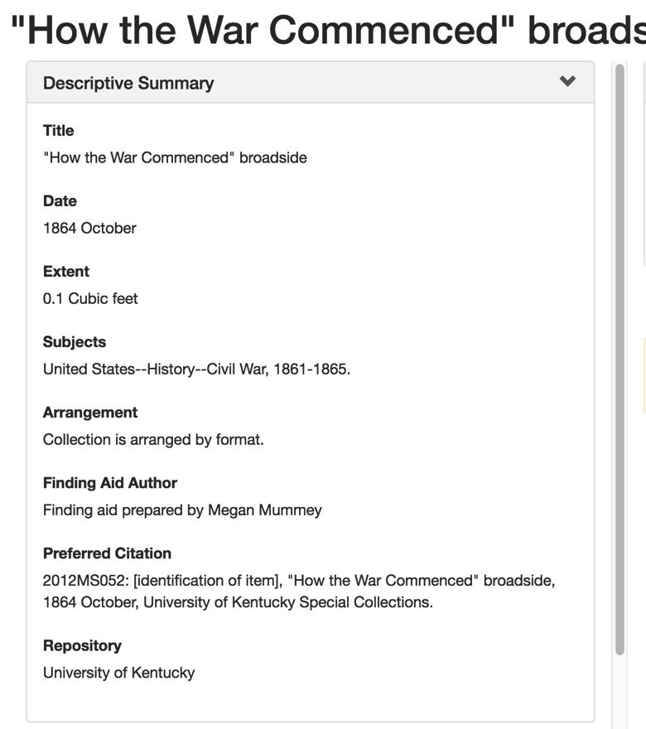
Use case:
Digital Library software
< />
XML
Regex

Slide 10
Some common software in tech services has regex support
MARCEdit
Vendor-specific: Voyager’s Global Data Change, etc.
Google Sheets
Text/XML Editors: vim, Sublime, EditPad, Oxygen
Programming languages
Databases like Oracle, MySQL
Command line tools: grep, sed, awk

Slide 11
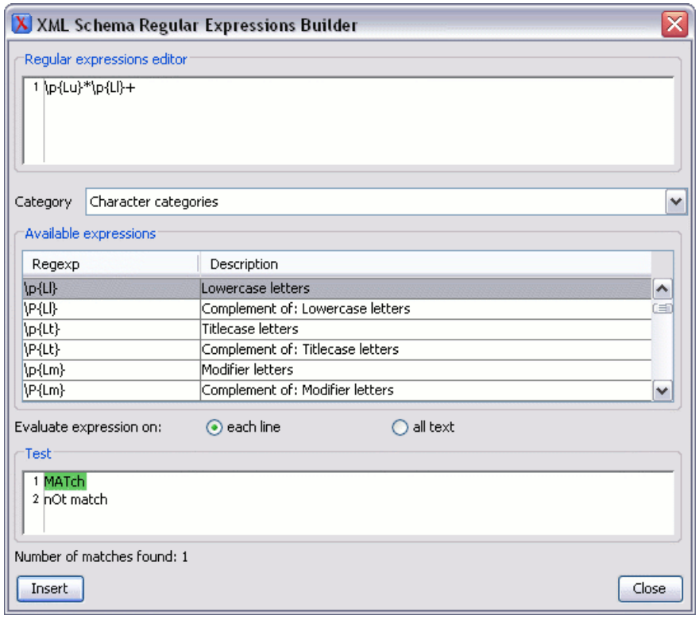
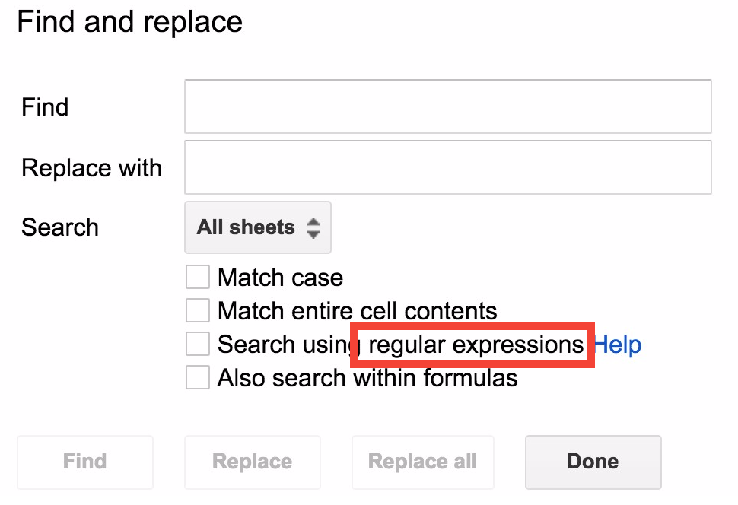
sed –e “s/now/meow/” file1 > file2

Slide 12
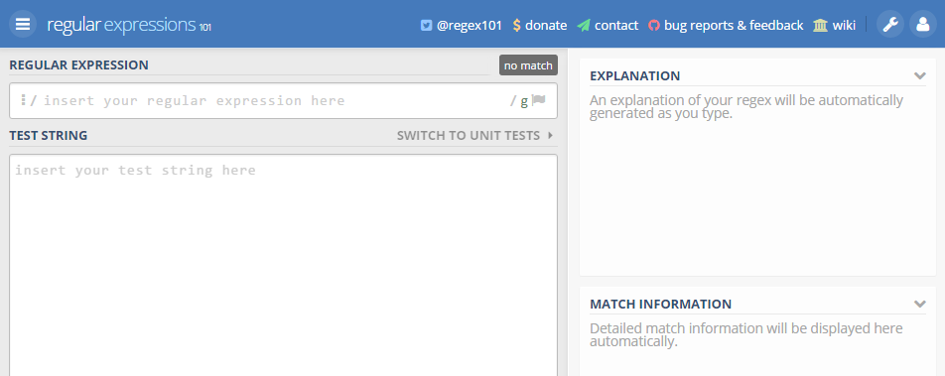
A nice learning tool: regex101.com

Slide 13
There are different “flavors” of regex
Depends on software or language you’re using
  e.g. Language with PCRE support, vim text editor
Different features available
Slightly different syntax to invoke some features
BUT there is a common core
  Once you know this, can look up details for your specific application

Slide 14
Structured text?
Biko, S. B., BIKO SPEAKS: A SELECTION OF HIS WRITINGS, Johannesburg, Bayakha Books, 1997, 30 pp. G (2 copies)

Slide 15
Forward slashes (/) are often used to indicate a regex
/ /
Regular
Expression

Slide 16
Forward slashes (/) are often used to indicate a regex
/ /
What does
this pattern
match?

Slide 17
Literal characters: the simplest regex!
/cat/
Matches:
  cat
  cataloging
  scatter
  wildcat

Slide 18
Literal characters: the simplest regex!
/cat/
Does NOT match:
  cart
  CAT
  act
  c a t

Slide 19
Unless specified otherwise…
Matching is case-sensitive
  To match, the capitalization in your data must match the capitalization in your pattern
Matching only part of the data is fine
  It doesn’t have to be the whole word or line

Slide 20
BACK OF YOUR SHEET
/cat/

Slide 21
Regex Bingo!
I will put a regex search pattern on the slide
Search the indicated column (like B, I, N, G, O) – does the regex match any of those strings?
If so, mark that space off!
If you get five in a line, shout “BINGO!”

Slide 22
N
/FREE/

Slide 23
Meta-characters
\ ^ $ | ( ) . [ ] ? * + { }
These are what give regular expressions their power.
If the word or phrase you’re searching for has punctuation, it may not match as you intend

Slide 24
But what if I want to search for those?!
You can “escape” such characters by preceding them with a backslash
For example, if you wanted to search for a literal carat, include this in your regex: \^

Slide 25
Carat ^
Start of line anchor
/^dog/
Matches:
  dog
  dogfood
  dog house
  dogma

Slide 26
Carat ^
Start of line anchor
/^dog/
Does NOT match:
  bulldog
  What a cute dog!
  dgo
  dooooog

Slide 27
B
/^app/

Slide 28
I
/^rad/

Slide 29
Dollar sign $
End of line anchor
/ugh$/
Matches:
  ugh
  Tough
  dough
  laugh

Slide 30
Dollar sign $
End of line anchor
/ugh$/
Does NOT match:
  taught
  ugh that’s gross
  UGH
  upright

Slide 31
N
/one$/

Slide 32
G
/per$/

Slide 33
Vertical bar
This or that?
/ab|c/
Matches:
  abdicate
  cabaret
  laboratory
  Jack

Slide 34
Vertical bar
This or that?
/ab|c/
Does NOT match:
  rad
  blue
  band
  Canada

Slide 35
O
/ash|rr/

Slide 36
B
/DA|BB/

Slide 37
Dot (period):
It matches any character
/m.t.e/
Matches:
  matte
  mother
  permitted
  tomatoes

Slide 38
Dot (period):
It matches any character
/m.t.e/
Does NOT match:
  smote
  tempted
  mothmen
  Mister

Slide 39
I
/t..ch/

Slide 40
N
/a.i.o/

Slide 41
Character classes
Square brackets – [ ]
This part of the expression only matches one character
Matches any character that appears in the brackets (but no others)

Slide 42
Character classes
Square brackets – [ ]
/m[ai]n/
Matches:
  man
  mine
  woman
  swimming

Slide 43
Character classes
Square brackets – [ ]
/m[ai]n/
Does NOT match:
  main
  chimney
  women
  am not

Slide 44
G
/s[oa]r/

Slide 45
O
/t[hr]o/

Slide 46
Character classes: some shorthand
[a-z] instead of [abcdefghijklmnopqrstuvwxyz]
[a-zA-Z] – any letter
\d instead of [0123456789]
\s – any whitespace like <space>, <tab>

Slide 47
Character classes (excluding) - carat in square brackets [^ ]
You can use similar notation to match any character EXCEPT what you specify
This is the same carat character as used in the left anchor, but there should be no confusion

Slide 48
Character classes (excluding) - carat in square brackets [^ ]
/o[^ao]r/
Matches:
  your
  autograph
  cobra
  ourselves

Slide 49
Character classes (excluding) - carat in square brackets [^ ]
/o[^ao]r/
Does NOT match:
  oar
  poor
  or
  coder

Slide 50
B
/z[^ek]/

Slide 51
I
/Qu[^a]/

Slide 52
Quantifiers:
How many of a thing?
These most recent patterns we’ve looked at have each matched exactly ONE character
  But what if it is optional?
  Or you can / must have more than one?
These metacharacters directly follow patterns to specify such things

Slide 53
Question mark ? (zero or one time)
Thing before it is optional
/do?r/
Matches:
  ardor
  dorsal
  drone
  Andrew

Slide 54
Question mark ? (zero or one time)
Thing before it is optional
/do?r/
Does NOT match:
  door
  dOr
  and
  Lando

Slide 55
N
/ang?e/

Slide 56
G
/din?e/

Slide 57
Star (asterisk): (zero, one, or more!)
Thing before is optional, repeatable
/il*e/
Matches:
  pumpkin pie
  bibliophile
  Miller
  gillless

Slide 58
Star (asterisk): (zero, one, or more!)
Thing before is optional, repeatable
/il*e/
Does NOT match:
  fills
  fire
  dinner
  tilted

Slide 59
O
/lan*c/

Slide 60
B
/smar*/

Slide 61
Plus sign: (one or more times)
Thing before is required, repeatable
/an+/
Matches:
  an
  annotate
  manner
  annnnnnnnn

Slide 62
Plus sign: (one or more times)
Thing before is required, repeatable
/an+/
Does NOT match:
  apple
  minnow
  Andover
  nasty

Slide 63
I
/is+i/

Slide 64
N
/ban+/

Slide 65
All of these can be used together
/^(dog|raccoon) ?fo+d$/
/[A-Z][a-z]* [A-Z][a-z]+/

Slide 66
Going back to this example:
/cat/
Matches:
  cat
  cataloging
  scatter
  wildcat

Slide 67
Search and replace
Search for:
  /cat/
Replace with:
  fuzzy beast
Data:
  My cats are the best.
Results:
  My fuzzy beasts are the best.

Slide 68
Search and replace
Flexibility for searching
Search for:
  /(cat|dog|horse)/
Replace with:
  fuzzy beast
Data:
  My horses are the best.
Results:
  My fuzzy beasts are the best.

Slide 69
Parentheses ( )
Capturing patterns
As you match patterns, you can “capture” parts of your data and rearrange them
In the replacement pattern, refer to these parts by their “back references” like \1, \2, \3, … in order of parentheses in the pattern

Slide 70
Simple example:
Reformatting names
My data:
  Jones, Martha
Search for:
  /([A-Za-z]+), ([A-Za-z]+)/
This sets:
\1 = Jones \2 = Martha
Replace with:
  \2 \1
Result:
  Martha Jones

Slide 71
What does this match?
/.*/

Slide 72
What does this match?
/(.*) (.*)/

Slide 73
What does this do?
My data:
  James Earl Jones
Search for:
  /(.*) (.*)/
This sets:
\1 = ? \2 = ?
Replace with:
  \2, \1
Result:

Slide 74
Regular expressions are “greedy”
That first “capture group” (.*) has two choices:
  Capture “James” and leave “Earl Jones” for the second
  Capture “James Earl” and leave “Jones” for the second
“Greedy” means it will capture as much as it can

Slide 75
Results:
My data:
  James Earl Jones
Search for:
  /(.*) (.*)/
This sets:
\1 = James Earl \2 = Jones
Replace with:
  \2, \1
Result:
  Jones, James Earl

Slide 76
Think about this:
How to remove all GMD?
Data: (lots of records like this)
=100 1_ $a Sachar, Louis, $e author.
=245 00 $a Holes $h [electronic resource] / $c Louis Sachar.
=264 _1 $a New York : $b Random House, $c 2015.
Goal:
Remove 245 $h

Slide 77
grep "index_title" $1*html | grep "Image 1 " | sed -e 's!.*\(catalog.*_1\).*Image 1 of \([^<]*\).*!\2\thttp://exploreuk.uky.edu/\1!' > $1.tsv

Slide 78
References
Regex101
  http://www.regex101.com/
Regular-Expressions.info
  http://www.regular-expressions.info/
Documentation for your particular software / application
  Where to use regex
  Which features are available
  How to invoke them

Slide 79

Contact Me
Email: Kathryn.Lybarger@uky.edu
Twitter: @zemkat
Tumblr: problem-cataloger.tumblr.com

