Slide 1
Have You Heard of
Mashcat?
(You Can #mashcat Too!)
Kathryn lybarger @zemkat
University of Kentucky libraries
OVGTSL May 26, 2016 #ovgtsl16

Slide 2
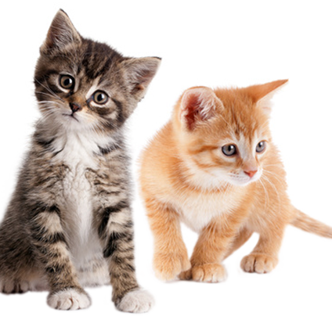
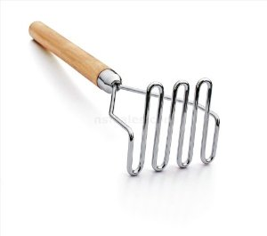
Have you heard of #mashcat?

Slide 3

mashcat: mashed catalog data
/ catalogers and developers
Event organized in 2012 in Cambridge
“for cataloguers, developers and anyone else with an interest in how library catalogue data can be created, manipulated, used and re-used by computers and software”
All presentations / storify available on website

Slide 4
http://www.mashcat.info/

Slide 5
Mashcat as a banner
“Mashcat” is now used by a loose group of catalogers, developers, library systems people working together, improving communications
No manifesto, but some underlying themes:
  Library data is a Good Thing.
  Library staff creating and improving library data is a Good Thing.
  Library systems is a Good Thing.
  Library data people should be conversing with library systems people (and vice versa).
  It’s time to move past “MARC must die” and throwing pebbles at each other.

Slide 6

Slack: mashcat.slack.com
Slack – an online messaging system
  Web site
  Desktop client
  Mobile apps
Channels
  General
  Meeting-planning
  Tools
  Bad-data-no-cookie

Slide 7

Twitter chats
Monthly chat (one hour) on a #mashcat topic
Question list created and published in advance
During the chat
  Moderator asks each question in turn
  Attendees answer questions, tagging with #mashcat
Storify record of each chat created, posted on website

Slide 8

Twitter chats: library topics
Future of library authorities
Discovery layers and metadata
Systems migrations

Slide 9
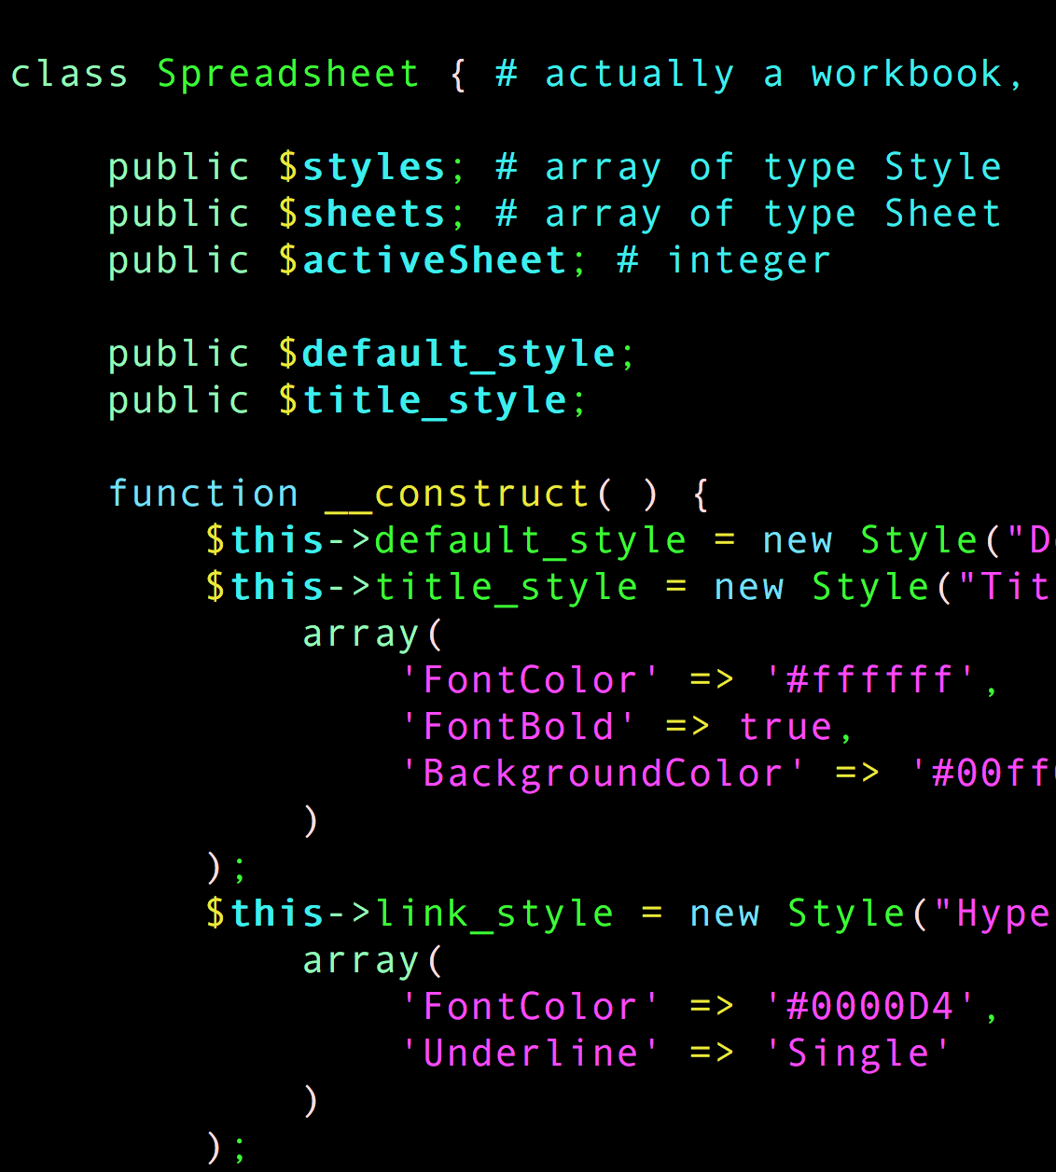
Twitter chats: developer topics
Data licensing and open data
Linked open data
Developing skills past library school

Slide 10
Twitter chats: communication
How catalogers and library technologists can build better relationships
Communicating requirements and detecting IT brush-offs
Cataloging and coding as applied empathy

Slide 11

Webinars
OpenRefine (Owen Stephens)
  Installing OpenRefine
  Using OpenRefine
MarcEdit (Terry Reese)
  Evolving MarcEdit: Leveraging Semantic Data in MarcEdit
Recordings, slides available on the mashcat web site

Slide 12

Mashcat 2016 (Boston)
At Simmons College, following ALA Midwinter
Variety of talks and activities:
  Shall we become two-headed monsters?
  Library Workflow Exchange
  Zine Union Catalog Project with Dreams of Linked Open Data (brainstorming)
  There’s only one rule I know of…you’ve got to be kind

Slide 13

Code of conduct
Excerpt: Mashcat is dedicated to providing a harassment-free conference experience for everyone, regardless of gender, gender identity and expression, sexual orientation, disability, physical appearance, body size, race, age or religion. We do not tolerate harassment of conference participants in any form.
Badge lanyards at the Boston event:
Green: It’s okay to take my picture
Yellow: Please ask first
Red: Don’t take my picture

Slide 14
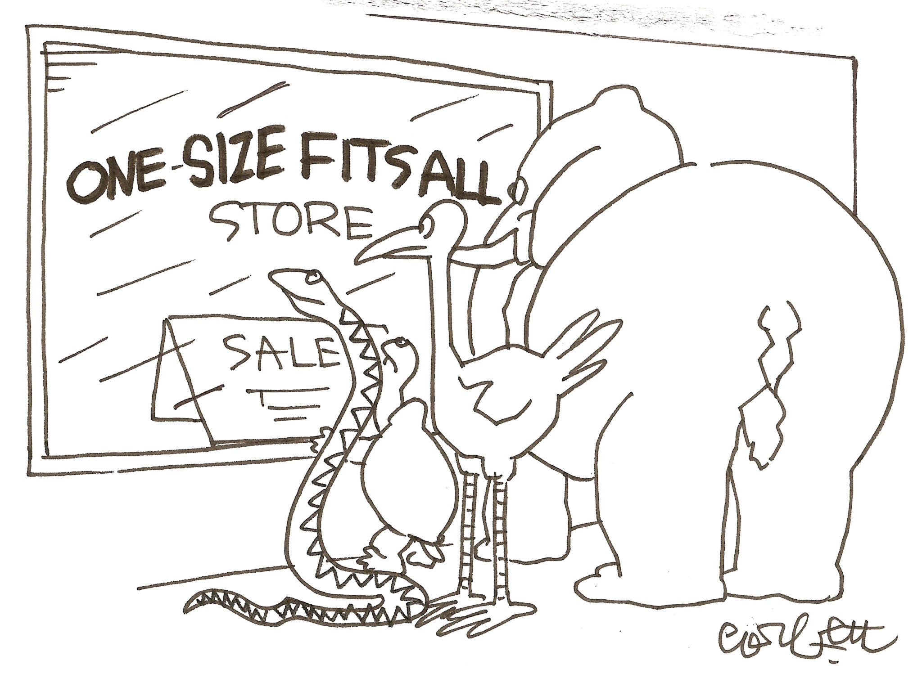
Why mashcat?
Everyone’s collection is different
Everyone’s needs are different
Everyone’s resources are different
Everyone’s skills are different
And everyone can help!

Slide 15

We do have programmers on staff
They do development on large software projects
  Synchronizing oral history audio with transcripts
  Data communication between our ILS and other campus systems
  Archiving born-digital newspapers from publishers
These projects are often:
  Large and complex
  For a large audience
  Urgent
  High priority

Slide 16
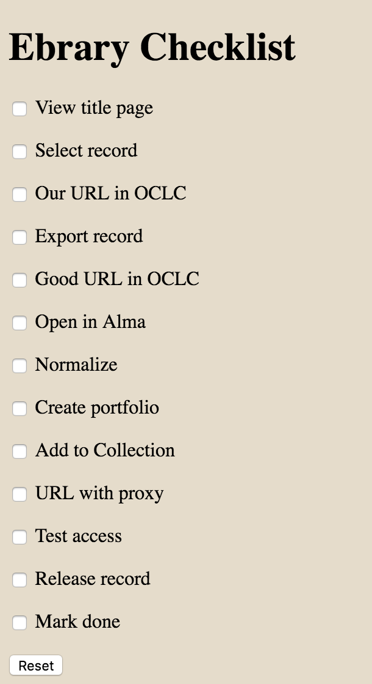
How about this tool?
Send idea to our programmers?
  Small and simple
  Experimental (just me)
  Not urgent
  Low priority
But useful to me!
There’s room for lots of such programs

Slide 17

A hard boundary between catalogers and developers?
Developers can build cataloging tools
Catalogers can help developers
Not all programming requires a “programmer”
But where to start?

Slide 18
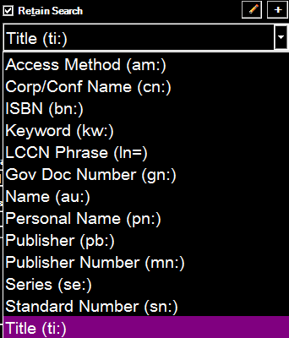
Become a power user
“What does this button do?”
  Could it be useful?
  How to recognize if I press it accidentally?
“Can I set my preferences differently?”
  Fonts and Colors
“Can I quickly get to what I use most?”
  Toolbars
  Indexes

Slide 19
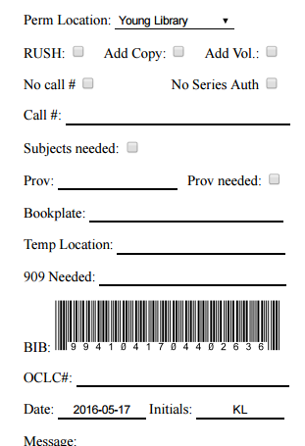
…even for regular software
Did you know that there are barcode fonts?
They can be used in Microsoft Word, Adobe Acrobat, etc.
Type in a space formatted as that font, it will make a barcode
We use “Barcode 3 of 9”

Slide 20
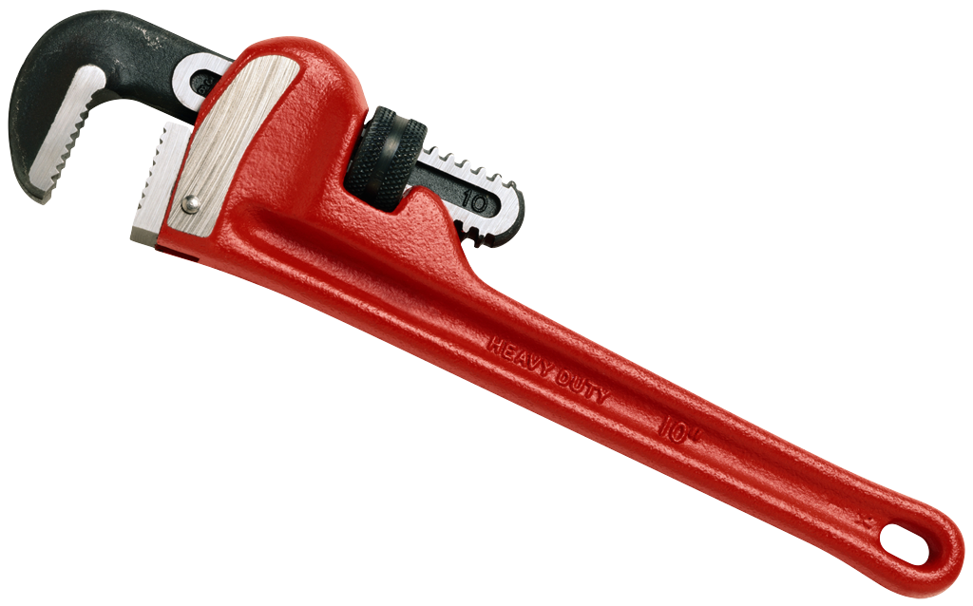
Thinking critically about your tools
Does it do what you need?
How could it be more efficient?
What are other people saying about it?
This may be easier when you’re starting with a new tool…

Slide 21
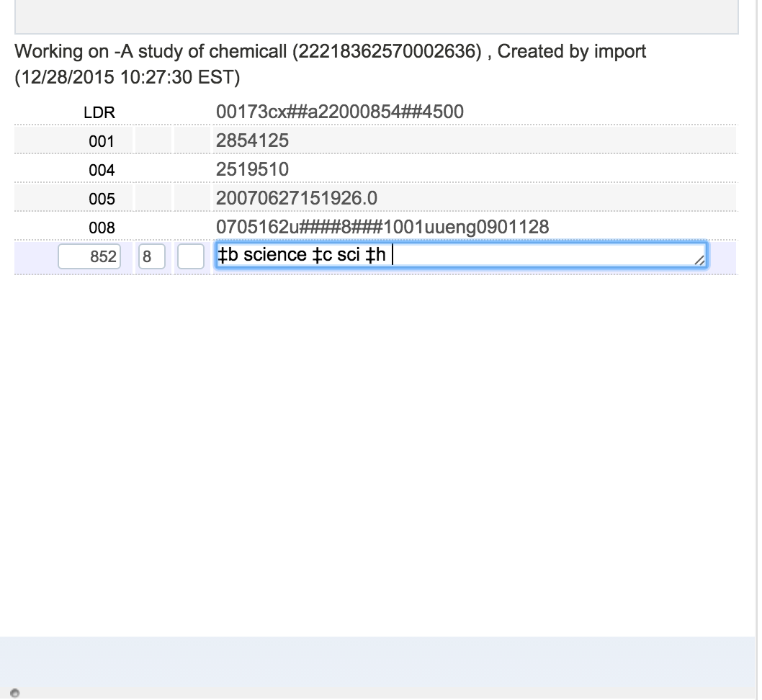
Someone may know the answer
“I wish there was a way to quickly copy the call number from the bib to the MFHD…”
“You can, by using Alt-U.”

Slide 22
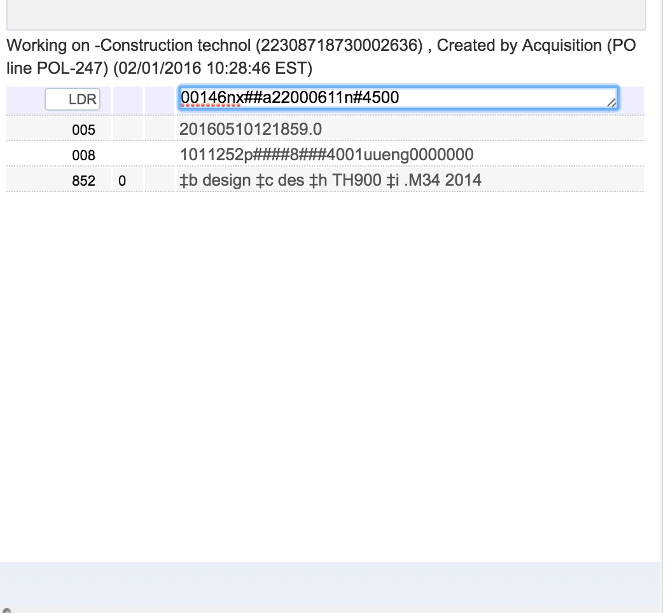
Someone may have a workaround
“I wish I could edit two MFHDs at once…”
“You can! Just open two web browsers side by side.”
“Or if you just need to SEE one and edit the other, use the snipping tool.”

Slide 23
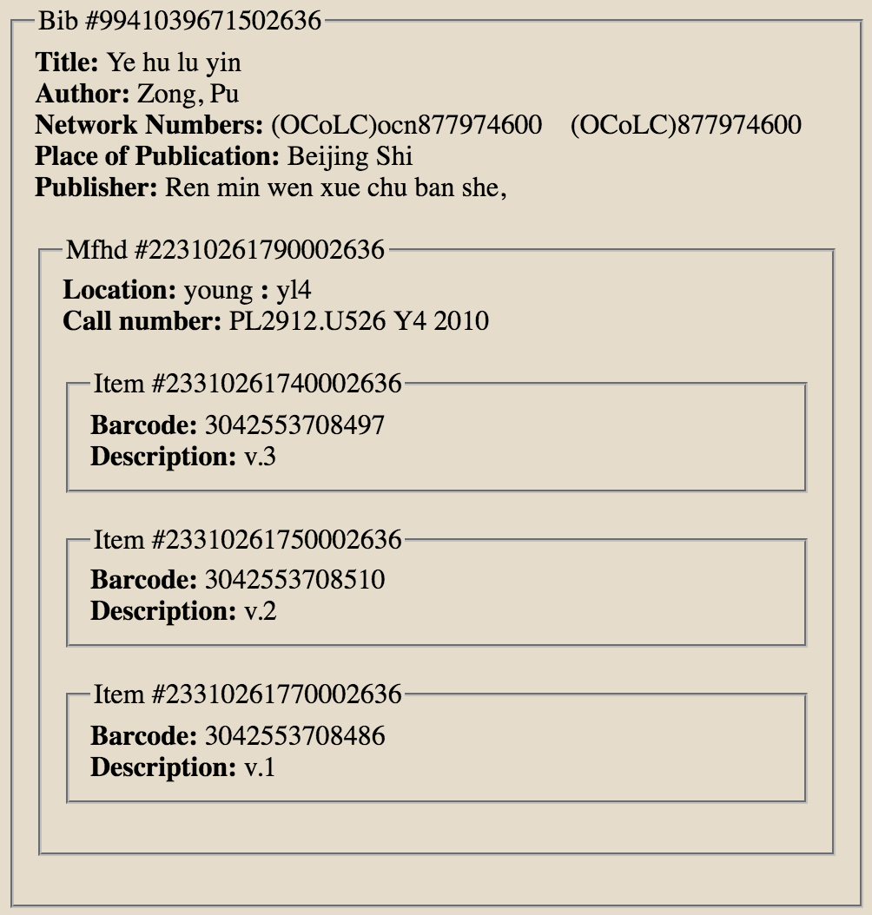
Someone may have a tool
“I wish we had a Hierarchy button, like in Voyager.”
“You can. I wrote one using the API.”

Slide 24
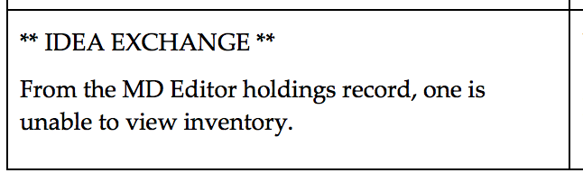
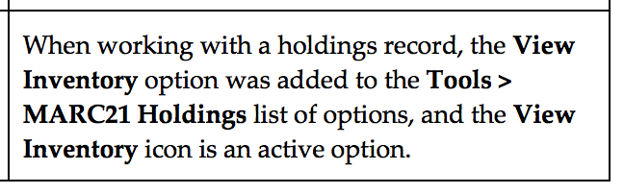
It may just need to be fixed
“I wish it didn’t take so many clicks to get from a MFHD to its items.”
“Good news! Now it doesn’t.”

Slide 25
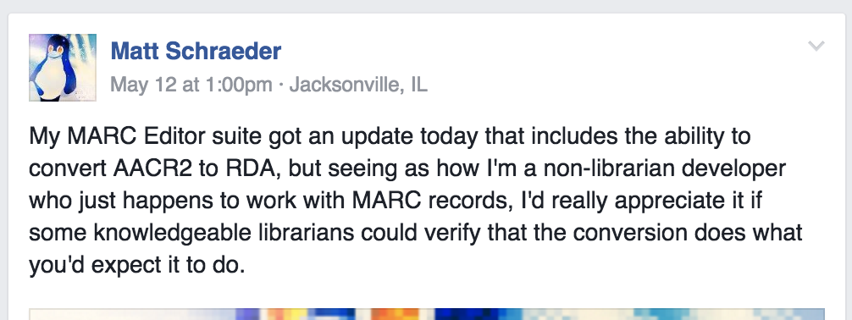
Collaborating with developers

Slide 26
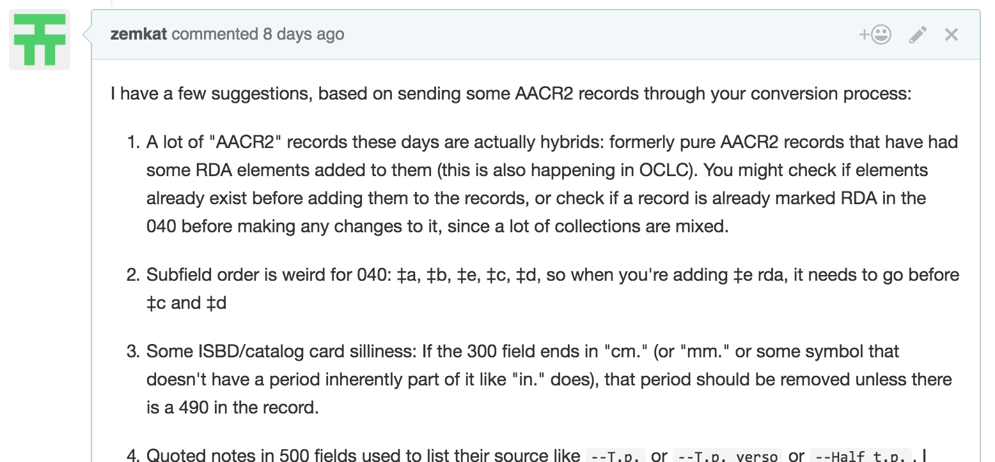
I provided some feedback…

Slide 27
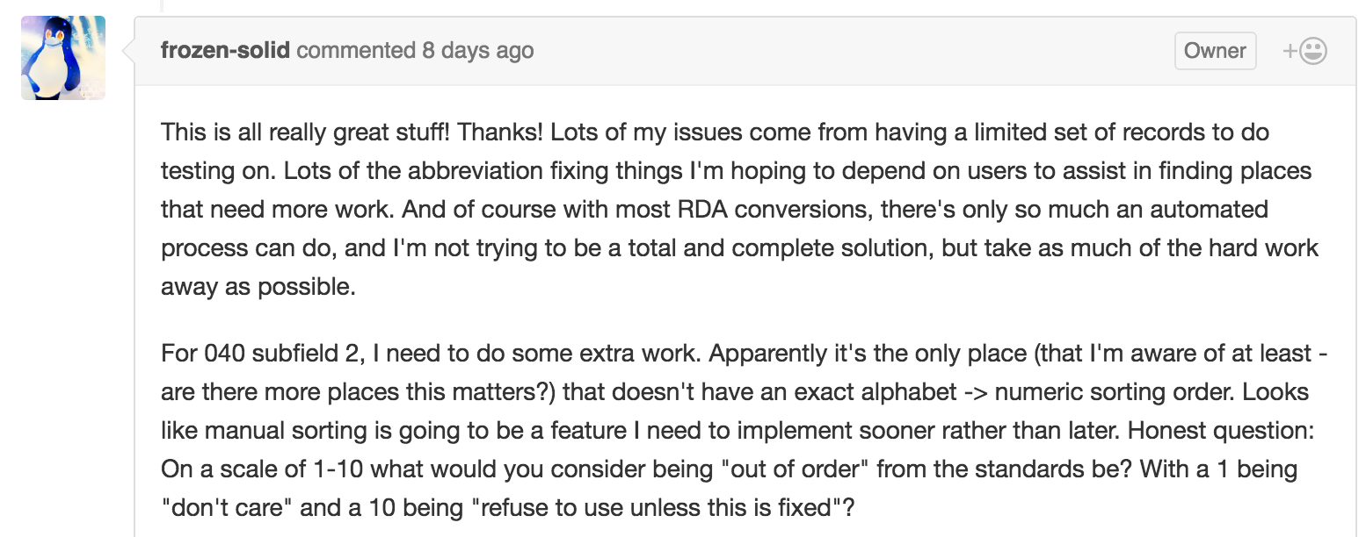
Software was improved!

Slide 28

Macros: AutoHotKey
AutoHotKey
  Free, open-source macro-creation and automation software for Windows
Programs can run automatically in the background
  Trigger with hotkey, string or mouse button
  Can be program-specific

Slide 29
Macros: Text replacement
Typing hard-to-type characters:
  ; Type (c) to produce the copyright symbol
  :*:(c)::©
  ; Type single Greek characters by surrounding them by bangs (!)
  :*:!alpha!::α

Slide 30
Macros: More text replacement
Type long but common phrases:
::brn::Includes bibliographical references (pages ) and index.

Slide 31
Macros: Making your hotkeys consistent across systems
Hotkeys often have different behavior for different systems
Ctrl-D:
  Connexion: Subfield delimiter
  Voyager: Diacritic mode
  Alma: Delete record
I wrote a macro to make Ctrl-D do subfield delimiter everywhere
$^d::
IfWinActive, Voyager Cataloging
{
Send {F9}
} else {
Send ^d
}
Return

Slide 32
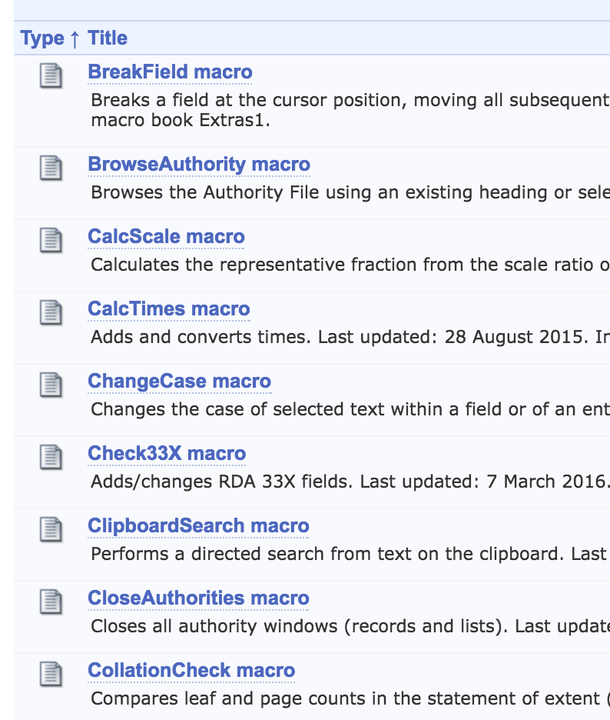
Macros in OCLC Connexion
Written in “OML”
  Like Visual Basic
More than just keystrokes
  Work with specific fields
  Work with fixed fields
  Pop up windows
Many included with Connexion
Resources
  Walt Nickeson’s macros
  OCLC Macro Language for the Complete Beginner (Joel Hahn)

Slide 33
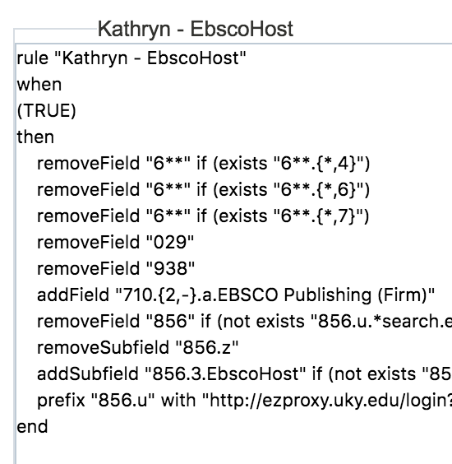
Programming within an ILS?
Alma uses:
  Normalization rules
  Merge rules
Edit rules within Alma
  Templates provided for common rule types
  Extensive documentation on Ex Libris web site

Slide 34
Join us!
Visit the web site
http://www.mashcat.info/
Join the mashcat Slack site
Watch twitter hashtag #mashcat for events
Or organize your own!

Slide 35
Any questions?

Slide 36

Contact me
Kathryn Lybarger
Email: Kathryn.Lybarger@uky.edu
Twitter: @zemkat
Github: https://github.com/zemkat
Blogs
  http://problem-cataloger.tumblr.com/
  http://may-subd-geog.tumblr.com/
  http://cataloging-taught-me.tumblr.com/
  http://library-computer.tumblr.com/

Slide 37
Resources
Mashcat sites
  http://www.mashcat.info
  https://mashcat.slack.com/
AutoHotKey
  https://autohotkey.com/
OCLC Connexion macros
  http://www.oclc.org/support/services/connexion/macros.en.html
Alma
  Using Normalization Rules
  Using Merge Rules

