Slide 1

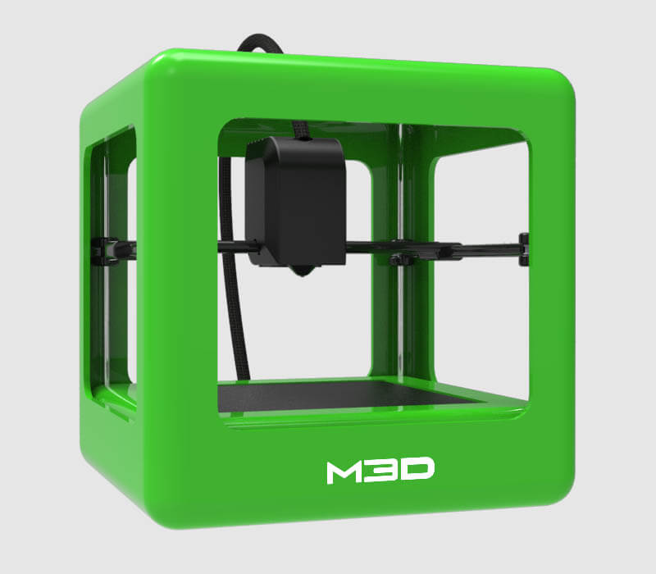
M3d micro
Retail: $300
Weight: 1 kg
Print Area: 109 x 113 x 116mm
  (less in top corners)
Supports most standard filament
Includes printing software
Self-calibrating

Slide 2
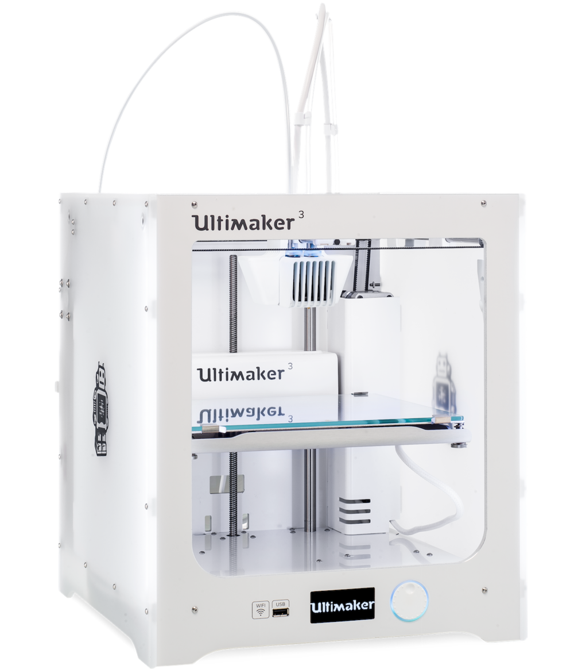
Ultimaker 3
Retail: > $3500
Weight: 25 kg
Print Area: 215 x 215 x 200mm
Higher quality prints
Heated bed
Dual extrusion
  2 colors in one print
  2 materials in one print

Slide 3
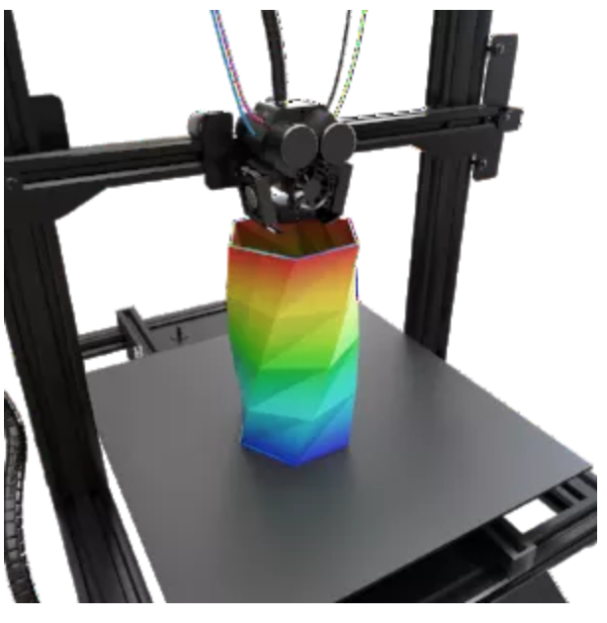
M3D CRANE QUAD
Retail: $550?
  (in pre-orders)
Full color printing!
  4 heads, mixes CMYK
  (or use four materials)
Heated bed
Print Area: 214 × 214 × 230mm

Slide 4
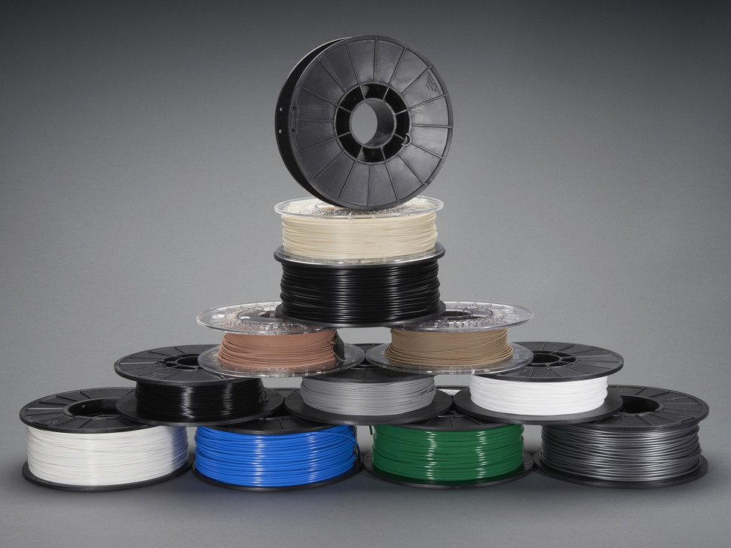
Filament
(3d printer "ink")
PLA – compostable plastic
ABS – Lego plastic
Flexible (e.g. "NinjaFlex")
Nylon
Carbon fiber
Wood
Metal (filled)
...and more!
Image from Adafruit catalog

Slide 5
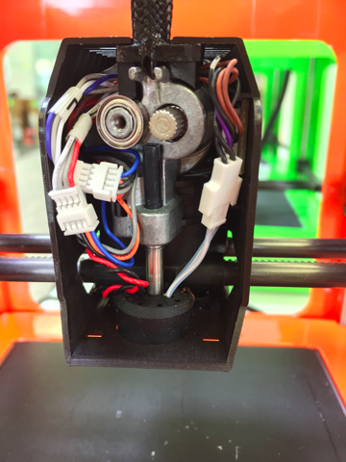
How does it work?
Gears feed the filament down to a heater
Filament is melted and extruded
Head moves around, building model in layers
Image from M3D support site

Slide 6
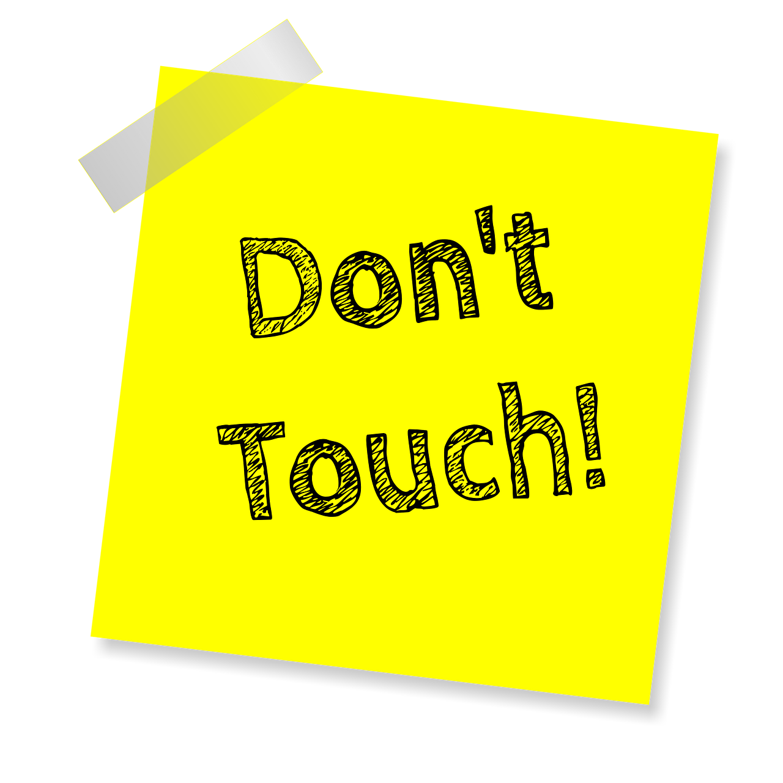
How hot is that nozzle?
PLA – 215°C - 235°C
ABS – 230°C - 240°C
NinjaFlex – 210°C - 225°C
Nylon – 240°C - 280°C
Wood – 200°C - 260°C
Polycarbonate – 250°C - 320°C
Temperature Guide from Filaments.ca
These are in CELSIUS, so that's over
400 DEGREES FAHRENHEIT

Slide 7
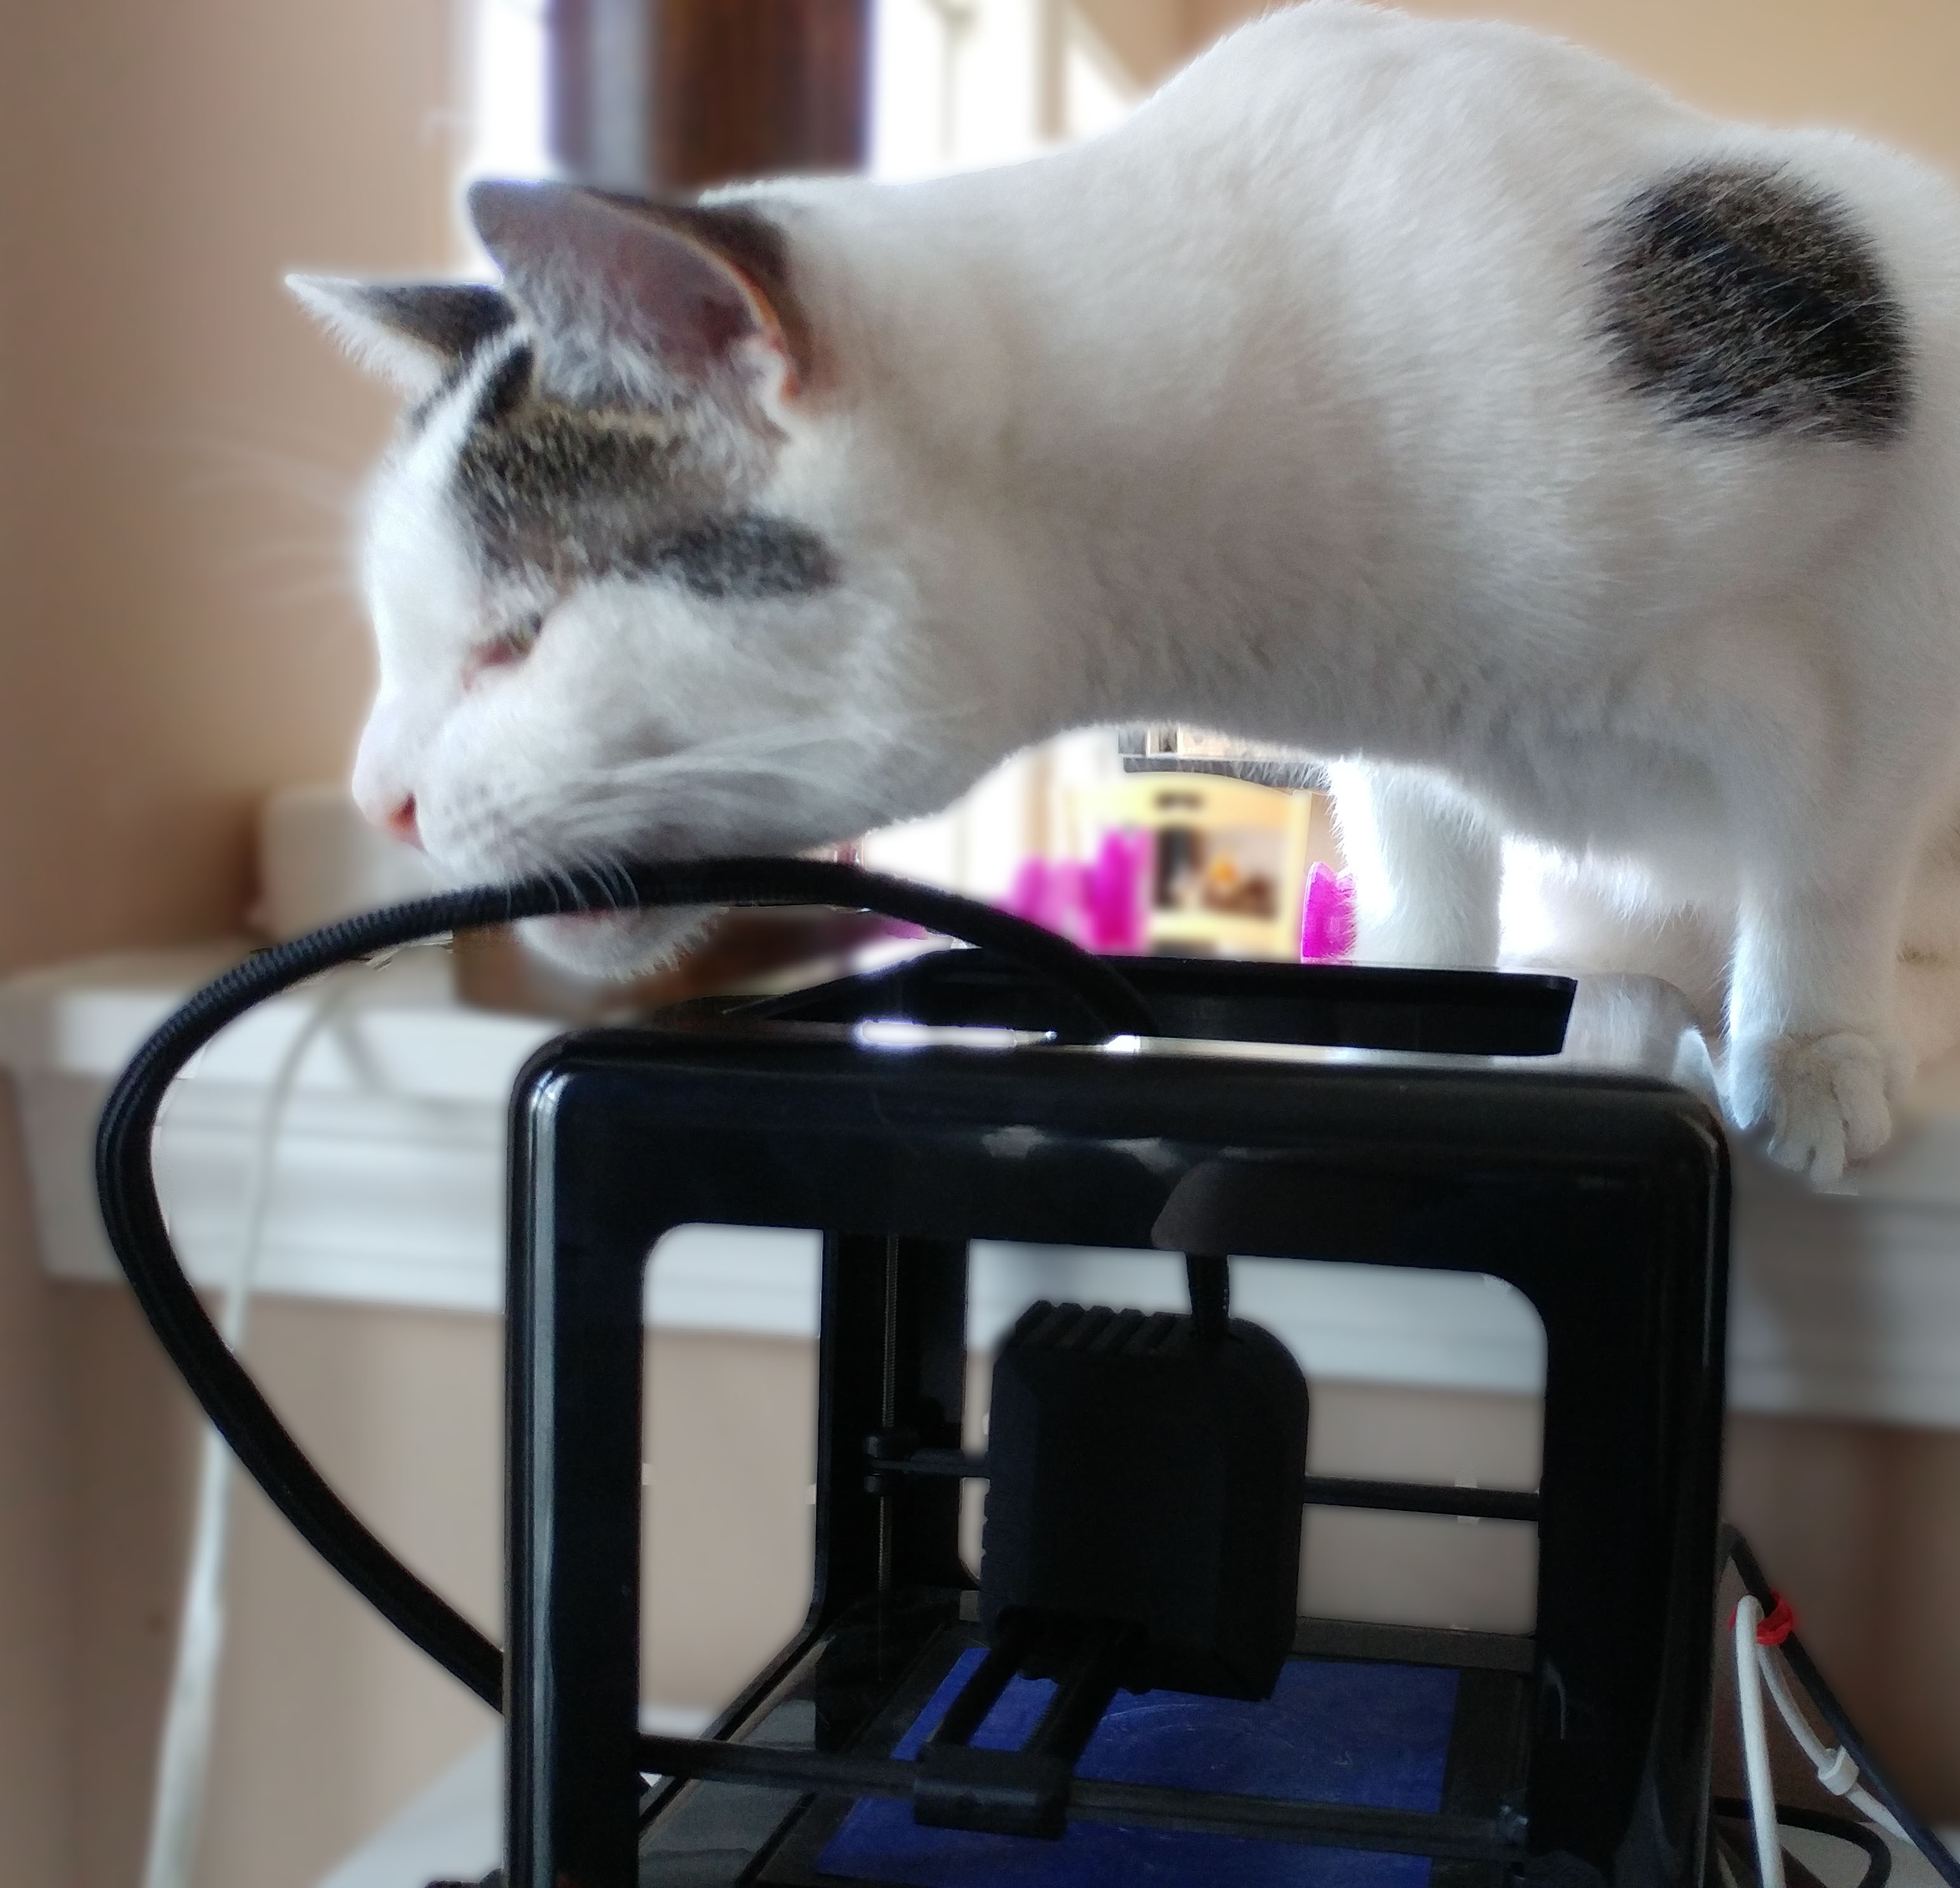
Is it safe?
  PLA (corn starch) is safest
    No toxic fumes
    Some microparticles
    No extraordinary ventilation needed
  Other filaments (including ABS)
    Varying degrees of harmful fumes
    Use in a well-ventilated area
    Some printers have filtered enclosures

Slide 8
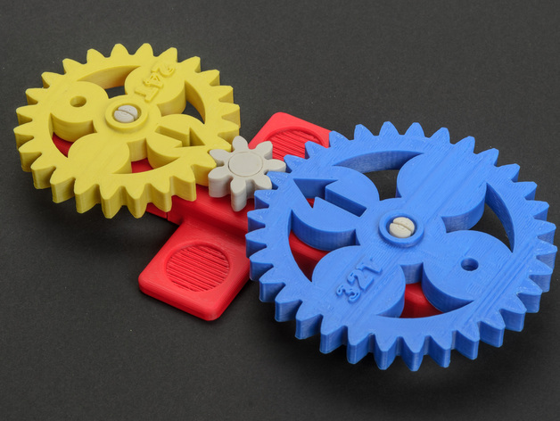
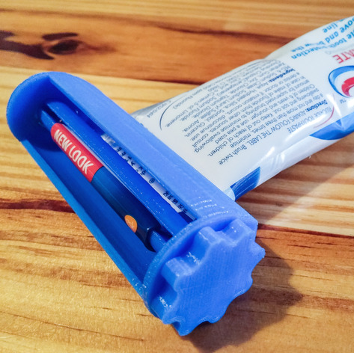
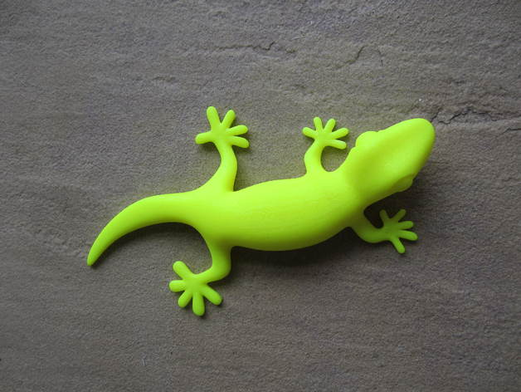
Thingiverse
Download or share printable files
  Or order patterns printed
Categories:
  3D Printing
  Art
  Fashion
  Gadgets
Household
Tools
Toys & Games

Slide 9
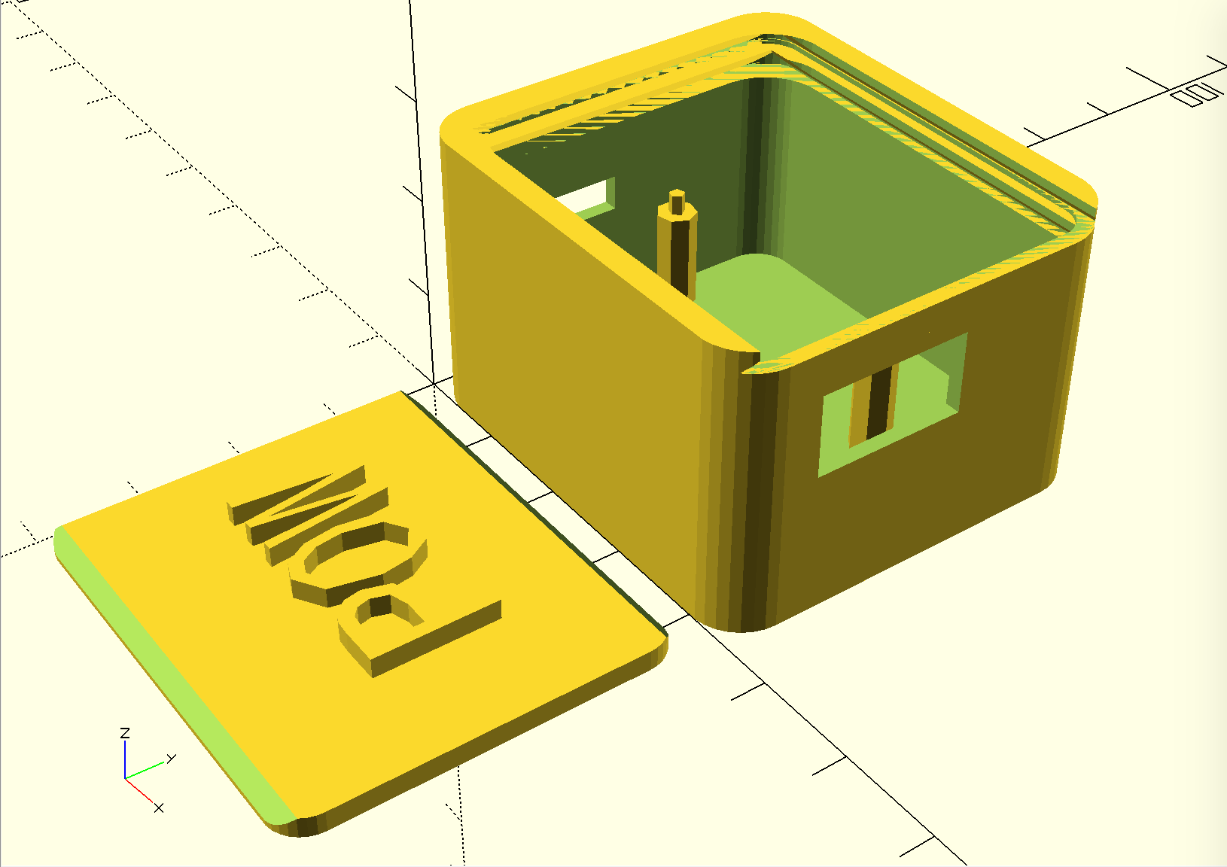
Design your own
Parameterized designs
Remix from Thingiverse
Design software:
  OpenSCAD
  TinkerCAD
  Google Sketchup
  …

Slide 10
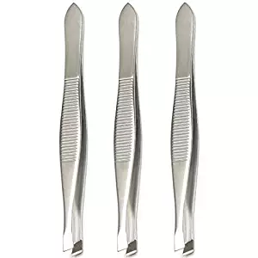
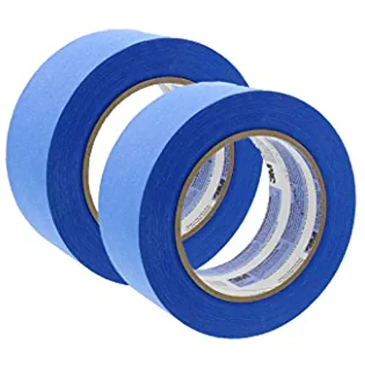
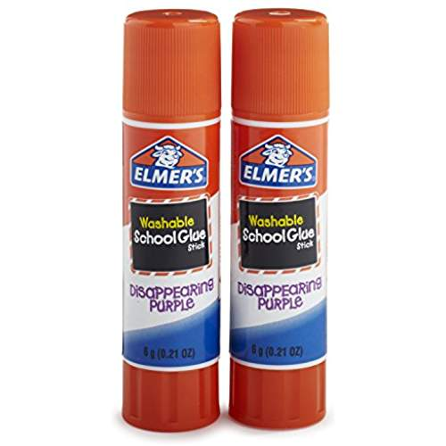
Tools for printing
Painter's Tape (on bed)
  Apply to bed for easier to remove prints
Glue (on bed)
  Sticky, avoids peeling up
Tweezers
  Cleaning nozzle (very hot!)

Slide 11
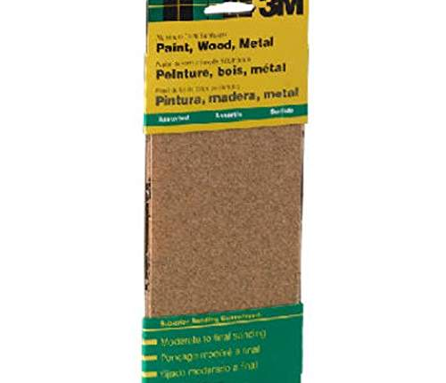
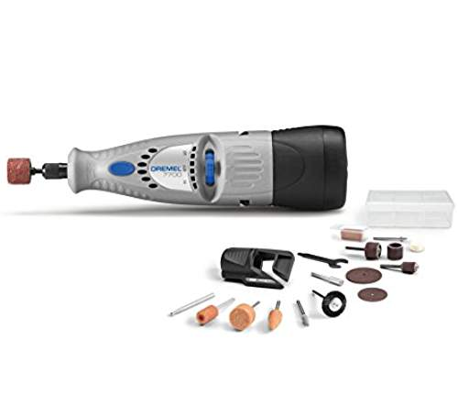
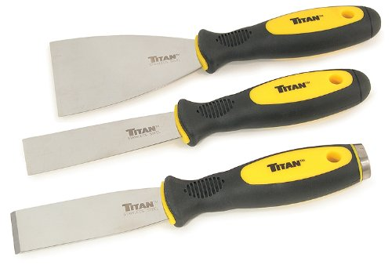
Tools for finishing
Palette knife
  Lifting prints from bed
Sandpaper
  Various grits
Files
Dremel

