Slide 1


GRIMA:
Whispering in Alma's ear with APIs
Kathryn Lybarger @zemkat
Ex Libris Bluegrass Users Group (EBUG)
June 1, 2018
All Lego images from Brickipedia
https://lego.wikia.com/

Slide 2

Ordering at Starbucks...
Barista: What can I get started for you?
Me: Hot chocolate, please.
Barista: What size?
Me: Tall
Barista: Whip cream?
Me: Yes please.

Slide 3
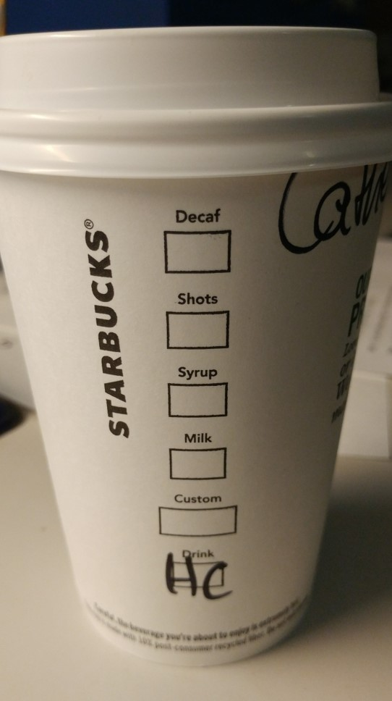
Ordering at Starbucks EFFICIENTLY
Grande
Hazelnut
Soy
No whip
Hot chocolate

Slide 4
API: Application
Application Programming Interface
“a set of clearly defined methods of communication between various software components” -- Wikipedia
Many software systems used in libraries offer them:
  GOBI
  Browzine
  WorldCat
  Alma / Primo

Slide 5
Task:
Delete this
Bib Record
Alma (Web interface)
Repository search for MMS ID
Click "Edit record” to load in Metadata Editor
Click Trash Can icon
Alma API
DELETE /almaws/v1/bibs/9941024389702636

Slide 6
Task:
Delete this Portfolio
Alma (Web interface)
Repository search for Portfolio ID
Edit Portfolio
Click action menu, Delete
Alma API
DELETE /almaws/v1/electronic/e-collections/X/e-services/X/ portfolios/53269609430002636
Search for portfolio in the collection
View all the collection's portfolios

Slide 7
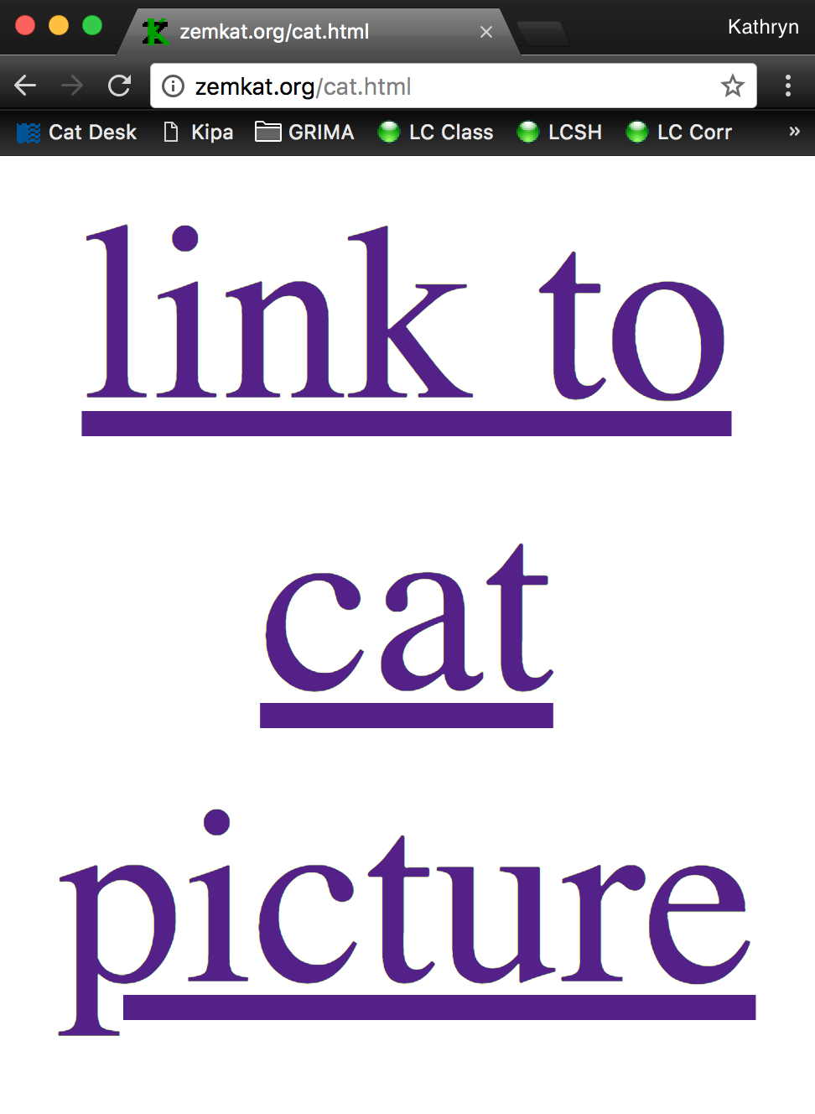
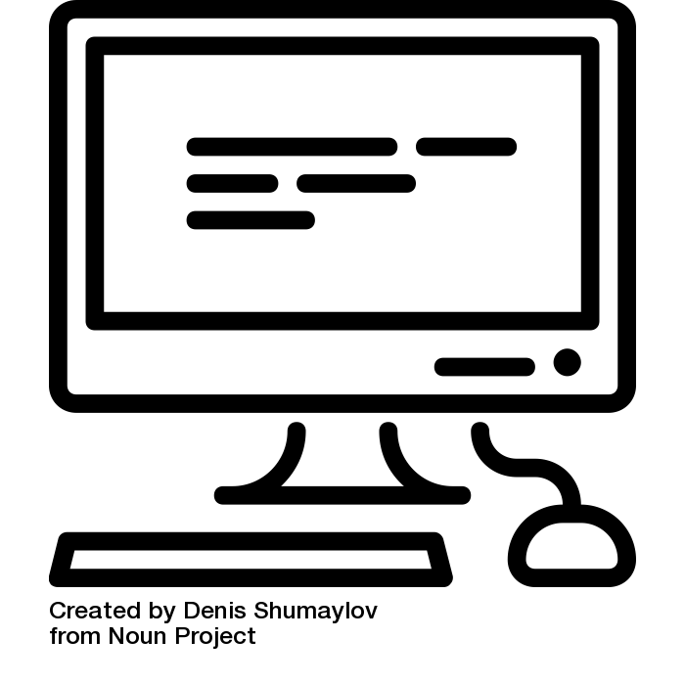
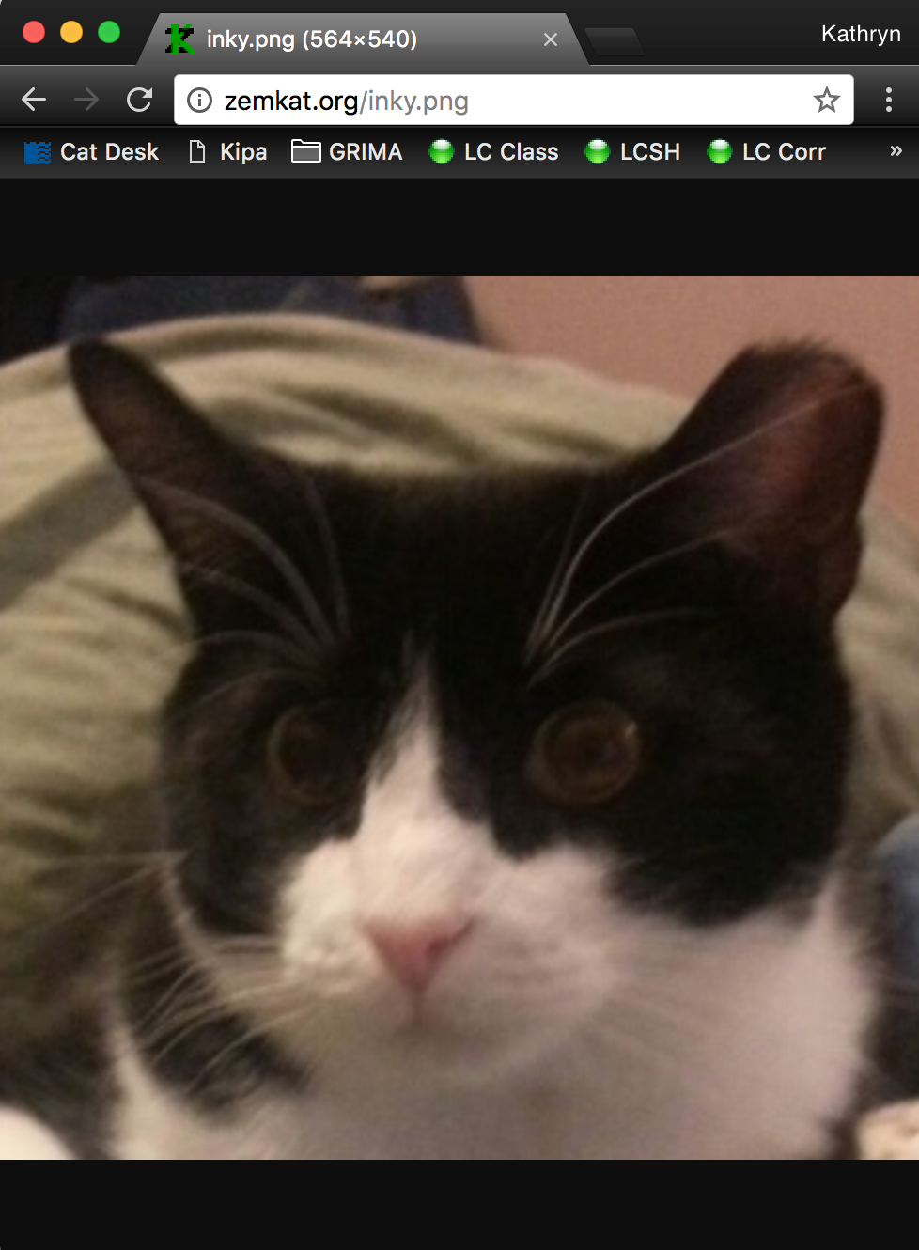
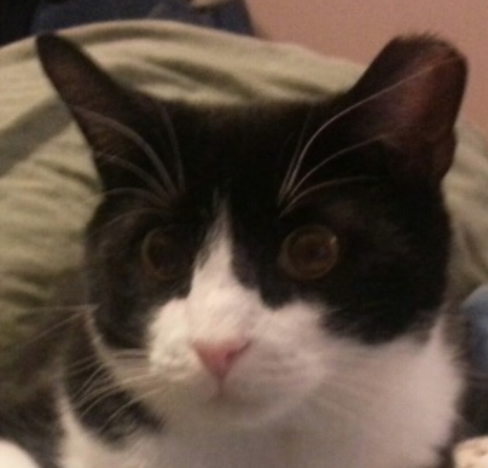
web browser
web server
GET /html/cat.png

Slide 8
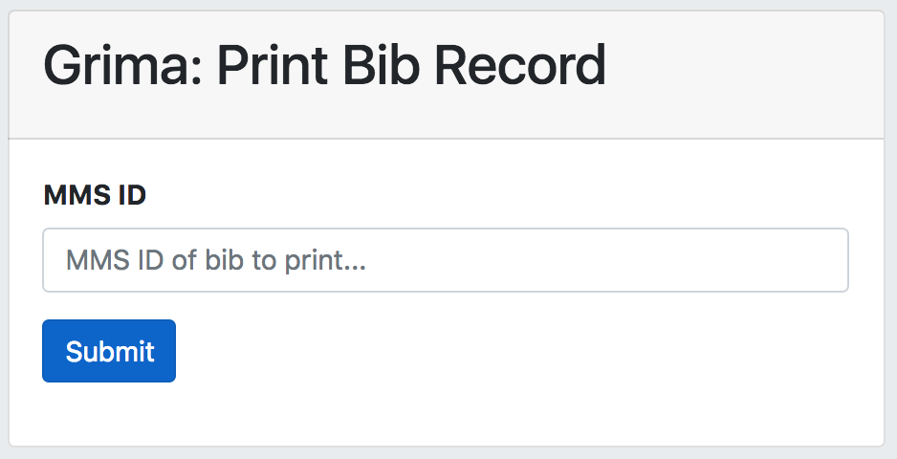
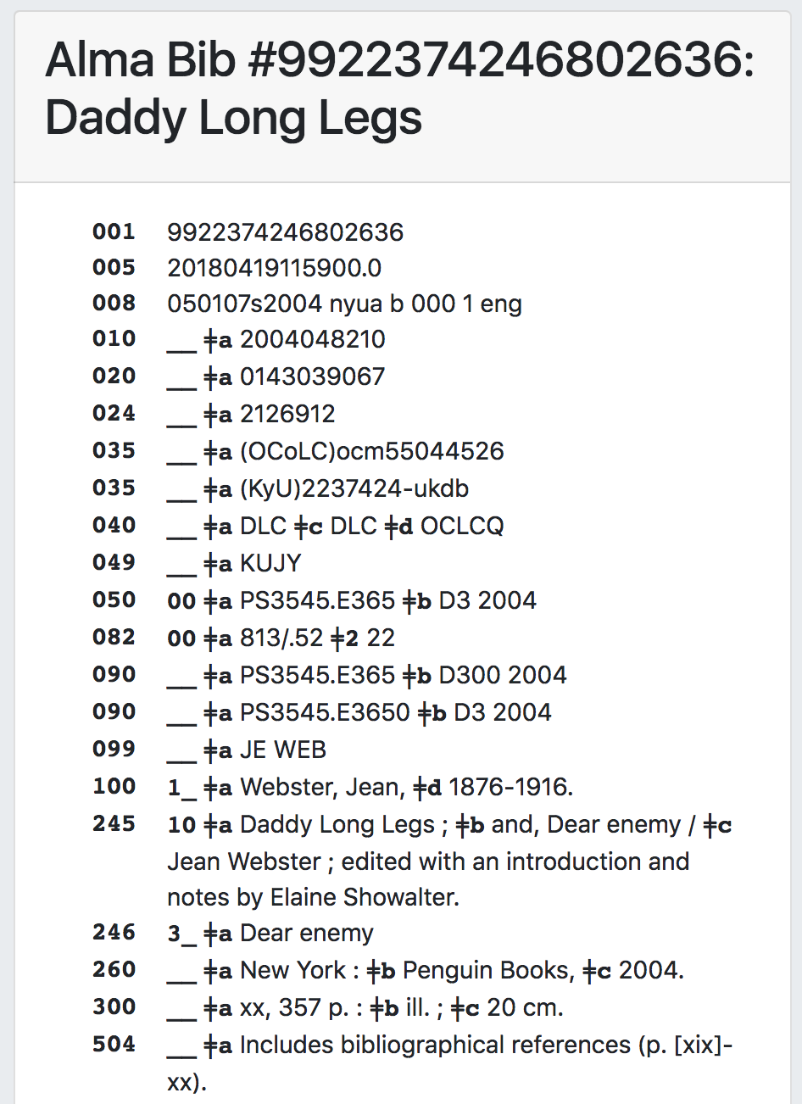
Your program
Alma server
GET /almaws/v1/…
<XML>

Slide 9
Why APIs?
Direct communication with the server
Good error handling – what if something goes wrong?
Often fewer steps than the user-interface
Specifically supported; will not break when interface changes

Slide 10
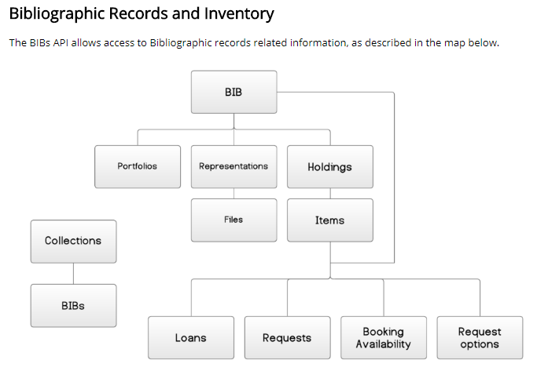
Alma's APIs
Bibs
Electronic
Configuration (Sets)
Analytics
… (and more)
Visit the Ex Libris Developer Network for more information
http://developers.exlibrisgroup.com/alma/apis/

Slide 11

REST APIs
GET – Retrieve a record
POST – Add a new record
PUT – Modify a record
DELETE – Remove a record

Slide 12
API calls do simple tasks, may be used together for complex tasks
Get (GET) all bib records in a set
For each bib record:
  Make a particular change
  Update (PUT) record in Alma

Slide 13
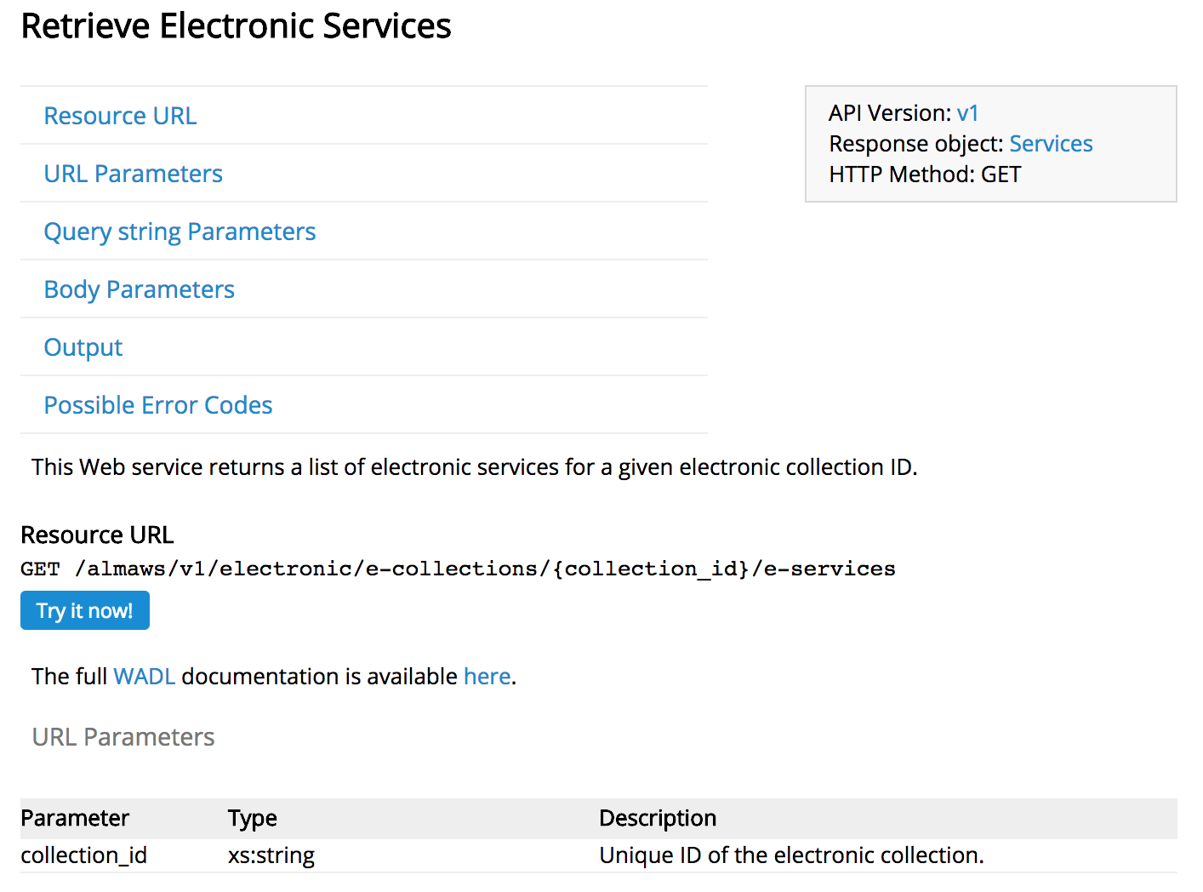
APIs are well-documented in
Ex Libris Developer Network

Slide 14
Grima (Library)
https://github.com/zemkat/grima
Written in PHP
Objects
  Bib, Holding, Item, etc
  Functions make common API calls
Available on GitHub

Slide 15
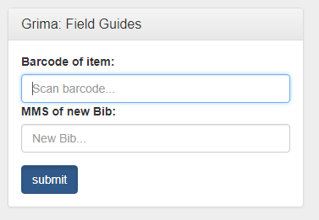
"grimas"
"Can you write me a grima that does this?"
Small programs using Grima library to do specific tasks
Web-based (or command-line)

Slide 16
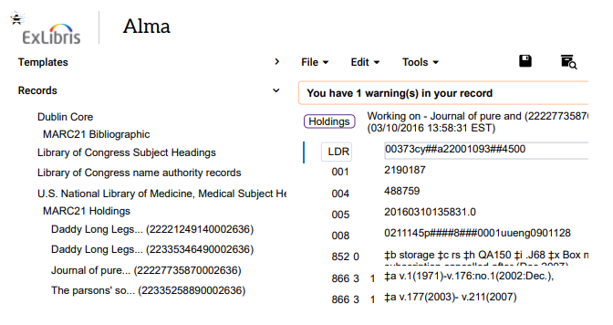
Printing a record?

Slide 17
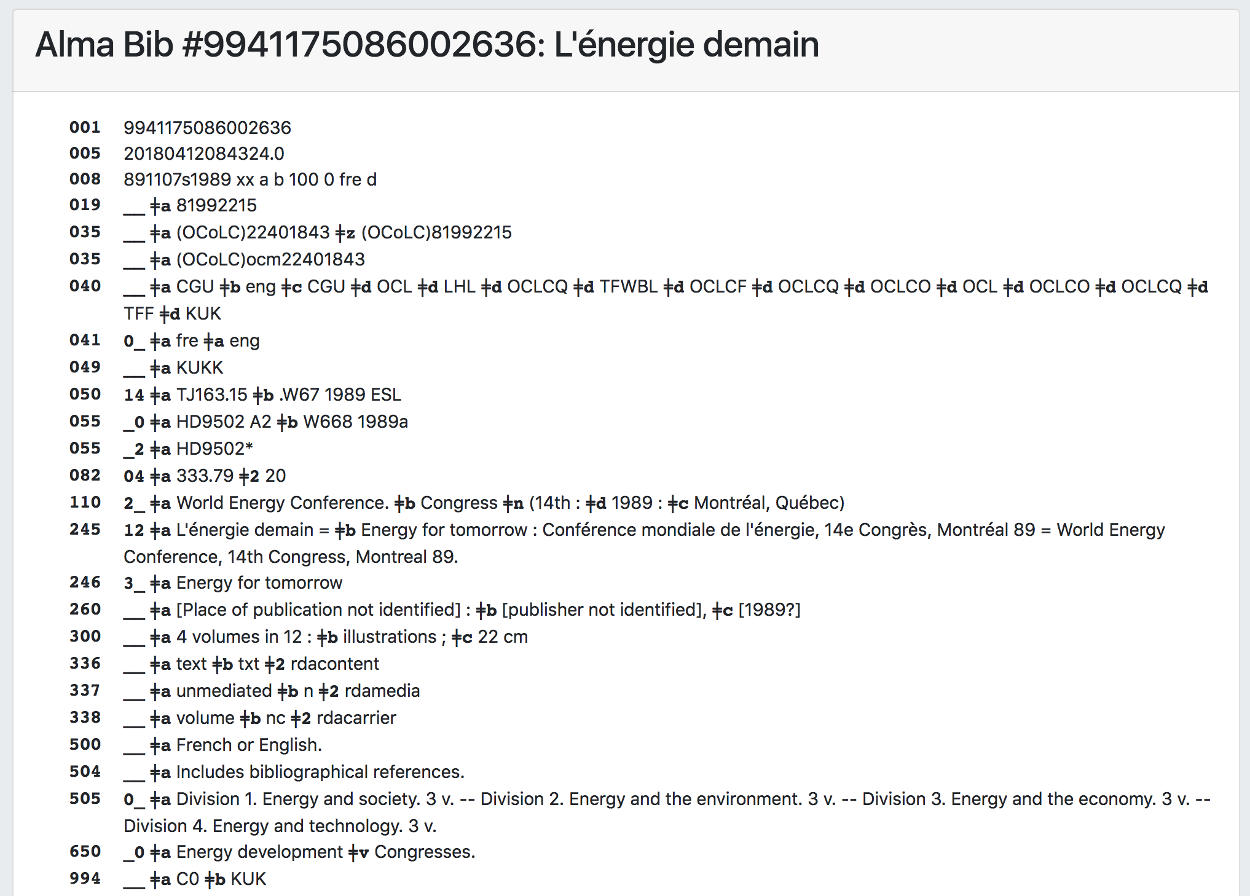

Slide 18
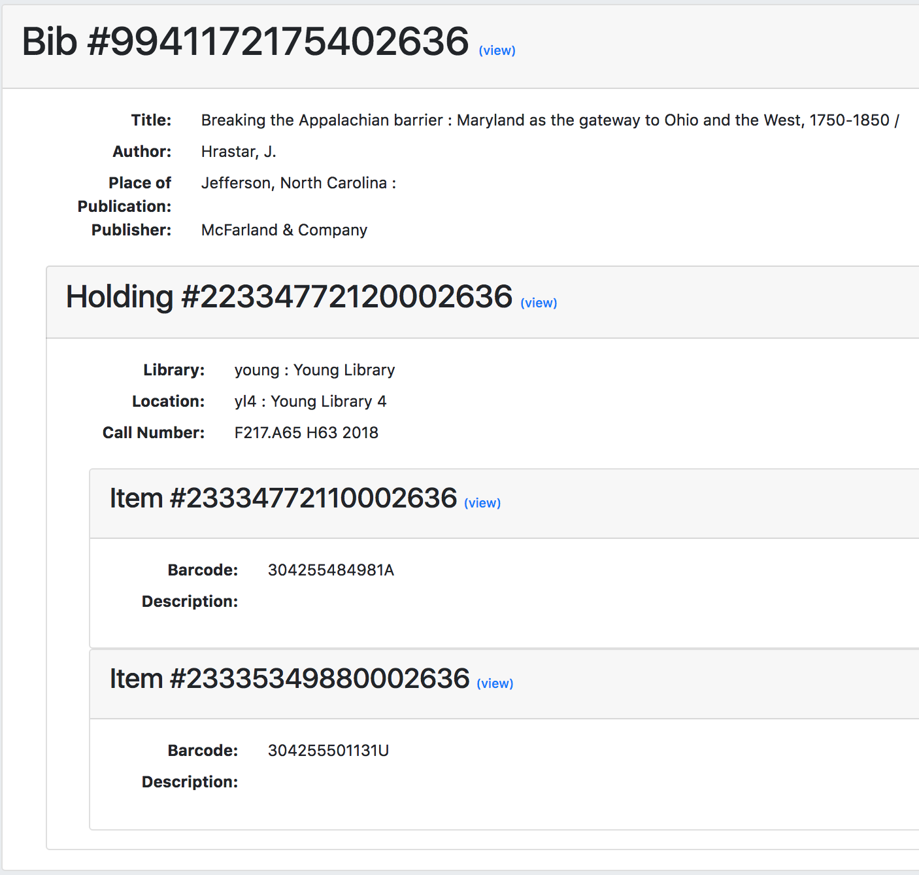
Hierarchy: Printing data from multiple records

Slide 19
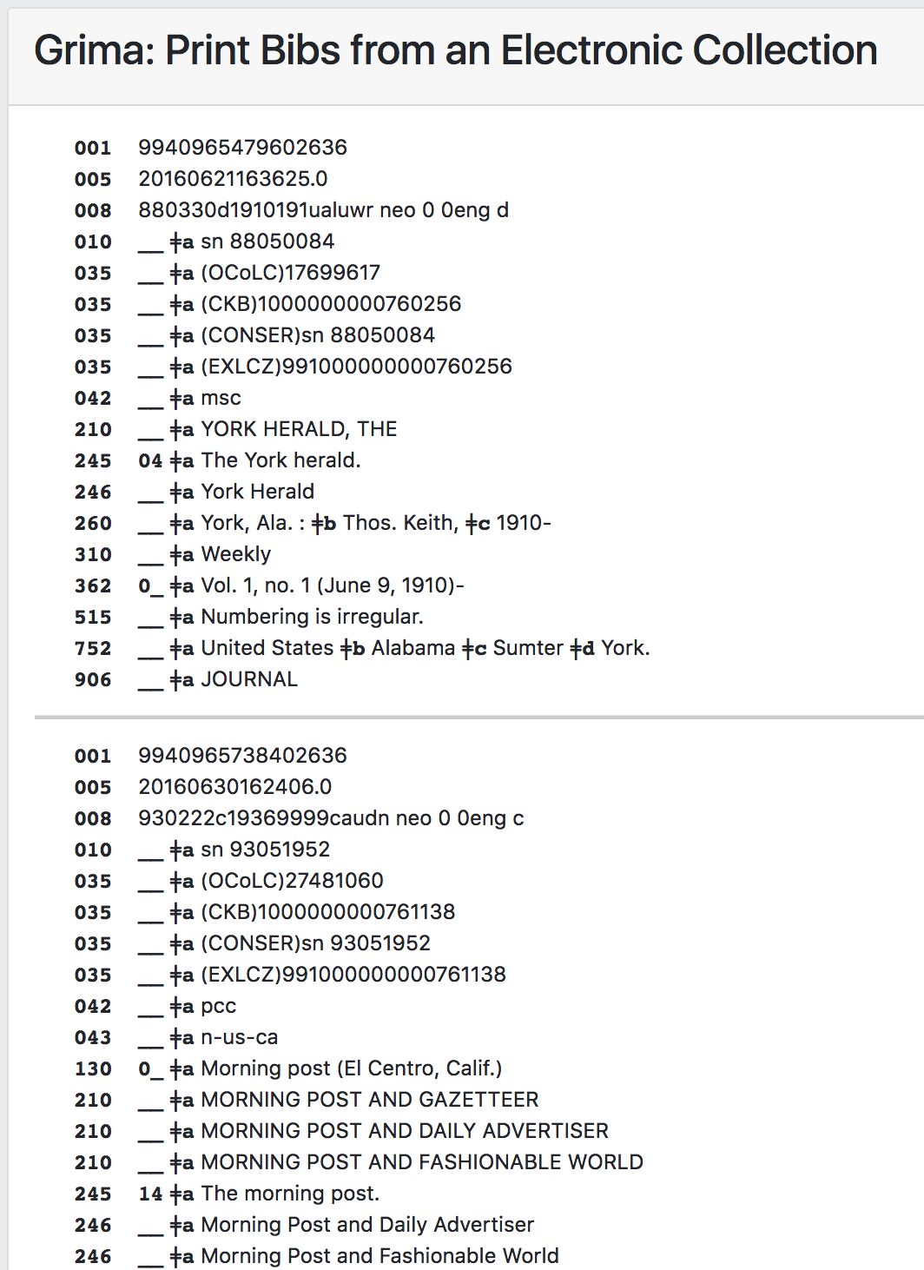
Print Bibs from an Electronic Collection
(hundreds!)

Slide 20
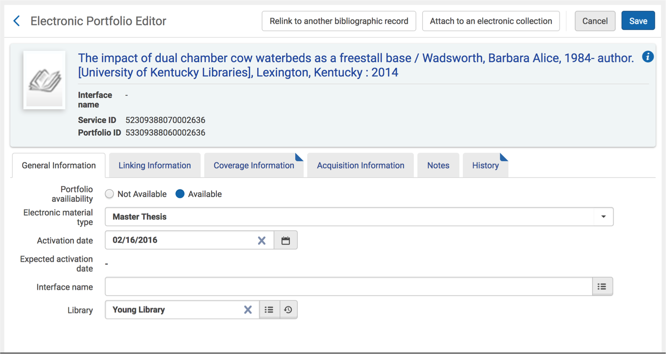
Deleting Records?

Slide 21
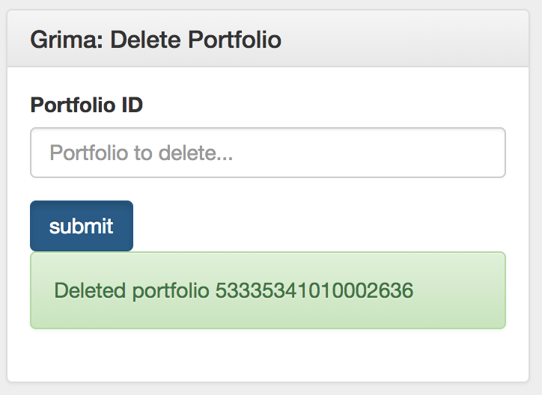
Deleting a Portfolio

Slide 22
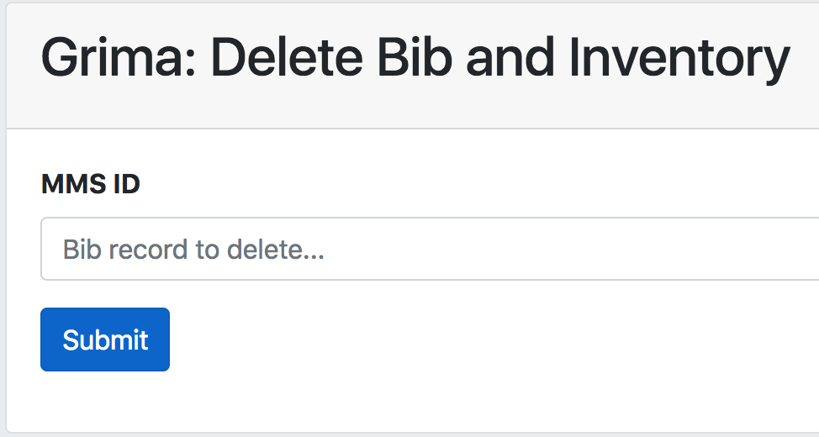
Deleting a Tree
Bib
Holding
Item1
Item2
Portfolio

Slide 23
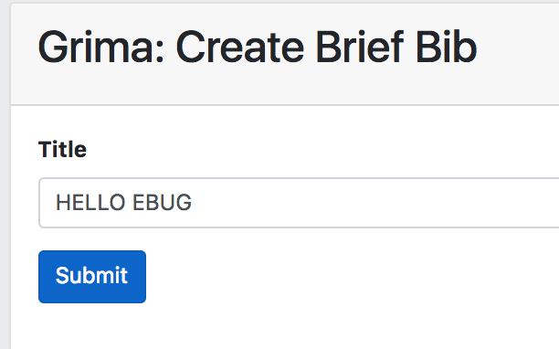
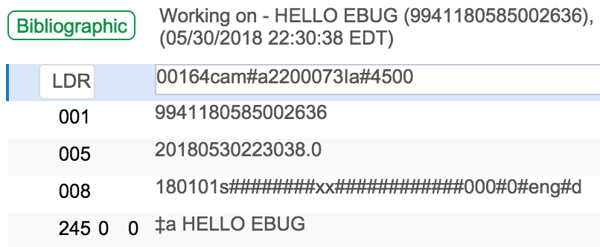
Adding a Record

Slide 24
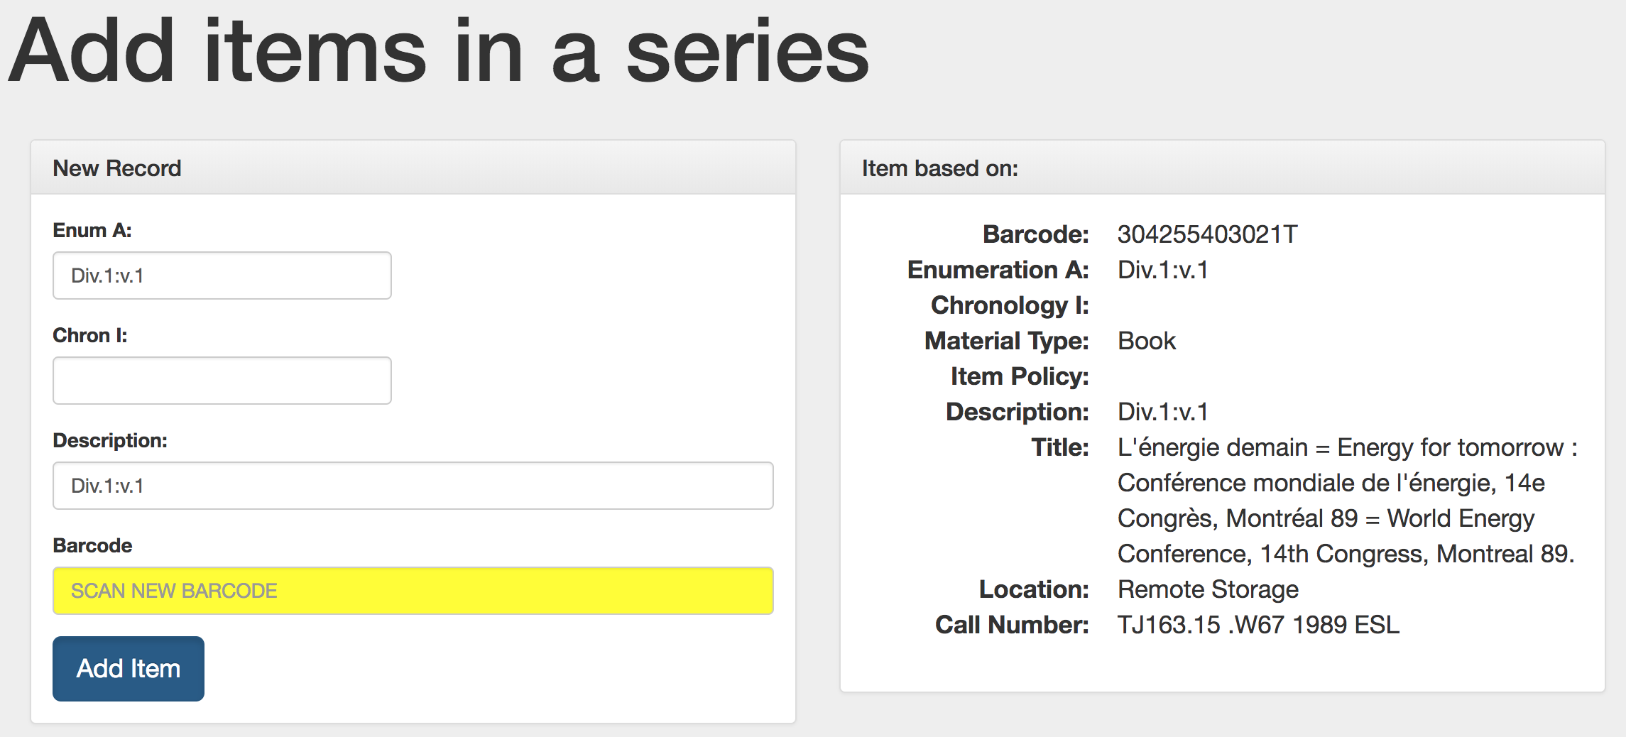
Adding several records

Slide 25
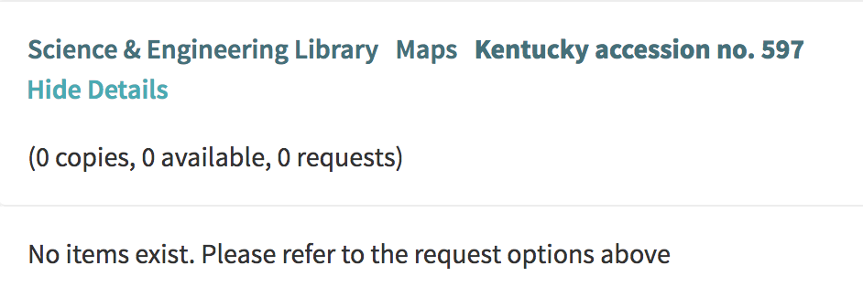
Adding many records all at once
Many of our holdings records don’t have items
Primo’s display of these items is confusing to patrons
We can use the API to add items to all item-less holdings in certain locations

Slide 26
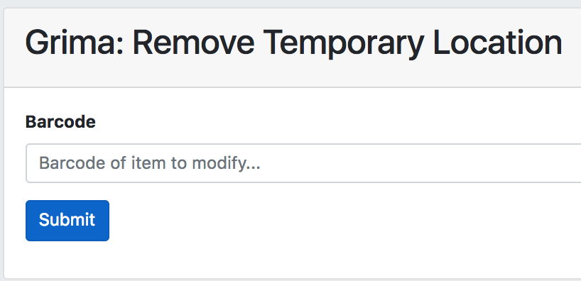
Remove Temporary Location:
Modifying a Record
Scan in barcode of item in hand
Grima:
  Downloads the item
  Removes temporary location
  Updates record in Alma

Slide 27
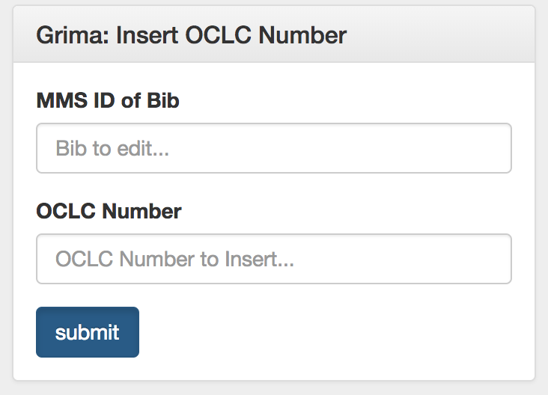
Insert OCLC Number: Modifying a Record
Normally to overlay:
  Edit Bib Record
  Add OCLC number of incoming record
  Save and Release Bib Record
  Export from OCLC

Slide 28
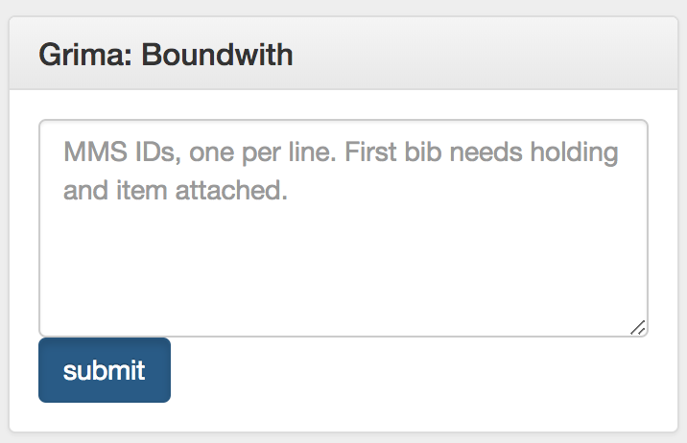
Boundwith: Modifying lots of records
Adds 501 to all bibs
Adds 774 for all other bibs to first one
Adds 014 for all other bibs to holding
(Alma creates boundwith overnight)

Slide 29
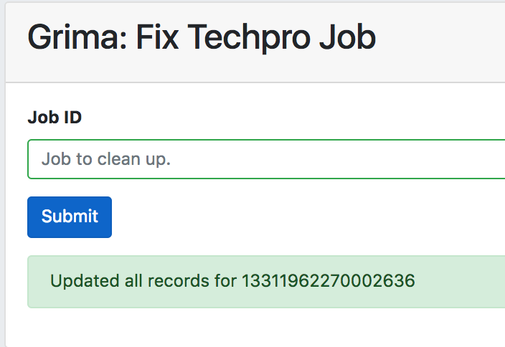
Fix an Import: Modifying even more records!
We send materials out for contract cataloging
  In Alma, Bib -> Holding -> Item
Contract cataloging sends back Bibs
  Holding still blank, has extra fields
This job:
  Run the import as normal
  Give the Job ID to grima
  Cleans up all loaded records

Slide 30
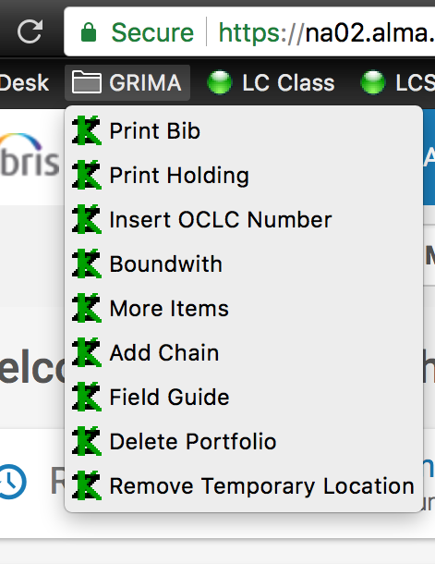
Using Grima
Each of these tasks is a web page
I store bookmarks to them in a GRIMA directory on the bookmarks bar
Readily available while in Alma
Each user can curate their own list

Slide 31
You can run Grima too!
Run on your own computer
  Web-based -- should work on Windows, Mac, Linux
  (Still testing, instructions coming soon)
Run on a central computer
  Library web server
  Cloud server (e.g. Heroku)

Slide 32
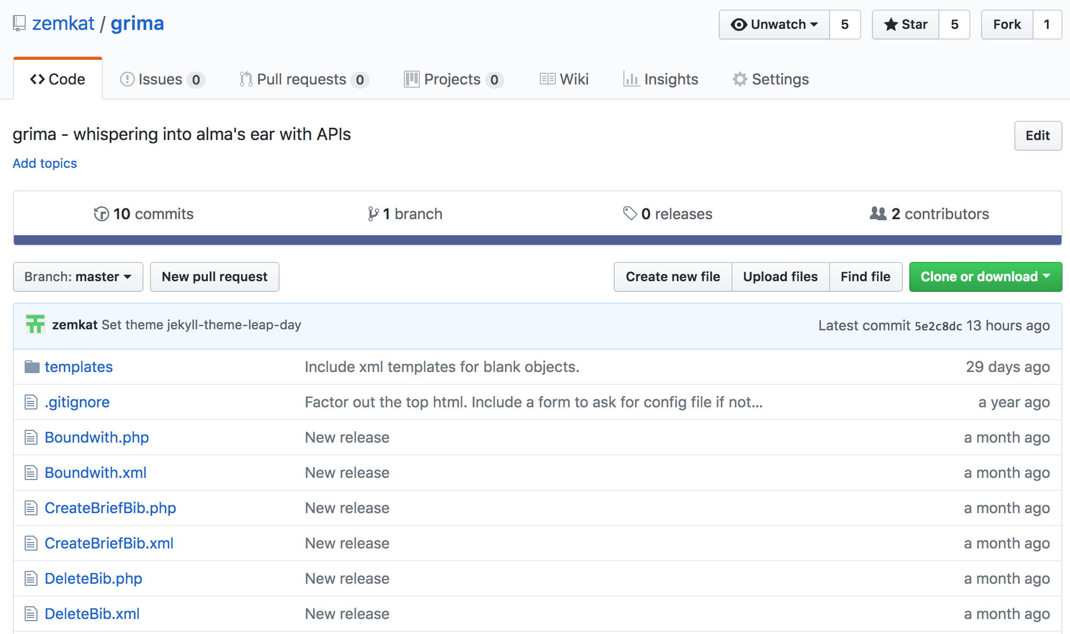
https://github.com/zemkat/grima

Slide 33
API Keys
A secret code you pass to the server along with your API calls
It communicates:
  What institution are you from?
  What permissions do you have?
  Why are you making the call?
Looks like: l7xx63344efed7804764987364443pok1cc8

Slide 34
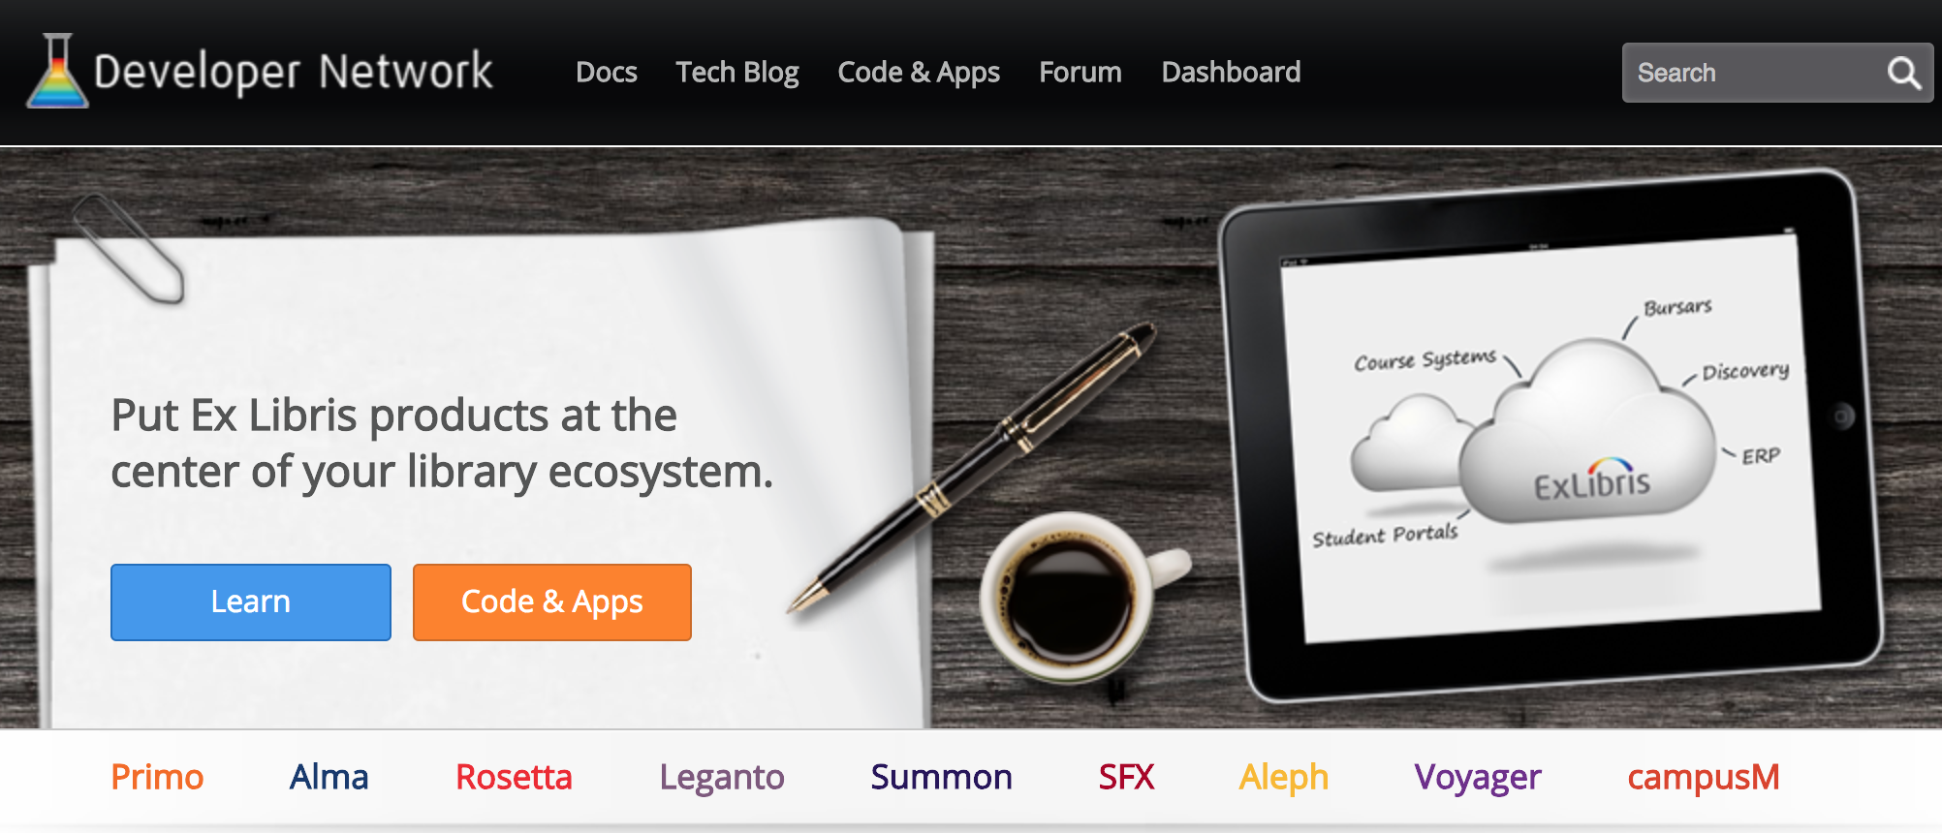
Ex Libris Developer Network

Slide 35
Ex Libris Developer Network
Create a free account (anyone can do this)
Have your account linked to your institution (your systems admin can help)
Then you can create API keys that will let you query YOUR database

Slide 36
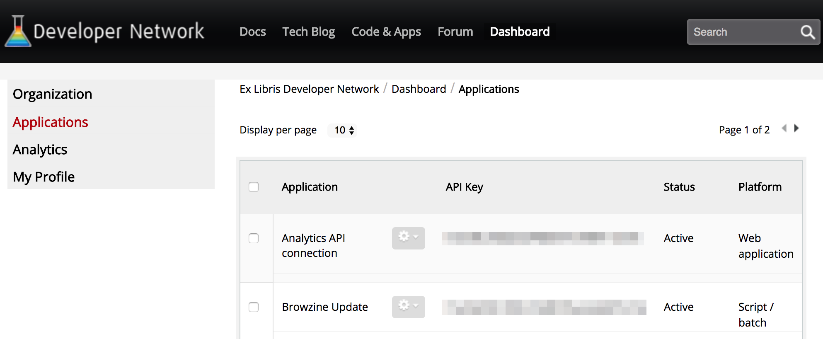
Create a New Application

Slide 37
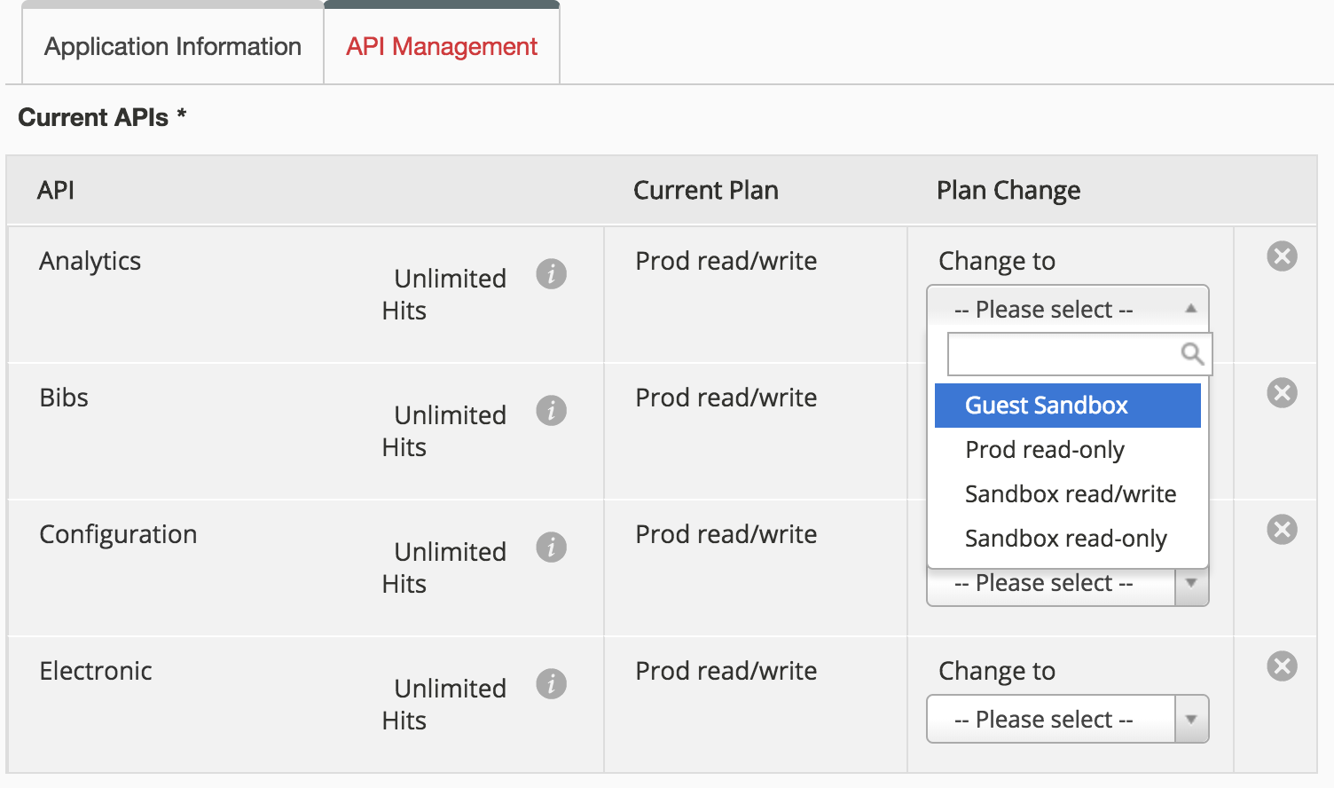
API Permissions

Slide 38
Which permissions?
Which APIs?
  Bib, Electronic, Configuration, Analytics
Production or Sandbox?
  Running on live data, or testing in your sandbox?
Read-only or Read/Write?
  Some grimas only read from the database

Slide 39
Developing more grimas
I write these programs because Alma doesn’t do exactly what I need
My grimas may be useful to you, but you probably have different needs
The grima library should make developing new programs fast and easy

Slide 40

Anatomy of a common grima
Input – what to give it?
Task – what to do?
Output – what to display?

Slide 41
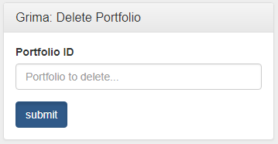
Input
<GrimaForm>
<Title>Grima: Delete Portfolio</Title>
<Field
name="portfolio_id"
label="Portfolio ID"
placeholder="Portfolio to delete..."
/>
</GrimaForm>

Slide 42
Task
function do_task() {
$port = new Electronic_Portfolio();
$port->loadFromAlma($this['portfolio_id']);
$port->deleteFromAlma();
$this->addMessage...
}

Slide 43
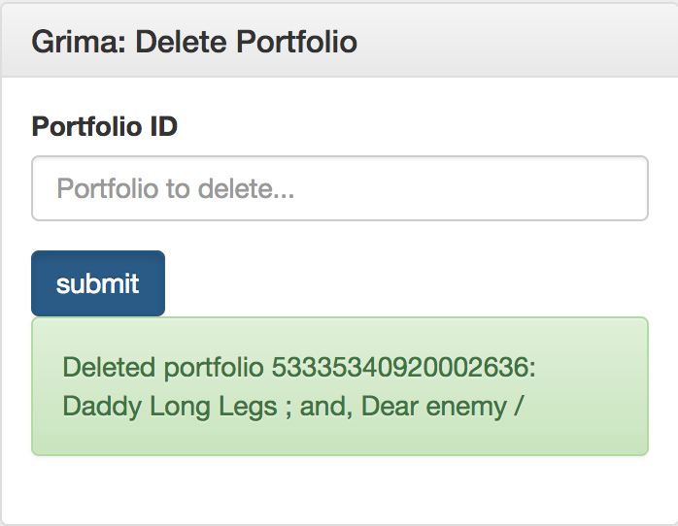
Messages
Array Access
$this->addMessage(
'success',
"Deleted portfolio {$port['portfolio_id']}: {$port['title']}");

Slide 44
Output
The form you just used (default)
  Messages indicating success or error
Specify with included template engine
Maybe calling another grima
  Display the bib record you just modified
  Display the file hierarchy you just modified

Slide 45

Standard Disclaimer
While actively used at UK
Still under active development
Some areas more complete than others (for now!)

Slide 46
What do you think?
Do these programs look useful?
Are there other annoying Alma processes you suspect could be automated?

Slide 47


Contact
Kathryn Lybarger @zemkat
<Kathryn.Lybarger@uky.edu>
University of Kentucky Libraries

