Slide 1
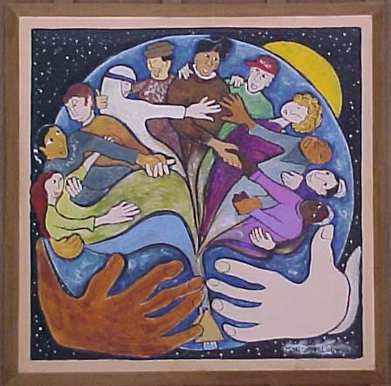
Insights for International Partnerships in
Videoconference Teaching of Global Social Work
Katherine Tyson McCrea, Ph.D., Loyola University Of Chicago School Of Social Work
Jonas Ruskus, Ph.D., Violeta Ivanauskiene, Ph.D., and Daiva Kuzmickaite, Ph.D., Vytautas Magnus University School Of Social Welfare And Department Of Social Sciences
With: Cordelia Grimes and students from around the world taking Global Social Work And Participatory Action Research

Slide 2
Education
From Latin, educare
  “To bring out that which lies within”
  To draw forth out of, lead out of
Ethnocentrism
  The belief in the inherent superiority of one’s own culture (Sociology)
  The tendency to view others’ culture or practices from the perspective of one’s own (Dictionary.com)
The problem: In a world of scarce resources, how do we educate social workers for 21st century global practice so we replace ethnocentrism with multi-cultural humanism?

Slide 3
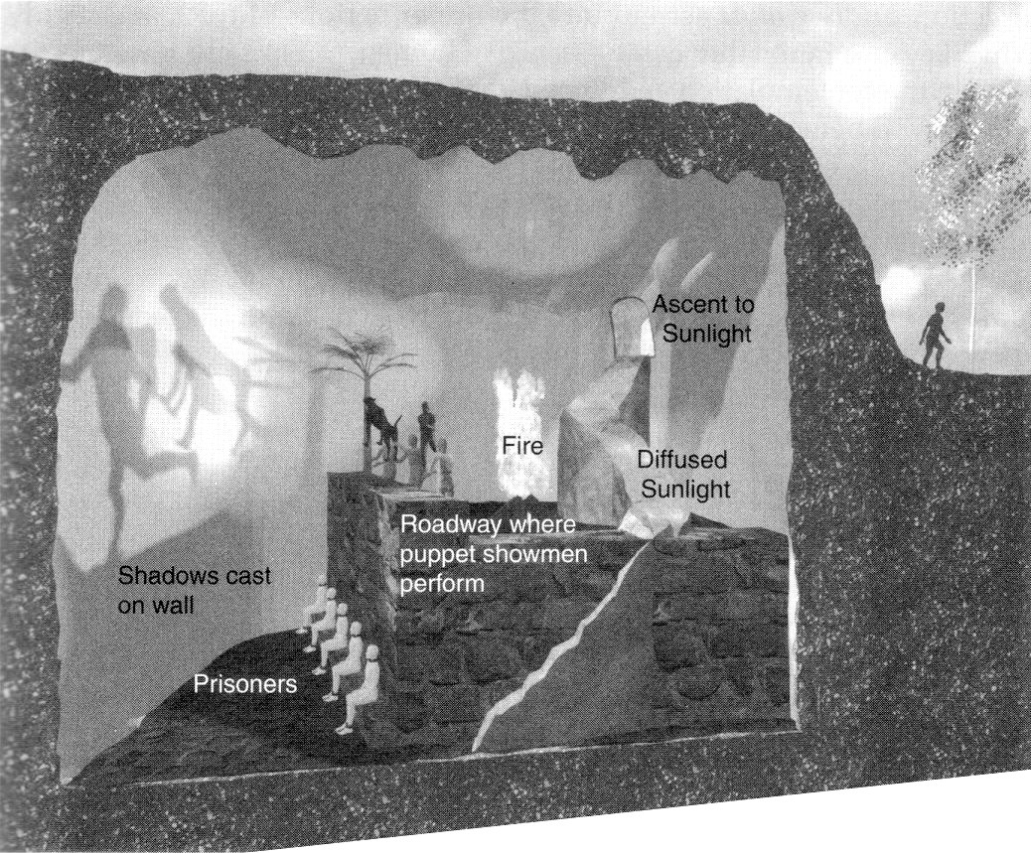
Economic inequalities, geographical distance, and cultural differences can lock teachers and students into an ethnocentric Plato’s cave (http://en.wikipedia.org/wiki/Allegory_of_the_Cave)
With a global videoconference partnership we leave the cave and know each other in our different contexts as we really are…
Consider though that it is the whole group leading each other out of the cave, rather than only the teachers…

Slide 4
Topics to be addressed
1) Introductions, Accomplishments, and Background
2) Pedagogical theory and practices
  Video by Kaunas colleagues
3) Promoting cross cultural awareness and glocalization of social work knowledge
  Presentation by Cordelia Grimes, U.S. global social work student
  Video by U.S. Global Social Work students
4) Curriculum development for research and global social work practice classes

Slide 5
Background
1a
Introduce ourselves: Who are we here today?
Our videoconference partnership: Creating an international class that could never occur without videoconferencing
History
  Vytautas Magnus University: http://www.vdu.lt/en/
Key features:
  US and Lithuanian instructor
  Class and materials in English but ongoing translation by Lithuanian instructor
  Students from all over the world and many language backgrounds because Vytautas Magnus School of Social Welfare is truly global

Slide 6
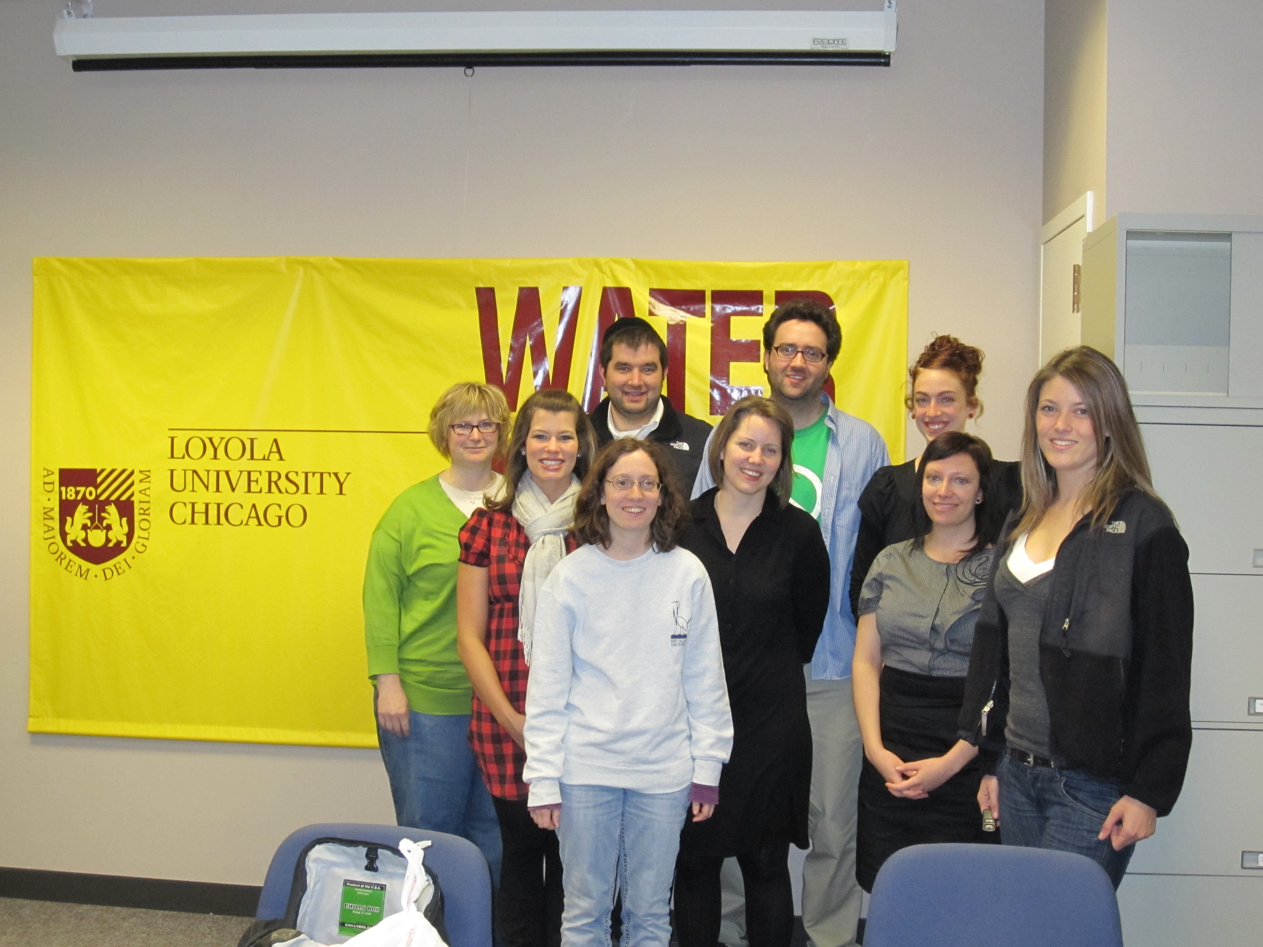
Since 2006
Global social work:
9 semesters
Participatory action and
Qualitative research:
7 semesters
Class sizes ranged from 8-22
At each location
Spring, 2010 class

Slide 7
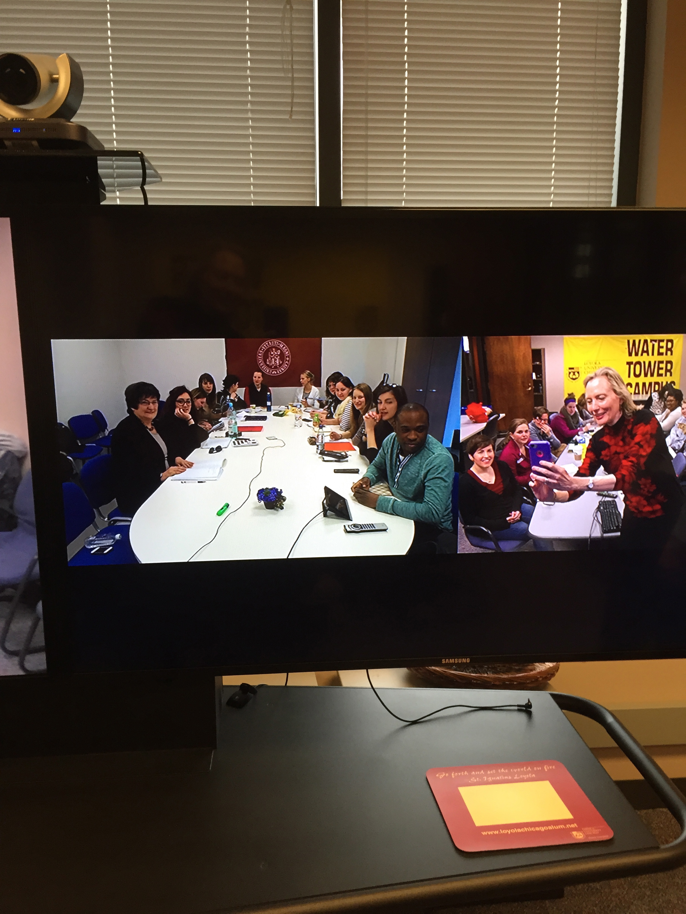
U.S. dassroom
What we see:
Lithuanian
classroom

Slide 8
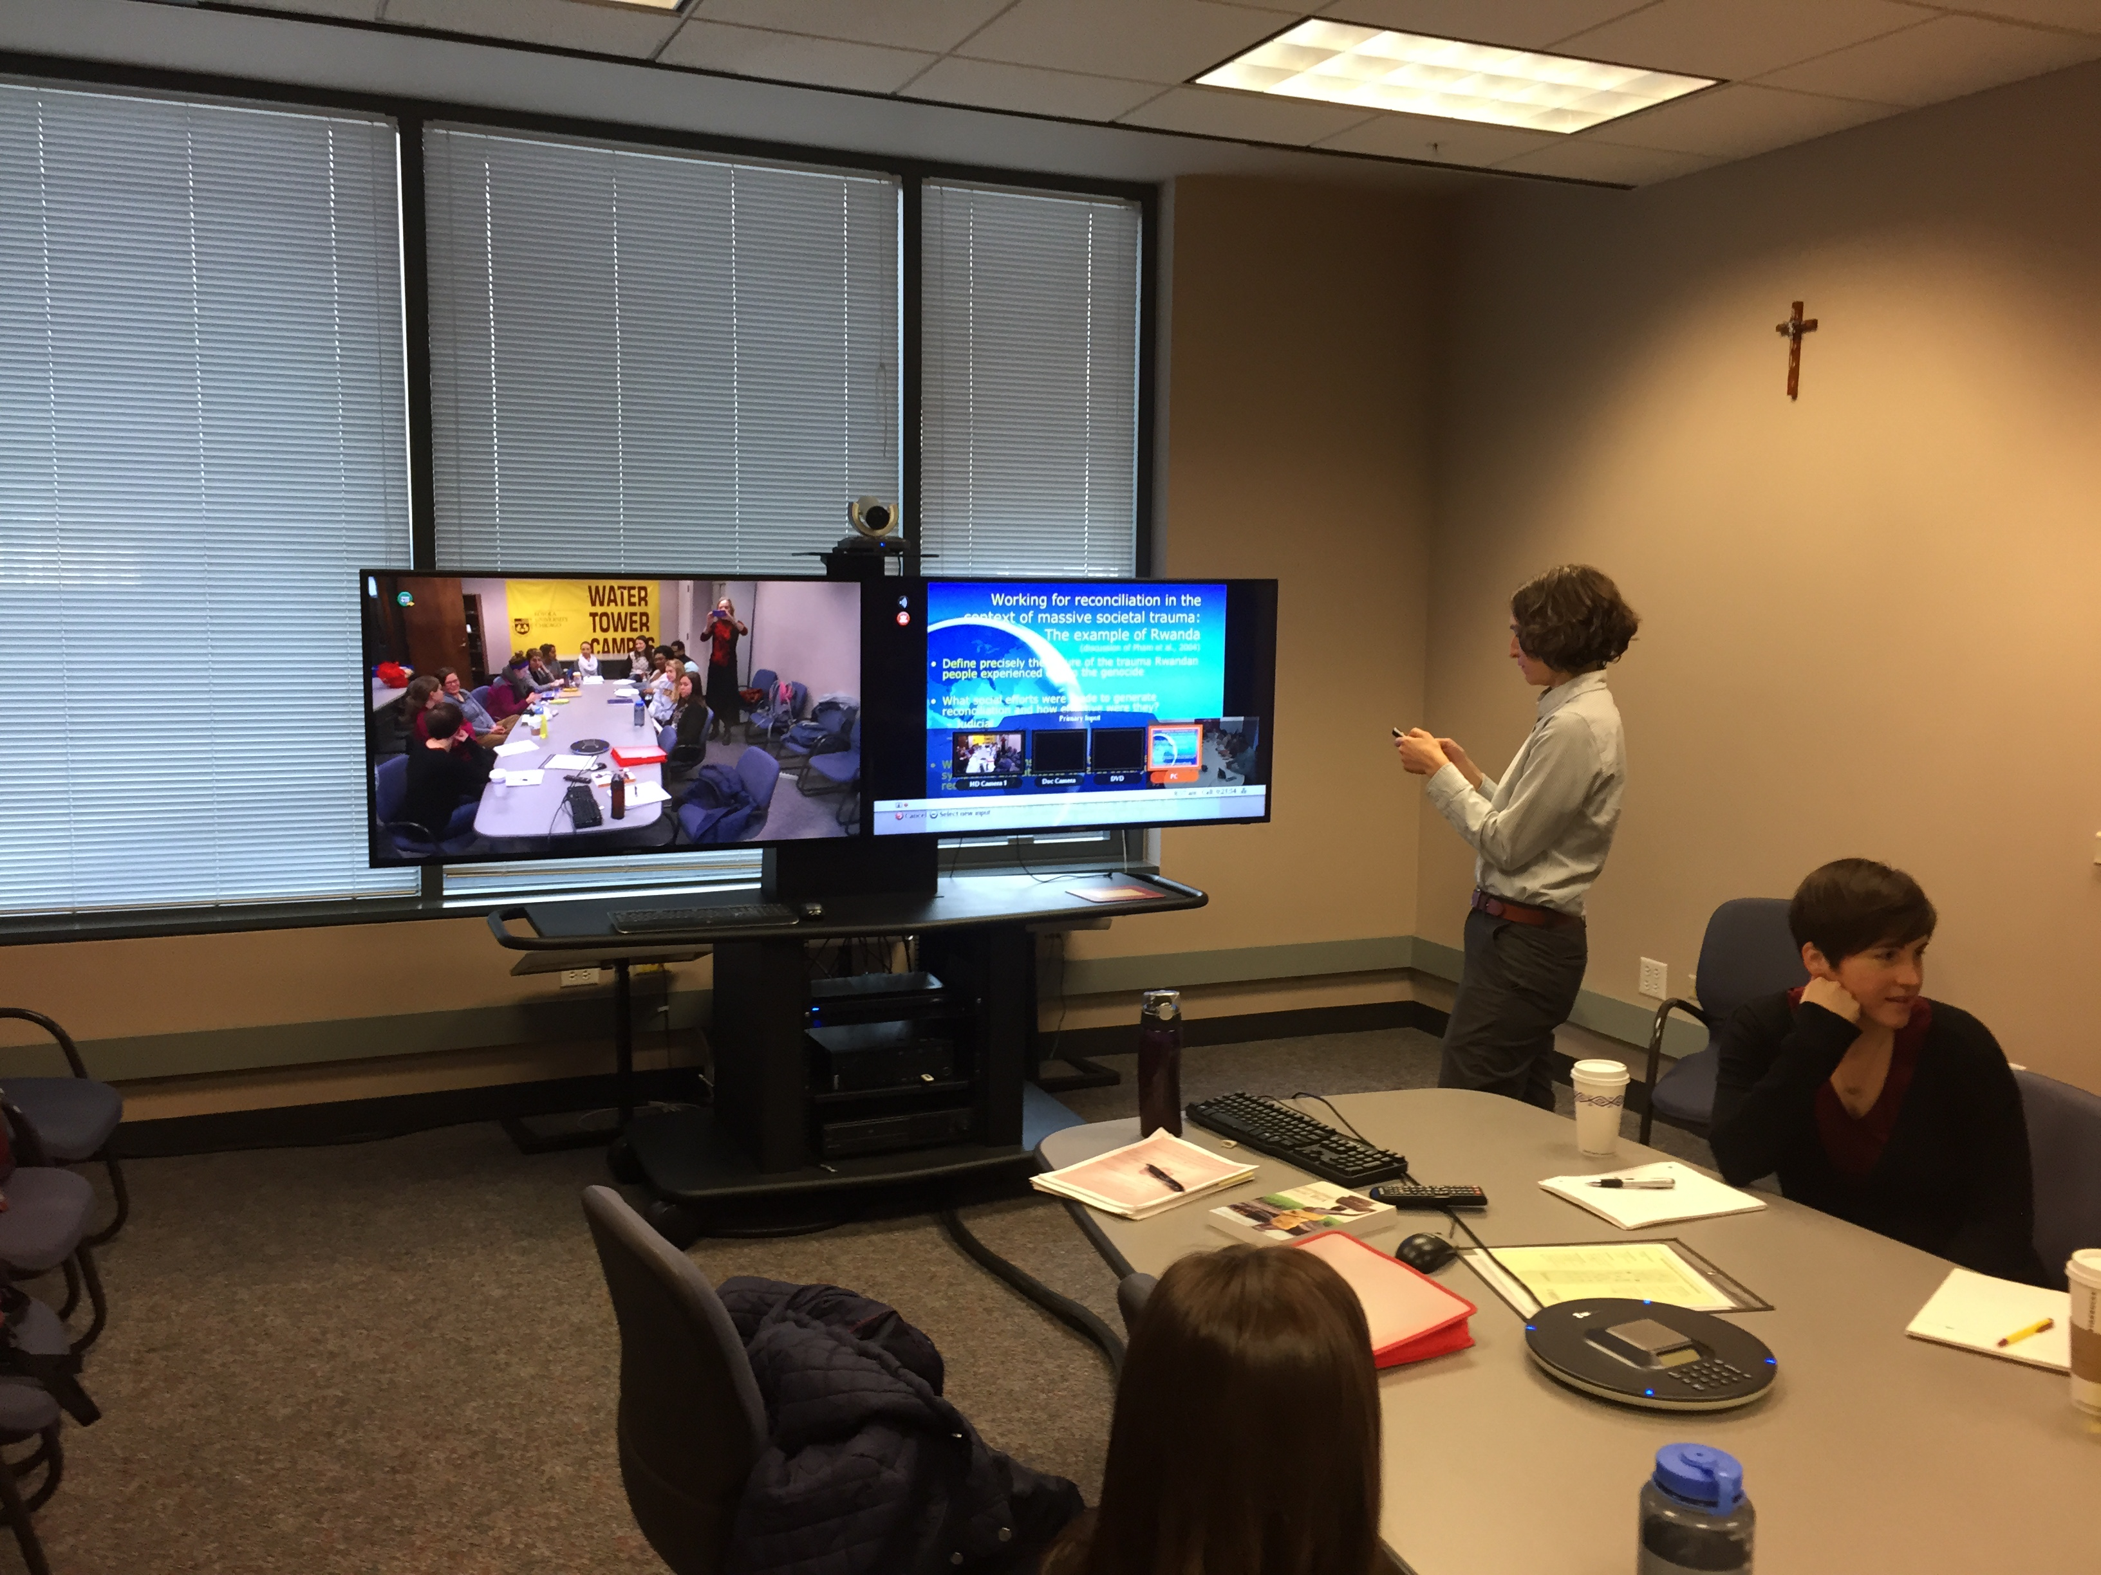

Slide 9
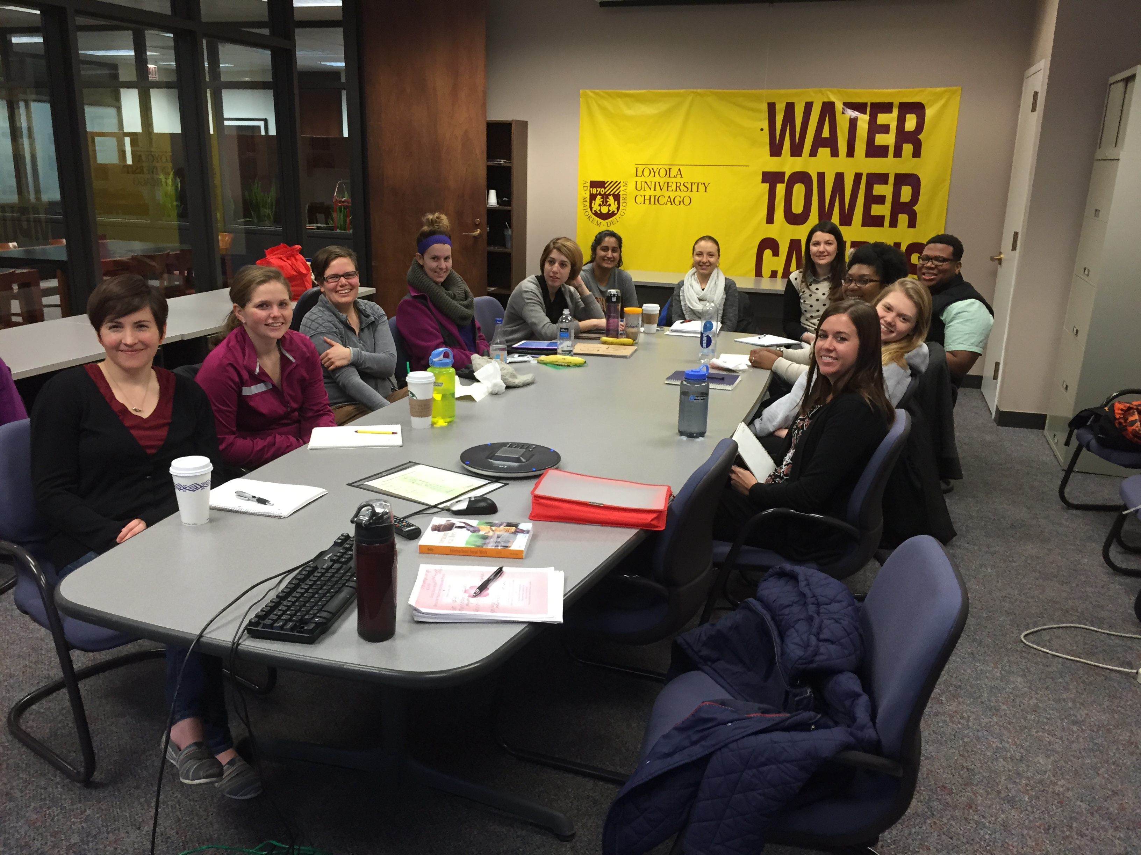
Our class
Spring,
2015

Slide 10
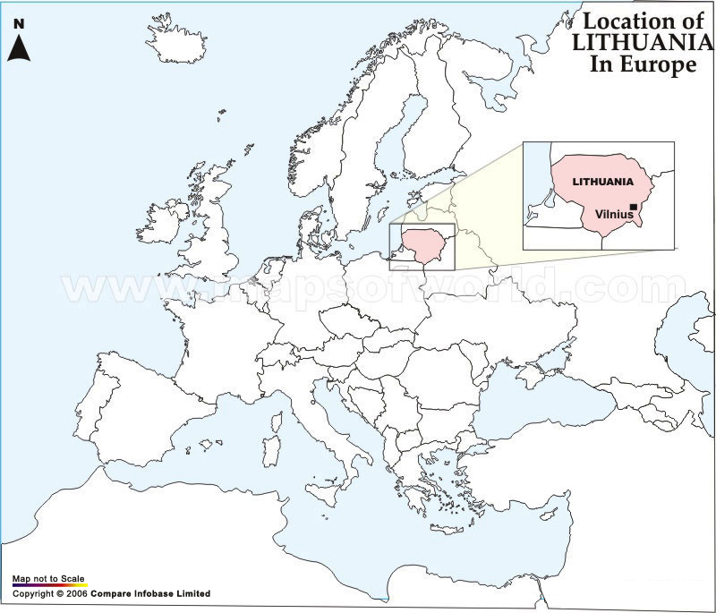
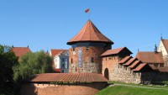
History of Partnership
Kaunas castle

Slide 11
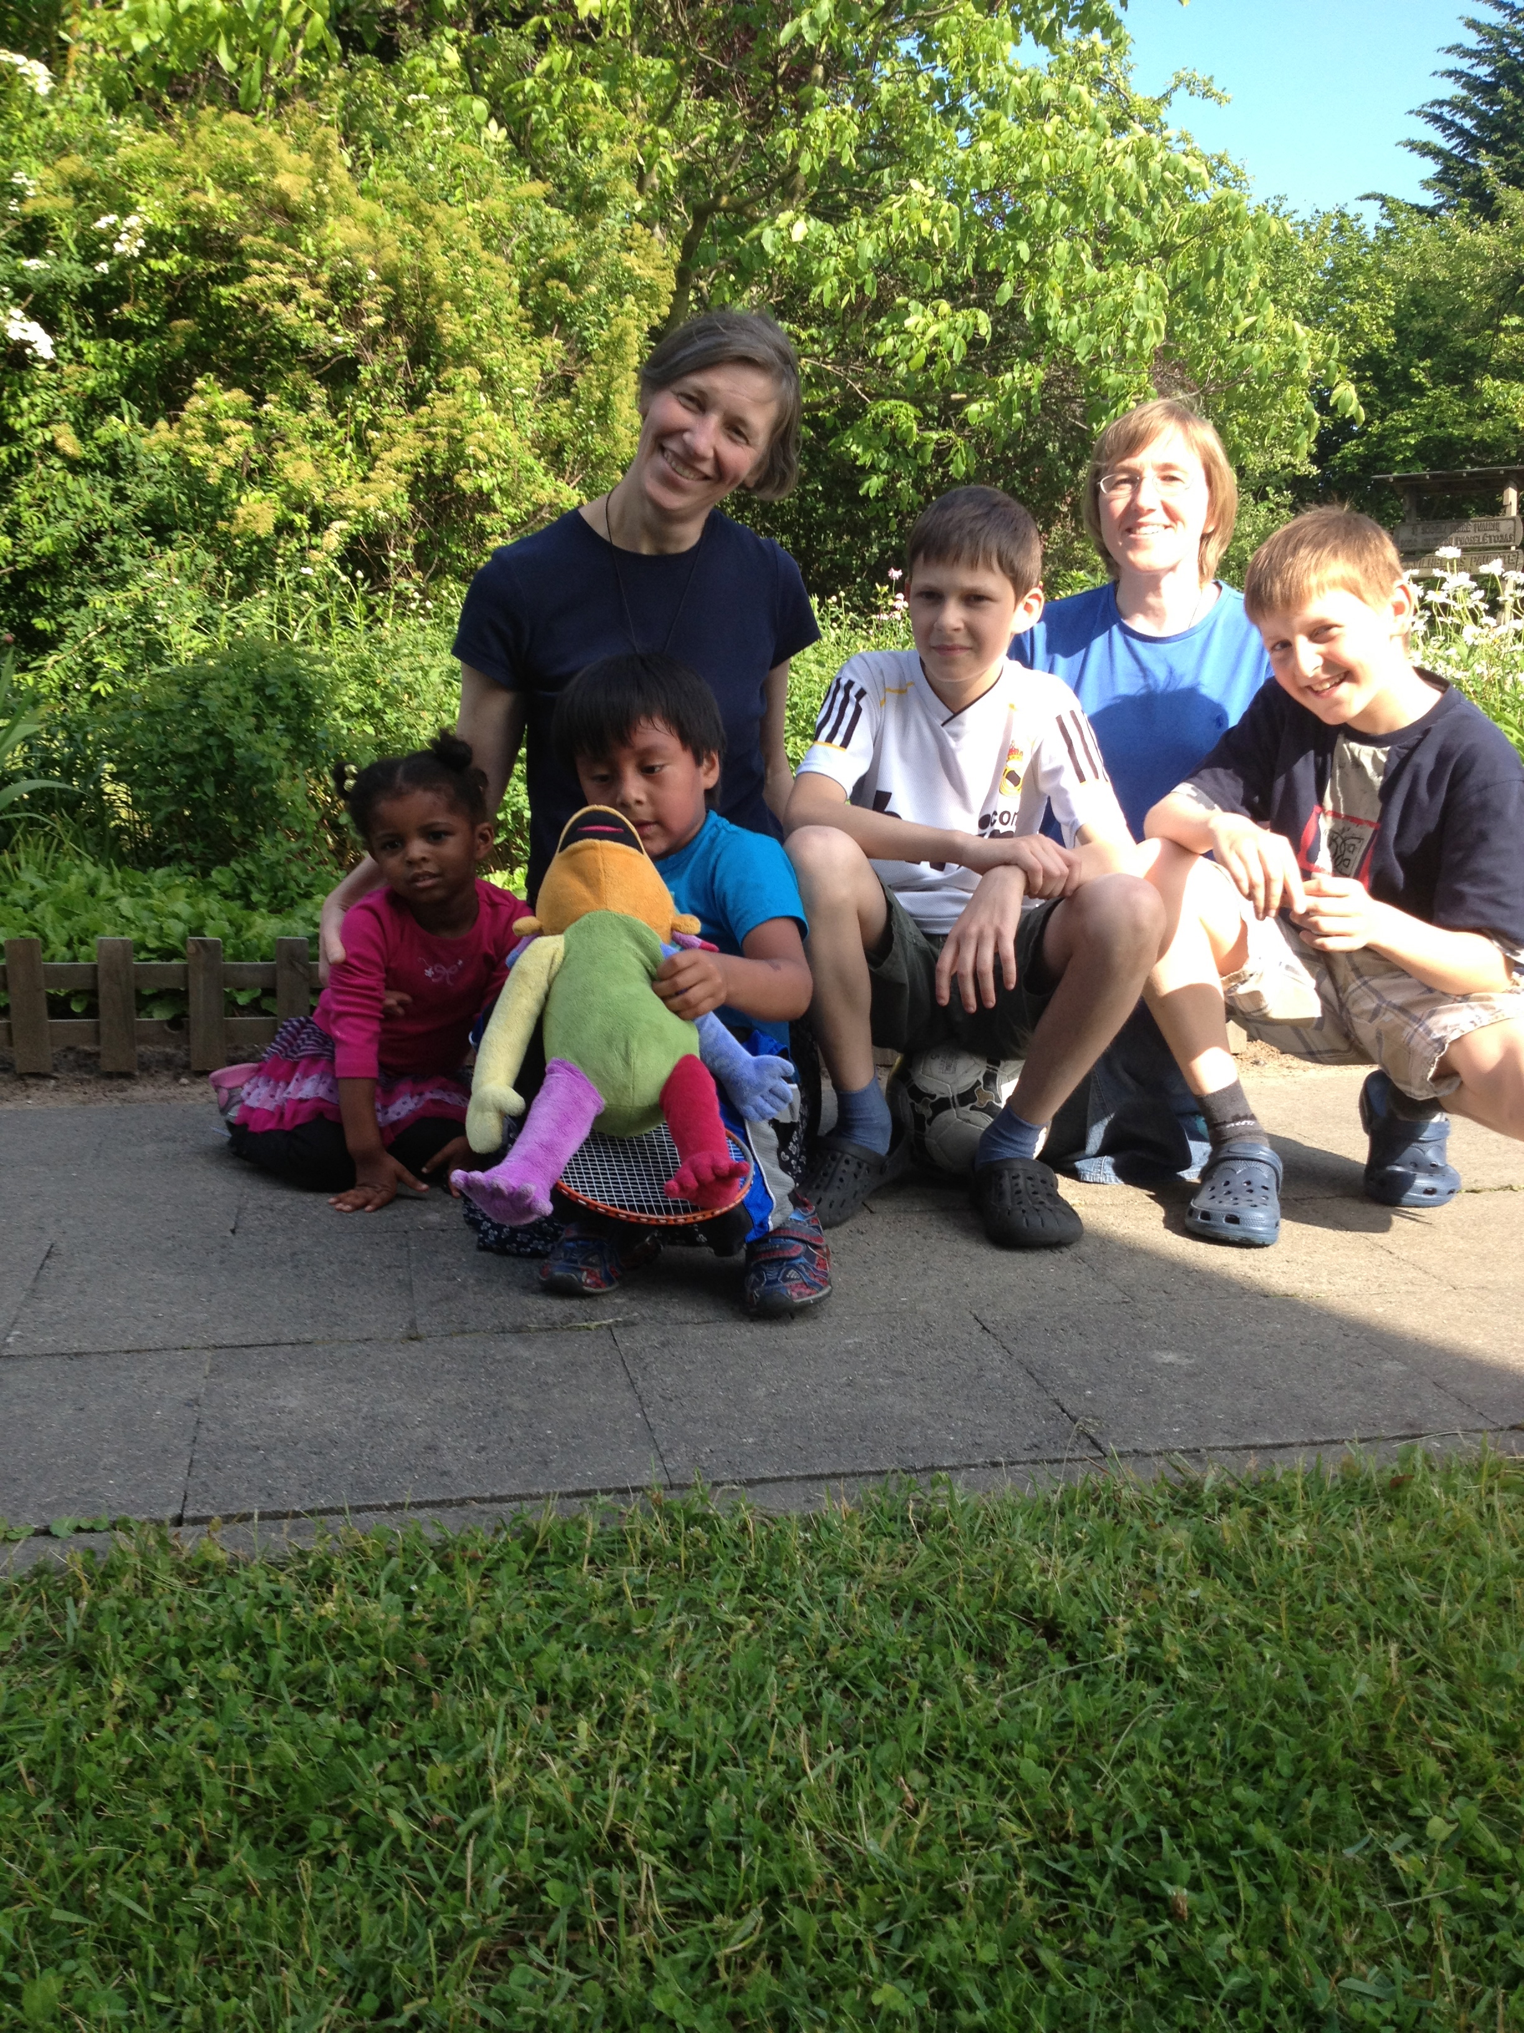
Professor and Mother
Superior Daiva Kuzmickaite
with her sons Domantus and
Gyvydus and Sister Oona
With my children Naomi and
David (and Eebee) in
Kaunas, 2012

Slide 12


About Vytautas Magnus University
“The beginnings of higher education in Lithuania go back to the 16th century when, in 1579, the college founded by Jesuits in Vilnius became a higher school of education, the University of Vilnius. In 1832, Czar Nicholas I closed the university. After the independence of Lithuania was declared, in 1918, the State Council decided to re-establish the University of Vilnius. Since Vilnius was occupied and the Lithuanian government transferred to Kaunas, this decision was not put into effect.
In 1920, Higher Courses of Study were begun in Kaunas,
laying the
foundation for the establishment of a university.
In February 1922,
the Lithuanian Government of Ministers decided to
establish the University of Lithuania in Kaunas.
The ceremonial opening of the university took place
on February 16, 1922. On June 7, 1930, the university
was named Vytautas Magnus University.
It was closed during the Soviet occupation.
The act of re-establishing Vytautas Magnus University
was proclaimed on April 28, 1989.”
http://www.vdu.lt/en/faculties/faculty-of-social-sciences/

Slide 13
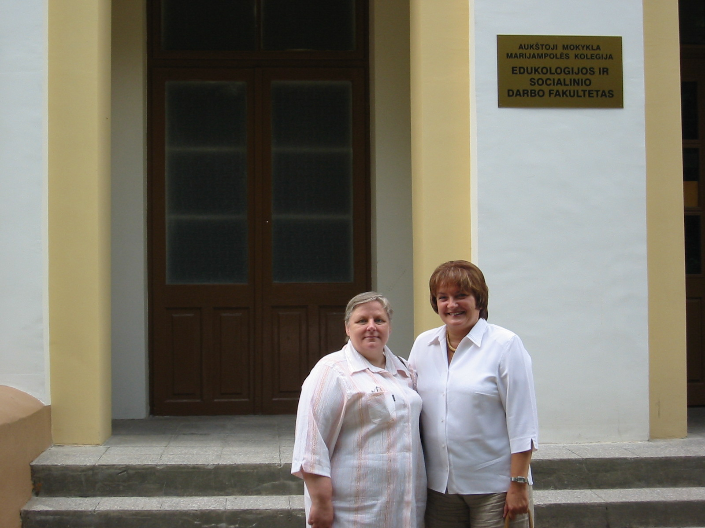
First Global Social Work class: Spring, 2006
Global Social Work
Professors Ivanauskiene
(right) and Liobikiene
(left) in Marijampole,
Lithuania, 2005

Slide 14
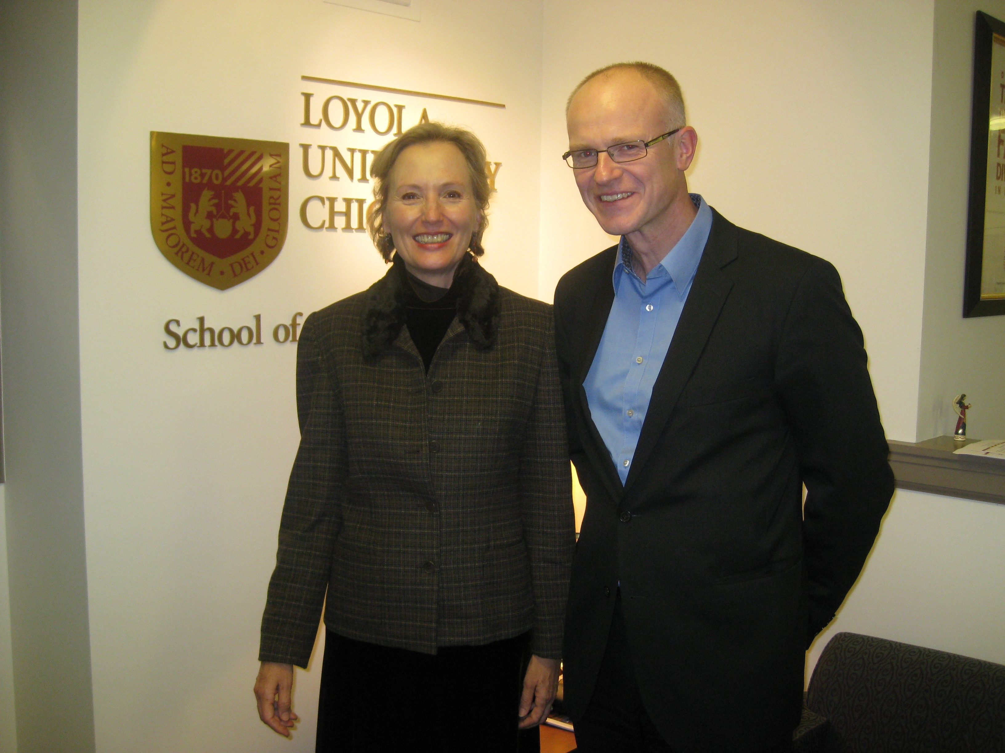
Participatory action
and qualitative research
class began 2008
With Professor and Vice-Dean
Jonas Ruskus
(here in 2012 visiting Chicago with their
EU-funded Curriculum
Development project)

Slide 15
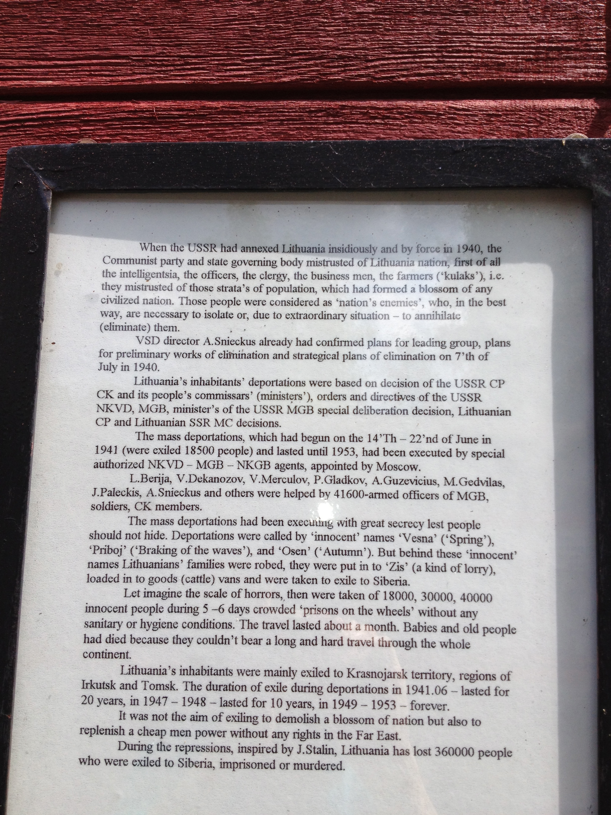
Plaque in park
commemorating
the 360,000 Lithuanian
people deported,
murdered, or imprisoned
under J. Stalin, 1941-1953

Slide 16
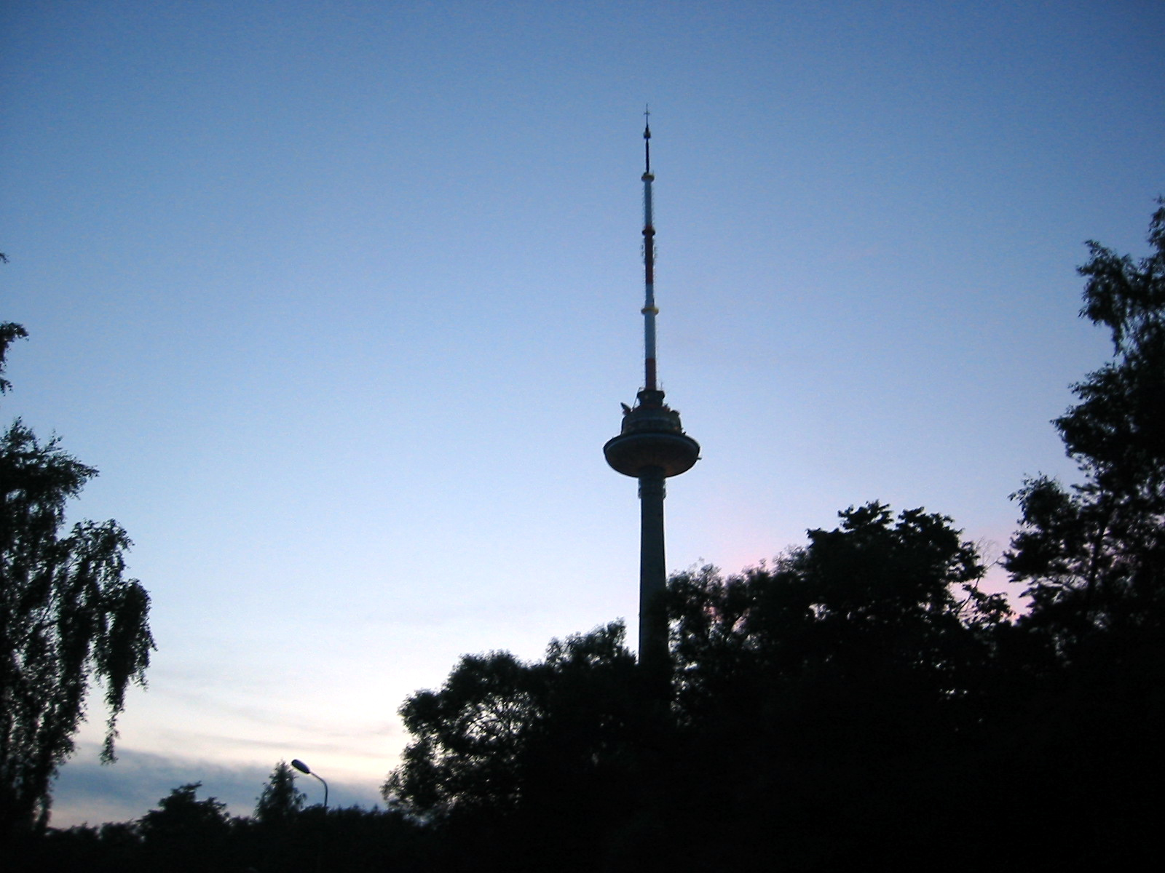
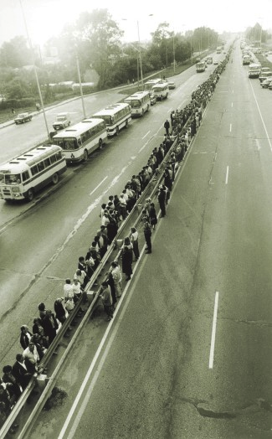
The Lithuanian national monument of the
TV tower where 14 Lithuanians were murdered
by Soviets during the Singing Revolution
Lithuanians, Latvians and Estonians join together
singing along the Baltic Way in early phase of
the Singing Revolution
TV Tower
Vilnius, LT

Slide 17
Accomplishments
Students participating have come from over 25 countries, including Lithuania, India, Uzbekistan, Azerbaijan, Kazakhstan, Finland, Sweden, South Korea, China, Nigeria, Israel, Germany, Poland, Ukraine, Slovenia, U.K., Czech Republic, and Italy
The impact of this global diversity is that students discuss key issues such as peace-building processes from very different perspectives depending on their countries. Ex: Nigerian v. U.S. perspectives on nonviolent civil disobedience
Student evaluations routinely are very positive, ex.: “content of this course should be taught throughout the curriculum” “life-changing experience”
Faculty experience the partnership as enhancing their teaching skills as well as content knowledge (KTM learned participatory action research)
It makes it possible for our Schools of Social Work (at Loyola as well as Vytautas Magnus) to have a truly global specialization

Slide 18
Accomplishments
Glocalization:
  Local experience influencing practice and research conceptualizations as students share from perspectives of profoundly diverse contexts (Hugman et al.)
  builds both respect for local and diverse cultural values, and also a sense of what is universal and globally applicable (Healey)
  It builds a sense of culture-rich, common humanity (Kuzmickaite)
Most students participating could not afford to participate in such an international experience in-person, so it provides an experience of global amity without additional expenditure of resources that cannot occur by any other mode of instruction

Slide 19
Accomplishments
Facebook page created by Immanuel David from Nigeria: https://www.facebook.com/groups/376703492454445/
  Here students share stories of peace and resources
Website being created by Mukhayyokhon Azamova from Uzbekhistan: http://globalsocialworkloyola.weebly.com/
Blog to which all students contribute: http://internationalswedpartners.blogspot.com
Student enthusiasm: Course evaluations consistently high
Videos this year by students and Lithuanian faculty

Slide 20
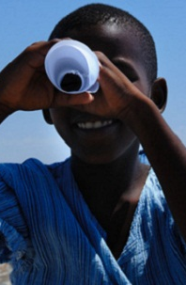
Pedagogy

Slide 21
Pedagogical constructs
Social interaction is necessary to support learning, but focus on conceptualization is necessary to promote learning (Gillies, 2008)
Instructors at both sites (and therefore partnership between instructors) is essential , esp. when many students are learning in a second language
Emphasizing preparation: readings and power points available ahead of time with expectation of discussion during VC (Gillies, 2008)
Managing inequalities in resources is essential: quality of personal computers, access to readings
Matching student motivation to course content: Critical that students’ learning goals include cross-cultural, global experience, and this is made clear at registration, otherwise they can experience the video-conference as an obstacle: “I feel as though the dual campus set-up slows down the learning process significantly”

Slide 22
“Social presence”
Social presence is: ‘ ‘the degree to which individuals perceive intimacy, immediacy, and their particular role in a relationship’ (Belderrain, 2006, p. 149). The degree to which individuals perceive they are interacting with real people when they are online (Sung & Meyer, 2012, South Korea)
Generally applied for online learning but also used in VC pedagogical theory
Five facets (factor analysis of online learning study by Sung & Meyer, 2012):
  social respect (e.g. receiving timely responses),
  social sharing (e.g., sharing information or expressing beliefs),
  open mind (e.g., expressing agreement or receiving positive feedback),
  social identity (e.g., being called by name),
  Intimacy (sharing personal experiences)

Slide 23
Other literature on teaching via videoconferencing (VC)
Considerable evidence that when used in elementary, middle and high schools, videoconferencing brings together students from different backgrounds and improves students’ tolerance, awareness of diverse others, and mutual understanding (Gillies, 2008, Scotland)
Many studies indicate VC does not reduce instructor-student interaction or quality of learning and
Distance learning has a positive impact on clients in remote as well as local sites (cited in Bergin, Stein & Mullin, 2009, U.S.)
But when the same content can be covered in traditional classrooms, students tend to not like distance classrooms (Bergin, Stein & Mullin, 2009, U.S.)
Recent studies emphasize that effective interaction is key and different from traditional classrooms: what are the components?

Slide 24
Research reports about the challenges of videoconferencing
If instructors rely on lecture format, experience becomes even more distant
Complicated to ensure connections between students across sites:
  Students at remote or local site can be inattentive “with impunity”
  Distant students can be more reticent, as though they “disappear”
Students perceive small group time and doing tasks during VC time as a “Waste of time” (Gillies, 2008 and our experience also)
Students are extremely sensitive to technological glitches and even changing from 2 to 3 sites can cause reduced student engagement and satisfaction (echoed by our experience)

Slide 25
Other challenges we encountered
Some students were self-conscious about how they looked on camera and became shy or somewhat agitated (nervous laughter, etc.) initially – requires reassurance
Students could feel more disconnected from instructor because eye contact with local students is cut in half (because of having to face away from them to face camera, have all students appear to distance site, and be audible with microphone)
Some students feel exposed (inferior, embarrassed) by public mid-term
If students are less active and discussion is slow, it helps to assign readings to students to take the lead in discussing

Slide 26
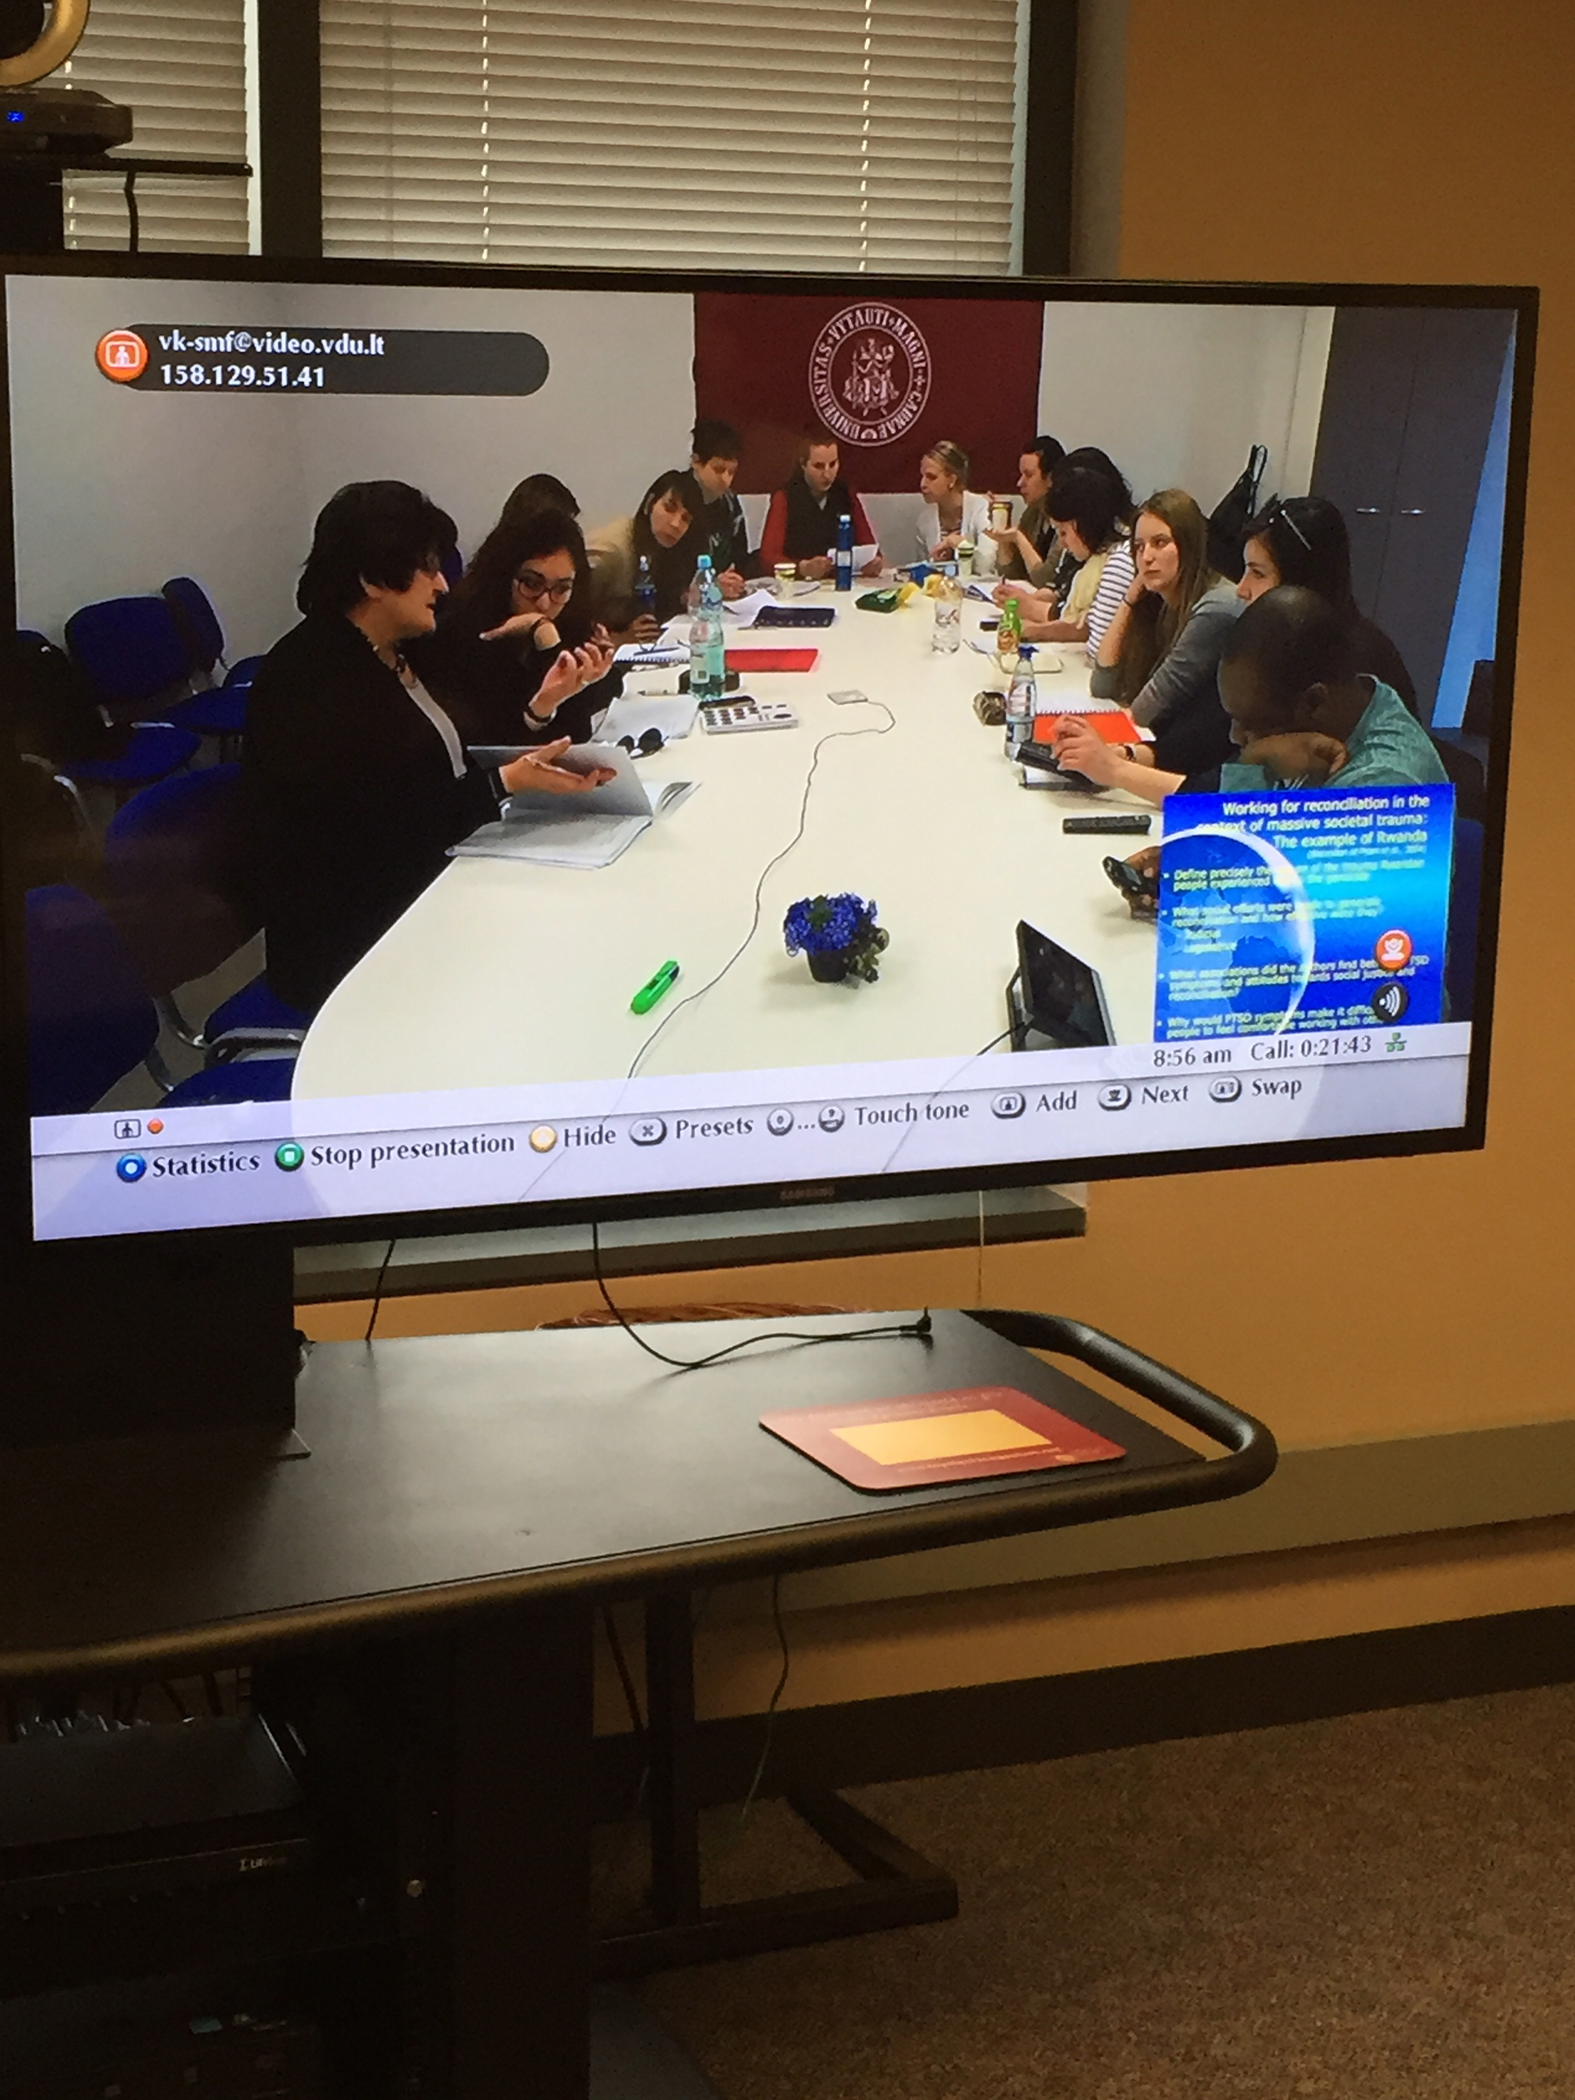
Handling challenges of videoconference format
Reduced connection with local students because
of instructor’s shared eye contact. Handled through:
  Open discussion of problem
  Ensuring contact with local students alone, especially in research class
  Check-ins orally and anonymously in writing about
  students’ experiences in class
Video format dilutes personal expressions (2 dimensions
rather than 3 in-person) so instructor in particular needs to project positive personality more intensely
Microphones and rate of speech have to be managed
for all students

Slide 27
How we managed differences in socio-culturally imparted educational values
History of U.S. imperialism, with regard to social work knowledge also: compensated for consistently by discussion of importance of empowering, glocalized approach
U.S. social work knowledge and research seeks more quantification and use of experimental design; EU models more participatory, humanizing and advocacy-based: combined both in research class with gradual emphasis on EU-type models
Different socio-cultural experiences of teacher-student and student-student relationship
  U.S. students expected lecture to start immediately with imparting concepts; Kaunas students more comfortable with conversational pleasantries
  U.S. students socialized to be more active, critical, can quickly take over class discussion
  Essential to encourage interaction by Kaunas students and U.S. students from outside U.S.
  Students from other cultures socialized to be carefully prepared and value education more than U.S.
  U.S. students learn from example of assiduous scholarship and commitment to education of the students from outside U.S., U.S. instructor drew attention to this

Slide 28
How we encouraged student discussion
In general, we did the following more and more intensely in VC teaching
Summarizing reading content and key concepts in power point slides and verbally so that students have common base of knowledge for discussion
Asking questions about applications to practice in their countries as a focus for every reading covered
Instructors in both sites focused on encouraging student discussion by:
  Amply praising students when they did talk
  Rarely cutting off sharing, even when it can seem tangential
  Setting example by sharing own personal cultural experiences

Slide 29
How we managed economic inequalities
U.S. students more likely to take for granted their education (arrive unprepared or go online during class), while instruction time is more prized by students outside U.S.;
U.S. students have laptops, those outside U.S. don’t; required U.S. students to keep laptops closed out of respect
U.S. Social Work profession highly bureaucratized, organized, and resourced compared to what occurs in most other countries
Emphasized the learning possible by creative freedom for social work services in other countries
  Example: Students did shared presentation about Men’s crisis centers – a center existed in Kaunas, but not in Chicago
  Example: Non-violent protest impossible in Nigeria where dissenters are killed; but building civil society democratic structures is alternative strategy

Slide 30
Encouraging student-student interaction
E-mail non-responsiveness tended to be seen by U.S. students as disinterest of Kaunas students, so Instructors assured all students if they did not hear from each other in a few days, instructors would link them by email
Create shared rituals:
  Saying hello and goodbye in different languages with students instructing us all about how to
  Sharing about different holiday traditions and celebration days (Lithuanian independence days)
Encourage collaboration in presentations
Mid-term on blog with question requiring that students read others’ posts
Social media, also created by students for each other

Slide 31
Teaching and learning with English as a 1st and 2nd language
Slower pace of speech – something to learn for U.S. students who have not previously interacted with students who are still learning English
Idioms – occasions for comic relief!
Brings up interesting questions for discussion about the role of language in cognition, formation of culture, and social work knowledge
Language, inequality, and privilege: U.S. student commented: “I feel worried that those speaking English as a second language have to work so much harder than we do”

Slide 32
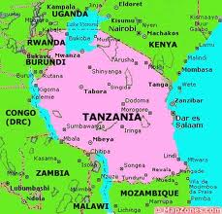
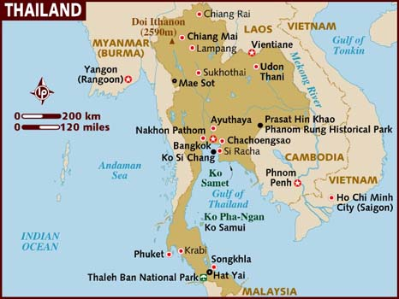
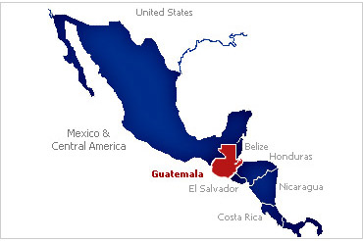
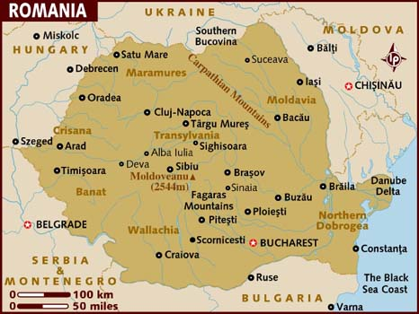
Educating for cross-cultural awareness

Slide 33
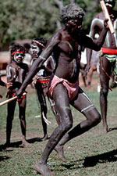
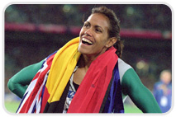
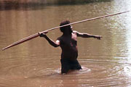
We used all possible media to convey different cultural
experiences: pictures,
Maps,Youtubes,
Ted talks, movie clips,
Power points, etc. of people
talking, singing,
dancing, to help
students experience
richness of cultures
Australian Aboriginals dancing and fishing
Cathy Freeman, 1st Australian Aboriginal person to win Olympic Gold Medal (2000, in sprinting)

Slide 34
Educating for cross-cultural awareness
Educate students to acculturate to diverse customs:
  US students shut laptops
  Conversation to foster connection in accord with Lithuanian customs
Students contribute social work practice and social changes from every continent
Always include maps of locations we study
Include photos of different peoples to represent diverse cultural traditions
Present rituals and practices with daily meaning for students:
  Saying hello and goodbye in different languages
  Holiday traditions
  Flowers blooming in Spring
  Foods and meals
Make use of social media to foster connection across distances

Slide 35
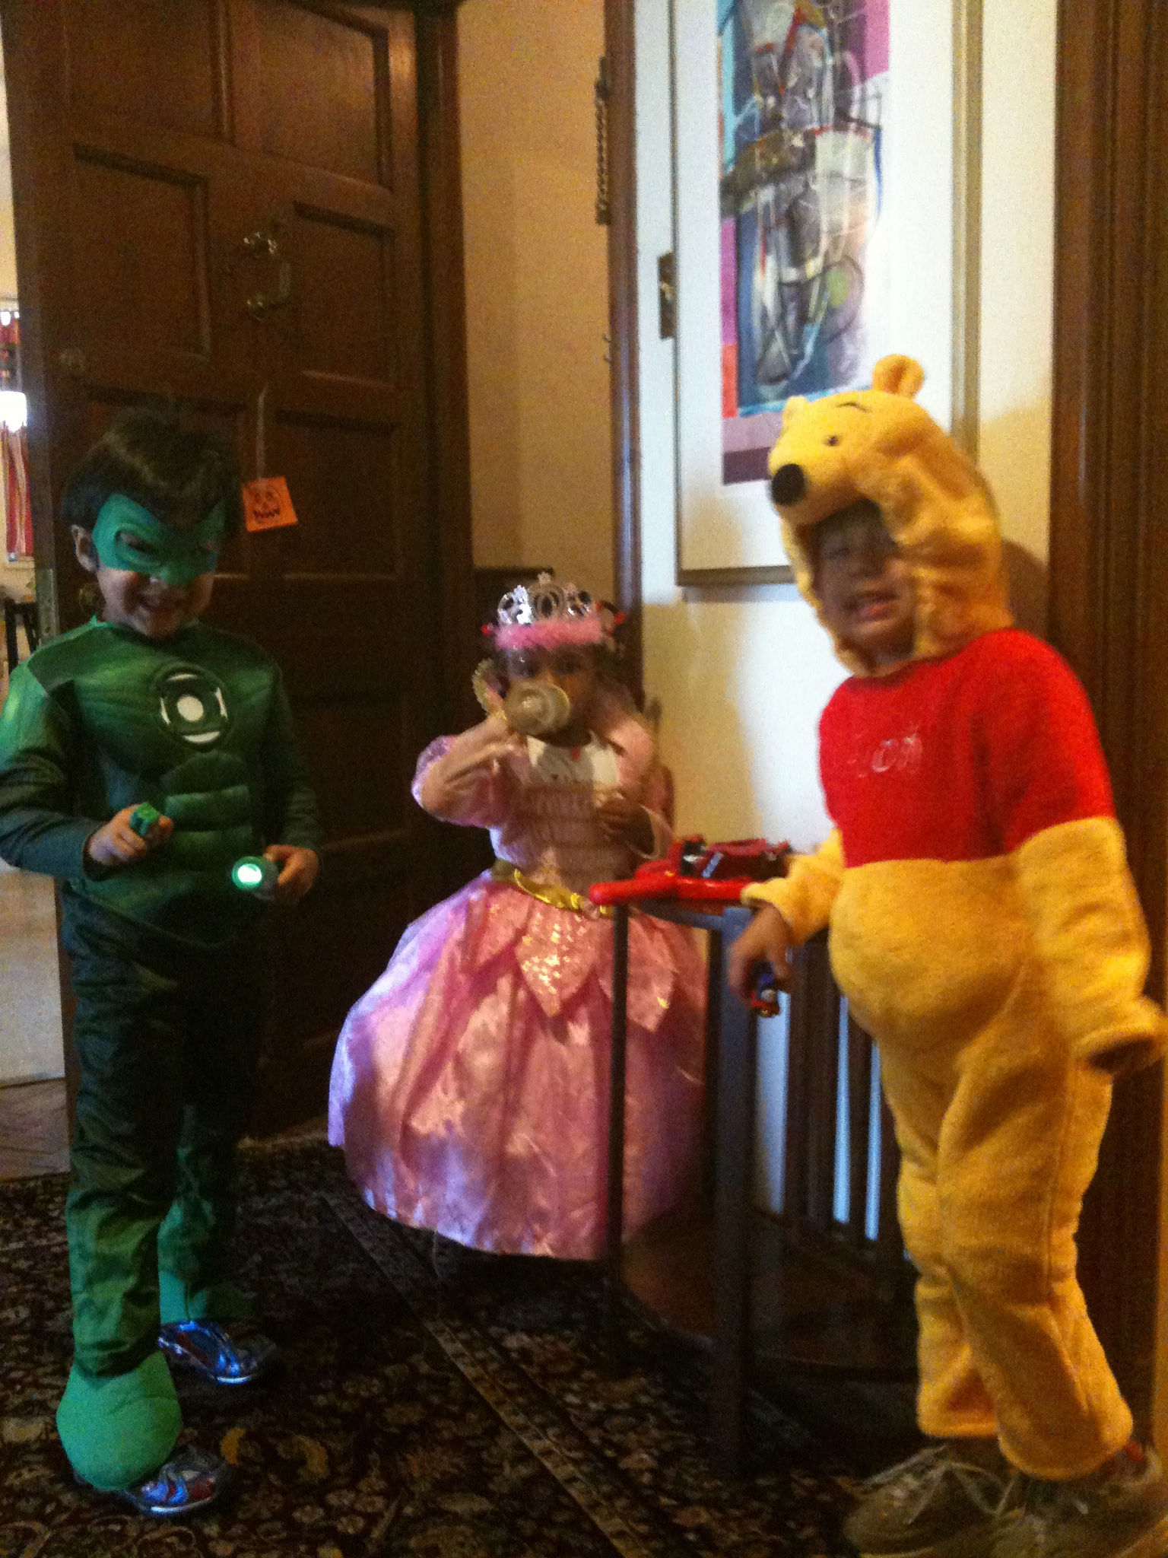

Happy
Halloween!

Slide 36
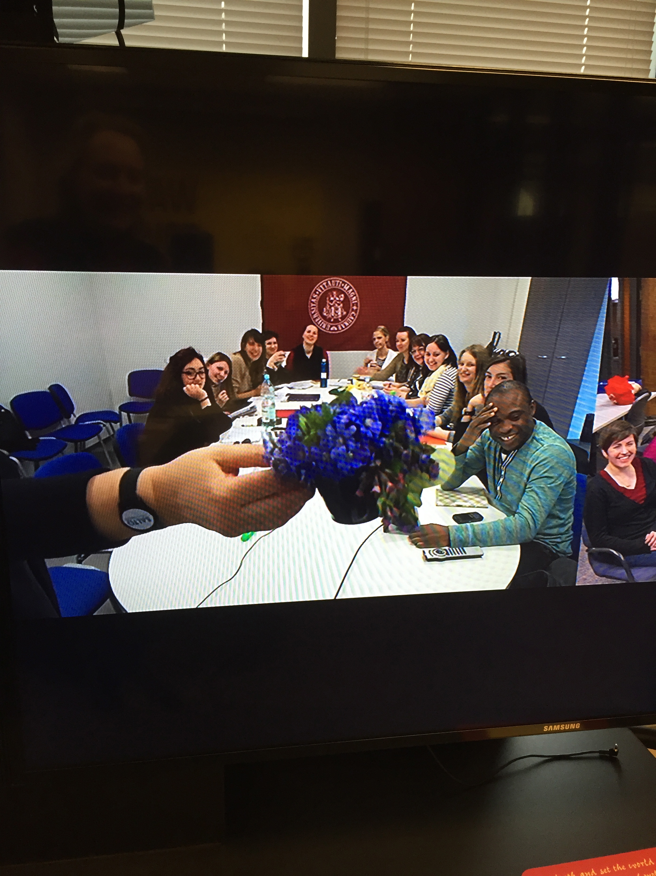
Kaunas students pick violets to celebrate Social Work Day and Spring
March, 2015

Slide 37
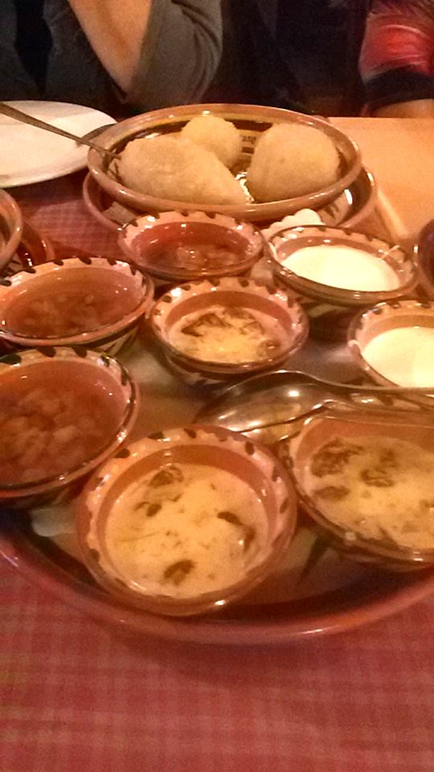
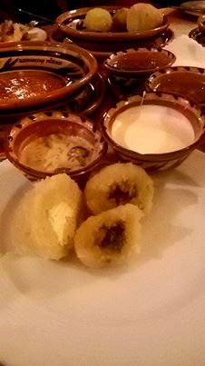
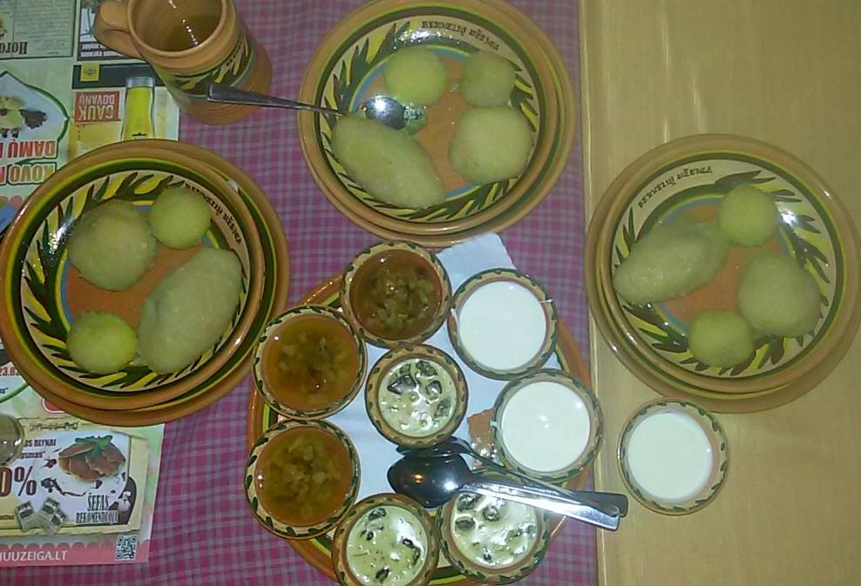
Photos of Lithuanian
Cepellini shared with
class

Slide 38
Educating for cross-cultural awareness: What needs healing and how do we go about it?
Understanding socio-cultural variations in trauma:
  Societal-level (Soviet occupation of Lithuania, African holocaust)
  Community: police brutality and criminal justice system racism in U.S. and
  Personal (familial) trauma
Grounding practice in indigenous healing practices for societal and familial trauma
  South African Zulu tradition for community healing of trauma, including familial trauma
  Restorative justice practices from aboriginals in Australia
  Truth and reconciliation post apartheid (South Africa)
  Post genocide: community healing practices in Rwanda, art-based interventions for Mayan children post-genocide in Guatemala

Slide 39
Educating for cross-cultural awareness: Poverty, social justice, and empowerment
Understanding the degree and conditions of poverty around the world
  Poverty in terms of income
  Poverty in terms of resources (shortages of water, famines)
  Poverty in terms of access to education
  Poverty in terms of lack of medical care, women’s health, child and infant mortality
  Poverty in terms of shortages of employment and economic mobility: Lithuania and other post-Soviet countries
  Poverty as a state of mind, held in place by political will: Muhammad Yunus
  Sen: Poverty and Development in terms of Freedom and Unfreedom
Positive (empowerment-based) and negative (intrusive, dominating) examples of global social work interventions
  Example of child welfare interventions in Romania

Slide 40
Educating for cross-cultural awareness: Dialogue and stories to promote and preserve peace
Question: Does ethnic identification invariably become a trigger for strife with those of other ethnicities? (Bender Shetler, 2010)
  Political science empirical studies indicate more diverse societies are characterized by conflict, corruption, slowed economic development
Historical memory “can be used to promote either violence or peace”:
  Examines history of Luo and Bantu identities in Tanzania and Western Kenya,
  data come from oral histories gathered by Zedekia Oloo Siso, popular historian, of interviews with elders along the shores of Lake Victoria
  Reconciliation agenda of historian
“Demonstrate basic brotherhood between peoples of North Mara” who only recently became enemies describe “migration, warfare, prophecy, colonial chiefs, moral behavior” (641)
Example of how story can be used for peace-building; because it is oral, it is relatively invulnerable to political influence

Slide 41
Transformational dialogue and stories of peace
Using our class and examples of dialogue to bridge walls of strife and hostility
  Understanding the socio-cultural origins of terrorism and genocidal hate
  Examples from within strife-torn countries of peace-building and humanitarian efforts: Israel and Palestine (Grodofsky, 2007)
Transformational dialogue (Gergen)
  Promoting sharing of personal stories aside from immediate strife-laden topics
  Development of interpersonal empathy replaces dehumanization that is the trigger for conflict
  Facilitating working together and collaboration (example of ballroom dancing with Israeli and Palestinian children)

Slide 42
U.S. faculty perspective: What are most notable elements U.S. students learn from Lithuanian colleagues?
Nonviolent re-building of democracy through
  Singing Revolution
  Ongoing participation of citizenry in building democracy (tends to be more vigorous in this relatively smaller country)
  Memorializing and healing processes to recover from massive trauma occurring under Soviet occupation
Courageous and creative social work initiatives building on insights from around the world: example Men’s Crisis Center in Kaunas, none in Chicago
Respect for different cultural values and practices and how those influence classroom relationships
High educational standards in a society that deeply values education

Slide 43
Student evaluation and feedback
For the first six years, anonymous mid-semester written course evaluations helped to better calibrate pedagogy and curriculum
Common themes in feedback:
  “I learned more about different cultures and viewpoints in our class discussion.”
  “I thoroughly enjoyed the global aspect of the class and the ability to engage with students from other countries and cultures”
  “There should be more courses like this”
  “The content should be required of all social workers”
  “The best course I took at Loyola”

Slide 44
Presentation by Cordelia Grimes,
M.S.W. student, Loyola University Chicago
School of Social Work
Video by Global Social Work Students, 2015:
https://www.dropbox.com/s/yk4zc1pvg9ne8ng/Global%20SW.mp4?dl=0

Slide 45
The Student’s Perspective
Cordelia Grimes, M.S.W. student
Loyola University Chicago
School of Social Work

Slide 46
Course Benefits and Values
A platform for dialogue: building cross-cultural and cross-national competencies
A starting point for international professional collaboration and networking
An investment in the future of International and National Social Work Professions: working to build the profession globally starting with the newest members
A generation ideally positioned to incorporate technology in an increasingly globalized world
  An opportunity to brainstorm ideas and develop cross-national direct service, policy, research projects, etc… within a “glocalized” framework

Slide 47
Course Suggestions
  What worked well?
    Class discussions prompted by asking to give examples from “home countries”
    Incorporating current events and topics into discussions
    Applying readings to micro, mezzo, and macro levels: comparing and contrasting different countries’ histories, perspectives, and/or services
    Building relationships
      Common values, experiences, concerns, etc…
      Facebook group page (created by Enakele David)
  Areas for improvement
    Facilitating partnerships for group projects between students at different Universities
    Shared Teaching Opportunities
    Technology glitches (Facebook provides rapid communication when this happens)

Slide 48
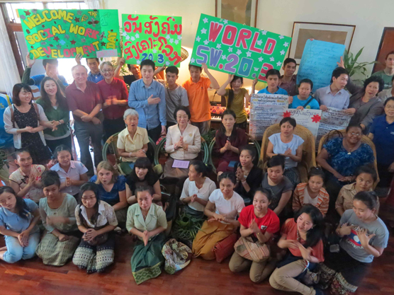
Curriculum
Peace-Building
Social Justice
Human Rights
Research to advance social
justice
Celebration of social work day in Thailand,
University of Utah, College of Social Work partnership

Slide 49
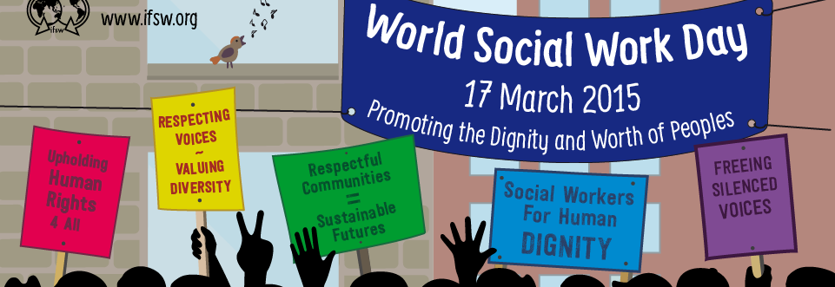
Key Global Social Work Concepts

Slide 50
Video made by colleagues in Kaunas
https://www.youtube.com/watch?v=F810vOEfCyA&feature=youtu.be

Slide 51
Key curriculum concepts
Promoting recognition of diversity and common humanity to remedy ethnocentrism (Kuzmickaite)
Social work as peace-building: informs practice and research
  Positive peace and negative peace
    Social work in particular builds civil society structures that promote democracy and positive peace
  Structural violence: Harm caused to persons by systems, when no one person can be held accountable
    Paul Farmer: deprivation of medical care and medicines in developing nations that is readily available elsewhere
    U.S.: “We charge genocide” to U.N.: institutional racism of criminal justice system
  Socio-cultural foundations of terrorism
  The Lucifer effect: Zimbardo
Experiencing glocalization through students’ sharing experiences

Slide 52
Building on indigenous and local knowledge for global social work practice and research: case examples
Ethical principles for international clinical research from Bucharest Early Intervention Project
Working with local leadership to build change in inhumane cultural practices: examples in Kristoff, Half the Sky
Facilitating healing of social trauma through culture-specific adaptions of trauma theory
  Examples from Rwanda, South Africa, Guatemala (Lykes)
Maori principles for social work supervision in New Zealand
Advocating for local community rights against incursions by stronger powers: Vieques
Reconciliation after genocide and apartheid: Truth and Reconciliation Commission in South Africa

Slide 53
Approaches to global development
Development in terms of five freedom guarantees, Amartya Sen
Poverty is a violation of human rights and remediable by supporting indigenous economic development: Muhammad Yunus
Global actions recognizing imperialistic domination of local economies, governmental corruption
    Organizing to oppose unjust use of proceeds from tantalum mining in democratic Republic of Congo, Ted talk for mid-term
Heroic actions on behalf of impoverished and “silenced” populations
  Malala Y
  Ted talk about SOLA School for girls in Afghanistan

Slide 54
Elements of “borderless” social work (Hugman et al., 2010)
“Insurgent multiculturalism”
Pluralizing differences
Historically locating social work practice in indigenous contexts
Revising concept of Identity: nation-bound or transnational? (ex of Muslim identity)
Reflecting about interpersonal communication:
  Recognition that social workers’ clients: may be migrants who face discrimination in their new country – often criminalized or vagabonds…(contrast with tourists…)
  Authenticity can be associated with degree of life in country v. “otherness” (newcomers)

Slide 55
Human rights orientation
U.N. Declaration on Human Rights
Advancing social justice within and between countries
Fostering cross-cultural and transnational cooperation
Understanding poverty as a violation of human rights (Yunus)
Recognizing that what seems like a violation of human rights from one perspective might not seem so to others:
  Restorative justice to seek reconciliation between aboriginals and European descendants in Australia
Women’s rights: Global gender inequality; importance of advocating for women’s education and preservation of women’s health and wellbeing (Kristof, Half the Sky)

Slide 56
Global social work curriculum topics
1
Globalization and the roles of global social workers
International Social Work and Advancing Human Rights
History and contexts for global social work practice
Poverty, structural violence, stigma and initiating virtuous social cycles
Cultural and familial transmission of aggression, competition, and competition
Gender-based discrimination and social work interventions to respond

Slide 57
Global social work curriculum topics
2
Understanding and remediating societal processes that cause people to dehumanize and harm others
National and community-based efforts at reconciliation and peace-building in the wake of violence
Group and individual psychotherapy in response to traumatizing violence
Care of vulnerable children and developing child welfare infrastructures
Adoption as an example of complexities in fostering children’s human rights

Slide 58
Key concepts in Research from a Global Perspective
U. S. focus on quantitative and experimental designs is not shared or prioritized globally except
Participatory Action and Qualitative Research
  Research is based on relationships that form the identities of researcher and subject
  Research can advance social justice
Research can include and affirm the values and priorities of people participating as subjects
Maintaining scientific principles and standards in qualitative and participatory action research

Slide 59
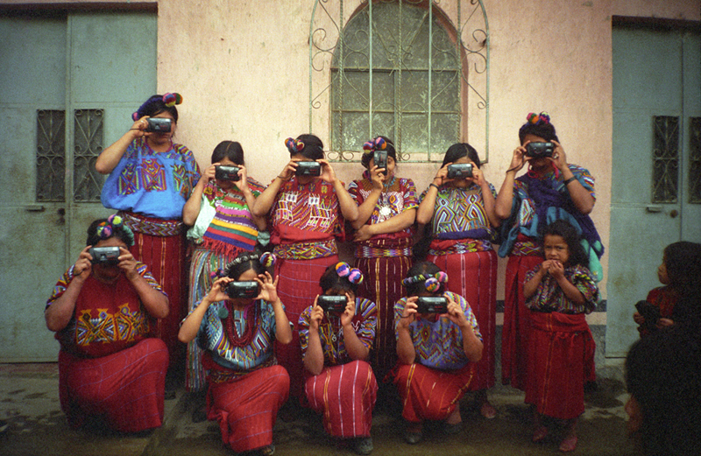
So – really -- who is studying whom in research?
From Participatory Research Project with Mayan women, M. Brinton Lykes

Slide 60
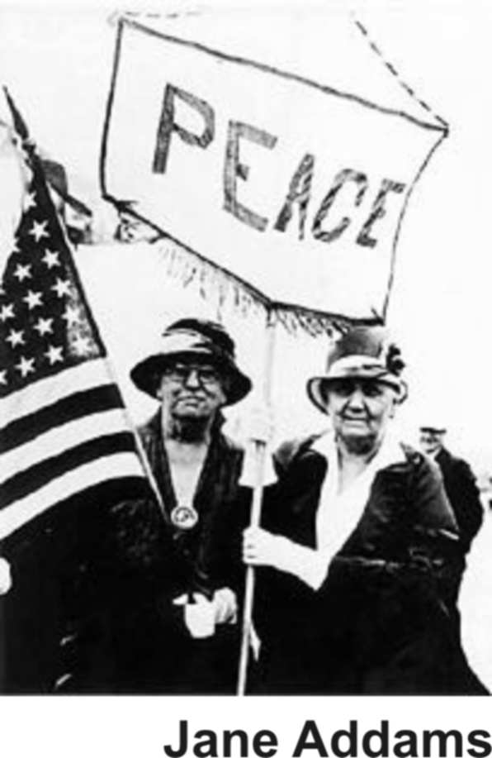
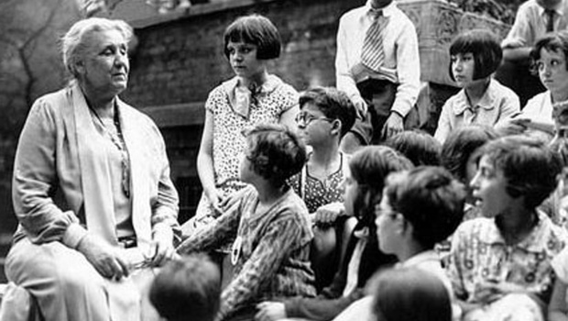
Historical Foundations in U.S. for social work
with global impact and a social justice,
peace-building,
participatory action research orientation

Slide 61
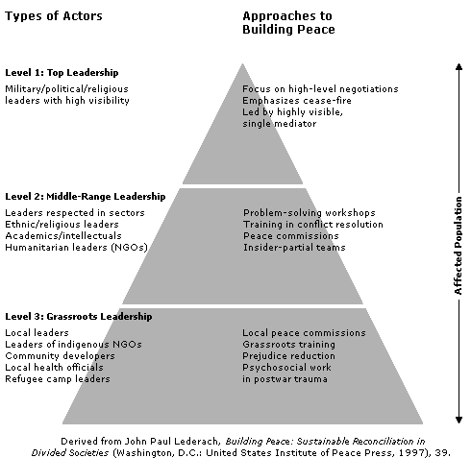
Where are we as
researchers in this
peace-building
Pyramid?

Slide 62
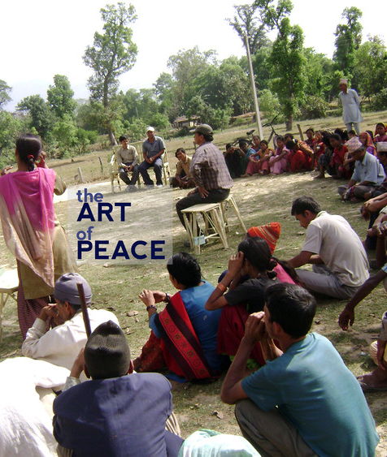
Participatory action research as
a peace-building process
Photo from onbeing.org: About John Paul Lederach’s participatory action research for peace

Slide 63
Central Issues in Research
“Research is about the power to define reality. To say that you are doing research suggests that you are undertaking systematic investigation with a view to making some claim about the world.” (Laws et al. p. 26-27)
Will research be the best way to use resources for development?
How can we conduct research that empowers severely disadvantaged populations, improving their lives through the process and findings of the research, without sacrificing scientific quality?

Slide 64
Curriculum Topics: Participatory Action and Qualitative Research to Advance Social Justice: A Global Perspective
1
The Impact of Research on Participants
The impact of Culture and Values on Research
The Literature Review
Research Designs

Slide 65
Curriculum Topics: Participatory Action and Qualitative Research to Advance Social Justice: A Global Perspective
2
Creating and Using Logic Models
Process and Outcome Evaluations
Understanding Practitioner Decision-Making and Knowledge Utilization
Biography, history and narrative study of lives
Using research findings: Products, authorship and dissemination of findings

Slide 66
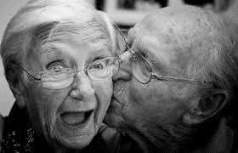
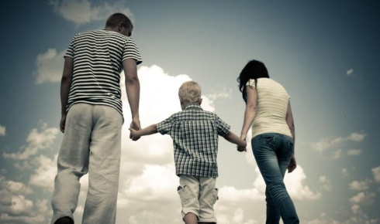
Frequent themes in global social work student presentations
Well-being of elderly and elder care homes, esp. in post-Soviet countries
Sex trafficking prevention and post-trafficking trauma treatment services
Women’s reproductive health issues, esp. female genital mutilation and efforts to build community support to prevent it
Alleviating poverty: micro-lending, services for
homeless persons, helping impoverished children
International child welfare: services for children,
helping orphans and street children

Slide 67
Sample topics of research projects in Participatory Action and Qualitative Research
Working with educational leaders to reduce corporal punishment in Swaziland Schools
Evaluating an NGO’s peace-building work after the civil war in Zimbabwe
Studying and evaluating services for homeless persons in Kaunas
Helping women immigrants to the U.S. who experienced genital cutting
Fostering closer relationships between children and teachers in Kaunas schools
Improving social services for marginalized populations in India
Understanding and evaluating services for persons with alcoholism in U.S. and Lithuania

Slide 68
Selected references
Bell, Daniel, and Carens, Joseph. (2004). The Ethical Dilemmas of International Human Rights and Humanitarian NGOs: Reflections on a Dialogue Between Practitioners and Theorists. Human Rights Quarterly, 26, 300-329.
Bender Shetler, J. (2010). Historical memory as a foundation for peace: Network formation and ethnic identity in North Mara, Tanzania. Journal of Peace Research 47(5): 639-650.
Berger, R., L., Stein, and Mullin, J. (2009). Videoconferencing: A viable teaching strategy for social work education? Social work education. 28:5, 476-487.
Castro, Arachu PhD, MPH; Farmer, Paul MD, PhD. (2005). Understanding and Addressing AIDS-Related Stigma: From Anthropological Theory to Clinical Practice in Haiti. American Journal of Public Health, 5(1), 53-59.
Gillies, Donald. (2008). Student perspectives on videoconferencing in teacher education at a distance. Distance Education, 29:1, 107–118 Hare, Isadora. (2004). Defining Social Work for the 21st Century: The International Federation of Social Workers' Revised Definition of Social Work. International Social Work, 47, 407-424.
Grodofsky, Merav Moshe. (2007). The Contribution of Law and Social Work to Interdisciplinary Community Development and Peace Building in the Middle East. Journal of Community Practice, 15, 45-65.
Healey, Lynn M. (2008). International Social Work: Professional Action in an Interdependent World. 3rd edition. Oxford: Oxford University Press.

Slide 69
Selected references (2)
Hugman, R., M. Moosa-Mitha, (2010). Towards a borderless social work: Reconsidering notions of international social work. International Social Work 53(5): 629-643.
Kristof, Nicolas, and Cheryl Wudun. (2010). Half the Sky: Turning Oppression into Opportunity for Women Worldwide. New York: Vintage.
Lykes, M. B. (1994). Terror, silencing, and children: International multidisciplinary collaboration with Guatemalan Maya communities, Center for Human Rights and International Justice, Center Affiliated Faculty Publications, Boston College: 1-22.
Kathleen Maas Weigert. Structural Violence. In Lester Kurtz (Editor-in-Chief), Vol. [3] of Encyclopedia of Violence, Peace, & Conflict, 3 vols. pp. [2004-2011] Oxford: Elsevier.
Post, Jerrold. (2005). The new face of terrorism: Socio-cultural foundations of contemporary terrorism. Behavioral Sciences and Law, 23, 451-465.
Sen, Amartya. (1999). Development as Freedom. New York: Random House.
Muhammad Yunus, The Nobel Peace Prize Lecture, 2006. Grameen Bank. See also: http://www.grameen-info.org/
Zeanah, Charles H., Koga, Sebastian, Bogdan, Simion, Stanescu, Alin, Tabacaru, Cristian, Fox, Nathan A., Nelson, Charles A., BEIP Core Group 2006, Ethical Considerations In International Research Collaboration: The Bucharest Early Intervention Project, Infant Mental Health Journal, 27:6, 559-576.
Zimbardo, Philip. (2007). The Lucifer Effect: How good people turn evil. New York: Random House.

