Slide 1

One Year Later:
Establishing an Institutional Repository

Slide 2
Who? Us Again?
A Government Documents Librarian and Projects Specialist Collaborate on Establishing an Institutional Repository

Slide 3
Who We Are

Slide 4
Darren Sweeper
Head, Government Information, Legal Reference and Data Librarian.
Interested in the Social Sciences broadly speaking with a focus in Political Science, Family Studies & Justice Studies research.
Experienced in data and statistical information literacy instruction.
Using government documents to promote life-long learning.
Recently developed interest in scholarly communication, open access and institutional repositories.

Slide 5
Karen Ramsden
Research and Projects Specialist.
Received a Masters in Public Administration and a graduate certificate in Program Evaluation and currently finishing a graduate certificate in Data Collection and Management.
Expertise in fundraising for over fifteen years.
Employed in Higher Education for twenty years.
Has worked in both the administrative units and academic units in a university environment.

Slide 6
Our Repository Roles
Darren Sweeper – Scholarly Communications Librarian and Liaison to the External University Repository Committee
Karen Ramsden – Coordinator of the Digital Commons Repository

Slide 7
Our Applicable Skills
Darren has previous experience in building a repository and scholarly communications.
Additionally, Darren has established relationships with numerous University faculty that may to help serve as ambassadors for the Repository.
Karen has established relationships with high level administrative leadership through her work as Co-Chair of a Middle States Standard, membership on numerous University-wide committees and her experience working with various administrative departments for the past fourteen years.

Slide 8
Why an Institutional Repository at MSU?
Montclair State University achieved Doctoral Research III status in January 2016.
Serves faculty and institutional interests by collecting, organizing, preserving, and disseminating faculty scholarship and creative works in a digital, open-access environment.
Brings together all of Montclair State's research and creative works under one umbrella, with an aim to preserve and provide access to that research.
Consistent with the library’s archival role and responsibility in preserving publications and other artifacts documenting Montclair State’s history and the activities of its faculty, students, staff, and administrators.
Keep up with changing landscape of scholarly communications, open access and digital publishing.

Slide 9
Who is Involved?
The Library has subscribed to Digital Commons, powered by bepress, to serve as the hosted environment for our Repository.
Librarians with varied expertise at Sprague Library.
Library Institutional Repository Committee.
University Institutional Repository Committee.

Slide 10
Goals
Create
Innovate
Collaborate

Slide 11
Create
Create an optimal task force.
    Internal stakeholders
    External stakeholders
Set up plan on how to involve task force members.

Slide 12
Collaborate
Reach out to key stakeholders.
Ask to participate in various University events.
Committee members and targeted faculty are your key champions.

Slide 13
Innovation
Think outside the box
Don’t rely on traditional marketing tools
It’s okay to borrow other school’s ideas

Slide 14


Overarching Goal
Demonstrate the library’s added-value to its stakeholders.
Centrality of library historically overlooked on campus.
Promoting the library leads to a “seat at the table” for funding.
                =

Slide 15
Stay focused
Sell the Repository at every opportunity.
Internal sell is just as important and many times more difficult than an external sell.
You will encounter obstacles no matter how well prepared you think you are.
Exude confidence even when the process proves challenging.

Slide 16
Our Takeaways
Building your repository is a marathon not a sprint.
You will find support where you least expect it.
Participate in webinars, training sessions and read the available literature – the field of open access and the value of repositories changes constantly.
Don’t rush the process - soft launch first, then hard launch.
If you believe in the value, others will too.
Stay positive - you will succeed.

Slide 17
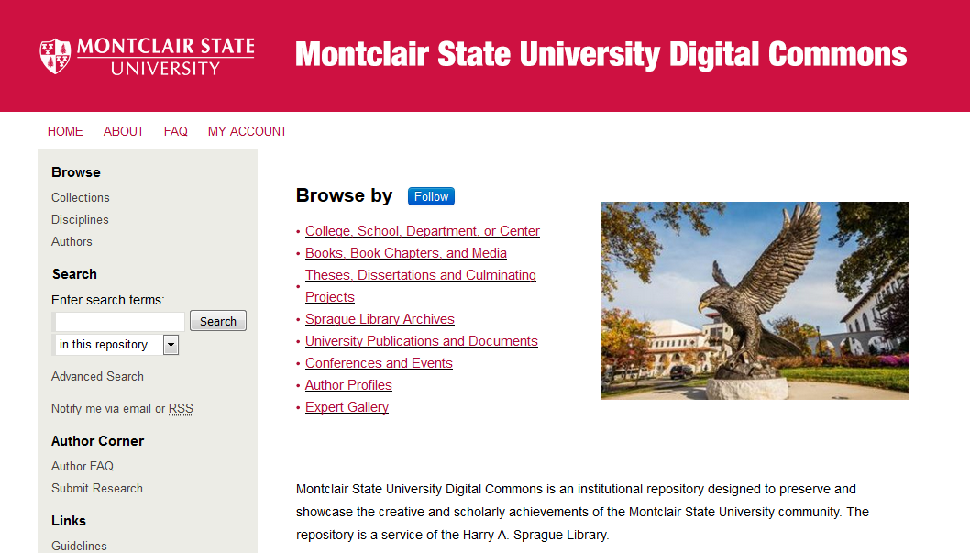
https://digitalcommons.montclair.edu/

Slide 18
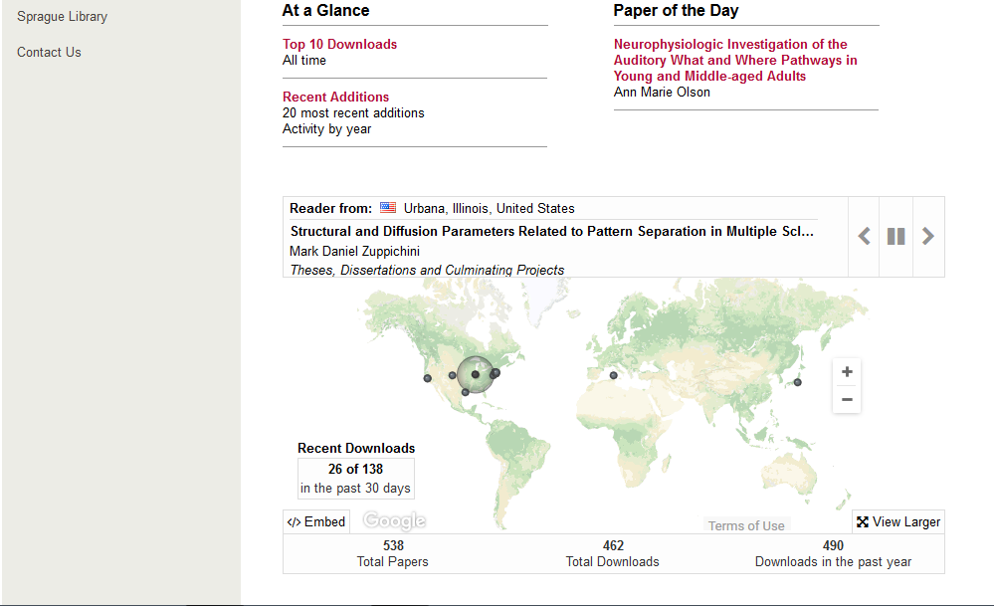

Slide 19
Questions?

Slide 20
Thank You!

