Slide 1
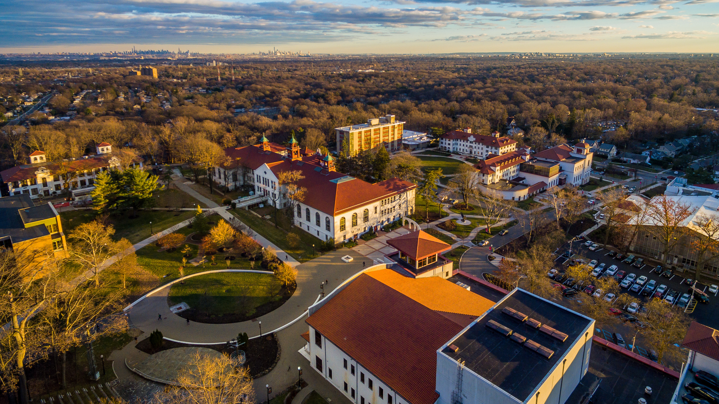

Increasing Scholarly Visibility:
Utilizing Your Research Platforms
to Support Open Science Initiatives

Slide 2


About Me
Research and Projects Specialist.
Manage two research platforms.
Working in Higher Education more than twenty years, mostly in administrative side of Higher Education.
Received a Masters in Public Administration and currently pursuing 2nd Masters Degree in Social Research Methods and Analysis.
I’m not a librarian.

Slide 3

Montclair State University

Slide 4
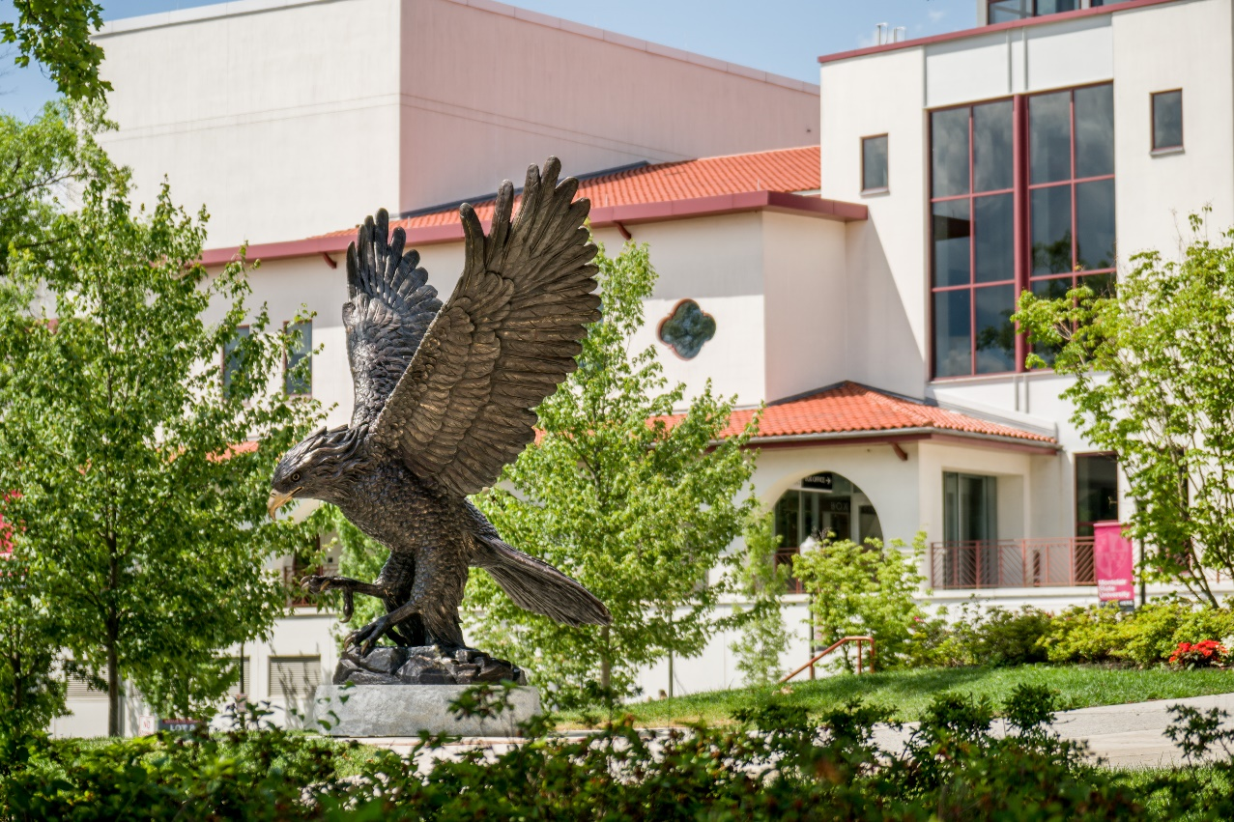
More than 300 doctoral, master’s and
baccalaureate programs
Serving over 21,000 students
R2-Doctoral University: High Research Activity
11 colleges and schools
Recognized as a public research university in the State of New Jersey

Slide 5

Our Culture of Research

Slide 6

Infrastructure Support and Initiatives
To support research-related activities a new position was created at the University in 2018, Vice Provost for Research, who leads the efforts to develop the University’s policies, practices, and culture in ways that are characteristic of a productive and high-functioning doctoral research university.
The creation of a University-wide research landing page, and the redesign of all college and school webpages to include links to showcase their research.
In 2019 the University succeeded in negotiating a new and more favorable agreement with the federal government in regard to the amount of funding provided for the overhead costs that support our research programs.
Promote scholarly activities using three research platforms, and participation in a statewide initiative to promote research.
Creation of The Office of Research which assists in identifying funding opportunities for sponsored research, provides training workshops, assists in the preparation of external grant applications, and administers the non-financial aspects of awards.

Slide 7


University Strategic Plan 2025 – Project SOAR
Vision Plan includes the language “acclaimed for its research contributions”
Consists of Three pillars:
  Fostering Student Transformation
  Growing through Diversity and Access
  Discovery and Application of Knowledge

Slide 8
  Pillar 3 - Discovery and Application of Knowledge
  Montclair State University will embrace and fulfill its identity as a Carnegie R2 doctoral and New Jersey public research institution, expanding both its national and international research impact, enhancing its research portfolio and reputation, driving innovation and relevant solutions for the social, economic, educational and health care challenges of the culturally diverse communities of New Jersey and the region.
Objectives:
  3.1 Improve and upgrade business processes, facilities and technological resources in support of research.
        Establish a Scholarly Communication Center in the Library which would leverage our Digital Commons and facilitate access to scientific journals, research databases, and sci-finder tools.
  3.2 Improve external funding for research.
  3.3 Expand and enhance the reputation and impact of University research.
        Fully populate and deploy Digital Commons and Research with NJ to propagate and broadcast more widely the scholarly productivity of the faculty and students.
        Broaden scope of research partnerships nationally and globally.
        Launch a robust research communication program in print and online to convey the University’s strengths and accomplishments in research, scholarship and creative activity.

Slide 9
Building a Culture of Research
University Leadership Support – Philosophical and Financial
Improve and Enhance University Research infrastructure
Increase in Research and Scholarly Output
Promote Research activities
Increased collaboration
Increased external funding
Replication and reuse
Opportunity
Support
Communication
Sustainability

Slide 10
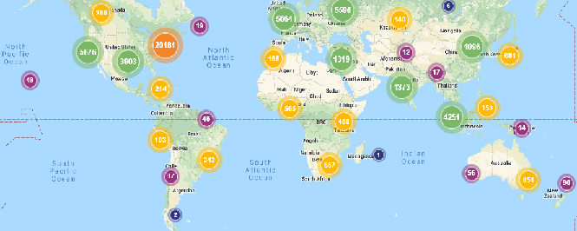
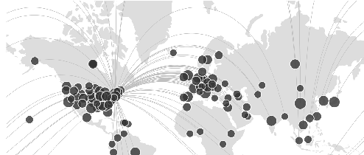

Major Players
Our Research Platforms
Research with NJ
Montclair State Univeristy Digital Commons
Research with Montclair
Increased Visibility
and Access to Scholarly Output

Slide 11
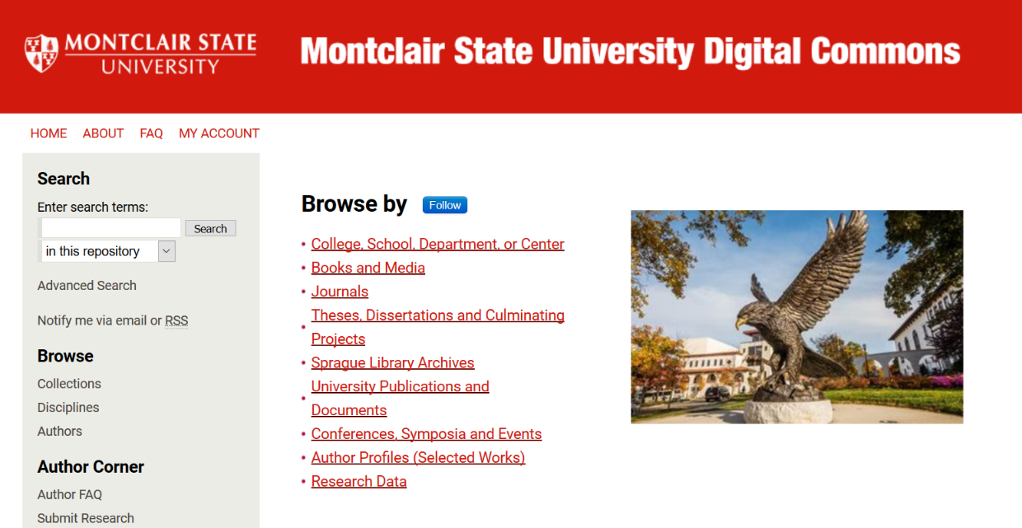
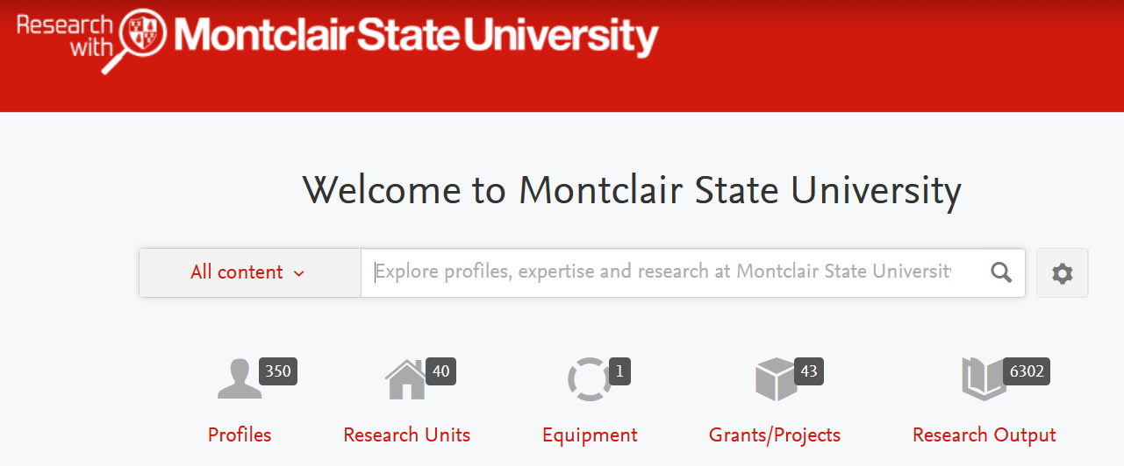

Our Research Platforms
Internal Research Platforms
Research with Montclair
Montclair State University Digital Commons

Slide 12

Montclair State University Digital Commons
Our University’s Institutional Repository.
Publicly launched by University President Susan Cole on April 25, 2018. All current employees are permitted to upload scholarly works, administrators are welcome!
Managed by an internal library committee.
Aligns with the Montclair State’s emphasis on research as it relates to the University’s new strategic plan and other University initiatives and aligns with the State of New Jersey’s emphasis on research, innovation and collaboration.

Slide 13

Impact of the Repository
April 25, 2018 (Public Launch)
As of January 20, 2020
2,500+ downloads
1,500+ works posted
228+ Institutions
80 Countries
65,000+ downloads
3,867+ works posted
3,500+ Institutions
177 Countries

Slide 14
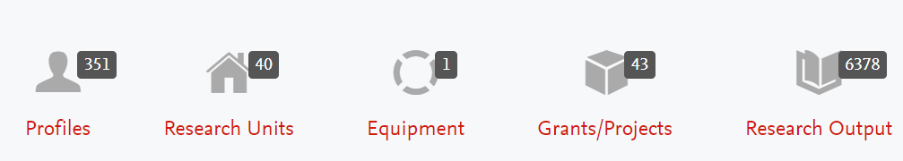

Research with Montclair
STEM-related researchers with high number of research items in Scopus are included.
Researcher profiles are uploaded through files prepared through our Human Resources portal.
Current Tenured and tenure-track faculty are included.

Slide 15
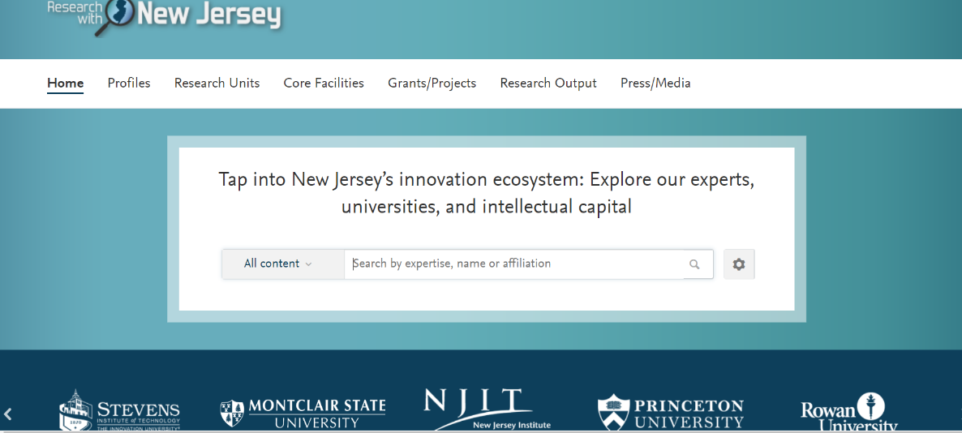

Research with New Jersey
The University is part of ResearchwithNJ , a scientific database launched in 2018 by New Jersey Governor Phil Murphy to support scientific collaboration and the growth of the State’s innovation economy.
Aligns with the State of New Jersey’s emphasis on research, innovation and collaboration.
State project is under the purview of the New Jersey Economic Development Association (NJEDA).

Slide 16
What is Open Science?
Movement to make scientific research and data accessible to all.
Umbrella term for various assumptions about the development and dissemination of knowledge.
Utilizes the prevalence of the Internet and associated digital tools to enable greater local and global research collaboration.
Economists consider scientific knowledge generated by public research a public good, with access open to everyone, generating higher social returns.

Slide 17
Open Science and Your Research Platforms
Research Platforms
Inspires Collaboration
Aids in the Rapid Transfer of Knowledge
Archival and Storage of Research and Data
Allows for Replication and Reuse

Slide 18
What Role can the Library Play in promoting research and open science initiatives?

Slide 19
Become Agents of Change
Partner and Collaborate
Embrace Disruptive Technology

Slide 20
Suggested Steps
Lobby for a seat at the table.
Stay abreast of your institution’s priorities and initiatives - and “ask how can we partner?”
Keep University Leadership informed of your efforts – be proactive and promote what you do.
Word of mouth and in-person meetings bring success, particularly as your institution focuses on research. Talk to your researchers, seek out those who publish, listen to their stories, make them aware of the benefits of being added to the repository.
Tenure-track faculty are very open to collaborating and showcasing their research.
Participate in or attend University events, focus on those that are showcase research.
Faculty are always willing to discuss and share their research - engage them!
Show them the impact and they will come!

Slide 21
Links
Montclair State University Digital Commons
Research with Montclair
Research with NJ
Montclair State University Research Page
Strategic Plan 2025
Presenter contact info:
Karen Ramsden
973-655-5276
ramsdenk@montclair.edu

Slide 22

Thank You!

