Slide 1
A Tale of Two Platforms
Making Pure Work with the Digital Commons Showcasing Solution
Oct 16, 2019
Karen Ramsden | Research and Projects Specialist, Montclair State University
Simone Polgar | Product Manager II, bepress

Slide 2
Introduction
The Elsevier-Montclair relationship:
In 2016, Montclair State University adopted Digital Commons as its IR and showcasing solution. This was an initiative led by the library to showcase faculty publications, books, student theses and dissertations, and institution-led journals.
In 2018, as part of the ResearchwithNJ initiative, Montclair State University adopted Pure. This was an initiative led by the Vice Provost for Research to highlight the university’s research expertise to foster new and stronger industry collaborations.
In late 2018, driven by a desire to maximize the utility and coordination between both platforms, Montclair State University initiated its participation in the Pure-Digital Commons beta integration program.
Montclair State University recently adopted Scopus (2020).
This presentation highlights the steps and considerations the combined Montclair State University Library Internal Repository Committee and Lead Pure Administrators went through together with Elsevier to define the integration and flow of records, and highlight the results and anticipated impacts.

Slide 3

About Montclair State University
Opened as the New Jersey State Normal School at Montclair in 1908 with the mission to educate and train an initial class of 187 students in the science of education.
Achieved University status in 1994 and now currently serves 21,000 undergraduate and graduate students.
The University has 11 colleges and schools with more than 300 doctoral, master’s and baccalaureate programs.
Recognized as a “high research activity” doctoral granting universities in the United States.
Additionally the University is recognized as a public research university in the State of New Jersey.
Situated on a beautiful 252-acre suburban campus just 12 miles from New York City.

Slide 4
About the Presenters
Karen Ramsden
Simone Polgar
Research and Projects Specialist.
Digital Commons Coordinator.
Lead Administrator for Research with Montclair (powered by Pure).
Working in Higher Education more than twenty years.
Previous role was Research Analyst in University Advancement (now University Development).
Member of various University-wide committees and project.
Majority of experience is in the Administrative side of Higher Education.
Received a Masters in Public Administration and post graduate certificates in Program Evaluation and in Data Collection and Management.
Pursuing 2nd Masters Degree in Fall 2019 in Social Research Methods and Analysis.
Product Manager for Digital Commons and Expert Gallery Suite “Showcase More” efforts
Focused on content ingestion workflows and feature development
Masters in Library and Information Science
Contributing as Product Manager to information management and library technology companies for 6+ years

Slide 5
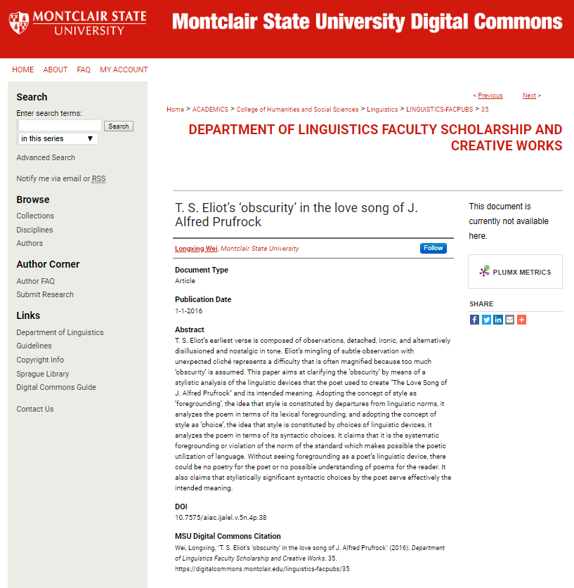
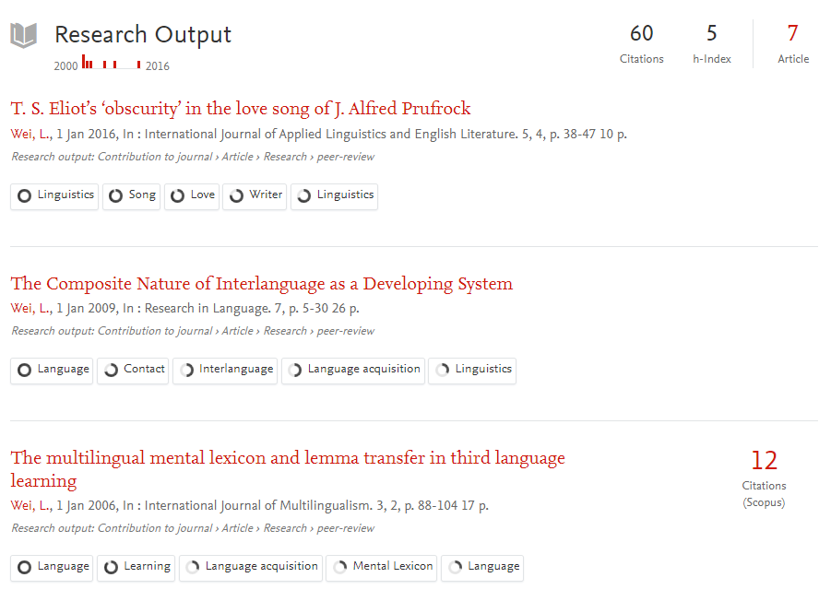
Highlighting MSU Innovation with Two Platforms
Integration between the Pure and Digital Commons portals began in summer 2019 and is currently in progress, nearing completion.
Notes:
https://researchwith.montclair.edu/en/persons/longxing-wei
https://researchwith.montclair.edu/en/publications/t-s-eliots-obscurity-in-the-love-song-of-j-alfred-Prufrock
https://www.scopus.com/record/display.uri?eid=2-s2.0-84969951798&origin=inward&txGid=74fa6ffc305337fd4a3d1e18351780f2
https://digitalcommons.montclair.edu/linguistics-facpubs/35/

Slide 6
Highlighting MSU Innovation with Two Platforms: Montclair State Digital Commons
Digital Commons
The Library subscribes to Digital Commons, to serve as the hosted environment for its institutional repository.
The mission of the Montclair State University Digital Commons is to showcase scholarly and creative works, research data, and other materials produced by the faculty, staff and students of Montclair State University.
A service of Sprague Library, the repository provides free, worldwide access to the scholarly, creative, and cultural works of Montclair State University.

Slide 7
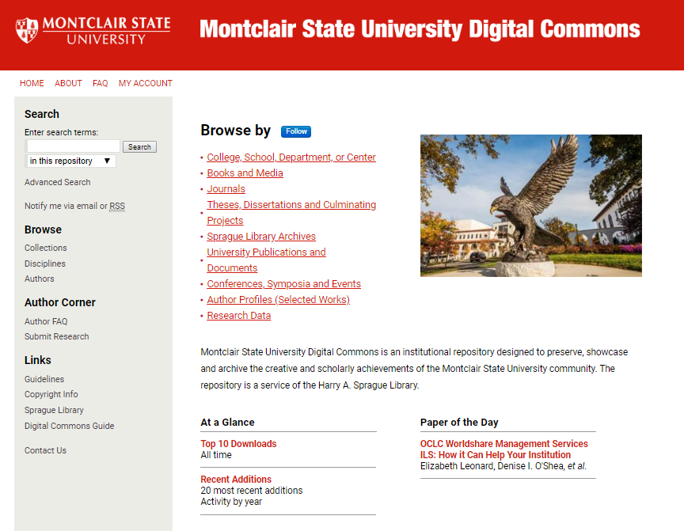
Montclair State University Digital Commons
"By capturing the intellectual output of Montclair State University, the repository provides visibility and influence to a worldwide audience, which, in turn, opens up new avenues for further research, innovation, and collaboration, and supports the University’s mission as a Carnegie-designated high level research doctoral university and state-designated public research institution."

Slide 8
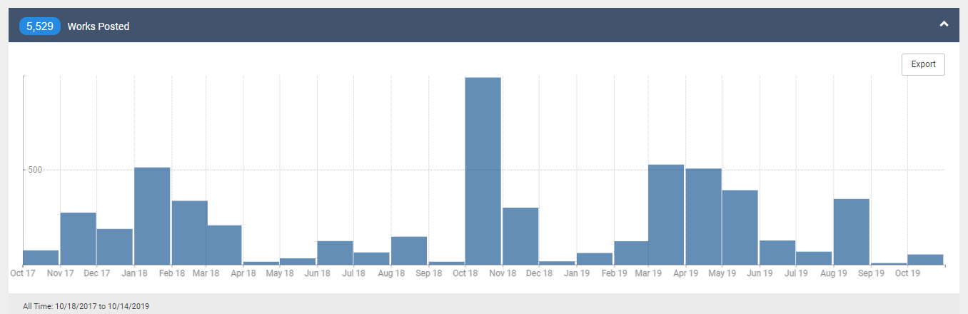
Montclair State University Digital Commons Works Posted

Slide 9
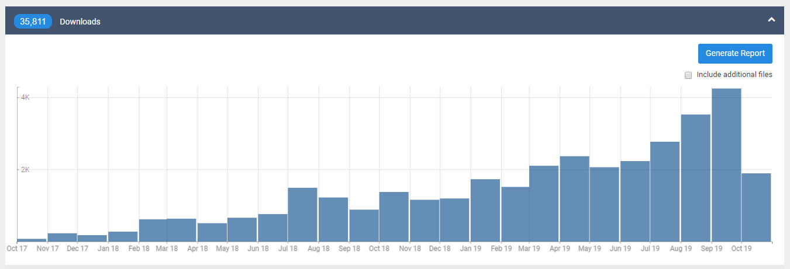
Montclair State University Digital Commons Downloads

Slide 10
Highlighting MSU Innovation with Two Platforms:
Research with Montclair
Pure
The University is part of ResearchwithNJ , a scientific database launched in 2018 by New Jersey Governor Phil Murphy to support scientific collaboration and the growth of the State’s innovation economy.
Aligns with the State of New Jersey’s emphasis on research, innovation and collaboration. New Jersey is marketing itself to be known as an “Innovation State.”
State project is under the purview of the New Jersey Economic Development Association (NJEDA).
As a result of this partnership, the University also created the Research with Montclair portal.
Research with Montclair highlights Montclair State research highlighting STEM faculty and aims to advance collaboration, discovery and innovation by helping to connect researchers not only across disciplines, but across institutions, government and industry.
Notes:
Consider moving the quotes to the top to highlight
Karen – I added this quote that you provided to Jillian (ELS marketing) this last year. "By capturing the intellectual output of Montclair State University, the repository provides visibility and influence to a worldwide audience, which, in turn, opens up new avenues for further research, innovation, and collaboration, and supports the University’s mission as a Carnegie-designated high level research doctoral university and state-designated public research institution .“
Montclair is now level R2? We can specify that

Slide 11
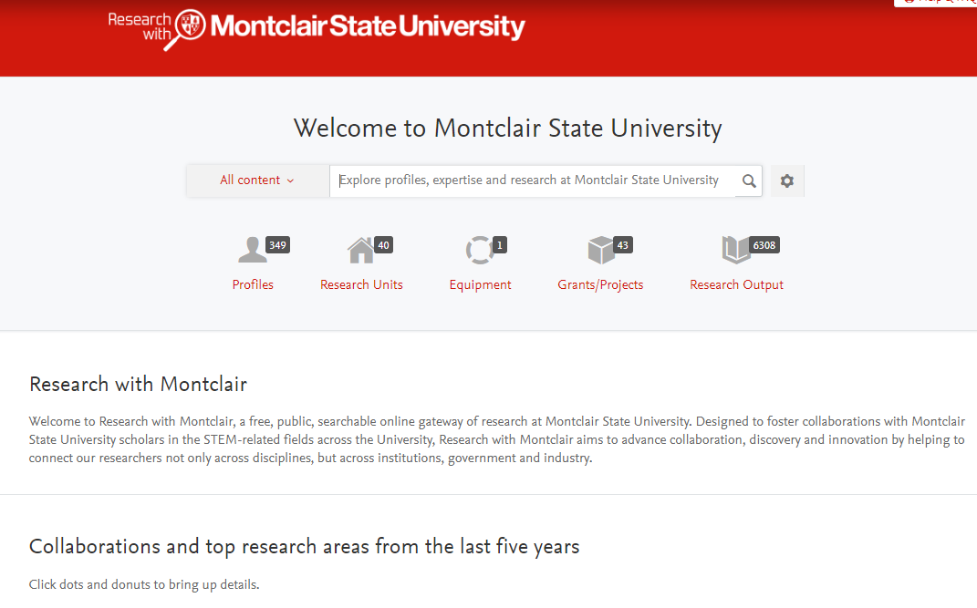
Research with Montclair

Slide 12
Pure-Digital Commons Beta
Beta for select Pure-Digital Commons joint customers, including Montclair State University, to leverage the strengths of both platforms to further advance the institution’s goals:
Produce a robust system of institutional records by populating Digital Commons with Pure records.
Maximize the visibility of the institution’s output through Digital Commons.
Demonstrate cross-platform interoperability.
Help identify new full-text content and/or metadata records that can be added to IR.
Cut down on duplicative work.
Aligns with Montclair State University’s forthcoming strategic plan (APEX 2025) which emphasizes expanding its research footprint nationally and globally, as well as its scholarly portfolio and reputation.
“Timely and unique opportunity to build our repository with data from a trusted source
and to work with a team who understood how valuable keeping the integrity of the DC
is to us.”

Slide 13
Pure-Digital Commons Beta with Montclair
The Vice Provost for Research is the team lead for Pure.
The Library Internal Repository Committee oversees all Digital Commons initiatives.
Karen Ramsden serves as a lead administrator for Digital Commons and Pure.
  Heard about the beta opportunity at a past conference
  Viewed beta integration between systems as “a natural fit” for collaboration between the two systems.
  Advocated to the Library Internal Repository Committee and Dean of the Library for robustness of data in each system and the benefits of populating Digital Commons with Pure records.
  Library Internal Repository Committee gave input on what they would like to see, voiced concerns and any recommendations.
  Current flow of content is Scopus→ HR verification→ Pure→ Digital Commons.
  Karen Ramsden primary point of contact at Montclair State University for Digital Commons.
  Alignment with bepress Digital Commons Consultant Services and Product to define best workflow to relay back to institution.
Notes:
Consider moving the quotes to the top to highlight (or to new slide 7)

Slide 14
Stakeholders (University)
Key Repository Internal Stakeholders
Key Pure Internal Stakeholders
Repository Internal Library Committee
Faculty
University Leadership
Research Offices
Administrative Divisions
Library
Colleges and Schools
Vice Provost for Research
Faculty
University Leadership
Development Team (alumni, fundraisers)
Research Offices
Library
Marketing and Communications
Colleges and Schools
Notes:
Karen – Your new slide is represented. Thank you!

Slide 15
Platform Communication
Beta workflow between Digital Commons and Montclair included ingestion to Digital Commons demo site for review; select manual metadata edits; refinements with Pure; and then batch uploading to live Montclair repository where content was once again reviewed.
Digital Commons and Pure
Montclair, Digital Commons, and Pure
Digital Commons worked directly with Pure to procure metadata for MSU affiliated content originating in Scopus and represented in Pure.
Pure metadata was mapped to Digital Commons schema.
Digital Commons beta team and Montclair worked directly. Digital Commons team ingested Pure metadata into Montclair repository, producing new records to enhance existing collections.
Ongoing. Planned quarterly ingests for deltas.
Checking against Scopus as source of truth.
Montclair ensured existing communities and structures in DC would be similar in Pure to ease the Pure-Digital Commons integration.
Montclair ensured all departments and/or schools were checked in both platforms and updated accordingly to assist with the data ingestion.
Provided ongoing feedback during beta on metadata integrity content expectations for repository.

Slide 16
Content Transfer
Successes
Challenges
Over 6000 eligible records for inclusion in IR
Moved cautiously with demo site before publishing to live
Able to use existing tools to ingest content at volume
Excellent working relationship with Pure
Excellent development partner relationship with Montclair
Metadata issues
  Author affiliations
  Additional desirable metadata (consistent links to source content, citation data)
  Text formatting
  Dupes
Record review by Montclair anticipated by institution; necessary

Slide 17
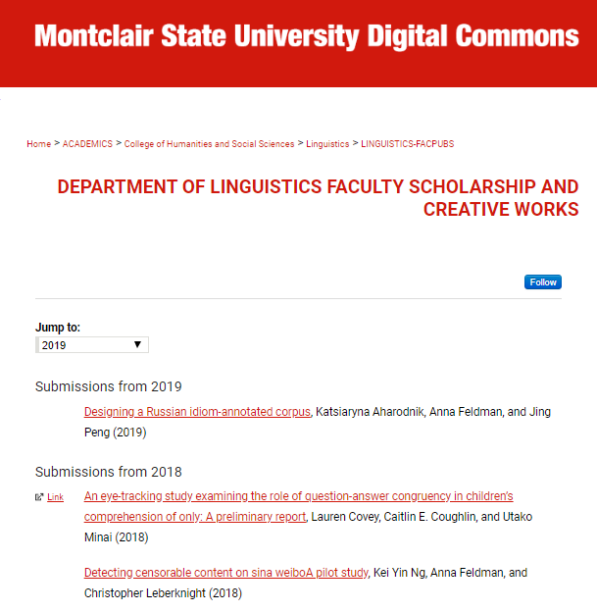
Results
Linguistics collection populated with Pure assets.
Parallel track to ingest remaining content.
Montclair expected results from integration:
  Will help build repository inventory.
  Will archive the research of researchers no longer active with the university and therefore not featured in Research with Montclair.
  Will help fill gaps where structures/dept have no info.
  Will enhance repository performance; expecting surge in views and hits.
Notes:
Consistency of text

Slide 18
Next Steps
Digital Commons Next Steps
Montclair Next Steps
Periodic updates to Montclair repository with deltas on quarterly bases.
Pursuing parallel integration with Pure as part of upcoming Harvesting platform for automated harvesting of Pure content.
Ongoing discovery with Pure-Digital Commons Beta with Montclair and other development partners for optimal integration.
Looking at qualifying data.
Ensuring data integrity/clean up.
Anticipate this happens over time.
Subsequent ingests.
Being able to report out to University Leadership.
Monitoring (Google analytics before and after).
Include information about data ingestion in forthcoming outreach efforts to internal and external stakeholders.

Slide 20
Appendix

Slide 21
Integration Example
Notes:
https://researchwith.montclair.edu/en/persons/longxing-wei
https://researchwith.montclair.edu/en/publications/t-s-eliots-obscurity-in-the-love-song-of-j-alfred-Prufrock
https://www.scopus.com/record/display.uri?eid=2-s2.0-84969951798&origin=inward&txGid=74fa6ffc305337fd4a3d1e18351780f2
https://digitalcommons.montclair.edu/linguistics-facpubs/35/

Slide 22
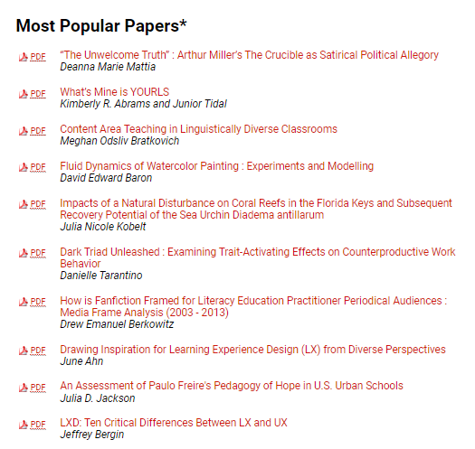
Montclair State University Digital Commons

