Slide 1
My experience with SfD
Justin Robar, BA (St. Thomas), MA (Brock)
PhD student Management/Leadership
jrobar2@uwo.ca

Slide 2
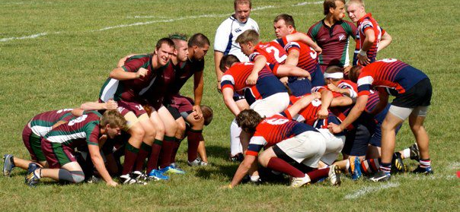
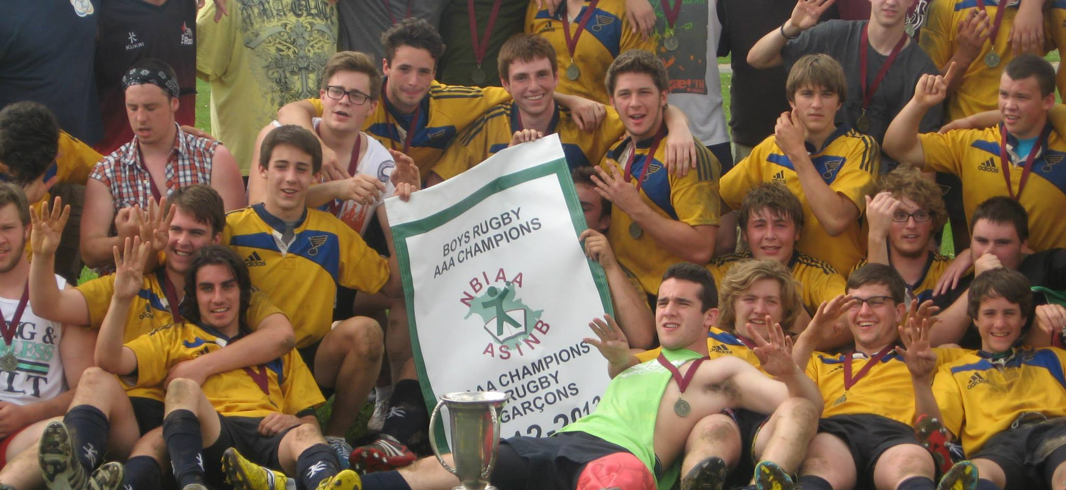
The start of my rugby career and rugby’s impacts on me

Slide 3
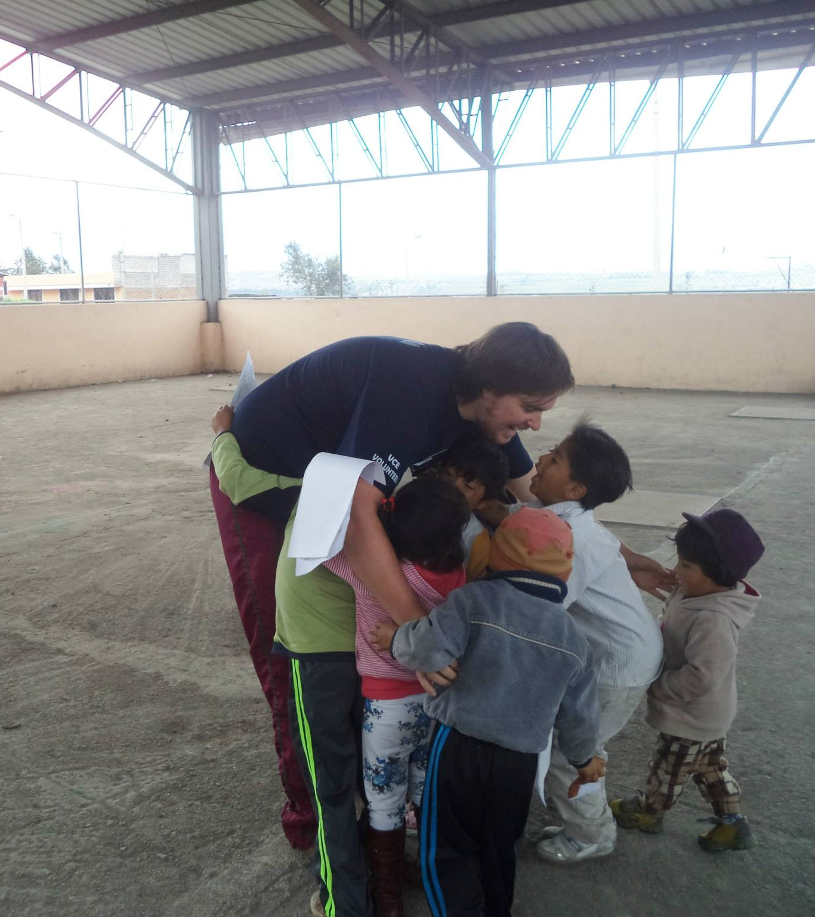
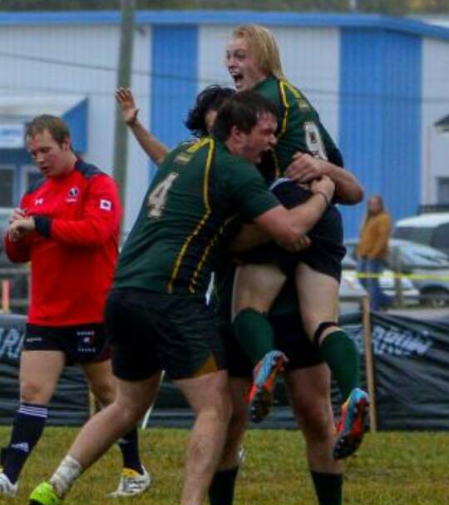
Volunteering internationally for the first time and STU Rugby

Slide 4
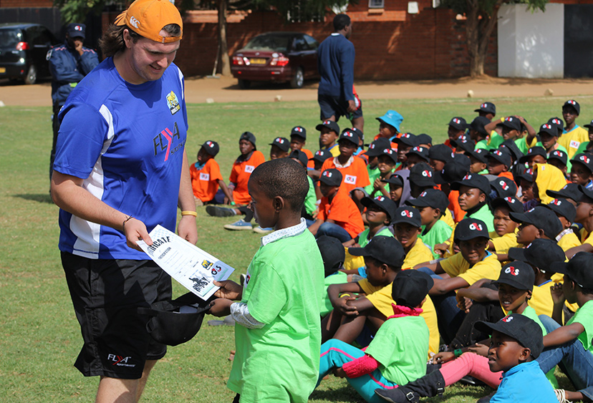
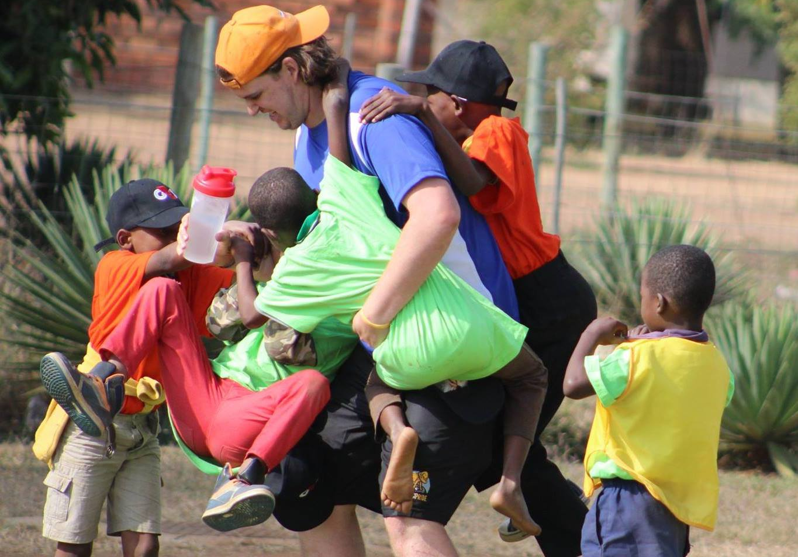
First experience with SfD

Slide 5
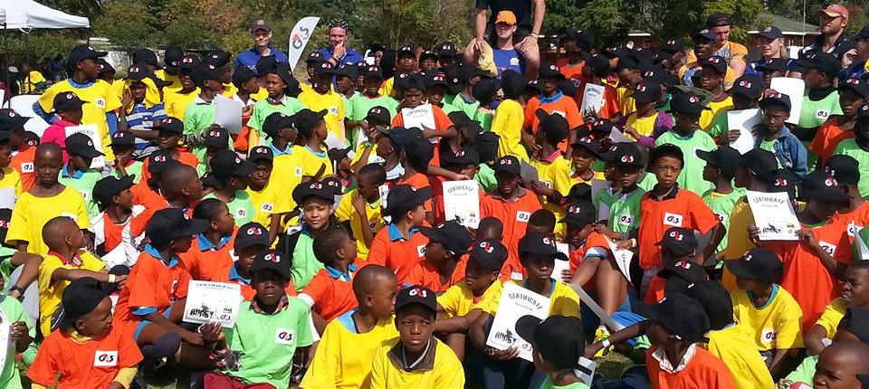
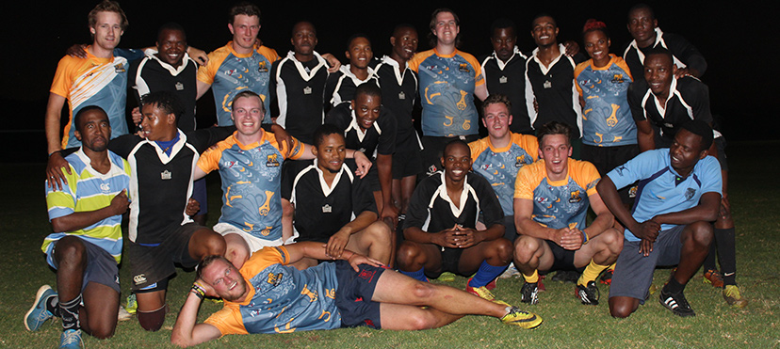
Understanding the issues associated with SfD
Colonialism
Power relations
Income Inequality

Slide 6
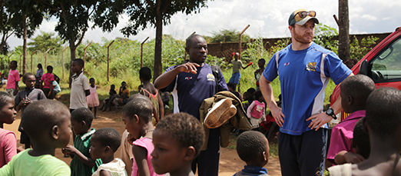
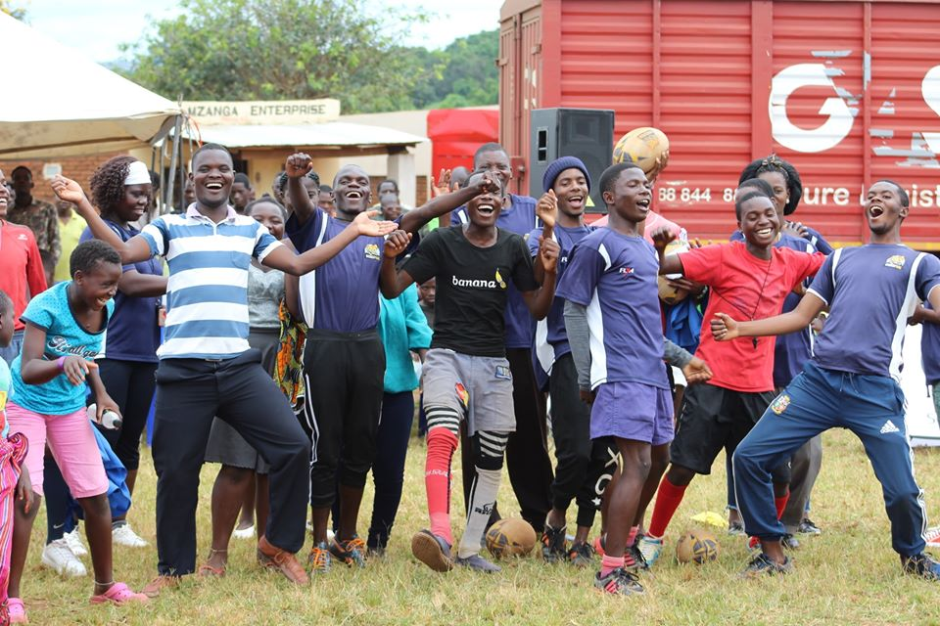
The project
Sport and Education Centre
Video
My research project

Slide 7
Research Questions
What do community members (teachers, parents, former participants) involved in a Sport for Development initiative perceive as the impacts of the program?
How have community members been engaged in the various stages of the SfD development and implementation?
What are the current, and anticipated impacts of the Sport-Education Centre being constructed by the Sport for development organization?

Slide 8
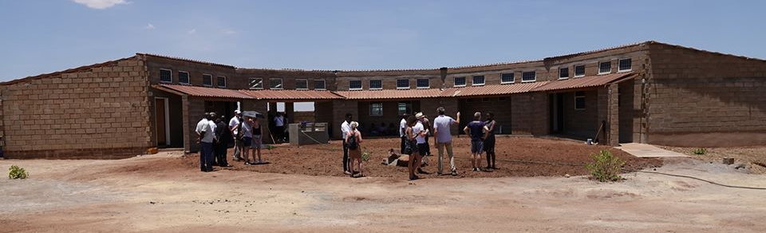
Community Development Through the Centre
  Economic Development
  “I understand the community centre, once it is built it will need workers. Maybe garden tenders’ cleaners, and the like and I expect that they will come from the community yeah. The working people there should come from the community so that the community can benefit.” (Interview, 2019)

Slide 9
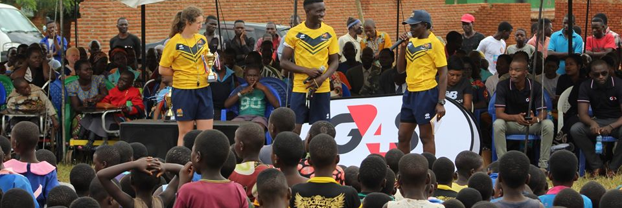
Community Development Through the Centre
  Use by the Community
  “they are going to have fun in everyday life in terms of sports, I think also to have the sports like volleyball and let’s say even football I think we can also involve these different sports in that centre”. (Interview, 2019)

Slide 10
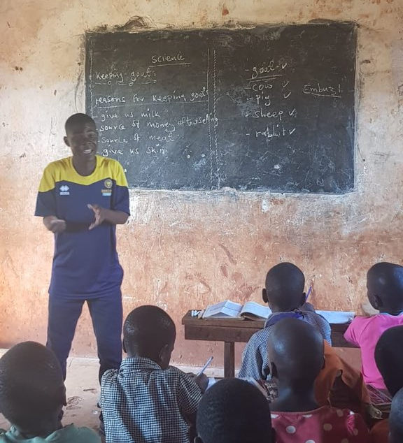
Community Development Through the Centre
  Education Opportunities
  “In the long-term, we’ll be a part of the community, sport will be there, but programs might lead to families learning small-scale farming, or to be a bike mechanic and open up their own shop” (Interview, 2019).

Slide 11
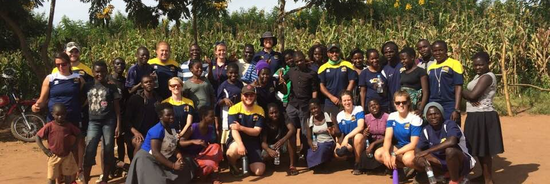
Community Interaction and Engagement
  Community Engagement
  “John was a teacher I spent a lot of time with, he was with me as a buddy coach when I was coaching at his school and therefore, we got to interact daily for two weeks. His story and my time with him is a good example of the engagement and development of buddy coaches within the organization. “

Slide 12
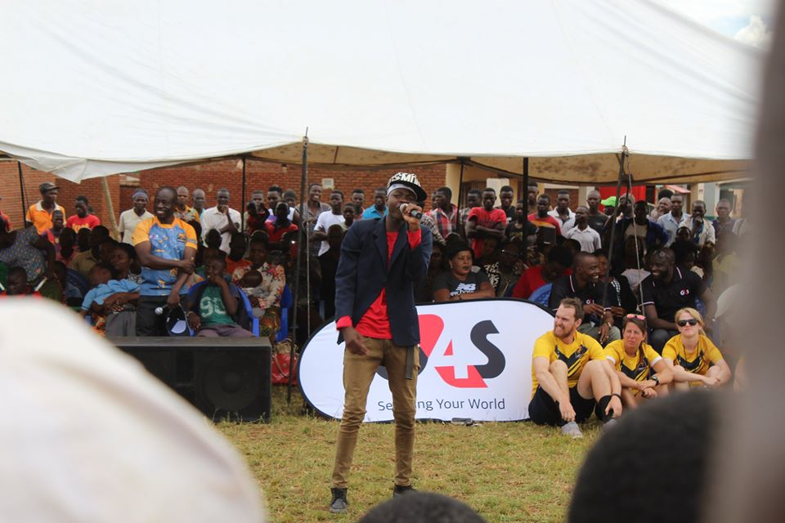
Cultural Exchange
“What do you mean you don’t know how to dance”

Slide 13
Sponsors and Partnerships
“seeing (the sponsor) was feeding everyone with the food they had it was just really great. It felt as though it was a community event and not just our event.” (Interview, 2019)
G4S Video

Slide 14
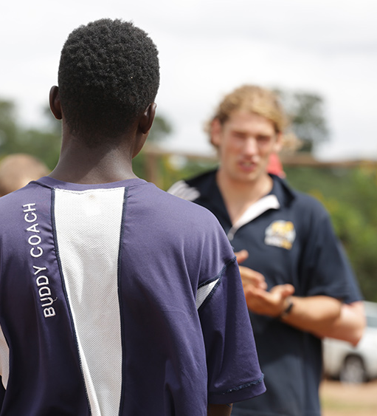
Development of Participants
  Pro-social Development
  So, we talk of conflict resolutions, we talk decision making, we talk building self-esteem and having full confidence, we talk lots of skills that they have to learn so they are able to live in the community better, without any challenges, without some conflict. (Interview, 2019)

Slide 15
Professional Development
We are going to be developing people. We talk a lot about communities, but I think we need to consider the individuals that are involved in this whether it is sporting skills or providing educational input, that will mean people have more of an insight into improving their lives (Interview, 2019)

Slide 16
Positive Environment
Here in (the country) we use a saying which goes like ‘an idol mind is a devil’s workshop’. When someone is just standing there, you can think of them going somewhere and doing a malpractice which can negatively affect his or her health. But because they are busy with sporting activities, rugby as an example they don’t have that time to go around and do some other bad stuff that can negatively affect their lives.

Slide 17
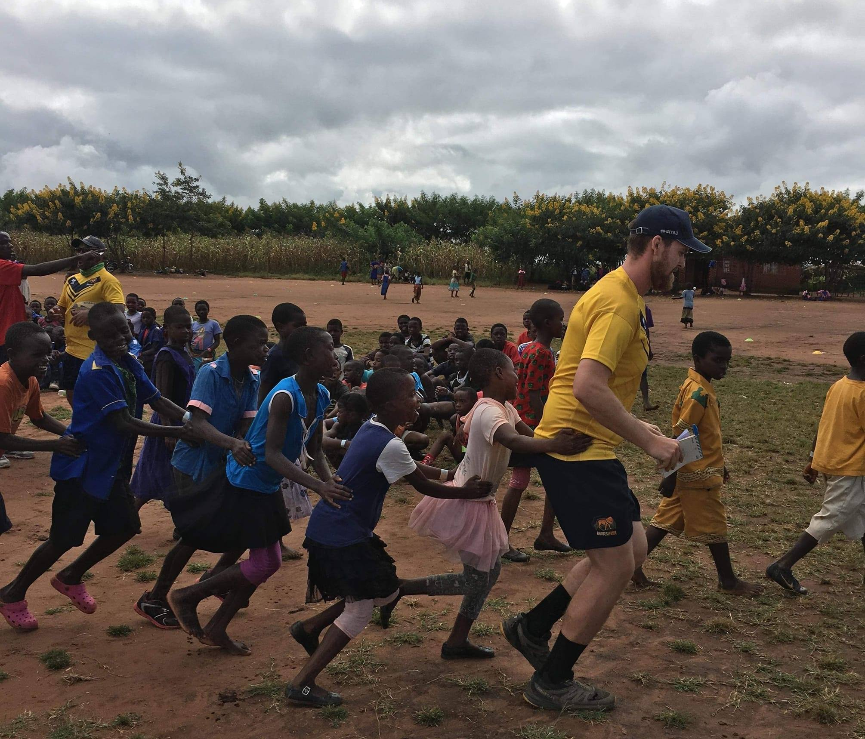
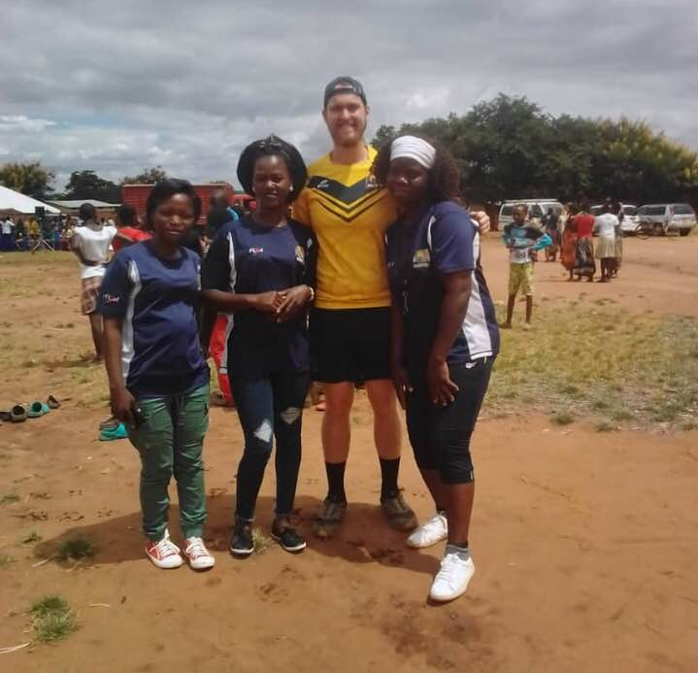
Development of Female Participants
“this is the first country I’ve been to that they will pass to girls first”.

Slide 18
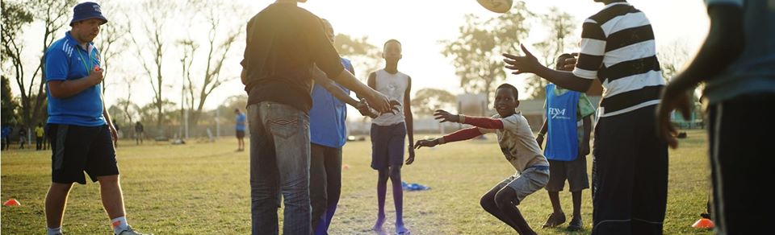
Rugby Development
  High-Performance Rugby Development
  Opportunities for Players

Slide 19
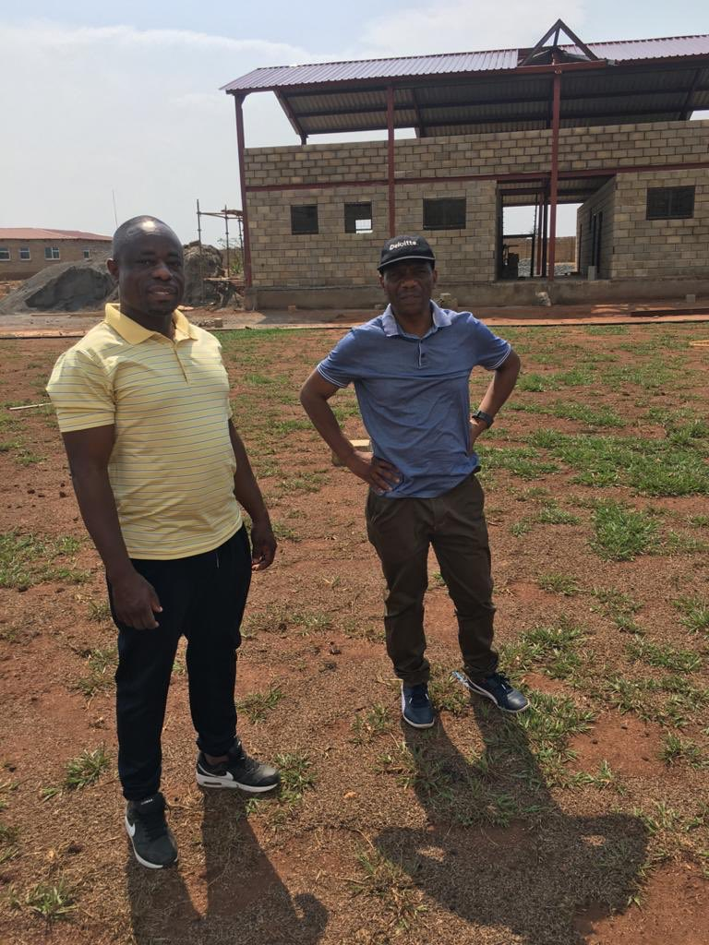
Concluding thoughts
Update on the centre
Education programming

Slide 20
Questions?

