Slide 1

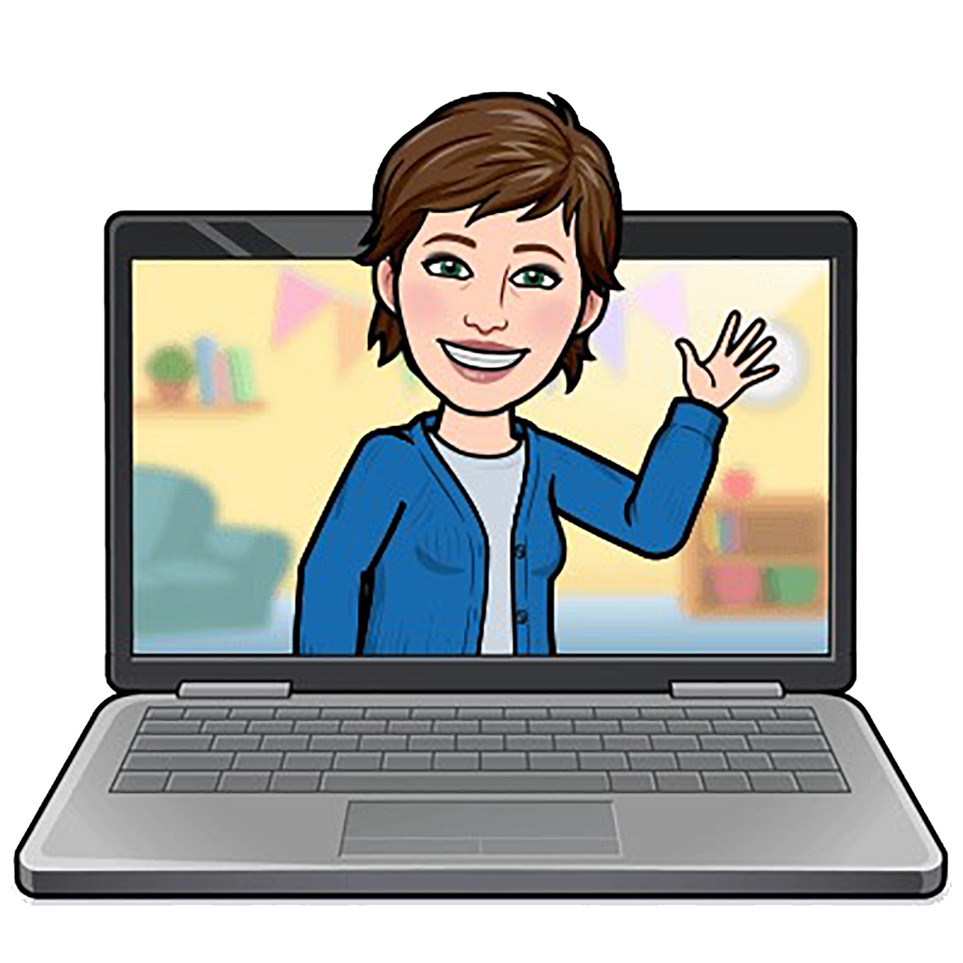

Landing an
academic library job
A look behind the curtain
Missouri Library Association ∙ September 30, 2021
Judy Schmitt
Reference Librarian

Slide 2
TODAY’S AGENDA
About you (and me!)
UMSL’s most recent librarian search
by the numbers
A peek behind the curtain
UMSL’s application evaluation process
Strategies for application success
Examples

Slide 3

About you (and me!)

Slide 4
ABOUT YOU
How long out of library school?
First job or looking for a change?
How is your search going? Any bites?
What do you hope to learn here?

Slide 5

MY OWN SEARCH
I got my library degree in December 2017 and began at UMSL in February 2019.
I had a few things going for me. There were also a few strikes I had to either accept
or overcome, and I was able to leverage a few bits of luck in my cover letter and interviews.
PROS
CONS
SERENDIPITY
Design skills.
No recent library experience.
UMSL’s needs matched
my background.
Highly motivated.
Could not relocate.
Kept options open.
Mid-life brain!
Was non-traditional student.
Excellent written communication skills.
Rusty interview skills.
Used former professor and UMSL librarian as reference.
Ignorance of interview process in academic libraries.

Slide 6
UMSL’s most recent librarian search

Slide 7
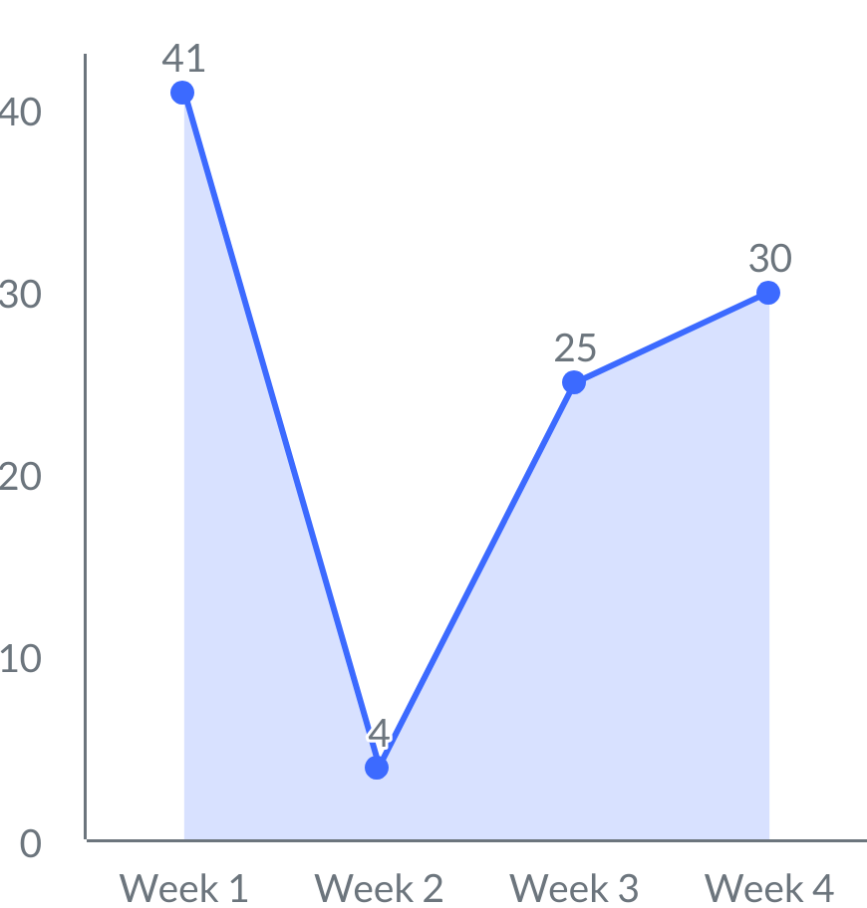
UMSL SEARCH TIMELINE
Our search was accelerated so that we’d have someone
in place at the beginning of the Fall 2021 semester.
LESS THAN 3 MONTHS FROM START TO FINISH
OUR TIMELINE
17–20
APPLICATIONS RECEIVED April 19 through May 14
31
HR diversity review
Search committee formed
14
Job closed
8–17
Zoom interviews
MARCH
APRIL
MAY
JUNE
Applications received
21
12
Offer made
19
HR diversity meeting
1
Job posted
24–28
HR approval
Phone interviews

Slide 8
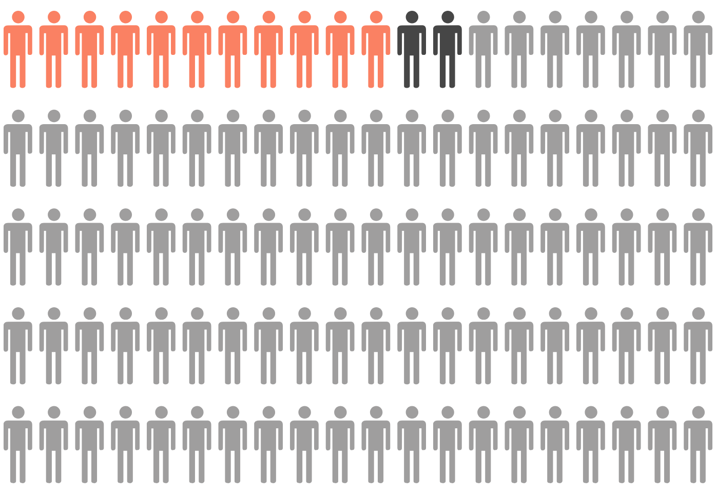
UMSL SEARCH APPLICANTS
Due to COVID, no university-sponsored travel was permitted.
Final interviews took place via Zoom and lasted about 4.5 hrs (including breaks).
THE CHOSEN FEW
APPLICATIONS
100
+ 1 submission error
PHONE INTERVIEWS
11
(2 declined, so we interviewed 2 alternates)
ZOOM INTERVIEWS
4
= 1 person = 1%

Slide 9
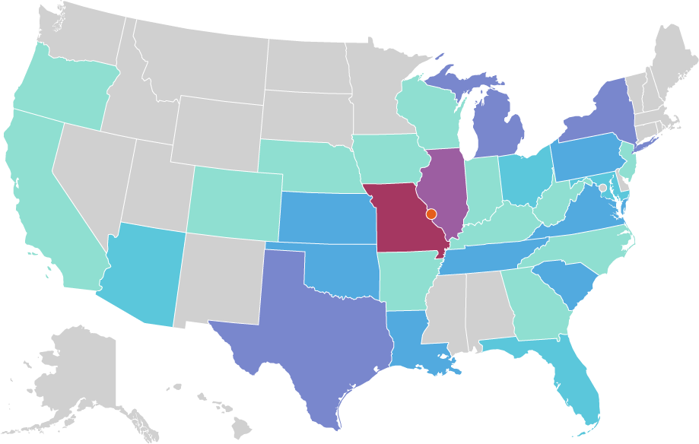
UMSL SEARCH GEOGRAPHY
Applications originated in 29 states. Missouri was heavily represented with a total
of 39 job seekers, and 28 of those applicants lived within 25 miles of UMSL.
WHERE’D THEY ALL COME FROM?
28 applicants
11 applicants
7 applicants
4 applicants
3 applicants
2 applicants
1 applicant
0 applicants

Slide 10
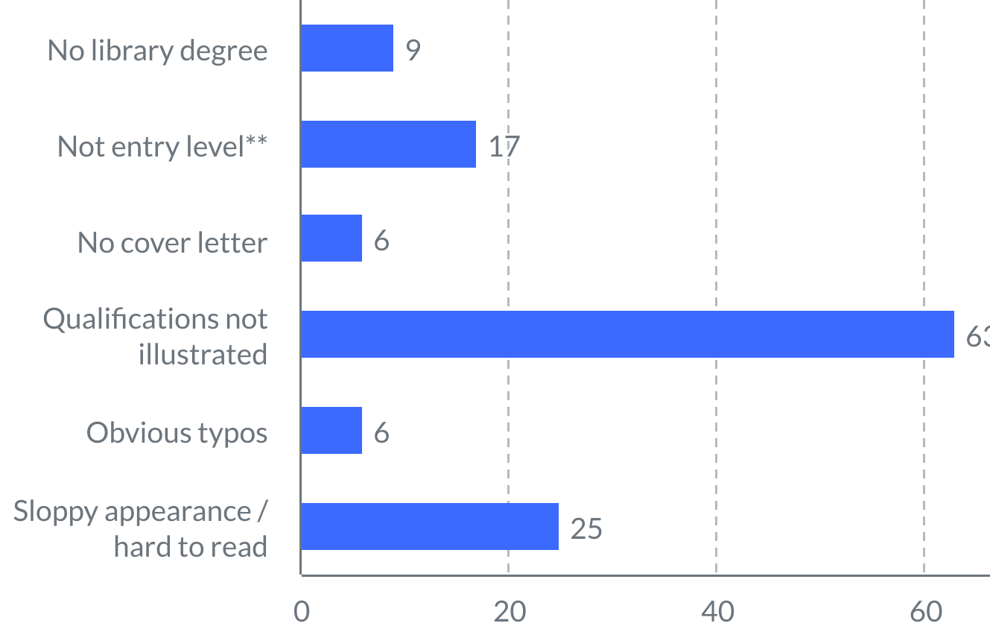

UMSL SEARCH REJECTIONS
With 100 applications, we could afford to be fairly ruthless with our exclusion criteria.
Here are the most common reasons for elimination.
THE “NO” PILE *
NO LIBRARY DEGREE at time of hire
9%
Automatic disqualifier
NOT ENTRY LEVEL
17%
NO COVER LETTER
6%
QUALIFICATIONS NOT ILLUSTRATED
63%
OBVIOUS TYPOS
6%
SLOPPY APPEARANCE/HARD TO READ
*Many applications had more than one issue.
**Degree more than 5 years old.
25%

Slide 11
A peek behind the curtain:
the search process at UMSL

Slide 12
SEARCH STAKEHOLDERS
Library Search Committee
Creates and circulates job announcement • Reviews applications
• Selects top candidates (with justification for HR) • Formulates interview questions • Interviews applicants • Checks references
• Recommends final candidates to Dean and HR
Library Dean
Approves search • Meets with final candidates • Calls chosen
candidate to extend offer • Submits offer letter (contract)
to candidate for signature/formal acceptance
Human Resources and ODEI
Meets with committee to inform about inclusive hiring practices
• Certifies candidate pool to ensure diversity in ethnicity, gender, disability, and veteran status • Completes on-boarding process

Slide 13
RECRUITMENT STRATEGY
The search committee must submit to HR a document outlining
where the position announcement will be posted.
•
American Library Association (ALA) JobList and affiliated caucuses
•
•
•
•
•
•
Black Caucus of the American Library Association
Chinese American Library Association
Asian/Pacific American Library Association
American Indian Library Association
REFORMA
Middle East Librarians Association
•
LIBJOBS (International Federation of Library Associations)
•
Missouri Library Association (MLA)
•
St. Louis Regional Library Network (SLRLN)
•
University of Missouri School of Information Science and Learning Technologies (to reach alumni from SISLT)
•
University of Illinois’ iSchool: School of Information Sciences (to reach alumni from U of I)
•
UMSL Libraries’ home page
•
UMSL’s career postings site

Slide 14
JOB QUALIFICATIONS
The job ad lists all of the required and preferred candidate qualifications,
as well as the major responsibilities for the position being filled.
Required qualifications:
•
Master of Library Science degree from an ALA-accredited institution at the time of appointment
Excellent oral and written communication skills
Knowledge of emerging trends in academic libraries
Ability to work well with diverse populations
Familiarity with academic research resources and tools
Ability to work independently and collaboratively
•
•
•
•
•
Preferred qualifications:
•
Experience in an academic library
Coursework, research, or occupational experience in Education
•
Responsibilities:
•
Provide research assistance to students, faculty, and staff through research consultations, library instruction sessions, and other means
Complete assigned reference shifts in-person and/or online through chat
Select library resources, prepare research guides, and liaise with the College of Education and other academic departments in assigned subject areas
Participate in promoting the Library’s services through campus outreach efforts
Assist in the Library’s record management activities and initiatives
Take part in other departmental activities and serve on internal and external committees
•
•
•
•
•

Slide 15
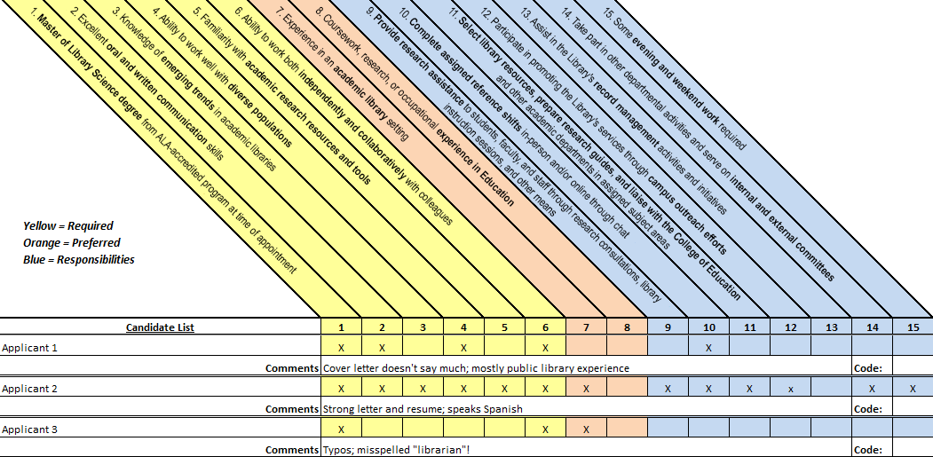
APPLICATION EVALUATION
At UMSL, we use a grid to see which qualifications each applicant
possesses and to record our comments.

Slide 16
Strategies for application success

Slide 17
GETTING THROUGH THE DOOR
Our search committee noticed many things that applicants could have done better.
Here are some recommendations to help your application move to the Yes pile.
COVER LETTER
RESUME OR CV
SUBMISSION
Customize for each position.
Which? Pay attention to ad.
Send all requested documents.
Address each qualification.
Tailor objective statement.
Explain if “overqualified,” but don’t point out shortcomings.
For entry level,
education near top.
Descriptive filenames.
Transcript only if requested.
Showcase communication skills, employer research.
Reverse chronological order.
Proofread. And then
proofread again!
Relevant experience.
Don’t use current job
logo or stationery.
Bullets are easier to digest.
Don’t miss deadline.
Proofread!
Proofread!

Slide 18
MY LETTER
Here’s how the cover letter for my current position
mapped to the items on the job announcement.
MY LETTER
PART OF JOB ANNOUNCEMENT
I am writing to express my strong interest in the position of Reference Librarian I at University of Missouri–St. Louis. As a recent MLIS graduate
with experience in an academic library setting and a background in the health sciences publishing industry, I am eager to share my skills with UMSL.
I obtained my MLIS in December 2017 after completing a library internship at Fontbonne University. At Fontbonne, I interacted with the library’s diverse student population and helped them discern and fulfill their information and technology needs. I also gained familiarity with the library’s print and electronic research tools—including databases, LibGuides, and other resource materials—and collaborated with the reference librarians to provide instruction. Since obtaining my degree, I have attended multiple webinars and conference sessions related to public service, reference, and academic librarianship in an effort to learn about emerging trends.
Required qualifications
1
2
3
4
5
6
Library degree
Oral & written communication
Emerging trends
Diverse populations
Academic resources and tools
Independent/collaborative
2
1
1
2
4
Preferred qualifications
1
Background in health sciences or sciences
1
Academic library experience
2
5
2
3
Responsibilities
6
1
2
3
Research assistance, instruction
Shifts at Public Service Desk
1
3
Select resources, prepare guides, liaise with academic departments
Serve on committees
4

Slide 19
BUT WAIT, THERE'S MORE!
I threw in everything I could to make myself a more valuable candidate.
MY LETTER, continued
PART OF JOB ANNOUNCEMENT
Before obtaining my MLIS, I worked in the publishing industry—first as an editorial assistant and later as a layout professional—composing health sciences textbooks for Elsevier and chemistry and biology textbooks for Cengage Learning. As a senior compositor at Graphic World, I instructed coworkers, both individually and in group sessions, in the use of advanced software features. More recently, my work as a self-employed graphic designer has strengthened my independent judgment, communication, and collaboration skills. Furthermore, my active participation in professional and social organizations has fostered a deep commitment to service, and this volunteer work—in addition to my past employment as a bookseller—has provided multiple opportunities to engage with diverse populations.
Required qualifications
2
1
1
2
3
4
5
6
Library degree
Oral & written communication
Emerging trends
Diverse populations
Academic resources and tools
Independent/collaborative
1
6
2
Preferred qualifications
1
Background in health sciences or sciences
6
Academic library experience
4
2
Responsibilities
4
1
2
3
Research assistance, instruction
Shifts at Public Service Desk
Select resources, prepare guides, liaise with academic departments
Serve on committees
Included to improve marketability
4

Slide 20
ACING THE INTERVIEWS
Once you’ve wowed the committee on paper,
it’s time to look ahead to the interviews.
PHONE INTERVIEW
CAMPUS VISIT
Take the call in a quiet, comfortable spot.
Be prepared for a long day!
People really can hear a smile.
Perfect your handshake, remember to smile.
Nerves are expected.
Review the job description and your
application beforehand.
Consider working up an elevator pitch.
Be prepared to answer questions about
required and preferred qualifications.
Take notes.
Rehearse your presentation; anticipate questions.
If necessary, take a moment to
collect your thoughts.
Try to appear confident, even if you’re not.
Project your voice, modulate your tone/pitch.
Come up with a few questions for the committee.
Reach out to references before committee does.
Send thank-you note(s).
Send thank-you note(s).

Slide 21
OFFER THANKS
The job of job-seeking doesn’t end with the interview! A thank-you note tells the search committee you remain interested after learning more about the position. And it’s good manners!
AFTER PHONE INTERVIEW
AFTER CAMPUS VISIT
I enjoyed speaking with you yesterday about the Reference Librarian I position at UMSL. The job seems to be an excellent match for my skills and interests.
I would enjoy many aspects of the position, including participating in departmental activities and serving on committees. I truly feel volunteerism is a great way to benefit an organization, and it’s also one of the best ways to learn and grow as a person and make a measurable difference in the community. In the past, I’ve served as a Meetup organizer (two years in two different groups), as newsletter editor and president (two years each) of a local writers’ group, as a summer intern at the St. Louis Psychiatric Rehabilitation Center, and as the Program Chair for the 2018 MLA Conference.
Thank you so much for your time and consideration. I am very interested in working with you and hope to have an opportunity to meet with you in person.
Thank you so much for your warm welcome yesterday and for taking the time to meet with me. I really enjoyed speaking with the Search Committee about the Reference Librarian I position, learning more about UMSL and the work environment in the library, and meeting the rest of the staff after my presentation. I also appreciated the meals! Lunch at Maggiano’s was a real treat; my second pasta dish was even better than the first!
I’m truly excited by the possibility of working with you and your colleagues. Yesterday’s meeting reinforced my confidence that my skills and personality would allow me to excel in the position, and it’s a challenge I’d be thrilled to take on.
Thank you again, and I look forward to hearing from you in a few weeks. In the meantime, enjoy your holiday preparations and please don’t hesitate to contact me if you have any questions.
I enjoyed speaking with you yesterday about the Reference Librarian I position at UMSL. The job seems to be an excellent match for my skills and interests.
I would enjoy many aspects of the position, including creating and refining LibGuides. During my practicum at Fontbonne, I worked on several LibGuides and printed information literacy handouts. I know it can be a challenge to provide a summary of relevant resources that won’t overwhelm the reader with too much information. (By the way, I looked at your Social Work LibGuide and really like the way you broke down how to define topics and search for articles.)
Thank you so much for your time and consideration. I am very interested in working with you and hope to have an opportunity to meet with you in person.
Thank you so much for your warm welcome yesterday and at Zia’s the night before. I really enjoyed speaking with the Search Committee about the Reference Librarian I position and presenting to the staff. I also appreciated the tour! I know you didn’t plan it, but I liked getting a look at your Canvas site and video tutorial. Your enthusiasm for your job is contagious!
I’m truly excited by the possibility of working with you and your colleagues. Yesterday’s meeting reinforced my confidence that my skills and personality would allow me to excel in the position, and it’s a challenge I’d be thrilled to take on.
Thank you again, and I look forward to hearing from Lindsay in a few weeks. In the meantime, please don’t hesitate to contact me if you have any questions.

Slide 22
APPEARANCE MATTERS
Appearance is important, but that doesn’t mean your documents should be
flashy or extremely stylized. Keep the spotlight on you!
Keep it simple
Clean, easy to read, consistent font(s)
Create a “brand”
Harmony, consistency, psychology of color
Use templates
Good design, minimal effort

Slide 23
DESIGN TEMPLATES
These templates are often pretty showy, so you may need to pare them down.
Remember, the focus should be on your accomplishments, not the design of your documents.
WEBSITE
DESIGNED FOR
BEST FEATURES
TEMPLATE CATEGORIES
Canva
Image-heavy creations and social media
Lots of assets (esp. images)
Excellent for social media
Many tutorials
Resumes
Letterheads, letters
Presentations
Social media
canva.com
Piktochart
Business communication and collaboration
Lots of icons
Easy-to-build infographics
Great support
Reports (incl. resumes)
Presentations
Social media
piktochart.com
Venngage
Marketing and external communication
Infographics
Cartoon avatars (Premium)
Resumes
Cover letters
Presentations
Social media
venngage.com
Flipsnack
Catalog publishing
Digital flipbooks
Analytics
CV & Resumes
Letterheads
flipsnack.com

Slide 24
Examples

Slide 25

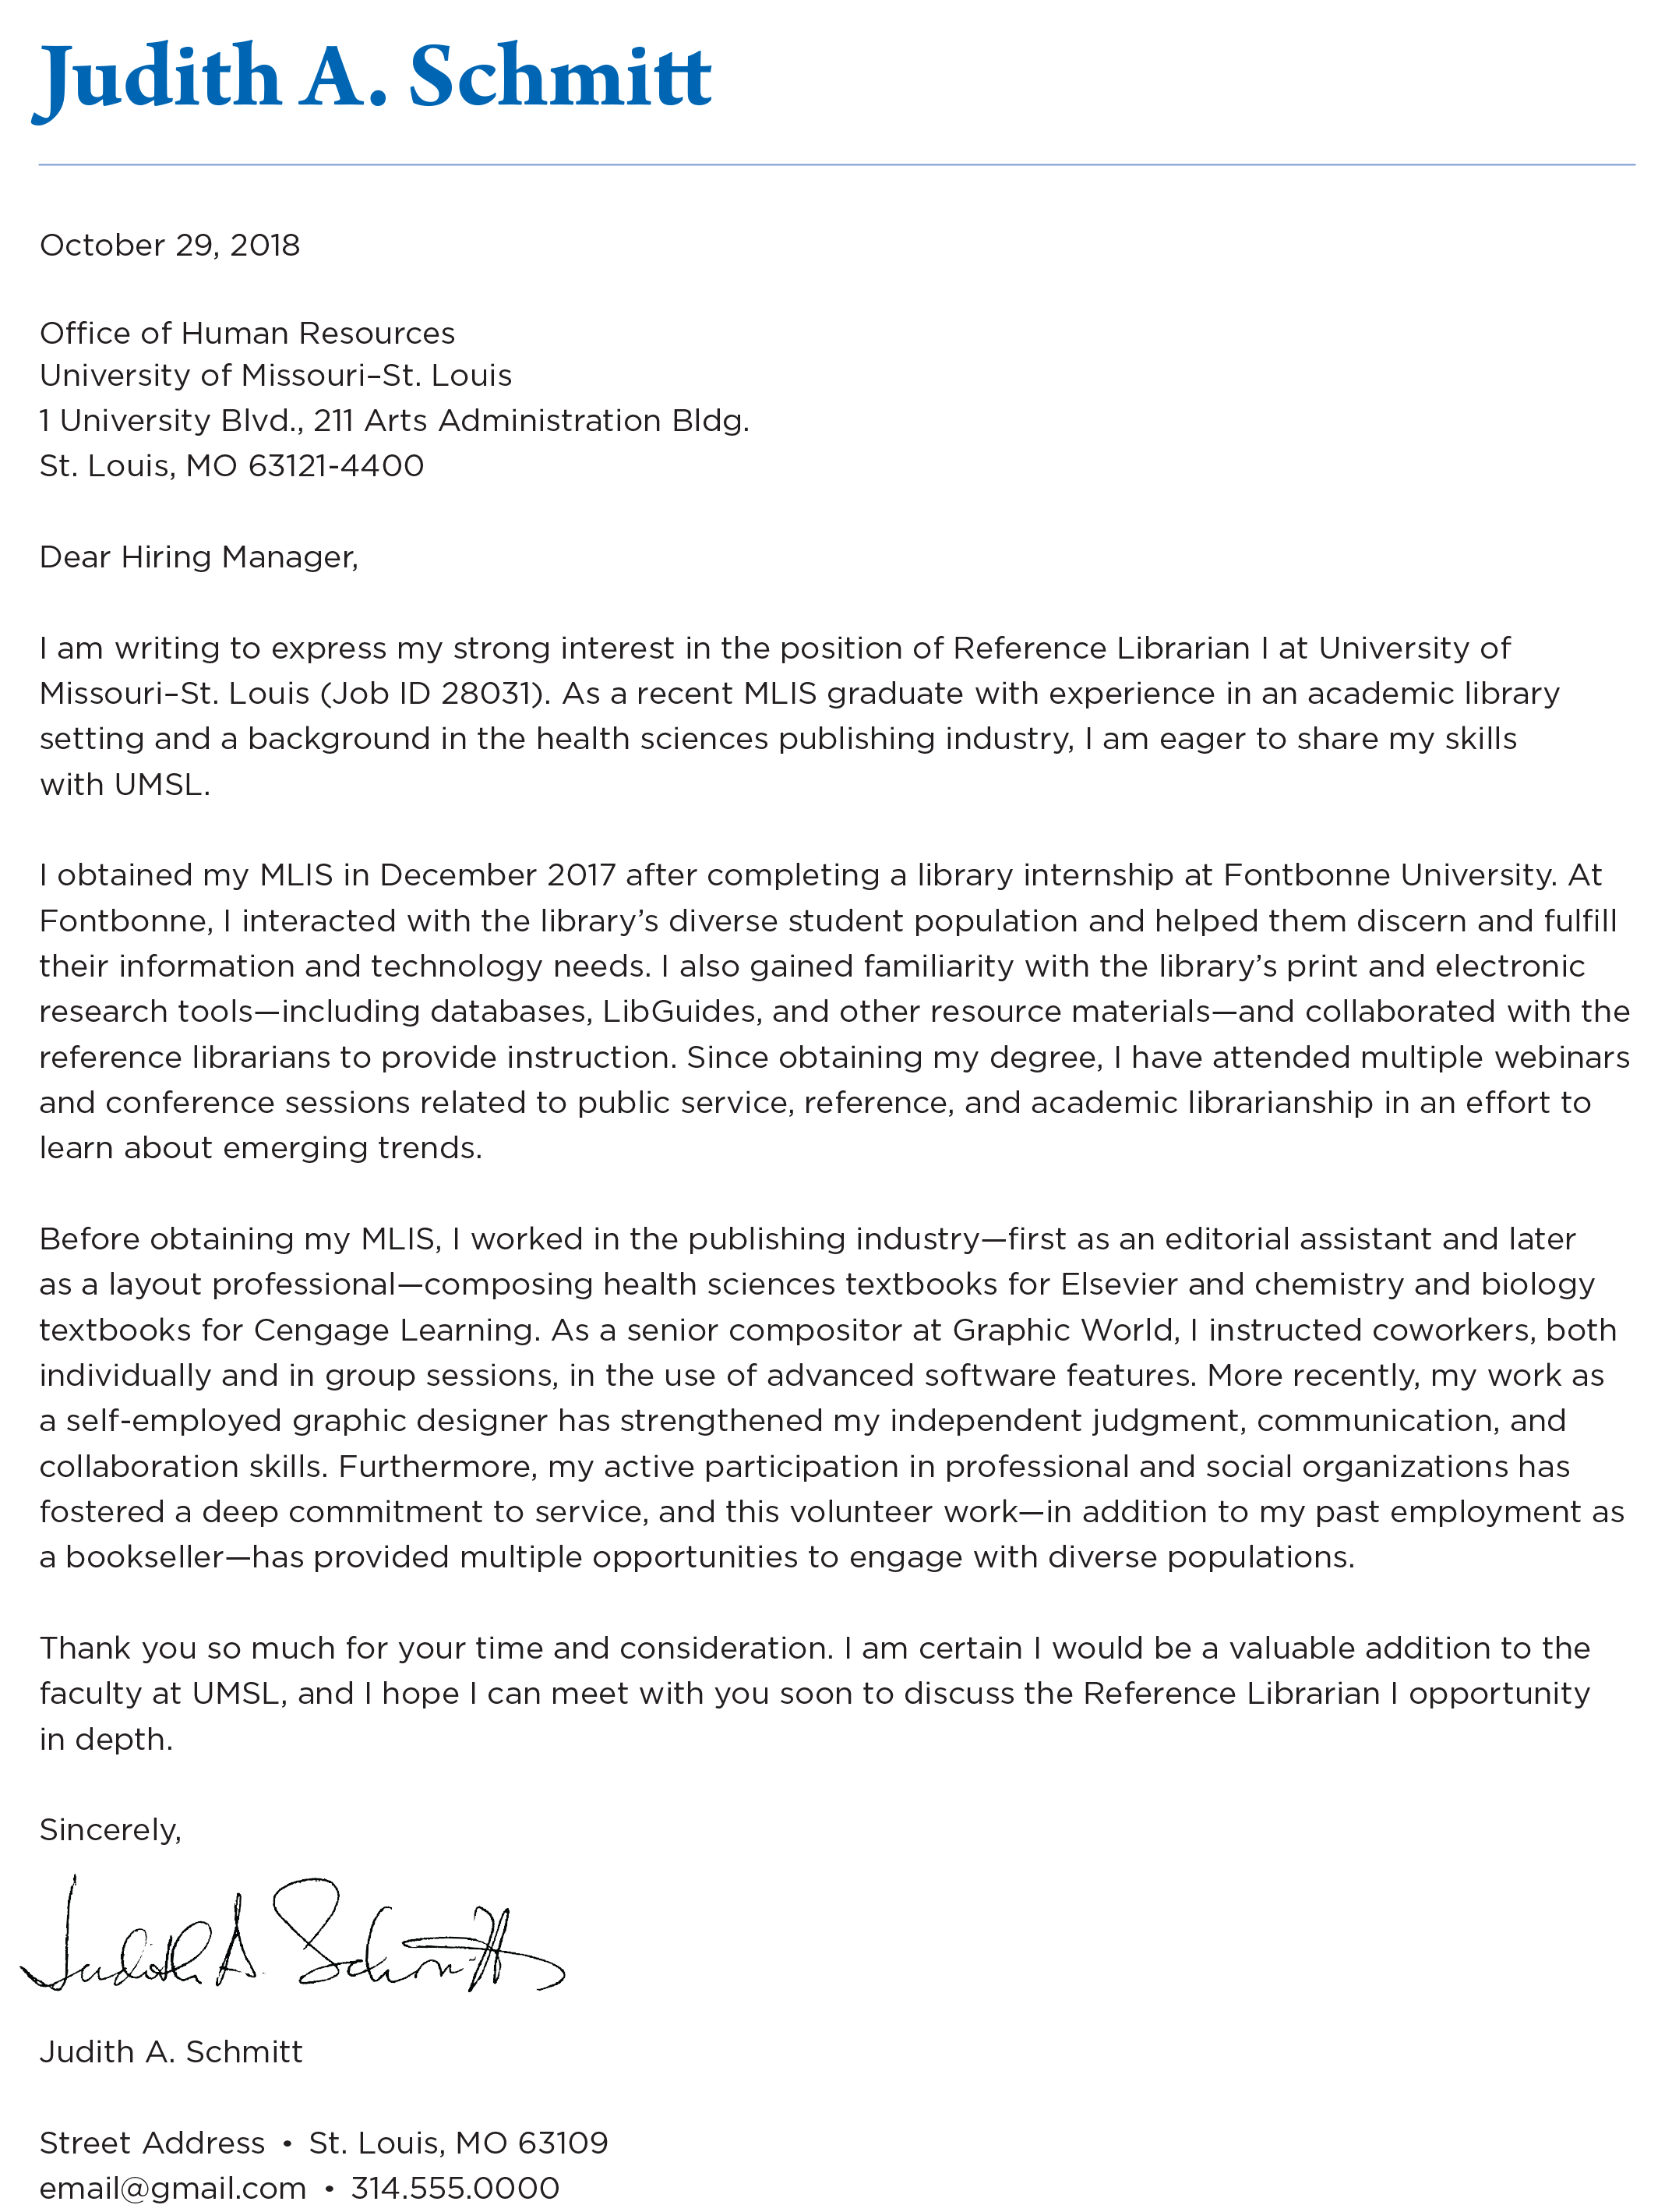
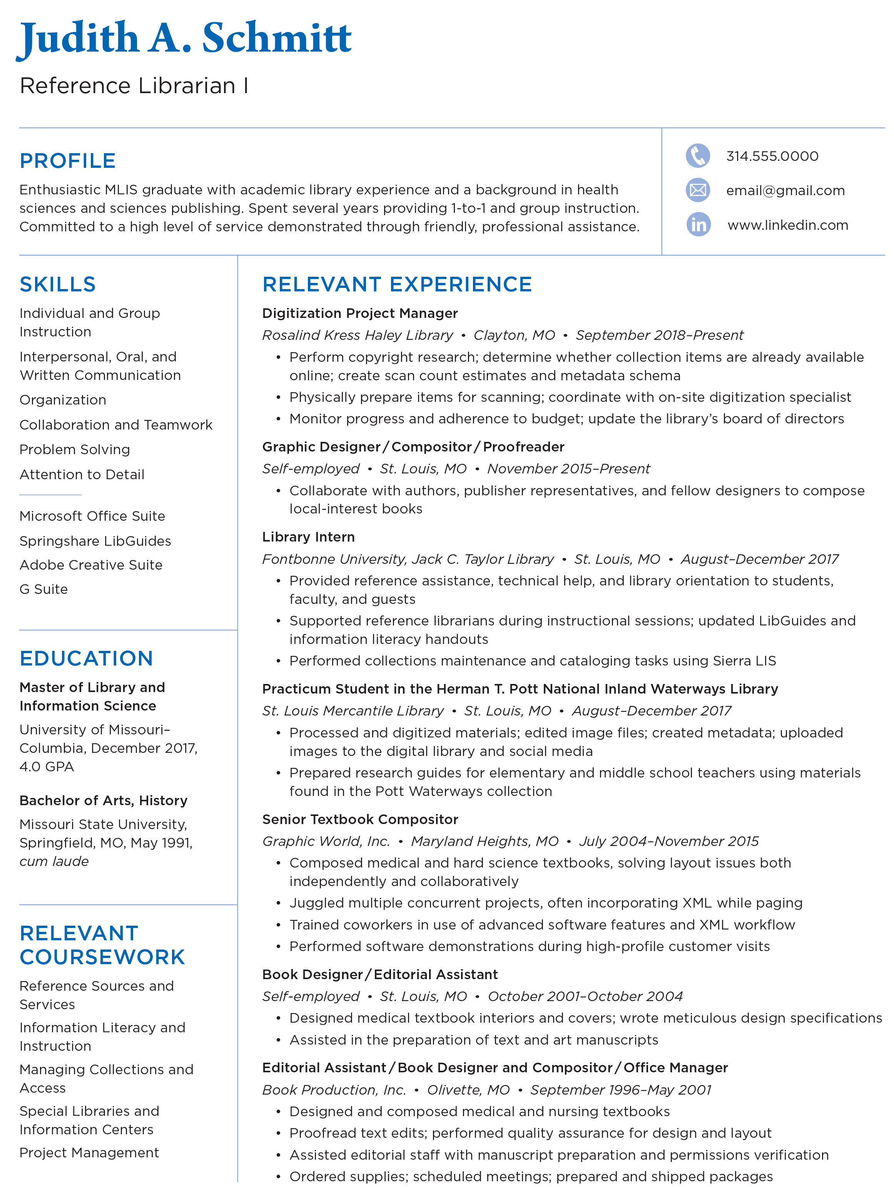
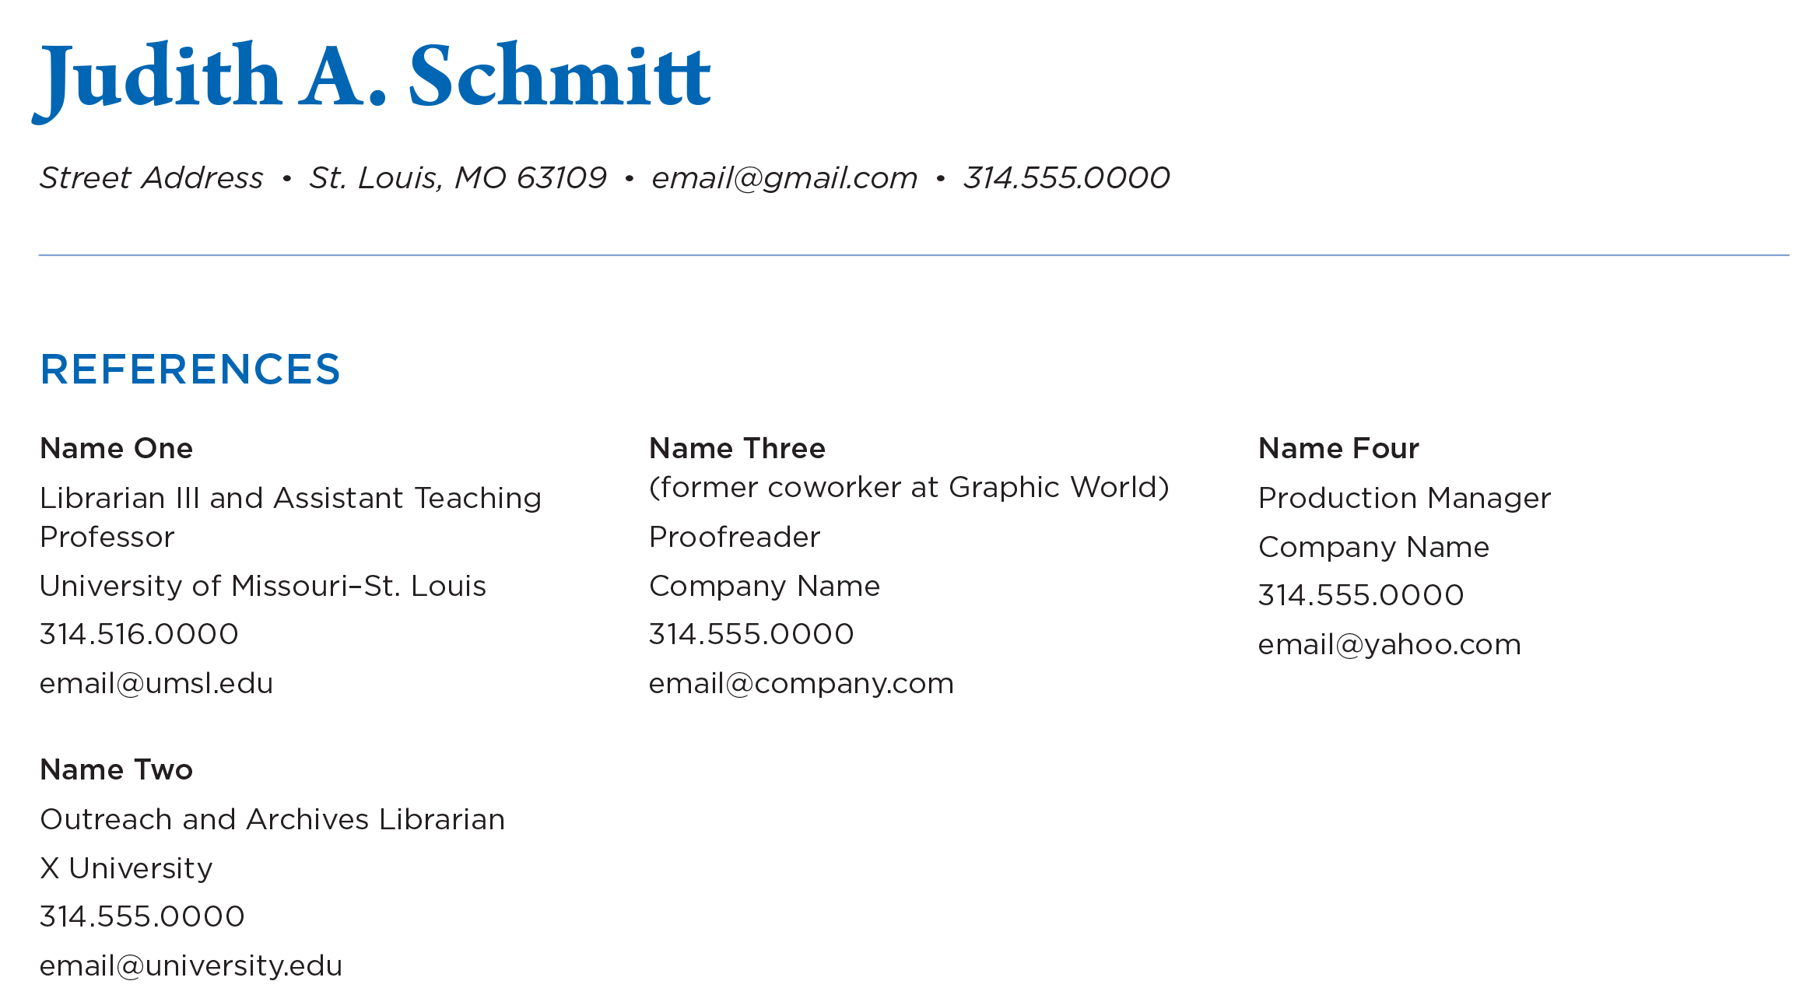
MY BRAND
All of my documents—cover letter, resume, and reference list—had a similar look.
I chose blue because it suggests wisdom, competence, and serenity.
COVER LETTER
RESUME
REFERENCE LIST

Slide 26
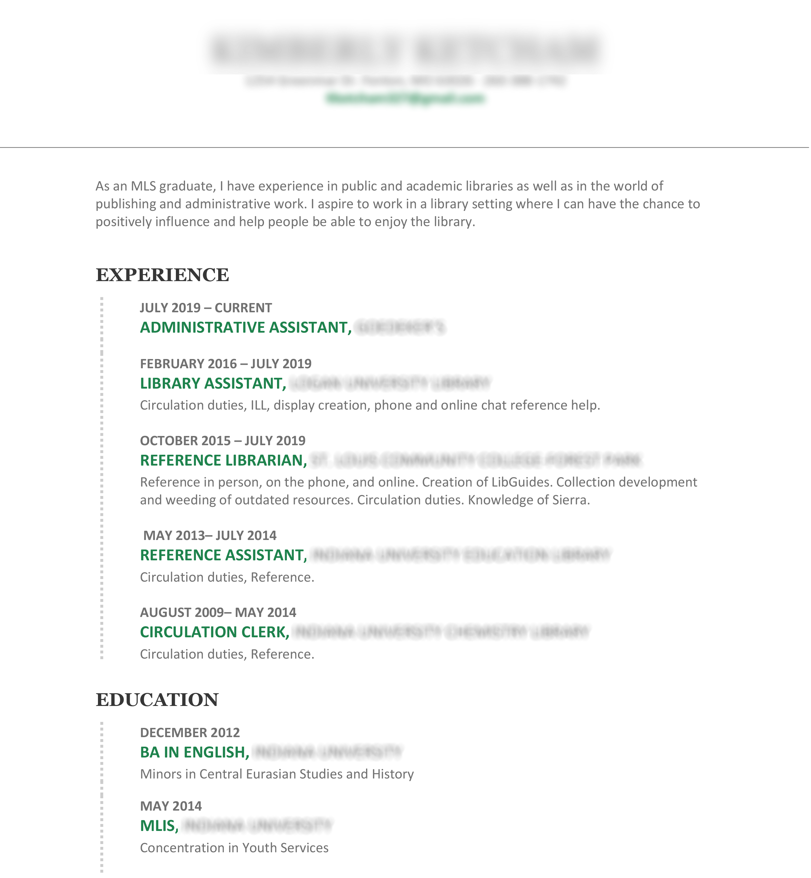
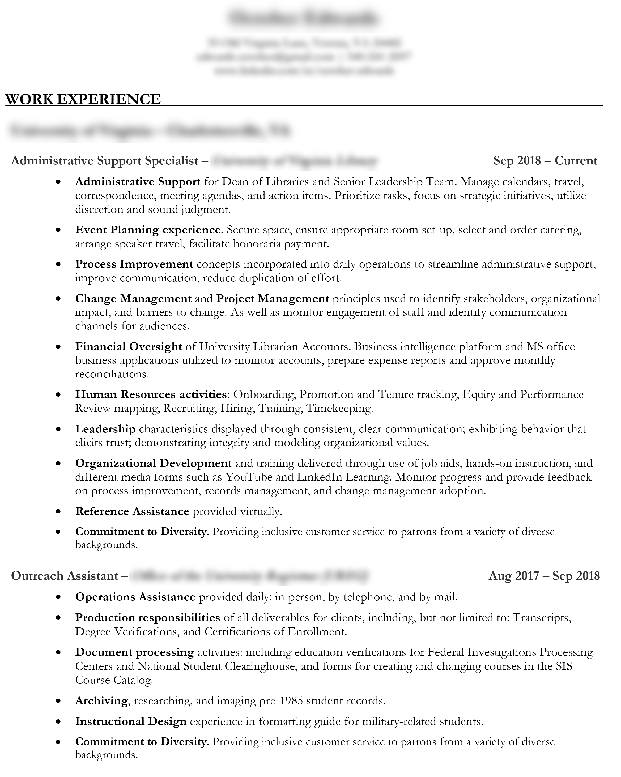
EASY ON THE EYES
Here are a couple of examples of simple, nice-looking resumes.
They both exceeded one page, but that didn’t bother us.

Slide 27
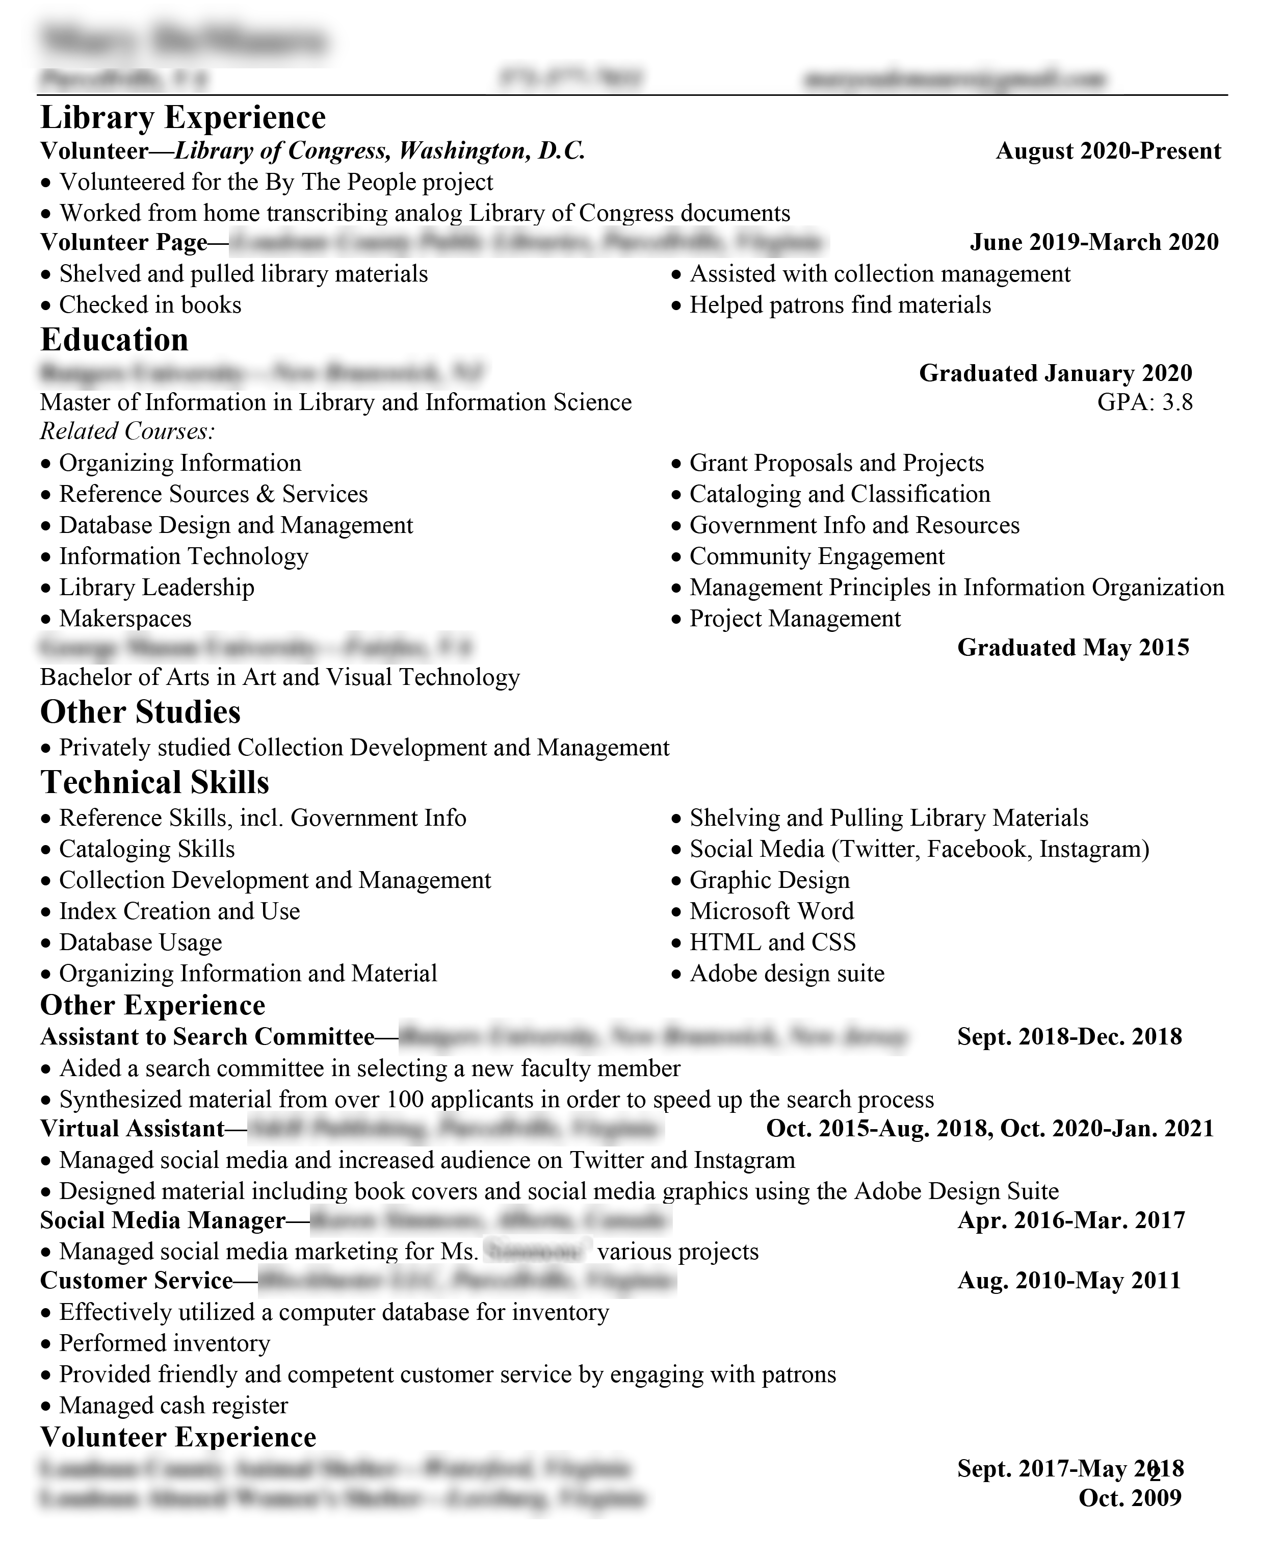
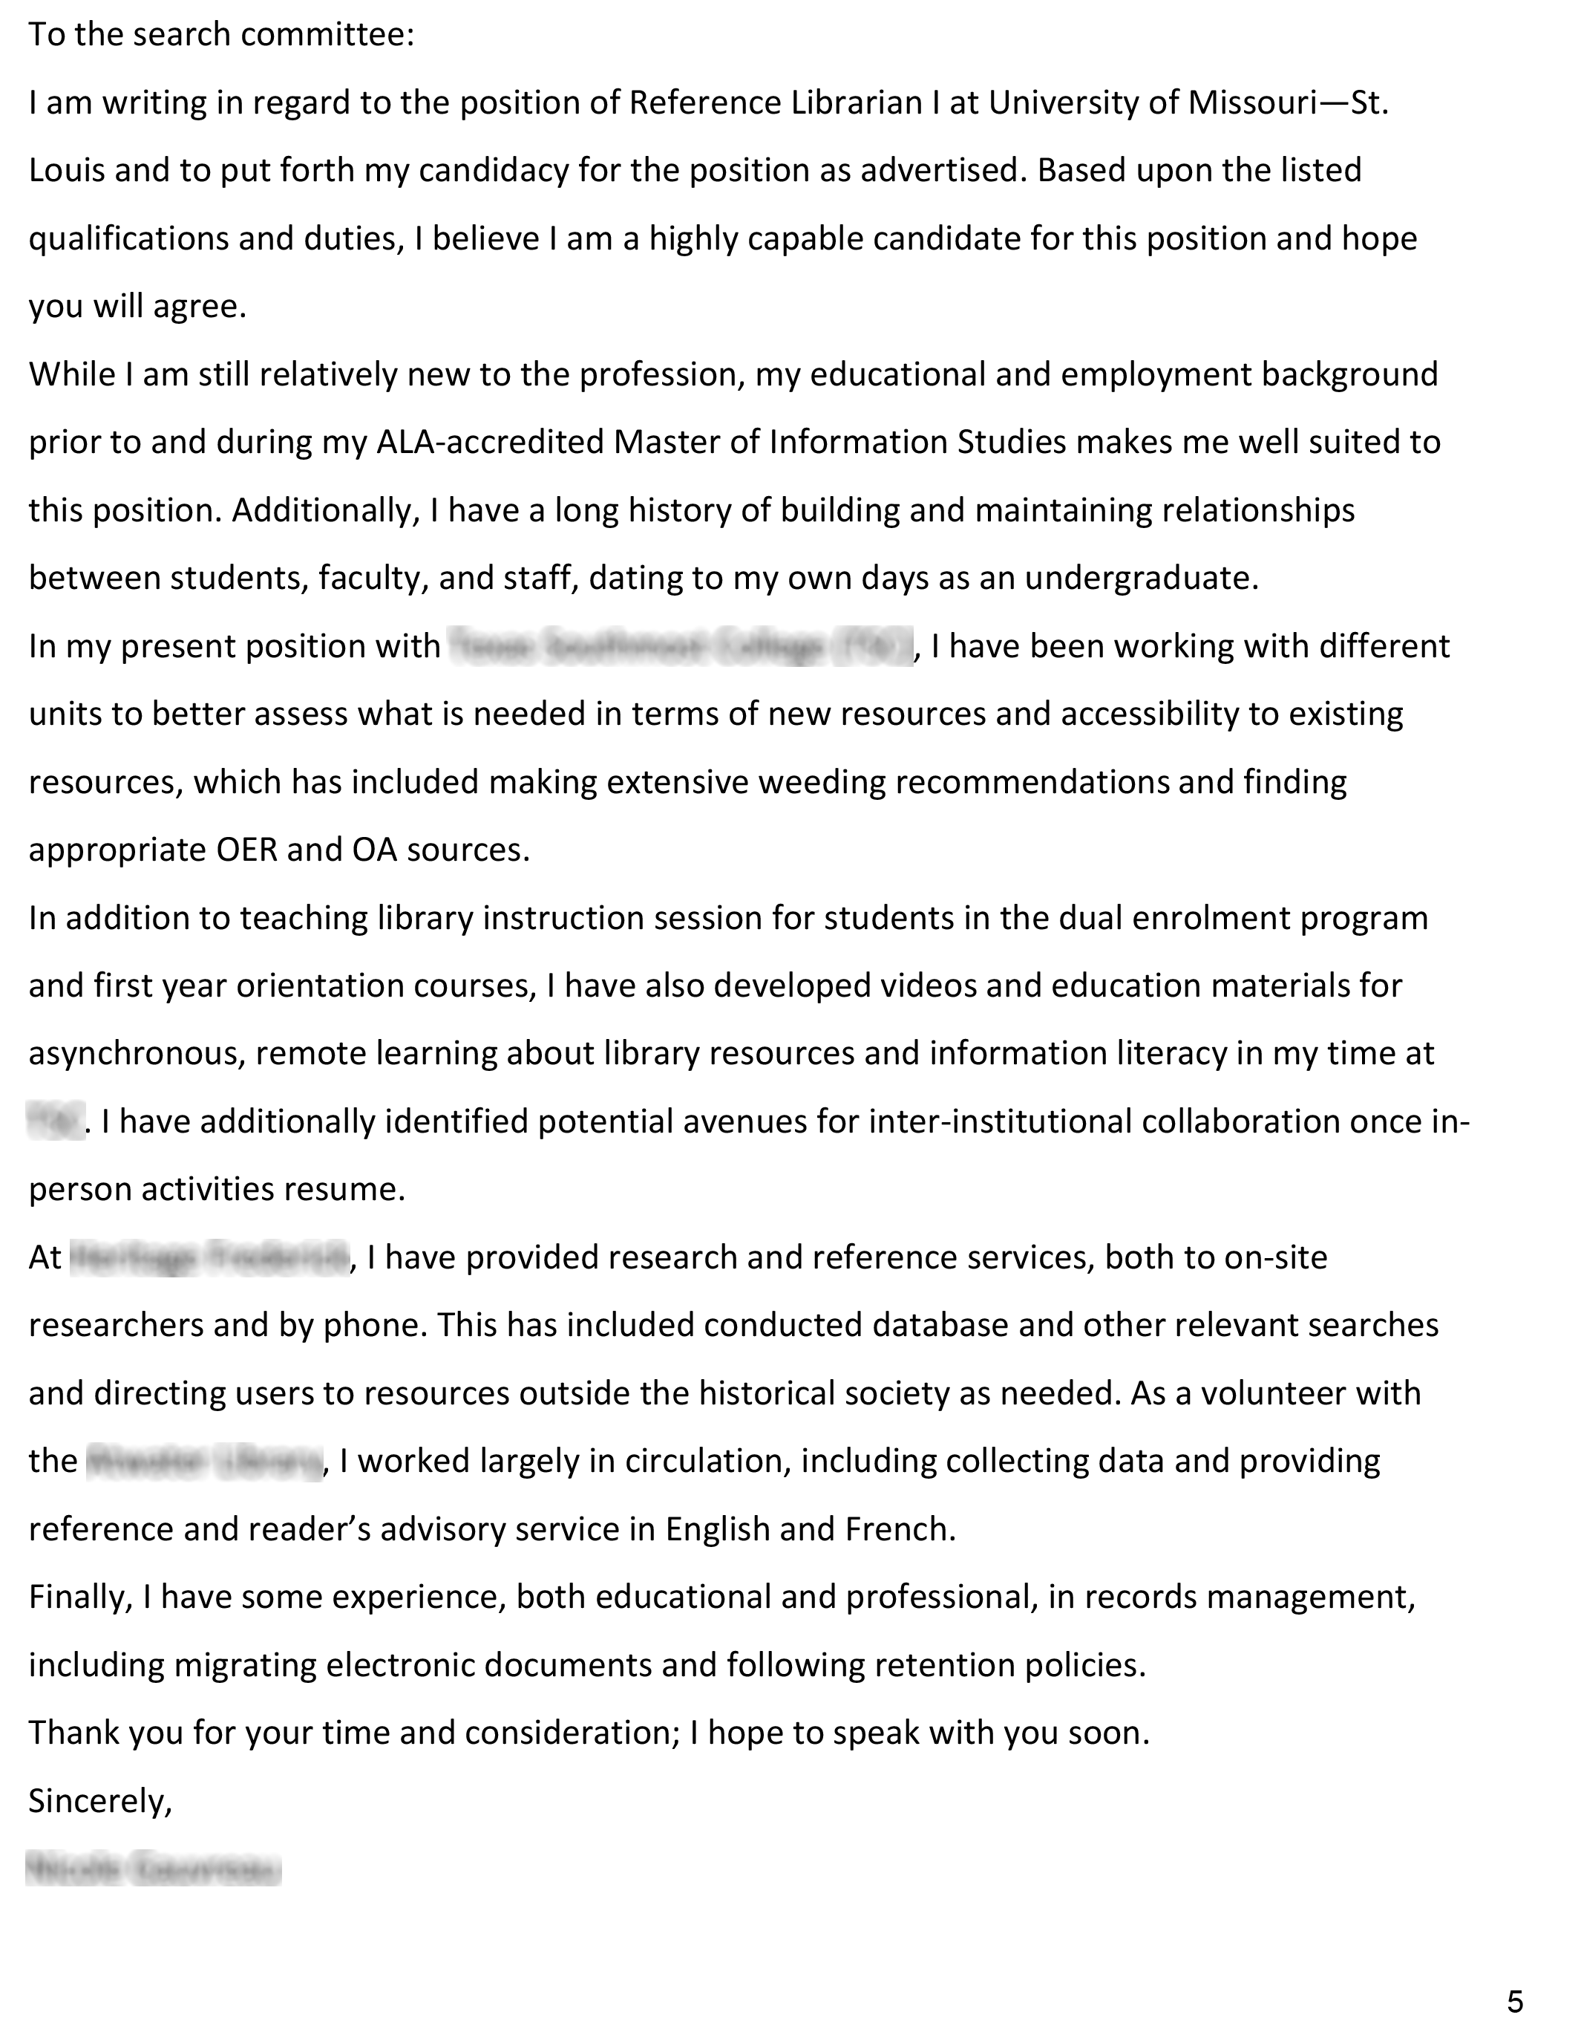
WHAT NOT TO DO
Our search committee found these submissions harder on the eyes.
White space is our friend, but double spacing is not.

Slide 28
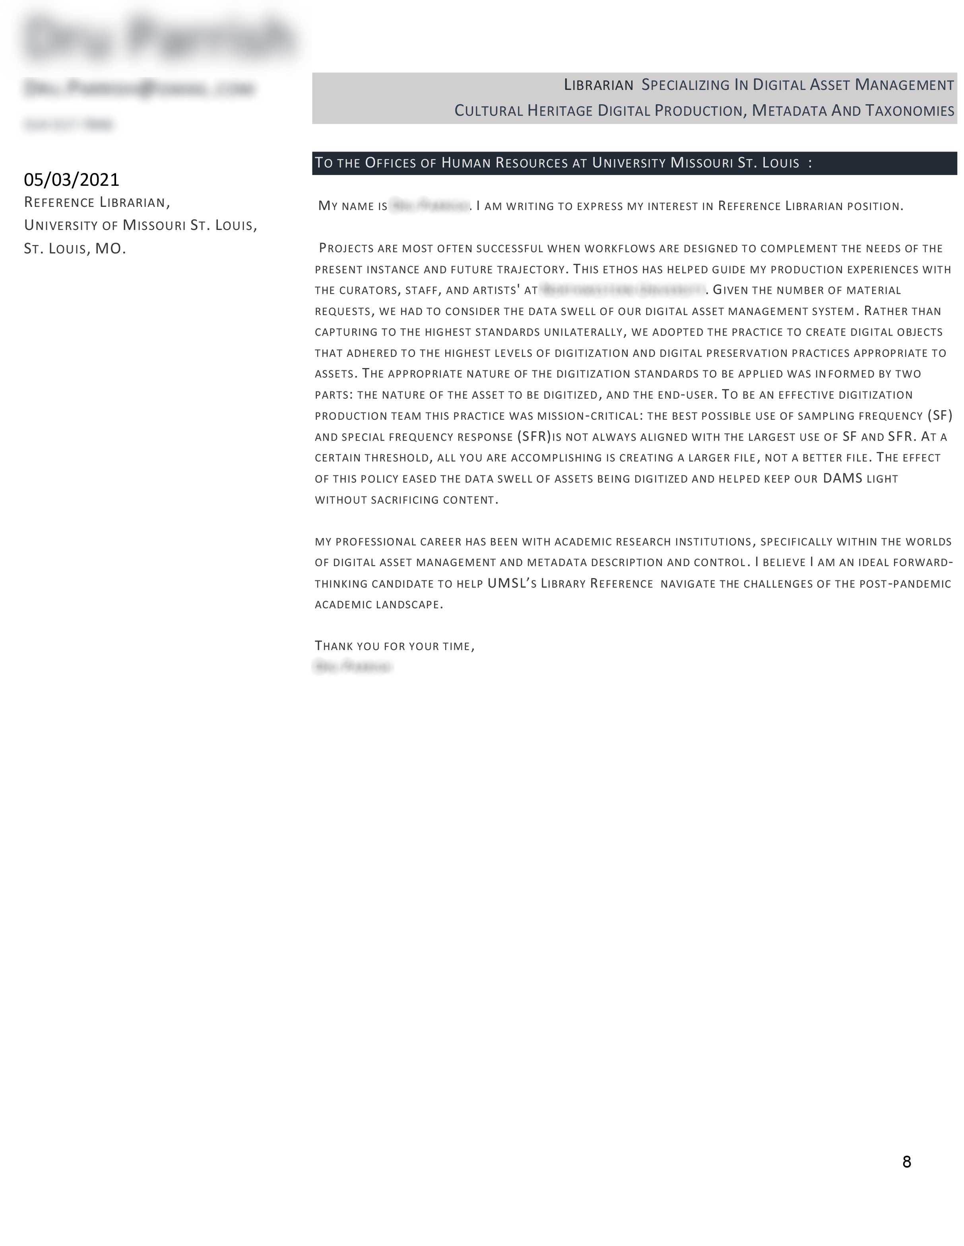
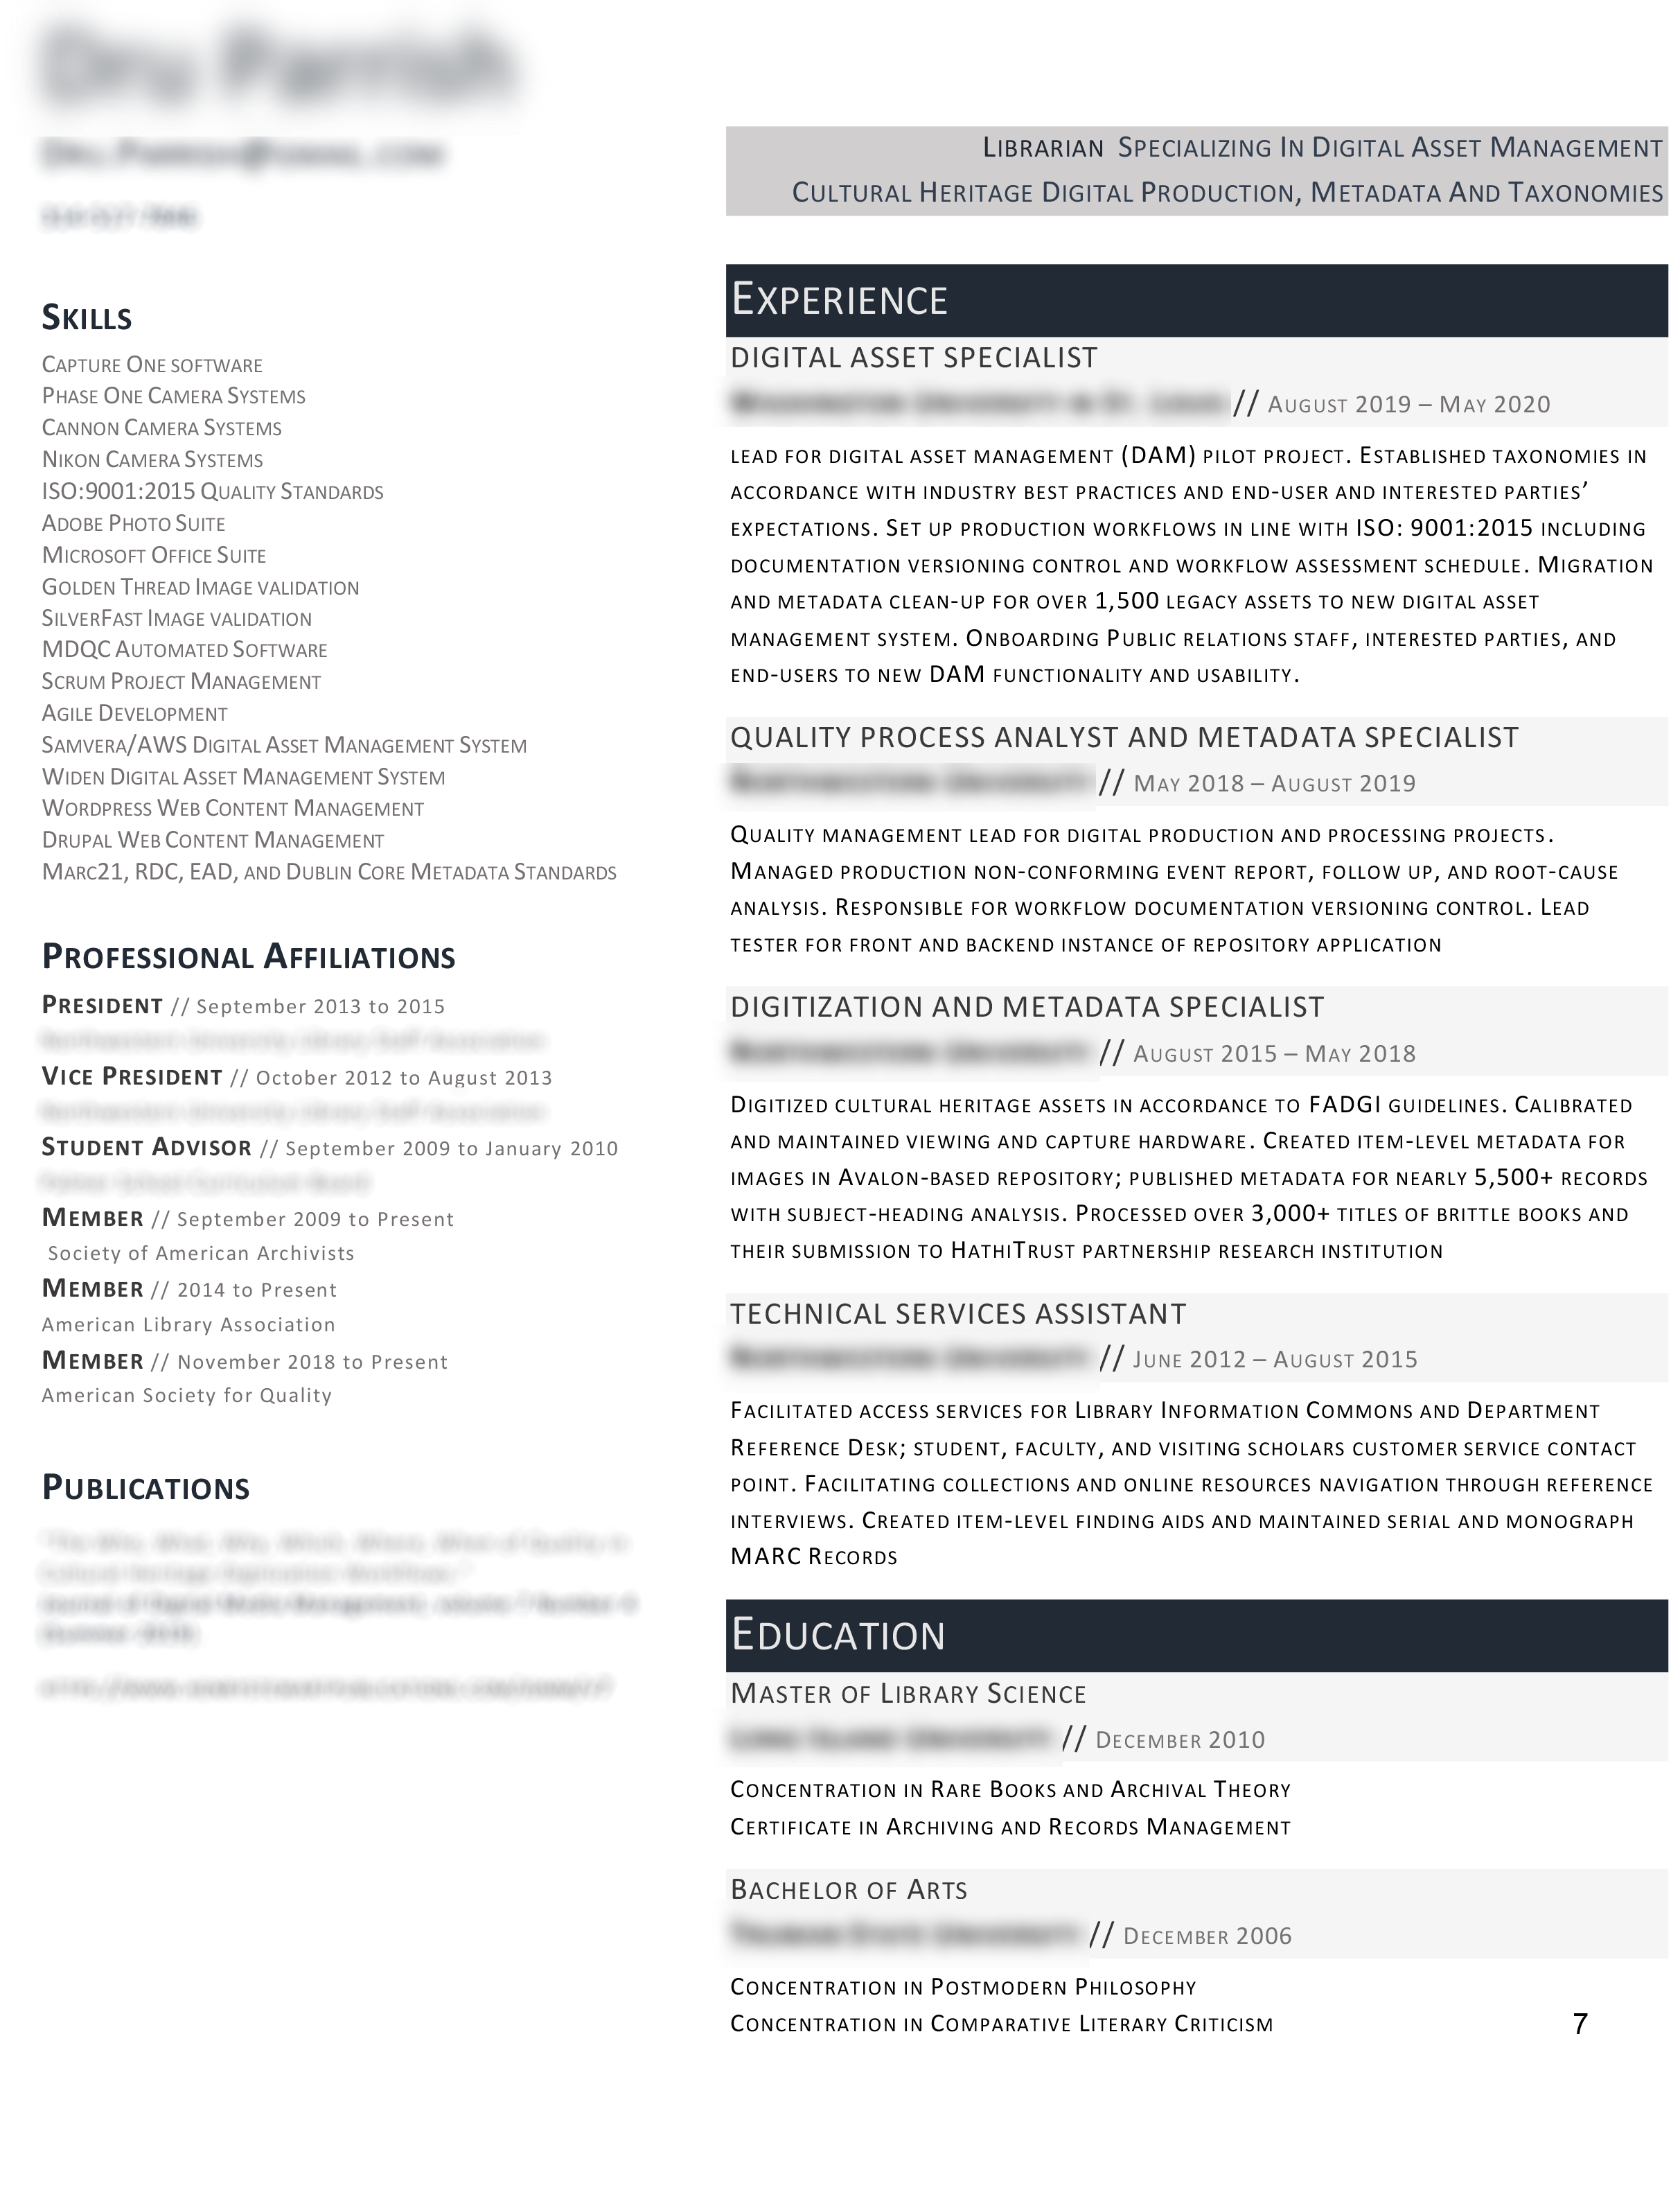
ANOTHER NO-NO
This one was set entirely in small caps. That, along with the fact that
the applicant clearly wanted a job in archives, took it out of the running.

Slide 29
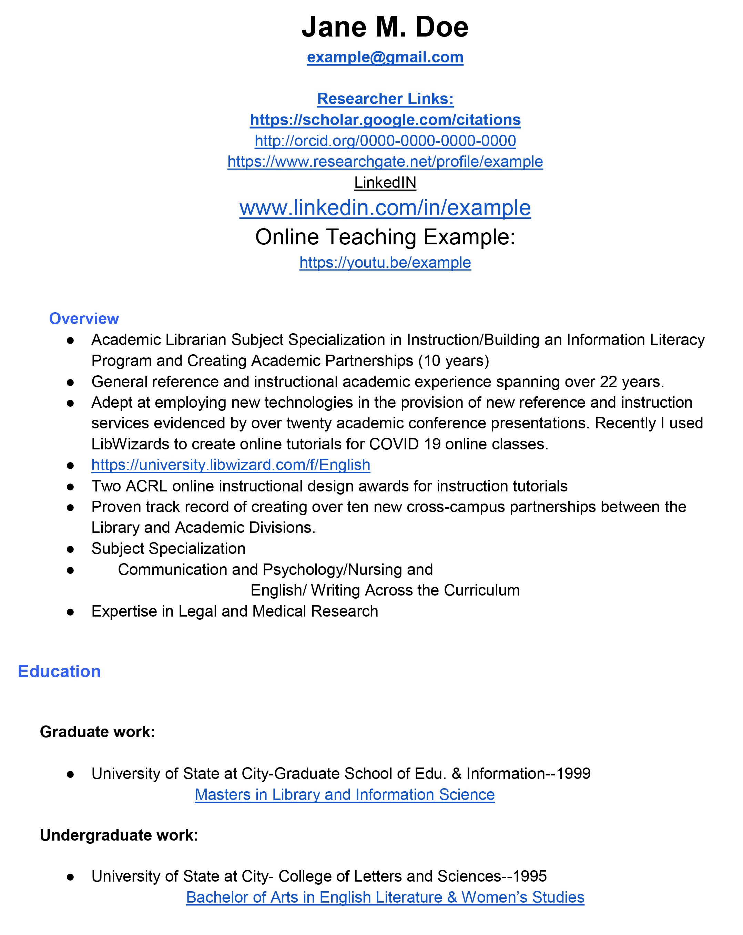
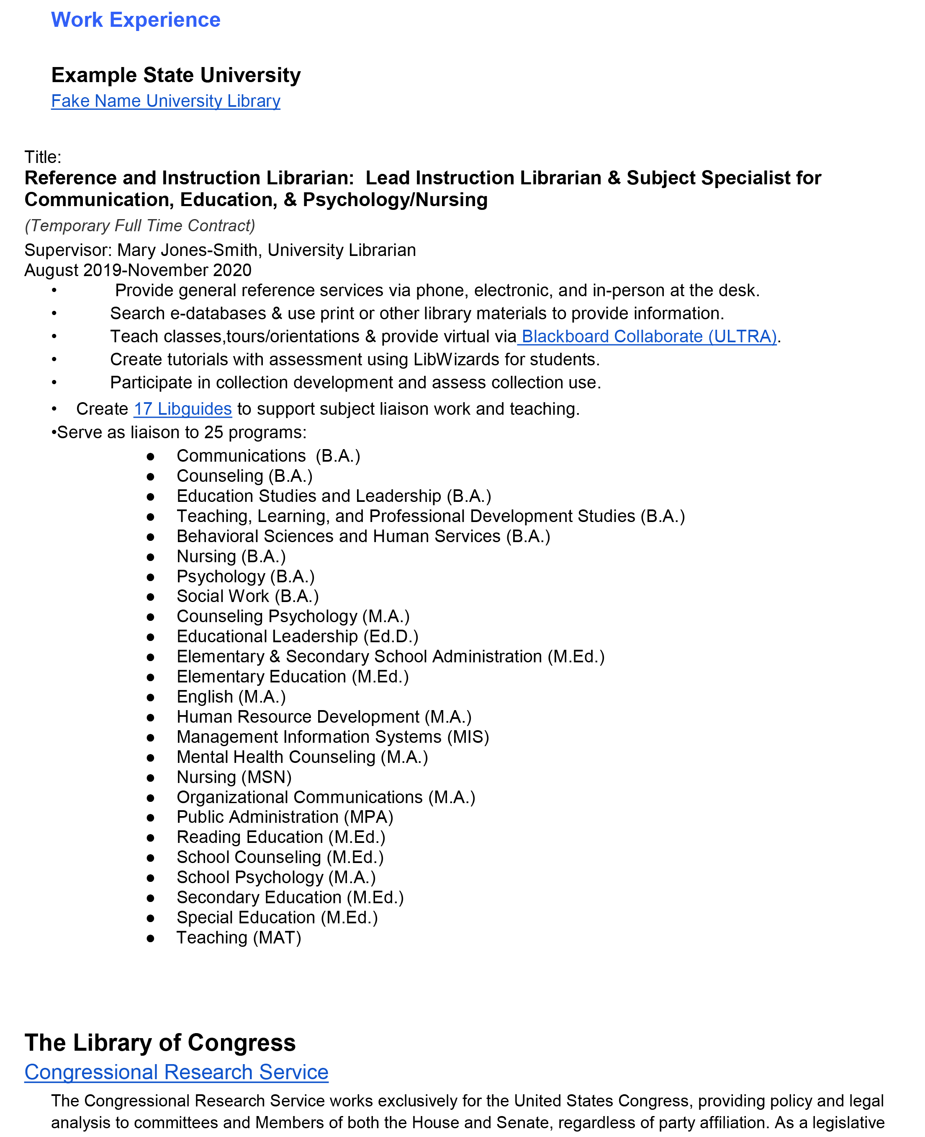
SO MUCH UGLINESS
This is bad—in so many ways. Sadly, it’s a CV
and continues for another 9 pages.

Slide 30
Questions?

Slide 31



ICON ATTRIBUTION
clover
clover by Aldric Rodríguez from the Noun Project
brand
Icon made by photo3idea-studio from www.flaticon.com
puke
puke by Andi from the Noun Project

Slide 32


Thank you,
and good luck
with your search!
j.schmitt@umsl.edu

