Slide 1
The Intracorporate Conspiracy Trap
J.S. Nelson

Slide 2
Definition
The intracorporate conspiracy doctrine provides all types of associations immunity from conspiracy suits based on the legal fiction that an enterprise and its agents are a single actor incapable of the meeting of two minds to form a conspiracy.

Slide 3
Incredibly Wide-Spread and Powerful
1984 Copperweld Corp. v. Independent Tube Corp.
  U.S. Supreme Court held that the intracorporate conspiracy doctrine shielded a parent company from being able to conspire with its wholly-owned subsidiary for purposes of Section 1 of the Sherman Act because they should not be considered separate economic entities.

Slide 4
Incredibly Wide-Spread and Powerful
1984-2000, sweeping the federal and state courts in all areas outside antitrust: tort, criminal law, and many other parts of the law
By 2000, the U.S. Ct. of Appeals for the Eleventh Circuit became the last circuit to agree that a civil RICO 1962(c) indictment must name a person distinct from (not an agent of) the RICO enterprise.
Today the Eleventh Circuit is the only circuit still halting application of the intracorporate conspiracy doctrine at the door of criminal liability (and about to lose this argument).

Slide 5
Why Spread So Fast?
Push by academics: 1998 argument by Prof. Martin that too close to vicarious liability
Push by businesses
Push by attorneys who want to be doctrinally immune for their actions on behalf of clients
Caseload pressures and budget cuts
    2012 total federal caseload: 360,550
    2006 total state caseload: 102,400,000 (last year for which consolidated data available)

Slide 6
Last of the “unity” doctrines
1960, U.S. Sup. Ct. struck down similar doctrine that held that a man and his wife could not conspire because they compose a single entity within a marriage (Dege)
Two legs:
  A corporation is a legal “person.” This fiction has only become stronger over time (see Citizens United), but still weakest in the criminal law (no 5th Amend. rights).
  Corporate unity: the idea that a corporation and its agents are one body. Allegedly based in agency law. But article shows that a mis-understanding of the law.

Slide 7
Limited Exception to the Doctrine
When employee’s actions fall outside the scope of his or her employment: when she acts for her own benefit and not for the benefit of the employer.
Limited range of how interpreted. E.g., in Third Circuit, to be outside the scope of agent’s authority, the agent must have been “acting in a purely personal capacity.”

Slide 8
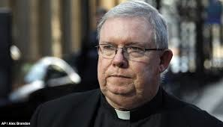
The Monsignor Lynn Case

Slide 9
Monsignor Lynn
Facts not in disagreement:
  For twelve years, from 1992 to 2004, Monsignor Lynn served the Archbishop of Philadelphia as the archdiocese’s Secretary of the Clergy
  Job was to supervise priests and to investigate sex-abuse claims
  In 1994, Lynn complied a list of 35 “predator” priests based on hundreds of secret sex-abuse complaints
  Said on the stand that he hoped the list would help his supervisors address the growing crisis
  Actual actions: merely reassigned priests and hid the abuse within the church
  Supervisors ordered all copies of the list destroyed (prosecutors found one after a top official died; church even lied to own lawyers about existence)
  Lynn never contacted authorities
  As late as 2012, one of the “predator” priests on list still serving in a parish

Slide 10
Monsignor Lynn
All parties agree that Lynn’s actions:
  Allowed priests to continue to abuse children
  Sheltered the priests from potential prosecution
  Directly protected the Archdiocese’s reputation

Slide 11
Monsignor Lynn
In 2012, charged with:
(1) Child endangerment
(2) Criminal conspiracy with the priests
Judge dismisses criminal conspiracy with one priest
---no evidence of “shared criminal intent” with priest to abuse children (not coordinating with Rev. Brennan)
Jury found Lynn not guilty of conspiracy with other priest (Avery)
---did silence one of the priest’s accusers, but no evidence that Lynn was affirmatively trying to “help [the predator priest get] to another parish so [that] he can continue to enjoy what he likes to do.”
Child endangerment conviction overturned on appeal because Lynn had no duty to supervise children

Slide 12
Monsignor Lynn
Conspiracy charge can reach what no other type of prosecution can:
  Need a judicial proceeding (actual investigation by authorities) and knowledge of investigation for obstruction of justice or similar charge---Lynn too successful
  Criminal conspiracy has longer statute of limitations and can introduce context of actions to infer coordination
  For tort, needs to share duty: “Aiding and abetting” the Archdiocese’s cover-up would allow imposition of church’s duty to report; Lynn could have been helping to evade
  Thought experiment may help:
    “Imagine that A is involved in a suit against B, and B and his attorney threaten suit in another court against C, one of A's witnesses, to keep C from testifying. A may not have a cause of action against B—only C would. But A, not C, is the primary victim of the conspiracy, because it is A's suit that suffers if C is too intimidated to testify.” (Kedem example)

Slide 13
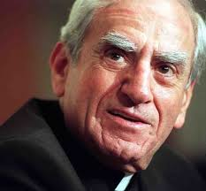
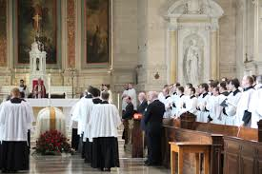
With Whom Did Lynn Conspire?
Cardinal Bevilacqua
(Archbishop of Philadelphia)
Archdiocese of Philadelphia
(Cardinal’s top lieutenants at his funeral)

Slide 14
Intracorporate Conspiracy Doctrine Dangerous
NOT properly based in agency law
  Why should an agent be immune for conspiracy with the principal?
  Why should a principal be immune for conspiracy with its agent? And how extensive should this definition of an agent be? Becoming all conspiracies in all forms.
NOT proper to apply to criminal law
  U.S. Sup. Ct.: “[C]ollective criminal agreement—partnership in crime—presents a greater potential threat to the public than individual delicts.... Group association for criminal purposes often, if not normally, makes possible the attainment of ends more complex than those which one criminal could accomplish.” (Callanan v. U.S.)
  Think especially about social conformity and the pressures on employees within work cultures.
NOT proper to apply to tort law
  NOT vicarious liability
  About direction of activity and sharing of duties (e.g., all through the Restatement)

Slide 15

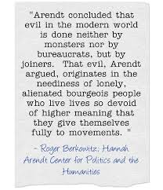
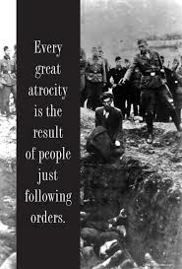
“Just Following Orders”
“The fact that a person acted pursuant to order of his Government or of a superior does not relieve him from responsibility under international law, provided a moral choice was in fact possible to him.” (Principle IV, Nuremberg Tribunal)

