Slide 1
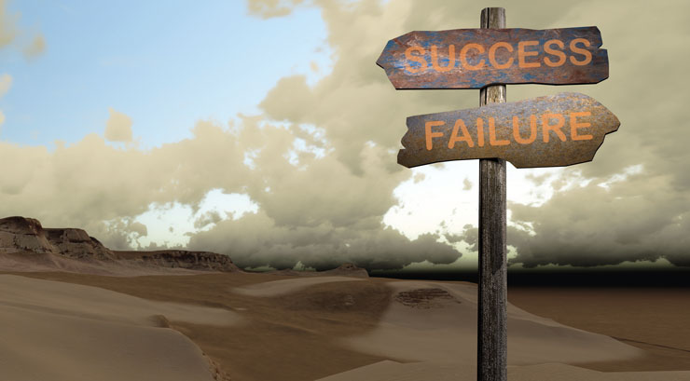
Early Colleges and Academic Libraries: Instruction Failures and Successes
Jolene Cole
Instruction Coordinator
Assistant Professor of Library Science
jolene.cole@gcsu.edu
Georgia College

Slide 2

Overview
The Development
The Implementation
The Assessment
The Future

Slide 3

Early Colleges
Georgia has several Early Colleges
Uniquely designed to meet the needs of the students in the local communities
Can be found on high school or college campuses
Rural, suburban or urban settings
Curriculum varies among schools
Seed money for the initiatives came from grants from the Bill and Melinda Gates Foundation
Notes:
Georgia College Early College (GCEC) is a 7th grade through 12th grade public educational institution that is located on GC's campus. GCEC is an alternative to the traditional middle and high school with partnerships among Baldwin County and Putnam County schools, Oconee RESA (Regional Educational Service Agency) and the John H. Lounsbury College of Education. Early College's Legacy Class began fall 2006 with an enrollment of 53 students. Early College prepares students to complete high school, gives them an opportunity to earn college credit, and assists them in becoming eligible for the Hope Scholarship.
The Early College Initiative
Currently, Georgia has several Early Colleges. Each school is uniquely designed to meet the needs of the students in the local communities it serves. Early Colleges may be found on high school or college campuses or in rural, suburban or urban settings. The curriculum varies among schools to meet the requirements of the Department of Education and the school's local partner college or university. Seed money for the Early College initiatives came from grants from the Bill and Melinda Gates Foundation.

Slide 4
Early College:
Georgia College
Began 2006
7th-12th Grade
Alternative Education
Opportunity to Earn College Credit
Many are first generation college-bound students
Strong focus on service and problem-based learning
Notes:
Georgia College Early College (GCEC) is a 7th grade through 12th grade public educational institution that is located on GC's campus. GCEC is an alternative to the traditional middle and high school with partnerships among Baldwin County and Putnam County schools, Oconee RESA (Regional Educational Service Agency) and the John H. Lounsbury College of Education. Early College's Legacy Class began fall 2006 with an enrollment of 53 students. Early College prepares students to complete high school, gives them an opportunity to earn college credit, and assists them in becoming eligible for the Hope Scholarship.
The Early College Initiative
Currently, Georgia has several Early Colleges. Each school is uniquely designed to meet the needs of the students in the local communities it serves. Early Colleges may be found on high school or college campuses or in rural, suburban or urban settings. The curriculum varies among schools to meet the requirements of the Department of Education and the school's local partner college or university. Seed money for the Early College initiatives came from grants from the Bill and Melinda Gates Foundation.

Slide 5
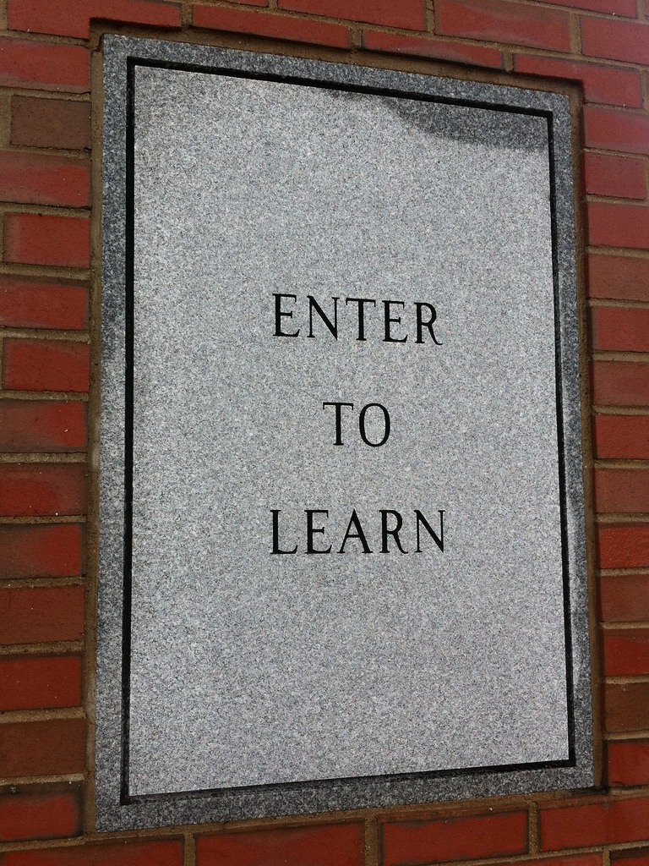

Slide 6



Identify services and resources available in the library.
Identify the different types of material available in the library.
Search the library catalog, identify a call number and find a book on the shelf.
Apply criteria to evaluate sources for credibility and authority.
Learning Objectives

Slide 7

Program
Library Services – iPad activity
Building Layout
Checking out items
Research Center
Call Numbers
Research
Research Packets
Topic development – Mind Mapping
Keywords/Search Terms - Worksheet
Galileo Use
Saving and storing Research – GoogleDocs
Evaluating resources – CRAP Test

Slide 8




Example of
Engaged Programing
iPad Activity
Library Scavenger Hunt via Instagram
Adapted from: University of Montevallo: Carmichael Library
Mind Mapping: Group Activity
Keywords and Concepts: Worksheet

Slide 9
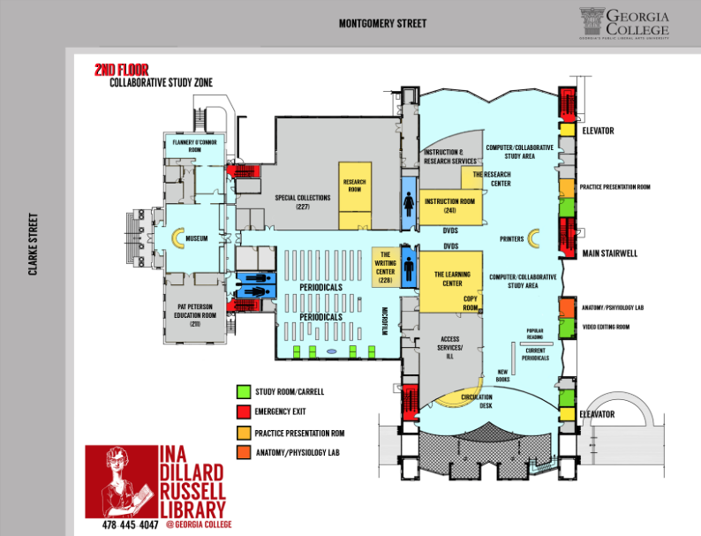
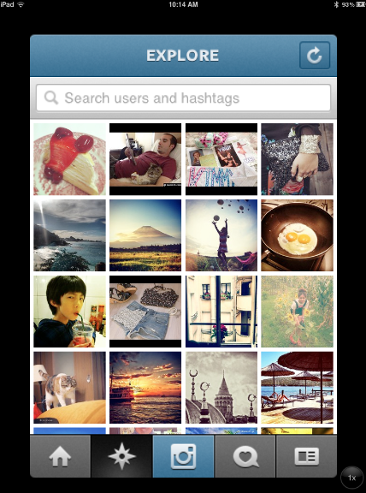

Instagram Hunt
Students Given
Directions with Questions
Maps of the Library
iPad mini with Instagram
Account Info

Slide 10
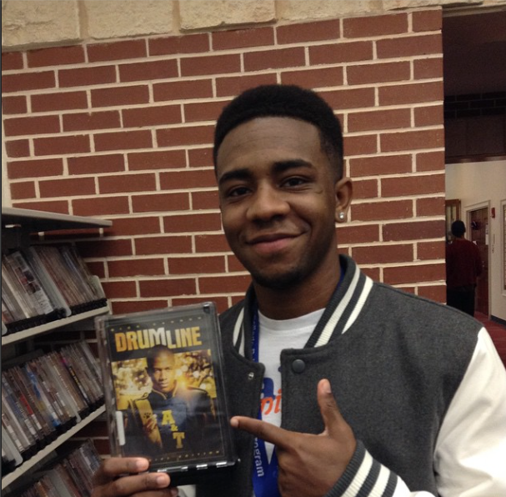
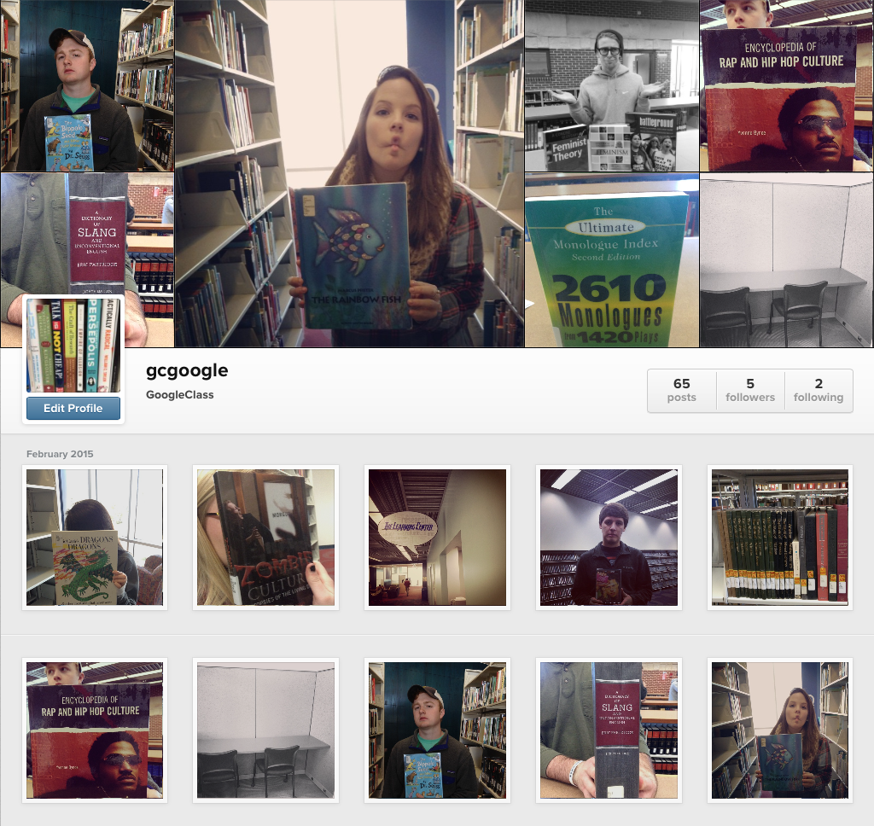
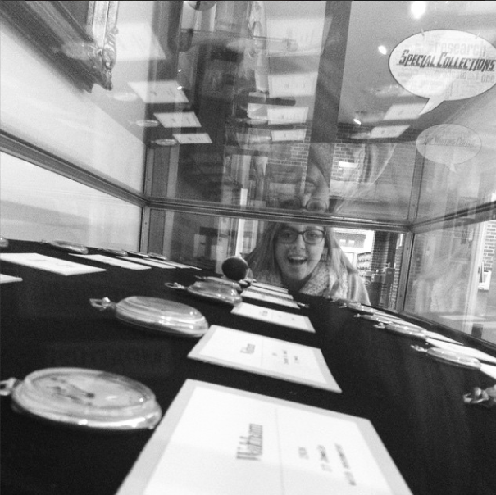
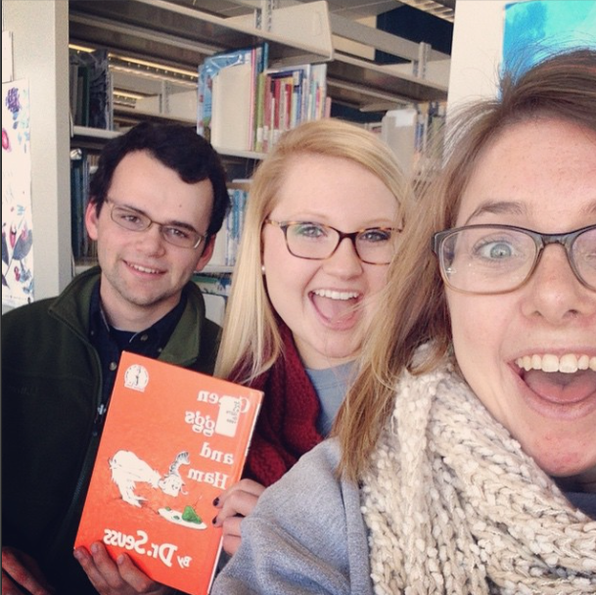
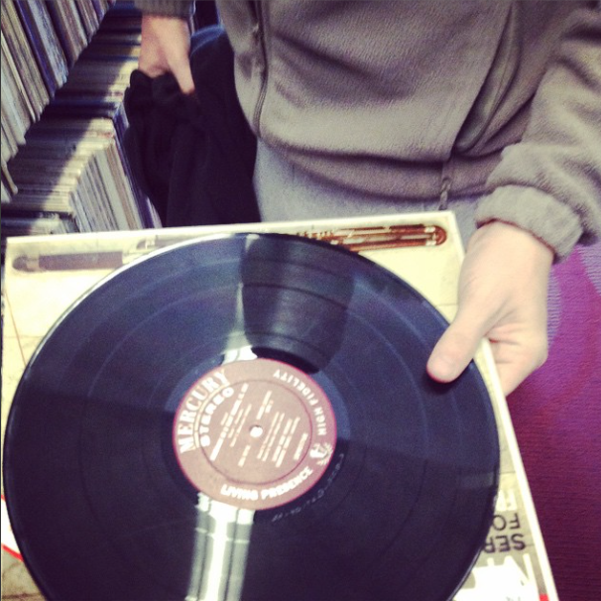

Slide 11
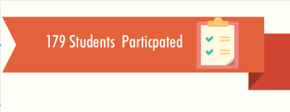
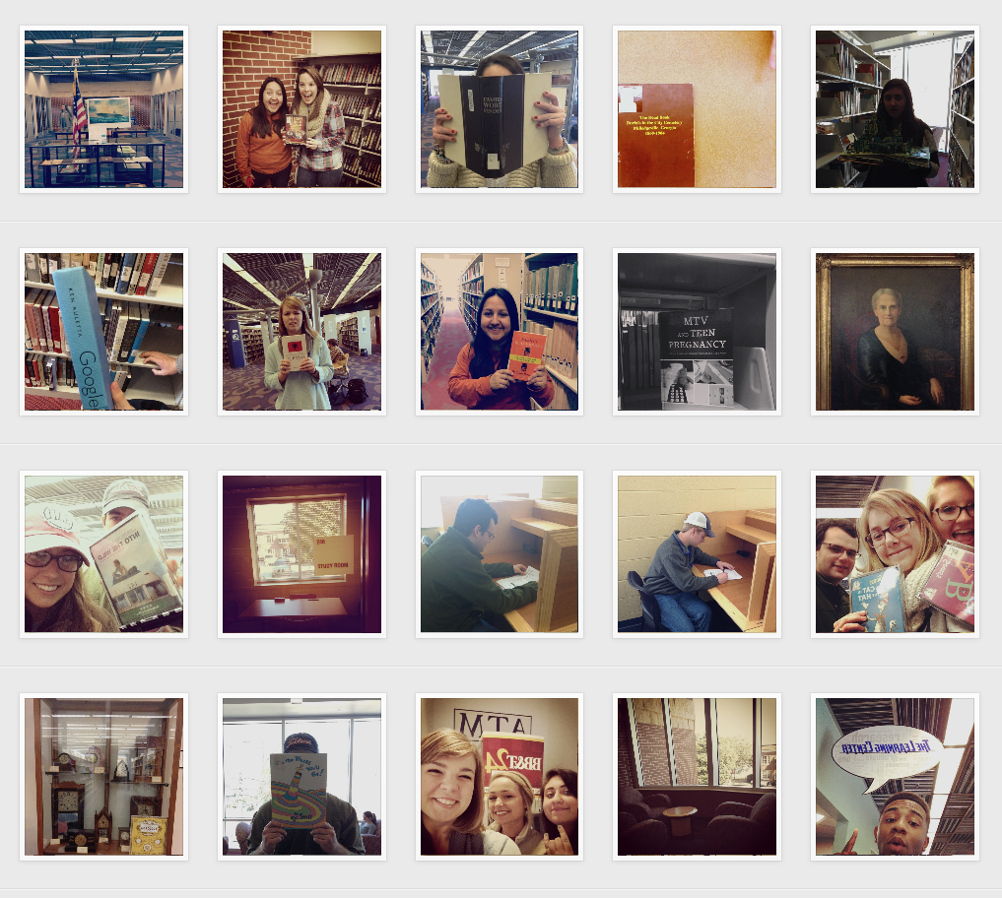
Place your screenshot here
Successes
New Student Population
New Collaboration
Students Loved the Technology & App
Future Outreach Established

Slide 12
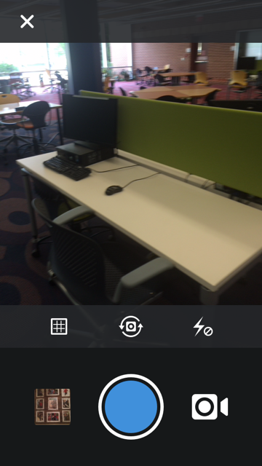
Place your screenshot here
Failures
Confusion
Varying Capabilities
Activity Issues
Too little time- too late in the process
Assessment

Slide 13
The Future
New Student Orientation
Increased Interactions
Added Services

Slide 14

References
Photo Credits:
https://www.flickr.com/photos/theilluminated/5386099858
http://www.levenger.com/blog/?p=2406
http://www.huffingtonpost.com/mo-seetubtim/20-things-successful-peop_b_6160560.html
http://thistimeimeanit.com/fear-success-fear-failure
https://flic.kr/p/9jdCUM
Content
http://www.slideshare.net/lmwallis/instagram-opening

Slide 15


