Slide 1
Library Systems and Web Analytics: What can we learn?
Jody Condit Fagan
Notes:
First I’m going to talk about my summer leave project, very briefly, because 20 minutes is not enough time to discuss everything.
Then I’m going to talk about a big picture agenda for web analytics and library systems which I came up with on my summer leave project. As part of that, towards the end, I will offer just a few nuggets of web analytics information from some of our library systems.
But before I do any of that, I want to explain Why I care about web analytics?

Slide 2
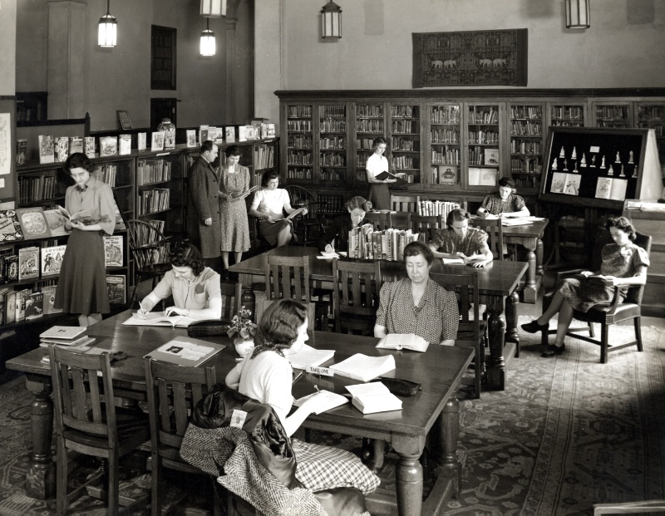
Russell Hall. School Library Laboratory (Fifth Floor). Miss Gilbert Advising Gentleman At Shelves. Teachers College. (May, 1940) (1940), by Photographer: Unknown
Notes:
What’s important to me is people being able to access the information they need. People making new discoveries. People connecting ideas together. Some of you know, but some of you don’t know, that my first eight years in academic libraries were enjoyably spent on the reference desk and conducting instruction classes.
It is immediately rewarding when you see someone at the reference desk finding what they need, or someone in your class taking careful notes. The scene in this slide probably evokes some emotion from some of you.
http://historicalphotos.pressible.org/rebecca/russell-hall-school-library-laboratory-fifth-floor-miss-gilbert-advising-gentleman-at-shelves-teachers-college-may-1940-1940

Slide 3

Notes:
If web analytics looked like this, [SLIDE], it would be much easier, I think, to feel interested in them.

Slide 4
Notes:
692,130 visits total.
But instead, they look something like this [SLIDE]. Some of you in the room might find it interesting that we have had almost 700,000 “visits” to our library systems - and this does not even count the library web site. But I’m guessing NONE of you FELT the same excitement you would have as if you’d been able to see these 700,000 people walk through the door, like you do every day in the public areas of our library locations.
What’s important is that even though many of the interactions between people and information in our online systems are now hidden from us, to remember that the activity at the heart of it all is still the same.
Sources:
Google Analytics – LEO Account
Google Analytics – www.lib.jmu.edu
Google Analytics – Serials Solutions Account Traffic Sources Report

Slide 5
Jody’s Summer Leave Project Activities
How libraries are putting web analytics to practical use
New developments with Google Analytics
Review existing systems’ reports and log files
Research commercial Key Performance Indicators
What KPIs might be relevant to JMU Libraries?
Recommend changes to analytics / logs at JMU
Visual display and presentation of quant. Information (Tufte)
Notes:
So, we don’t have time to talk about all that. So I picked one thing to focus on, which is the Validity of web analytics and what libraries might do to increase the utility of web analytics.

Slide 6
Validity:
The association of an abstract theoretical concept with its empirical manifestation
Encyclopedia of Social Science Research Methods (Sage)
Notes:
DOI:10.4135/9781412950589
[VALIDITY SLIDE 1] Review the definition of validity. One can never prove that a high SAT score means that you will do well in college, but you can demonstrate that SAT scores are a valid measure for predicting college performance.
So one of the first steps with respect to validity is called CONTENT validity.

Slide 7
Validity:
The association of an abstract theoretical concept (information literacy)
with its empirical manifestation
(know what subject corresponds with call number HB)
(evaluate a web site’s authority)
Encyclopedia of Social Science Research Methods (Sage)
Notes:
DOI:10.4135/9781412950589
Some of you have participated in examinations of information literacy test items to determine if the content of the questions is really relevant to information literacy today. For example, if there was an old question that involved knowing the LC Classification system, you might determine that question no longer has content validity. In my summer leave work, I wrote a paper reviewing a set of commercial web analytics ratios thinking about their content validity for the library environment.

Slide 8
Validity:
The association of an abstract theoretical concept (users finding relevant information)
with its empirical manifestation
(average order value)
Encyclopedia of Social Science Research Methods (Sage)
Notes:
DOI:10.4135/9781412950589
For example, there is a metric called “average order value,” which works great for Amazon.com.
At first blush, it seems like it would not be good for libraries. We don’t put price tags on the value of information, even though our vendors do. But then I thought about the ways companies increase average order value – they have features like “customers who bought this also bought…” Well, maybe our systems SHOULD do that, and do that so well that our users do end up checking out more items or downloading more articles because they were relevant!
What’s also so important is that web metrics are different for different types of sites. For example, a system like R2 would be considered a “commerce” site – we want users to find their database and make selections quickly. So we would want to see low average time on site and maybe low pageviews per visit. For Go for the Gold, we would want to see a high average time on site and high pageviews per visit. For the catalog, it gets confusing because users looking up a call number should have low pageviews per visit, but users doing serious research should have high pageviews per visit. What’s important is thinking about how the intended user behavior might translate into web analytics.
So if you are REALLY interested in the various web metrics available, I have a paper you can read.

Slide 9
Validity:
The association of an abstract theoretical concept (users finding relevant information)
with its empirical manifestation
(full-text downloads per session)
Encyclopedia of Social Science Research Methods (Sage)
Notes:
DOI:10.4135/9781412950589
For today, we’re going to look at a metric I’ve been interested in recently, which is a conversion rate. [VALIDITY SLIDE 4]
Since we don’t have customers making purchases, we have customers choosing databases or downloading full-text articles.

Slide 10
Notes:
692130 visits total

Slide 11
(see handout)
Notes:
The number of sessions in Quick Search rose from 198,207 to 239,456, or 21%, in the past two years (write on board) . But, that can happen for a variety of reasons. Just because people are getting more used to it, or due to its prominent location. Or because individuals are using more devices per individual. So an increase or decrease in an online system alone doesn’t say much about its utility.
Now, sessions like we have here are just a count. One way to begin to add meaning to web analytics is to use more ratios, because they are proportional to something. For example, I found that full-text downloads plus abstract views per Quick Search session rose from 2.39 to 2.55 in the past year (write on board). That seems like a good trend! It seems like maybe Quick Search is not only used more, but that users are finding more relevant information than they used to.
Figure: Average visit value for Quick Search / EDS, Source: EBSCO Admin statistics
So the question is, does an increase in full-text downloads per session indicate that users are finding more relevant information? So what social science researchers often do is they correlate patterns with experimental designs. This is called CONSTRUCT validity. For example,
Suppose we had asked a quick pop-up survey of all these 200,000 users in both years, “How relevant was the information you found today?” And suppose the ratings went UP from 2011 to 2012. I have just added to my validity argument. Other experiments could be designed.
Librarians have done this with information literacy, with LibQUAL, with some collections metrics, and now it is time for them to do it with web analytics. They need to choose web metrics more carefully, and study them in parallel with usability studies and other experimental designs, and report on THAT to the field instead of how to navigate Google Analytics, which you can learn from the web site.

Slide 12
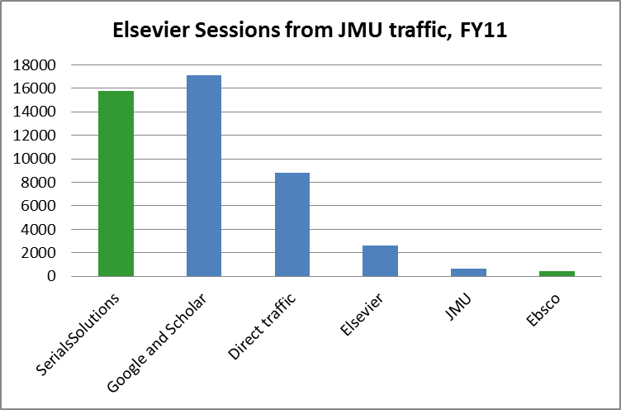
Note: Data from Elsevier, Inc.
Notes:
I promised to share a few nuggets of information about our own systems.
Overall system traffic picture
Elsevier graphs
Visits over time - remember, a decrease in visits or increase in visits doesn’t necessarily say much about the system
The catalog since the redesign
The increase of the catalog as a portal (See Traffic Sources spreadsheet in LEO segmented)
WebPAC – not the Millennium client.

Slide 13
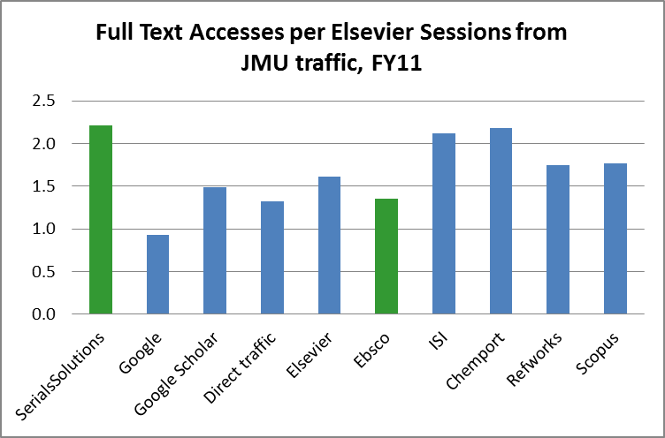
Note: Data from Elsevier, Inc.

Slide 14
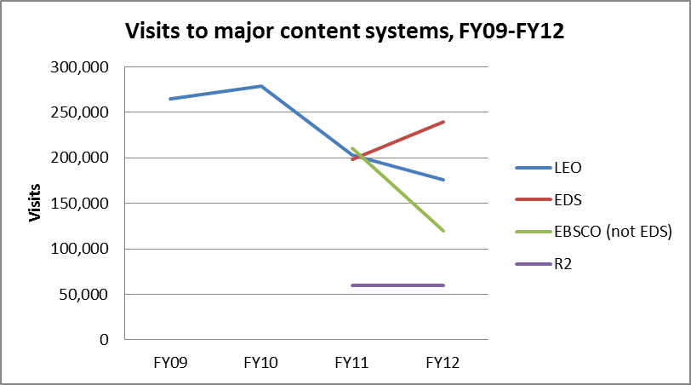
Data from JMU Library Catalog Google Analytics account and EADmin Reports & Statistics Session Report
Notes:
Note: The library web site received over 1 million visits and is therefore off the charts; session/visit data currently unavailable for Serials Solutions. Data from JMU Library Catalog Google Analytics account and EADmin Reports & Statistics Session Report (Session counts for eds profiles; other profiles)

Slide 15
(see handout)
Notes:
692130 visits total

Slide 16
Library Systems and Web Analytics: What can we learn?
Jody Condit Fagan

