Slide 1
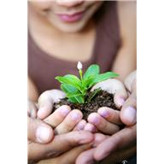
WEEDING YOUR GARDEN:
Avoiding the thorns

Slide 2

GET A GRIP!
Weeding makes people anxious—
Trustees
Directors
Librarians
Patrons

Slide 3

A solid plan will calm and soothe

Slide 4

PLANNING
Set criteria for weeding project based on your Collection Development policy.
Notes:
What is your mission?
What do you collect? How long do you keep it?
What do you keep long-term?

Slide 5
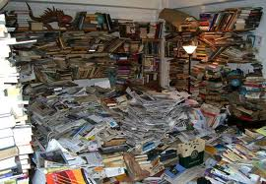
SET GOALS
What do you want to accomplish?
  Make space?
  Eliminate older titles?
  Get rid of duplicates?
  Find the floor?
Notes:
Have some concrete ideas in place about number or % to weed
Perhaps concentrate on one area? Kids, non-fiction, etc.

Slide 6
What are some questions to address?
How long will the project take?
Will your project generate hundreds of boxes of books or just a few?
Will you work with others or alone?
If you work with others, who?
If you reassign library personnel, what happens to their other work while they are weeding?
Will the library remain open while you work?

Slide 7
RESOURCES
Think about what you need to accomplish your goal:
    Is this a one-time or ongoing project?
    How long will it take—be realistic!
    Funding—will you need extra?
    Will you need supplies?
    Are there other costs?
  Personnel
    How many people will you need to get the job done?

Slide 8
Present your plan
Put your plan into writing
Have contingencies in mind
Get all necessary approvals
Secure additional funding if needed
Identify personnel who will do the work
Line up supplies
Plan the timing for storage and/or disposal options

Slide 9
PR
Before you start weeding be sure to tell people/patrons
  What you are going to do
  Why you are going to do it
  How you are going to do it
  What the benefits will be
  Reach as many constituents as possible

Slide 10

Listen
Ask for input
If people have concerns, consider them
Amend your plan if necessary
Think about options
Explain your decisions
Make your process
thoughtful and inclusive

Slide 11

Ready to get your hands dirty?

Slide 12

Hire or assign
Identify how many people you will need
  Assign existing personnel and adjust workloads as necessary
  Hire additional people if necessary

Slide 13
TRAINING
Discuss procedures
Distribute procedures in writing
Make sure everyone who needs to know is on board with the plan (Don’t let anyone be surprised!)
Identify someone as point person for questions
Rehearse! Do a “dry run” and see how it goes

Slide 14
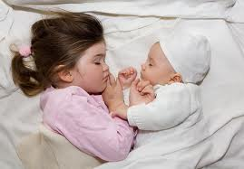
TIMING
Pick a weeding time that will be the least disruptive to your patrons and workflow
  Summer
  Between semesters
  Evenings or quietest
  part of the day

Slide 15
Process
Decide on a process to identify books for weeding, for example
  Flag weeded books on the shelf
  Pull weeded books and put on carts
  Store weed books for second stage review

Slide 16
SECOND REVIEW
Once books are pulled or tagged, a second person should review the books before they are discarded
Check your Collection Development policy to make sure you want to weed the selected titles—
  Do you collect books by RI authors?
  Do you collect books about specific topics?
  Do you keep everything from 1977?

Slide 17
Decide and discard
Decide what stays and what goes, based on the criteria in the plan
After the second review, send the weeded books to the “de-accession team”
  On carts
  In boxes
  Have the team come to the books
  Make a paper list and work from it

Slide 18
DEACCESSION
Make sure you have a person or people to de-accession the books
  Remove labels, barcodes and anti-theft devices
  Adjust catalog records
  Mark the books as withdrawn, so they don’t come back to you
Notes:
If a whole bunch of books are going to show up for de-accession at once, make sure you have enough people to do the job, or enough storage space and time to allow the process to occur without a bottleneck

Slide 19
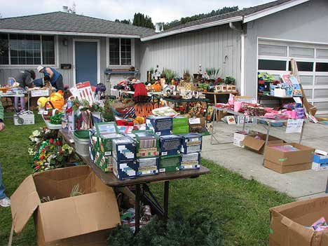
DISPOSAL
Who is in charge of the disposal ? Its in your plan, right?
How and when?
  Sale?
  Offer to others?
  Recycle?

Slide 20

Disposal options
Having a book sale?
  When?
  Where?
  Who?
  Where will the books be stored until the sale?

Slide 21
Offer to others
Make a list of weeded items and send it out to other libraries/organizations
  Where will the books be stored?
  How will they get to people who want them?
    Who retrieves them?
    Who sends them?
  What happens to them if no one wants them?

Slide 22
Recycle
Donate to a company like Better World Books
  Possible (minimal payback to library)
Donate to an organization that takes books
Take to the landfill recycling bins
Other?

Slide 23
For any disposal option
Think about logistics
  Will you need to rent a truck?
  Will you need to cover shipping costs?
  Will you need to rent/find temporary storage?
  Will you need to purchase boxes?
  Will you need to hire additional workers?

Slide 24
KEEP RECORDS
Make sure you keep a list of weeded titles for a while
Make sure you count the number of volumes withdrawn for your annual report/statistics
Keep notes about what went well and what could be done better next time

Slide 25
SHARE!
There is very little in the literature about this topic, and what exists is dated, so—
  Create a presentation and share what you learned with your colleagues
  Write an article for a local, regional or national publication
  Create a YouTube or other video about your project

Slide 26

Celebrate!
Avoid the thorns while weeding your garden by :
  Planning ahead
  Getting input
  Setting realistic goals
  Minimizing disruption
  Creating a workflow
  Recording the project
  Reporting the results

Slide 27

HAPPY WEEDING!
Joanna M. Burkhardt
Collection Management Officer
University of Rhode Island Libraries
jburkhardt@uri.edu

