Slide 1

What Goes Around Comes Around: Calibrating the Academic Research Life cycle to the OA Life Cycle
Jill Emery
Portland State University
Graham Stone
University of Huddersfield
This work is licensed under a Creative Commons Attribution 4.0 Unported License
URL: https://library3.hud.ac.uk/blogs/oawal/

Slide 2
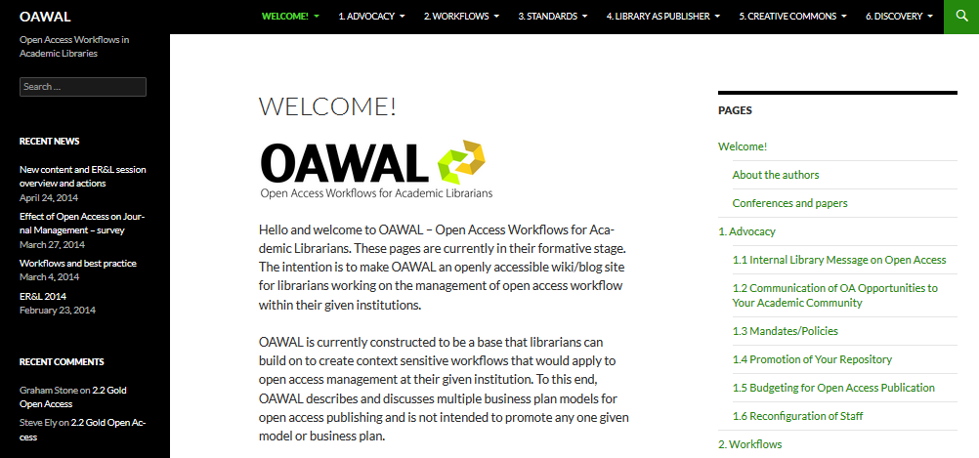
OAWAL: Open access workflows for academic librarians

Slide 3

What Is OAWAL?
A work in progress
Crowdsourcing comments through 2015
Goal is to produce an openly accessible wiki/blog reference site for librarians working on the management of open access workflows
To contain best practice guidance and charts for research & publishing alignment
URL: https://library3.hud.ac.uk/blogs/oawal/

Slide 4
What Is OAWAL?
OAWAL contains international examples
Aimed at those who may be new to or whose jobs now include OA
OAWAL is agnostic regarding the route to OA & level of advocacy
OAWAL wants to promote incorporation with the research & publication process
URL: https://library3.hud.ac.uk/blogs/oawal/

Slide 5
What Is OAWAL Right Now?
Advocacy
Workflows
Standards
Library as Publisher
Creative Commons
Discovery
URL: https://library3.hud.ac.uk/blogs/oawal/

Slide 6
HHuLOA & Jisc OA PATHFINDERS
HHuLOA: Hull, Huddersfield, Lincoln Open Access
https://library3.hud.ac.uk/blogs/hhuloa
Aim of the project is to identify how open access support mechanisms can be used with the development of research
Miggie Pickton, Research Support Librarian, University of Northampton
http://researchsupporthub.northampton.ac.uk/2015/04/23/open-access-and-the-research-lifecycle-a-guide-for-researchers/
“Intended for researchers who wish to engage with the open access agenda, but aren’t entirely sure how best to achieve this, this short guide highlights some of the issues to consider at each stage of the research lifecycle and the tools that are available to support you.”

Slide 7
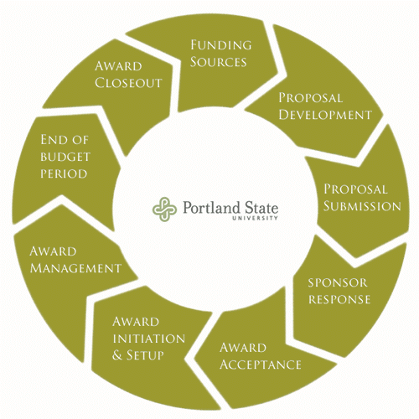
Why the Research Lifecycle?
Important to remember that publication & data are the outputs of research; not the basis for research
Faculty faced with multiple time constraints
Faculty respond more positively when their process is understood
Our timelines are not their timelines
Sponsored Projects Lifecycle from PSU Research Development & Administration https://sites.google.com/a/pdx.edu/research/lifecycle

Slide 8
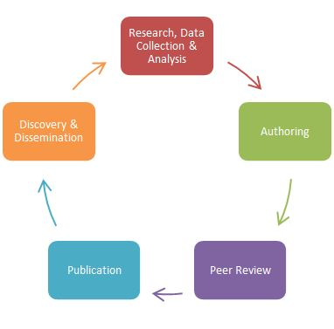
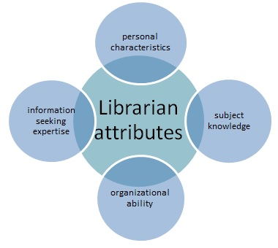
North American Visions
Is it time to re-envision the role of academic librarians in faculty research? – Barbara Brydges & Kim Clarke, University of Calgary http://libraryconnect.elsevier.com/articles/2015-07/it-time-re-envision-role-academic-librarians-faculty-research#sthash.NcrWdr6x.dpuf
University of Florida George A. Smathers Libraries, Scholarly Communication Home Page: http://cms.uflib.ufl.edu/ScholComm/Index.aspx

Slide 9
the Research Lifecycle
For librarians/repository managers
For researcher managers
For researchers
For publishers
For the US and UK
https://library3.hud.ac.uk/blogs/oawal/homepage/conferences-and-papers/
http://bit.ly/1NrkbRk
URL: https://library3.hud.ac.uk/blogs/oawal/

Slide 10
the Research Lifecycle
For librarians/repository managers
  7 stages of the publishing process as described by Neil Jacobs (Jisc OA Services)
  Institutional processes – not all institutions will have all processes up and running
  Publisher services that directly impact upon the work of the open access team
  Above campus services
  6 sections of OAWAL
URL: https://library3.hud.ac.uk/blogs/oawal/

Slide 11
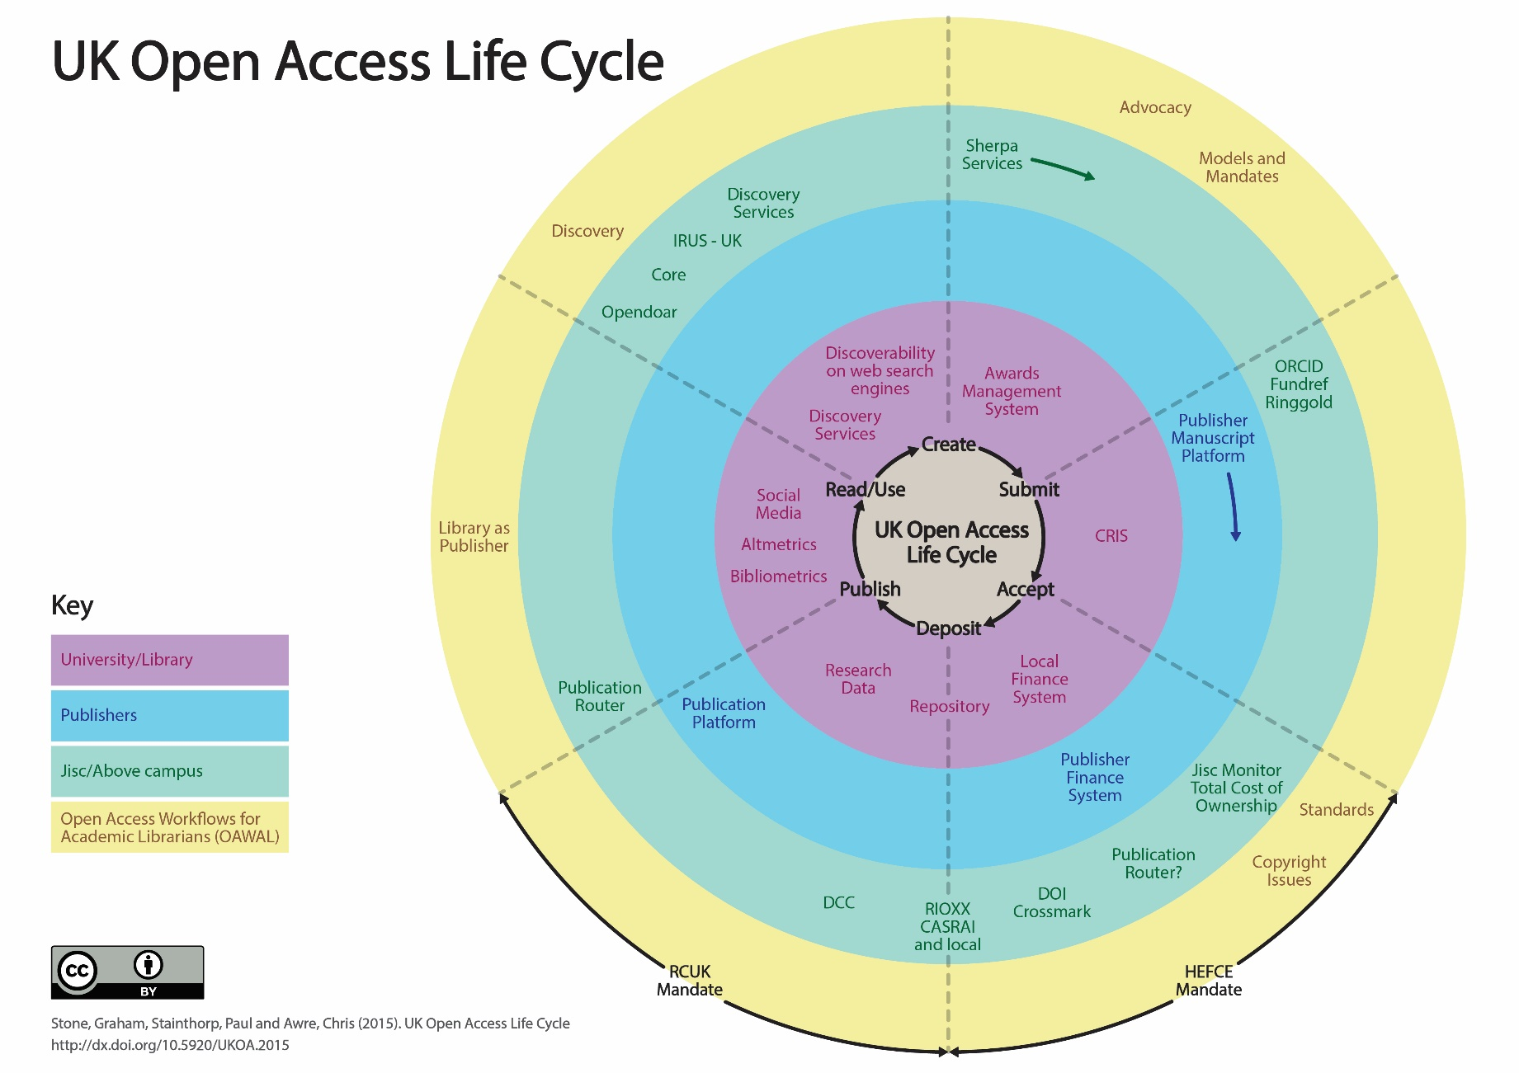

Slide 12
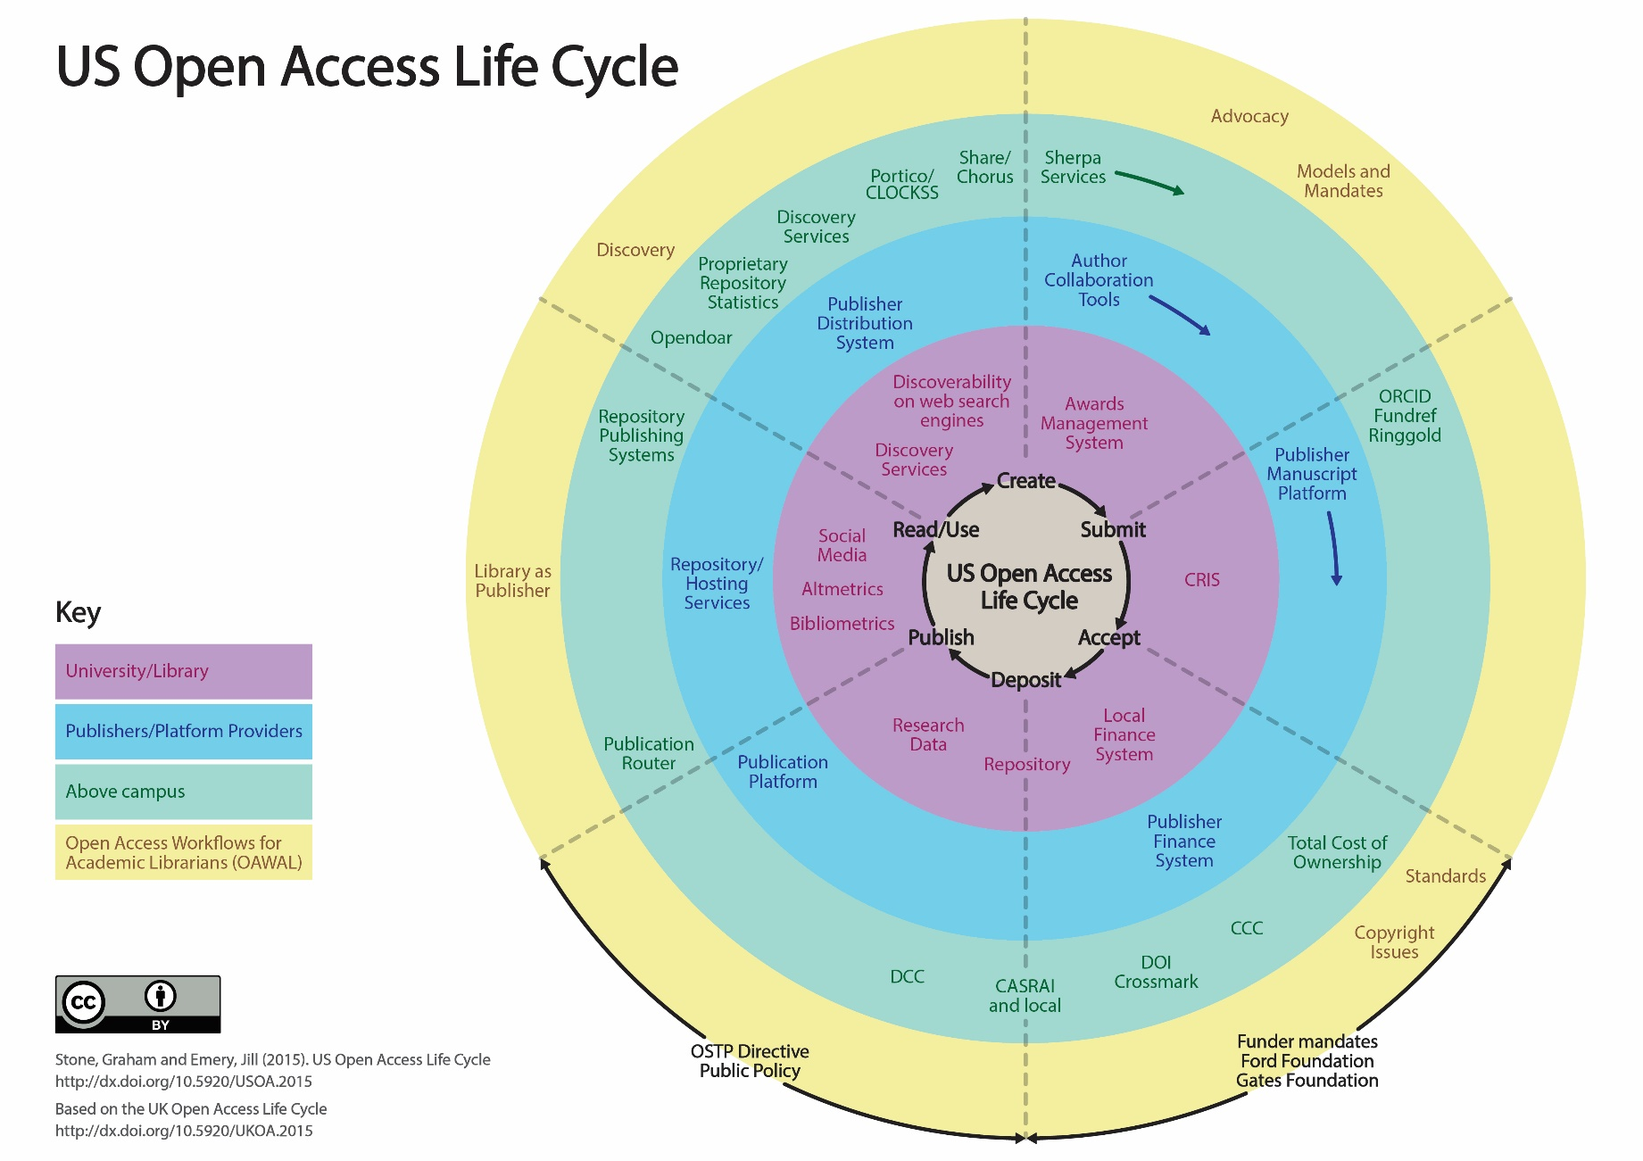

Slide 13
the Research Lifecycle
For research managers
  Institutional processes – not all institutions will have all processes up and running
  Funder liaison/mandates that directly impact upon the work of the open access team
  Above campus services
  9 stages of the Sponsored Projects Lifecycle
URL: https://library3.hud.ac.uk/blogs/oawal/

Slide 14
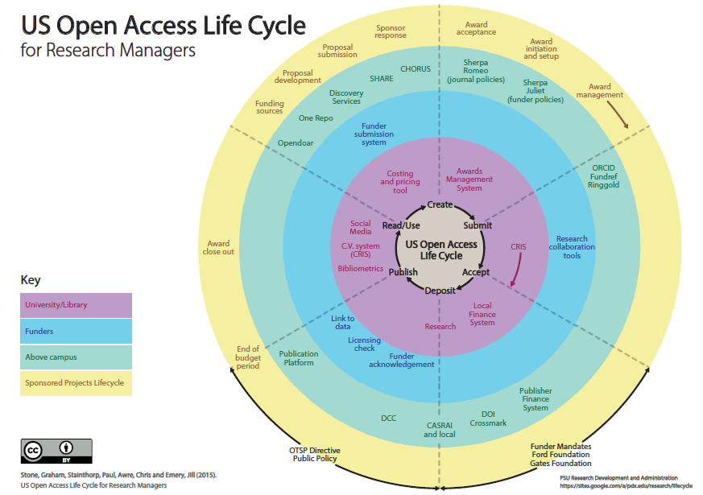
http://bit.ly/1NrkbRk

Slide 15
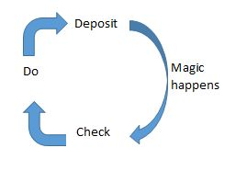
the Research Lifecycle
For researchers
URL: https://library3.hud.ac.uk/blogs/oawal/

Slide 16
the Research Lifecycle
For researchers
  Institutional processes – not all institutions will have all processes up and running
  Funder liaison/mandates that directly impact upon the work of the open access team
  Above campus services
  Publisher services that directly impact upon the work of the researchers
  6 sections of OAWAL
URL: https://library3.hud.ac.uk/blogs/oawal/

Slide 17
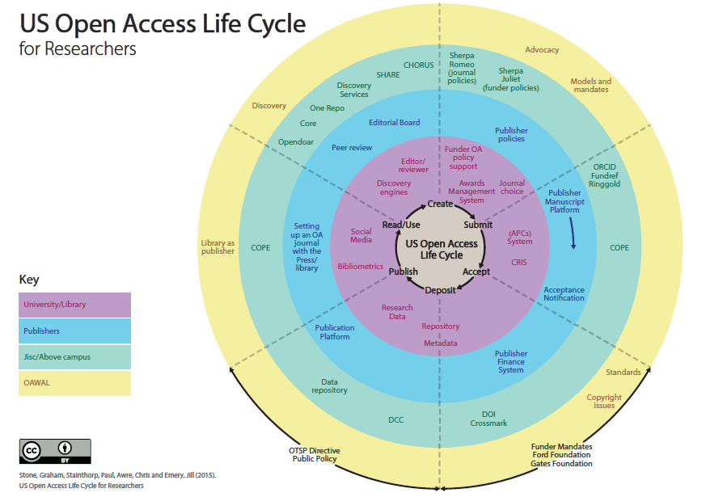
http://bit.ly/1NrkbRk

Slide 18
the Research Lifecycle
For publishers
  Institutional processes – not all institutions will have all processes up and running
  Funder liaison/mandates that directly impact upon the work of the open access team
  Above campus services
  6 sections of OAWAL
URL: https://library3.hud.ac.uk/blogs/oawal/

Slide 19
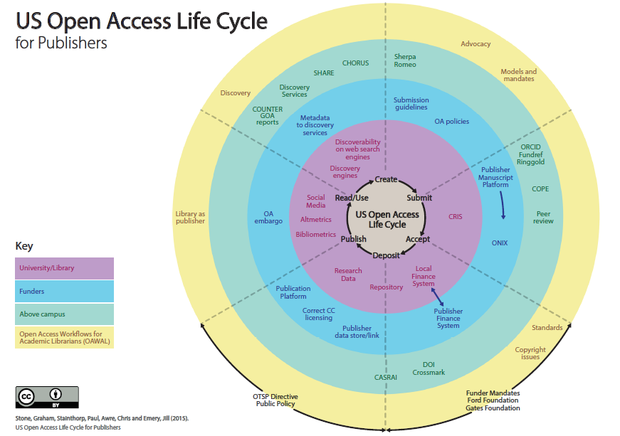
http://bit.ly/1NrkbRk

Slide 20
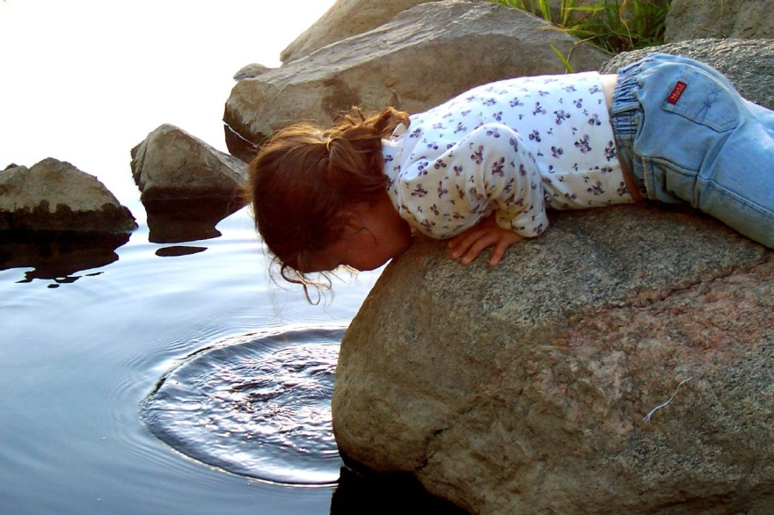
Ripple Effect
URL: https://library3.hud.ac.uk/blogs/oawal/
‘Ripple effect’ by Michelle Hofstrand available at https://flic.kr/p/4gBYo under a Creative Commons Attribution-NoDerivs 2.0 Generic. Full terms at https://creativecommons.org/licenses/by-nd/2.0/

Slide 21

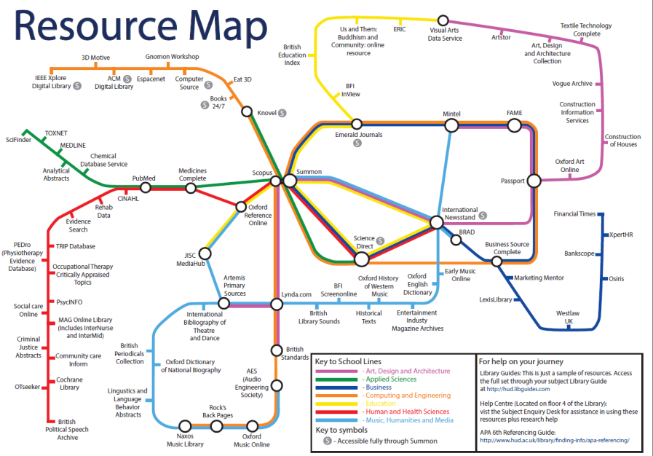
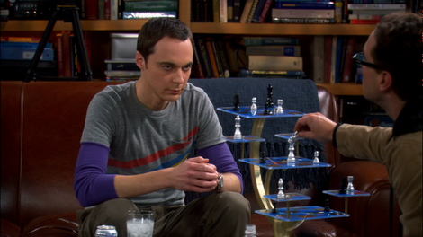
Joining the dots
From this:
To this:

Slide 22
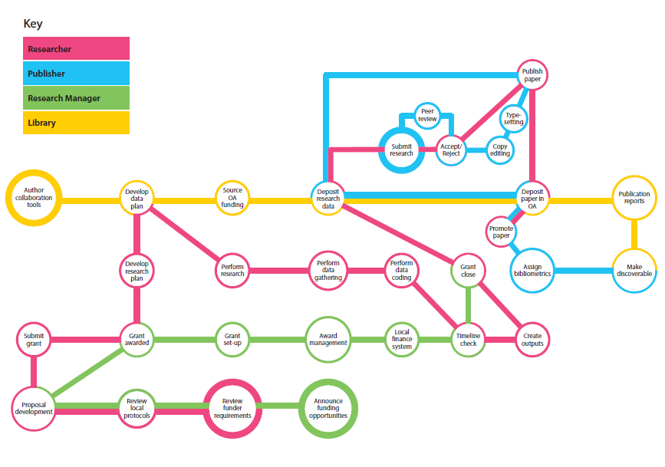
The research underground map
http://bit.ly/1NrkbRk

Slide 23

Further Questions?
https://library3.hud.ac.uk/blogs/oawal/
Jill Emery: jemery@pdx.edu
Graham Stone: g.stone@hud.ac.uk
This work is licensed under a Creative Commons Attribution 4.0 Unported License

