Slide 1
5 March 2019
Unlock the value of
open content
Notes:
NEXT: Swetta intro

Slide 2
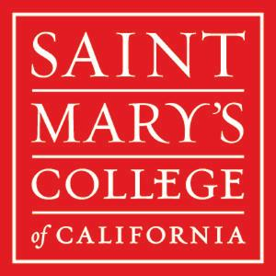
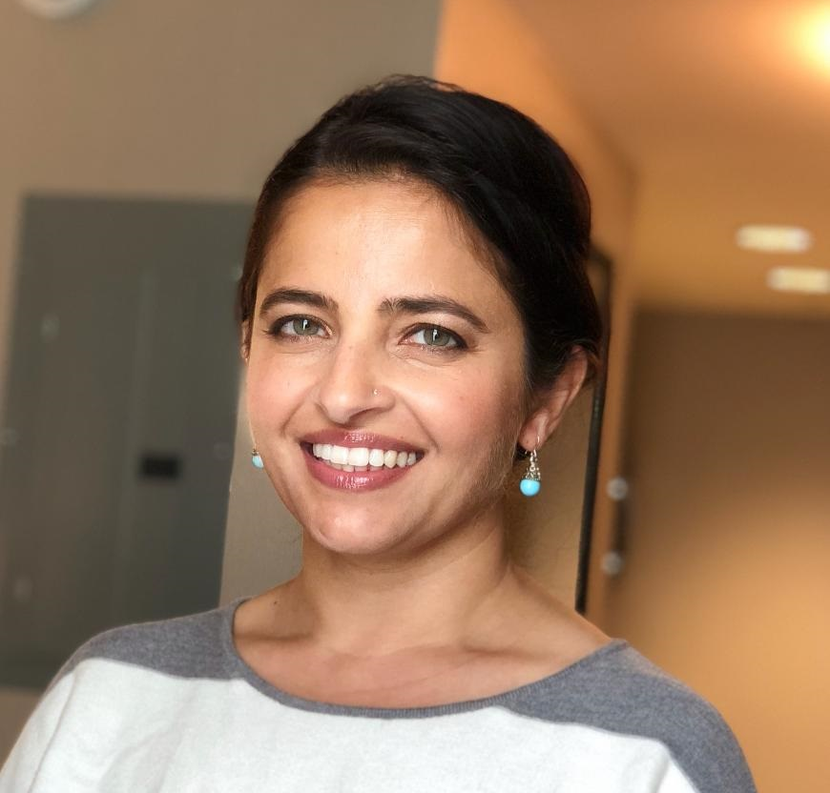
Swetta Abeyta
Collection Management and Library Subject Liaison
St. Mary’s College of California
Notes:
Hello, My name is Swetta Abeyta, and I’m a Collection Management analyst and library subject liaison. In my job, from the technical services side, I’m looking at Open access in terms of the metadata and usage of OA journals on our campus, and then on the public-facing size, I’m looking at the impact of Open Access and Open educational resources from an outreach and research lens.
NEXT: Open access at SMC

Slide 3
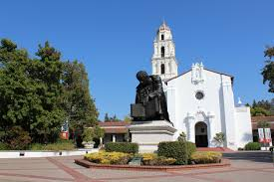
Open Access at Saint Mary’s College
Or...what we’re trying to do
Formed a library committee:
            Investigating action items and goals for campus
      Future whitepaper on OA and OER
Notes:
I want to talk about what we’re doing, or more accurately, what we’re TRYING to do at my institution. Saint Mary’s is a private Lasallian Catholic college. We have close to 4000 students and are trying to implement OA and OERs on our campus. You’ll hear Jill discuss what they’re doing at her institution, and...we’re not at that stage yet. I would say we’ve fallen into OA more than taken the lead on it at our campus. OA has snuck in and while we’re excited about it, but we need better messaging around it. And because we realize the importance of OA in our institution, we’ve formed a library committee to get a better handle on how to make open practice more cohesive and comprehensive. We’re trying to align our OA and OER goals with our campus strategic plan, and hope to work on a whitepaper in the near future.
NEXT: Open content at SMC

Slide 4
Open Content at Saint Mary’s College
Includes OA
  Databases include OA journals
  DeliverOA, EmbedOA
  Unpaywall
Includes OER
  Textbook out of print? Looking into OER
Stakeholders
        Impacts our faculty, researchers, students, and librarians
Notes:
So even without the comprehensive OA plan, we’re still finding ways to support Open content in our library. We’ve highlighted OA during Open Access week, we discuss OA during instruction and reference sessions.
Currently, we access OA through journals that we find through our discovery layer (we use Ebsco EDS), and we are looking into the Open Access Button and its useful DeliverOA and Embed OA options that allow ILL staff in libraries to find OA journals and allows patrons to check for Open Access options before they submit their ILL requests, respectively.
we’re also using Unpaywall when possible.
In terms of Open Educational Resources, one of our main books on writing research papers is out of print. One of my colleagues suggested that we replace the book with an OER option. There’s some faculty interest there. In this way, we’re hoping to identify and help faculty early adopters. There are some faculty that are going to be excited about OERs and we want to support them.
We understand that with open content, this impacts all of us in our entire campus ecosystem, from the faculty member who’s conducting research to a librarian helping a student find a research article that’s not available through our licensed databases.
NEXT: Considerations for open content

Slide 5
Considerations for Open Content
Content varies
  Purchased BePress (Digital Commons)
    Store faculty profiles
    Publish one open access
    (Engaging Pedagogies in Catholic Higher Education)
  Working with Vendors to display open content
Considering the consequences of prioritizing content
  How to display licensed content vs. open content
Notes:
So, when we specifically look at Open Content, we have some tools already in place and some other tools we can get with some guidance from vendors. We subscribe to BePress’s Digital Commons, which is our digital repository. We’re currently storing our faculty profiles and college-specific items there, but also publish and store an open access journal in Digital Commons.
One of the nice facets we’ve noticed from other Discovery vendors is the ability to limit to Open Access journals. Our vendor doesn’t currently have this facet available, but we’ve submitted an enhancement request. One of the questions that was brought up in our discussion for this presentation is how to prioritize content...would we prioritize licensed content that we pay hundreds of thousands of dollars for, or display open content. This is something we’re considering, but don’t have an official policy.
NEXT: Goals for open content

Slide 6
Goals for Open Content
Team up -- we can’t do it alone!
Help faculty understand the different OA publishing models and copyright
Market library resources related to Open Content (Digital repository, librarian knowledge, ILL options)
Impact student retention and persistence
Align Lassalian responsibility and social justice with OA and OER
Notes:
What do we want to get to eventually in terms of open at our campus? We know that the library can’t do this alone.
We want to team up with faculty, administration, the bookstore, IT services, and students.
We want to make sure we remove any hesitancy on our Faculty’s end in publishing in OA by giving them tools to understand the different models and understand copyright issues.
We also want to market the options that we already have available in the library, such as our Digital repository as possibility for storing OA journals, and leverage the librarian knowledge of the OA landscape, utilizing the tips and tricks I’ve mentioned already.
With OERs, we hope to impact student retention. Would saving money on textbooks encourage students to continue on with a class or a degree? We hope to investigate this.
Finally, I work at a Lasallian institution. One of the core principles of Lasallian tradition is concern for the poor and social justice. We hope to make a case that having a campus that encourages an open practice is aligned with this core principle.
Now I’ll pass it over to Jill. Thanks!
NEXT: Jill intro

Slide 7

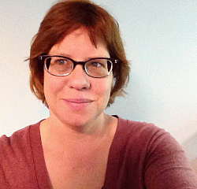


Jill Emery
Collection Development and Management Librarian
Portland State University
Notes:
NEXT: What is “open” at PSU

Slide 8
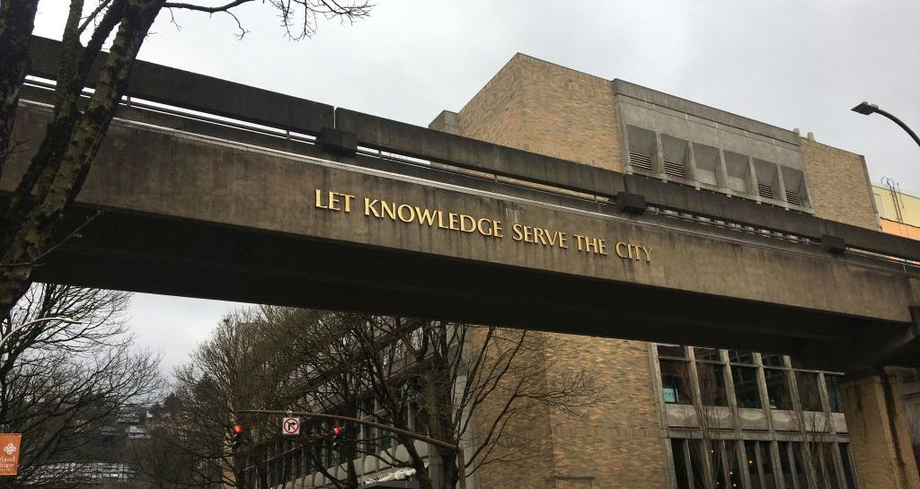
What is Open at Portland State University Library?
From the Scholarly Publishing & Academic Resource Coalition (SPARC): “Open Access is the free, immediate, online availability of research articles combined with the rights to use these articles fully in the digital environment. Open Access is the needed modern update for the communication of research that fully utilizes the Internet for what it was originally built to do—accelerate research.”
Open Access at Portland State:
Open Access research outputs promoted through LibGuides, A-Z listing of resources, & the catalog.
PDXScholar & PDXOpen, make available locally created scholarly works from faculty & students.
Data Management services are available to make data and other research products, such as lab notebooks, open to the public.
Support open creation through nominal APC support.
Notes:
NEXT: Open practice at PSU

Slide 9
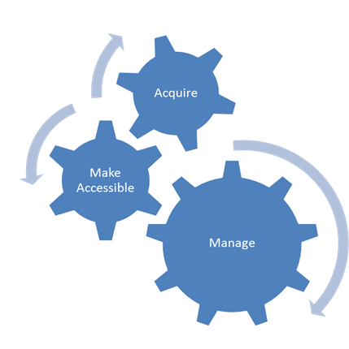
Open Practice at Portland State University Library
Our technologies group develops open source tools to promote content & services
We’ve adopted a Library Faculty Publication OA Policy
Research & Instruction faculty promote the use of Metrics Toolkit & other metrics for research assessment
Digital Scholarship Team participates in OpenCon through faculty sponsorship & local events (OA week, regional OpenCons)
Notes:
NEXT: Open practice at PSU (continued)

Slide 10
Open Practice at Portland State University Library
Digital Initiatives (DI) works closely with faculty & departments to get material into PDXScholar
DI accepts student work with approval of faculty & departments
DI & Research & Instruction faculty promote OA content & OER adoption & use
Research & Instruction faculty create LibGuides promoting use of OA content for topic guides & for post graduation use
Working with faculty senate on OA Publications
Notes:
NEXT: Open practice at PSU (continued)

Slide 11
Open Practice at Portland State University Library
Bibliometrics are key component of content evaluation for collection and retention
Use of OA content is also gauged when considering renegotiation of packages through using COUNTER statistics
With ILL, access services makes use of the OA Button to discover access alternatives
DI distributes an annual impact report
Negotiate for OA provisions in creative ways
Notes:
NEXT: Best practice for open practice

Slide 12

Best Practice for Open Practice
Whole library/all library workers define what open means & develops open practices
Collaborate with new partners
Lead by example
Open services can be scaffolded
Promotion of open as leading to student success both currently & in the future
Notes:
NEXT: Danielle intro

Slide 13
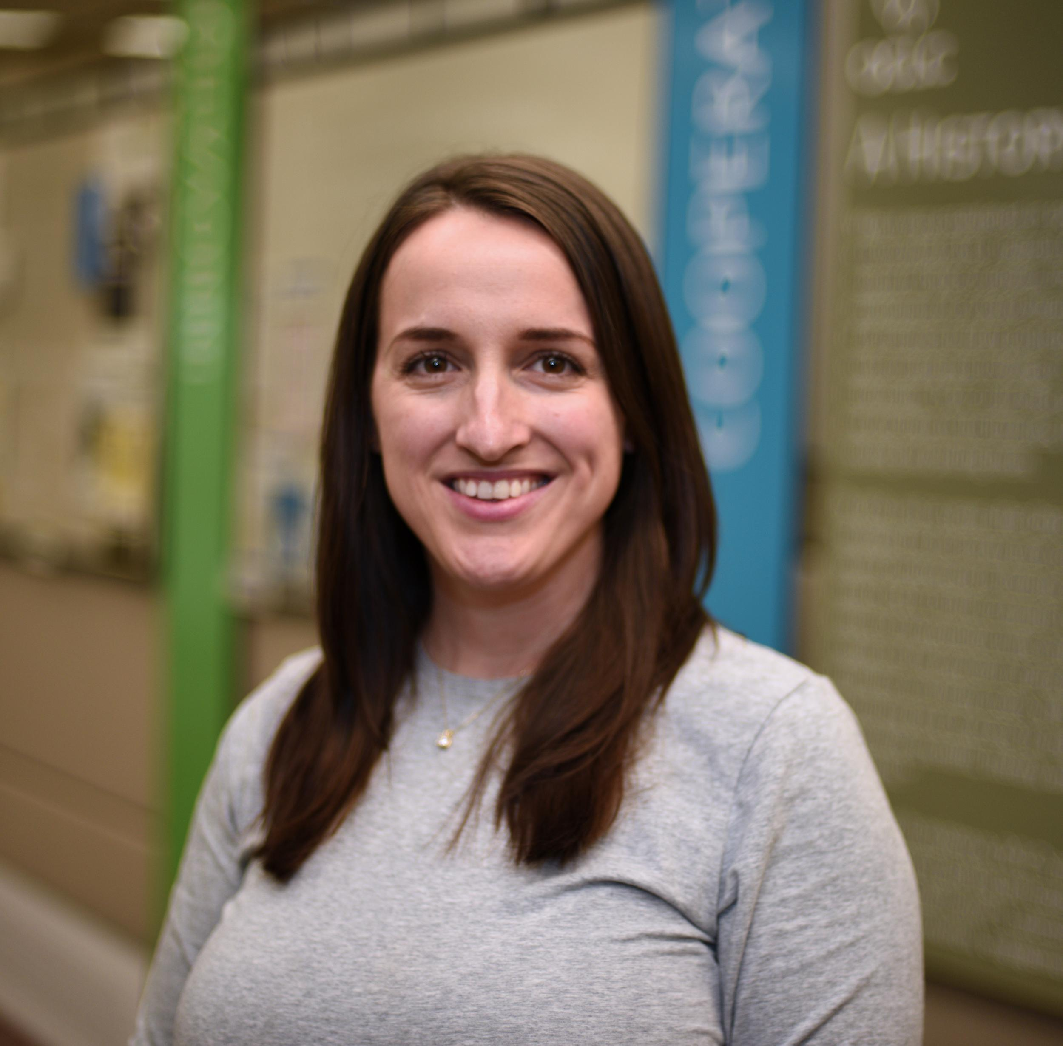
Danielle Bromelia
Product Analyst
OCLC
Notes:
NEXT: What does “open” mean?

Slide 14

What does “open” mean?
Notes:
Libraries are now expected—by researchers, funders, faculty, and especially end-users—to provide services that support open materials
“Open” in context to the library community is generally describes how content is published, accessed and used. (Depending on who you ask) there’s a general acknowledgment that the term “open” describes a continuum, rather than defining a specific set of criteria.
NEXT: How we define open content

Slide 15
How OCLC defines open content
Freely available
Digital
Accessible immediately and online
Usable fully in a digital environment
Inclusive of Public Domain where digital and available online
Notes:
OCLC uses the term “open content” and defines it as digital content that is freely available, immediate, and online, with the rights to use that content fully in a digital environment. ​​This includes Public Domain content that is digital and available online.
We recognized there are many degrees of access to information. Not all open or open access content is immediately free, free to use, or free of most rights restrictions.
As a company that is considered a research organization, a vendor and community partner, OCLC sits in this unique space that presents us with many opportunities and challenges.
NEXT: Why OA matters to us and the libraries we serve

Slide 16
Why open content matters to us
and the libraries we serve
Benefits
Challenges
Expanded collections
Unlimited access
Dissemination of knowledge
Greater visibility for libraries
Shift/lessen burden on budget
Access updates and broken links
Hosting or platform changes
Standards to identify
Variations in editorial practices
Notes:
While there are many benefits to open content, such as unlimited access, unlimited dissemination of knowledge to not just students but community members, greater visibility for library created and curated content, and lessening of the budget burden, there are also hurdles.
Challenges include identifying quality content when we get sparse metadata, how should we handle integration of Open Educational Resources, and technology issues like platform changes and broken links.
NEXT: Integration Opportunities

Slide 17
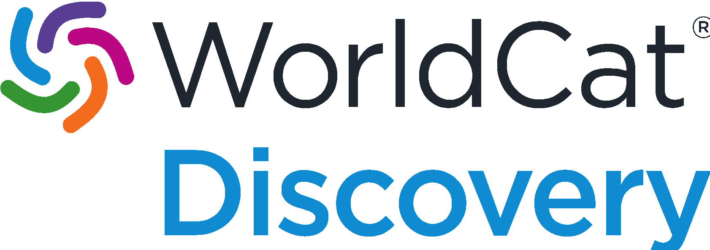
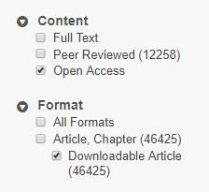
Integration opportunities
OA filter in WorldCat Discovery
  50M records (and growing!)
Impactstory / Unpaywall partnership
  Supports OA full text link validation
  Creation of an Unpaywall collections
380 open access collections in the WorldCat knowledge base (and growing!)
Forthcoming: OA filter in WorldCat.org
New MARC 856 standard to flag Open Content!
Notes:
Today, we want to highlight how we’ve integrated Open Content into two of our products: WorldCat Discovery, and the WorldCat knowledge base.
For those unfamiliar, WorldCat Discovery is a OCLC OPAC (catalog) interface.
In August of 2018, we wanted to figure out how to give catalog users an easier way to see what Open Content was available to them. We identified databases that contained citations open content (like JSTOR, DOAJ, DOAB, Hindawi, Biomed Central) as well as records within WorldCat that contained a 506 subfield f Star Heading of Unrestricted Online access to create an Open Access filter.
A parallel effort as the same time was trying to figure out how to integrate with Unpaywall to validate DOI’s on any citation searched in WorldCat Discovery to guarantee the DOI would always be taking the user to an item that is Open Access.
In the WorldCat knowledge base, we have around 380 collections of freely available content available, representing nearly 100 providers that is always growing. Users can surface these links on citations in WorldCat Discovery and in addition, cataloging customers, can download MARC for these collections to add Open Content to their local OPAC.
We are always looking for new integration opportunities to help surface Open Content.
In a few months we hope to have the Open Access filter live in WorldCat.org and by the end of the year take advantage of the new MARC standard to capture more records in WorldCat that contain Open Content!
NEXT: Research and initiatives

Slide 18

Research and initiatives
OCLC is proud to be a participant and voice in the Open Access movement alongside great associations and partners such as NISO’s ODI, COAR, SPARC, IIIF, ORCid, and DataCite.
Open Content Survey
MARC21 format changes to improve the designation of OA and license information.
Stay up to date at https://oc.lc/open
Open Content Survey
Notes:
As a member of the library community we are always looking on ways we can better educate ourselves and participate in the Open Content movement. Staff at OCLC seek out opportunities and become involved in ODI, SPARC, IIIF, MARC and more.
We have an amazing research department. They are one of the world's leading centers devoted exclusively to the challenges facing libraries and archives in a rapidly changing information technology environment. Our researchers work on a number of projects relating to open content and are always contributing in the community. One recent effort included the creation of the open content survey, for which we received 705 responses from 82 countries. Results are currently being analyzed, and will be shared later this year. On OCLC’s open content webpage at oc.lc/open, you can learn more about what we are doing and stay up-to-date on news, activities, and events.
Earlier we told you about a new MARC standard. OCLC, in collaboration with the German National Library, crafted a discussion paper, which became a proposal, which then was accepted to become a new MARC standard to help identify Open Access and License Information for Remote Online Resources
MARC 21 next steps:
Library of Congress officially publishes the changes (not sure exactly, but sometime soon)
OCLC starts development process, schedules development (this typically happens in the Fall)
Libraries can start making use of the field in WorldCat
OCLC starts populating data (likely end of year through next year depending on how quickly the records can be updated)
NEXT: Many questions remain/Q&A

Slide 19


Notes:
Many questions about open content remain.
How we can create more opportunities to help surface Open Content?
How can we fund and sustain these efforts?
What are actions that the community wants us to pursue?
Where do we see opportunities to surface Open Content in unique but related platforms, like Open Educational Resources, Repositories, and traditional OPACs.
OCLC is committed to improving the visibility and accessibility of open content materials and engaging with the community in these questions.
So how about questions from you?
NEXT: Thank you!

Slide 20
Thank you!

