Slide 1


BRINGING IT HOME!
Jeremy Smith
Digital Projects Manager in Scholarly Communication, University of Massachusetts Amherst
Jody Carson
Associate Professor of Early Childhood Education, Northern Essex Community College
Kevin Corcoran
Executive Director, Digital Learning,
Connecticut State Colleges & Universities
Sue Tashjian
Coordinator of Instructional Technology,
Northern Essex Community College
The benefits of regional collaboration
Bringing It Home: The Benefits of Regional Collaboration by Jeremy Smith, Jody Carson, Sue Tashjian, Kevin Corcoran, is licensed under a Creative Commons Attribution 4.0 International License.

Slide 2
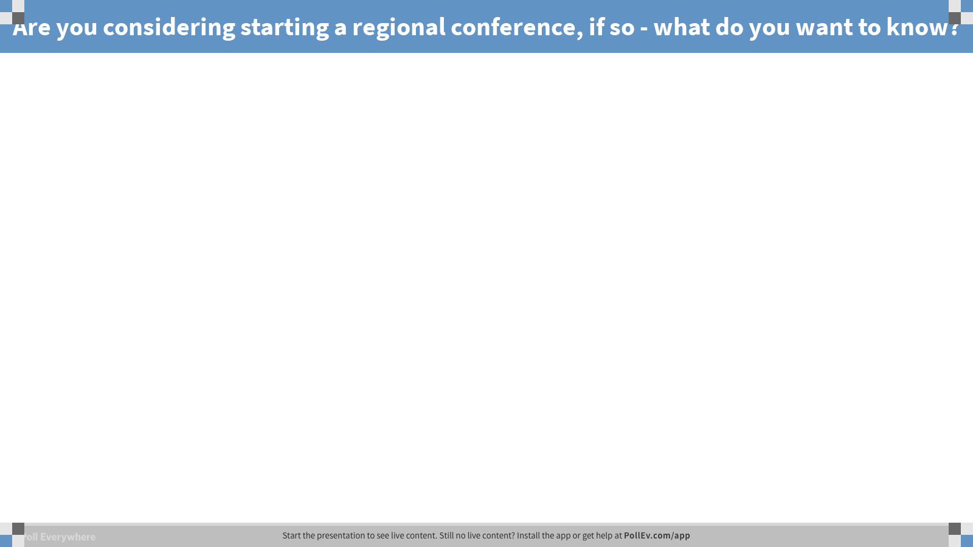

Slide 3
Agenda
How it All Began
Nuts & Bolts
Benefits of Regional Collaboration
Tips & Advice
Moving Ahead

Slide 4
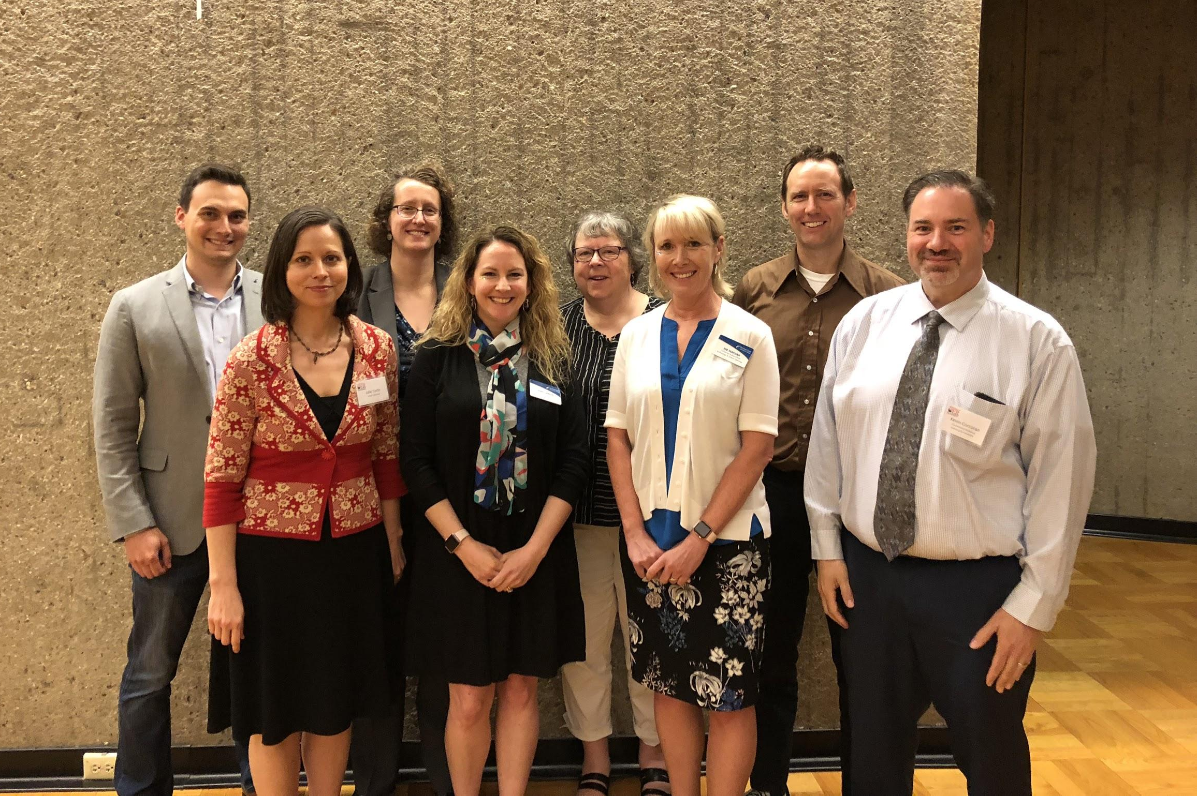
Core Planning Team

Slide 5
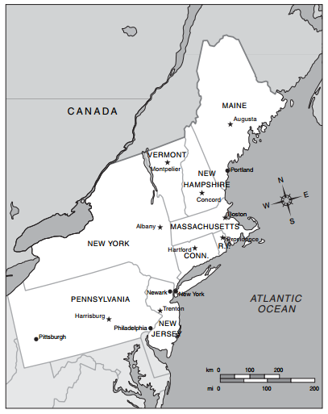
Northeast Region
UMass Amherst

Slide 6








Attendance by State
1
16
66
46
33
10
5
9
PLUS
Edmonton, AB
Ontario
Arizona
California
Georgia
Washington, DC
Nevada

Slide 7
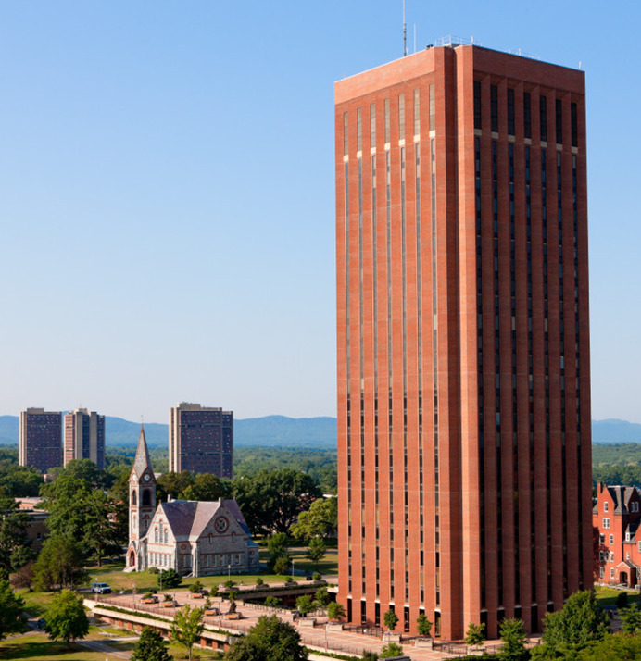
How It All Began

Slide 8
Nuts & Bolts

Slide 9
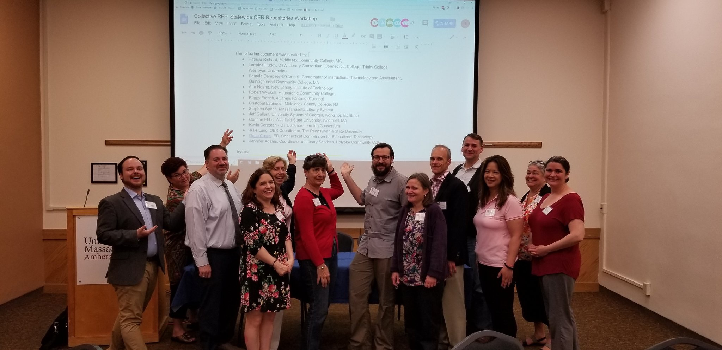
Benefits of Regional Collaboration

Slide 10
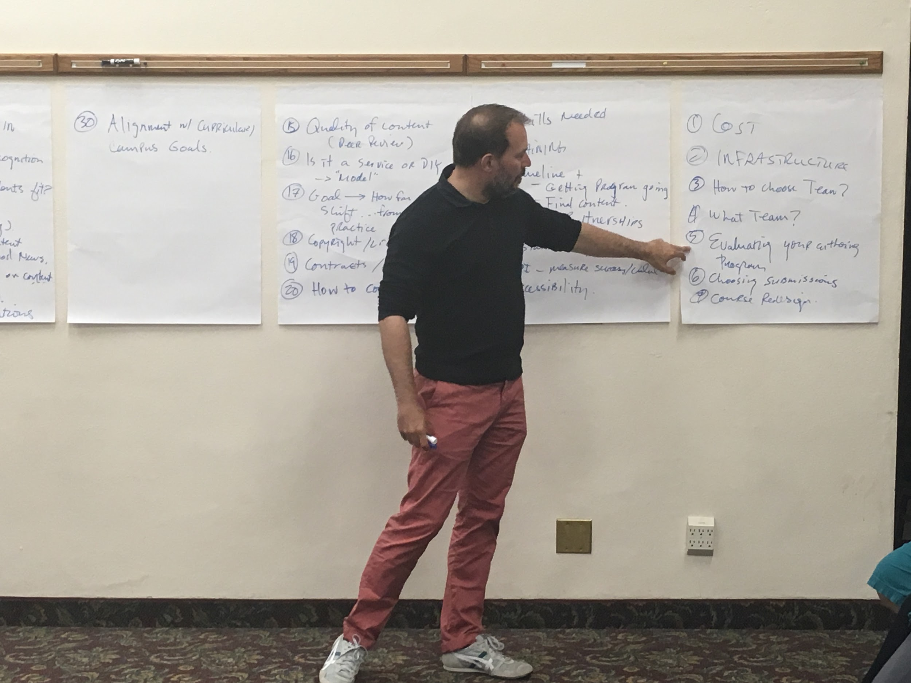
Tips & Advice
Tips & Advice

Slide 11
Moving Ahead

Slide 12
BRINGING IT HOME!
Thank you!
Questions?
The benefits of regional collaboration

