Slide 1
Participation on the high plains
Increasing Student Engagement in an Upper-Division, Three-Credit Information Literacy Course
Jennifer Mayer
Melissa Bowles-Terry
LOEX of the West, June 2012
Notes:
Good morning, I am Jennifer Mayer, Research and Instruction Librarian at the University of Wyoming Libraries. My talk today is about how my colleague and I engaged students in our credit information literacy credit class.
Melissa Bowles-Terry, my co-teacher and UW Libraries’ Instruction and Assessment coordinator regrets she is not able to be here today, so I will present our work.

Slide 2
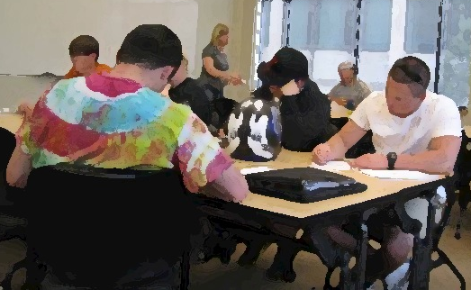
Today’s Talk
Overview of our 3 credit course
Engaging students from a variety of disciplines
Assessment
Future Directions
Q & A

Slide 3
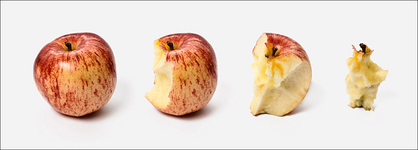
LBRY 3020: Beginnings and Evolution
University Studies Program (USP)
LBRY 3010: Research from a Distance 1.0 credit hours, online
LBRY 3020: Managing and Navigating the World of Information 3.0 credit hours
Prepares students to be knowledgeable consumers of information in our global, high-tech society. Skills taught enable students to locate and manage information resources, preparing them for university level research and life after graduation. Prerequisite: WA (Writing, Freshman Composition).
http://www.flickr.com/x/t/0099009/photos/szb78/3349572686/
Notes:
WHY WE OFFER CLASS Managing and Navigating the World of Information: ties to our university’s General Education Plan (University Studies Program) which has been in place since 2003. USP has many requirements, the L is one, to meet IL instruction in a more in-depth way. The course catalog description appears on the slide.
WAYS STUDENTS can get currently meet their “L” requirement: Our USP general education program requires students to complete an information literacy intensive course, and for many students that is embedded in their major. This usually happens in a freshman level course, but the junior level information literacy class taught by librarians meets the general education requirement for transfer students or others who missed the IL class offered within their majors.
HISTORY/EVOLUTION: R & I decided to teach a credit class in 2007. Four librarians met—2 focused on developing 3010 (off-campus, 1 credit) and the other 2 on 3020 (on-campus, 3 credits, for students grad school bound). Both were offered for the first time in Spring 2008. We get a professional development stipend for teaching credit classes via the Outreach School.
3020 MAJOR REVAMP for Spring 2010 by MBT, team taught Spring 2011, Spring 2012.
COURSE PREFIX: LBRY was approved by the registrar (noted L requirement), since we are not under the College of Ed (LIBS) media specialists classes (which are no longer offered). HOW IS IT DIFFERENT/LIT REVIEW: Most articles, presentations discuss 1 credit, or freshman level, or online IL courses and assessment. Our students are juniors and seniors and have a disciplinary identity when they come to our class.

Slide 4
Poll
How many teach a credit IL course?
How many credit hours?
1.0 or 2.0
3.0 or 4.0
Class level?
Freshman
Sophomore
Junior
Senior
Graduate
Format?
Online
Face to Face or Hybrid
Focus?
General/interdisciplinary
Subject specific
How many have an IL requirement at your institution?
Notes:
Make clear entire poll is about Information Literacy credit classes

Slide 5
LBRY 3020 Learning Outcomes
Students will be able to locate, evaluate and use information appropriately.
Students will be knowledgeable users of library and information resources.
Students will use information as a commodity by completing exercises to find and evaluate information and to manage and manipulate it for a targeted goal.
Notes:
All of our learning outcomes are based on ACRL IL Standards as well as the university studies program standards--both helped guide our course content.
I’ll give you a chance to read these. Read them myself to make sure I leave up long enough.

Slide 6
LBRY 3020 Learning Outcomes, cont’d.
Students will become information literate learners, able to integrate technology skills and information literacy skills.
Students will demonstrate an understanding of ethical issues such as plagiarism, copyright and intellectual freedom.

Slide 7


LBRY 3020 Course Structure
Libguide http://libguides.uwyo.edu/LBRY3020
Syllabus: current→post-graduation information needs
TIP http://tip.uwyo.edu/info_overload.html
Textbook
Notes:
Team taught Spring 2011 and Spring 2012.
3.0 credit class, met twice a week in the library classroom for 75 minutes each. 30 individual classes during the semester with 24 students total (2 dropped), similar numbers for Spring 2011. The class is capped at 24, which is seating for the room, don’t want it to be bigger, although could work with a few less students.
Libguide for 2012, Wikis for previous 2 years. Libguide worked well, we posted all course materials there including syllabus (show a few aspects of the libguide) Our guide had about 1700 views during the semester. Briefly show
Syllabus: How syllabus is structured, relates to TIP and George textbook (search, locate, evaluate, utilize). You can take a closer look at our syllabus if you want later.
TIP: Show brief view of TIP, created by UW Librarians, is included in ACRL’s PRIMO database of quality instructional tools. Has modules, quiz has 50 questions, multiple choice.
George book, cover on slide
Fee→free
Exercises throughout semester culminates in research presentation and paper at the end of the semester.

Slide 8
LBRY 3020 Course Structure
TIP: Tutorial for Information Power
Elements of Library Research by Mary George
Investigating
Searching
Locating
Evaluating
Utilizing
Research Assignment to Research Plan
Strategy and Tools for Discovery
Fine Art of Finding Sources
Insight, Evaluation, Argument and Beyond
Notes:
Helped guide the arc of the semester.

Slide 9
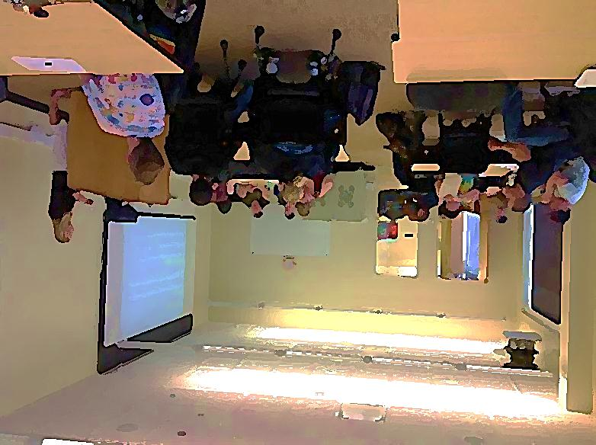
Engaging Students & Cohesion
Themes: Pop Culture, Education, Foodways, Social Justice, Social Media Technology
Seating
Notes:
Choices by instructors, class discusses, we brainstorm on whiteboard or bubbl (a free online concept mapping tool), and class votes
Cohesion in interdisciplinary class—majors ran gamut art, social sciences, health, physics, geography, english
Encouraged them to use theme as it related to their major area of study in their work for the class, presentation and paper.
This image is our classroom.

Slide 10
So, Exactly How Did We Engage Students?
Class Discussion:
Articles, textbook chapters
Active learning:
Ethnographers
Video clips with discussion
Ipads
Exercises related to major
Individual tech exercises
Notes:
Active Learning and Participation were guiding principles for this class.
Discussion and Participation: Heavily weighted part of grade 40%. Counted discussion and completing exercises, so not all verbal. Other %s for grade. Students select articles for discussion and provide questions for discussion. They are responsible for finding, evaluating, and sharing the common readings. Instructors select 5 articles and related questions for class discussion related to social justice. Questions for discussion with open ended prompts from instructor. Discuss George textbook readings. We started discussion early in the semester to set that as the norm for the class.
Active Learning exercises: Activities include library ethnographers, video clips with exercises and discussion (Ring, High Fidelity), used ipads for a couple of exercises, political fact checking, finding examples of famous plagiarism or copyright lawsuits on youtube, testing search engines
Exercise related to major: Call #s, what does research look like in your major, preso/paper could relate to major.
Individual exercises—hands on work—some tech tools work, setting up Refworks acct, posting to Wikipedia
We use some exercises from The Library Instruction Cookbook
Mini lectures (images, primary sources, writing) and Guest speakers—used sparingly & effectively and for only part of the class scholarly comm libn, gov info libn, 1 class field trip to archives and rare books—when we were discussing primary sources.

Slide 11
More On Engaging Students
Peer review
Reflective writing
Notes:
Peer Review was a little awkward, not bad. Each student wrote up their research plan, and in the following class, a table mate reviewed it using a rubric and returned their feedback. May try it again as an anonymous process.
Reflective Writing—we had them write on: What was a research project you were successful at, research hang-ups, how will you manage your research this semester, how do you define information literacy (early and later), what went well and what did not with your paper?

Slide 12
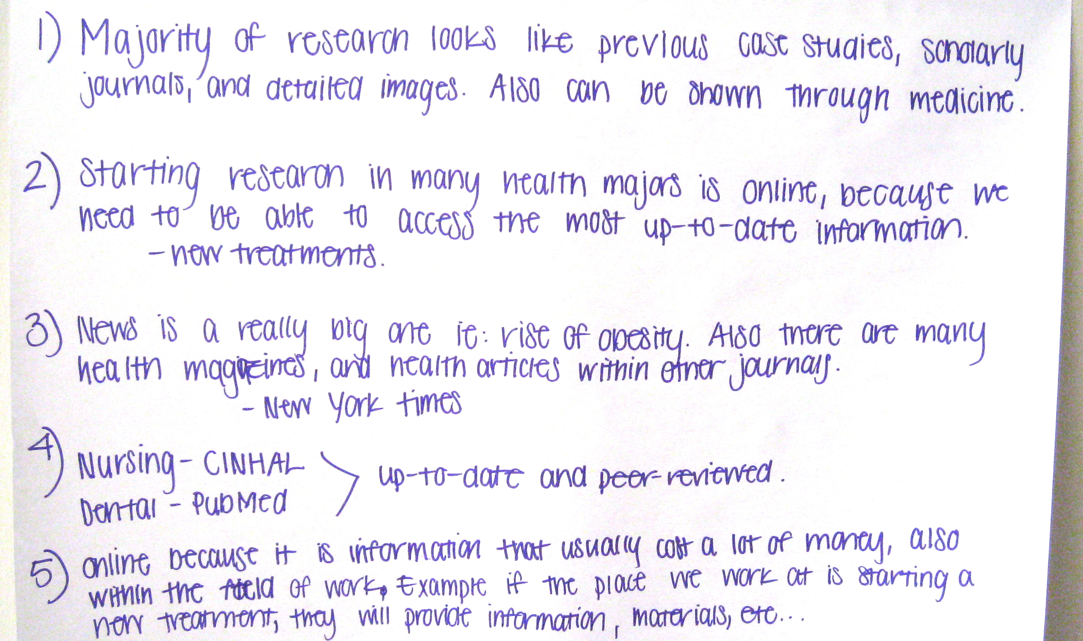
How do you engage students?
Notes:
Photo of giant post it note, we had students get into groups by major/discipline and write what research looks like in their field, and then present to the class—this one is by health students.
Please take a few minutes talk to neighbor, how you engage students in a 1 shot BI or in a credit course. Then I will talk about how we assessed the various aspects of our credit class.

Slide 13
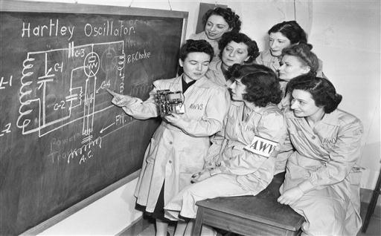
Assessment Tools and Strategies
Pre and post tests
TIP quick checks and quiz
Exercises
Discussion
Midterm evaluation
Drafts & conferences
Synthesis Essay
New York, Feb. 29, 1943. (AP Photo/Robert Kradin)
Notes:
Some of our assessment activities took place at certain times, other was ongoing
Pre/Post—same test at the very beginning of the semester and at the very end and it provided excellent evidence of the impact of our class.
TIP quick checks (a few multiple choice questions per module in class and quiz at end)
Exercises
Participation and discussion: had students write out answers to text book chapters, greatly helped that part of the discussion in class, especially for the more introverted students to have notes.
Midterm eval
One on one conferences
Synthesis essay

Slide 14
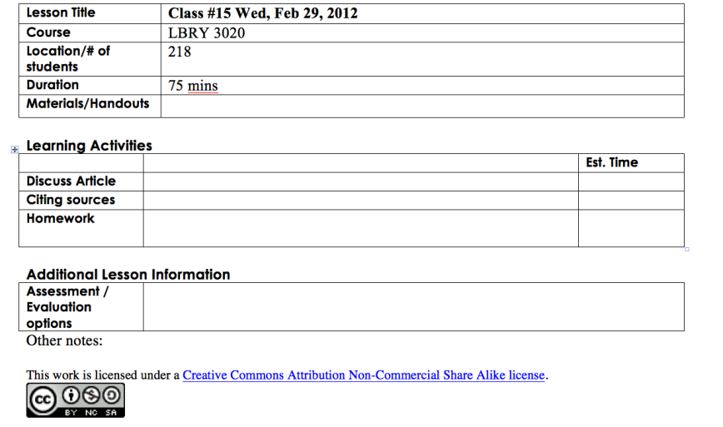
Lesson Plans and Grading
Notes:
How we planned and graded: We split the class into 2 groups. Used rubrics for the presentation and the paper. Met once a week to touch base and plan details of following weeks’ lesson plans. Noted in spreadsheet header for each class meeting how to assign points for each class period.

Slide 15
Assessment Findings
Comparing LBRY 3020 Spring 2011 and Spring 2012
Pre and post
TIP scores
Overall grades
Themes from Student Evaluations

Slide 16
Assessment Findings
Comparing LBRY 3020 Spring 2011 and Spring 2012
Pre and post test results
Concept | Improved Spring 2011 | Improved Spring 2012
Secondary v. primary source | 18% (64% → 82%) | 21.25% (60% → 81.25%)
Popular v. scholarly source | 9% (55% → 64%) | 45% (55% → 100%)
Definition of peer review | -5% (82% → 77%) oops! | 20% (80% → 100%)
Total Improvement | 8% | 13%
Notes:
The Pre and Post test were the same 10 questions with multiple choice, each tied to a specific ACRL standard ex. A peer reviewed journal is or the library catalog contains and 5 additional confidence questions (ex. I have a well-defined information research process—agree, I think I do, I’ve never thought about it, disagree).
Difficulty with Boolean! Not relevant to them, apparently they do not search that way.
Based on pre/post test, results from both semesters show that students increased knowledge and confidence, but more so in Spring 2012 than Spring 2011.

Slide 17
Assessment Findings
Comparing LBRY 3020 Spring 2011 and Spring 2012
TIP scores
Spring 2011 Average | Spring 2012 Average | UW Average
90.25% | 84.5% | 87%
Final grades very similar for both classes
Spring 2011: 80.3261%
Spring 2012: 80.5175%
Notes:
Students completed online tutorial TIP. All UW students are required to take TIP, so that is the UW average on this chart.
Our class’s TIP quiz scores were slightly higher in 2011 and slightly lower average in Spring 2012, but in the neighborhood both years.

Slide 18
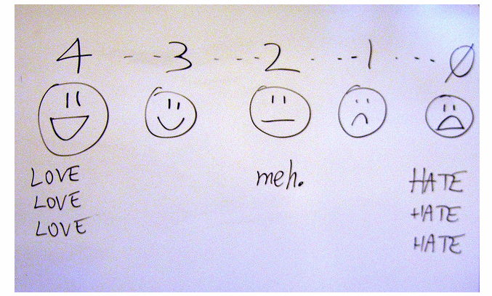
Class Evaluation Feedback
Positives, negatives
Changes implemented
http://www.flickr.com/photos/billsophoto/4175299981/
Notes:
Positives: class environment, appreciated approachability, helped develop research skills and awareness of resources available to them.
Negatives: A couple of comments about difficulty understanding when exercises were due if continued outside of class
Neutrals: I wish I had this earlier
Changes: More clear about when items were due. We did not make any significant changes to the class between years, just tweaks to exercises, order

Slide 19
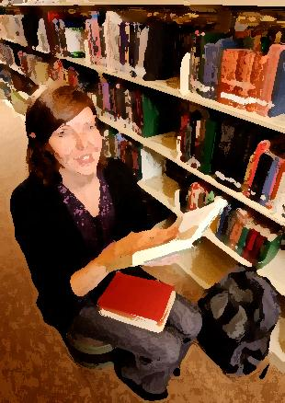
Anecdotal Findings
Student
Bonded with their groups
Librarian
Invigorating change
Semester-long work with students
Helped fill in gaps
Parallels role of other teaching faculty on campus
Notes:
Students: For the most part, got close to others at their table of 3 or 4. Sometimes they bonded to the point of dating. Several made friends.
My perspective: Gratifying experience.
Student/Teacher Relationships—nice to build. Also excellent to work closely with a colleague.
Informed/Confirmed—where are L gaps on campus programs, where is it strong?
Why some majors not represented? More L classes in their disciplines, advising, transfer students, etc. Ex. No engineering, music, education
How our students approach research—blogs, google, youtube, a few had used databases.

Slide 20
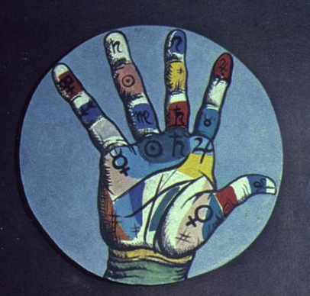
Future Directions
Currently revising our University Studies Program
Communication
Writing
Subject Specific
Detail from: Berni, Antonio, Ramona & the Fortune Teller, 1976, Painting and collage
Notes:
The L requirement was in place in 2003 as part of our University Studies Program. One of our librarians was a committee member during the creation of USP, and she got buy in for the L requirement, after attending Immersion.
Currently, the USP is being streamlined and various requirements are jettisoned (O, D, G, L, others)—too difficult for students to deal with alphabet soup of requirements. Instead, IL and other components will be seen as embedded throughout the curriculum. Another R & I librarian is heavily involved with the revision as a committee member, and has chaired the USP Course approval committee. We will continue to have librarian representation on the revision committees during this process. Does not effect the majority of our one-shots. In terms of one-shot visits that are with an L class, those faculty will probably still be involved with the library one way or another. The biggest impact will probably be on LBRY 3010 and 3020, our credit classes. We plan to morph our previous L courses into the new Communications requirement (C1=freshman comp, C2 writing in a discipline (us), C3 Writing/communication in a profession. The new USP description includes terms like critical thinking and inquiry and analysis, that is our expertise, so we feel good about our role. We want our class to remain open to all disciplines and are optimistic that this is possible. Another future avenue for our credit classes is to develop and offer some with subject specific focus, ie research in the humanities, arts, business, social science etc .

Slide 21
References
George, Mary W. The Elements of Library Research: What Every Student Needs to Know. Princeton, N.J: Princeton University Press, 2008.
Sittler, Ryan, and Douglas Cook. The Library Instruction Cookbook. Chicago: Association of College and Research Libraries, 2009.
TIP: Tutorial for Information Power. University of Wyoming Libraries. http://tip.uwyo.edu/info_overload.html

Slide 22
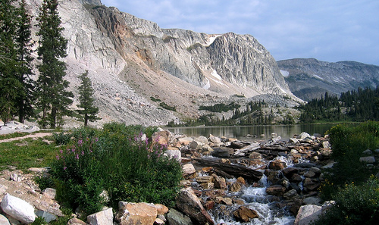
The Snowy Range outside of Laramie, WY
http://www.flickr.com/photos/pfc/988596162/

