Slide 1
Library Training for the
Harvard Negotiation Law Journal
2020-21 Academic Year
Jennifer Allison, Research Librarian
Harvard Law School Library

Slide 2
Today’s Training
What’s Up at the Library?
HOLLIS
Scan and Deliver
InterLibrary Loan (ILL)
Bluebook
Getting Help For Finding Sources

Slide 3

What’s Up At The Library?

Slide 4
What’s Up At The Library?
As of today, July 17:
All Harvard libraries are closed.
The law library’s print books are not available.
Print books from the library’s offsite storage facility, as well as from Widener and Lamont libraries, can be checked out through HOLLIS and picked up at Lamont by appointment.
E-Books, if we have them, can be accessed through HOLLIS.
You can make InterLibrary Loan (ILL) requests.
The law library’s research librarians are working from home and ready to help!

Slide 5
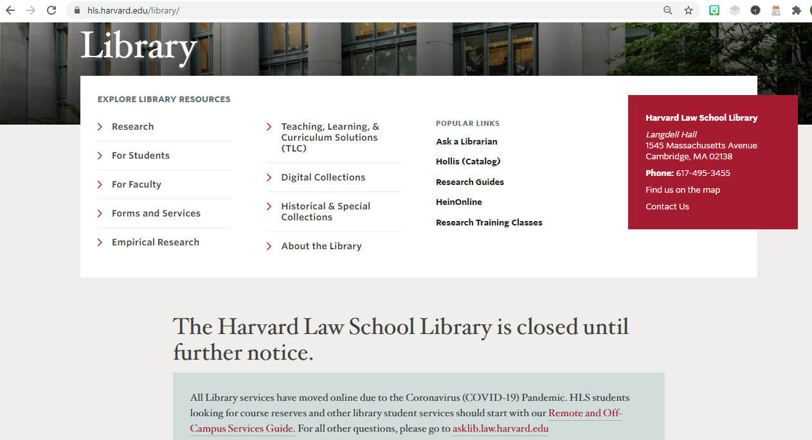
What’s Up At The Library?
To get the latest news about the state of things at the law library, start at our website:
https://hls.harvard.edu/library/

Slide 6
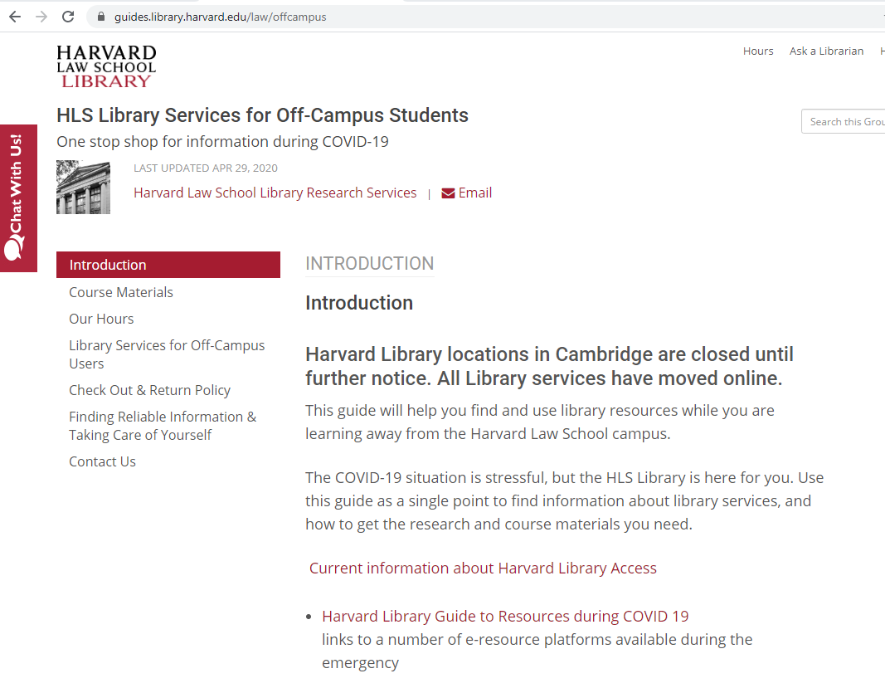
What’s Up At The Library?
Also, see the guide to HLS Library Services for Off-Campus Students:
https://guides.library.harvard.edu/law/offcampus

Slide 7
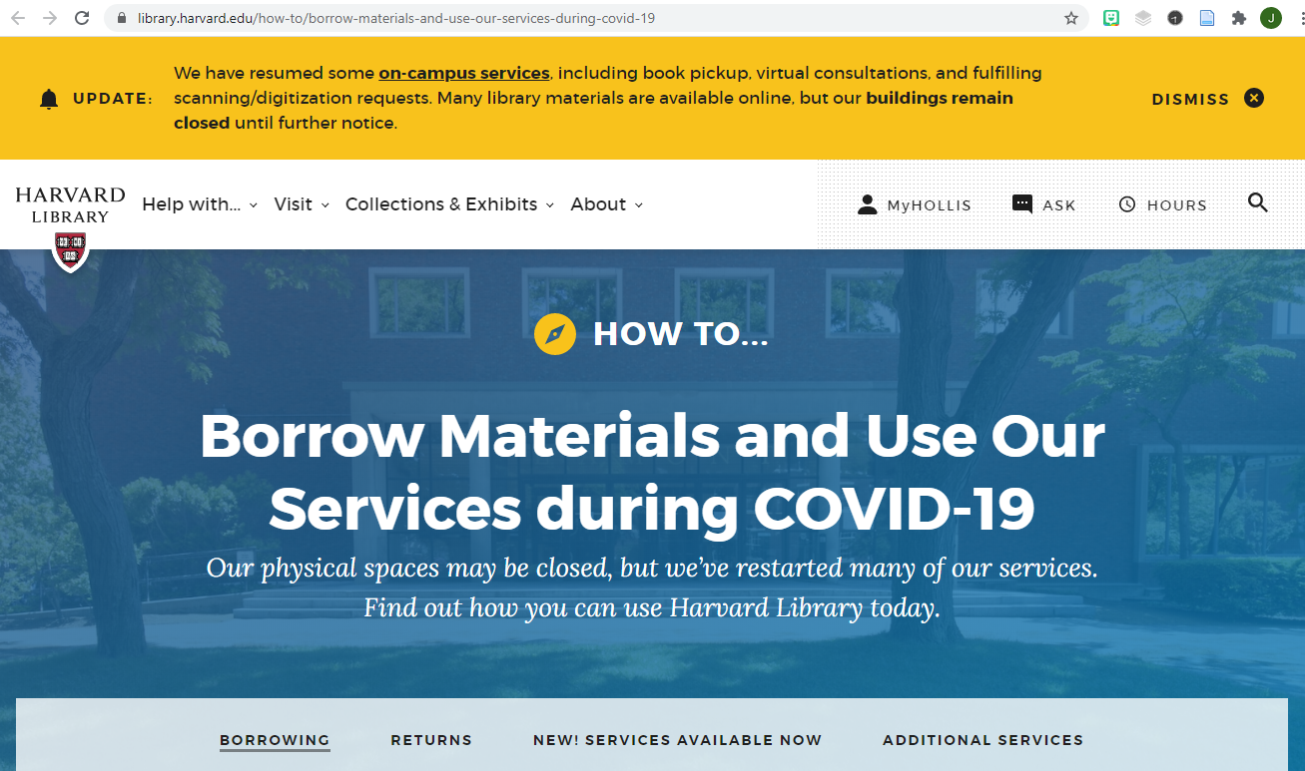
What’s Up At The Library?
See the Harvard Library’s guide on borrowing and services during COVID-19.
https://library.harvard.edu/how-to/borrow-materials-and-use-our-services-during-covid-19

Slide 8
What’s Up At The Library?
Email Jennifer:
jallison@law.harvard.edu
Ask a Librarian:
research@law.harvard.edu

Slide 9
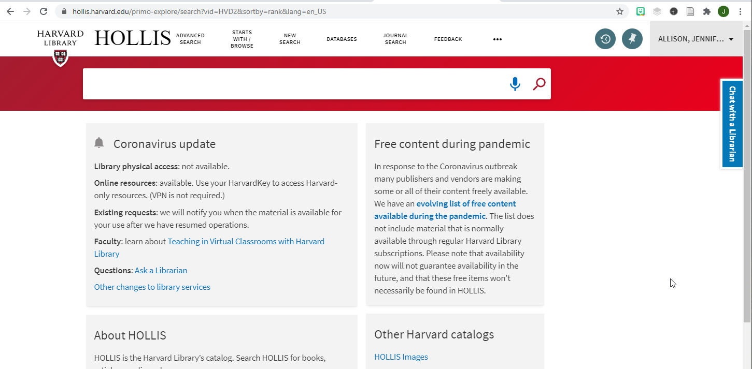
HOLLIS

Slide 10
HOLLIS
HOLLIS is the Harvard Library catalog.
Go to https://hollis.harvard.edu.
Sign in with your HarvardKey credentials.

Slide 11

HOLLIS: Database Access
This is footnote 9 of the article by Professor Chow that you will be publishing this fall. It cites a treaty.

Slide 12
HOLLIS: Database Access
U.N.T.S. = United Nations Treaty Series.
This publication is in HeinOnline, which you can search by citation.
Use HOLLIS to access HeinOnline.

Slide 13
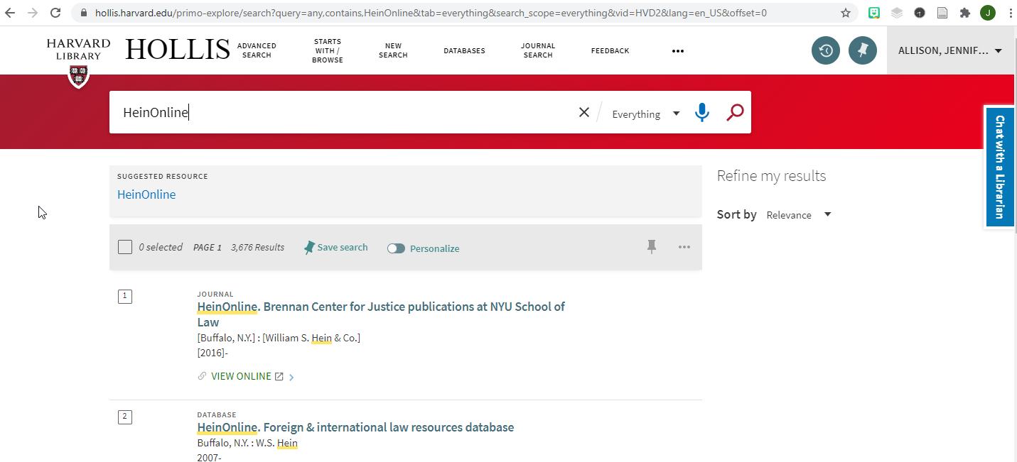
HOLLIS: Database Access
Search HOLLIS for HeinOnline, all one word.
Click the link under
Suggested Resources.

Slide 14
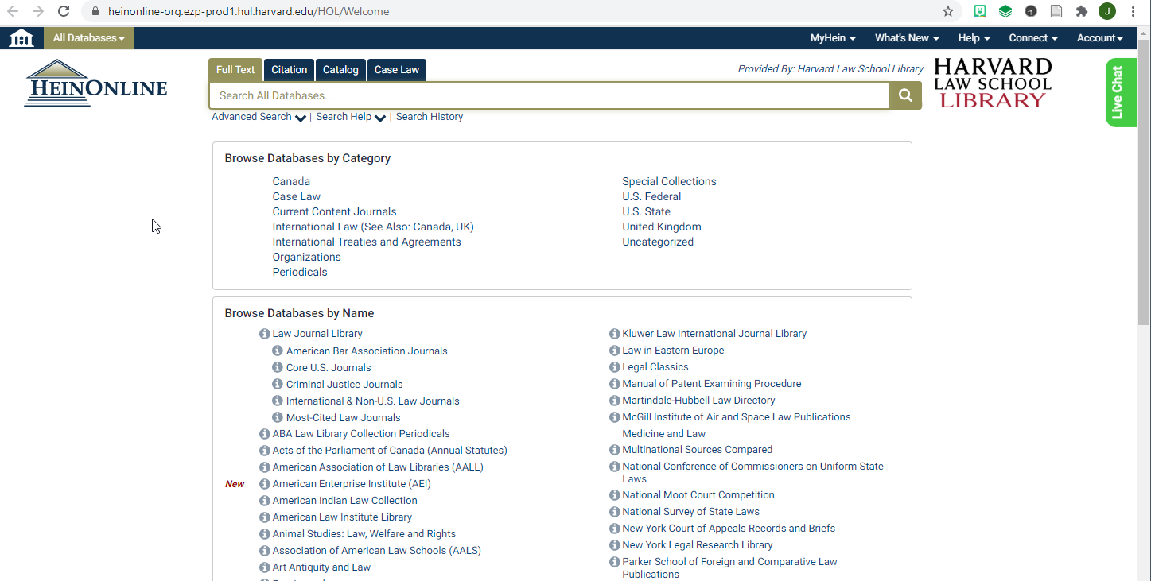
HOLLIS: Database Access

Slide 15
HOLLIS: Database Access
HeinOnline has PDF page image scans of law review articles, bar journal articles, older books, treaties, older statutes and regulations, presidential documents, restatements and model laws, and much more.

Slide 16
HOLLIS: Database Access
To find this treaty, go to HeinOnline and click the Citation tab.
Then, enter the UNTS citation.

Slide 17
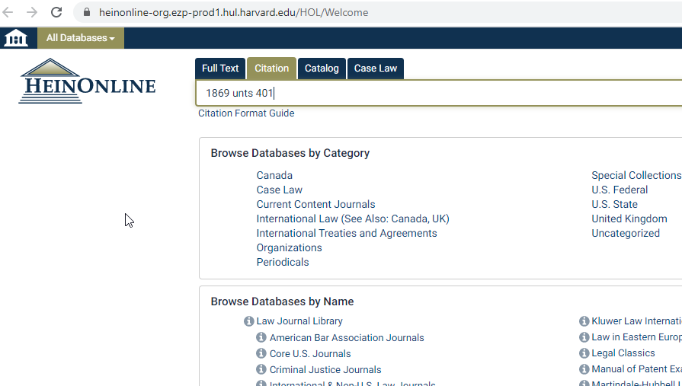
HOLLIS: Database Access
Click the Citation tab.
Enter the UNTS citation.

Slide 18
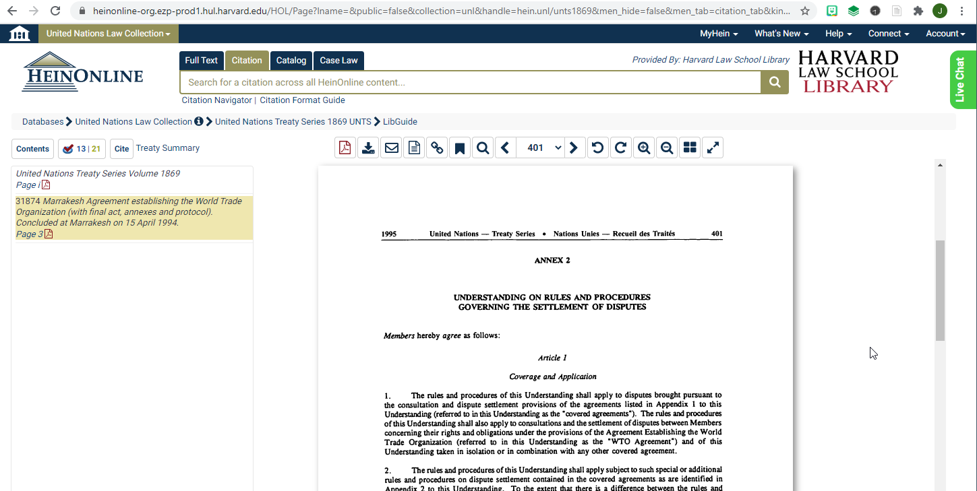
HOLLIS: Database Access

Slide 19

HOLLIS: Database Access
Now you try it! This is footnote 24 of the Chow article. Search for the General Agreement on Tariffs and Trade (GATT) in HeinOnline: (1) search for HeinOnline in HOLLIS, (2) go to HeinOnline and click the Citation tab, (3) Enter the UNTS citation.

Slide 20

HOLLIS: E-Book Access
Dark Library, by i threw a guitar at him, CC BY 2.0, https://flic.kr/p/2bfkfiW.

Slide 21
HOLLIS: E-Book Access

Slide 22
HOLLIS: E-Book Access
This is a footnote in the Eckblad article that you are publishing in the fall.

Slide 23
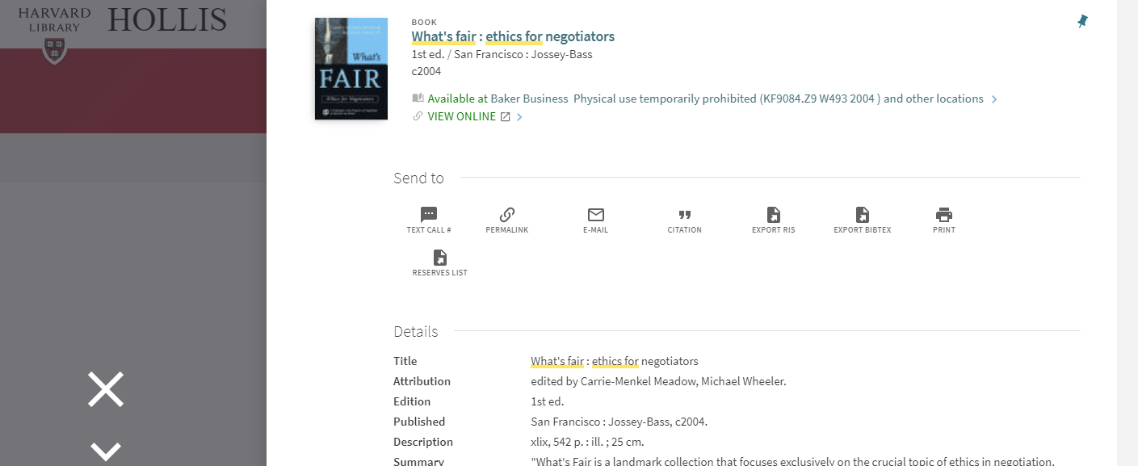
HOLLIS: E-Book Access
HOLLIS says we have this book available online.

Slide 24
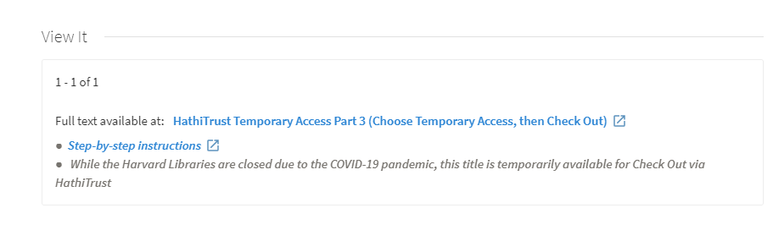
HOLLIS: E-Book Access
Scroll down in the record. HOLLIS shows that we have temporary access to it through the HathiTrust database.

Slide 25
HOLLIS: E-Book Access
To access a book in HathiTrust, do the following:
Click the link in the HOLLIS record.
If prompted, enter your HarvardKey credentials.
On the HathiTrust page, click Temporary Access.
You will see a page with a yellow box at the top.
Click the Check Out button in this box.

Slide 26
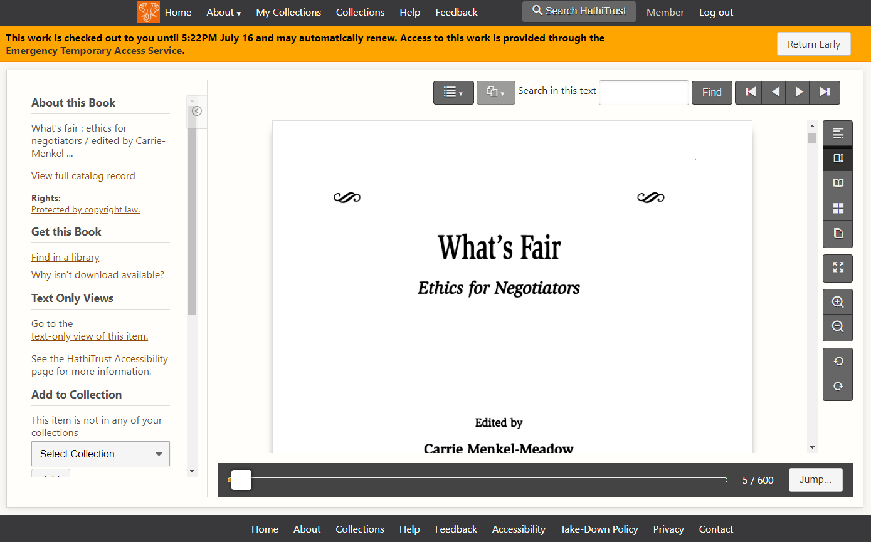
HOLLIS: E-Book Access

Slide 27
HOLLIS: E-Book Access
Think of this as having checked out our print copy.
You cannot download it as a PDF because of copyright restrictions. But you can look through the pages.

Slide 28

Scan and Deliver
XoMEox, Reading a Book, CC BY 2.0, https://flic.kr/p/24jLggj

Slide 29

Scan and Deliver

Slide 30
Scan and Deliver
This book is cited in the Lin article that you are publishing in the fall.

Slide 31
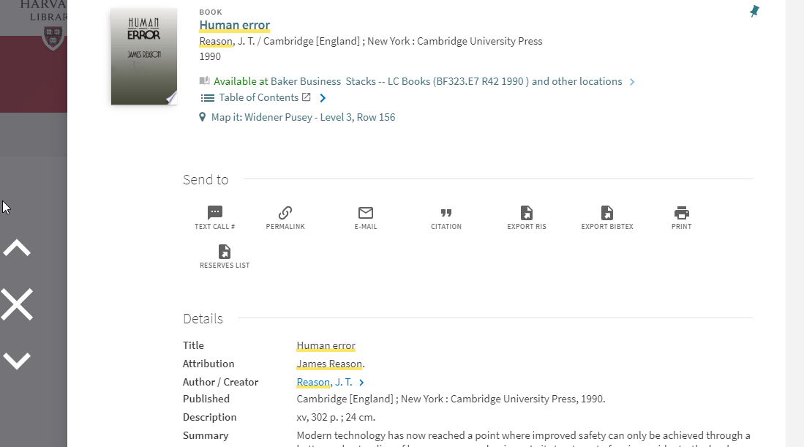
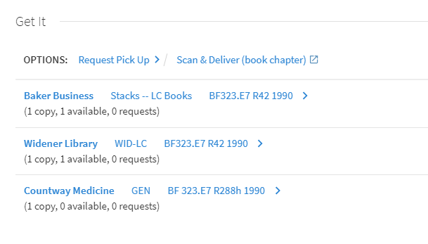
Scan and Deliver

Slide 32
Scan and Deliver
There is no e-Book version.
However, because it is at Widener, you can submit a Scan and Deliver request for the pages you need.

Slide 33
Scan and Deliver
Scan and deliver is a free service offered by the Harvard Library.
Request a portion of a book, or a whole journal article, that we only have in print in offsite storage, or on the shelves at Widener or Lamont.
You will receive a scan by email in approximately four business days.
More information:
https://library.harvard.edu/services-tools/scan-deliver

Slide 34

InterLibrary Loan (ILL)

Slide 35
InterLibrary Loan (ILL)
Harvard’s libraries are closed.
Other libraries, however, are open.

Slide 36
InterLibrary Loan (ILL)
If you see a book that you need that we just don’t have,
click the link in the HOLLIS record to submit an ILL request for it.
Our colleagues in the ILL department will try to get it for you.
No promises, though.

Slide 37
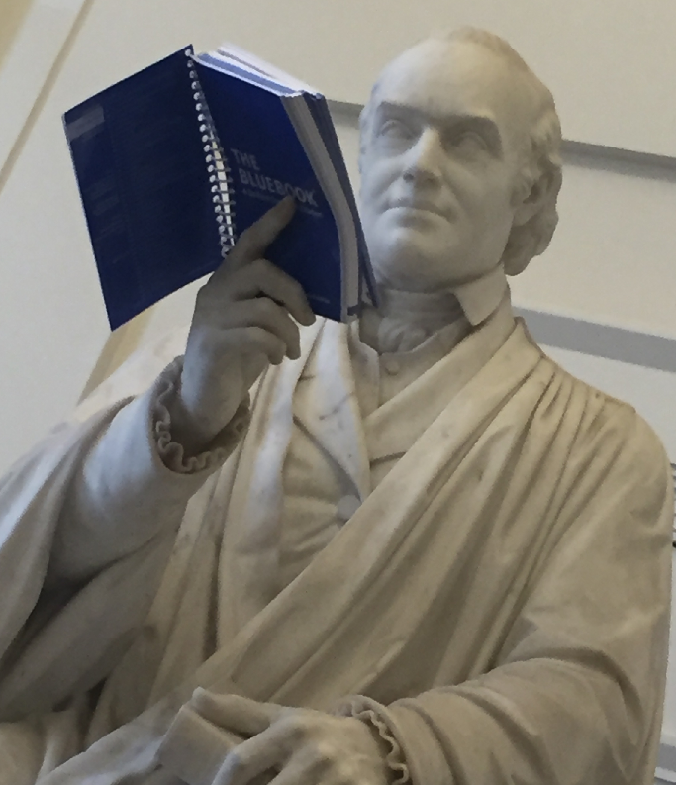
Bluebook

Slide 38
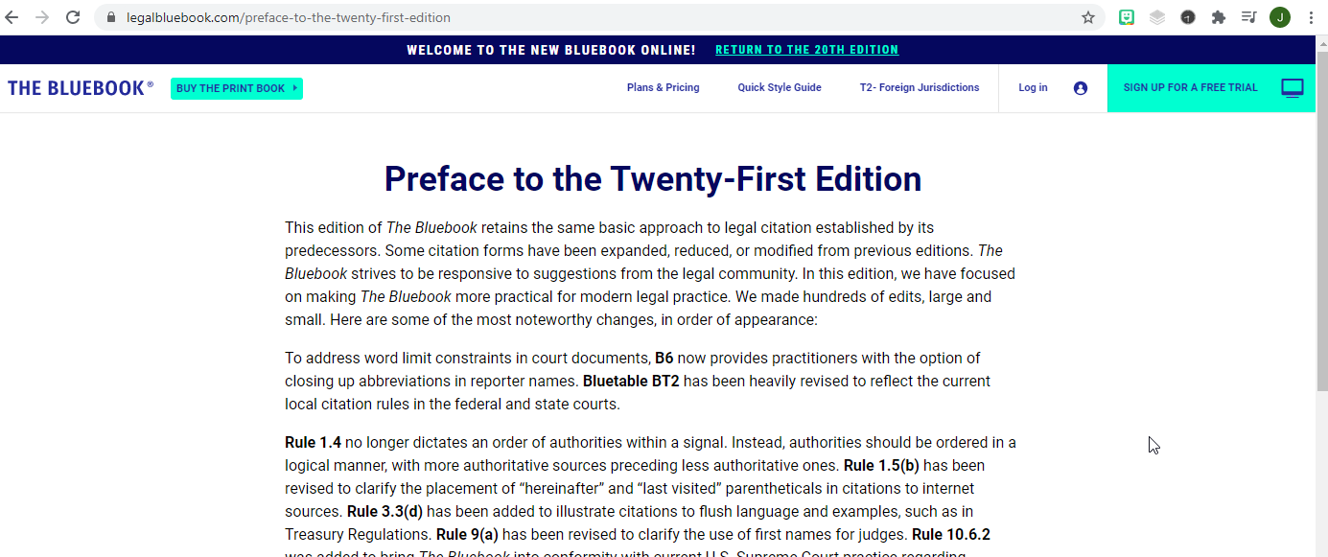
Bluebook
The Bluebook released a new edition this summer.

Slide 39
Bluebook
The law library cannot provide Bluebook access to students.
There is no option to buy an institutional license.
Furthermore, we cannot buy a license for every single HLS student.

Slide 40
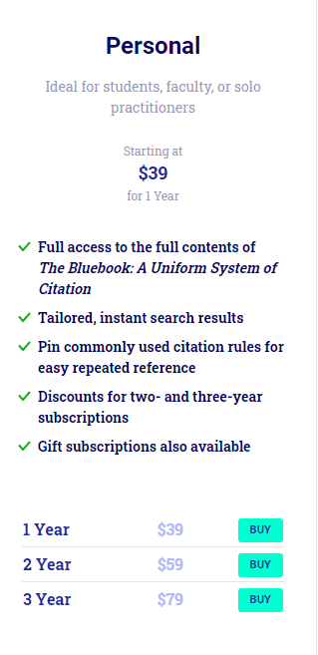
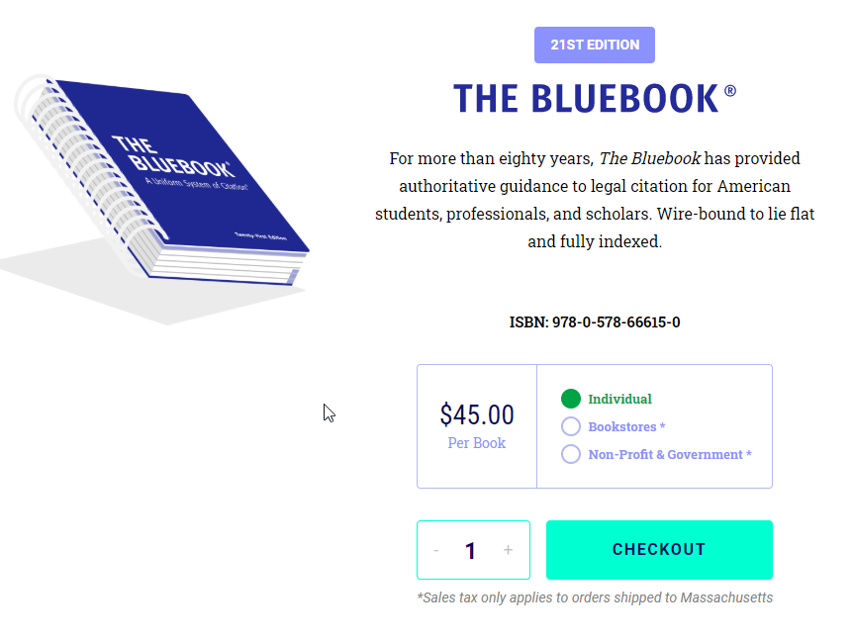
Bluebook
To buy the new edition
(print copy or electronic access):
https://www.legalbluebook.com/

Slide 41
Getting Help
It is much harder to find sources than it used to be.
The librarians have had a few months to get used to the new system, and have some tricks up our sleeves.
Let us help you.

Slide 42
Getting Help
10-Minute Rule:
Don’t spend more than 10 minutes looking for a source.
If you can’t find it after 10 minutes, ask the library for help.

Slide 43
Getting Help
Jennifer:
jallison@law.harvard.edu
Ask a Librarian:
research@law.harvard.edu

Slide 44

Be Well, and We Miss You!

