Slide 1
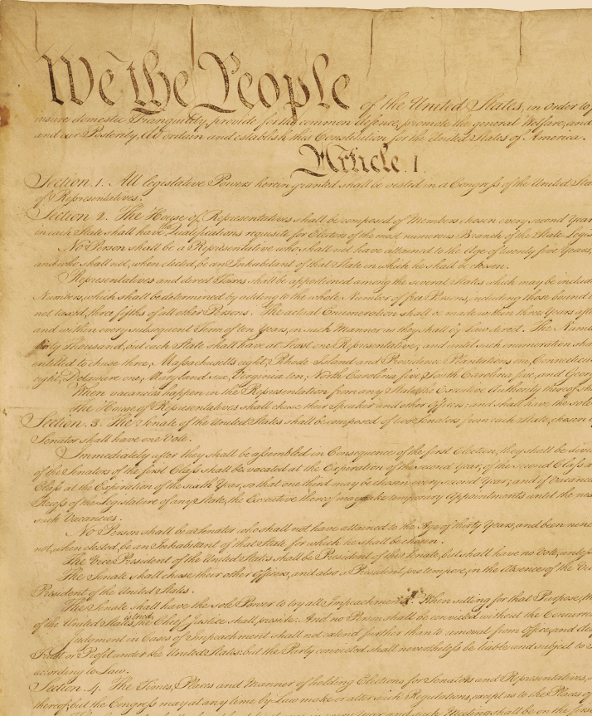
Introduction to Constitutional Law Research
Harvard Law School Library
Jennifer Allison, Research Librarian
Summer 2019
Photo Credit: COM Library, CC BY-NC-ND 2.0, https://flic.kr/p/5BmxLq

Slide 2
About Me
I am happy to see you all here today. ☺
I have worked as a law librarian since 2007 and at the Harvard Law School Library since 2012.
I have a law degree (Juris Doctor, or J.D.) from Pepperdine Law School in California. I am also admitted to the state bar in California.
I have a Masters in Library Science.
I have a Masters in German Law from the University of Würzburg in Germany.
I like teaching legal research and information literacy to people of all different backgrounds.
Photo Credit: COM Library, CC BY-NC-ND 2.0, https://flic.kr/p/5BmxLq

Slide 3
What we will cover:
Legal Research Method
Legal Primary Source: The Constitution
Legal Primary Source: Statutes
Legal Primary Source:
Opinions issued by the Supreme Court
Legal Secondary Sources:
Books, Journal Articles, and More
Photo Credit: COM Library, CC BY-NC-ND 2.0, https://flic.kr/p/5BmxLq

Slide 4
Legal Research Overview
Researching the law involves using two types of sources:
Primary sources
issued by the government. These include the Constituiton, statutes, and judicial opinions.
Secondary sources
written by lawyers and legal scholars to help explain what the law is and how to find it.
Photo Credit: COM Library, CC BY-NC-ND 2.0, https://flic.kr/p/5BmxLq

Slide 5
Legal Research Overview
Primary and secondary sources are available in subscription databases and also for free online.
We‘ll start by trying to find a primary source: the text of the U.S. Constitution.
Photo Credit: COM Library, CC BY-NC-ND 2.0, https://flic.kr/p/5BmxLq

Slide 6
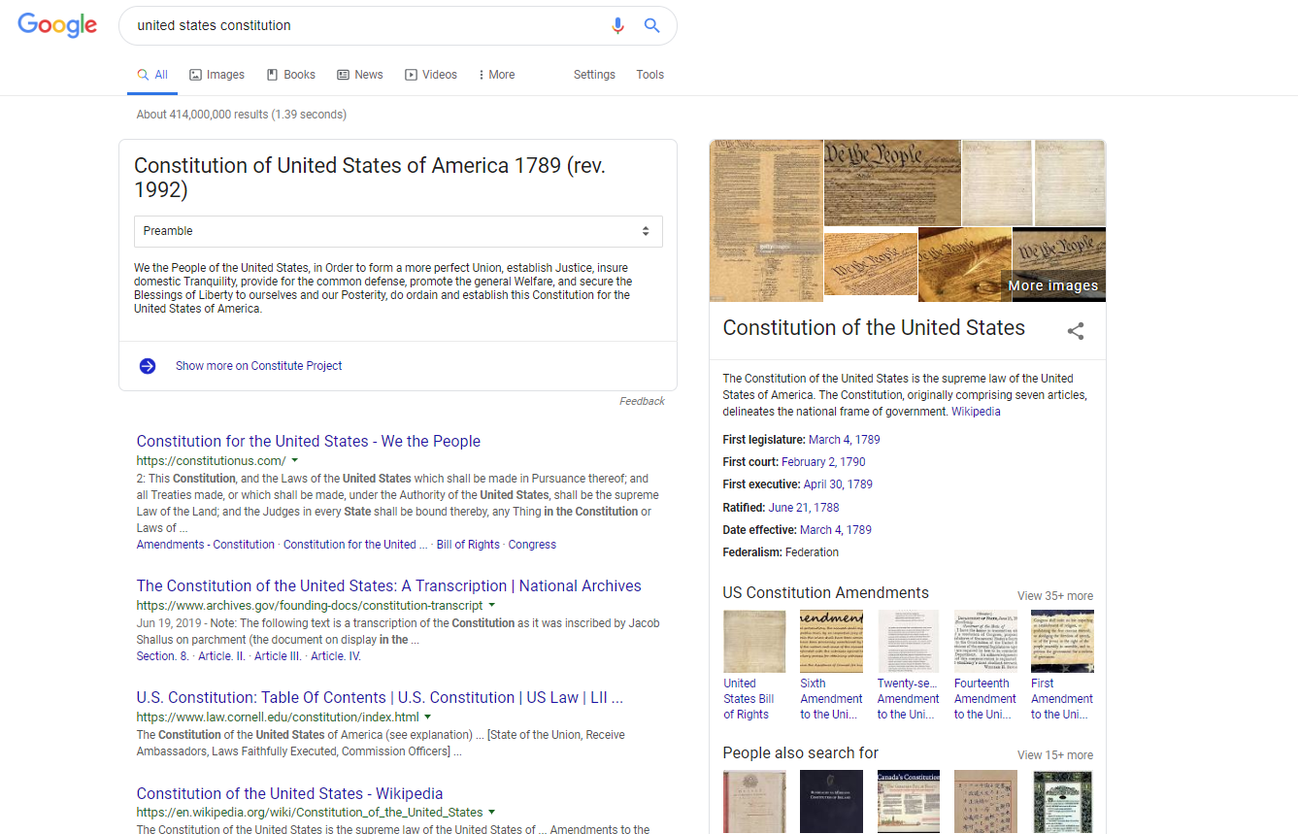
Be smart about which sources you use from Google search results.
If you are not sure how high-quality or legitimate a source is, try to find a page on the site that is labeled about, and read about the site.

Slide 7
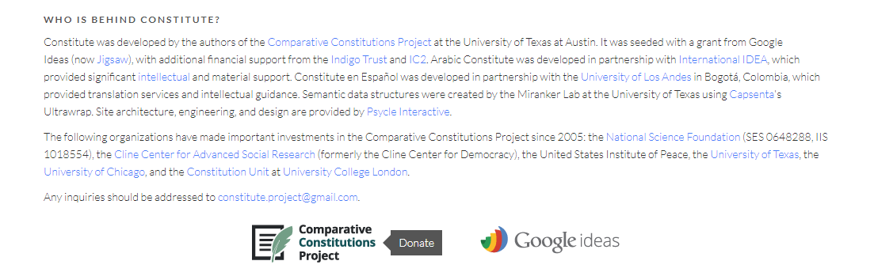
https://www.constituteproject.org/

Slide 8
https://constitutionus.com/

Slide 9
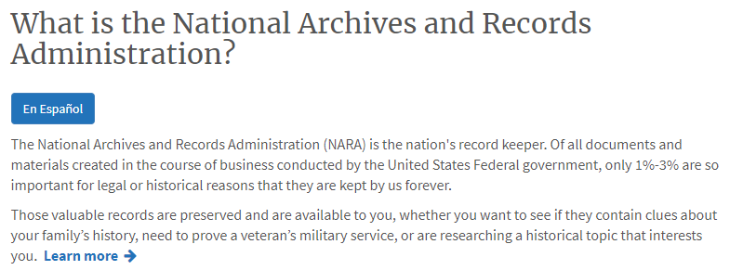
https://www.archives.gov/

Slide 10
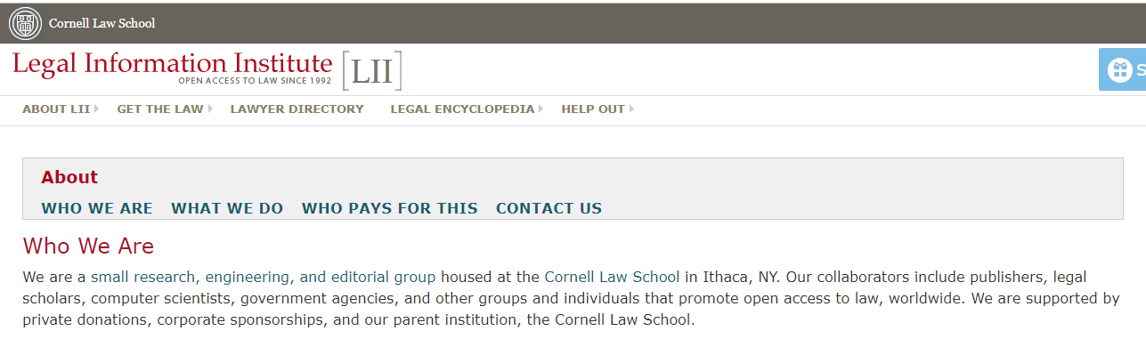
https://www.law.cornell.edu/

Slide 11
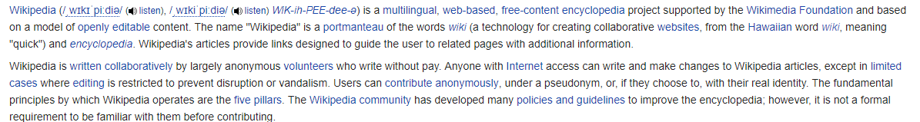
https://en.wikipedia.org/

Slide 12
So which of these five sources, based on what we know about them, seems like the most official, or legitimate?
All five will likely have the constitution and its language right. That said, I would still use the National Archives version.

Slide 13
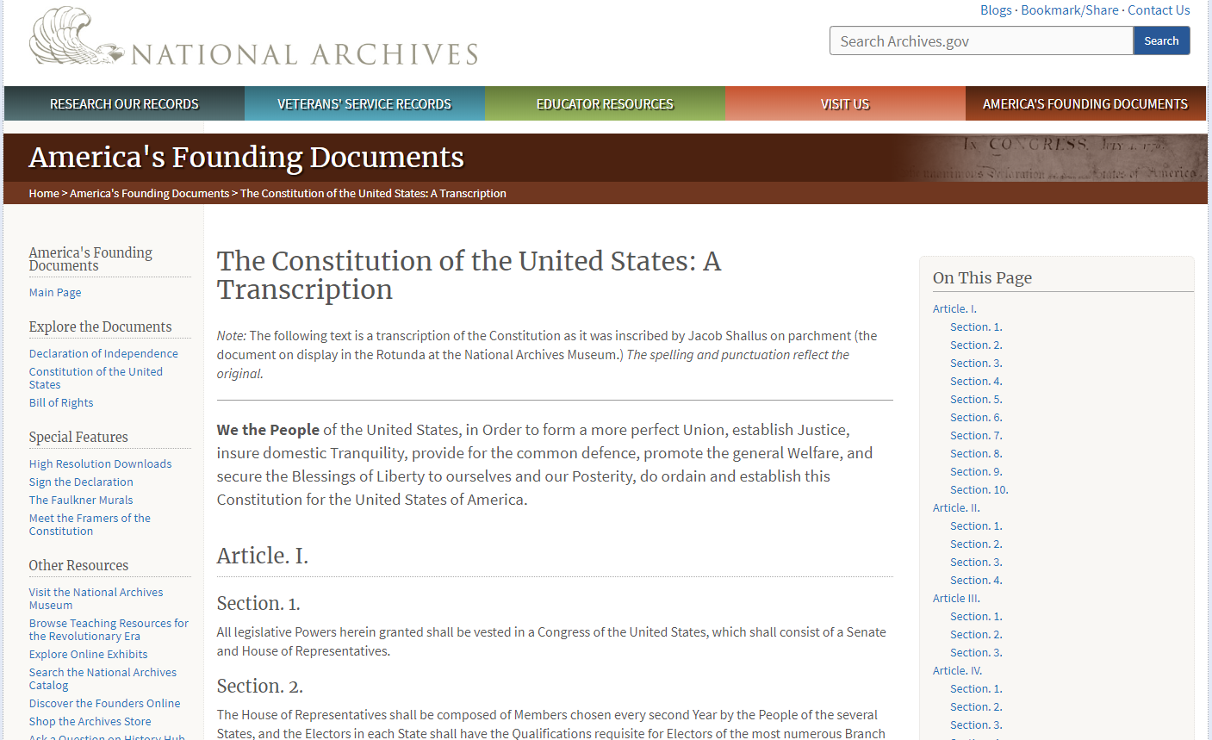

Slide 14
Remember, there are three types of
primary sources in U.S. legal research:
Constitution
Laws
(Statutes)
Court
Opinions
We have learned how to find the Constitution.
Let‘s learn more about how to find statutes and and court opinions.

Slide 15
One of the major rules about the legislative (Congress) and executive (President and executive agencies) branches of the government is that they are only allowed to enact and enforce laws (statutes) because the Constitution gives them the power to do so.
This means that laws cannot violate constituitonal principles.
If the constitutionality of a law is challenged, it is the judicial branch (courts) that interprets the Constitution and issues an opinion about it.

Slide 16


Photo Credits: Majunznk, CC BY-ND 2.0, https://flic.kr/p/bH5g8H; LaDawna Howard, CC BY 2.0, https://flic.kr/p/bHduxV

Slide 17
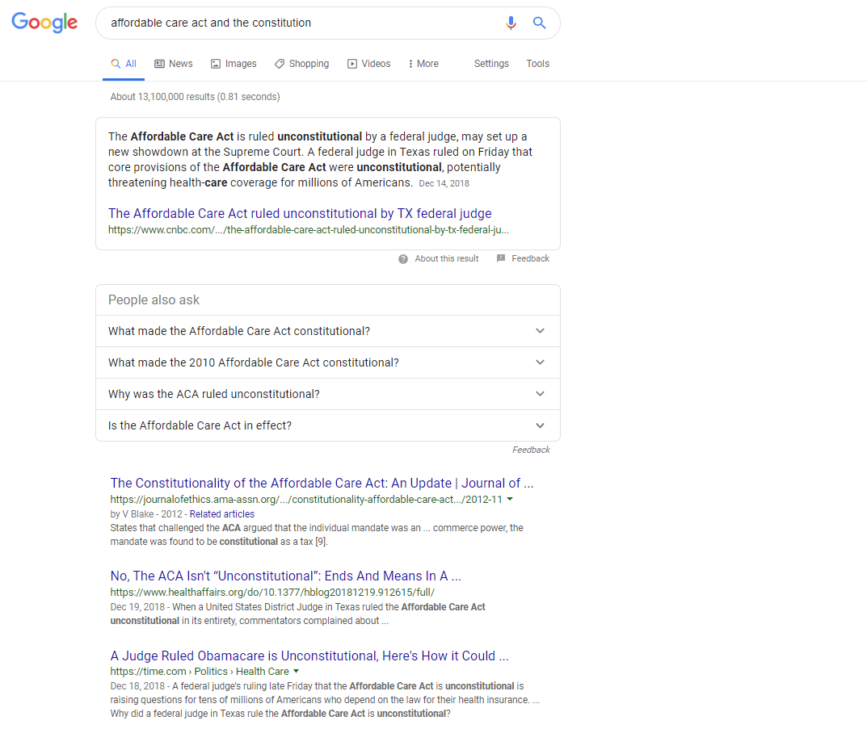
The battle over the constitutionality of the Affordable Care Act (Obamacare) has been going on in the courts for a long time.
Secondary sources are a good place to start to understand the history and development of this. These sources also cite relevant primary sources (judicial opinions and statutes).
Let’s look at the article from 2012, to get some perspective.

Slide 18
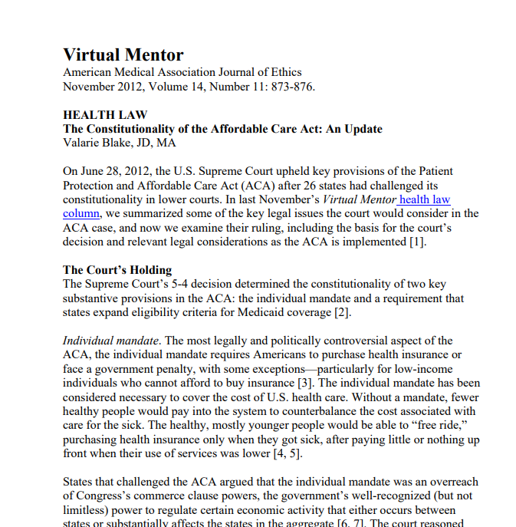
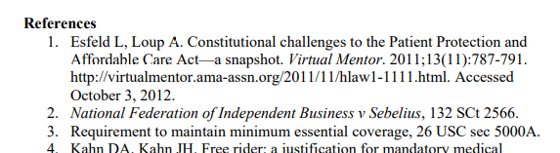
This article is really helpful because it cites both the 2012 Supreme Court case (in which the court declared that the ACA’s “individual mandate” is constitutional) and the law itself right in the first three footnotes.
It’s also helpful because the Court‘s decision in this case is kind of confusing, so we can read this article in preparation for reading the actual opinion.

Slide 19
According to the article, in the 2012 case of National Federation of Independent Business v. Sibelius, the Supreme Court ruled as follows:
The “individual mandate,” which is the part of the Affordable Care Act that fines people who do not buy health insurance, was challenged as unconstitutional because it violated the Commerce Clause. The Court agreed that it violates the Commerce Clause; however, it is not unconstitutional because, according to the Court, it is, effectively, a tax. The Constitution allows Congress to levy taxes against people. So the individual mandate is constitutional.
There was a second challenge to the law, regarding the constitutionality of the requiring the states to expand Medicaid coverage. This part of the law was found to be unconstitutional.

Slide 20
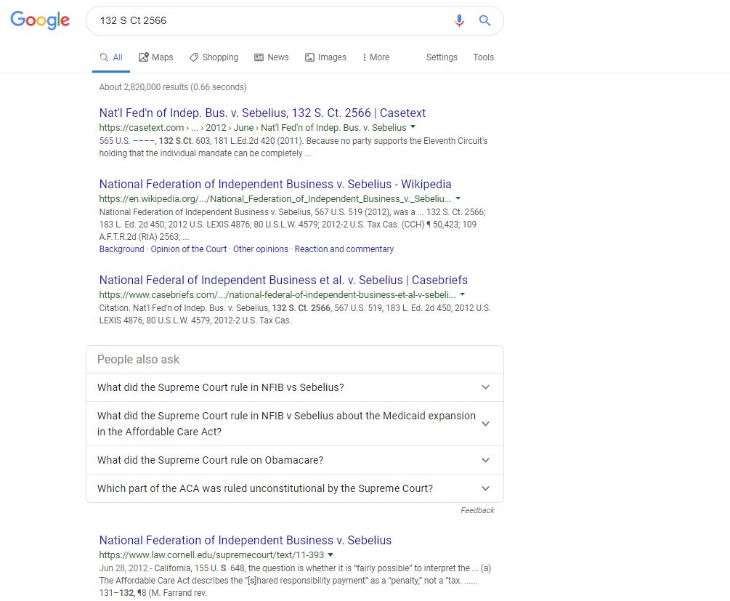
The citation for this 2012 Supreme Court‘s opinion, which is listed in footnote #2 of the article is this:
132 S. Ct. 2566
If we enter that citation into Google, it will return several websites that offer the text of the opinion for free.

Slide 21
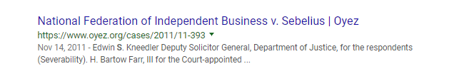
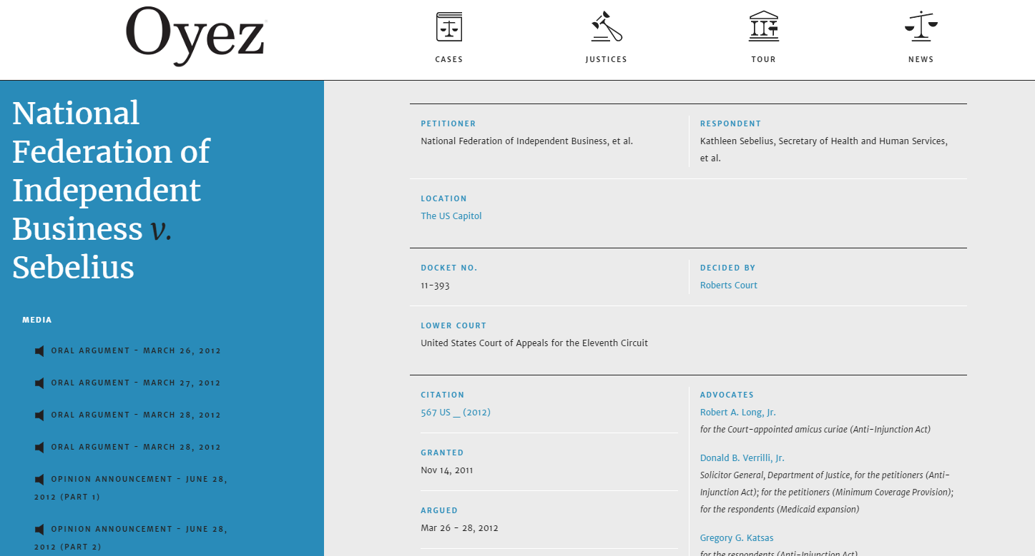
Oyez is a free law project sponsored by several law schools. It includes a timeline, a good summary of the opinion, and you can even listen to the lawyers make their arguments before the Court!

Slide 22
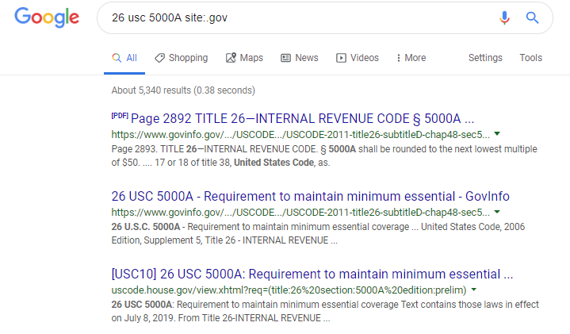
The other primary source cited in the 2012 article was the Affordable Care Act statute. U.S. federal statutes are organized by subject in the United States Code (U.S.C.). With a U.S.C. cite, it is really easy to find the text of the law on an official government website.

Slide 23
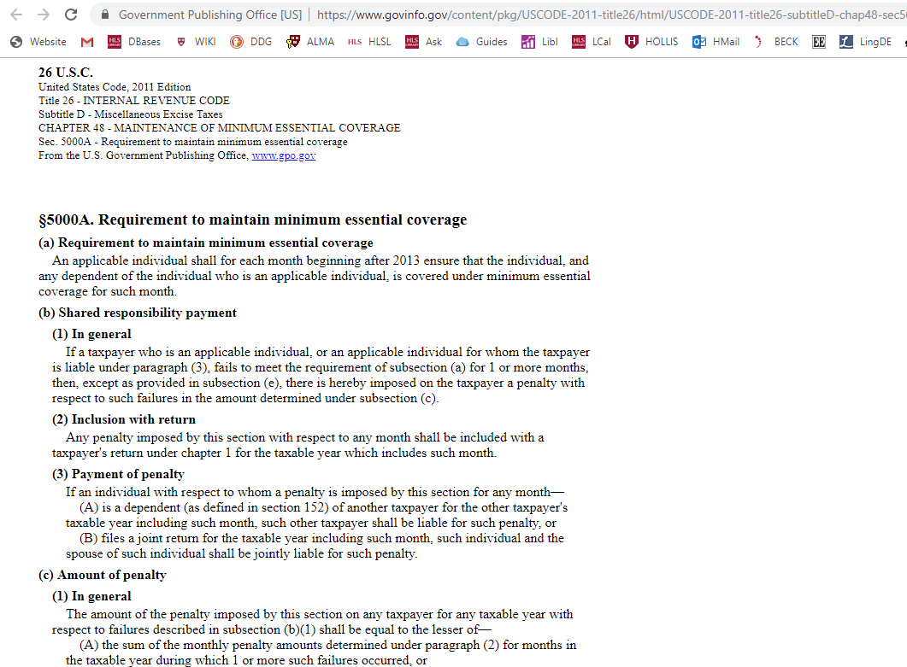
This is the text of the section of the Affordable Care act that imposes the individual mandate on people who do not buy health insurance.
It is published and made available for free online from the Government Printing Office (GPO), which is the official publisher of government documents.

Slide 24
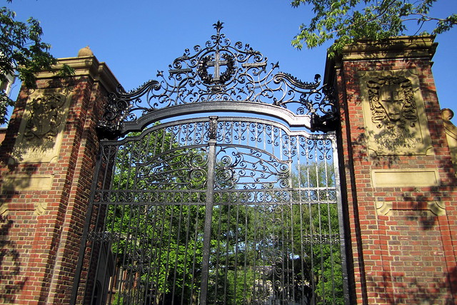
Photo Credit: Wally Gobetz, CC BY-NC-ND 2.0, https://flic.kr/p/8qnfkg.
While a lot of legal research can be done using free resources on the Internet, you will also want to look at subscription databases. You can access them on the Harvard network through the library catalog, HOLLIS.

Slide 25
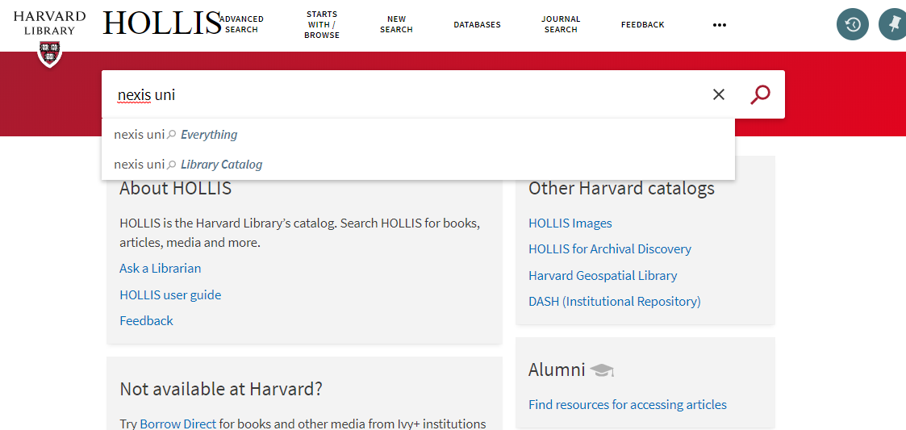
Go to https://hollis.harvard.edu and search in the library catalog for “nexis uni.”

Slide 26
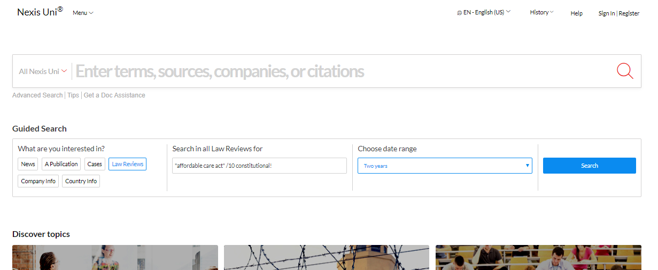
In our case, say we want to look at legal journal articles that have been published in the last two years about constitutionality of the ACA. The “Guided Search” option on the homepage is the best way to do this.

Slide 27
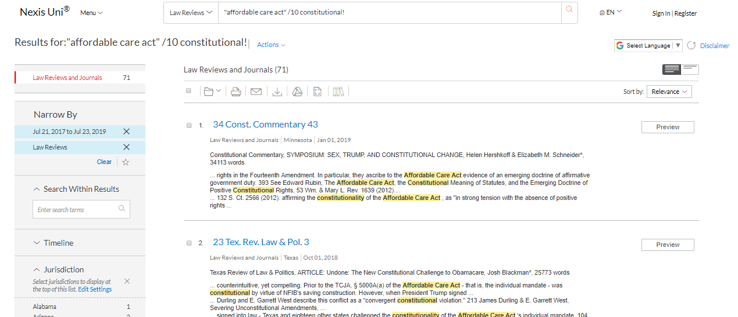
This search returns 71 results. The second result, from the Texas Review of Law and Politics, should be helpful in describing the landscape of this litigation since the Supreme Court’s 2012 decision.

Slide 28
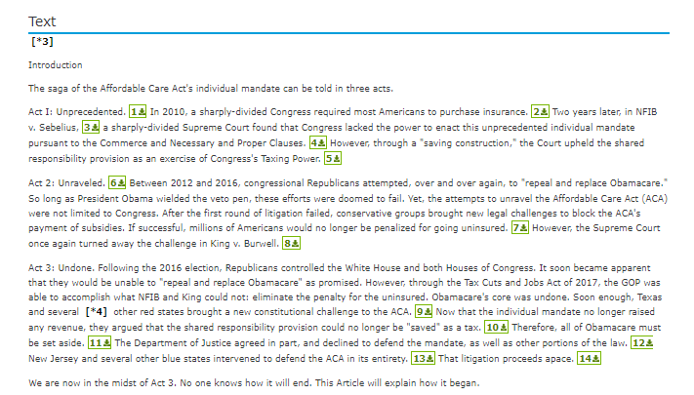
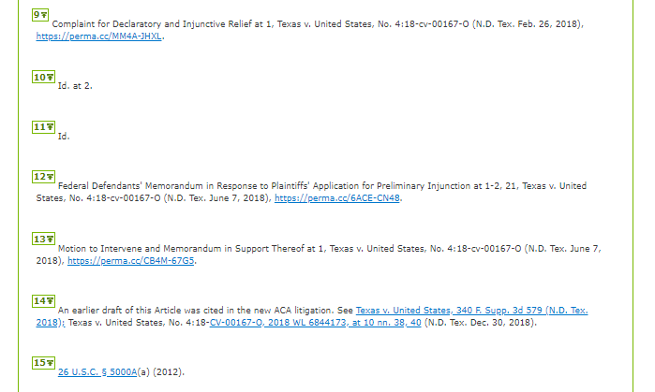
This article’s footnotes include hyperlinks to important primary and secondary sources.

Slide 29
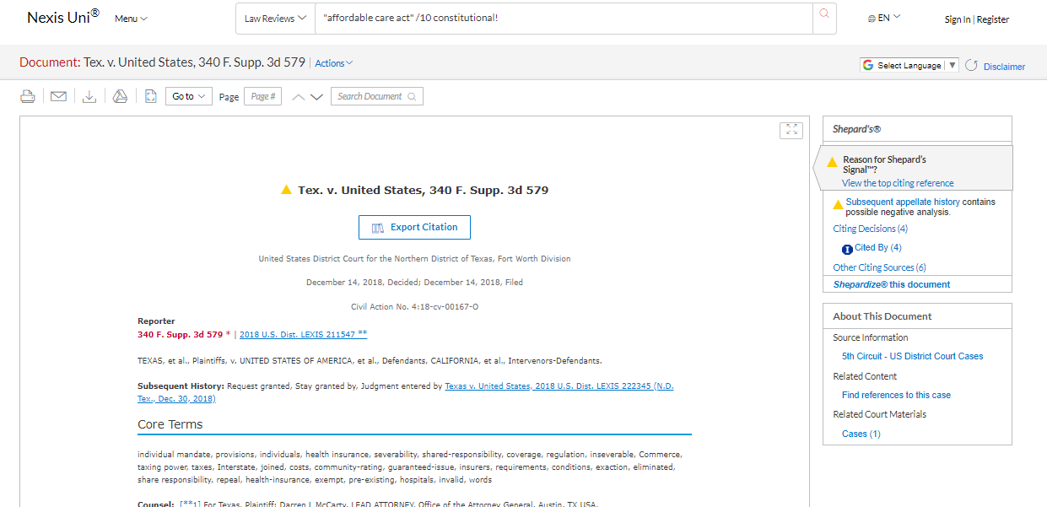
Here is an opinion from a federal trial court about the constitutionality of the ACA that was issued in 2018. Use the links on the left to see documents related to subsequent litigation in this case.

Slide 30


Slide 31
Final Tips
Start with free stuff online.
Be skeptical about the top Google results – are the sources legitimate?
Government sources are (usually) pretty trustworthy.
When you feel like you need more than what you can get for free online, try the Nexis Uni database.
Nexis Uni is NOT intuitive or easy if you have never used it before. Play around with it, click tabs and links and see what comes up.
Librarians are very knowledgeable AND like helping people. They won‘t think your questions are dumb. So ask them for help if you need it.
Photo Credit: COM Library, CC BY-NC-ND 2.0, https://flic.kr/p/5BmxLq

