Slide 1
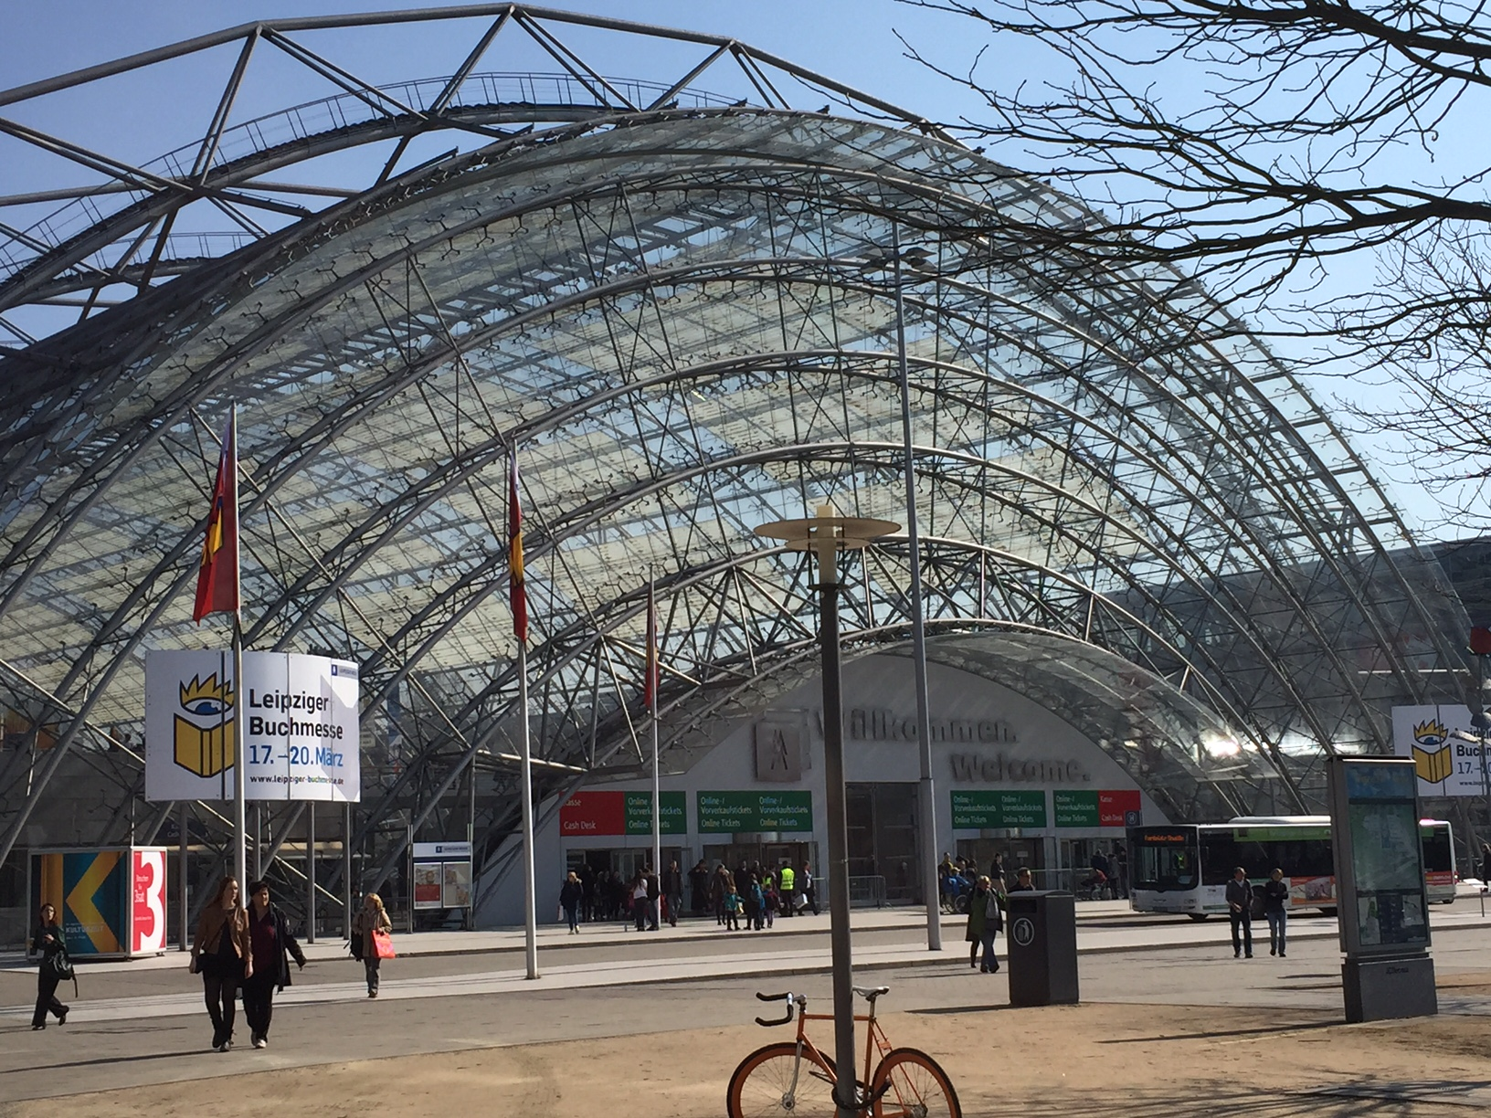
Leipzig Bibliothekskongress
and Buchmesse Visit
March 2016
Jennifer Allison

Slide 2
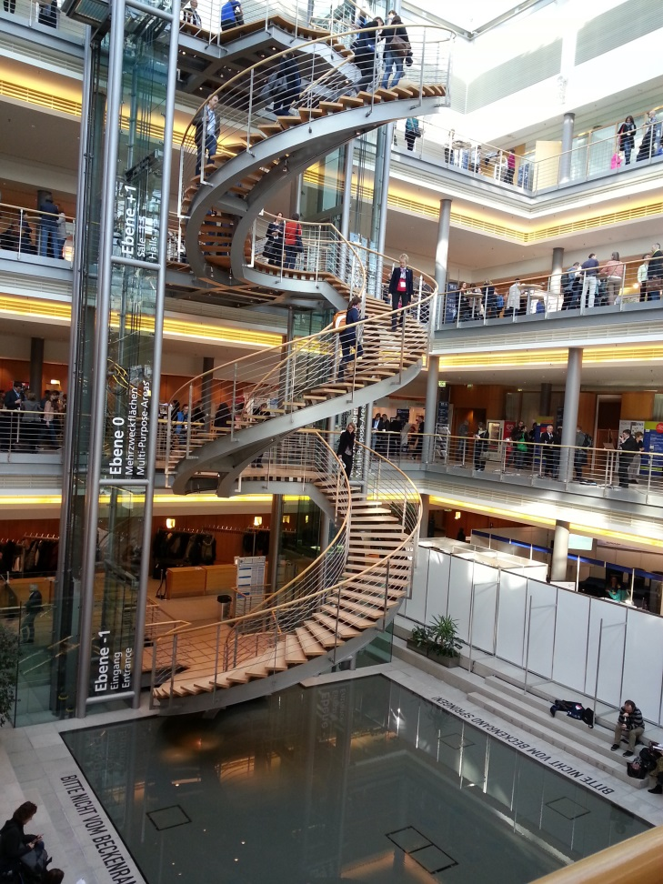
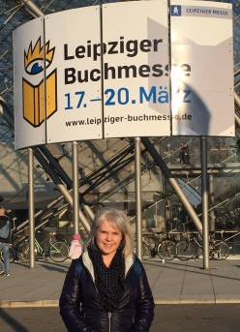
Leipziger Bibliothekskongress
Annual German national library meeting that returns to Leipzig every three years.
Leipziger Buchmesse
Second-largest book fair in Germany (after Frankfurt)

Slide 3
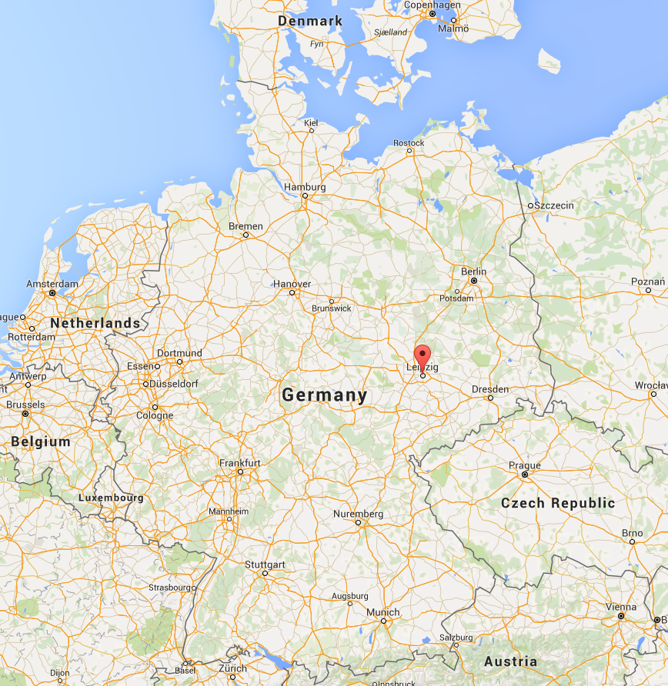
Leipzig
Largest city in the state of Saxony, in the former East Germany.
A musical city: Bach and Mendelssohn lived and worked here; orchestral music and opera are both very popular today.
Important site of peaceful demonstrations against the Communist regime in the DDR prior to German reunification.

Slide 4
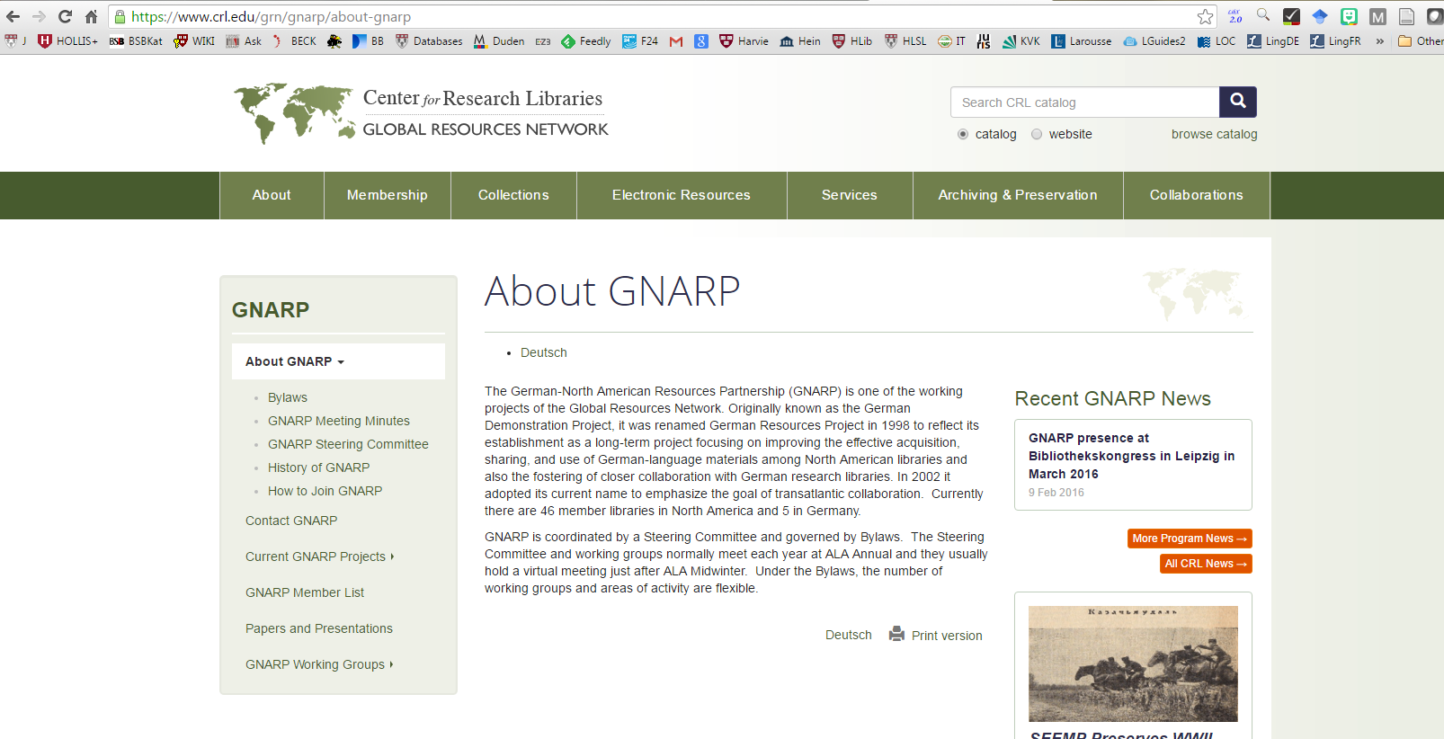
I received a travel grant from CRL’s German North American Resources Partnership (GNARP) to attend the conference.
The Harvard Library is an institutional member of this organization.

Slide 5
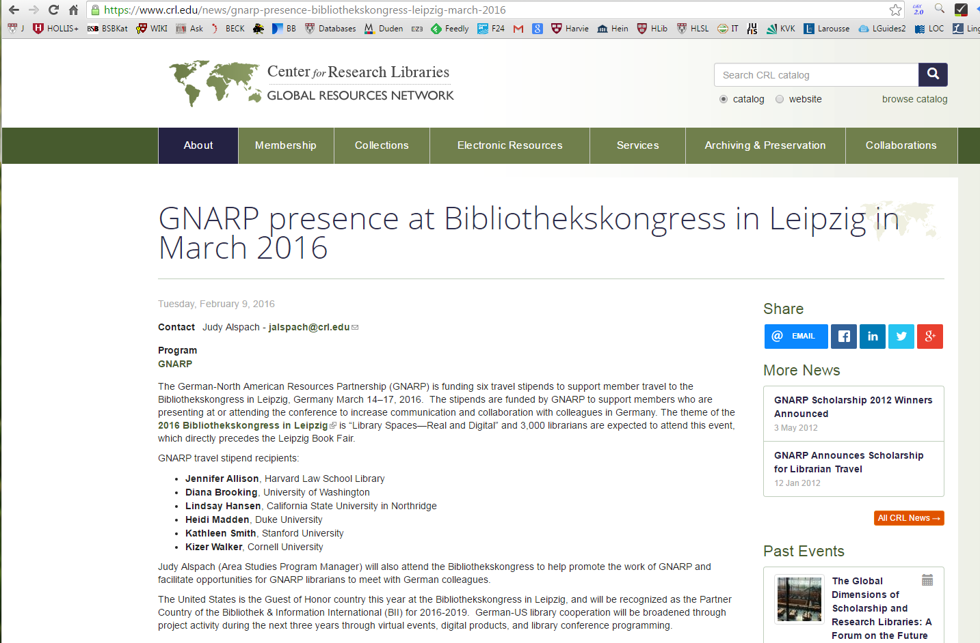
There were six American librarians who received
GNARP grants to attend the conference.

Slide 6
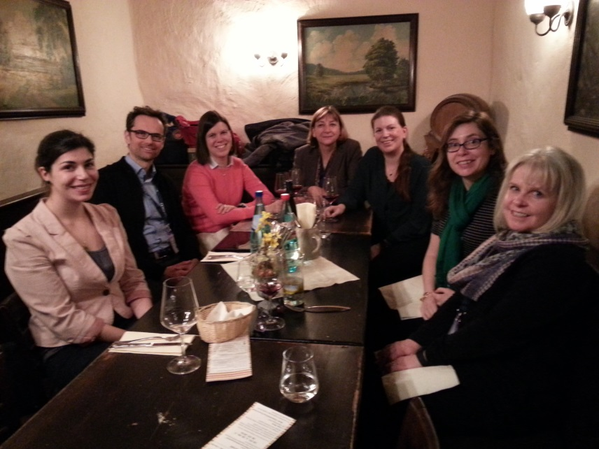
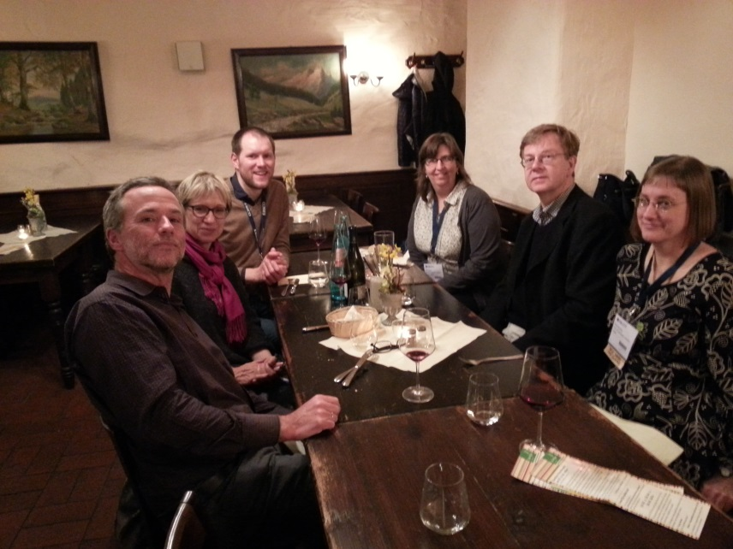
During the conference, GNARP hosted a dinner for the
American grant recipients and several German librarians
with whom they want to establish closer partnerships.

Slide 7
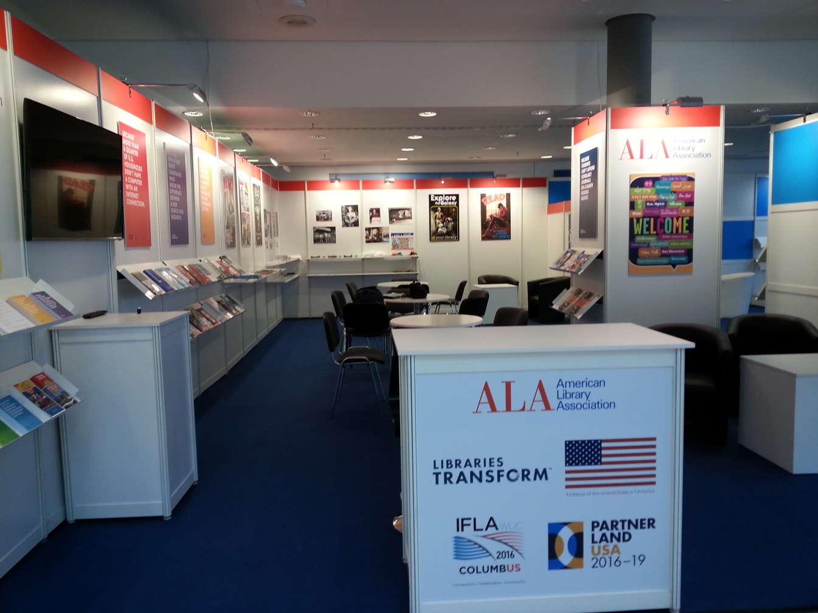
The “Guest Country” at the 2016 Bibliothekskongress
was the United States, so GNARP wanted to support Americans who were interested in attending.
ALA had a large booth in the exhibit hall.

Slide 8
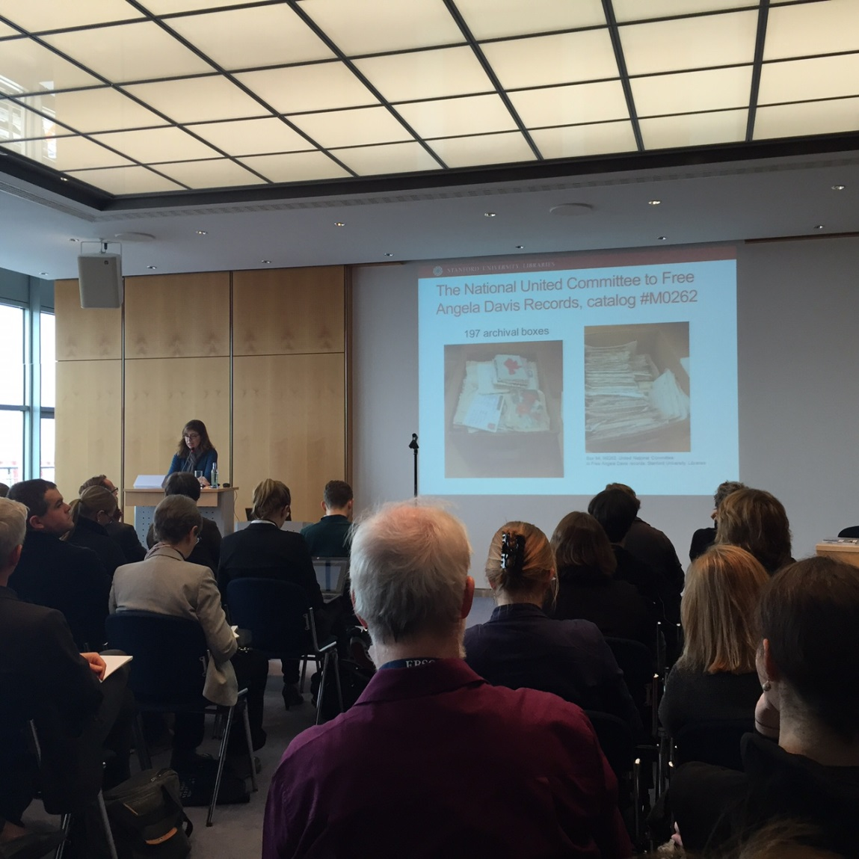
Conference Program Highlights
Library Organization and Preservation of Cultural Artifacts

Slide 9
Conference Program Highlights
This program was presented by Kathleen Smith, the Germanic Librarian at Stanford. She was amazing – she presented and answered questions all in German!
Library Organization and Preservation of Cultural Artifacts

Slide 10
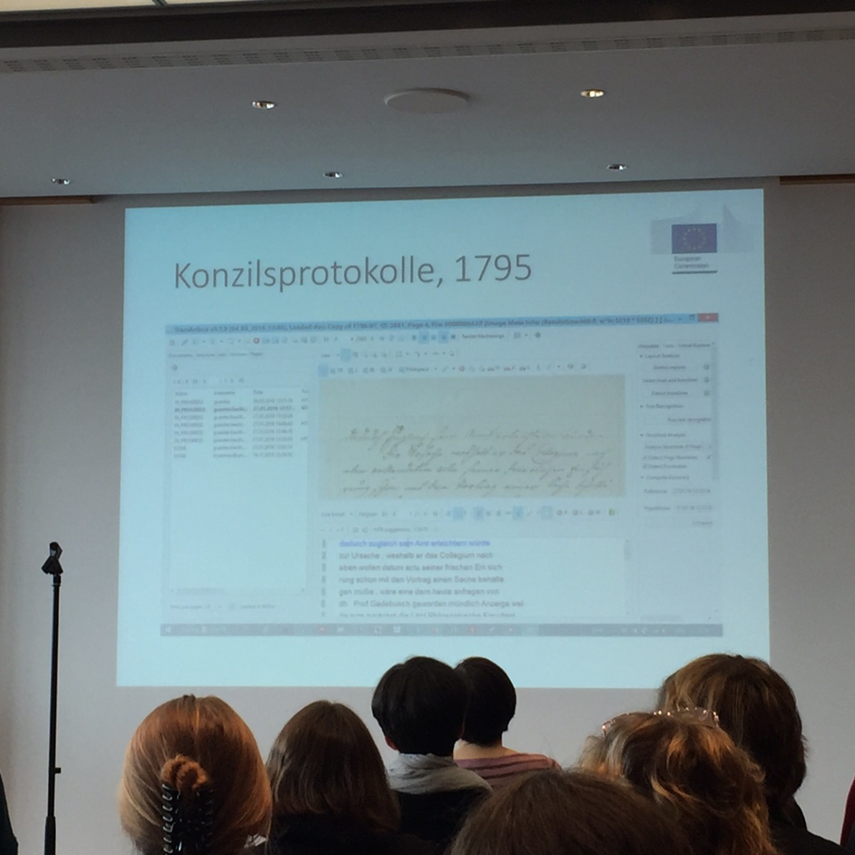
Conference Program Highlights
Library Organization and Preservation of Cultural Artifacts

Slide 11
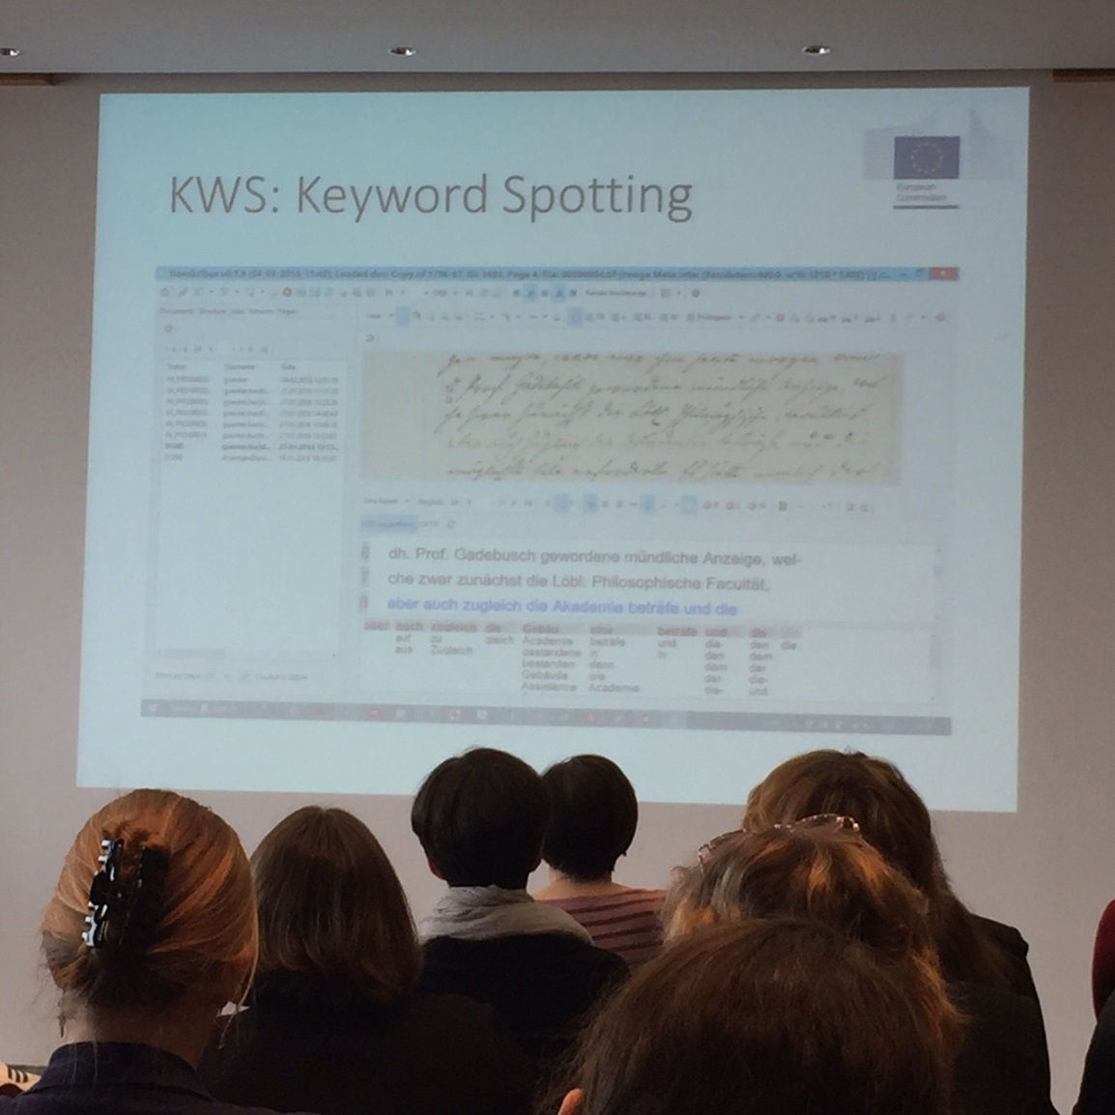
Conference Program Highlights
This part of the program was about Transkribus, an Austrian system for handwritten text recognition. They are doing very interesting work in this area in Europe.
https://transkribus.eu/Transkribus/
Library Organization and Preservation of Cultural Artifacts

Slide 12
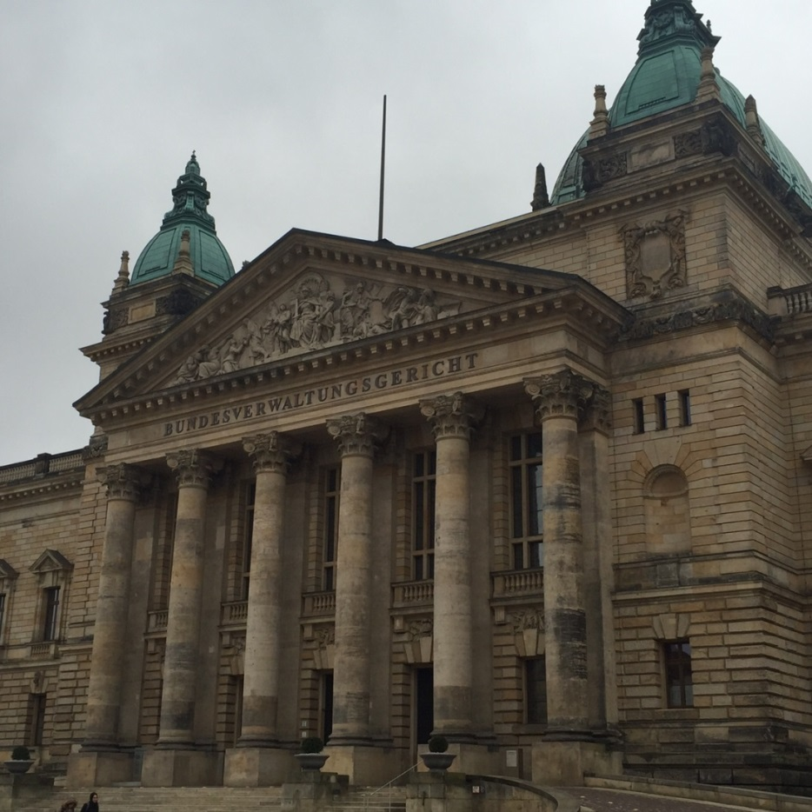
Conference Program Highlights
Meeting of the Arbeitsgemeinschaft für juristisches Bibliotheks- und Dokumentationswesen (AjBD).
This is the German-language local chapter of the International Association of Law Libraries (IALL).
The meeting was at the Bundesverwaltungsgericht (Federal Administrative Court).
The program was on the history of German legal publishing.

Slide 13
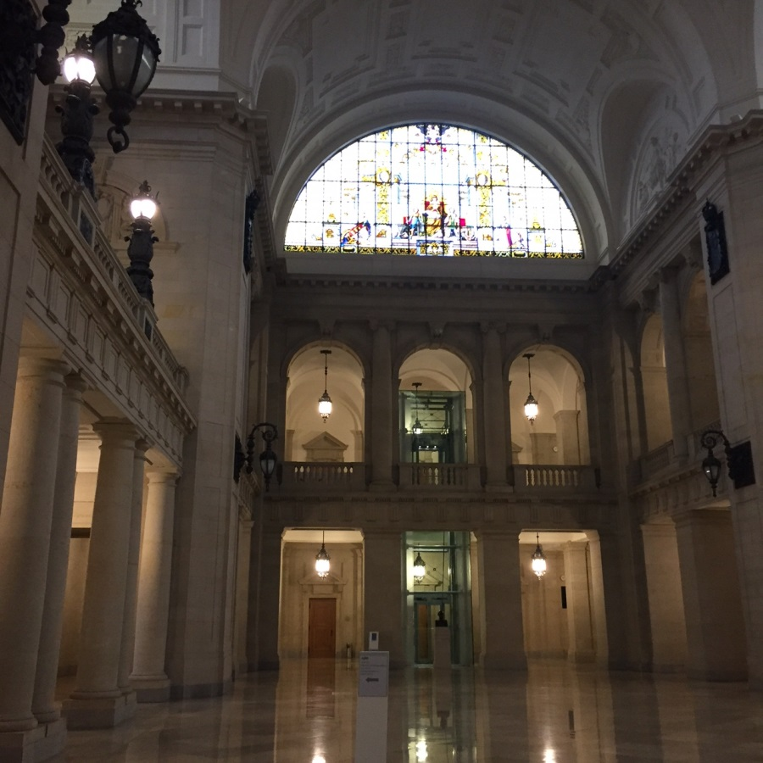
Conference Program Highlights
Meeting of the Arbeitsgemeinschaft für juristisches Bibliotheks- und Dokumentationswesen (AjBD).
This is the German-language local chapter of the International Association of Law Libraries (IALL).
The meeting was at the Bundesverwaltungsgericht (Federal Administrative Court).
The program was on the history of German legal publishing.

Slide 14
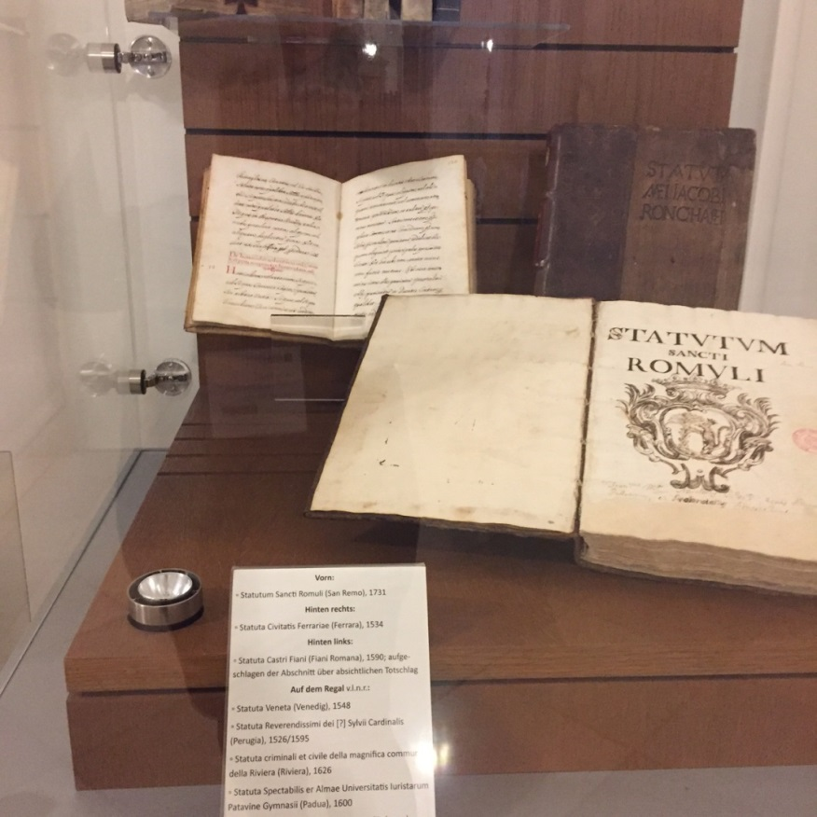
Conference Program Highlights
Meeting of the Arbeitsgemeinschaft für juristisches Bibliotheks- und Dokumentationswesen (AjBD).
This is the German-language local chapter of the International Association of Law Libraries (IALL).
The meeting was at the Bundesverwaltungsgericht (Federal Administrative Court).
The program was on the history of German legal publishing.

Slide 15
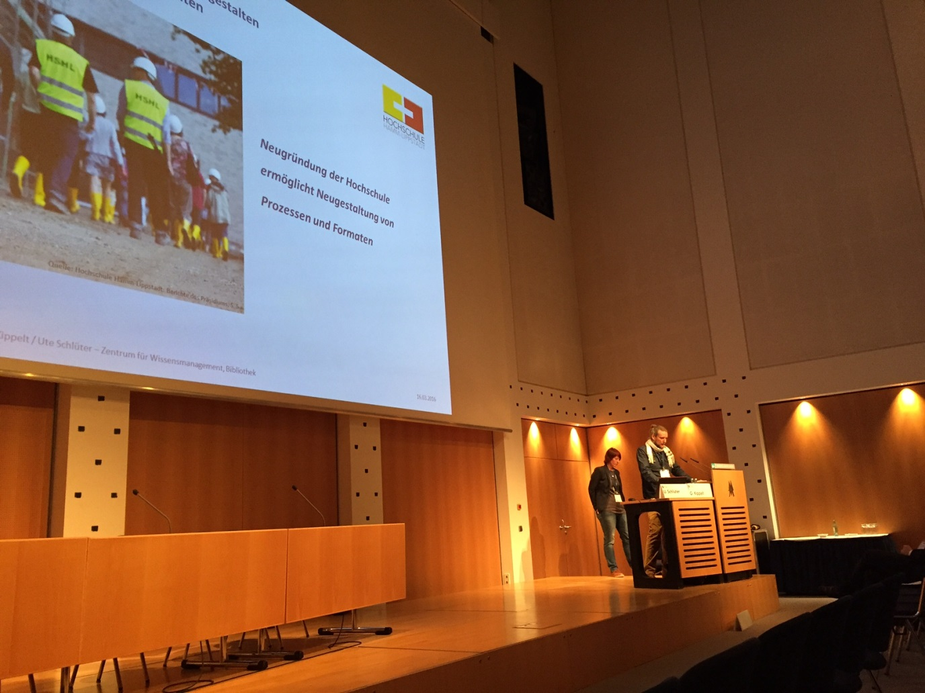
Conference Program Highlights
Information Competence in Academic Libraries

Slide 16
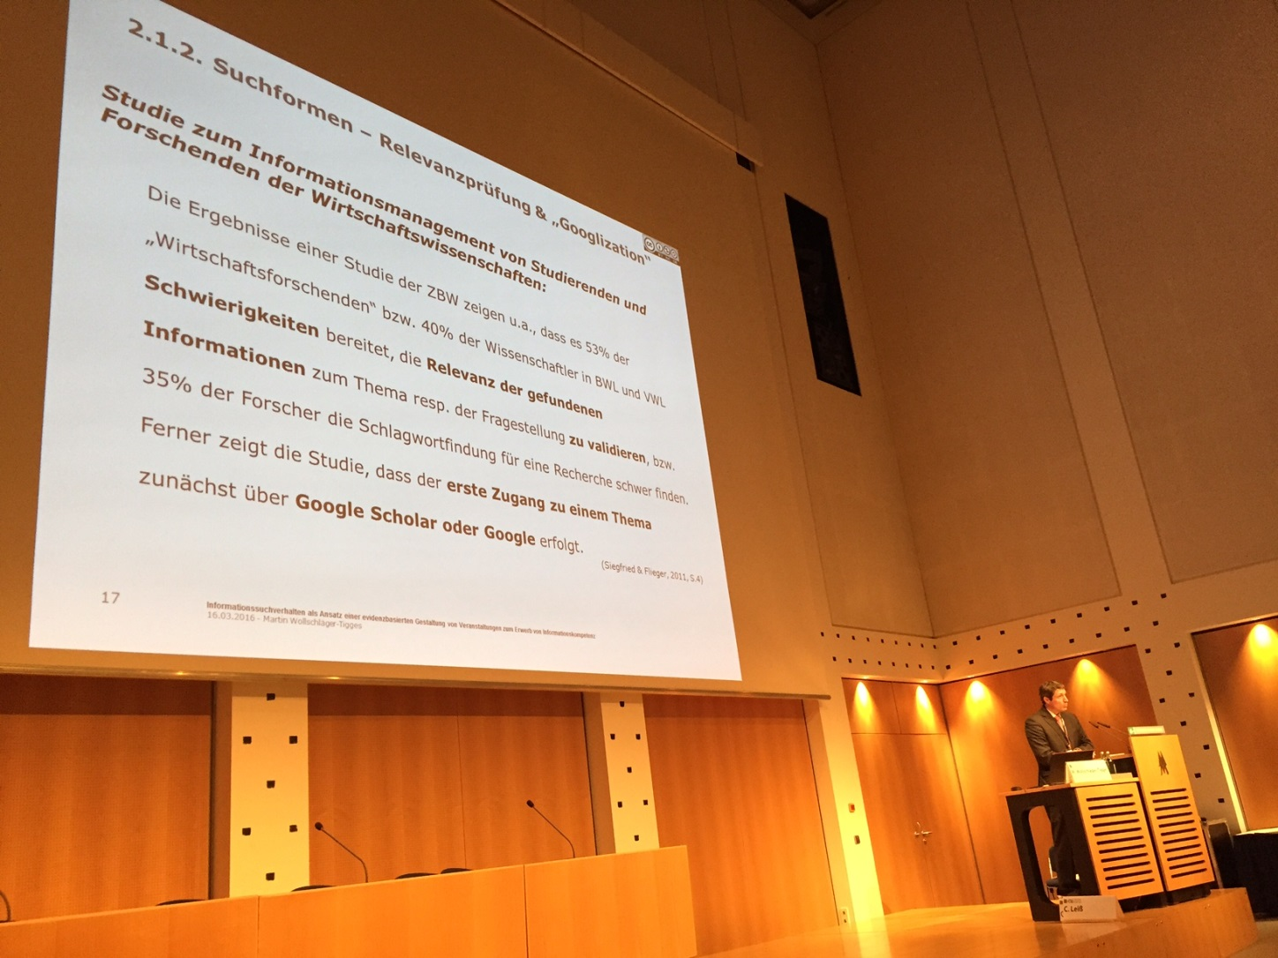
Conference Program Highlights
Information Competence in Academic Libraries

Slide 17
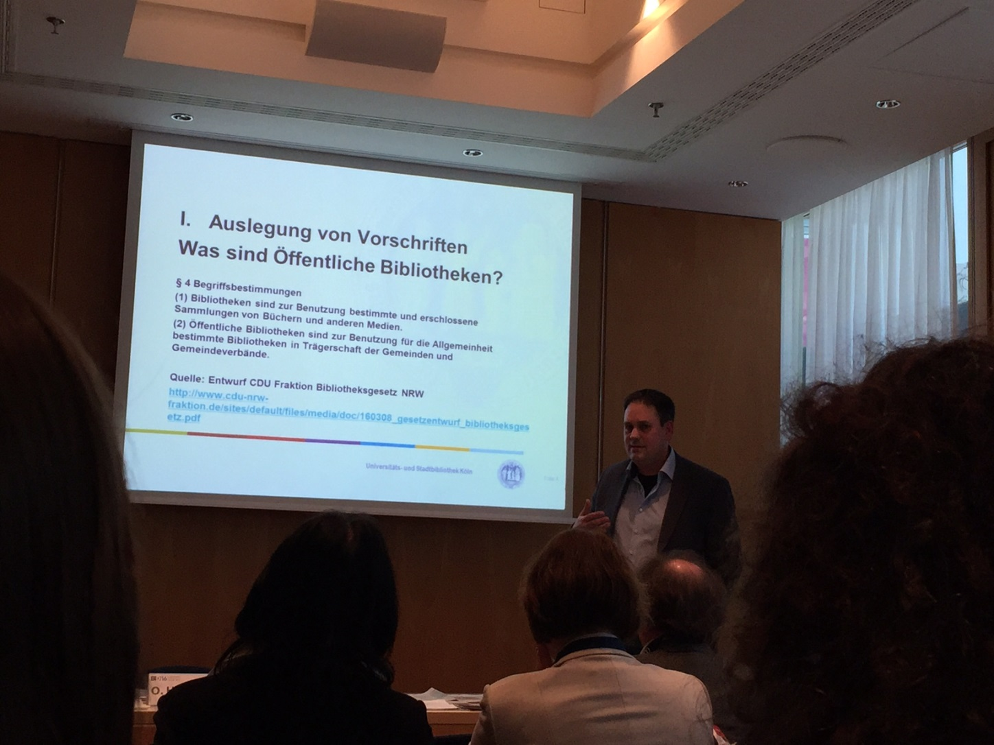
Conference Program Highlights
Copyright and Other Legal Issues in Public Libraries

Slide 18
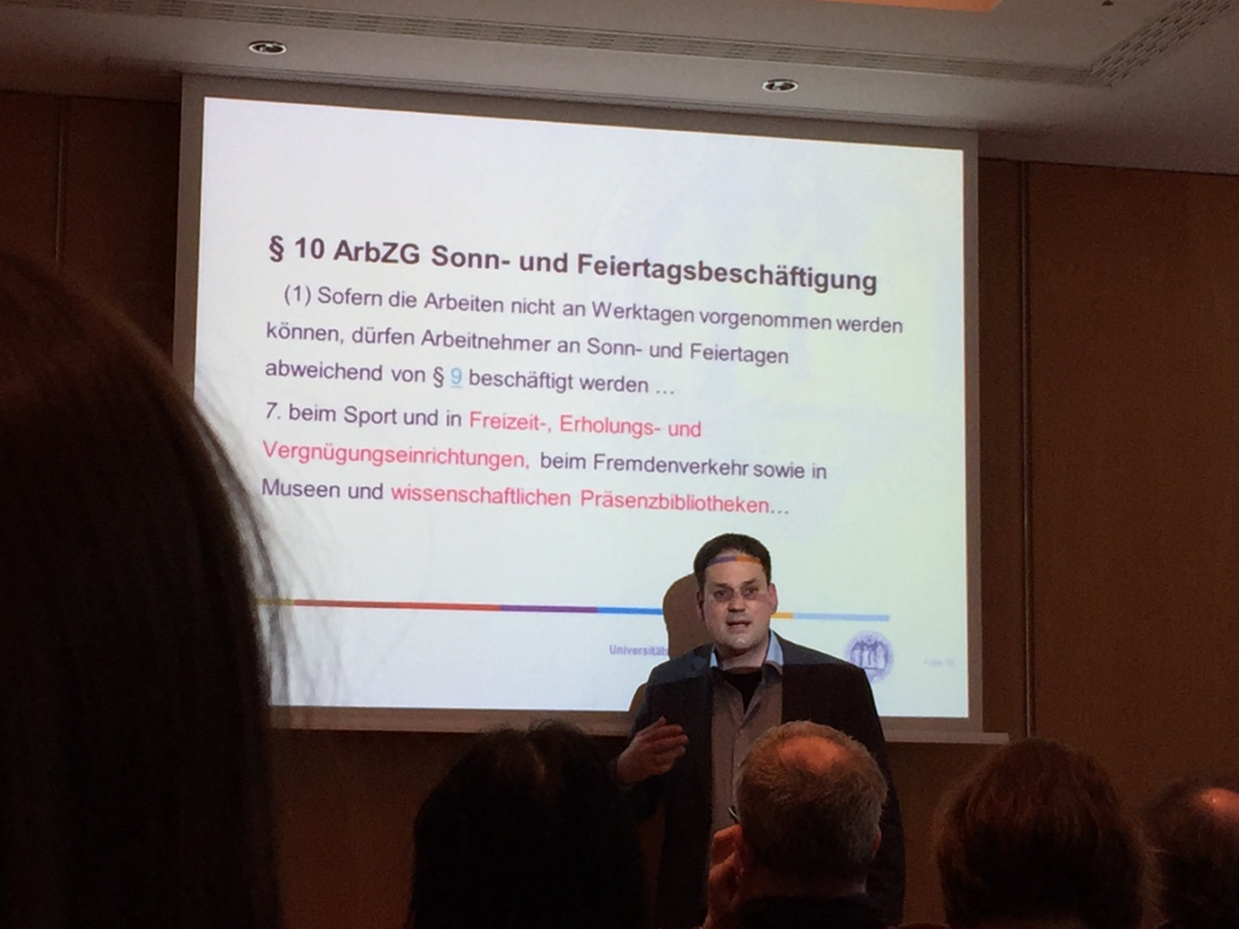
Conference Program Highlights
The presenter was Oliver Hinte, law library director at the University of Cologne (and a friend of mine).
Copyright and Other Legal Issues in Public Libraries

Slide 19
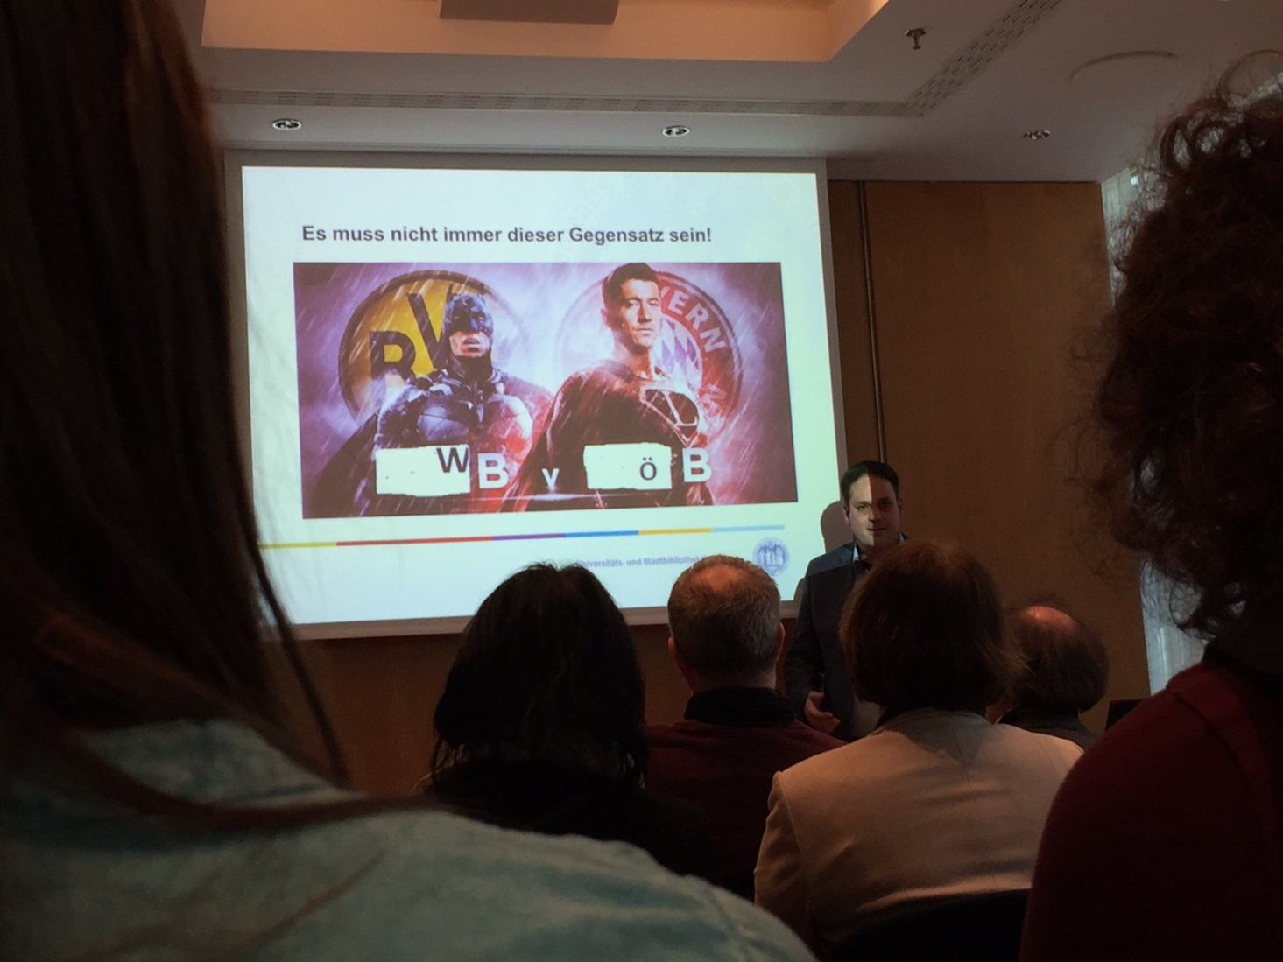
Conference Program Highlights
Oliver is very serious most of the time, but has a sense of humor too. This was the illustration he used to discuss differences between public and academic libraries.
Copyright and Other Legal Issues in Public Libraries

Slide 20
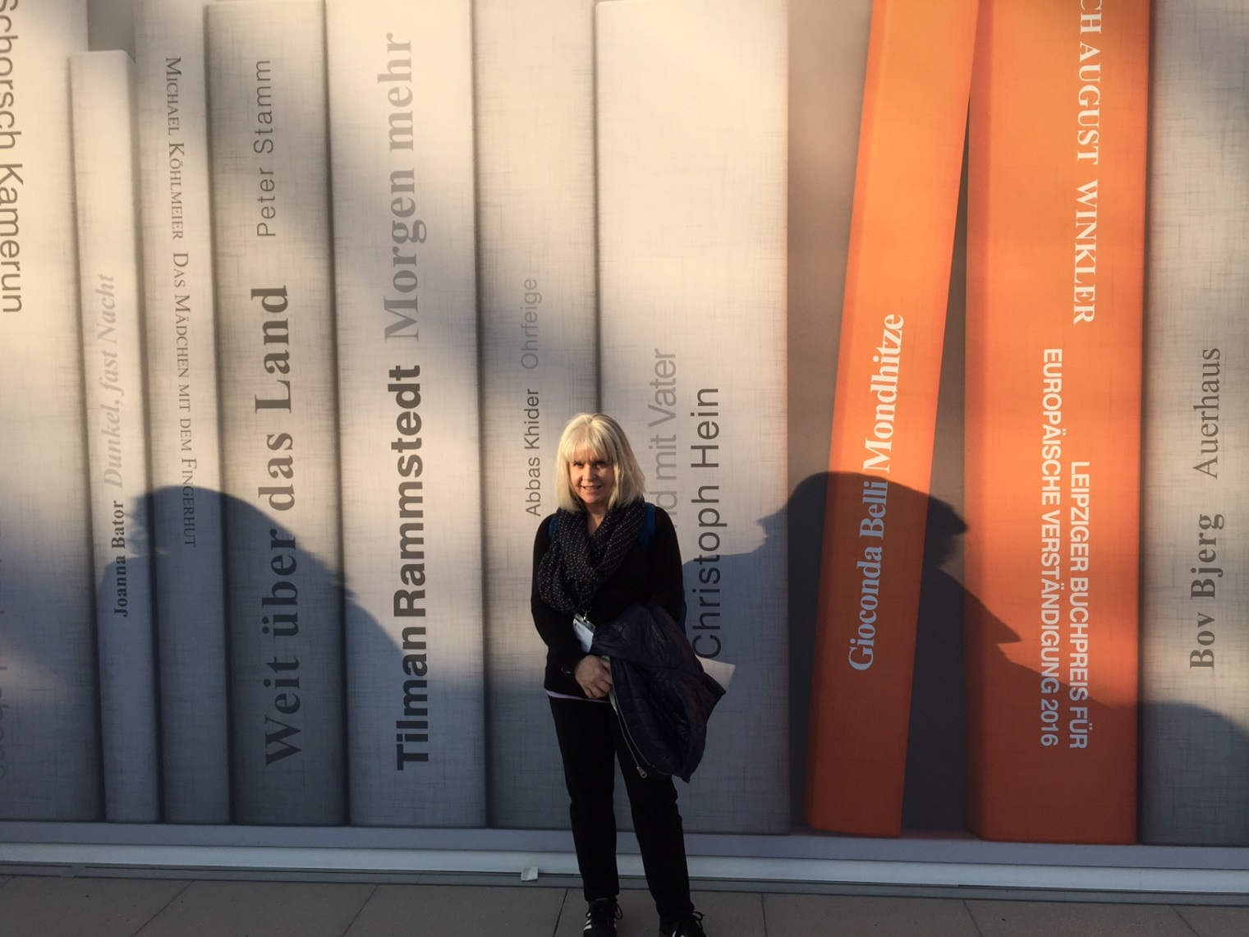
The Book Fair
Germans are great readers and love books and publishing arts.

Slide 21
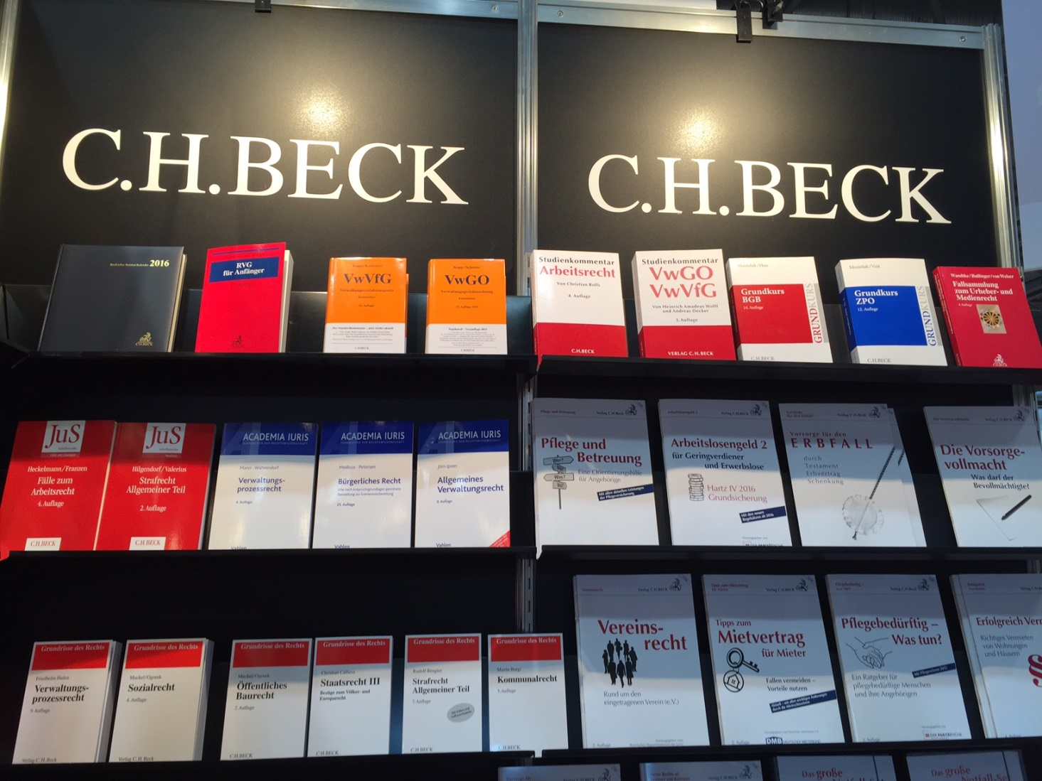
The Book Fair
A familiar sight to law librarians…

Slide 22
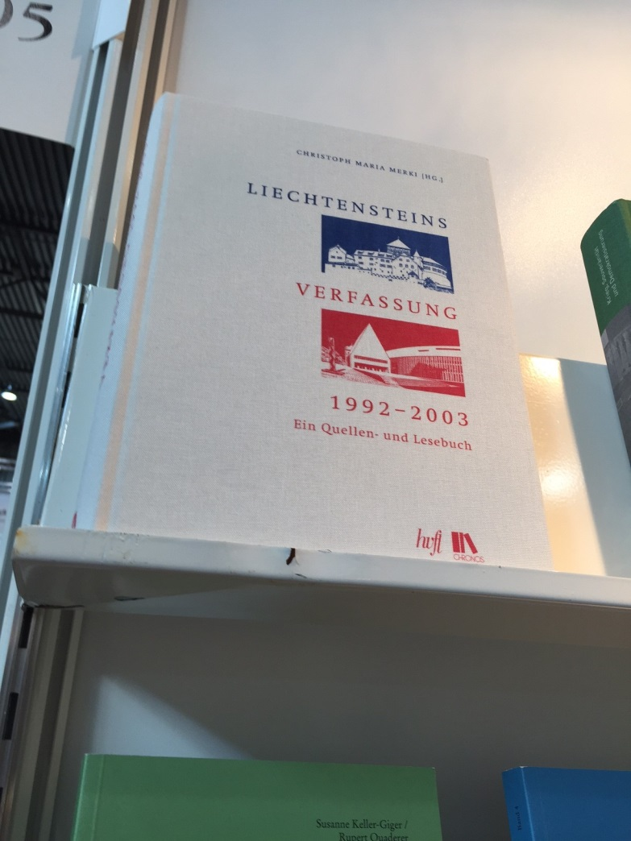
The Book Fair
A reminder to see if we have this when I get back. We do.

Slide 23
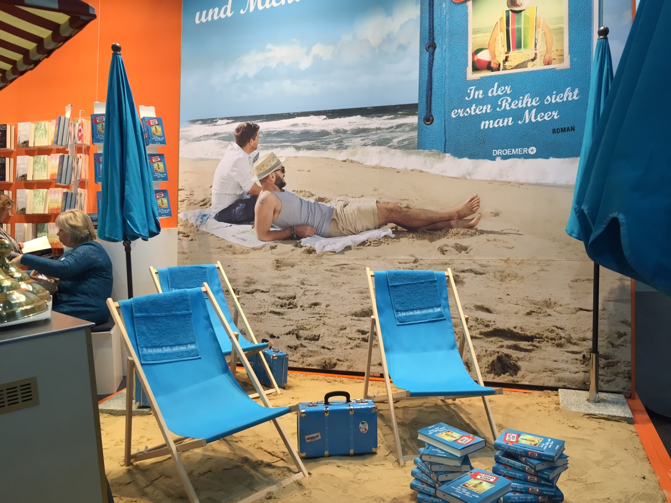
The Book Fair
One publisher used real sand to show off its beach reads.

Slide 24
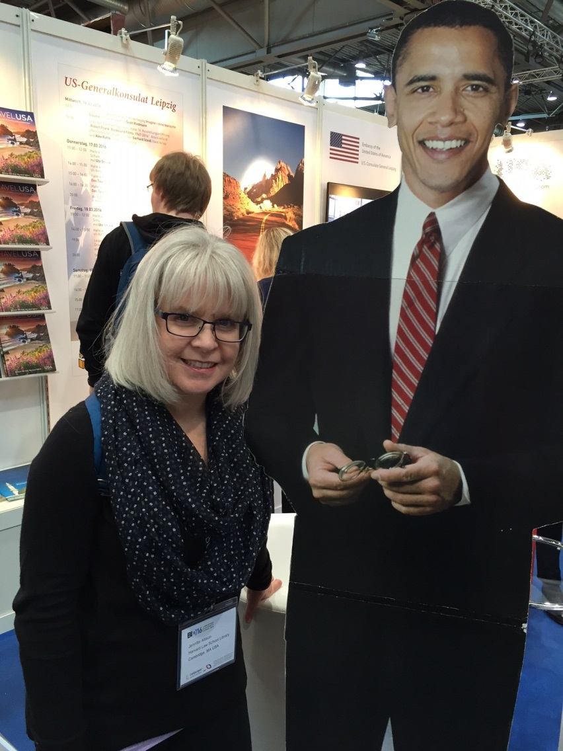
The Book Fair
I ran into a familiar friend at the U.S. Consulate of Leipzig’s booth.

Slide 25
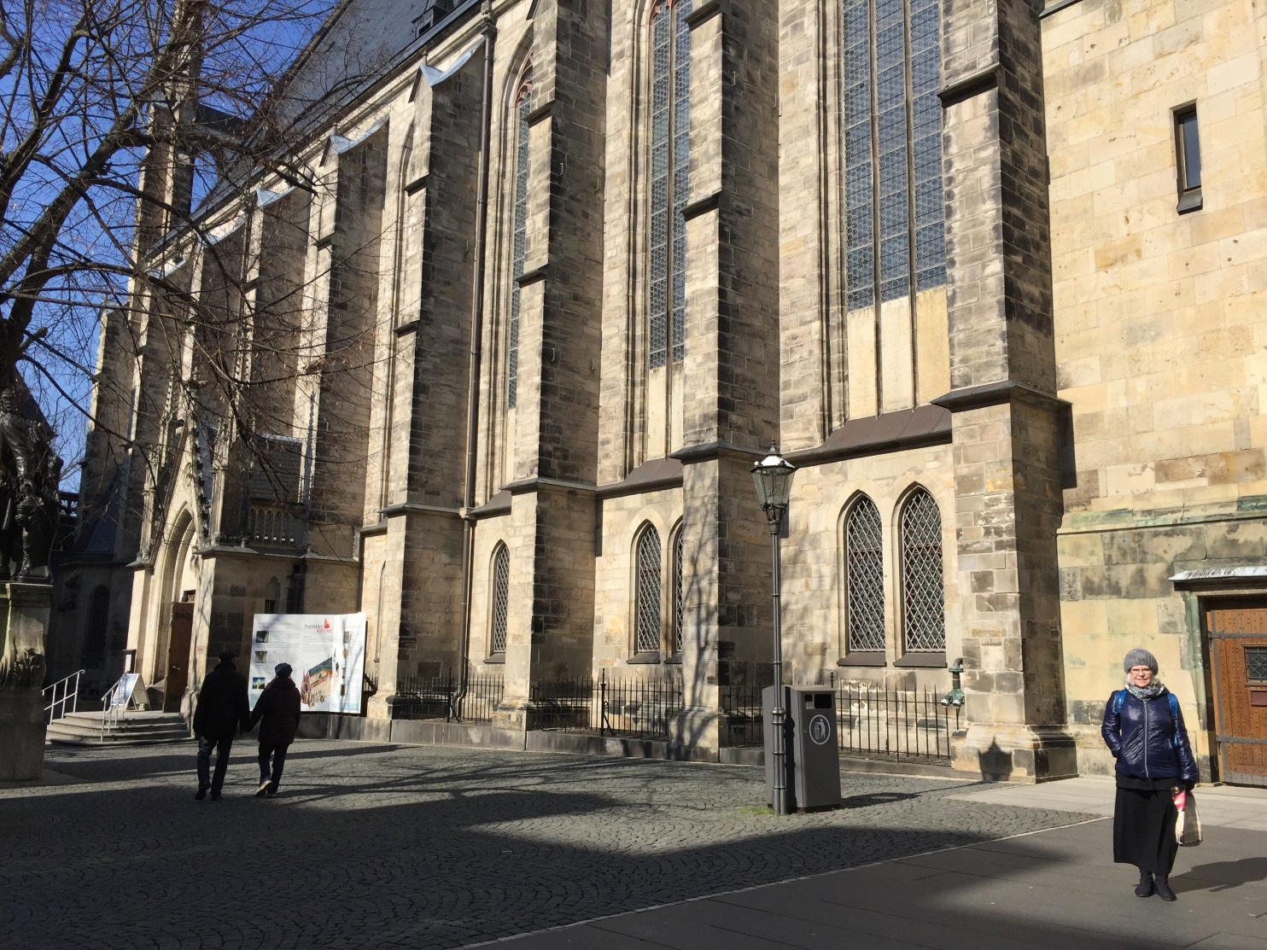
Beautiful Leipzig
St. Thomas Church

Slide 26
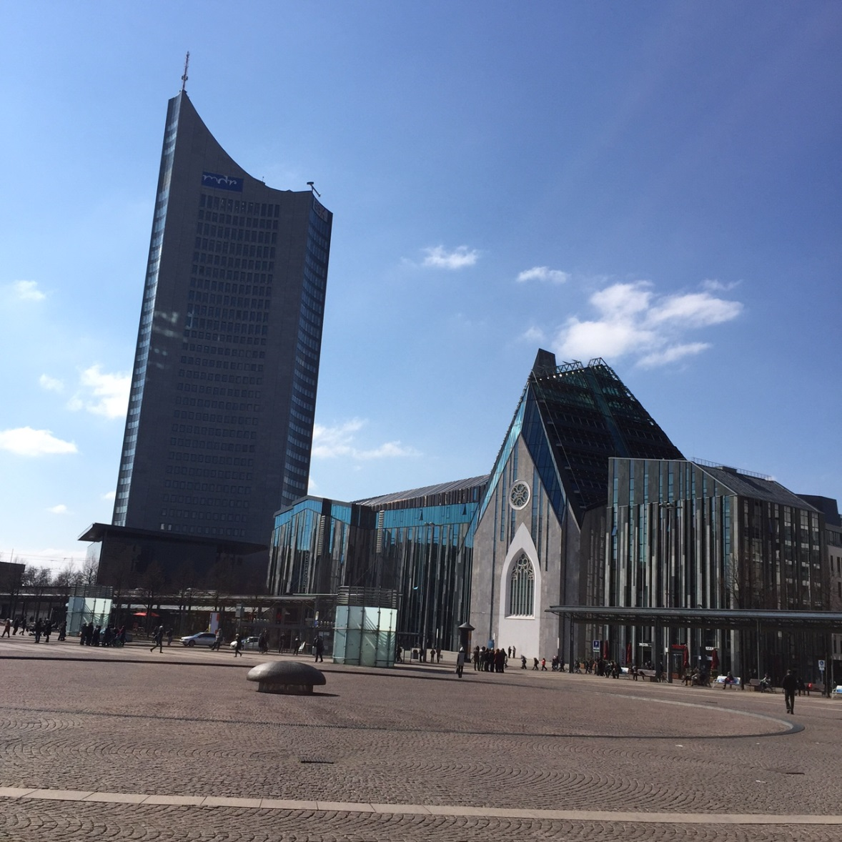
Beautiful Leipzig
Augustusplatz in Central Leipzig

Slide 27
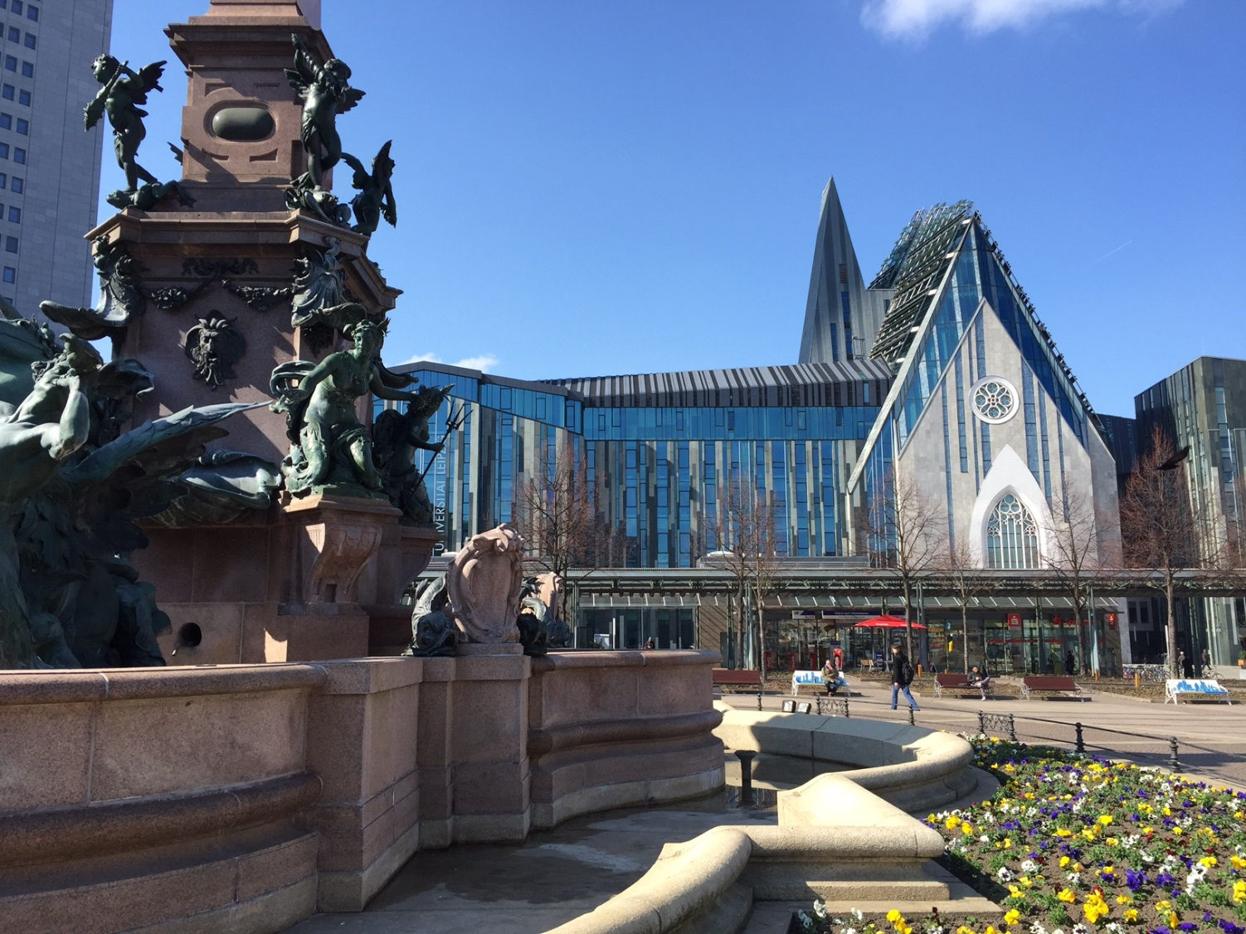
Beautiful Leipzig
Augustusplatz in Central Leipzig

Slide 28
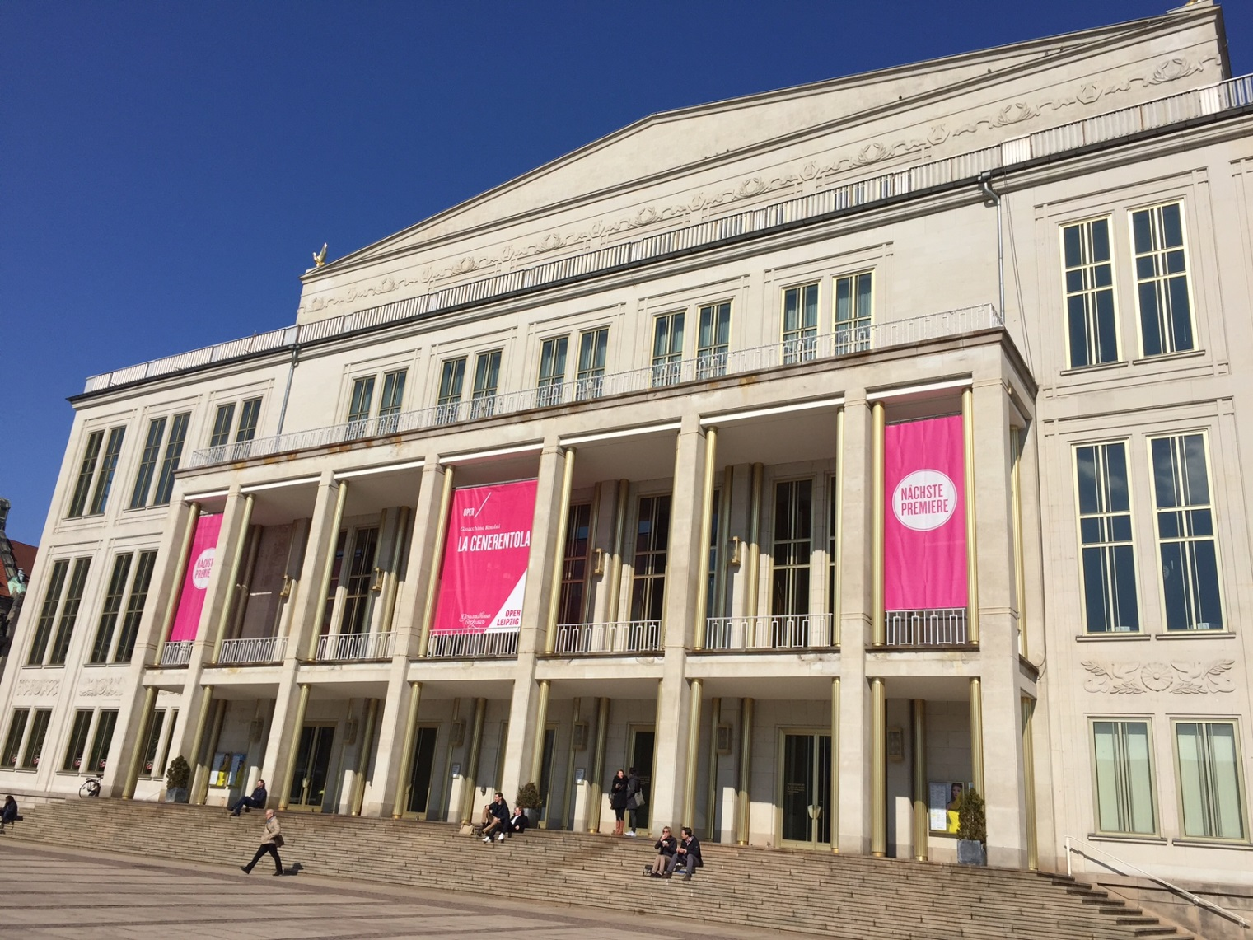
Beautiful Leipzig
Oper Leipzig

Slide 29
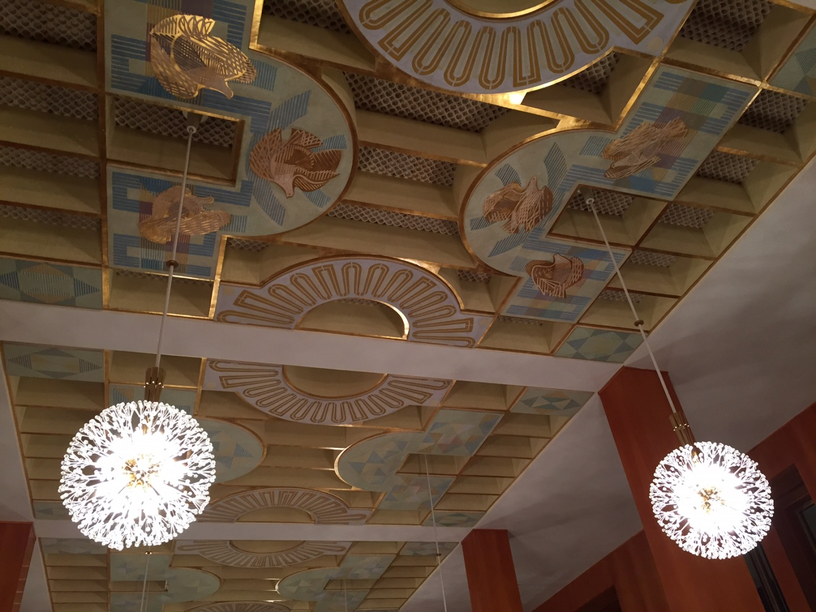
Beautiful Leipzig
Oper Leipzig

Slide 30
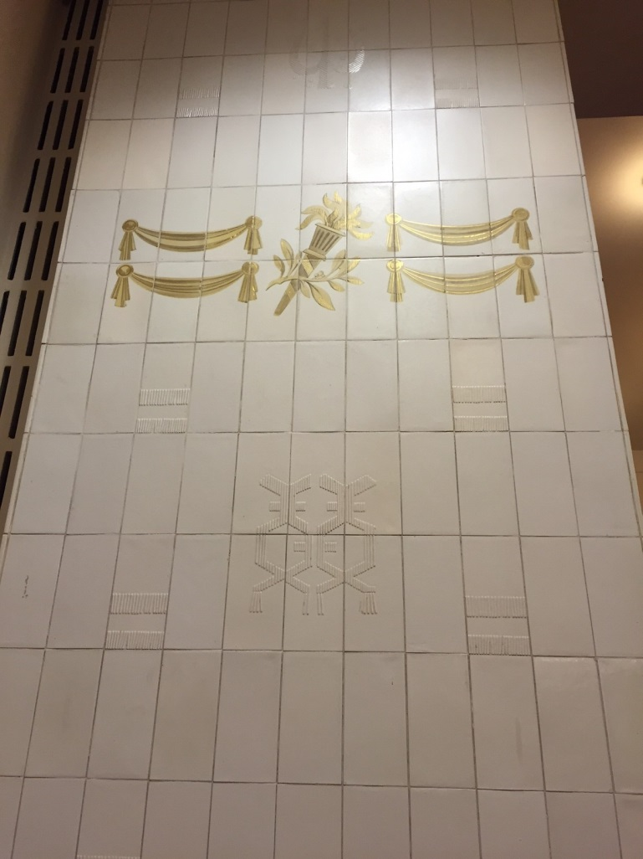
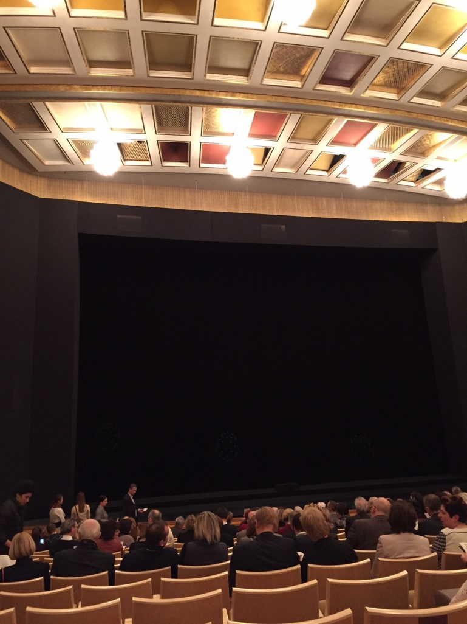
Beautiful Leipzig
Oper Leipzig

Slide 31
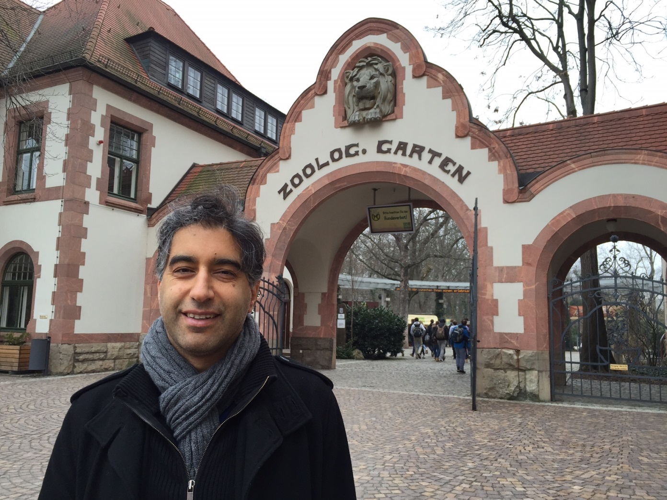
Beautiful Leipzig
Leipzig Zoo

Slide 32
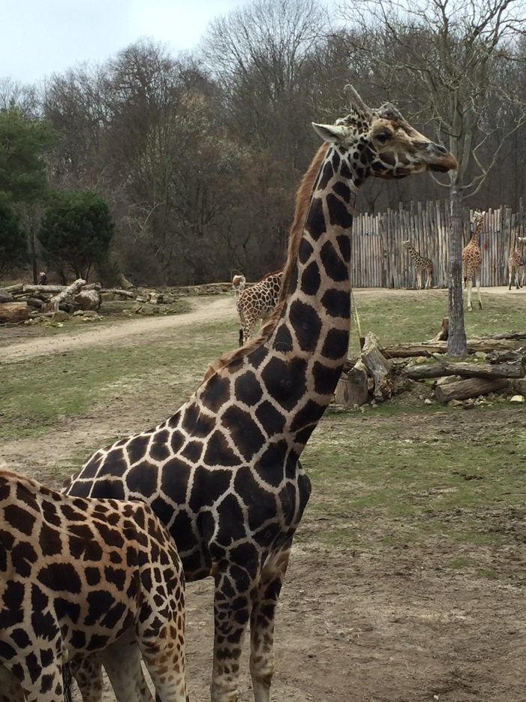
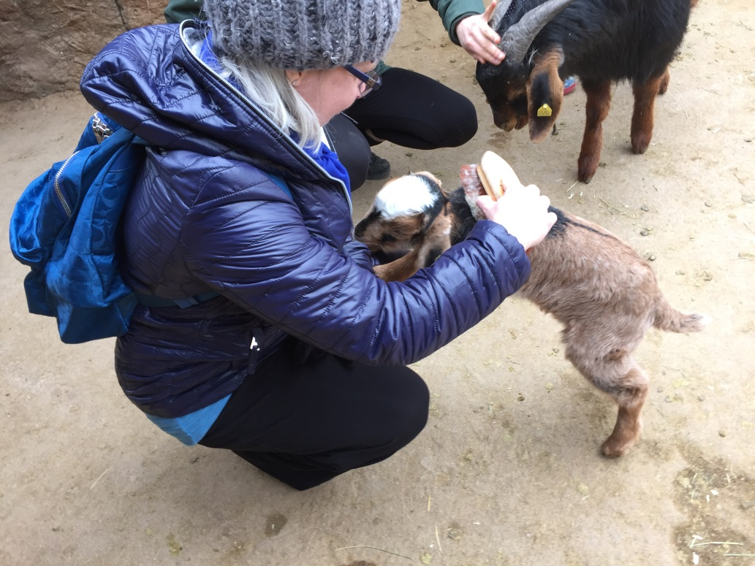
Beautiful Leipzig
Leipzig Zoo

Slide 33
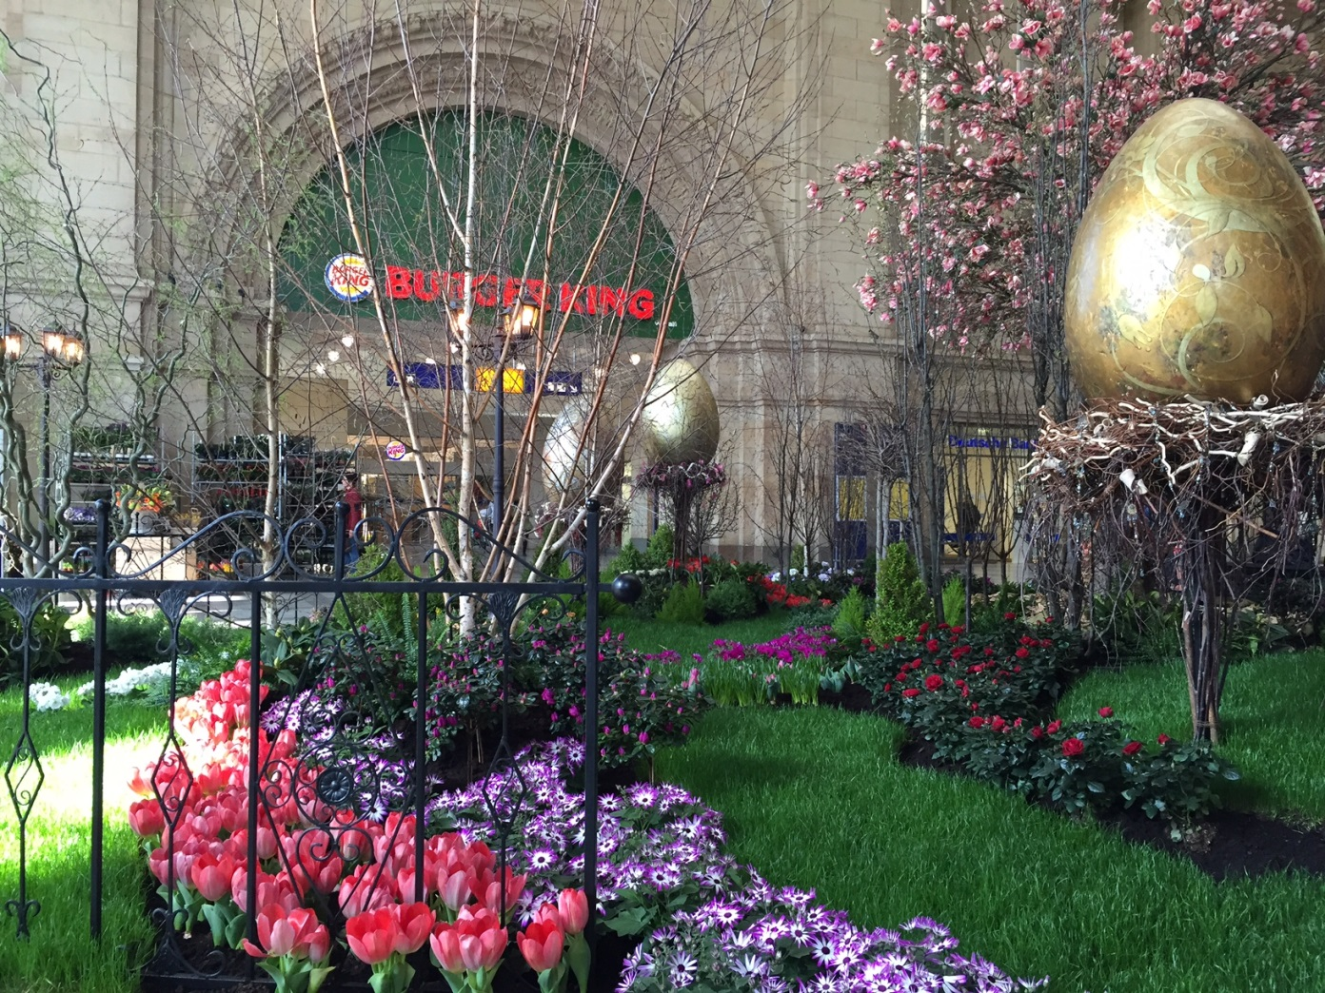
Beautiful Leipzig
Spring Garden inside the Leipzig Main Train Station

Slide 34
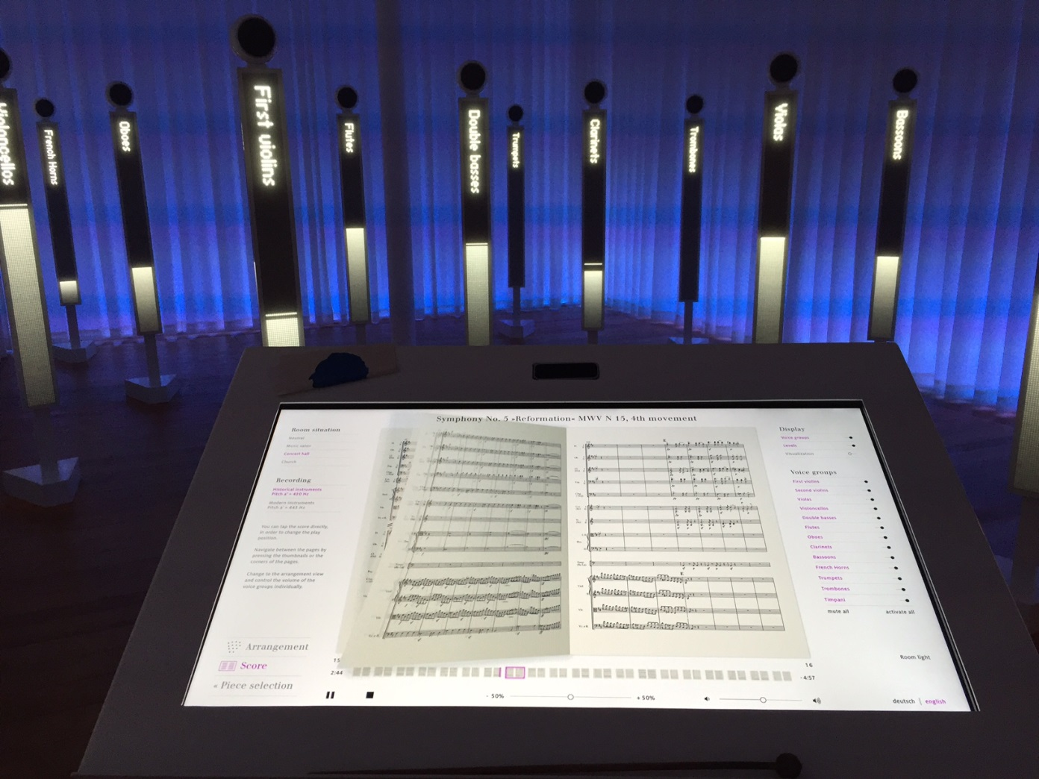
Beautiful Leipzig
Mendelssohn Museum

Slide 35
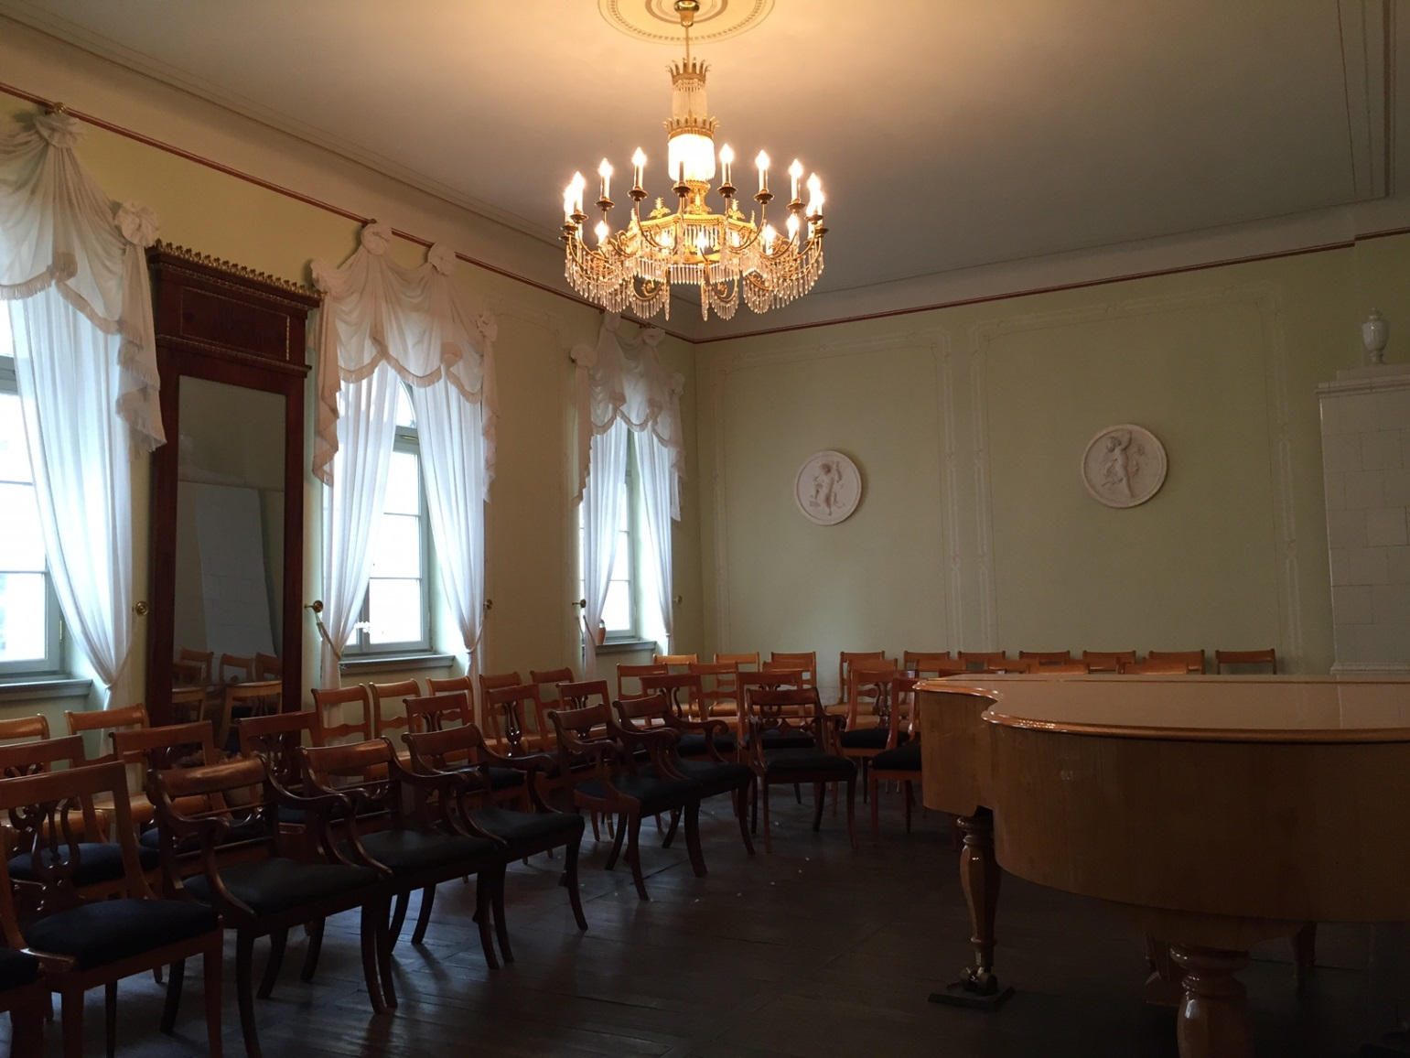
Beautiful Leipzig
Mendelssohn Museum

Slide 36
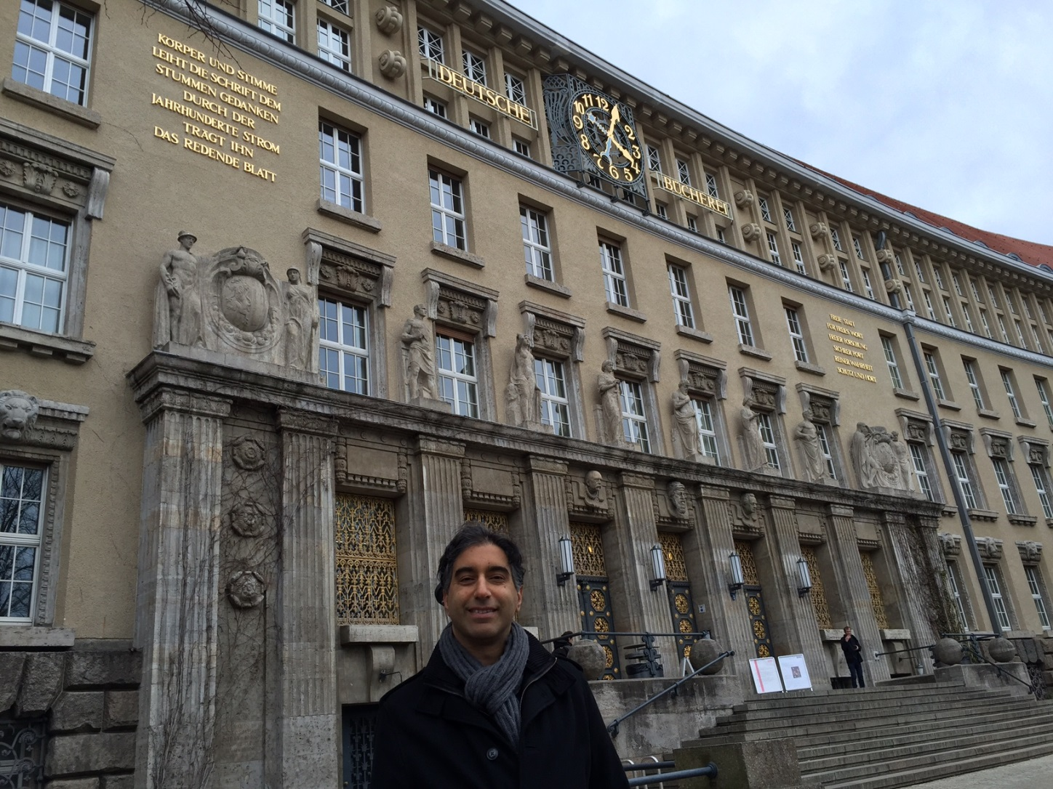
Beautiful Leipzig
German National Library - Leipzig

Slide 37
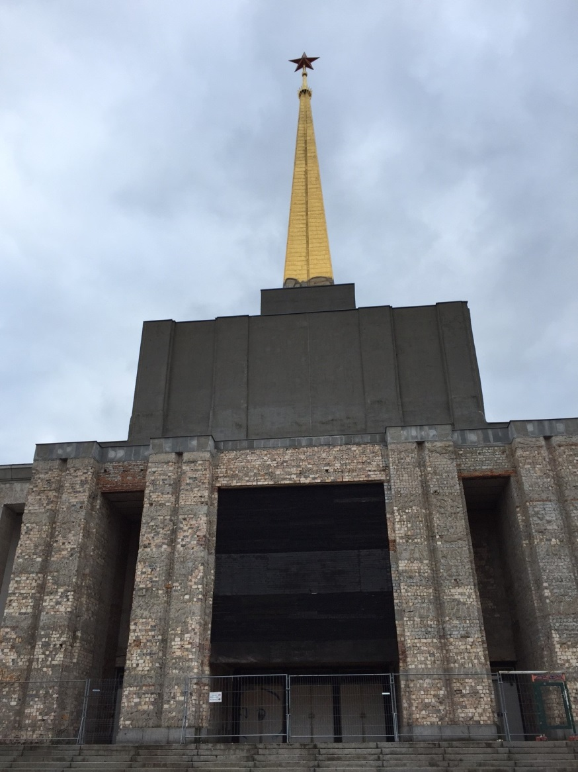
Beautiful Leipzig
Alte Messe – Soviet Pavilion

Slide 38
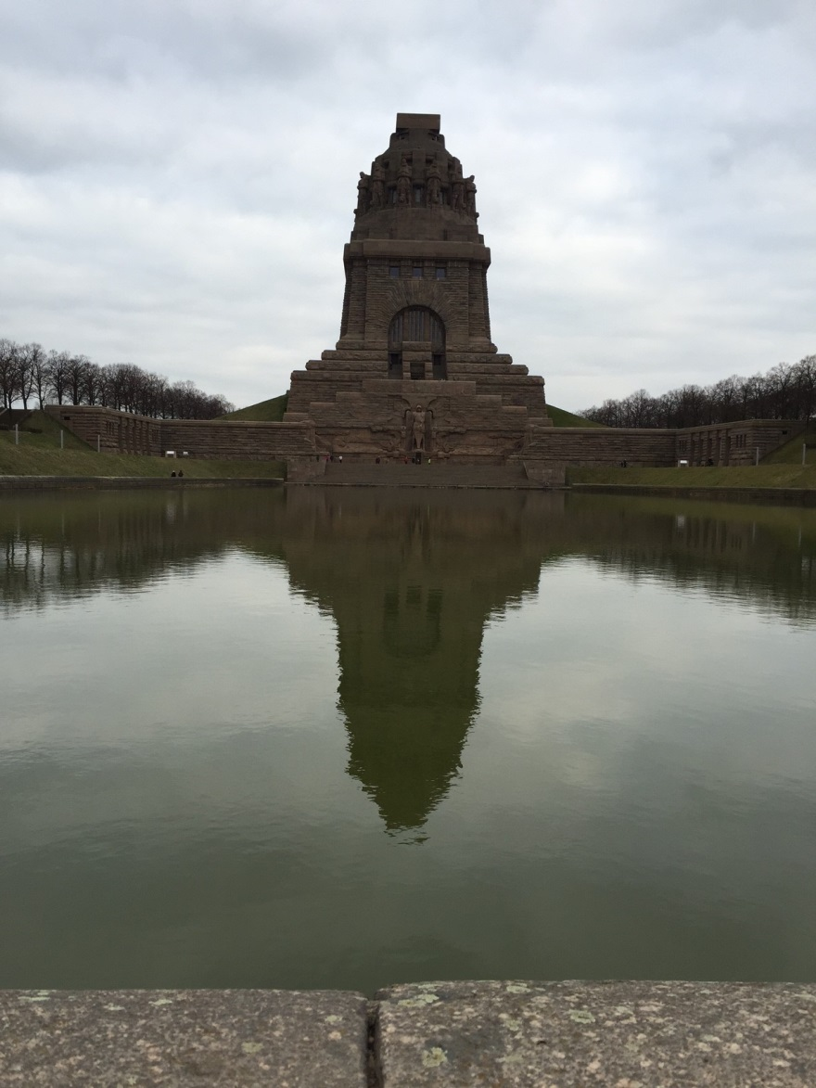
Beautiful Leipzig
Commemorates the Battle of Leipzig in 1813 in which Napoleon’s army was defeated.
The picture cannot really show how huge this is.
Monument to the Battle of the Nations (Völkerschlachtdenkmal)

Slide 39
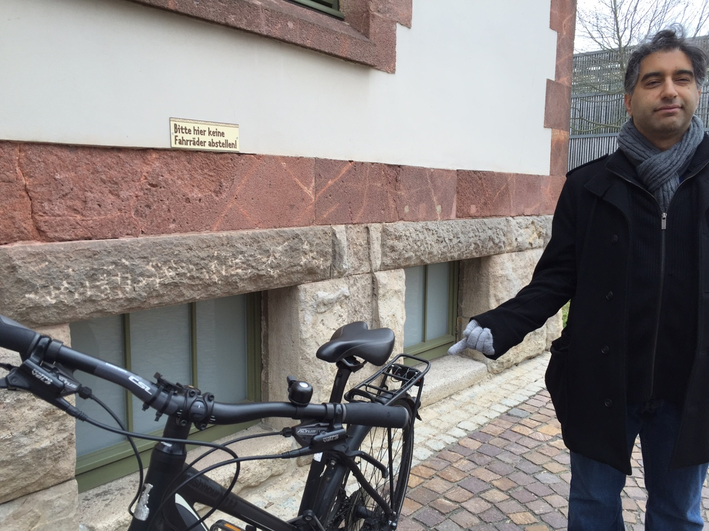
Rules? What Rules

Slide 40
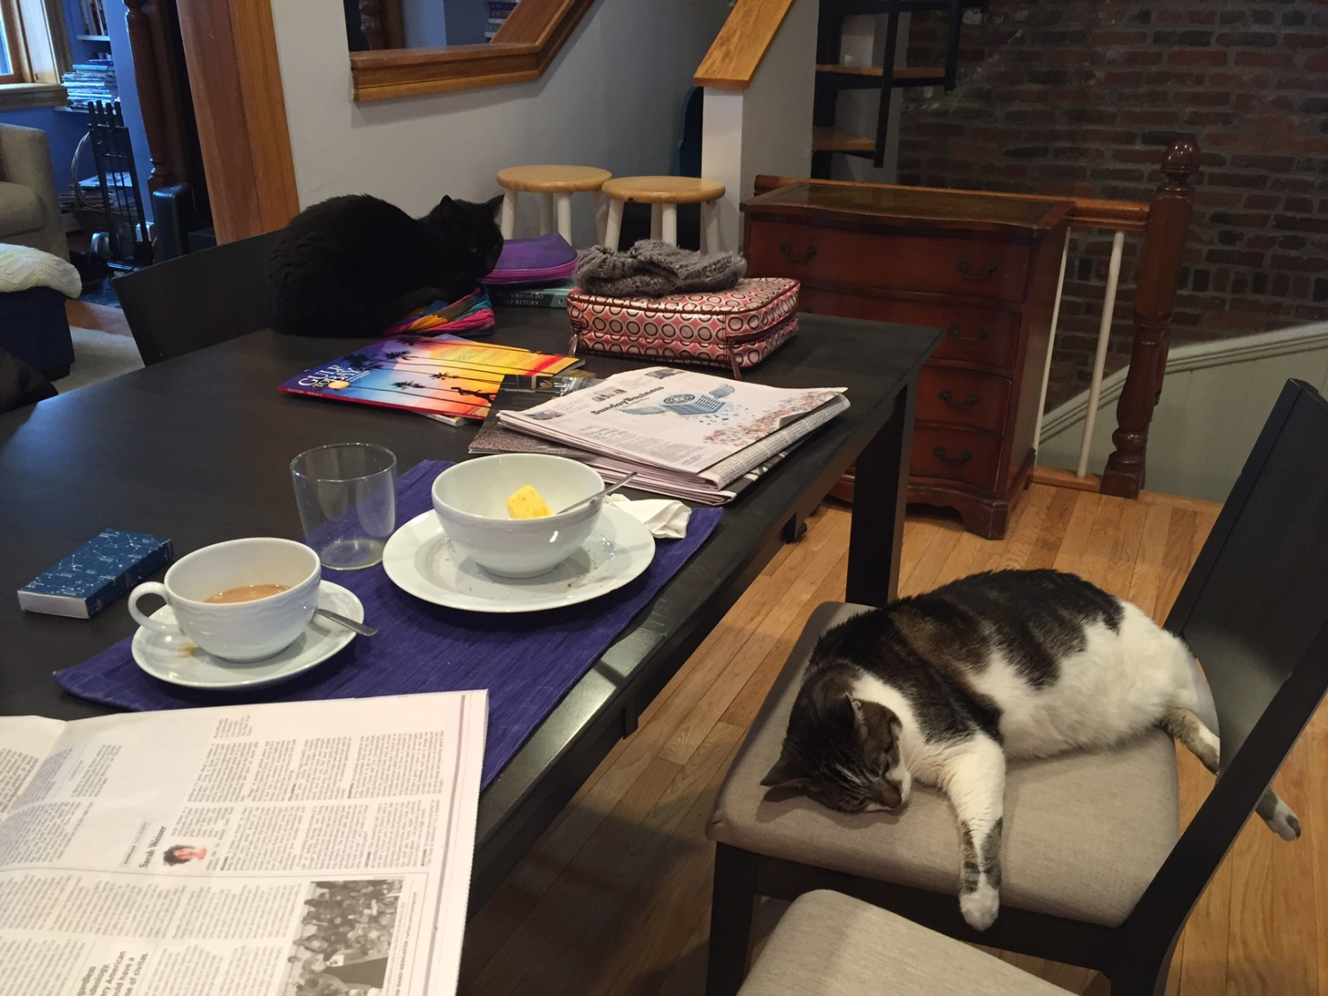
Travel is nice, but…

