Slide 1
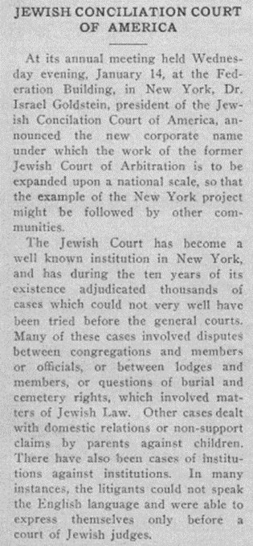
Creating a Space for Religious Arbitration
Jennifer Allison, JD, MLIS, LLM, Harvard Law School
Dr. Jonathan Hack, Lehigh University
Cumberland Law Review Symposium
February 25, 2021

Slide 2

The court that always succeeds in effectuating compromise between the litigants is praiseworthy, and regarding this it is said, “The judgment of peace shall you judge in your gates”
(Zechariah 8:16).
- Maimonides

Slide 3
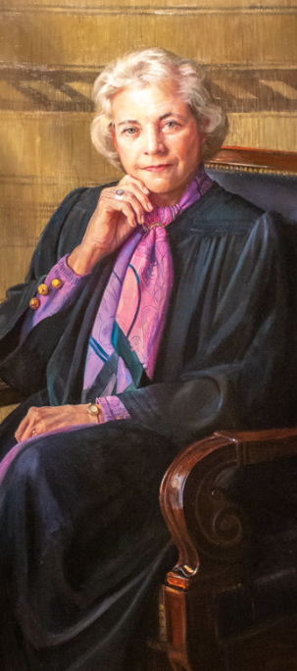
“The courts of this country should not be the places where resolution of disputes begins. They should be the places where the disputes end after alternative methods of resolving disputes have been considered and tried.”
- Justice Sandra Day O’Connor

Slide 4

Why Parties Seek ADR
Courts are crowded and bringing cases in them is expensive and time-consuming.
Parties want a process that encourages fair dealing, open dialogue, and equitable results.

Slide 5
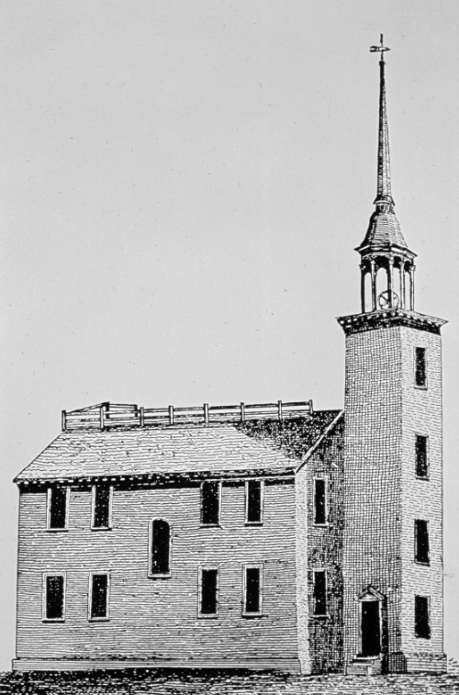
ADR in the American Colonies:
Colonial Boston, 1640
Early documented case of a dispute between Mrs. Hibbens and Mr. Crabtree over the quality of work she hired him to do.
Private arbitration was unsuccessful.
Dispute moved to the church, where her behavior was called into question.
She was excommunicated for “violation of brotherly norms and improper exercise of fraternal power.“

Slide 6
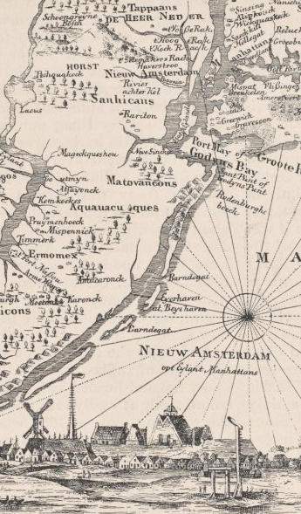
ADR in the American Colonies:
New Amsterdam, 17th Century
Governor Peter Stuyvesant felt compelled by public sentiment to create a “popular form of government.”
Accordingly, he established a board of men that were granted the power to attend court sessions as arbitrators and provide binding decisions on cases that were assigned to them by judges.

Slide 7
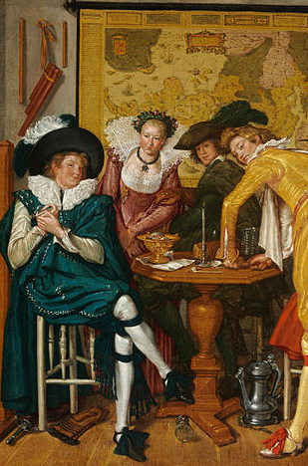
ADR in the American Colonies:
New Amsterdam, 17th Century
In one case, a gathering at the home of Mr. La Nooy turned a bit raucous, resulting in Mr. Fyn assaulting Mr. Withart with a wine glass and injuring him.
The case was referred to arbitration, and after the arbitrators settled on the monetary damages owed, they made the parties “mutually promis[e] ... not to molest one another on this subject in the slightest degree, but to live as good friends ought to do[.]”

Slide 8
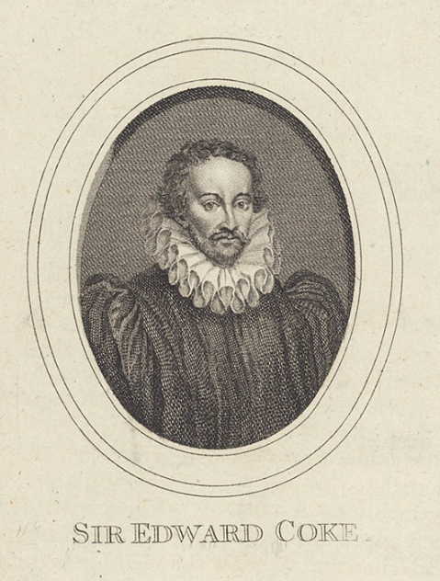
Arbitration and the Common Law:
Early Developments
An agreement to arbitrate “may be revoked at any time before an award is made.”
Vynior’s Case, 1609, opinion of Sir Edward Coke
Vynior’s Case is frequently cited by early English and American courts when they affirm the revocability of arbitration agreements.
In doing this, courts asserted their jurisdiction over legal disputes and signaled their hostility toward arbitration.

Slide 9
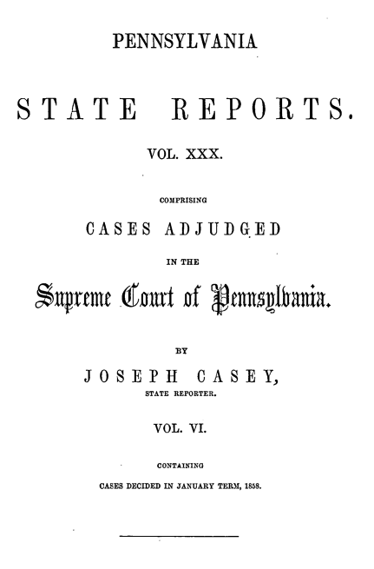
Arbitration and the Common Law:
Early Developments
Hostility toward arbitration eased in the nineteenth century, however.
American courts upheld arbitration awards made pursuant to the intentions of both parties, as long as there was no arbitrator misconduct.
“When an award is made pursuant to the submission, it becomes the law by which the parties are to act in relation to the subject matter that was in dispute.”
Robinson v. Bickley, 30 Pa. 384, 389 (1858).

Slide 10
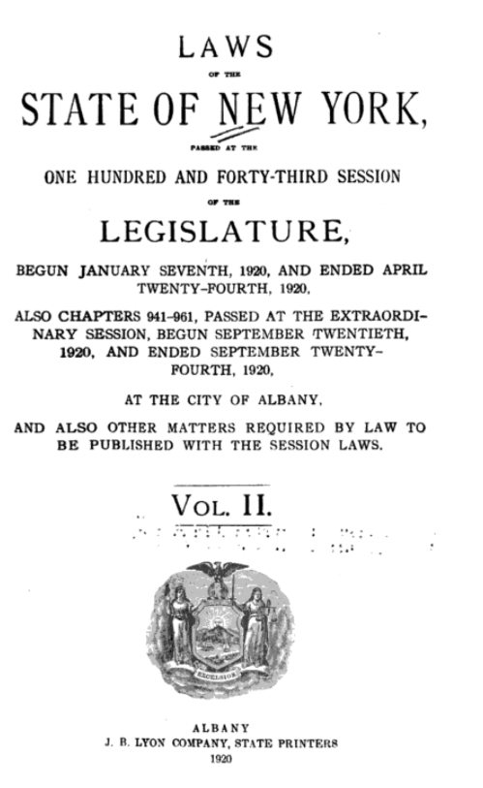
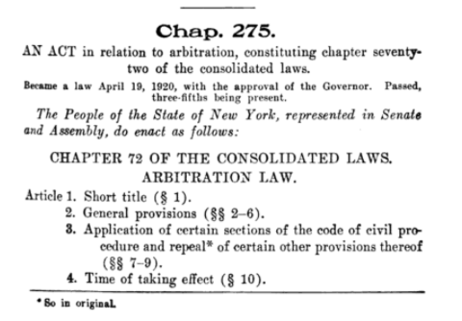
“Modern” Arbitration Statutes
of the 1920s
New York was the first state to enact what became known as a “modern” arbitration statute, in 1920.
This statute was enacted in response to significant increases in caseload volume in the New York courts.
Other states soon followed suit:
1923: New Jersey
1925: Oregon and Massachusetts
1927: California and Pennsylvania

Slide 11
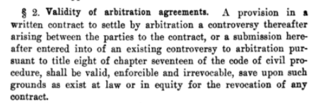
“Modern” Arbitration Statutes
of the 1920s
The New York law made agreements to arbitrate “valid, enforceable, and irrevocable.”

Slide 12
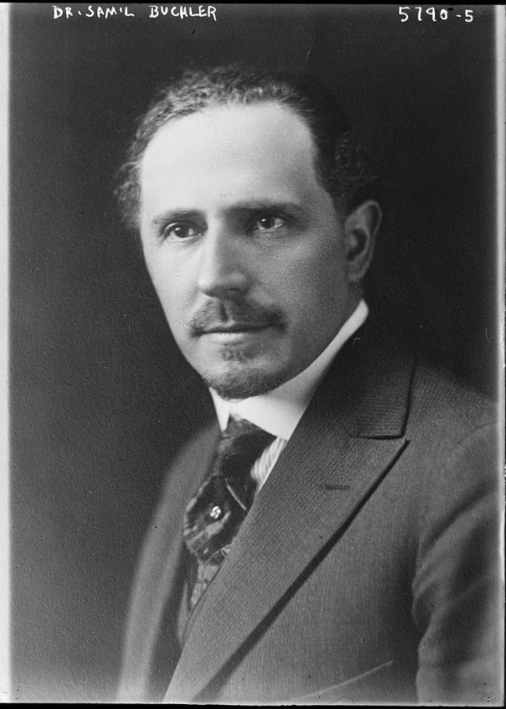
Jewish Dispute Resolution
in New York
As New York was enacting this arbitration law, organizations dedicated to providing dispute resolution services began to emerge.
One of the first organizations to enter this landscape, from a Jewish perspective, was the Jewish Court of Arbitration. It was founded by Rabbi Samuel Buchler (pictured at left) and Louis Richman in 1919 in New York City.

Slide 13
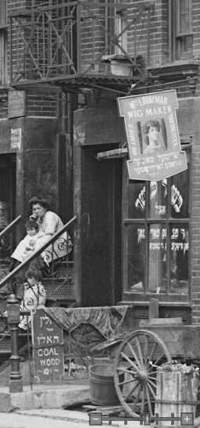
Jewish Dispute Resolution
in New York
The Jewish Court of Arbitration was created to provide a forum for recent Jewish immigrants to resolve their differences.
Its proceedings were in Yiddish, rather than English, and its focus was on resolving disputes equitably and in accordance with traditional Jewish values.
Given these characteristics, it was not favored as a dispute resolution forum for Americanized, assimilated Jews.

Slide 14
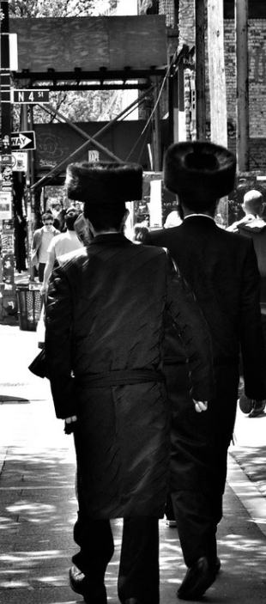
Jewish Dispute Resolution
in New York
In the wake of World War II, more and more Orthodox Jews immigrated from Europe to the United States.
Many of these immigrants worked to establish religious communities in their new country, prioritizing the creation of synagogues, Torah study, and a singular dedication to Jewish life.
For these communities in particular, the Jewish Arbitration Court provided an important foundation to the religious dispute resolution system that is still in use to this day.

Slide 15
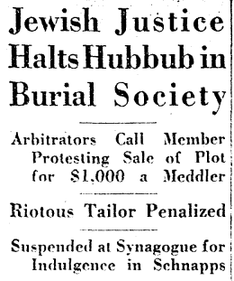
Jewish Dispute Resolution
in New York
New York’s English-language newspapers occasionally reported on the Jewish Arbitration Court’s proceedings. On December 27, 1928, the New York Herald-Tribune reported that the court had recently handed down two decisions related to funeral plots.
The article also explained the court’s process for “decid[ing] disputes involving the Jewish faith.” Specifically, each party is “charged fifty cents to cover administrative expenses” and given the opportunity to “tell his story to the three volunteer judges in English or Jewish.”

Slide 16
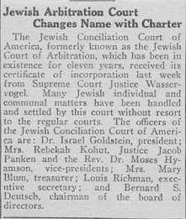
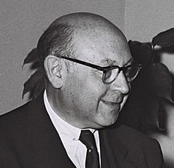
Jewish Dispute Resolution
in New York
In 1930, the court came under the leadership of Dr. Israel Goldstein, and it officially changed its name to the Jewish Conciliation Court of America.
Dr. Goldstein assumed the presidency of the organization “out of a deep concern for social justice and for Jewish dignity.”

Slide 17
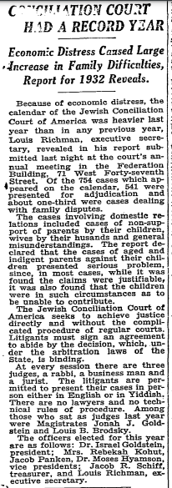
Jewish Dispute Resolution
in New York
By 1932, the court’s calendar had more than 750 cases, many of which, due to the ongoing impact of the Great Depression, involved disputes over financial support in families.

Slide 18
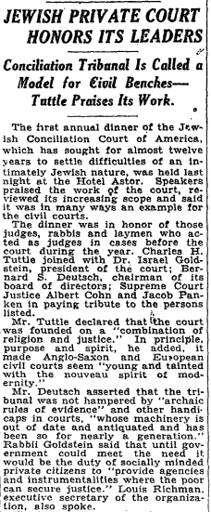
Jewish Dispute Resolution
in New York
Also in 1932, the court was praised for its work in service of “religion and justice” by Charles H. Tuttle, who had served as US attorney for the Southern District of New York.
Dr. Goldstein, as head of the court, characterized it as an “agency and instrumentality where the poor can secure justice.”

Slide 19
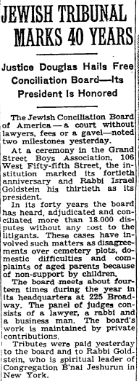
Jewish Dispute Resolution
in New York
In 1959, the Jewish Conciliation Board (having once again changed its name) celebrated its 40th anniversary and its 30th year under Dr. Goldstein’s leadership.
By this time, it had heard over 18,000 cases. Supported by private donors, it provided its dispute resolution services at no cost to those who came before it.

Slide 20
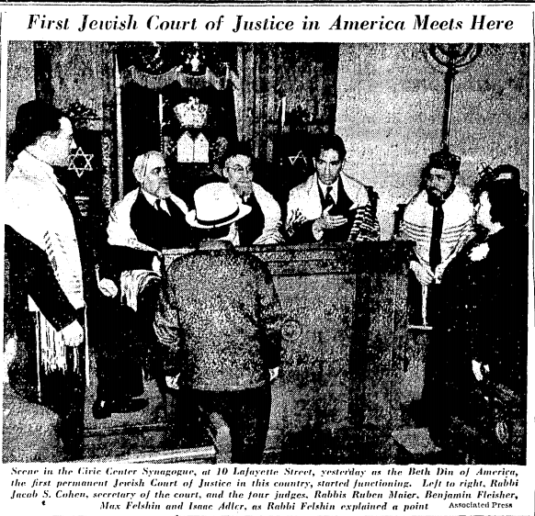
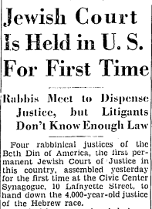
The Emergence of an American Jewish Religious Court of Law (Beit Din)
For all of the value it brought to the community, the Jewish Conciliation Court/Board was not a religious Jewish court of law, or Beit Din.
A Beit Din is designated under Halakha (Jewish law) to resolve financial and civil disputes among Jews.
This void was filled by the establishment of Beth Din of America, the first permanent Jewish court of justice in the United States. It met for the first time in 1939, at the Civic Center Synagogue in New York.

Slide 21
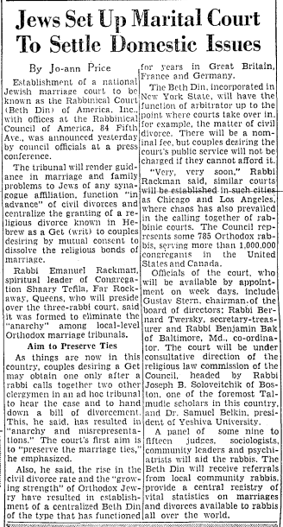
The Emergence of an American Jewish Religious Court of Law (Beit Din)
The organization known today as Beth Din of America was established in 1960 to provide a forum to which Jews could turn for resolution of their marriage and family disputes.
Rabbi Emanuel Rackman, one of the court’s first rabbis, explained that “it was formed to eliminate the ‘anarchy’ among local-level Orthodox marriage tribunals.”
The court had a selected advisory panel of “judges, sociologists, community leaders, and psychiatrists” to assist them in resolving disputes.

Slide 22
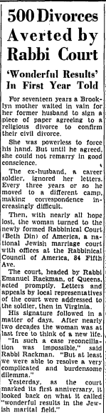
The Emergence of an American Jewish Religious Court of Law (Beit Din)
In 1961, Rabbi Rackman claimed that, in the court’s first year, it “had been instrumental in averting 500 divorces in various parts of the nation.”

Slide 23
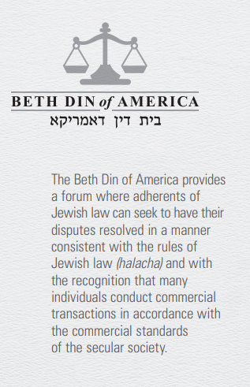
The Emergence of an American Jewish Religious Court of Law (Beit Din)
Today, Beth Din of America provides a variety of Jewish-centered mediation and arbitration services.
One way that parties can arrange to have their dispute resolved by a Beit Din is to enter into an arbitration agreement (shtar beirurin) that gives the Beit Din to have jurisdiction over their dispute.
Beth Din of America provides a simple form for this agreement, in English, on its website.
It also provides form language for a Beit Din arbitration clause to insert in an existing contract.

Slide 24
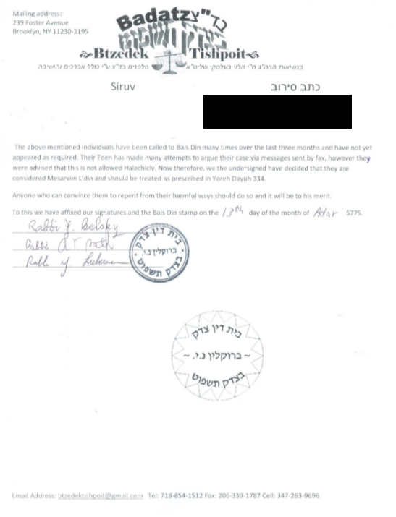
The Emergence of an American Jewish Religious Court of Law (Beit Din)
If there is no signed arbitration agreement, this does not mean that a party cannot seek a Beit Din arbitration.
Beth Din of America makes it easy for a plaintiff to initiate a arbitration proceeding: simply fill out a form on their website to request that they send a summons (hazmanah) the opposing party.
If the hazmanah is ignored, the Beit Din will issue a contempt order (siruv), which authorizes the petitioner to bring the case before a civil court.

Slide 25
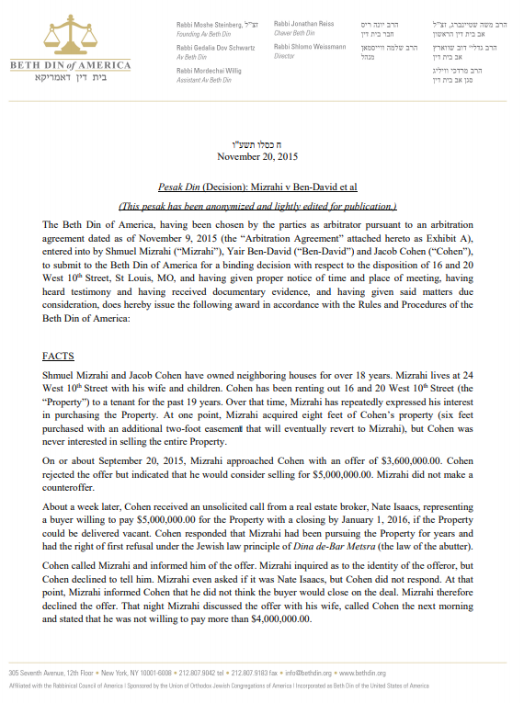
The Emergence of an American Jewish Religious Court of Law (Beit Din)
According to Beth Din of America’s published cases, its arbitration tribunals have resolved disputes involving many topics, including:
Real estate transactions
Brokerage fees
Employment contracts
Business partnership agreements
Landlord/tenant disputes

Slide 26
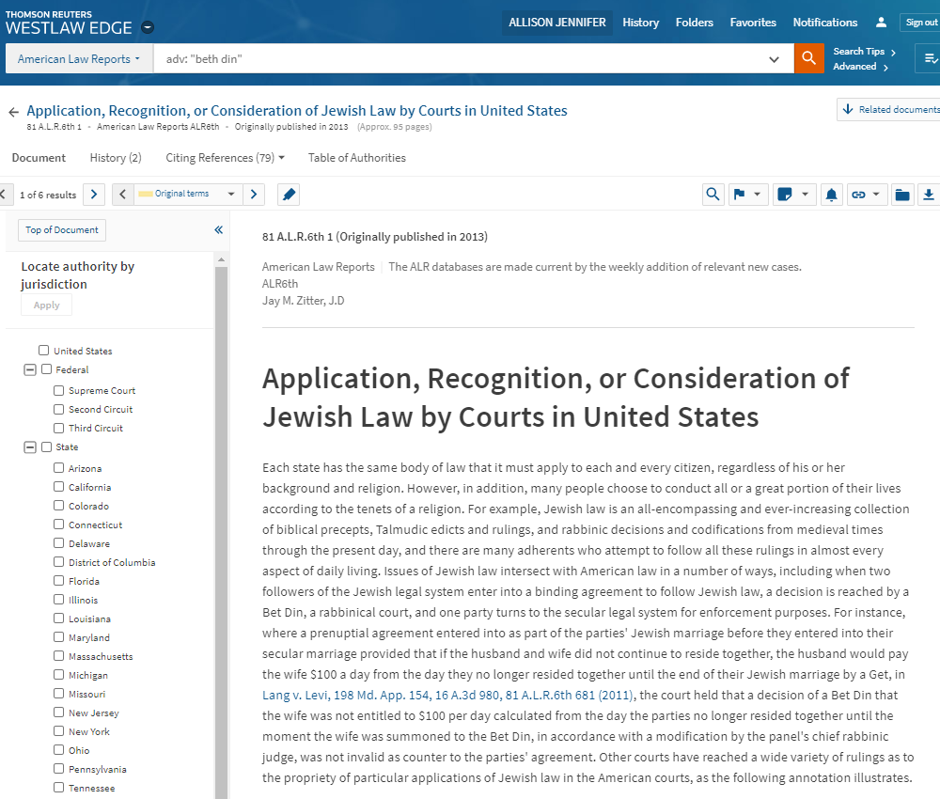
The Emergence of an American Jewish Religious Court of Law (Beit Din)
Beit Din decisions have been treated extensively in U.S. federal and state case law. The American Law Reports annotation “Application, Recognition, or Consideration of Jewish Law by Courts in the United States” includes an extensive description of a Beit Din’s powers and how they are exercised, citing both statutory law and judicial opinions as authority.
This annotation also provides a helpful sample Westlaw search query for researchers who want to find Jewish law materials in the database:
HALAKH! HALACH! "BETH DIN" "BET DIN" "BEIT DIN" "BEIS DIN" "BAIS DIN" TALMUD! TORAH HEREM CHEREM "MIXED SEATING" (DISINSTER! /P JEWISH ORTHODOX) SHULHAN SHULCHAN AGUNA! HETER PESHARA "RABBINICAL COURT" HE("JEWISH LAW")

Slide 27
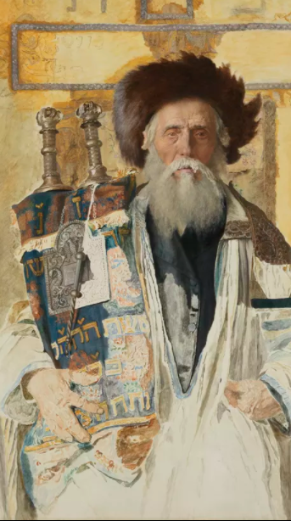
Doing Justice Lifnim Mishurat Hadin (Beyond the Letter of the Law)
There are several reasons that a Jew would prefer to use a religious tribunal rather than a secular court to resolve a dispute, including:
Choosing a secular court over a religious court indicates a rejection of religious law, issued by God to the Jews through the Torah.
The Beit Din reflects the morals and values of the Jewish people, especially the requirement that people conduct themselves in an ethical manner.

Slide 28
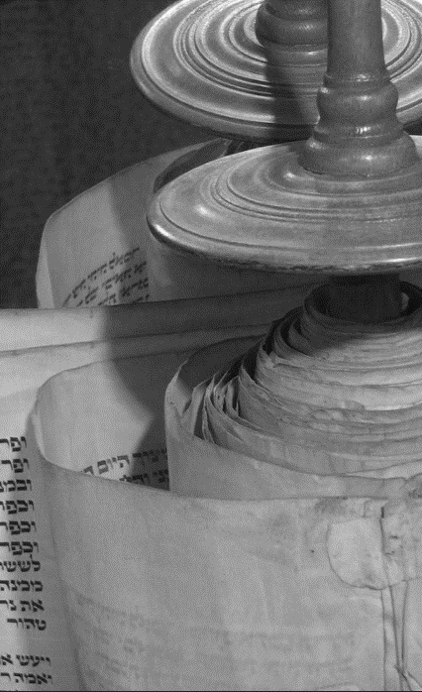
Doing Justice Lifnim Mishurat Hadin (Beyond the Letter of the Law)
The Beit Din embodies the Halakhic system that requires acting lifnim mishurat hadin (beyond the letter of the law).
Accordingly, although the letter of the law might dictate a certain outcome, coupling the legal outcome with an eye towards just and righteousness may allow dayyanim (Beit Din judges) to urge a more compassionate and equitable resolution.

Slide 29
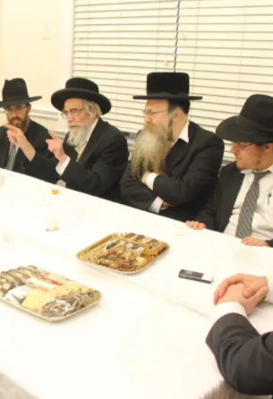
Doing Justice Lifnim Mishurat Hadin (Beyond the Letter of the Law)
Beit Din judges have three types of methodological approaches at their disposal as they work to resolve disputes:
Din – strict application of Halakha
Pesharah – compromise or equity
Pesharah kerovah l'Din – a blend of Pesharah and Din
These three approaches allow the judges to strive for a holistic, rather than purely legalistic, outcome that emphasizes fairness and justice for all the parties.

Slide 30
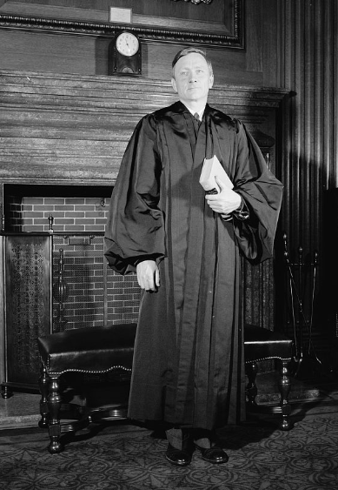
Doing Justice Lifnim Mishurat Hadin (Beyond the Letter of the Law)
During his speech at the 40th Anniversary Celebration of the Jewish Conciliation Board in 1959, Supreme Court Justice William O. Douglas illustrated this principle with his observation that religious Jewish tribunals are uniquely qualified to resolve disputes fairly:
“The Jewish Conciliation Board lays aside all prejudice and seeks to find what is the truth in local disputes, and what is a just solution.”

Slide 31
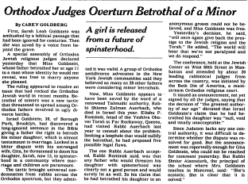
Doing Justice Lifnim Mishurat Hadin (Beyond the Letter of the Law)
A 1995 decision by a New York Beit Din illustrates this principle perfectly.
A father claimed to have betrothed his 13-year-old daughter to gain an advantage in an ugly marital dispute case. The court declared that the father’s claim was null and void, not through the application of any formal rules of evidence, but because it showed he was a bad, and therefore, untrustworthy person:
“Any father who would threaten his daughter with spinsterhood was clearly not a good person and would lie as well. So his claim that he had betrothed his daughter to an anonymous groom could not be believed.”

Slide 32
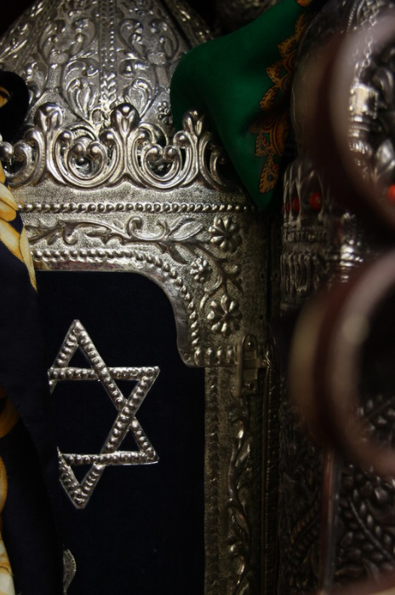
Conclusion
The legal system’s statutory recognition of the validity of arbitration created a regime in which both systems could co-exist.
Jewish arbitration, because it is imbued with Judaism’s ethical principles, offers a means of resolving disputes that reflect the values of the parties and the entire community.
The continued availability of Beit Din courts allows for a holistic outcome for parties who choose not to take their disputes to a civil court.

Slide 33
Image Credits
1: The Reform Advocate, Jan. 17, 1931, digitized by the National Library of Israel.
2: Guillaume Mangeret, Maimonides, CC BY-SA 2.0, https://flic.kr/p/9xCLKX.
3: Thomas Hawk, United States Supreme Court, CC BY-NC 2.0, https://flic.kr/p/2jrVKd5.
4: Rawpixel Ltd, Business People Shaking Hands in Agreement, CC BY 2.0, https://flic.kr/p/29ZEMSq.
5: Federal Street Church, Boston (1744), digitized by the Harvard Library.
6: Map of New Netherlands, 1656, digitized by the New York Public Library.
7: Willem Buytewech - Merry Company (1620), Wikimedia Commons.
8: Sir Edward Coke, digitized by the Harvard Law School Library for its Legal Portrait Collection.
9: Pennsylvania State Reports, v. XXX, 1858, digitized by HeinOnline.
10 & 11: Laws of the State of New York, 1920 , Vol. 2, digitized by Google Books.
12: Rabbi Samuel Buchler, digitized by the Library of Congress.
13: New York City Archives.
14: Gerald Rich, Mod Squad, CC BY 2.0, https://flic.kr/p/bNn7ac.
15: New York Herald Tribune, Dec. 27, 1928, ProQuest Historical Newspapers
16: Jewish Daily Bulletin, Dec. 17, 1930, digitized by Jewish Telegraphic Agency; photo of Dr. Goldstein from the World Jewish Congress of 1956, National Photo Collection of Israel.
17: New York Times, Jan. 12, 1933, ProQuest Historical Newspapers.
18: New York Times, Jan. 28, 1932, ProQuest Historical Newspapers.
19: New York Times, Dec. 7, 1959, ProQuest Historical Newspapers.
20: New York Herald Tribune, May 10, 1939, ProQuest Historical Newspapers.
21: New York Herald Tribune, Dec. 20, 1960, ProQuest Historical Newspapers.
22: New York Herald Tribune, Dec. 14, 1961, ProQuest Historical Newspapers.
23 & 25: Beth Din of America website.
24: Siruv issued by Badatz Btzdedk Tishpoit, party names have been redacted.
26: Westlaw
27: Isidor Kaufmann, Of the High Priest’s Tribe, digitized by the Jewish Museum.
28: J. Nathan Matias, Torah 5, CC BY-SA 2.0, https://flic.kr/p/miswS
29: Rabbinical Alliance of America, https://rabbinicalalliance.org/2018/06/26/igud-harabbonim-adds-distinguished-rabbis-to-its-beth-din/.
30: Justice William O. Douglas, 1939, digitized by the Library of Congress.
31: New York Times, July 11, 1995, ProQuest Historical Newspapers.
32 & 33: Nathalie_r, Torah Scrolls in a Hebron Synagogue, CC BY 2.0, https://flic.kr/p/a4Wrro

