Slide 1

Jennifer Raye, Scholarly Communication Librarian
Olivia MacIsaac, Scholarly Communication Associate
Sheel Patel, Assistant Professor of Pharmacy Practice
Anne Perez, BU Well Composition Editor, Senior, Pharmacy
Morgan Ragsdale, Former BU Well Format Editor
Spencer Lindgren, BU Well Video and Podcast Editor, Senior, Pharmacy
Supporting Open Access Through a Student-driven Journal
Notes:
Introduction to the panel; introduction to presentation format - discuss how this will be an informal conversation addressing a student-driven journal that is hosted on an IR platform at Butler University

Slide 2
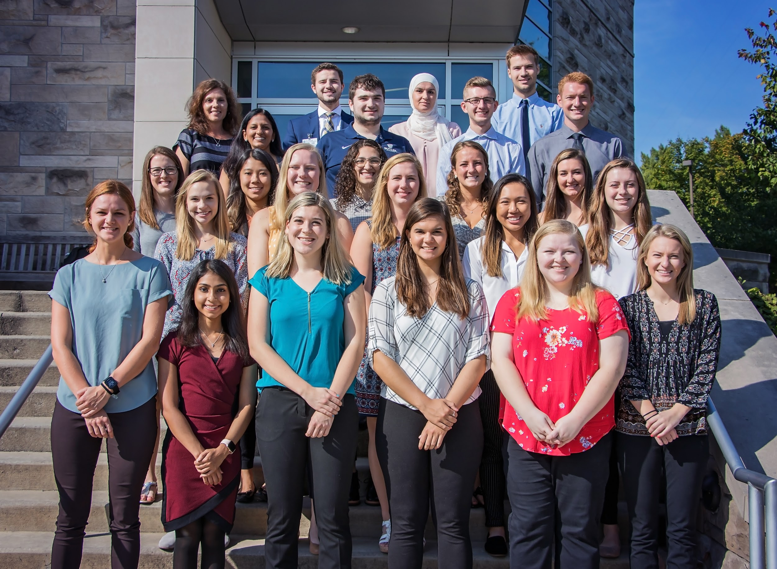
What is BU Well?
https://digitalcommons.butler.edu/buwell/
BU Well is Butler University's open-access, multimedia, student-driven healthcare journal. Every year, one volume is published relating to health, wellness, and life sciences.
Volume 5 Staff and Students
Notes:
What is BU Well? Talk about the history of the journal, talk about where it exist, and so on and so forth

Slide 3
How is this class structured?
https://digitalcommons.butler.edu/buwell/
Notes:
How has the class structure evolved over time?
What do the articles include? Multimedia-how are they evolving
Do you receive submissions outside of the Butler class? How does that work?
How is the executive board structured?

Slide 4
How does this journal fit into the field of healthcare?
https://digitalcommons.butler.edu/buwell/

Slide 5
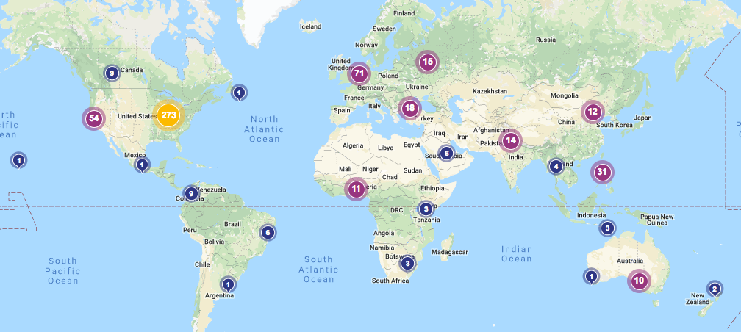
What impact does this journal have?
https://digitalcommons.butler.edu/buwell/
Notes:
Loaded question but we can drill down into it. We have the metrics for the journals--articles in this journal are being read globally (from South America to Japan),but have you seen the direct impact of the journal on campus?--or can the students on the exec. team speak on how working on this journal has impacted their academic career so far?

Slide 6
How does the library support BU Well?
https://digitalcommons.butler.edu/buwell/

Slide 7
Questions?
https://digitalcommons.butler.edu/buwell/

Slide 8


Follow us to stay updated
Thank you!
@BUWellJournal
@buwelljournal
instagramicon by instragram is CC-BY SA | twittertweeticon by raphaelsilva under a pixabay license

