Slide 1

Strategic Planning: Trying to Put All the Pieces Together
Jean Waldrop
Brackett Library, Harding University
jwaldrop@harding.edu

Slide 2


Have you ever tried to do a puzzle without knowing what it was supposed to look like?

Slide 3



Where to start?
Accreditation
Standards
Mission Statements
Strategic Plan
Outcomes
Assessment

Slide 4

A Good Start - Mission Statements
Does anyone else pull out the outside edge puzzle pieces first?
University Mission Statement
Library Mission Statement
Start with key words and phrases and try to incorporate those into a very short library mission statement.
Nelson, B. E. (2014). The academic library administrator's field guide.
Chicago : ALA Editions, an imprint of the American Library Association, 2014.

Slide 5
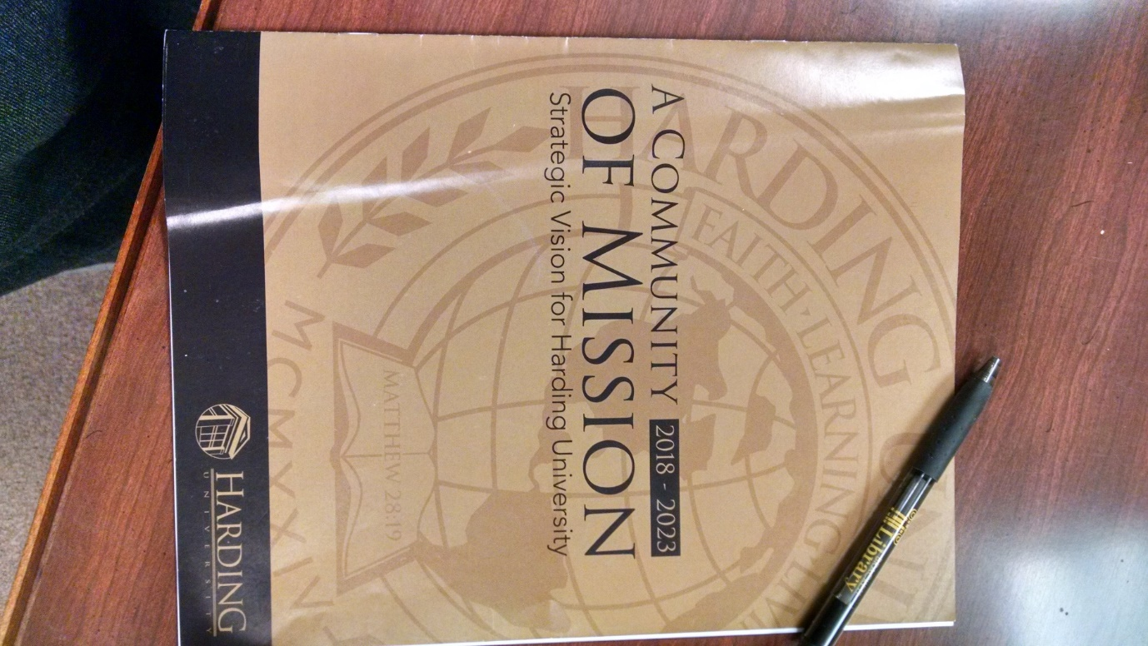
Strategic Vision
2018-2023
Had lunch meetings with students, staff and faculty
“What is one idea, big or small, that you believe would make Harding University better?”
5 strategic points
Faculty Pre-Session
Open online feedback
Presented to Board of Trustees in May

Slide 6
Information Systems and Technology Strategic Plan 2013-2018 and Action Steps
Scrutinize and evaluate emerging technologies that lead to a change to operational efficiencies, and advance teaching and learning
  Archive Harding social media
  Cooperate with Verizon to install a DAS cellular antenna system in campus buildings
  Evaluate and Implement degree audit and planning
  Incorporate IPV6 technology into the campus network
  Migrate to a new integrated library system, taking advantage of the cloud
  Replace existing SAN data storage with newer technology that makes use of SSD storage
  Retire Nortel phone systems, moving to VoIP solutions

Slide 7
Promote digital access and scholarship and deeper integration of digital technologies in learning, teaching and scholarship
  Establish an archivist position to preserve Harding's history and to initiate the start of a digital archive
  Expand Brackett Library's instructional online resources along with outreach to online classes and Harding's professional
  development centers
  Expand Brackett Library to create more space for testing lab, student collaboration, individual study and student technology
  support
  Implement a digital institutional repository
  Initiate a personal librarian program that will facilitate the integration of information literacy into the first-year experience 1
  Promote increased understanding and usage of the library's e-book and e-journal collections
  Redesign Pipeline portal
Promote improved digital and Web-based communication and public relations to help connect the Harding community
  Build and launch a portal for searching/browsing campus historical markers
  Develop and implement a vibrant and effective social media policy to be completed in collaboration with the Office of Public
  Relations
  Develop more effective communication with liaison departments and librarians
  Implement process for tagging and rating library resources

Slide 8
Other units included us in their strategic plan and action steps
Physical Resources
Expand Brackett Library to create more space for testing lab, student collaboration, individual study and student technology support
Student Support and Services
Iniate a personal librarian program that will facilitate the integration of information literacy into the first-year experience
Increase and enhance student social, recreational and study spaces on campus
  Expand Brackett Library to create more space for testing lab, student collaboration, individual study and student technology support

Slide 9
Looking at all sides
Do you ever try to put together small sections of the puzzle first?
Step back and look at University Learning Outcomes and Student Learning Outcomes
  How will these fit under the strategic plan?
  Are there things that would help or enhance the achievement of the SLOs?
  Are there resources that are needed to help with assessment of SLOs?
  Have we made sure that we are meeting criteria for accreditation and ACRL framework?
Step back and look at Assessment
    Are there resources or items that are needed for assessing strategic plan action steps and SLOs?
    Is there even a way to assess your strategic plan action steps and SLOs?

Slide 10
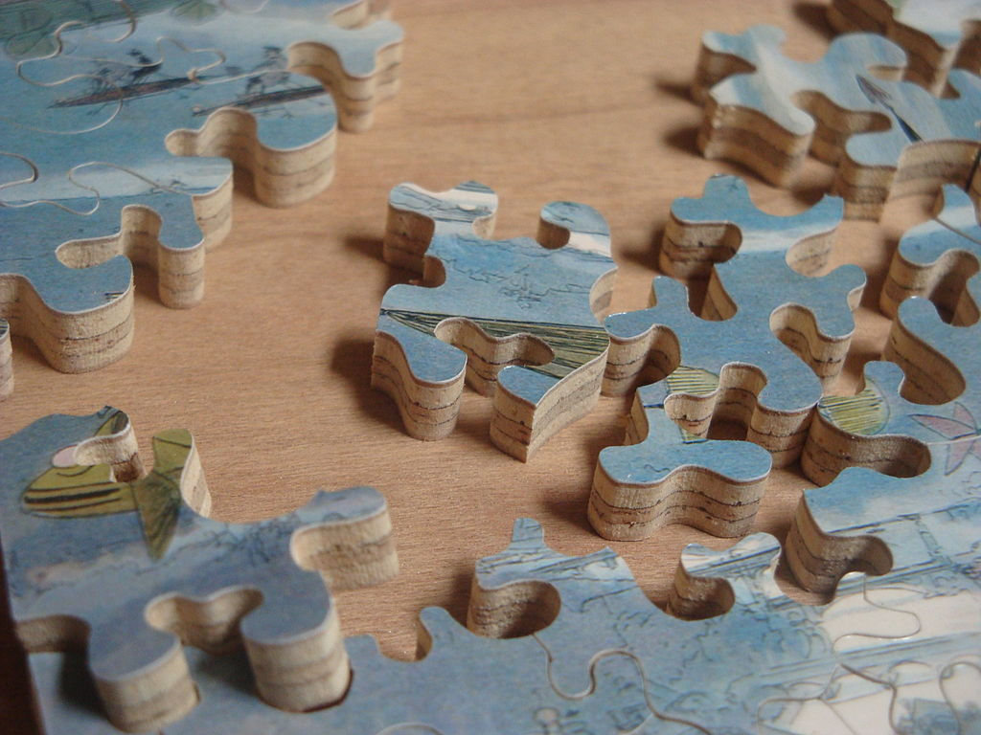
The Puzzle is starting to come together!
Is everything fitting in?
By Charles Hamm (Own work) [CC BY 3.0 (http://creativecommons.org/licenses/by/3.0)], via Wikimedia Commons. https://commons.wikimedia.org/wiki/File%3AClose_up_of_Hand_Cut_Jigsaw_Puzzle.JPG

Slide 11
You can finish the Puzzle!
Time to write your own strategic plan
Great resources:
"Guidelines for University Library Services to Undergraduate Students", American Library Association, September 1, 2006.
http://www.ala.org/acrl/standards/ulsundergraduate (Accessed September 22, 2017)
Document ID: aa690f2a-01be-ca04-3d7a-6bd0c30b18ab
"Standards for Libraries in Higher Education", American Library Association, August 29, 2006.
http://www.ala.org/acrl/standards/standardslibraries (Accessed September 22, 2017)
Document ID: e169adbd-8407-4434-31c5-c14771a447b2

