Slide 1

Current research & future directions in hearing healthcare
Presented by:
Jamie Marotto, Au.D., FAAA
Andrew J. Parker, M.D.
November 2014

Slide 2
Overview of today’s topics
Hair cell regeneration
  Brief review of anatomy & physiology
  Historical review of past research
  Ongoing research
  Future outlook

Slide 3
Overview of today’s topics
2. Hearing loss and aging
  Review of current literature of Dr. Frank Lin, one of the leading scientists in this field.
  “Hearing Loss and Incident Dementia.”
  “Hearing Loss and Falls Among Older Adults in the United States.”
  “Hearing Loss and Cognitive Decline in Older Adults.”

Slide 4
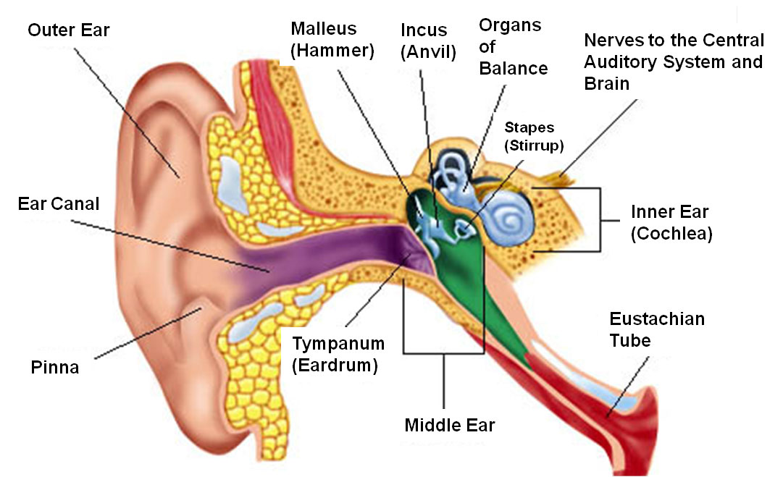
Anatomy
Photo retrieved from:
http://www.lyrichearing.com/sites/default/files/assets/cutaway_ear.jpg
Notes:
Latin word for snail

Slide 5
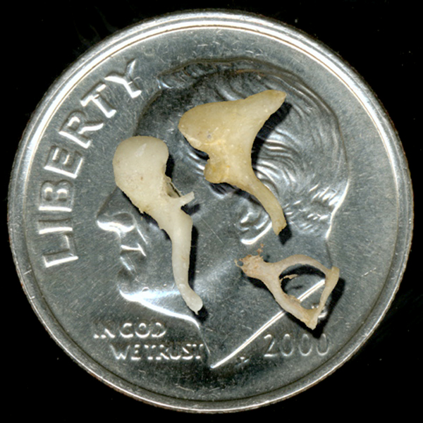
The Middle Ear
Photo retrieved from:
http://www.anatomybox.com/tag/coin/

Slide 6
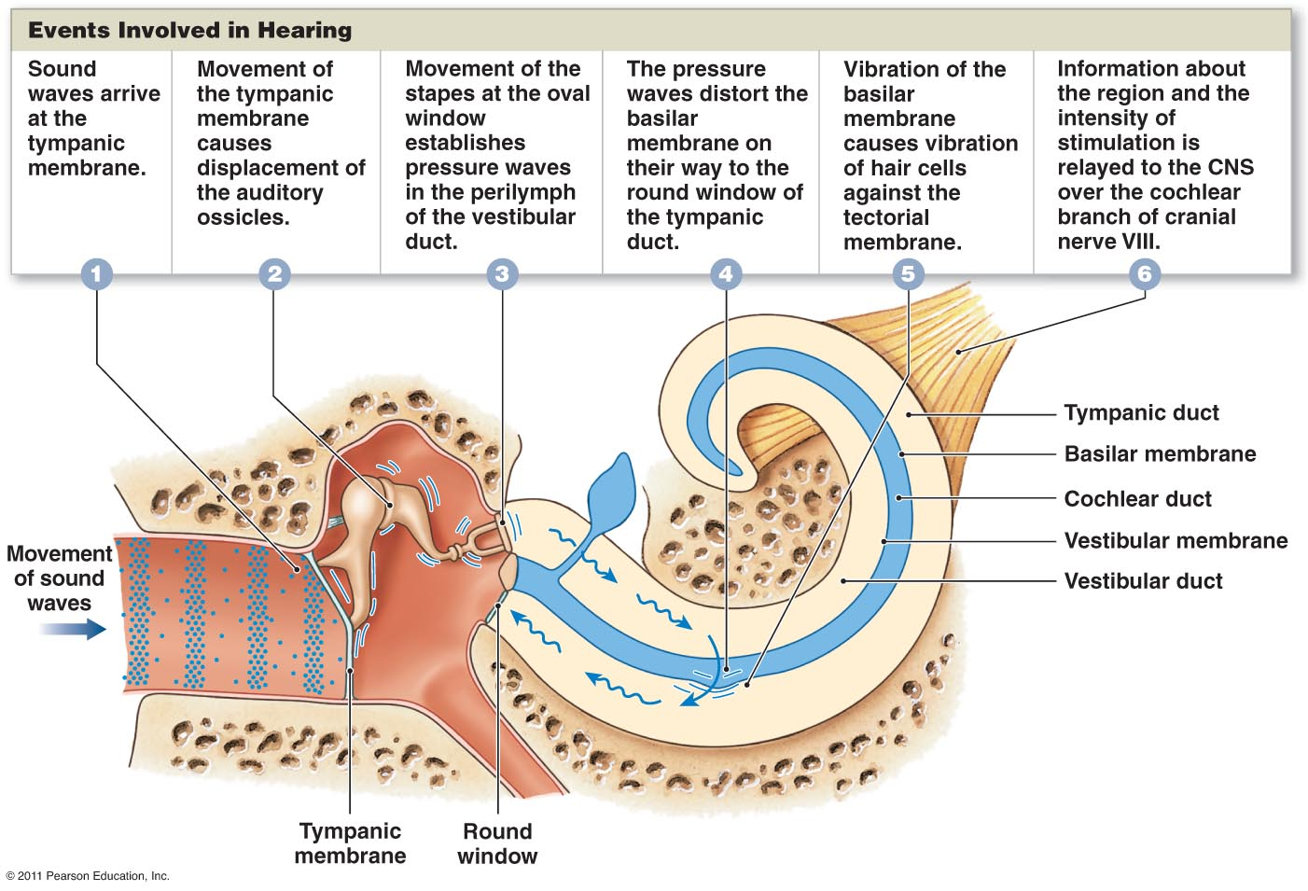
Physiology
Photo retrieved from:
http://www.highlands.edu/academics/divisions/scipe/biology/faculty/harnden/2121/images/hearing.jpg
Notes:
Auricle directs sound waves into the external auditory canal
Eardrum vibrates according to high and low frequency sounds
Vibration is transmitted from the eardrum to the malleus to the incus and then to stapes
Stapes vibrates, pushing the membrane of the oval window in and out
Movements of the oval window cause fluid pressure waves in perilymph of cochlea
Pressure waves are transmitted from the scala vestibuli to the scala tympani and then into the round window
Pressure waves deform walls of scala vestibuli and scala tympani, collectively causing the vestibular membrane to move (pressure in endolymph increases & decreases)
Pressure fluctuations in endolymph move the basilar membrane
Hairs of the organ of Corti, connected to the basilar membrane, move against the tectorial membrane and cause the generation of nerve impulses

Slide 7
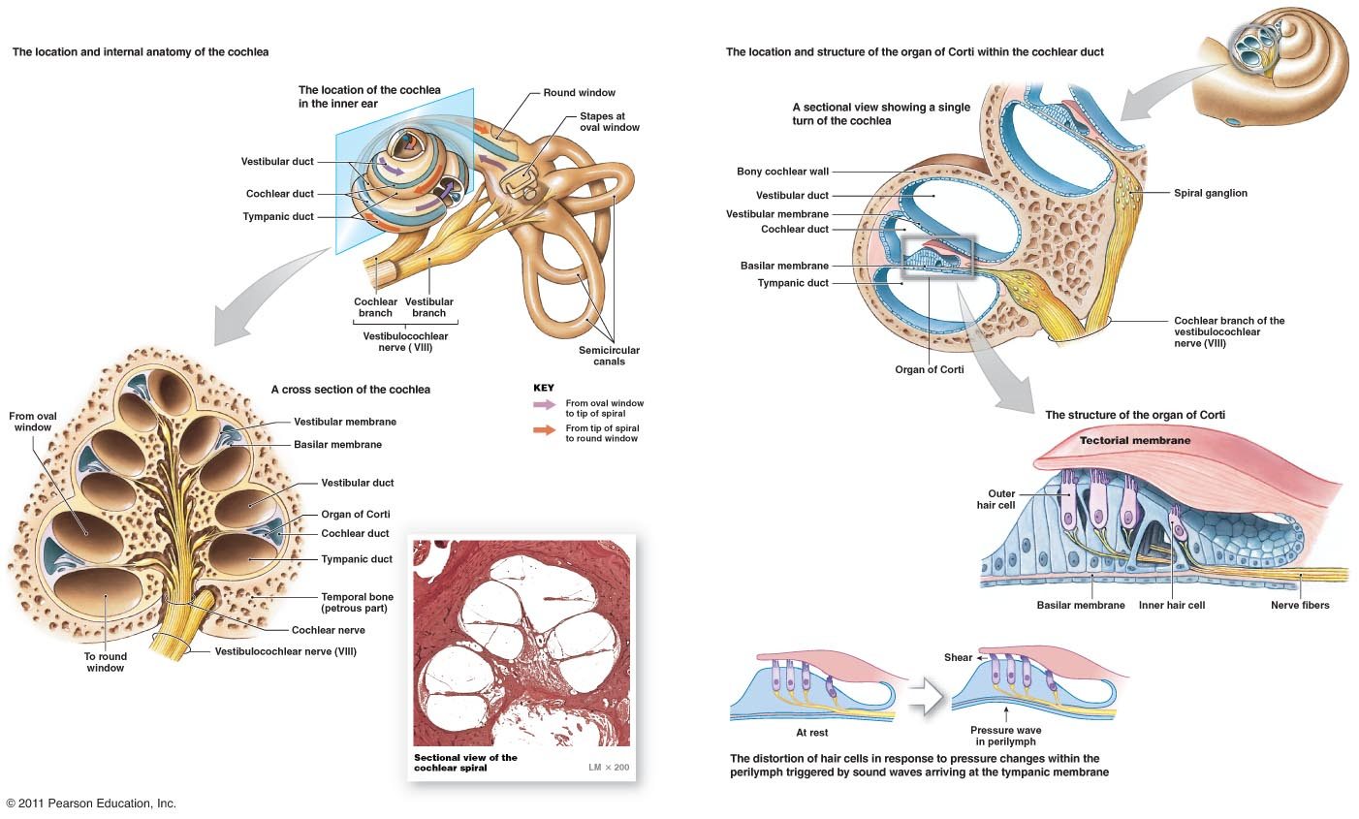
The Inner Ear
Photo retrieved from:
http://www.highlands.edu/academics/divisions/scipe/biology/faculty/harnden/2121/images/ear4.jpg
Notes:
Delicate membranes and ducts inside the cochlea
Pea sized!
“windows” are membranes that help the cochlea stay self contained
Hairs of the organ of Corti, connected to the basilar membrane, move against the tectorial membrane and cause the generation of nerve impulses

Slide 8
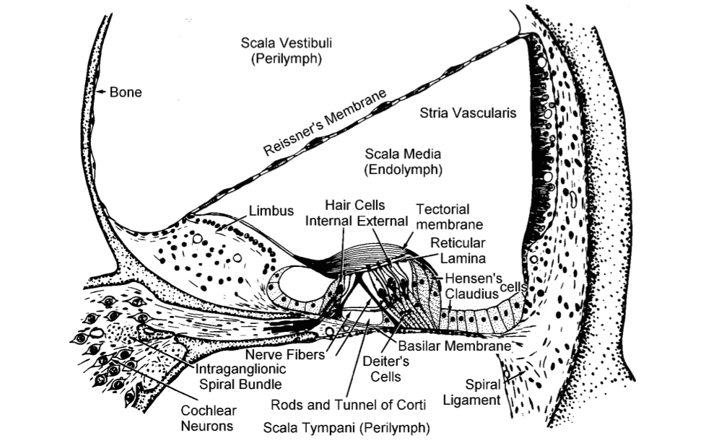
The Organ of Corti
Photo retrieved from:
http://www.who.int/occupational_health/publications/noise2.pdf
Notes:
Delicate membranes and ducts inside the cochlea
Pea sized!
“windows” are membranes that help the cochlea stay self contained
Hairs of the organ of Corti, connected to the basilar membrane, move against the tectorial membrane and cause the generation of nerve impulses
Stria vascularis – blood supply and regulates fluid
Supporting cells
Tectorial membrane
Fluid filled – endolymph and perilymph (potassium and sodium)
shearing

Slide 9
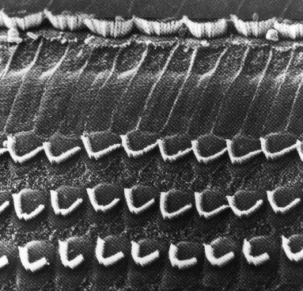
Hair cells
Photo retrieved from:
http://www.who.int/occupational_health/publications/noise2.pdf
Notes:
Outer hair cells – more of the mechanics
Inner hair cels – more of the complex coding (hearing in noise)

Slide 10
Hearing loss facts
Approximately 40 million American adults report some degree of hearing loss
Approximately every 3 out of 1,000 children are born with some degree of congenital permanent hearing loss
This type of hearing loss is irreversible, as hair cells are only generated during a relatively brief period during gestation
Notes:
Does anyone have any idea what type of hearing loss they have? When you were evaluated by your audiologist or ENT, what did they tell you?

Slide 11
Hair cell regeneration
Scientists predict that during the next two to five decades, biologically based methods will allow prevention of hearing and balance disorders and replacement of hair cells through regeneration or transplantation.
Two important discoveries led scientists to this bold prediction: apoptosis and hair cell regeneration in vertebrates
Notes:
Programmed cell death – making room for new cells

Slide 12
A historical timeline
1933 & 1937: Regeneration of the entire tail in amphibian embryos (Stone).
1986: The chicken cochlea is capable of regenerating hair cells following noise exposure to replace those that have been lost or damaged due to acoustic trauma (Cotanche).
1987: The avian cochlea is capable of regenerating the tectorial membrane and hair cells following drug-induced damage (Cotanche, Cruz).
1988: The avian cochlea is capable of regenerating hair cells following noise exposure to replace those that have been lost or damaged due to acoustic trauma (Corwin).
1994: Regenerated hair cells can re-establish neural connections in vertebrates (Ryals).
1995: Normal hearing can be restored in vertebrates after drug induced damage (Saunders).
Notes:
During this period of time it became clear that the assumption that warm blooded vertebrates cannot restore hair cells is wrong.
Both young and adult birds can regenerate new hair cells throughout life. This ability is widespread across vertebrates and hair cell organ systems.
Not in mammals

Slide 13
How does it actually happen in vertebrates?
First theory:
The dying hair cell is ejected from the cochlea.
A supporting cell will alter itself and become a new hair cell, thus taking its place.
Direct transdifferentiation - during which supporting cells change their gene expression and convert into hair cells without dividing.

Slide 14
How does it actually happen in vertebrates?
Second theory:
The dying hair cell is ejected from the cochlea.
A supporting cell will undergo cell division to produce two daughter cells: one is a supporting cell, one is a hair cell.

Slide 15
How can we attempt hair cell regeneration in mammals?
Two methods of delivery:
Gene therapy
Stem cell therapy

Slide 16
What is a gene?
A gene is a molecular unit of heredity
  Portion of DNA that codes for the production of a protein
  It holds the information needed to build and maintain an organism’s cells and pass genetic traits to offspring
  Genes correspond to various biological traits (i.e. eye color, blood type or risks for certain diseases)

Slide 17
Gene therapy
What is gene therapy?
  Experimental technique that uses genes to treat or prevent diseases
  Hair cell regeneration has seen its greatest successes in gene therapy
  There are several approaches being tested
    Replacing a mutated gene that causes disease with a healthy copy of the gene
    Inactivating (“knocking out”) a mutated gene that is functioning improperly
    Introducing a new gene into the body to help fight a disease
Notes:
Hair cell regeneration has seen its greatest successes in gene therapy largely because it would be applicable to the most common forms of hearing loss (presbycusis, noise induced hearing loss, hearing loss due to infection, trauma, and ototoxicity

Slide 18
Gene therapy
The cochlea is an ideal target for gene therapy for the following reasons:
  It is reasonably self-contained anatomically, allowing easy and direct delivery of gene therapy
  It is a fluid-filled organ, which allows the gene to spread throughout the organ easily
  Mutations in over 100 genes have been shown to cause hearing loss which allows the impact of these mutations on different cells in the inner ear to be studied further

Slide 19
Gene therapy
Currently being evaluated only in clinical trails
The most promising work involves studies on the atonal gene product called Atol1, which is designed to stimulate the development of sensory hair cells from supporting cells in the cochlea.
Work with Atol1 has been done in guinea pigs and mice to date.

Slide 20
Stem Cell Therapy
What is a stem cell?
  Cells that can divide and differentiate into diverse specialized cell types
  They can also self-renew to produce more stem cells

Slide 21
Stem Cell Therapy
Two types:
  Embryonic stem cells are derived from embryos that have been fertilized in vitro
  Adult stem cells are thought to be an undifferentiated cell, in other words, a non-specialized cell found amongst specialized cells.
  One major difference between adult and embryonic stem cells is their different abilities in the number and type of specialized cell types they can become.
  Embryonic stem cells can become all cell types of the body, as adult stem cells are thought to be limited to only specializing into different cell types of their tissue of origin.

Slide 22
Stem Cell Therapy in the Cochlea
The goal is to introduce a stem cell into the cochlea that can migrate to the site of damage and differentiate into specialized cells
Research to date in animal models has shown a few types of stem cells have molecular markers for cochlear cell types, but not complete differentiation into mature cells.

Slide 23
Stem Cell Therapy in the Cochlea
Targets for cell transplantation:
  Directly into the organ of Corti (it’s a small organ and relatively inaccessible)
  Into the spiral ganglion, where cells directly connect to the auditory nerve (more promising, easier to access)
  Stria vascularis (the main blood supply for the cochlea), various types of hearing loss can be caused by mutations in important genes in this area of the cochlea)

Slide 24
Stem Cell Therapy and the Cochlea: The Unknowns
Risks of stem cell therapy are not completely known, some scientists say there might be a risk for developing tumors
Unknown if new cells will form connections with the auditory nerve
Unknown if the auditory structures in the brainstem and brain will be able to properly interpret signals from stem cells

Slide 25
Future outlook
As delivery methods improve, we can expect to see important advances in the treatment of a variety of causes of hearing loss over the coming decade.

Slide 26
Take home points
Hearing is a very complex process. Before sound travels to the brain, it is turned into electrical information in the cochlea.
The cochlea houses the organ of Corti, where there are thousands of tiny hair cells and supporting structures that play a critical role in the hearing process.
Once these fragile hair cells are damaged, there is no way to fix it.
The majority of hearing loss comes from damage to either the hair cells or structures surrounding them in the inner ear.
Regeneration has been heavily studied in the recent decades: gene therapy and stem cell therapy have shown promise. The idea is to figure out a way to replace these damaged cells.

Slide 27
Take home points
Research has proven that vertebrates such as birds and fish naturally regenerate cells throughout their lifetime.
Gene therapy is when specific genes (portions of DNA) are used to induce hair cell regeneration from other supporting cells.
Stem cell therapy is when stem cells (cells that are typically derived from embryos and have the capability to turn themselves into new specialized cells) are injected into different parts of the cochlea.
The research is promising, however, it is still in its infancy, as clinical trials are only being done on animals (primarily rodents).
Scientists predict that within the next 50 years, we will be able to regenerate hair cells in humans

Slide 28
Hearing Loss and Aging
Review of some of the current literature by Dr. Frank Lin, one of the leading scientists in this field.
“Hearing Loss and Falls Among Older Adults in the United States.”
“Hearing Loss and Incident Dementia.”
“Hearing Loss and Cognitive Decline in Older Adults.”

Slide 29
  “Hearing Loss and Falls Among
  Older Adults in the United States.”
  Adults between 40 and 69 years old
  They found that the magnitude of the association of hearing loss with falls is clinically significant with a mild hearing loss being associated with nearly a 3-fold increased odds of falling over the preceding year.
  Dysfunction might be happening simultaneously to the hearing and balance systems (due to their shared location)
  Decreased hearing may also directly limit access to auditory cues that are needed for environmental awareness.
  This association may be mediated through cognitive load and reduced resources necessary for attention and maintaining postural control.
  Is this a modifiable risk? Can we do some type of rehabilitation to help?

Slide 30
  “Hearing Loss and Incident Dementia.”
  369 participants (age 36 to 90 years old) who were all dementia free at the onset of the study
  Those with mild, moderate and severe hearing loss had a 2-, 3-, and 5- fold increased risk for developing dementia, respectively
  For those who were 60 years or older, over one-third of the risk of incident dementia was associated with hearing loss
  Hearing loss may be causally related to dementia possibly through exhaustion of cognitive reserve
Notes:
Prevalence of dementia is projected to double every 20 years such that by 2050 over 100 million people, or nearly every 1 in 85 persons will be affected.
In this study, self reported hearing aid use was not associated with a significant reduction in dementia risk –unknown how hearing aid use effects cognitive decline

Slide 31
  “Hearing Loss and Cognitive Decline in Older Adults.”
  1162 adults with hearing loss (mild to moderate hearing loss) had annual rates of decline on cognitive tests, roughly 40% greater decline than their normal hearing peers
  Compared to those with normal hearing, individuals with hearing loss had a 24% increased risk for incident cognitive impairment.
  Rates of cognitive decline and the risk for incident cognitive impairment are directly associated with the severity of hearing loss
  Increased risks for cognitive decline can be attributed to untreated hearing loss leading to a heavier cognitive load
  Impaired communication from hearing loss can lead to social isolation

Slide 32
Key take home points from today
We have made enormous progress with understanding hair cell regeneration, but there is a lot left to be accomplished in order to put into clinical practice in humans.
There are established links between hearing loss as a risk factor for dementia
Older adults with hearing loss have a higher risk of falling
Hearing loss is independently associated with accelerated cognitive decline – mechanisms still unknown
Treating hearing loss more aggressively may help delay cognitive decline and perhaps dementia

Slide 33
Questions?

