Slide 1
Understanding Hearing Loss in the Geriatric Population
Presented by:
Jamie F. Marotto, Au.D., FAAA
September 17th, 2015
Jewish Family Services Home Companion Program

Slide 2
Overview
Hearing Loss Basics
  Statistics about hearing loss
  Signs and symptoms of hearing loss
  How hearing loss can effect the quality of life of your patients
Hearing Aids
  Introduction to Hearing Aids
  Hearing Aid care
  Basic troubleshooting tips
Tips for better communication with your patients
  Different types of communication styles
  Strategies to use in your day to day interactions with patients

Slide 3
Hearing Loss Facts
Hearing loss is a major public health issue that is the third most common physical condition after arthritis and heart disease.
Gradual hearing loss can affect people of all ages -- varying from mild to profound. Hearing loss is a sudden or gradual decrease in how well you can hear. Depending on the cause, it can be mild or severe, temporary or permanent.
Degrees of hearing loss: mild, moderate, severe, profound.
Hearing loss is an invisible condition; we cannot see hearing loss, only its effects. Because the presence of a hearing loss is not visible, these effects may be attributed to aloofness, confusion, or personality changes.

Slide 4
Hearing Loss Facts
In adults, the most common causes of hearing loss are noise and aging. There is a strong relationship between age and reported hearing loss.
In age-related hearing loss, known as presbycusis, changes in the inner ear that happen as you get older cause a slow but steady hearing loss. The loss may be mild or severe, and it is always permanent.
In older people, a hearing loss is linked to such conditions as dementia. Research has shown that older people with hearing loss might be at a greater risk for developing dementia compared to their peers without hearing loss.

Slide 5
Hearing Loss Facts
Noise-induced hearing loss may happen slowly over time or suddenly. Being exposed to everyday noises, such as listening to very loud music, being in a noisy work environment, or using a lawn mower, for example, can lead to hearing loss over many years.
Sudden, noise-induced hearing loss from gunfire and explosions is the number one disability caused by combat in current wars.
More often than not severe tinnitus (ringing or buzzing in the ears) will accompany the hearing loss and may be just as debilitating as the hearing loss itself.
Other causes of hearing loss include earwax buildup, an object in the ear, injury to the ear or head, ear infection, a ruptured eardrum, and other conditions that affect the middle or inner ear.

Slide 6
Hearing Loss Facts
Typically, hearing loss that occurs due to aging tends to effect high-pitched or “treble” sounds first. High-pitched sounds are typically female voices and children's voices.
Consonant sounds are also typically produced in the high-pitched range such as “s” “f” and “th”
Environmental sounds such as birds chirping or leaves rustling tend to be higher-pitched sounds
Therefore, if a patient has trouble hearing these high pitches, they will have trouble hearing females and children, hearing consonant sounds (typically the endings of words) and some environmental sounds.

Slide 7
Signs of Hearing Loss
A patient with hearing loss might say:
“I can hear you, but I can’t understand what you said.”
“Everyone else mumbles.”
“People speak too quickly, that’s why I can’t understand them.”
“I can’t hear what is being said at the dinner table when multiple people are talking.”
“I have trouble hearing my family members, especially my wife and grandchildren.”

Slide 8
Signs of Hearing Loss
A patient with hearing loss might:
Have the television on a very high volume setting
Constantly ask for repetition
Be startled when you enter the room
Have difficulty knowing where sounds are coming from
Complain of hearing a “ringing” or “buzzing” in their ears
Respond inappropriately to conversations
Have trouble hearing on the phone

Slide 9
Hearing Loss & Quality of Life
Untreated hearing loss can directly affect a patient’s quality of life
Patients may become more withdrawn from social activities and as a result they might be left feeling isolated and depressed
Patients might feel annoyed or anxious because they can’t follow conversations

Slide 10
Hearing Aids
Hearing aids are the recommended treatment for most hearing losses
They come in all different styles and technology levels, mostly all hearing aids today are digital
Hearing aids do not correct hearing like glasses correct vision, various factors will influence how much a patient will benefit from hearing aids (their own hearing loss, motivation, family support, type of hearing aid technology)

Slide 11
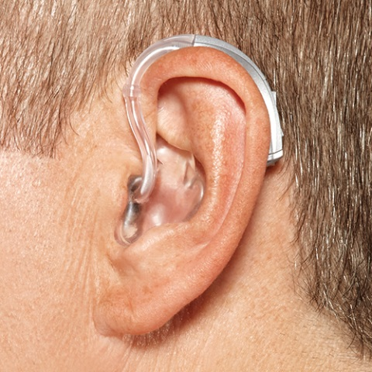
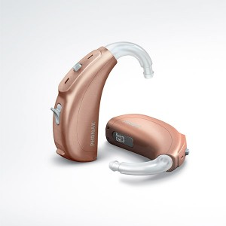
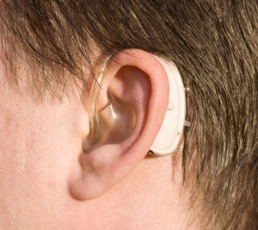
Hearing Aid Styles
Behind-the-ear hearing aid
  Traditional style with an earmold and tubing
  Hearing aid sits on top of the ear

Slide 12
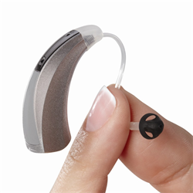
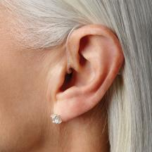
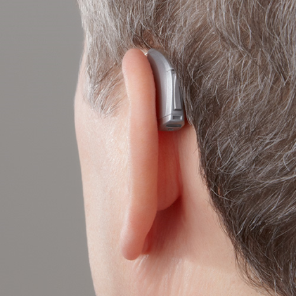
Hearing Aid Styles
Behind-the-ear hearing aid
  More modern style with the loudspeaker sitting in the ear and a clear, thin wire on the top of the ear
  No traditional earmold
  Less visible

Slide 13
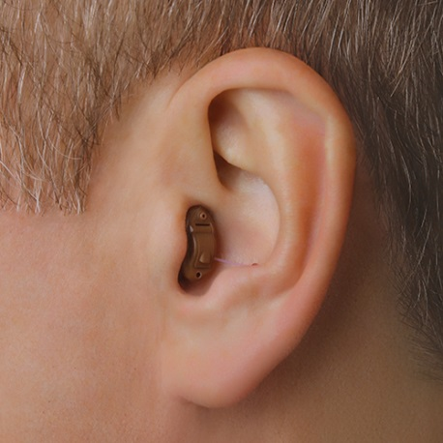
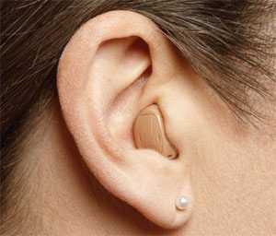
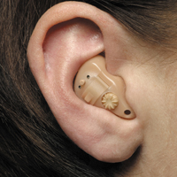
Hearing Aid Styles
In-the-ear hearing aid
  The hearing aid is housed in one piece
  Fits completely in the ear canal, some styles will be more visible than others

Slide 14
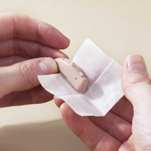
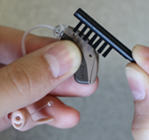
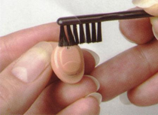
Hearing aid care
MORNING CARE
Close the battery door with battery in it
Insert hearing aid – RED in the RIGHT ear and BLUE in the LEFT ear
NIGHT CARE
Remove hearing aids from ears
Open the battery door
Wipe hearing aids with a DRY tissue
Brush off debris on hearing aid
Place hearing aids in case
WHEN TO REMOVE HEARING AIDS
Before bedtime
Before bath or shower
Whenever patient is not wearing the hearing aids, open the battery door and place hearing aids in case
Never get the hearing aids wet

Slide 15
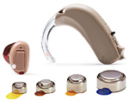

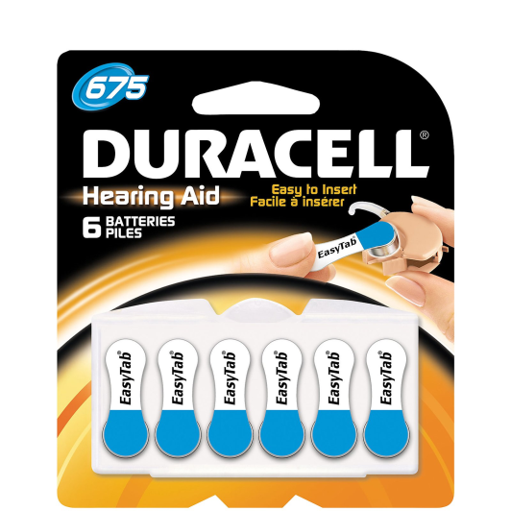
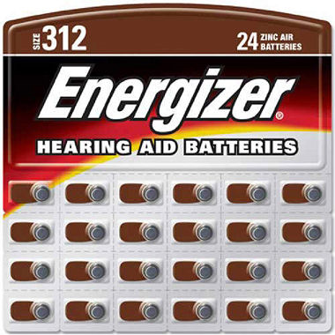

Hearing aid batteries
Blue – Size 675 – Largest - Lasts approximately 3 weeks
Orange – Size 13 – Lasts approximately 2 weeks
Brown – Size 312 – Lasts approximately 6-12 days
Yellow – Size 10 – Lasts approximately 4-8 days

Slide 16
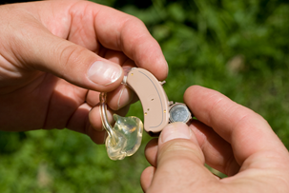
Hearing aid batteries
BATTERY INSERTION
Peel off colored sticker
Open battery door of hearing aid
Place battery in battery door of hearing aid
The flat side of the battery faces up
Do not force battery door closed
It is recommended that you change the battery the same
day(s) every week to ensure the battery is always charged
If the patient has two hearing aids, change both batteries at the same time
Dead batteries can be disposed of in the garbage
Do not peel off colored sticker from unused batteries. Once the sticker has been peeled off, the battery starts to lose charge
Batteries are poisonous. Please do not leave batteries on food trays. If ingested call the poison control hotline immediately at: 1-800-222-1222

Slide 17
Hearing aid troubleshooting

Slide 18
Hearing aid troubleshooting

Slide 19

Communication styles
Passive – Most people with hearing loss exhibit this communication style.
Passive Communicators tend to avoiding social interactions or withdraw from conversations due to fear of not be able to communicate well or from embarrassment of not understanding.
When they do participate, they may pretend that they understand by limiting responses to a nod.
They perceive it as “easier” to be passive.

Slide 20

Communication styles
Aggressive – Aggressive Communicators dominate conversations in order to avoid having to work to understand their communication partner.
They perceive any communication difficulties as being the speaker’s fault. A person with an aggressive communication style may ignore a speaker in order to force him/her to repeat.
Because they trample on the needs of
others, aggressive communicators are often
perceived as hostile or overbearing.

Slide 21

Communication styles
Assertive – Assertive Communicators are not afraid to disclose their hearing loss or to be open and honest about their communication needs when necessary.
They are not afraid to use communication strategies or to advocate for themselves.
Assertive communicators get their needs met.

Slide 22
Communication Strategies
Do not speak to unless you are in the same room as the hearing impaired individual
Do not speak to hearing impaired individual until you have their attention
Face the hearing impaired individual so that they can see your face
Ensure that the room has adequate lighting and that you are close enough for the hearing impaired individual to see your face
Ensure that there is no excessive background noise when trying to communicate with the hearing impaired individual
  Try to turn off the TV or radio when communicating
  Try to shut the door or window to eliminate noise from outside

Slide 23
Communication Strategies
Use clear speech
  Speak at a normal rate, do not speak too fast or too slow
  Speak clearly, do not exaggerate movements of your face because this will distort speech
  This will help the most with difficult accents
Do not speak directly into the patient’s ear
Be patient

