Slide 1
EDUCATIONAL CONSIDERATIONS FOR CHILDREN WITH HEARING LOSS
PRESENTED BY:
JAMIE MAROTTO, AU.D., CCC-A
CLINICAL ASSISTANT PROFESSOR

Slide 2
LEARNING OBJECTIVES
To have a basic understanding of the peripheral hearing mechanism
To have a basic understanding of how hearing loss is measured and described
To have a basic understanding of the etiologies of hearing loss in children
To differentiate between the treatment options for hearing loss in children
To understand the significance of FM technology in the classroom
To understand the typical presentation of a student with hearing loss, its potential effects on learning, and its associated psychosocial ramifications
To implement teaching and classroom modifications for students with hearing loss
To have a working knowledge of both internal and external resources to support students with hearing loss

Slide 3
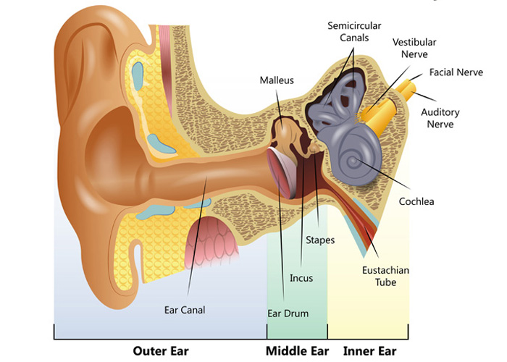
OUR HEARING SYSTEM

Slide 4
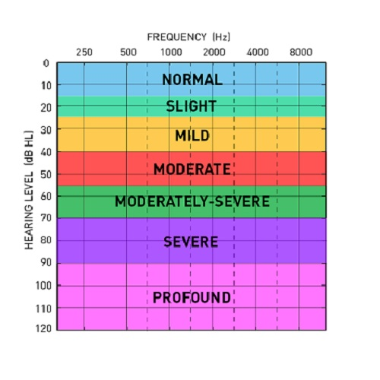
DEFINING HEARING LOSS
Degree
  Mild, Moderate, Moderately-Severe, Severe, Profound
Type
  Conductive, Sensorineural, Mixed

Slide 5
HEARING LOSS IN CHILDREN
More than 1.4 million children in America have a significant hearing loss, making hearing loss the most common birth defect
Approximately three children per 1,000 are born with a hearing loss
  ALL states mandate Universal Newborn Hearing Screenings
Approximately every six children per 1,000 acquire hearing loss by school-age
  The State of Connecticut mandates hearing screenings provided by the school for grades K, 1, 3, 4, 5, and 8.

Slide 6
HEARING LOSS IN CHILDREN
Approximately 15% of children in the U.S. have a low-frequency or high-frequency hearing loss in at least one ear
  Ear infections
  Noise exposure
Children with unilateral hearing loss will likely have difficulty in noisy environments and classroom settings.
Children with mild hearing loss are often diagnosed later in childhood, perhaps during a school screening
  Most likely, these children have fewer listening difficulties than children with more significant hearing loss

Slide 7
ETIOLOGY OF HEARING LOSS IN CHILDREN
3/1000 children born w/ HL
50% Genetic
30% Syndromic
70% Non-syndromic
25% Idiopathic
25% Non-genetic
Pre-lingual vs Post-Lingual
Genetic
Non-genetic
Idiopathic

Slide 8
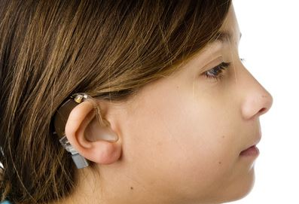
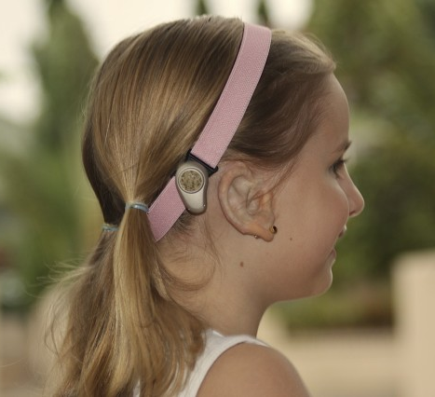
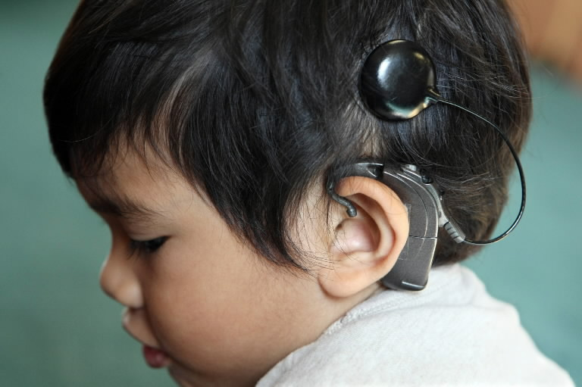
TREATING HEARING LOSS

Slide 9
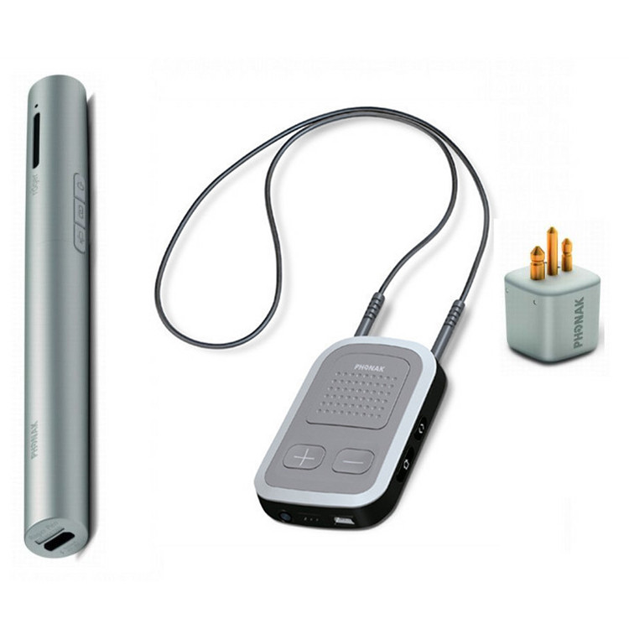
CHILDREN WITH HEARING LOSS IN THE CLASSROOM
The Importance of Utilizing an FM system

Slide 10
CHILDREN WITH HEARING LOSS IN THE CLASSROOM
Children with hearing loss may present similarly as children with learning disabilities
Signs of hearing loss may include:
  Inappropriate responses to questions
  Watching classmates to copy their behaviors
  Speech/Language difficulties
  Frustration
  Fatigue (especially at the end of the day)
  Academic failure
  Day-dreaming/Inattentiveness
  Poor sense of self

Slide 11
PSYCHOSOCIAL EFFECTS OF HEARING LOSS
Students with hearing loss and/or hearing devices may perceive themselves as different
They may be unaware of subtle conversational cues that could cause their behaviors to be viewed as inappropriate or awkward
They will likely have an impaired ability for selective hearing and experience difficulty suppressing background noise, which can make the learning environment stressful
They may experience self-esteem issues/cultural identity

Slide 12
HEARING LOSS AND LEARNING
Hearing loss impacts the development of receptive and expressive communication skills that can lead to reduced background knowledge and incidental learning
Pragmatic language use (interjections, apologies, ability to compare/contrast, problem solving, repairing conversation breakdown) is slower to develop in children with hearing loss
Reading and writing problems may result from a restricted language system
  Deficits in vocabulary, unfamiliarity with groups of related words, and unfamiliarity of syntactic structures interfere with children’s ability to understand printed text, to write sentences and paragraphs

Slide 13
CLASSROOM MODIFICATIONS
What are some practical modifications that a teacher can make in the classroom?
Installing carpeting or cork on the floor
Applying rubber tips (tennis balls) on chair and desk legs
Hanging acoustical panels, cork, felt, or flannel bulletin boards on walls
Placing bookshelves or wall dividers to create quiet areas within the classroom
Using cushions in place of chairs
Arranging desks and table in a staggered formation so sound will not travel directly to reflective surfaces
Arranging the classroom so instruction occurs away from the sound sources, such as an air vent

Slide 14
TEACHING MODIFICATIONS
Using visual aids for instruction
Gaining students’ attention before speaking to optimize their chances for successful speechreading
Encouraging all students to help minimize the noise level in the classroom
Address the student by name and identify the topic being presented
Facing the students when teaching and encouraging other students to participate in the lesson
Ensuring that the child with hearing loss has favorable seating, typically in front of the classroom, where the teacher’s face is most visible
Use clear speech

Slide 15
IN-SCHOOL RESOURCES
Educational Audiologist (contracted by the School District – not always present in the building)
Speech-Language Pathologist (most accessible!)
Itinerant Teacher (Teacher for the Hearing Impaired/Deaf)
School Social Worker/Psychologist
Talk to colleagues who know the student
Talk to the student! (if possible, when appropriate)

Slide 16
OUTSIDE RESOURCES
Student’s family members (in consultation with colleagues)
Private Audiologist (private practice, ENT practice, hospital or university setting)
Web Resources:
American Speech-Language-Hearing Association (ASHA) https://www.asha.org
American Academy of Audiology https://www.audiology.org
Success for Kids with Hearing Loss https://successforkidswithhearingloss.com
Hearing Aid Manufacturers: Phonak (www.phonak.com) Oticon (www.Oticon.com)
Cochlear Implant Manufacturers: Advanced Bionics (https://advancedbionics.com) and Cochlear (www.cochlear.com/us)

Slide 17
AUDIOLOGY AT SACRED HEART
Location: Center for Healthcare Education, Suite N-134
Email: audiology@sacredheart.edu
Phone: 203-396-6895

