Slide 1


An Introduction to Speechreading
Presented by:
Jessica Preston, Au.D., CCC-A
Jamie Marotto, Au.D., CCC-A
HLAA Southwest Chapter Meeting
April 10th, 2018

Slide 2
Today's agenda
Real-life examples
Speechreading definitions
What sounds are visible on the lips?
What does the evidence show?
Setting yourself up for successful speechreading
Communication strategies
Practice!

Slide 3
Definitions
Lipreading = the process of recognizing speech using only the visual speech signal and other visual cues, such as facial expression.
Speechreading = speech recognition using both auditory and visual cues as well as the talker’s facial expressions and gestures.
Utilizing visual cues is perhaps the most effective means for patients with hearing loss to enhance their recognition of spoken language

Slide 4
Speechreading
•It is important to learn which speech sounds are more visible on the lips so we can choose words with these sounds when communicating with people with hearing impairments at a slow rate of speech.
•It is also important to learn which speech sounds look the same on the lips to anticipate possible communication breakdowns.

Slide 5
Speechreading
Spoken language is both auditory and visual. Spoken language is NOT just an auditory language; it is very much a visual language.
Individuals with normal hearing and individuals with hearing loss rely on the integration of auditory and visual representations of spoken language to derive meaning.

Slide 6
Speechreading: Who does it?
Everybody: hearing, hard-of-hearing, and deaf
According to Seal, 2013:
Between 4 and 8 months of age, typically-developing infants shift their focus from a speaker’s eyes to the speaker’s mouth (and eyes), returning to the speaker’s eyes at around 12 months of age.
This gaze shift is believed to have an important role in the audiovisual foundations of the speech signal or the beginnings of speechreading. This gaze shift is also observed across all ages when the auditory signal is obscured or degraded.

Slide 7
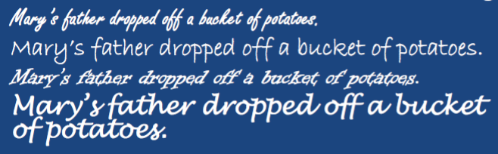
Speechreading: How do we do it?

Slide 8
The Three Cs
Context: the language
the topic, setting, register, familiarity of communication partners
Configuration: articulatory shapes or (more accurately) co-articulatory shape change
Cloze: the brain’s ability to “read between the lines,” to capitalize on context and configuration for comprehension

Slide 9
Speechreading
Important to improving your speechreading skills is personal awareness of how well you do in different settings and with different individuals.
Choose three different settings and three different individuals, and rate your reliance on and success with speechreading.

Slide 10
Lipreading
Only 50% of speech sounds are clearly visible on the lips.
It is important to learn which speech sounds are most visible and not become focused on lip-reading every sound, it is not possible—be realistic.

Slide 11
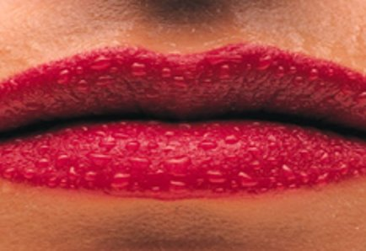
Clearly Visible Sounds
P / B / M
These sounds look the same on lips pressed together

Slide 12
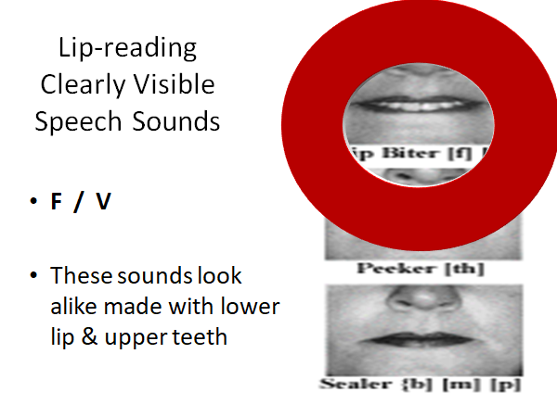
Clearly Visible Sounds

Slide 13
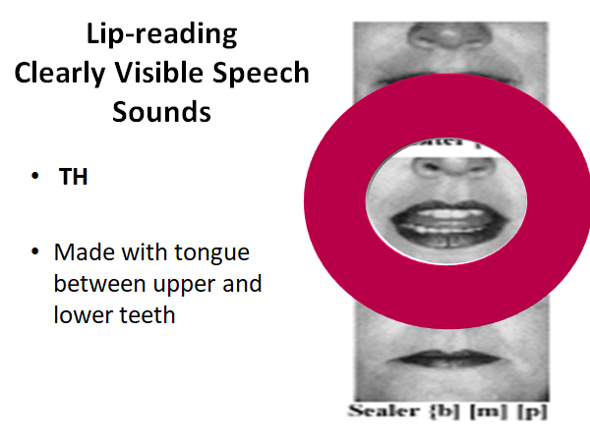
Clearly Visible Sounds

Slide 14

Clearly Visible Sounds
•W / Wh/ R
•These sounds look alike with lips pursed as in a whistle

Slide 15

Clearly Visible Sounds
•Sh / Ch / J / Zh
•These sounds look a like with lips rounded & forward

Slide 16
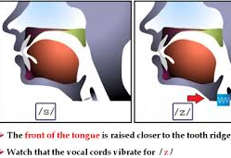
Not easily visible speech sounds
•S / Z
•These sounds look alike with teeth close together & lips tight

Slide 17
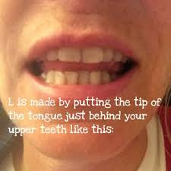
Not easily visible speech sounds
•L / N / T / D
•The tip of the tongue behind the upper teeth.

Slide 18
Evidence Supporting Training
According to Seal, 2013:
It is unknown which factors make one person a good speech reader; however, evidence suggests:
1. Speechreading performance varies broadly across individuals (children and adults, those with hearing loss and those with normal hearing, males and females, and across education levels.
2. Young adults perform better than older adults on measures of speechreading.

Slide 19
Evidence Supporting Training
Speechreading performance declines in aging (commensurate with decreased visual acuity and auditory acuity) such that word recognition declines from 6% to 13% per decade beyond 60 years of age.
Speechreading performance appears to be influenced (predicted) by several cognitive tasks that also diminish in aging:
  Working memory (especially spatial word memory on a computer screen)
  Processing speed (classification tasks on a computer screen)

Slide 20

Advocacy
How do you advocate for yourself?
Why is it important?

Slide 21
Tips for Communication Partners
Make sure your communication partner is looking at you
Have your communication partner select words with more clearly visible speech sounds
Reduce the background noise when possible
Have your communication partner practice using "Clear Speech"
Any other tips?

Slide 22
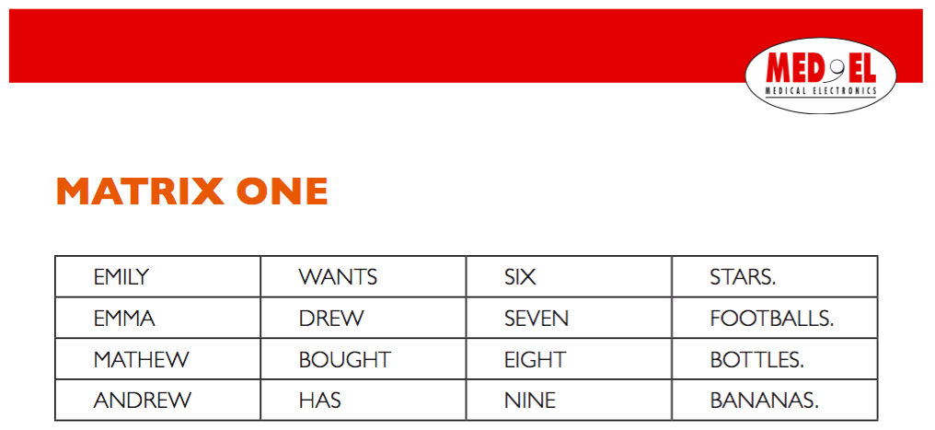
Exercises

Slide 23
Resources
Seal, B., Wilson, N. and Gaul, E. (2013). Speechreading 101. Presented at the American Speech-Language Hearing Association (ASHA) Conference in Chicago, IL.
Speechreading Exercises Retrieved from Med-El: http://www.medel.com/us/soundscape/

