Slide 1
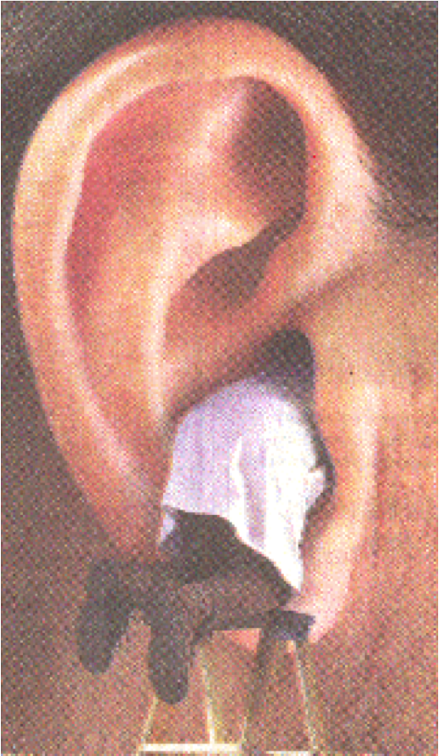
An Introduction to
Hearing Loss:
Examining Conductive & Sensorineural Loss
Presented by:
Jamie F. Marotto, Au.D., CCC-A
Clinical Assistant Professor
Department of Speech-Language Pathology
Sacred Heart University

Slide 2
Learning Objectives
To understand the profession of Audiology: what we can diagnose and treat
To learn how to ask hearing-related case history questions
To learn how to read all parts of an audiogram and to understand the associated terminology
To understand the difference between subjective and objective hearing-related assessments
To understand the difference between the various types and degrees of hearing loss and the associated terminology
To have a basic understanding of how specific etiologies might present on the audiogram

Slide 3
The Profession of Audiology
The inception of Audiology as a profession took place after World War II when several military personnel required services for the hearing problems they incurred during the war.
In the U.S., the Department of Veteran’s Affairs (VA) provided comprehensive services such as: hearing aid fitting, personal adjustment and orientation to hearing aids, auditory and speech reading training programs, training in the use of communication strategies, speech correction therapy, psychological counseling, and educational and vocational training.

Slide 4
The Profession of Audiology
Audiologist is defined today as an individual who “by virtue of academic degree, clinical training, and license to practice and/or professional credential, is uniquely qualified to provide a comprehensive array of professional services related to the audiologic identification, assessment, diagnosis, and treatment of persons with impairment of auditory and vestibular function, and to the prevention of impairments associated with them” American Academy of Audiology, 2004.

Slide 5
The Profession of Audiology
“The central focus of the profession of audiology is concerned with all auditory impairments and their relationship to disorders of communication. Audiologists identify, assess, diagnose, and treat individuals with impairment of either peripheral or central auditory and/or vestibular function, and strive to prevent such impairments.” Academy of Doctors of Audiology, 2016.

Slide 6
The Prevalence of Hearing Loss
According to the Hearing Loss Association of America (HLAA) 2016:
  About 20 percent of Americans, 48 million, report some degree of hearing loss.
  At age 65, one out of three people has a hearing loss.
  60 percent of the people with hearing loss are either in the work force or in educational settings.
  While people in the workplace with the mildest hearing losses show little or no drop in income compared with their normal hearing peers, as the hearing loss increases, so does the reduction in compensation.
  About 3 of every 1,000 children in the United States are born with a detectable hearing loss in one or both ears.
  Almost 15% of school-age children (ages 6-19) have some degree of hearing loss.
  Among adults aged 70 and older with hearing loss who could benefit from hearing aids, fewer than one in three (30 percent) has ever used them. Even fewer adults aged 20 to 69 (approximately 16 percent) who could benefit from wearing hearing aids have ever used them.

Slide 7
Our Scope of Practice
Identification of Hearing and Balance Disorders
Assessment and Diagnosis of Hearing and Balance Disorders
Treatment of Hearing and Balance Disorders
Hearing Conservation
Intraoperative Neurophysiologic Monitoring
Research

Slide 8
Work Settings
  Audiologists work in settings such as:
    Clinical settings (hospitals, private practice, or other medical facility)
    Professors at universities and colleges
    Research
    Hearing aid manufacturing companies
    Industrial/hearing conservation

Slide 9
Basic Psychoacoustic Principles
Frequency = Pitch
Amplitude = Loudness
Time = Duration

Slide 10
Assessment
Audiologists use a battery of tests (subjective/behavioral and objective) to determine the degree and type of hearing loss that is present.
Begin with a thorough case history and include questions such as:
  When did you start noticing trouble hearing?
  What type of situations do you notice the most difficulty?
  Are there situations where it is particularly difficult for you to follow a conversation, such as a noisy restaurant, the theater, in a car, or in large groups?
  Do you hear better in one ear than the other?
  Do you have ringing in the ears (one, both, can’t tell?)
  Any dizziness or imbalance?
  Family history of hearing loss?
  History of noise exposure? Recreational? Occupational? Military?

Slide 11
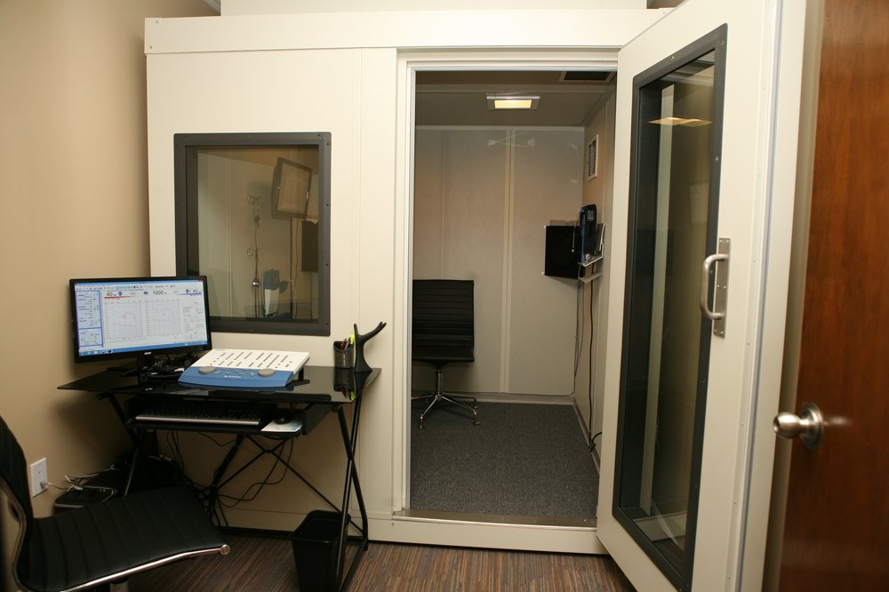
Assessment

Slide 12
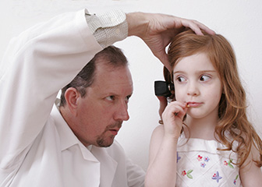
Assessment

Slide 13
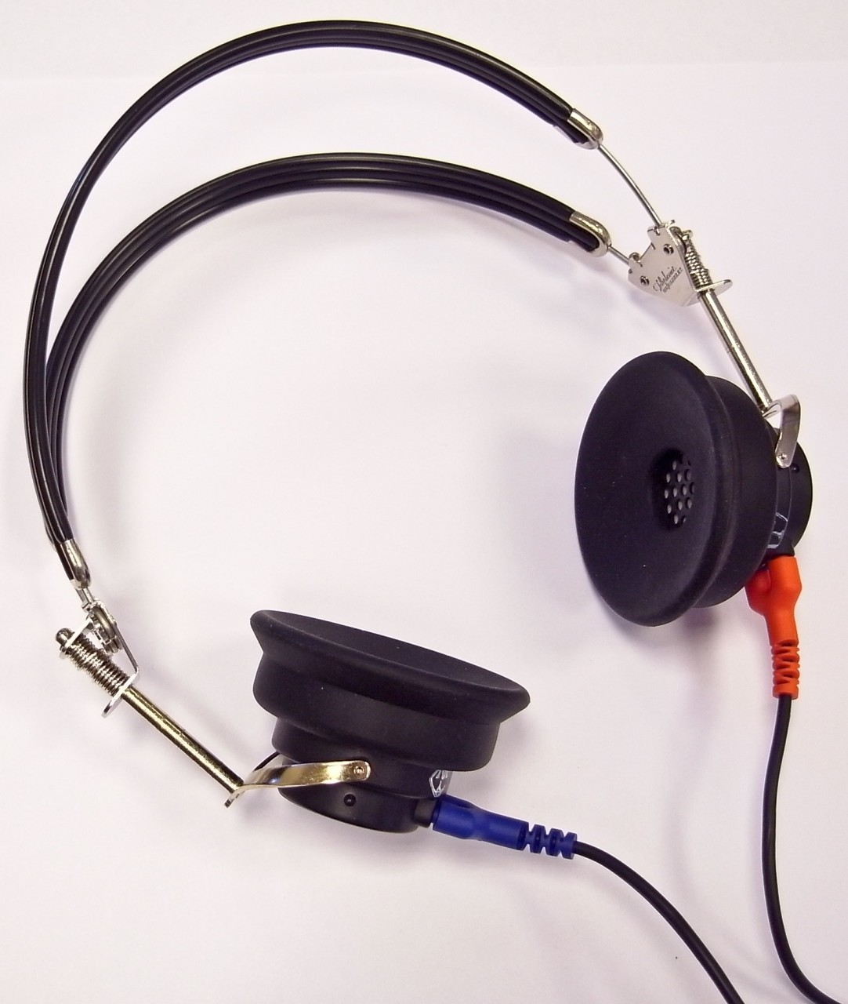
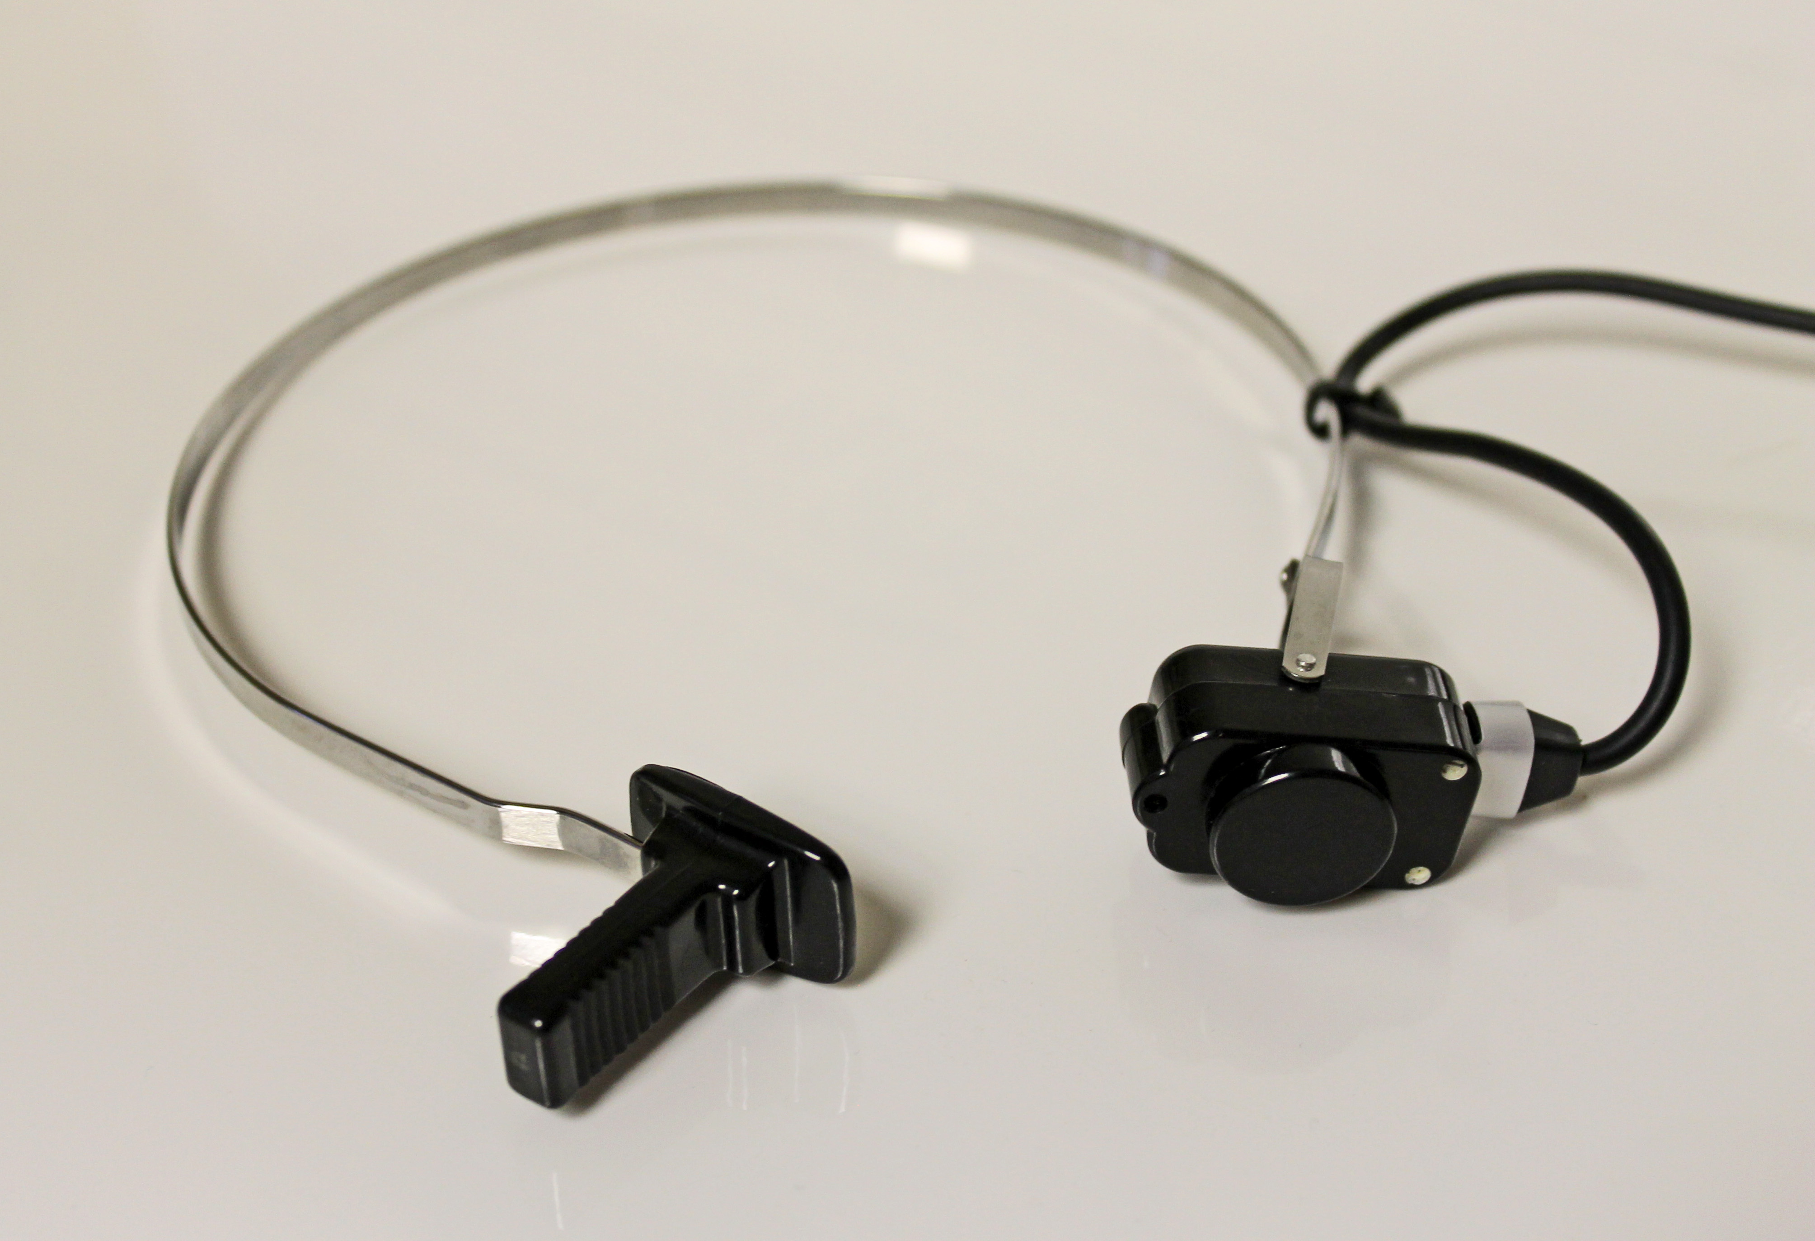
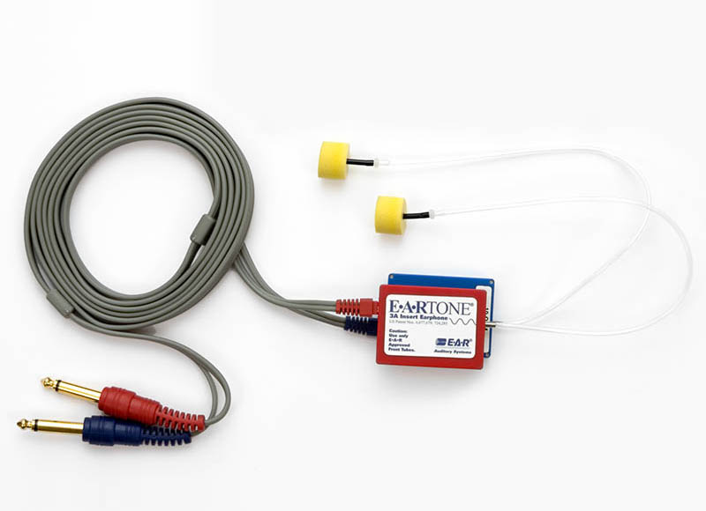
Assessment

Slide 14
Audiogram Terminology
Audiograms will almost always have a legend
Pure tone = a single frequency
Pure tone average (PTA) = average of thresholds at 500Hz, 1000Hz and 2000Hz
Air conduction: when sound travels through the air into the ear canal and stimulation progresses through the middle ear, inner ear and to the brain
Right ear= “0” or “∆” (unmasked/masked)
Left ear= “X” or “ ” (unmasked/masked)
Bone conduction: transmission of sound through the bones in the body, particularly the skull
Right ear= “<” or “[” (unmasked/masked)
Left ear= “>” or “ ] ” (unmasked/masked)
Air bone gap: The difference between air and bone conduction thresholds
Masking: distracting the “non-test ear” in order to verify the true response of the “test ear”

Slide 15
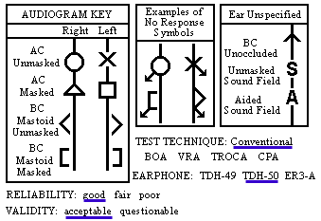
The Audiogram Legend

Slide 16
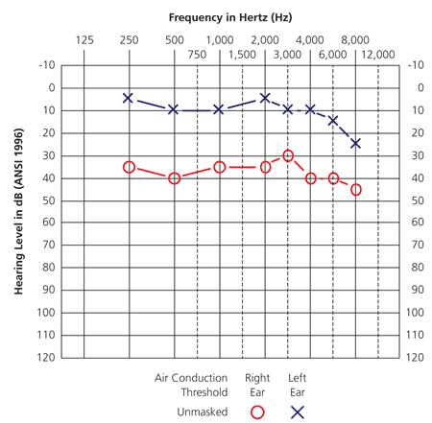
Pure-Tone Thresholds

Slide 17
Pure-Tone Thresholds
Finding a patient’s threshold: plotting the softest sound a patient can hear 50% of the time
Test frequencies from 250Hz to 8000Hz
“Raise your hand when you hear the beep”
Standard audiometry can be performed for patients school-age and up
Different methods to obtain behavioral information for young children, can test as young as 9 months old
  CPA= Conditioned Play Audiometry
  VRA= Visual Reinforcement Audiometry
  BOA= Behavioral Observation Audiometry

Slide 18
Speech Reception Threshold
Finding the softest bi-syllable word a patient can repeat back at least 50% of the time
Performed with “live voice” or recorded speech materials
Example words:
  Hot dog
  Baseball
  Airplane
  Ice cream

Slide 19
Speech Discrimination/Word Recognition
  Used with standardized monosyllable word lists; performed with “live voice” or recorded materials
  Estimating how well a patient can understand speech when the words are “loud enough”
  Typically performed in quiet (no background noise)
  Start 40dB above patient’s speech reception threshold
  The word repeated back must be exactly correct, no exceptions (useful to write down the error made to see whether the patient falls into a pattern)
  Example words:
    Pick
    Room
    Nice
    Said

Slide 20
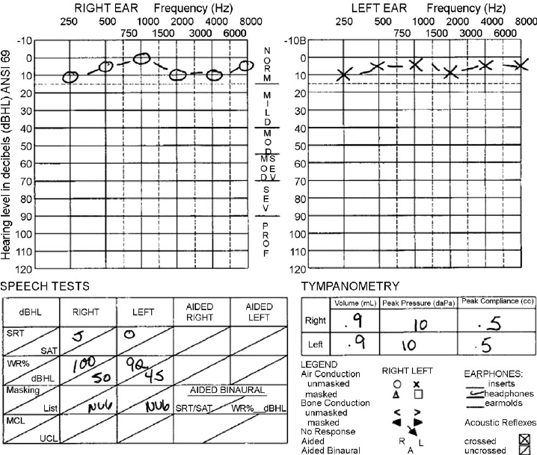
Speech Discrimination/Word Recognition
Notes:
Excellent: (100%-92%)
Good: (88%-80%)
Fair: (76%-60%)
Poor (56%-40%)
Very Poor (36%-0%)

Slide 21
Summary So Far…
Basic Subjective/Behavioral Battery:
  Pure Tone Thresholds
  Speech Reception Threshold
  Speech Discrimination/Word Recognition

Slide 22
Next Up…
Basic Objective Battery:
  Tympanometry
  Acoustic Reflex Thresholds
  Otoacoustic Emissions

Slide 23
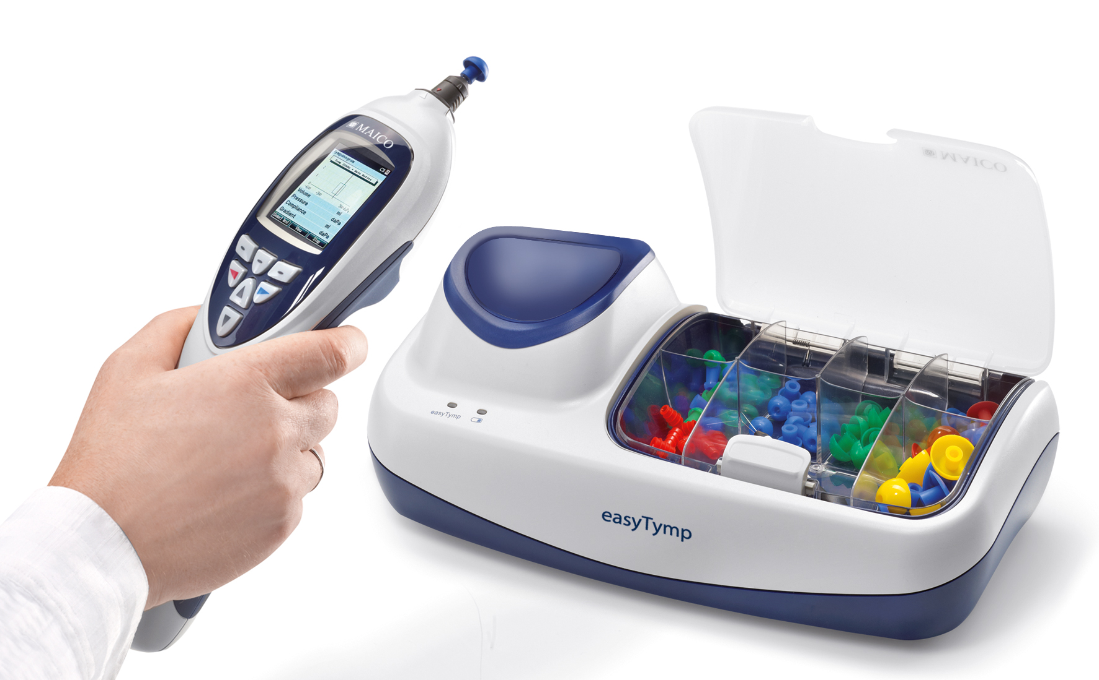
Tympanometry
A measure of middle ear function
How well is the eardrum moving?

Slide 24
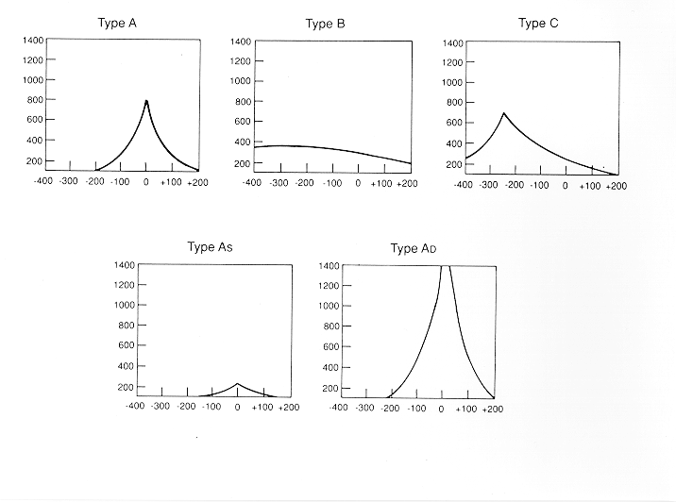
Tympanometry

Slide 25
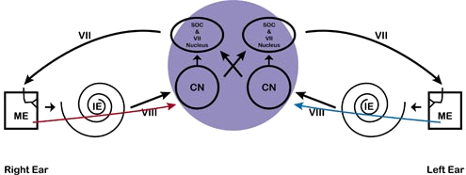
Acoustic Reflex Threshold
Notes:
The tendon attaches to the posterior portion of the neck of the stapes
When the muscle is contracted, the stapes moves to the side and tenses the membrane in the oval window, reducing the amplitude of vibration

Slide 26
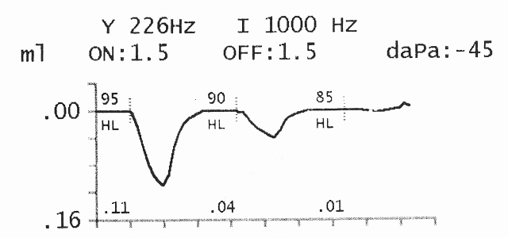
Acoustic Reflex Threshold

Slide 27
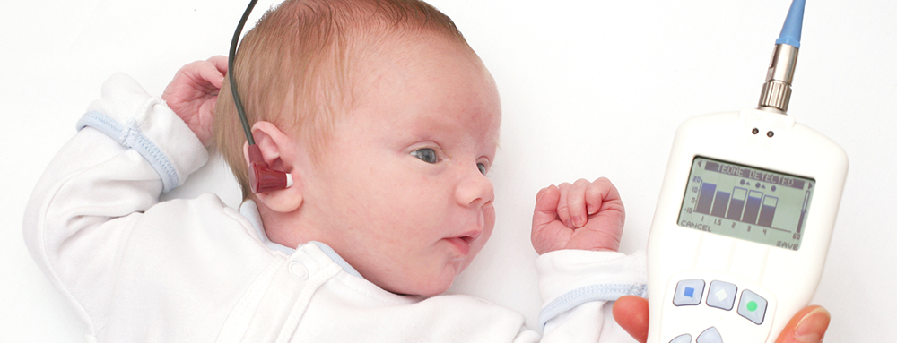
Otoacoustic Emissions
Notes:
No more than a mild HL

Slide 28
Now that we have detected hearing loss, how do we quantify it?

Slide 29
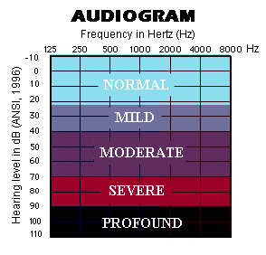
Degree of Hearing Loss

Slide 30
Degree of Hearing Loss
Hearing Loss | Effect on Word Recognition
Mild (PTA= 26-40dB HL) | In quiet situations, speech recognition will be fairly unaffected. In the presence of noise, speech recognition may decrease to 50% words correct if the PTA is 40dB HL. Consonants are most likely going to be missed, especially if the hearing loss involves high frequencies.
Moderate (PTA= 41-55dB HL) | The patient will understand much of the speech signal if it is presented in a quiet environment face-to-face, and if the topic of conversation is known and the vocabulary is constrained. If a hearing aid is not used, the individual may miss up to 50-75% of a spoken message if the PTA is 40dB HL and 80-100% if the PTA is 50dB HL.
Moderately-severe (PTA=56-70dB HL) | If the patient does not use a hearing aid, he or she may miss most or all of the message, even if talking face-to-face. He or she will have great difficultly conversing in group situations.
Severe (PTA=71-90dB HL) | The patient may not even hear voices, unless speech is loud. With amplification, the individual probably will not recognize some speech and detect environmental sounds.
Profound (PTA- 90dB HL or greater) | The patient may perceive sound as vibrations. An individual will rely on vison as the primary sense for speech recognition. He or she may not be able to detect the presence of even loud sound without amplification.

Slide 31
Types of Hearing Loss
Sensorineural: Damage to the inner ear or auditory nerve (most always is permanent)
Conductive: Damage to the outer or middle ear, problem with transmitting sound to the inner ear (can be temporary or permanent)
Mixed: A problem transmitting sound to a damaged inner ear (can be temporary or permanent)

Slide 32
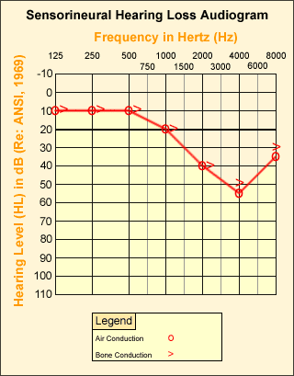
Sensorineural Hearing Loss

Slide 33
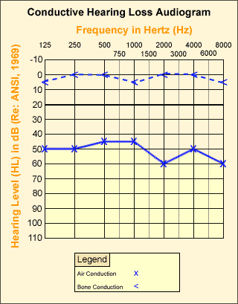
Conductive Hearing Loss

Slide 34
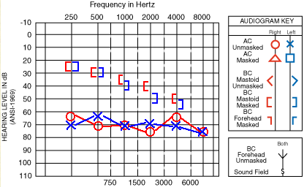
Mixed Hearing Loss

Slide 35
Some Causes of Conductive Hearing Loss
Problems in the outer ear
  Impacted ear wax
  Foreign bodies in the ear canal
  Otitis externa – Swimmer’s ear
  Exostoses – Tumors or growths in the ear canal
  Microtia – deformity of pinna (several grades)
  Anotia – absence of pinna
  Aural atresia – lack of ear canal

Slide 36
Some Causes of Conductive Hearing Loss
Problems in the middle ear
  Ear infection or fluid behind the ear drum
  Perforation of the ear drum
  Otosclerosis
  Cholesteatoma

Slide 37
Some Causes of Sensorineural Hearing Loss
Problems in the inner ear
  Damaged outer hair cells
    Aging
    Excessive noise exposure
    Ototoxic medications
    Genetics
  Viral and bacterial diseases (Meningitis)
  Malformed cochlea (Mondini’s malformation)
Notes:
Aminoglycoside antibiotics
Amikacin (very ototoxic)
Dihydrostreptomycin
Garamycin
Gentamicin (more vestibulotoxic)
Kanamycin
Neomycin (very ototoxic)
Netilmicin
Streptomycin (more vestibulotoxic)
Tobramycin
Viomycin
Asprin
Loop Diuretics
Chemotherapy Agents
Cisplatin
Carboplatin
Nitrogen Mustard

Slide 38
Onset of Hearing Loss
Progressive: hearing loss that occurs over the course of several months, increases in severity over time
Sudden: hearing loss that has an acute and rapid onset; examples, a virus that attacks the inner ear or hearing loss as a result of head trauma
Congenital: hearing loss present at birth

Slide 39
Other Hearing Loss Descriptors
Flat
Sloping
Rising
Peaked
Trough or “Cookie-Bite”
Asymmetric
Corner

Slide 40
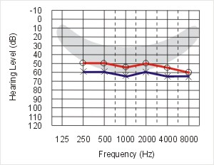
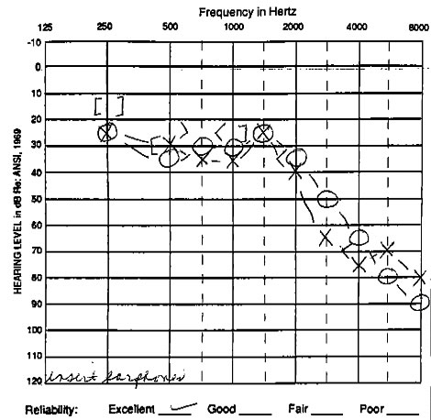
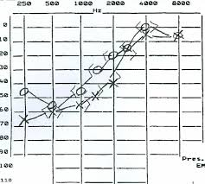
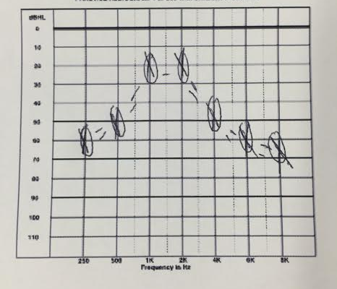
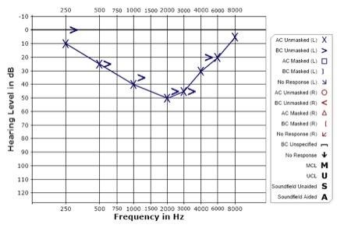
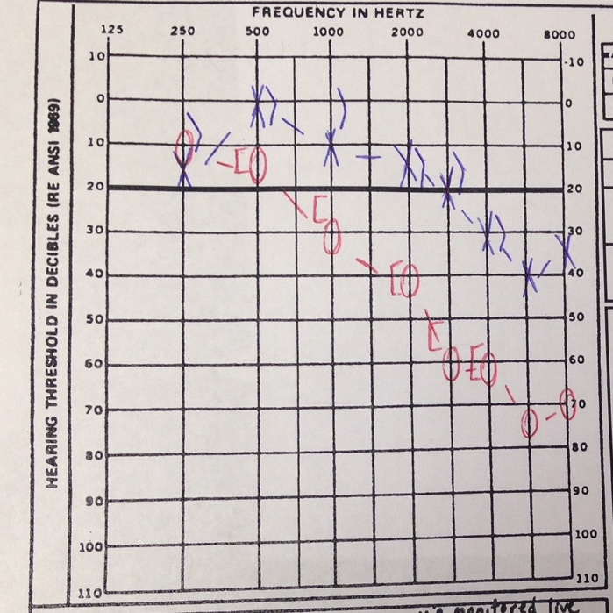
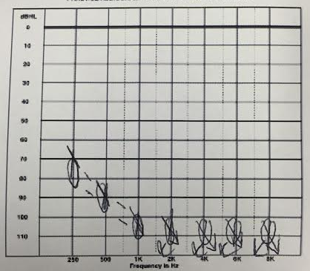

Slide 41
Let’s look at a few etiologies of hearing loss and how they might present on the audiogram…

Slide 42
Presbycusis

Slide 43
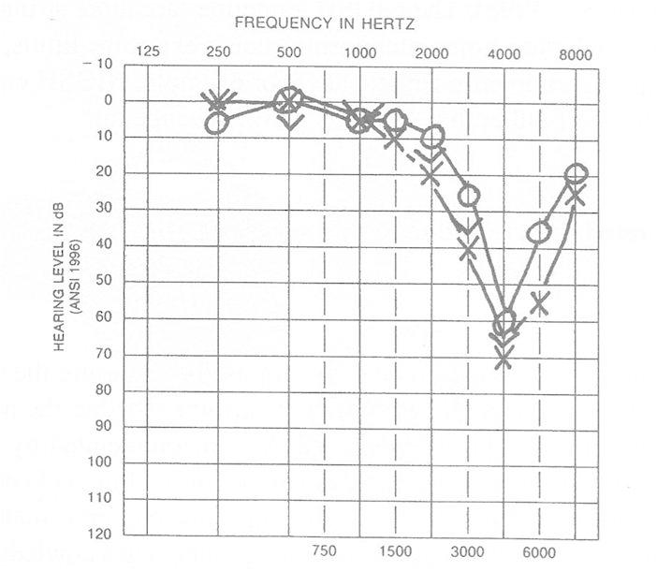
Noise-Induced Hearing Loss

Slide 44
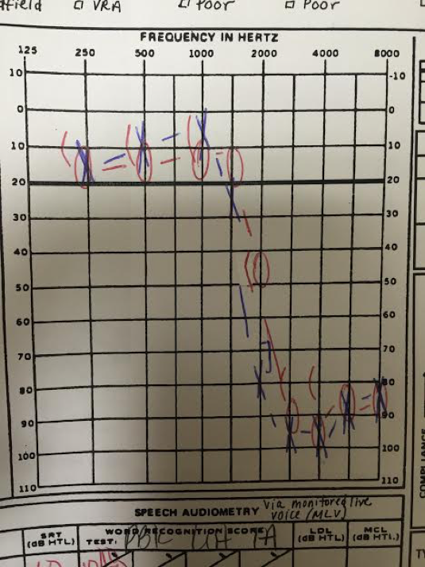
Ototoxicity

Slide 45
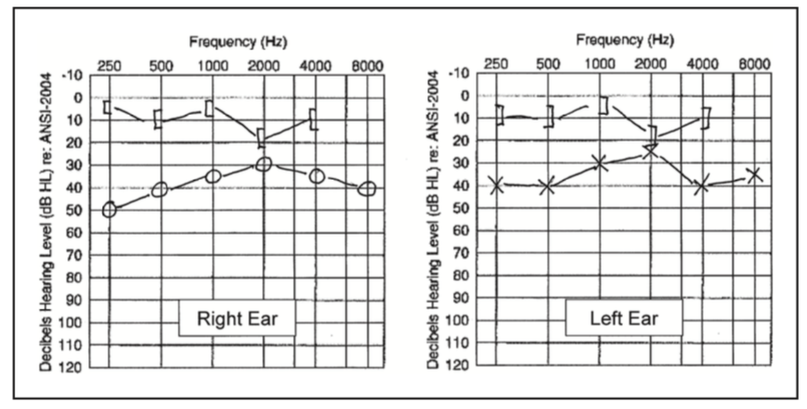
Otosclerosis

Slide 46
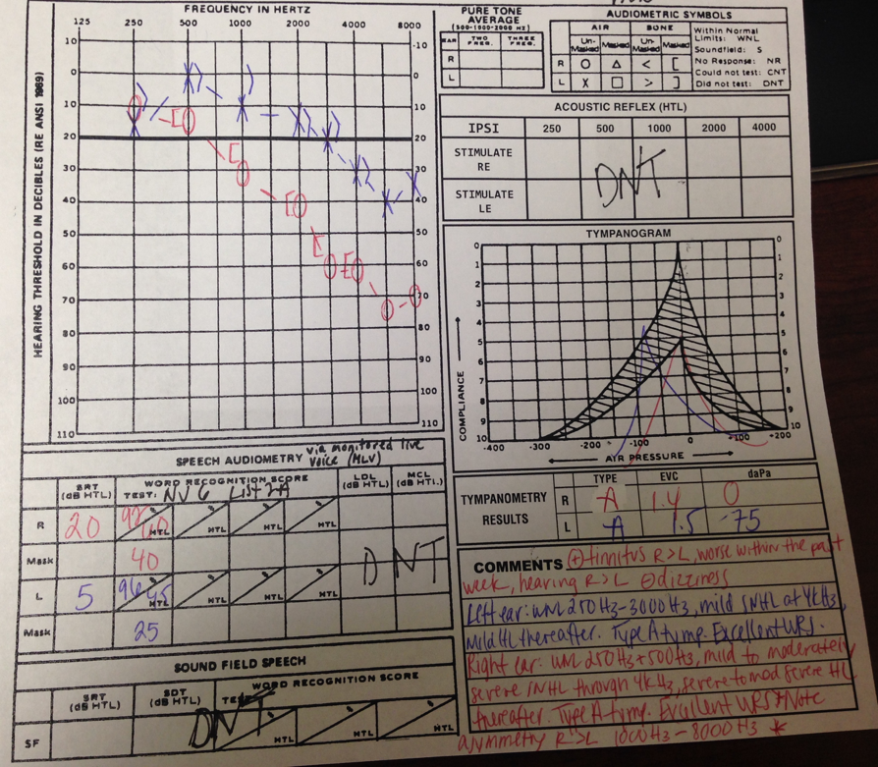
Asymmetric Hearing Loss

Slide 47
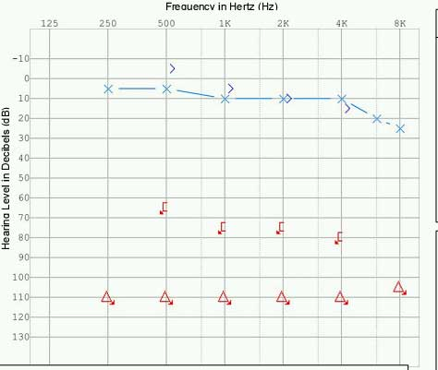
Sudden Sensorineural

Slide 48
What does it sound like to have a hearing loss?
https://youtu.be/Bcz7AeBMLSc
https://youtu.be/ar1Dq-M2ok4

Slide 49

Questions?
Email address: marottoj3@sacredheart.edu
Phone: 203-396-6894
Office: Sacred Heart University, Cambridge Campus #2-E-13 (we will me moving soon to 4000 Park Avenue in Bridgeport!)

