Slide 1
Library Research Series:
Grey Literature
Jackie Werner
Scholarly Communications and Research Librarian
jaclynwe@pcom.edu

Slide 2
What is Grey Literature?
“That which is produced on all levels of government, academics, business and industry in print and electronic formats, but which is not controlled by commercial publishers.”
Notes:
Fourth international conference on grey literature

Slide 3
What is Grey Literature?
Information that is unpublished or not published commercially
Annual reports
Blogs
Book chapters
Bulletins
Conference papers
Course materials
Dissertations
Emails
Fact sheets
Government documents
Interviews
Lectures
Legislation
Newsletters
Newspaper clippings
Pamphlets
Patents
Personal communication
Photographs
Policy statements
Posters
Press releases
Speeches
Statistics
Notes:
Black literature – peer-reviewed publications in commercial databases

Slide 4
Why Should I Care?

Slide 5
Grey literature…
Contains key information
Significantly affects outcomes of systematic reviews
Is more likely to report negative or inconclusive data
Helps avoid repeating research or reinventing the wheel
Is hard to find
Notes:
Required by cochrane

Slide 6
How Do I Find It?

Slide 7
Institutional Repositories

Slide 8
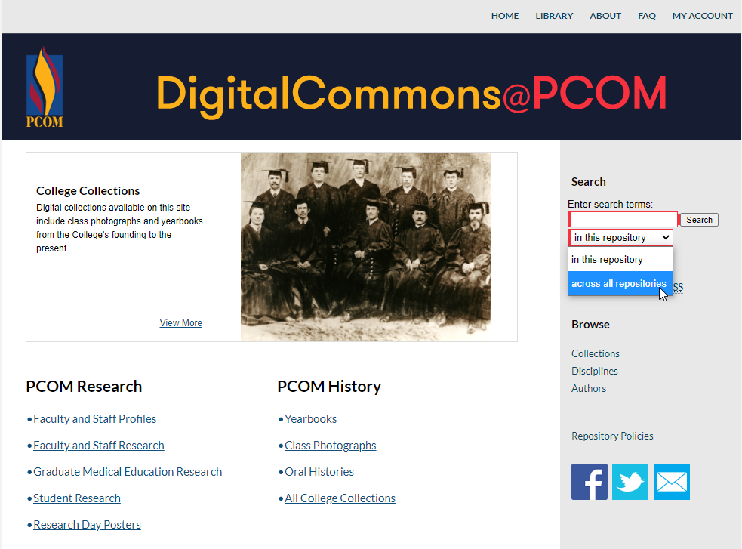
Notes:
Institutional repositories – like PCOM DigitalCommons, repositories of work done at that institution
DigitalCommons searches across all repositories on that platform
Great place to start for theses and dissertations
Some course materials, presentations, other unpublished work, but usually depends on individuals to put up
Interested in a specific place, just find their library webpage

Slide 9
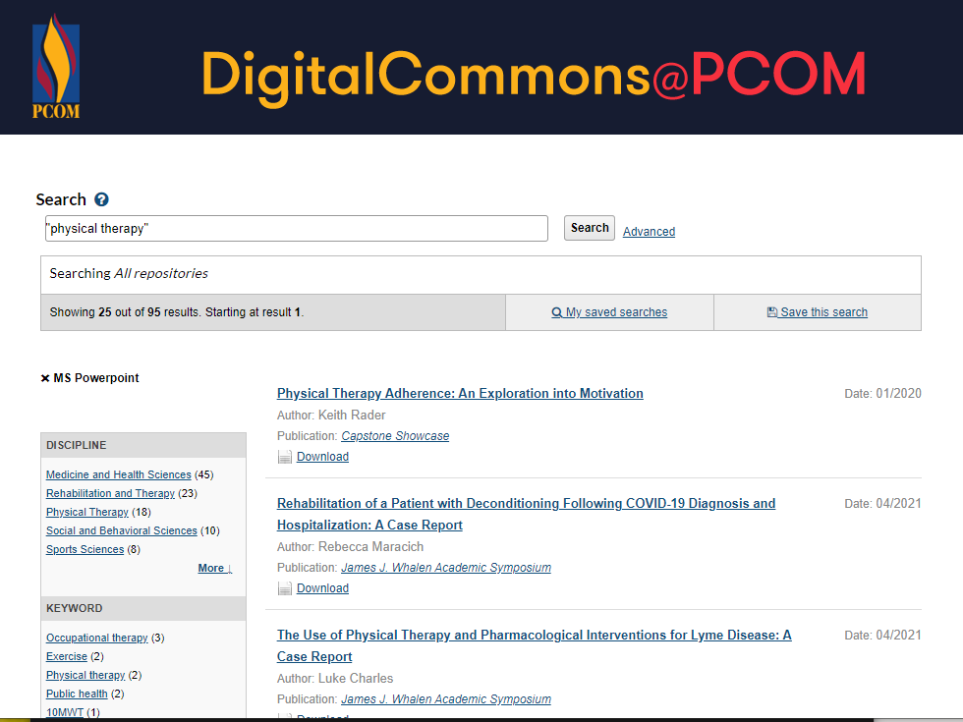
Notes:
Can search across all repositories on bepress
Different

Slide 10
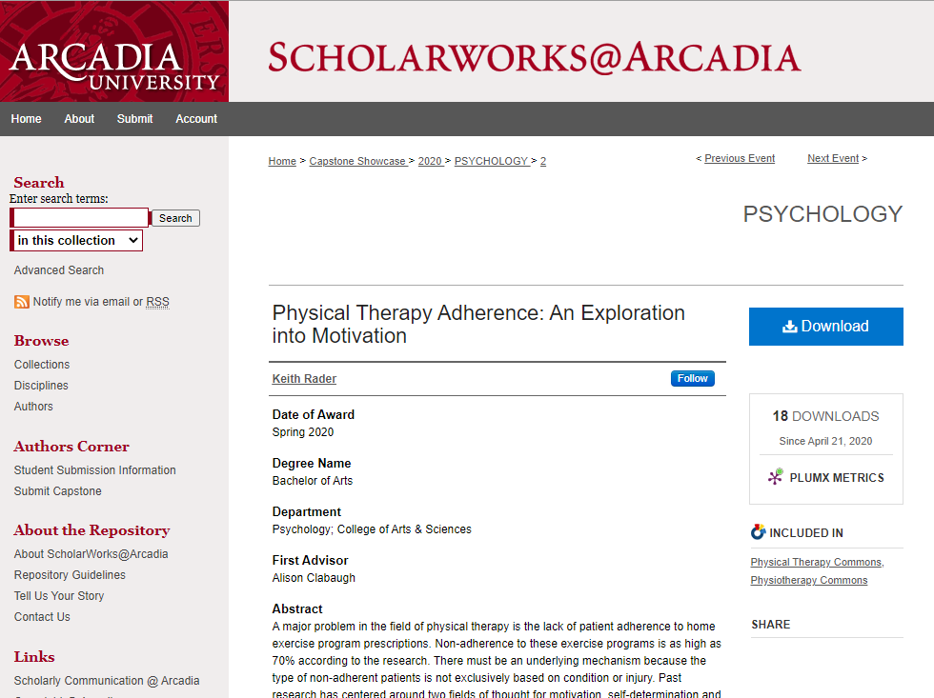
Institutional Repositories
Notes:
Find [subject] Commons on DC publictions – included in physical therapy commons
Digital Commons Network – network.bepress.com

Slide 11
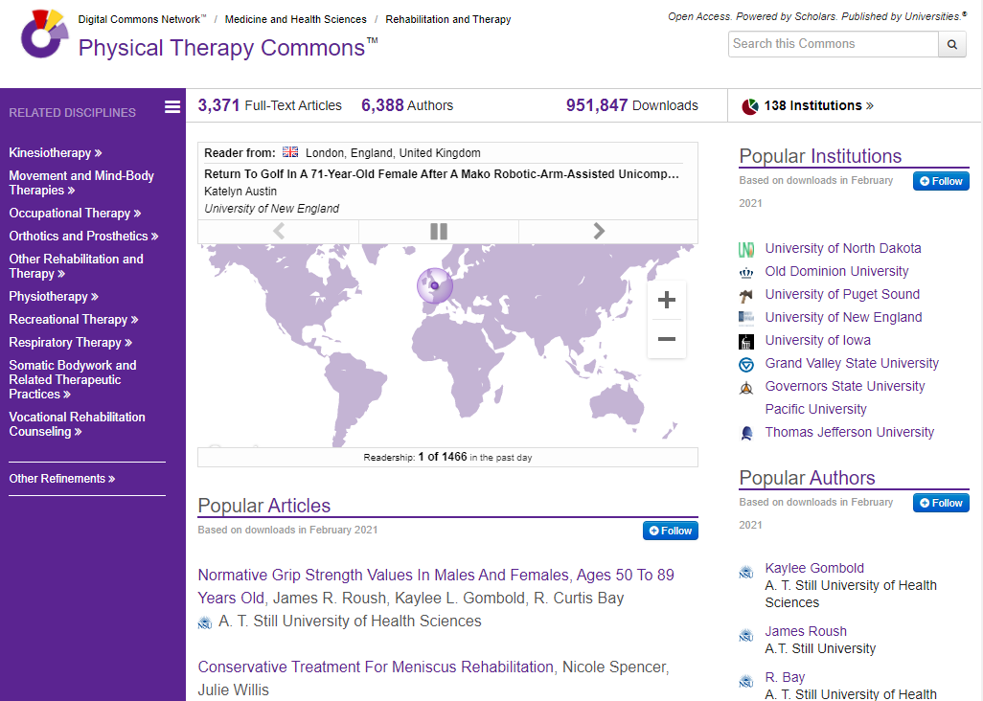
Institutional Repositories
Notes:
Find [subject] Commons on DC publications – included in physical therapy commons
Digital Commons Network – network.bepress.com
“search this commons” includes same filters as in previous search

Slide 12
Subject Repositories
(Preprints & Data)

Slide 13

Notes:
Preprints – scholarly articles pre-peer review
Most are eventually published, but some important results in mathematics preprint only
bioarXiv and medarXiv – offshoots of arXiv, a multisubject preprint repository around since 1991
medrXiv v. new
Be very careful with these – not peer-reviewed!

Slide 14
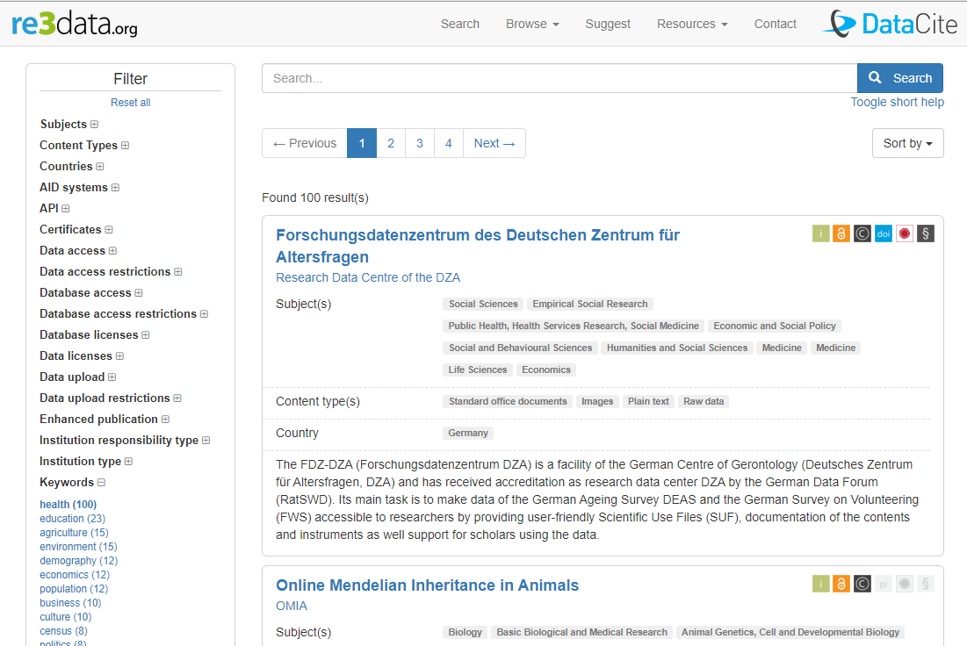
Notes:
Data – check articles of interest to see if data is published – more funders starting to require link from article itself
Re3data – registry of research-data repositories

Slide 15

Notes:
Data – check articles of interest to see if data is published – more funders starting to require link from article itself
Re3data – registry of research-data repositories
CDC, WHO, government websites for health data

Slide 16
Library Databases

Slide 17
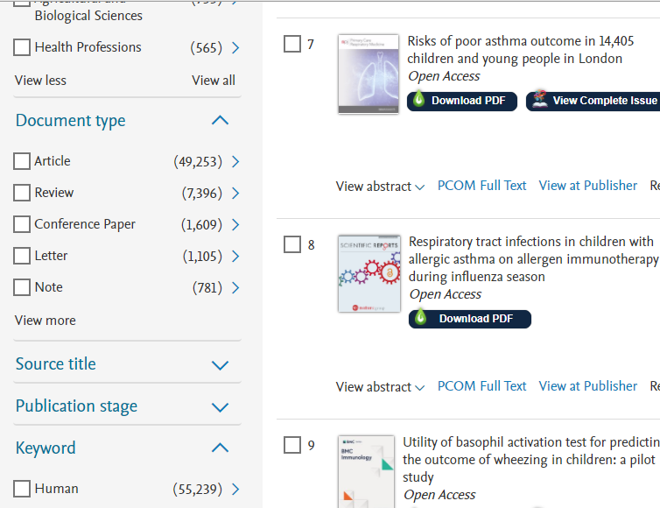
Scopus
Conference papers
Book chapters
Data papers

Slide 18
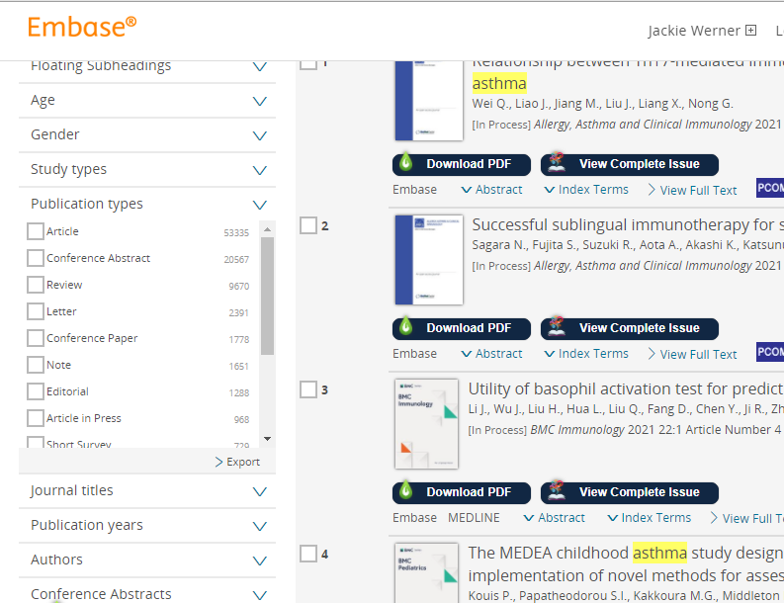
Embase
Conference abstracts
Conference papers
Book chapters

Slide 19
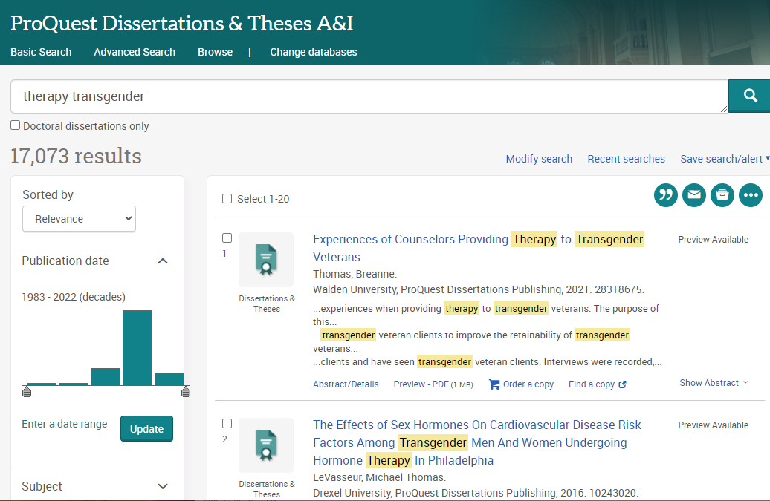
Dissertations &
Theses (ProQuest)
Dissertations
Theses

Slide 20
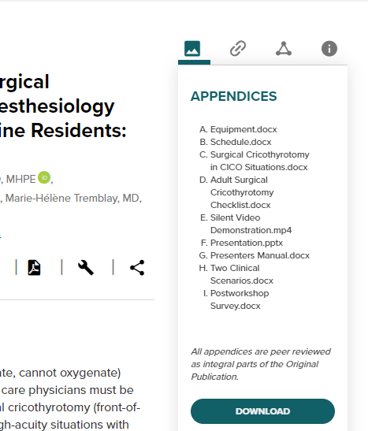
MedEdPORTAL
Teaching resources
Course materials
Peer-reviewed articles

Slide 21
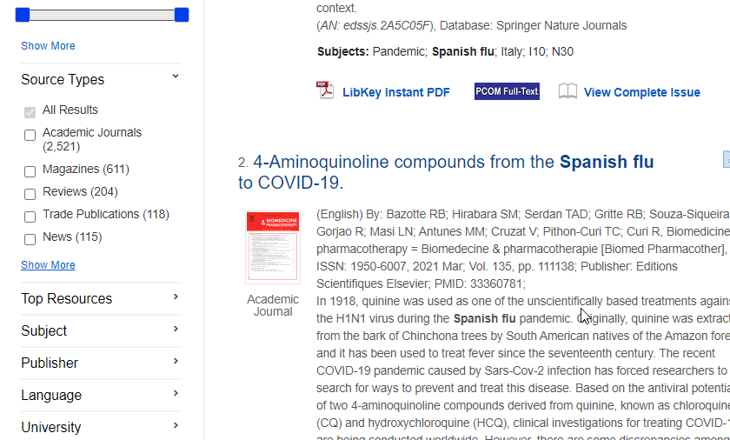
OneSearch
Trade Publications
News
Reports
Videos
Notes:
Searches many of our databases – good place to start for trade publications & news

Slide 22
Google
(yes, really)

Slide 23
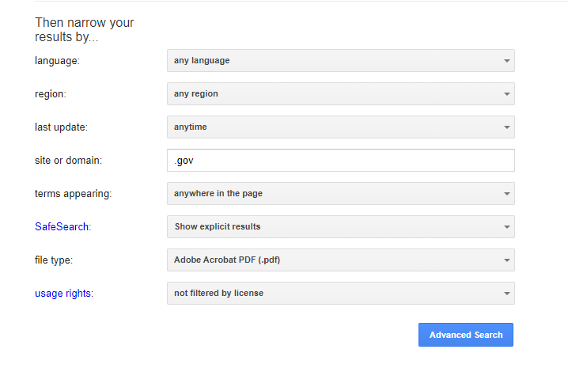
Notes:
Google advanced search – most important site, domain, file type
Keywords like “report,” “study,” “white paper”
Reports – search in .gov, .edu, or specific organization, pdfs or Microsoft word files
Search engines for many of these things, many specific to medicine
ex. Clinicaltrials.gov, uspto.gov (patent search)

Slide 24
Further Resources
Grey Literature in Health LibGuide
Digital Commons Network
bioarXiv (preprints)
medrXiv (preprints)
Registry of Research Data Repositories
Recommended Data Repositories (Nature)
HealthData.gov (US government)
MedEdPORTAL (course materials)
ClinicalTrials.gov
Google Patents

