Slide 1
The Good, the Bad, and the Ugly of Research Data
Jackie Werner, Scholarly Communications and Research Librarian
jaclynwe@pcom.edu

Slide 2
Why Should You Care?
Using the Good
Dealing With the Bad
Avoiding the Ugly
What does Research Data Management do for you?

Slide 3
The Good

Slide 4
The Good: Data as an Asset
Not just the end goal
Credit for data
Altmetrics

Slide 5
The Bad

Slide 6
The Bad: Data as a Requirement
Funding body requirements
  NIH data sharing: https://grants.nih.gov/grants/policy/data_sharing/
  NSF Data Management Plans: https://www.nsf.gov/eng/general/dmp.jsp
Journal requirements
  Some require materials and protocols be made available (ex. PNAS)
  National Research Council recommendation
Notes:
NIH data sharing: any grant above $500k must submit data sharing plan (including why it's not possible)
NSF: all grants must include data management plan
PNAS: "To allow others to replicate and build on work published in PNAS, authors must make materials, data, and associated protocols, including code and scripts, available to readers."
Sharing Publication-Related Data and Materials: Responsibilities of Authorship in the Life Sciences (2003)

Slide 7
The Ugly

Slide 8
The Ugly: Data as a Liability
"Our postdoc left and now no one knows where the data is or what it means"
"Where did all that PHI go?"
"Aren't we supposed to dispose of this data?"

Slide 9
What Can I Do?
Understand the Data Lifecycle
Follow Best Practices
Develop a DMP

Slide 10
The Data Lifecycle

Slide 11
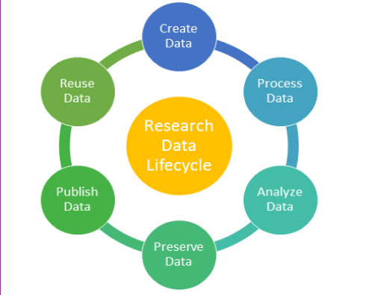
Image from NYU Libraries Data Management Planning Guide
Notes:
https://guides.nyu.edu/data_management
Create
Process: get raw data into usable format
Publishing not only findings - can include data itself (raw, processed, analyzed)
Research data management covers all steps

Slide 12
Best Practices

Slide 13
Plan
Develop data backup policies
Assign responsibilities
Determine potential repositories or journals
Determine budget for data
Notes:
Backup for all data, not just digital - paper lab notebooks? Paper surveys?
Responsibilities - which person/position will be in charge of collection and management upkeep? If positions will change in middle, decide how to pass on responsibilities
Will journals require or allow data publication? What are their guidelines?
Data costs can be part of grant - paid repository, salaries

Slide 14
Collect
Define and list types of data and file formats
Choose naming conventions
  Include same info in same order
  Never use same name in different folders (ex. data.xlsx)
  Use underscores and camel case instead of spaces
  Be extensible (ex. ex001 instead of ex1)
Preserve raw data
Notes:
Raw - document steps to clean data

Slide 15
AtherRat_ex012_norm_lipitor_056.tif
Notes:
Ex: experiment series name, experiment number, normal heart, treatment provided, slice number

Slide 16
Describe
Readme files
Meaningful directory hierarchy
Data dictionary
Notes:
Readme - general project files describing organization, responsible parties, instruments
Specific readmes for contents of data files - define parameters, contents, data and time formats, measurements, etc.
Data dictionary explains terms used in files and folders

Slide 17
Process and Analyze
Double-check data entry
Use consistent missing value coding
Document all analyses
Notes:
Data entry easily double-checked w/Redcap
Analysis documentation - include steps & complete software information so replicable

Slide 18
Publish and Share
Document all processing needed to ready data
Save data in stable formats
Include documentation with enough to make data reusable
Notes:
Formats - lossless data compression, supported by multiple software platforms (csv, txt)
Documentation - ex. Title, creator, persistent identifier, funders, dates, file format, etc.

Slide 19
Preserve
Keep three copies of data
Backup regularly
Store final data using stable file formats
Determine duration of storage
Consider data security
Notes:
Copies - original, on-site, off-site/remote
Storage options have pros and cons - personal comps/laptops, network storage, external storage, removable storage, remote storage
Hard to replicate data backup daily
Security policies classify data by sensitivity level
PHI should have data security in IRB
Researchers should know who's accessing what when

Slide 20
Data Management Plans

Slide 21
Components of a DMP
Data collection
Data description
Storage
Protection or privacy needs
Sharing and access
Preservation

Slide 22
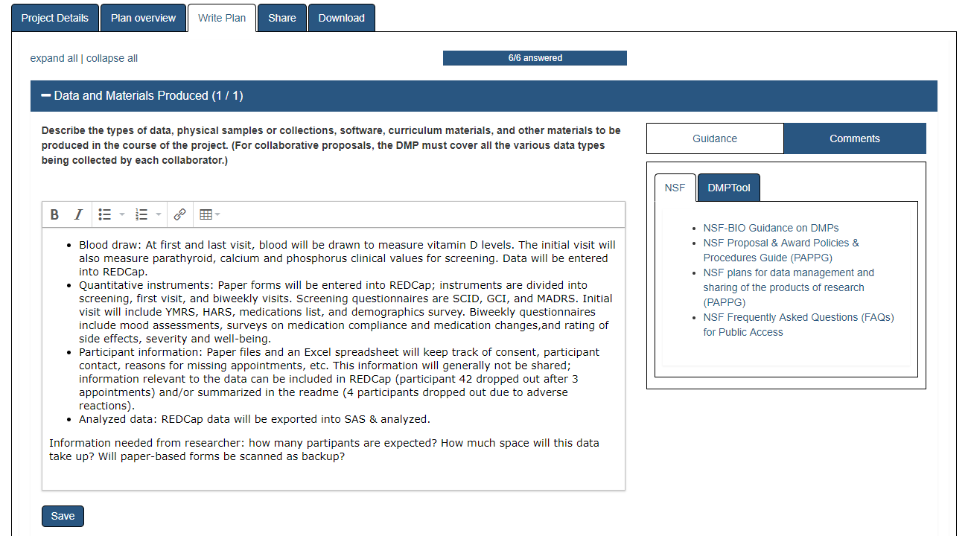
Notes:
Dmptool.org example project – live demonstration

Slide 23
https://libguides.pcom.edu/research/data_management

