Slide 1
Open Access and PCOM
Jackie Werner, Scholarly Communications and Research Librarian
jaclynwe@pcom.edu

Slide 2
What is Open Access?

Slide 3

What is Open Access?
Scholarly research that is DIGITAL
Free to ACCESS
Free to USE with minimal restrictions

Slide 4
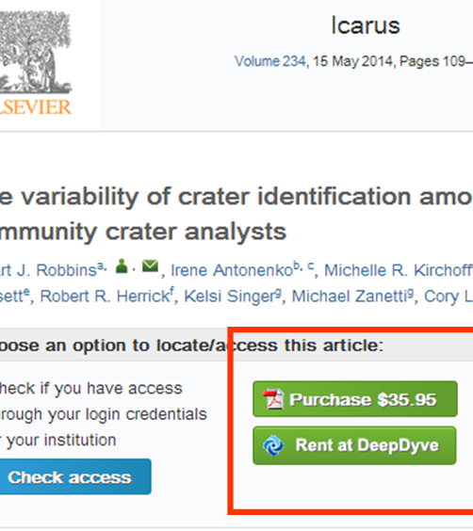
No Paywall
Notes:
Image from https://scholastical.wordpress.com/paywalls/

Slide 5
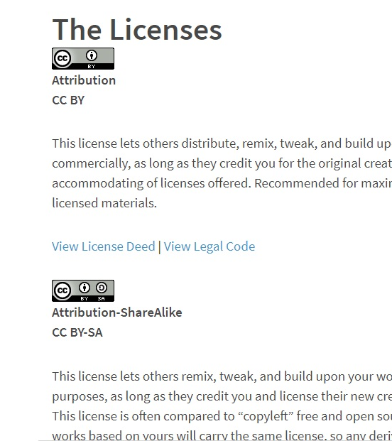
Creative Commons
(Usually)
Notes:
All include attribution, others include non-commercial, no remixes

Slide 6
Why Open Access?

Slide 7
Why Open Access?
Increased Access
Increased Exposure
Increased Rights

Slide 8
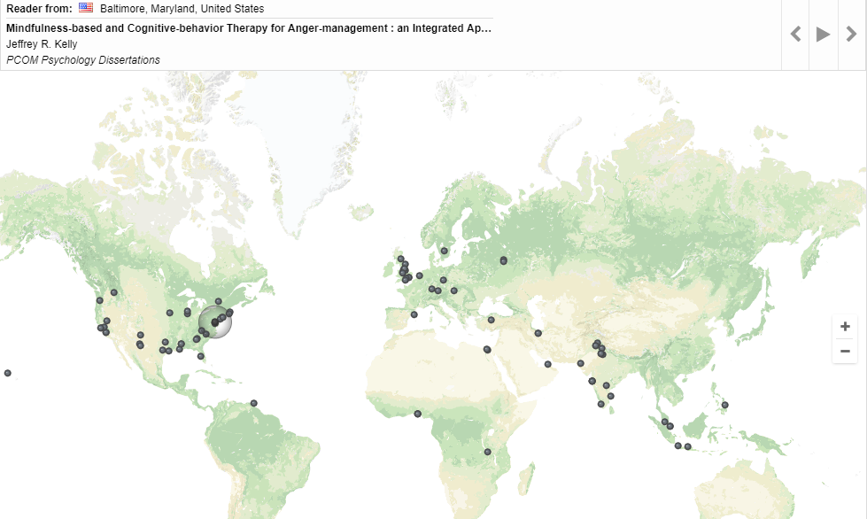
Increased Access
Notes:
Image from Digital Commons – map of where readers have accessed publications
Publically-funded research available to the public

Slide 9
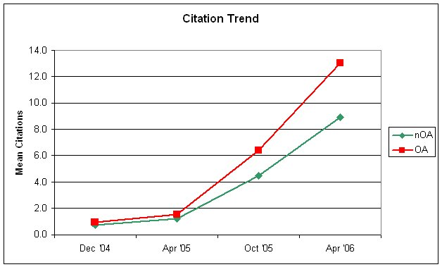
Increased Exposure
Notes:
Lot of research on open access citation advantage, most found advantage
Chart from Eysenbach, 2006, Journal of Medical Internet Research (doi 10.2196/jmir.8.2.e8)
Scholarly Publishing and Academic Resources Coalition of Europe: 70 studies on citation advantage until 2015, 46 found advantage vs. 17 none

Slide 10
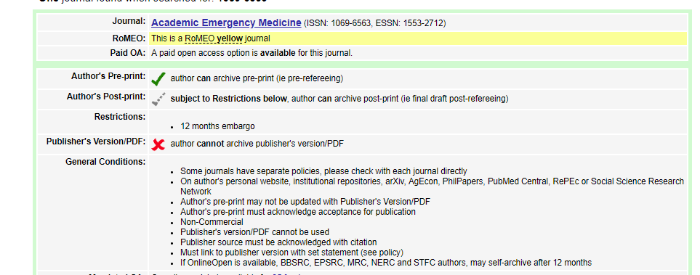
Increased Rights

Slide 11
How do I publish Open Access?

Slide 12
Green Open Access
Making work published in any journal available Open Access
Subject to publisher policies & embargos
Accepted manuscript, not formatted version

Slide 13
Gold Open Access
Work published in Open Access journals (pure or hybrid)
Freely available from publication
Author fees
Notes:
Ex. Applied cancer research, bmc - $1000, bmc biochemistry - $2145, plosone - $1595 author fees for publication

Slide 14
Do I have to pay?

Slide 15
NO

Slide 16
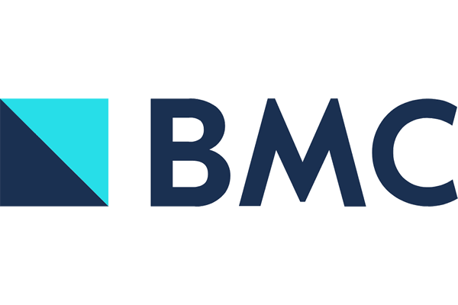

PCOM Library Pays Author Fees
Notes:
USE PCOM EMAIL!

Slide 17
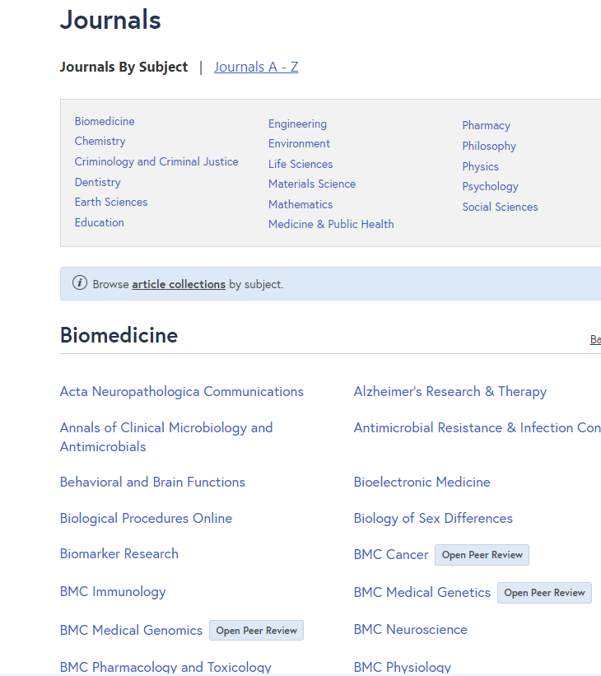
BioMed Central
63 journals
Library pays for all processing fees
Open peer review
Notes:
BMC Medicine: 7.25 impact factor
63 journals (biomed & medicine main, also pharmacy, psychology, etc.), broad interest & specialist
Pays for all article processing fees
Open peer review – peer review posted online

Slide 18
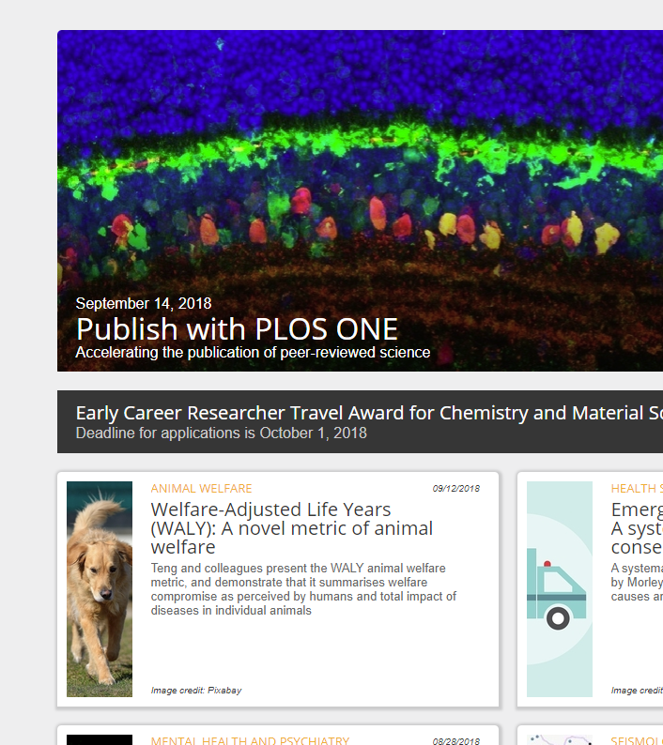
PLoS ONE
Multidisciplinary, novelty not a factor
Library and Department of Research pays
Up to 2 submissions in 12-month period
Notes:
PLoS ONE: public library of science, impact 2.766
multidisciplinary, accepts scientifically rigorous research, regardless of novelty
partnership w/department of research
Up to 2 submissions in 12-mo period

Slide 19
What about after I publish?

Slide 20
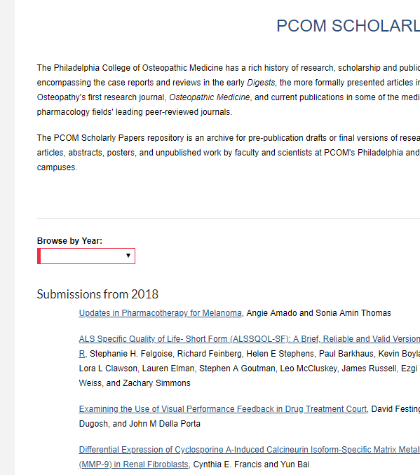
DigitalCommons@PCOM
Almost all journals allow pre- or post-print
Library adds faculty publications, soon resident
Permanent link & link to original
Notes:
Library automatically adds faculty/staff publications each month (get alerts from PubMed, Scopus, Embase w/PCOM affiliations and emails)

Slide 21
Any Questions?

