Slide 1
Microaffections & Microaffirmations in Library Learning
Isabel Espinal, UMass Amherst
Five Colleges Innovative Learning Symposium, January 2020*
*Additional readings added later

Slide 2
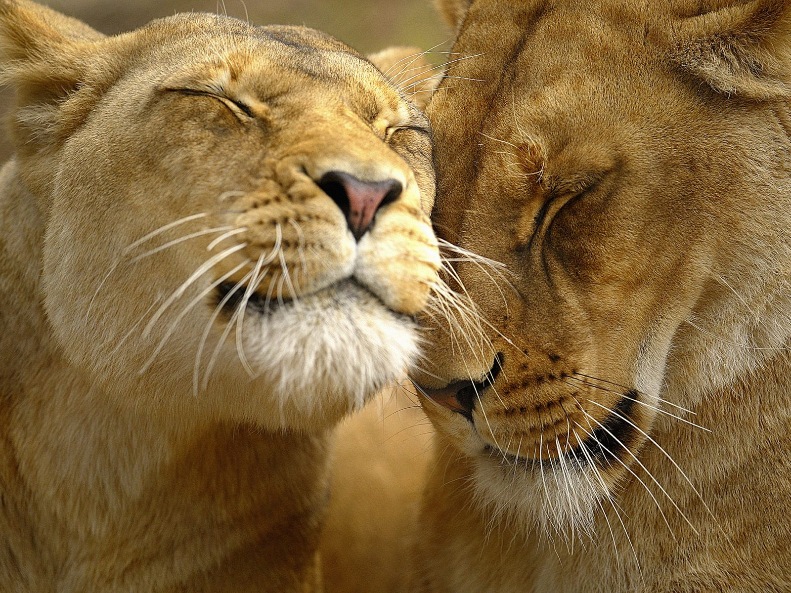
What are microaffections?
And why am I talking about them?
Notes:
Related to “positive psychology” -- from the human potential movement

Slide 3
Microaffections as counterpoint to microagressions
So what are microagressions?
“Microaggressions are common and casual verbal, nonverbal, and environmental slights, snubs, or insults, either intentional or unintentional, that communicate hostile, derogatory, or negative messages to target persons based solely upon marginalized group membership. What differentiates microaggressions from overt and deliberate acts of discrimination, is that the people perpetrating microaggressions often intend no offense or are unaware they are causing harm.” (Wing Sue, 2010)
From Microaggressions & Academic Libraries, https://microaggressionlibrary.com/
For many, many examples of what not to do, check out the website Microaggressions in Librarianship lismicroaggressions.tumblr.com/
Don’t commit microagressions!

Slide 4
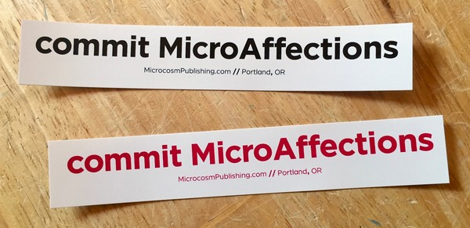

Slide 5
Microaffections are
"practices aimed at nurturing social affection. A provisional sketch of microaffection could include all the ways in which people subtly and skillfully include others, make others feel genuinely cared about, see others, hear others, think about others, and engage in social affection between in-group out-group categories that brings a concrete benefit to another, such as a genuine smile, or a genuine laugh, or a feeling of warmth, love, or safety."
Devin Coogan

Slide 6
A microaffection is
“... a subtle but endearing or comforting comment or action directed at others that is often unintentional or unconsciously affirms their worth and dignity, without any hint of condescension.”
Jim Burklo

Slide 7
Not so easy for everyone:
Microaffections take practice for many people
“...the cultivation of microaffection: priming ourselves for moments when, spontaneously, we go out of our way to make others feel like they are dignified, respectable, truly beloved members of society. It takes forethought in order to be able to offer kindness without forethought. It takes spiritual discipline to make it automatic for us to share warmth with people just because they’re people.”
Jim Burklo

Slide 8
What Works for Me: Go to the source: Love
Find or expand your source of love.
If you love what you do it is infectious.

Slide 9
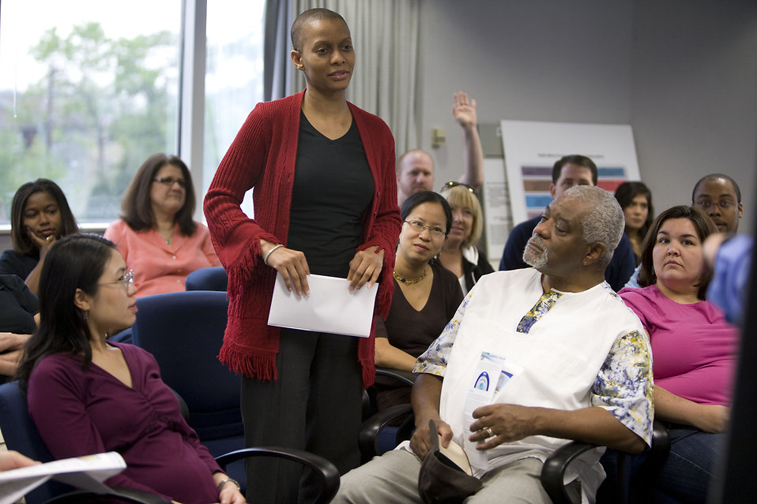
Micro affections as affirmative actions
CDC/ Dawn Arlotta acquired from Public Health Image Library. http://www.freestockphotos.biz/stockphoto/16494 This image is licensed under Public Domain.
Notes:
It’s important to deal with the macro issues and as well as the micro. I do work on the macro - affirmative action programs deal with that. One does not cancel the other.

Slide 10
Mary Rowe of MIT outlined the implications of a culture rich with micro-affirmations:
Block unconscious bias. Practice affirming the achievements of others. If you consciously and persistently look for excellence in the work of others and are universally respectful, you may be able to block your own unconscious bias from emerging.
Ameliorate damage. Your micro-affirmations might make up for, or balance out, some of the damage caused by micro-inequities in the workplace.
Meet a core emotional concern. Appreciation and affirmation are morale boosters, so micro-affirmations should lead to a more motivated and productive workplace.
Evoke reciprocal affirmation. Micro-affirmations can be contagious. When we compliment someone, he or she often is then inclined to compliment someone else.
Create a role-modeling effect. People are especially sensitive to the behavior of their immediate supervisors. When supervisors adopt the practice of micro-affirmation, they are important role models for colleagues and employees.
Rectify our own unconscious bias. Behavior is shaped by attitudes and vice versa. When we practice micro-affirmations, we may actually change some of our own unconscious biases.

Slide 11
Librarians of color defining microaffections
“Sometimes it’s as simple as just noting the small things. Telling someone the things they do that you appreciate, their certain way of dealing with something, or even just small kindnesses like noting their unique fashion sense or new haircut. A few don't respond but most people warm up and return the favor. A consistent, reciprocal environment of kindness. I would have to add though that I feel the key to doing this, creating this culture of kindness, is to be truthful. Find something, even if it’s the tiniest little thing (maybe the only thing!), you genuinely like about them or what they do. Don't make things up, people can often pick up on insincerity which can really take things the other way. However, once that is accomplished you'd really be surprised at how well people open up and in turn contribute to that "culture of kindness." :) I feel that gradually this can change the feeling of many departmental environments. It certainly has in ours!”
Amanda Aguilera
As an ally of the First Generation Low Income (FGLI) Program at my institution, I attend the events and talk to students. At these events, I introduce myself as a science librarian, as a first generation college graduate, and as the daughter of a chef and a baker. If students don't have questions about the library, that's okay, because at FGLI events, students can code-switch and talk about non-academic stuff with me.
Amanpreet Kaur

Slide 12
“I've been working on cultivating this at my workplace. Trying to do more intentional affirmation work - especially for those who are taking risks or putting themselves out there. I think it is really important. Honestly, most often, I just tell people when I appreciate something that they say/so - in private and public arenas. In my org we also have a problem of not affirming ideas or perspectives in meetings. Someone offers a different perspective or disagrees in a meeting and no one says anything, even when they actually agree. It ends up like this abyss. So I try to offer things like "Thanks for mentioning that perspective" or "Yes - agree." The only thing is, you have to be genuine - otherwise it can seem fake or saccharine sweet - two things I never seek to be.”
Yasmeen Shorish
“The library world needs more props in general. I love giving props to people who do great work! When I get props they motivate more almost more than anything else! #GiveProps!”
Max Macias
“OMG, this totally describes what I love doing! "“MICROAFFECTION: a subtle but endearing or comforting comment or action directed at others that is often unintentional or unconsciously affirms their worth and dignity, without any hint of condescension.” I'm very intentional with people when I say hi to them, look them in the eyes, and smile. Also I'm just a chatty Cathy and can't help but comment on what makes me happy about others. :) I truly believe positive, affirming actions from individuals can make workplace culture a better place (at least from the lower ranks; now if only those from the top-down would do the same). If my small words and actions can make someone's day better, it's worth it. It admittedly takes energy to push microaffections out, but helpful #ArchivistFairy at yo' service.”
Annie W. Tang

Slide 13
Microaffections Rubric
“I love your topic” | “Thanks for mentioning that perspective.” | Smile at students | “I appreciate that you…” | Help a coworker get promoted
Note someone’s unique fashion sense or new haircut | “I love your idea” |  | Smile at coworkers | Admit when you commit a micro aggression and apologize
Invite a colleague for coffee, lunch or drinks | Publicly appreciate something a coworker or student did | Give people props when they do great work. #GiveProps | Send a thank you note to a coworker in genuine, specific appreciation | Hug someone
Say or do these things to students of color
BINGO!
Say:
I love you
Say or do these things to colleagues of color

Slide 14
What do microaffections have to do with education?
Education as a positivist experience.
Helps in retention.
Education is theoretically empowering. Let’s make it so!

Slide 15

Make it so!

Slide 16
Readings
Bruce, Symphony. “Teaching with Care: A Relational Approach to Individual Research Consultations.” In The Library With The Lead Pipe, Feb. 2020, http://www.inthelibrarywiththeleadpipe.org/2020/teaching-with-care/ .
Burklo, John. Microaffection: The Antidote to Microaggression. Huffington Post. November 23, 2016. http://www.huffingtonpost.com/jim-burklo/microaffection_b_8631396.html
Cooke, Nicole A. “Leading with Love and Hospitality: Applying a Radical Pedagogy to LIS.” Information and Learning Sciences, vol. 120, no. 1/2, Nov. 2018, pp. 119–32. doi:10.1108/ILS-06-2018-0054.
Coogan, Devin. On Microaffection. Medium. May 27, 2016. https://medium.com/@devincoogan/on-microaffection-c1d56fac5bcb#.r89z3hguq
Ellis, James M., et al. “Examining First-Generation College Student Lived Experiences with Microaggressions and Microaffirmations at a Predominately White Public Research University.” Cultural Diversity and Ethnic Minority Psychology, June 2018. 2018-28120-001, doi:10.1037/cdp0000198.
Flanders, Corey E., Marianne LeBreton, et al. “Bisexual Women’s Experience of Microaggressions and Microaffirmations: A Community-Based, Mixed-Methods Scale Development Project.” Archives of Sexual Behavior, no. 1, 2019, p. 143.
Flanders, Corey E., Lesley A. Tarasoff, et al. “Positive Identity Experiences of Young Bisexual and Other Nonmonosexual People: A Qualitative Inquiry.” Journal of Homosexuality, vol. 64, no. 8, Aug. 2017, pp. 1014–32. doi:10.1080/00918369.2016.1236592.
Gearity, Brian T., and Lynett Henderson Metzger. “Intersectionality, Microaggressions, and Microaffirmations: Toward a Cultural Praxis of Sport Coaching.” Sociology of Sport Journal, vol. 34, no. 2, June 2017, pp. 160–75.
Microaggressions in Librarianship http://lismicroaggressions.tumblr.com/
Molina, Rose L., et al. “Creating a Culture of Micro-Affirmations to Overcome Gender-Based Micro-Inequities in Academic Medicine.” The American Journal Of Medicine, Feb. 2019. doi:10.1016/j.amjmed.2019.01.028.
Pittinsky, Todd L. “Why Overlook Microaffirmations? Microaffirmations Communicate to Students That They’re Welcome, Visible, and Capable of Performing Well.” Phi Delta Kappan, no. 2, 2016.

Slide 17
Powell, Candice, et al. “Micro-Affirmations in Academic Advising: Small Acts, Big Impact.” The Mentor: An Academic Advising Journal, Oct. 2013, https://dus.psu.edu/mentor/2013/10/839/ .
Rowe, Mary. “Unconscious Bias: May Micro-Affirmations Provide One Answer?” IWER Institute for Work and Employment Research, 22 Feb. 2015, http://iwer.mit.edu/2015/02/22/unconscious-bias-may-micro-affirmations-provide-one-answer/ .
Salim, Selime, et al. “Bisexual Women’s Experiences of Microaggressions and Microaffirmations and Their Relation to Mental Health.” Psychology of Sexual Orientation and Gender Diversity, Feb. 2019. 2019-10844-001, doi:10.1037/sgd0000329.
Sterzing, Paul R., et al. “Familial Pathways to Polyvictimization for Sexual and Gender Minority Adolescents: Microaffirming, Microaggressing, Violent, and Adverse Families.” Psychology of Violence, Nov. 2018. 2018-55869-001, doi:10.1037/vio0000224.
Sterzing, Paul R., and Rachel E. Gartner. “Lgbtq Microaggressions and Microaffirmations in Families: Scale Development and Validation Study.” Journal of Homosexuality, Dec. 2018. 2018-66542-001, doi:10.1080/00918369.2018.1553350.
Topor, Alain, Tore Dag Boe, et al. “Small Things, Micro-Affirmations and Helpful Professionals Everyday Recovery-Orientated Practices According to Persons with Mental Health Problems.” Community Mental Health Journal, no. 8, 2018, p. 1212, doi:10.1007/s10597-018-0245-9.
“Transforming Workplace Culture with Micro-Affirmations - Leadership Blog | MIT Sloan Fellows.” Leadership Blog, 27 July 2016, https://mitsloan.mit.edu/fellows/leadership-blog/transforming-workplace-culture-with-micro-affirmations/ .
Tynesha M. McCullers. “Make Sure You Affirm and Support Risk-Takers in Public, Not in Private with Microappreciations.” The Black Youth Project, 9 Sept. 2019, http://blackyouthproject.com/make-sure-you-affirm-and-support-risk-takers-in-public-not-in-private-with-microappreciations/ .

