Slide 1
Soviet foreign policy expertise and
U.S.-Soviet relations during the Cold War
(the 1950-s-1960-s)
Iana Shchetinskaia
Russian State University for the Humanities
ivshchet@gmail.com

Slide 2
Scholarly debate: policy expertise and influencing foreign policy
U.S. foreign policy expertise:
Cold-War academic research (Lowen 1997, Chomsky et al. 1997, Engerman 2003, Levin 2013)
Policy research in collaboration with state (Diamond 1992, Robin 2003, Wax 2008, Price 2016, Bessner 2018 )
Foreign policy analysis in think tanks (Denham, Stone, Garnett 1998, Abelson 2002, Medvedtz 2012, McGann 2016)
Sources of Soviet foreign policy:
The role of historians in cultural diplomacy and relying on personal correspondence and conversations (Zhuk 2018)
Analysis of selected institutions (Roh (2018)
The role of political leaders (Dawisha 1979, Mastny 2010, Garthoff 2015, Graeme 2018)
Other factors in foreign U.S.-Soviet Union relations
writers (White 2019), journalists (Fainberg 2021), diplomats (Gurman 2012), intellectuals (Foglesong 2007), and “ordinary” citizens (Feinberg 2017)

Slide 3
Research questions
Institutional landscape of policy knowledge production in the Soviet Union:
What interactions existed among Soviet policy-formulating institutions?
How they perceived the role of the U.S. as “the Other” for the Soviet Union?
Foreign policy discourse of Soviet Union foreign policy institutions
- Whether and how it transformed?
*the role of ideology
*foreign policy influence

Slide 4
Sources
Materials of the CPSU departments from Russian State Archive of Contemporary History (RGANI)
Materials of the Institute of International Relations and the World Economy from the State Public Historical Library
Memoirs by Soviet policy experts (i.e., G. Arbatov, N. Cherkasov, A. Cherniaev, etc.)
Materials of the CPSU International Department (and, to a lesser extent, the General Department) + the materials of the Institute of World Economy and International Relations (IMEMO), a Soviet think tank established in 1956

Slide 5
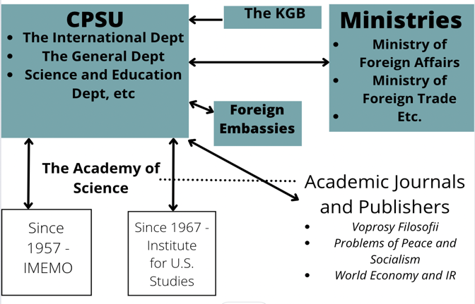
Institutional Landscape of Soviet Foreign Policy Analysis
The CPSU International and General Departments received memos and reports from multiple state and non-state organizations
The departments requested consultations, provided recommendations to other agencies, and confirmed foreign policy decisions
the ID and the General Department employed the Academy of Science to analyze foreign policy issues
Soviet academic journals (i.e., Voprosy Filosofii), scientific journals filled in the gap in Soviet knowledge production; the ID provided consultations and occasionally made decisions
Since 1957, first academic think tanks were established

Slide 6
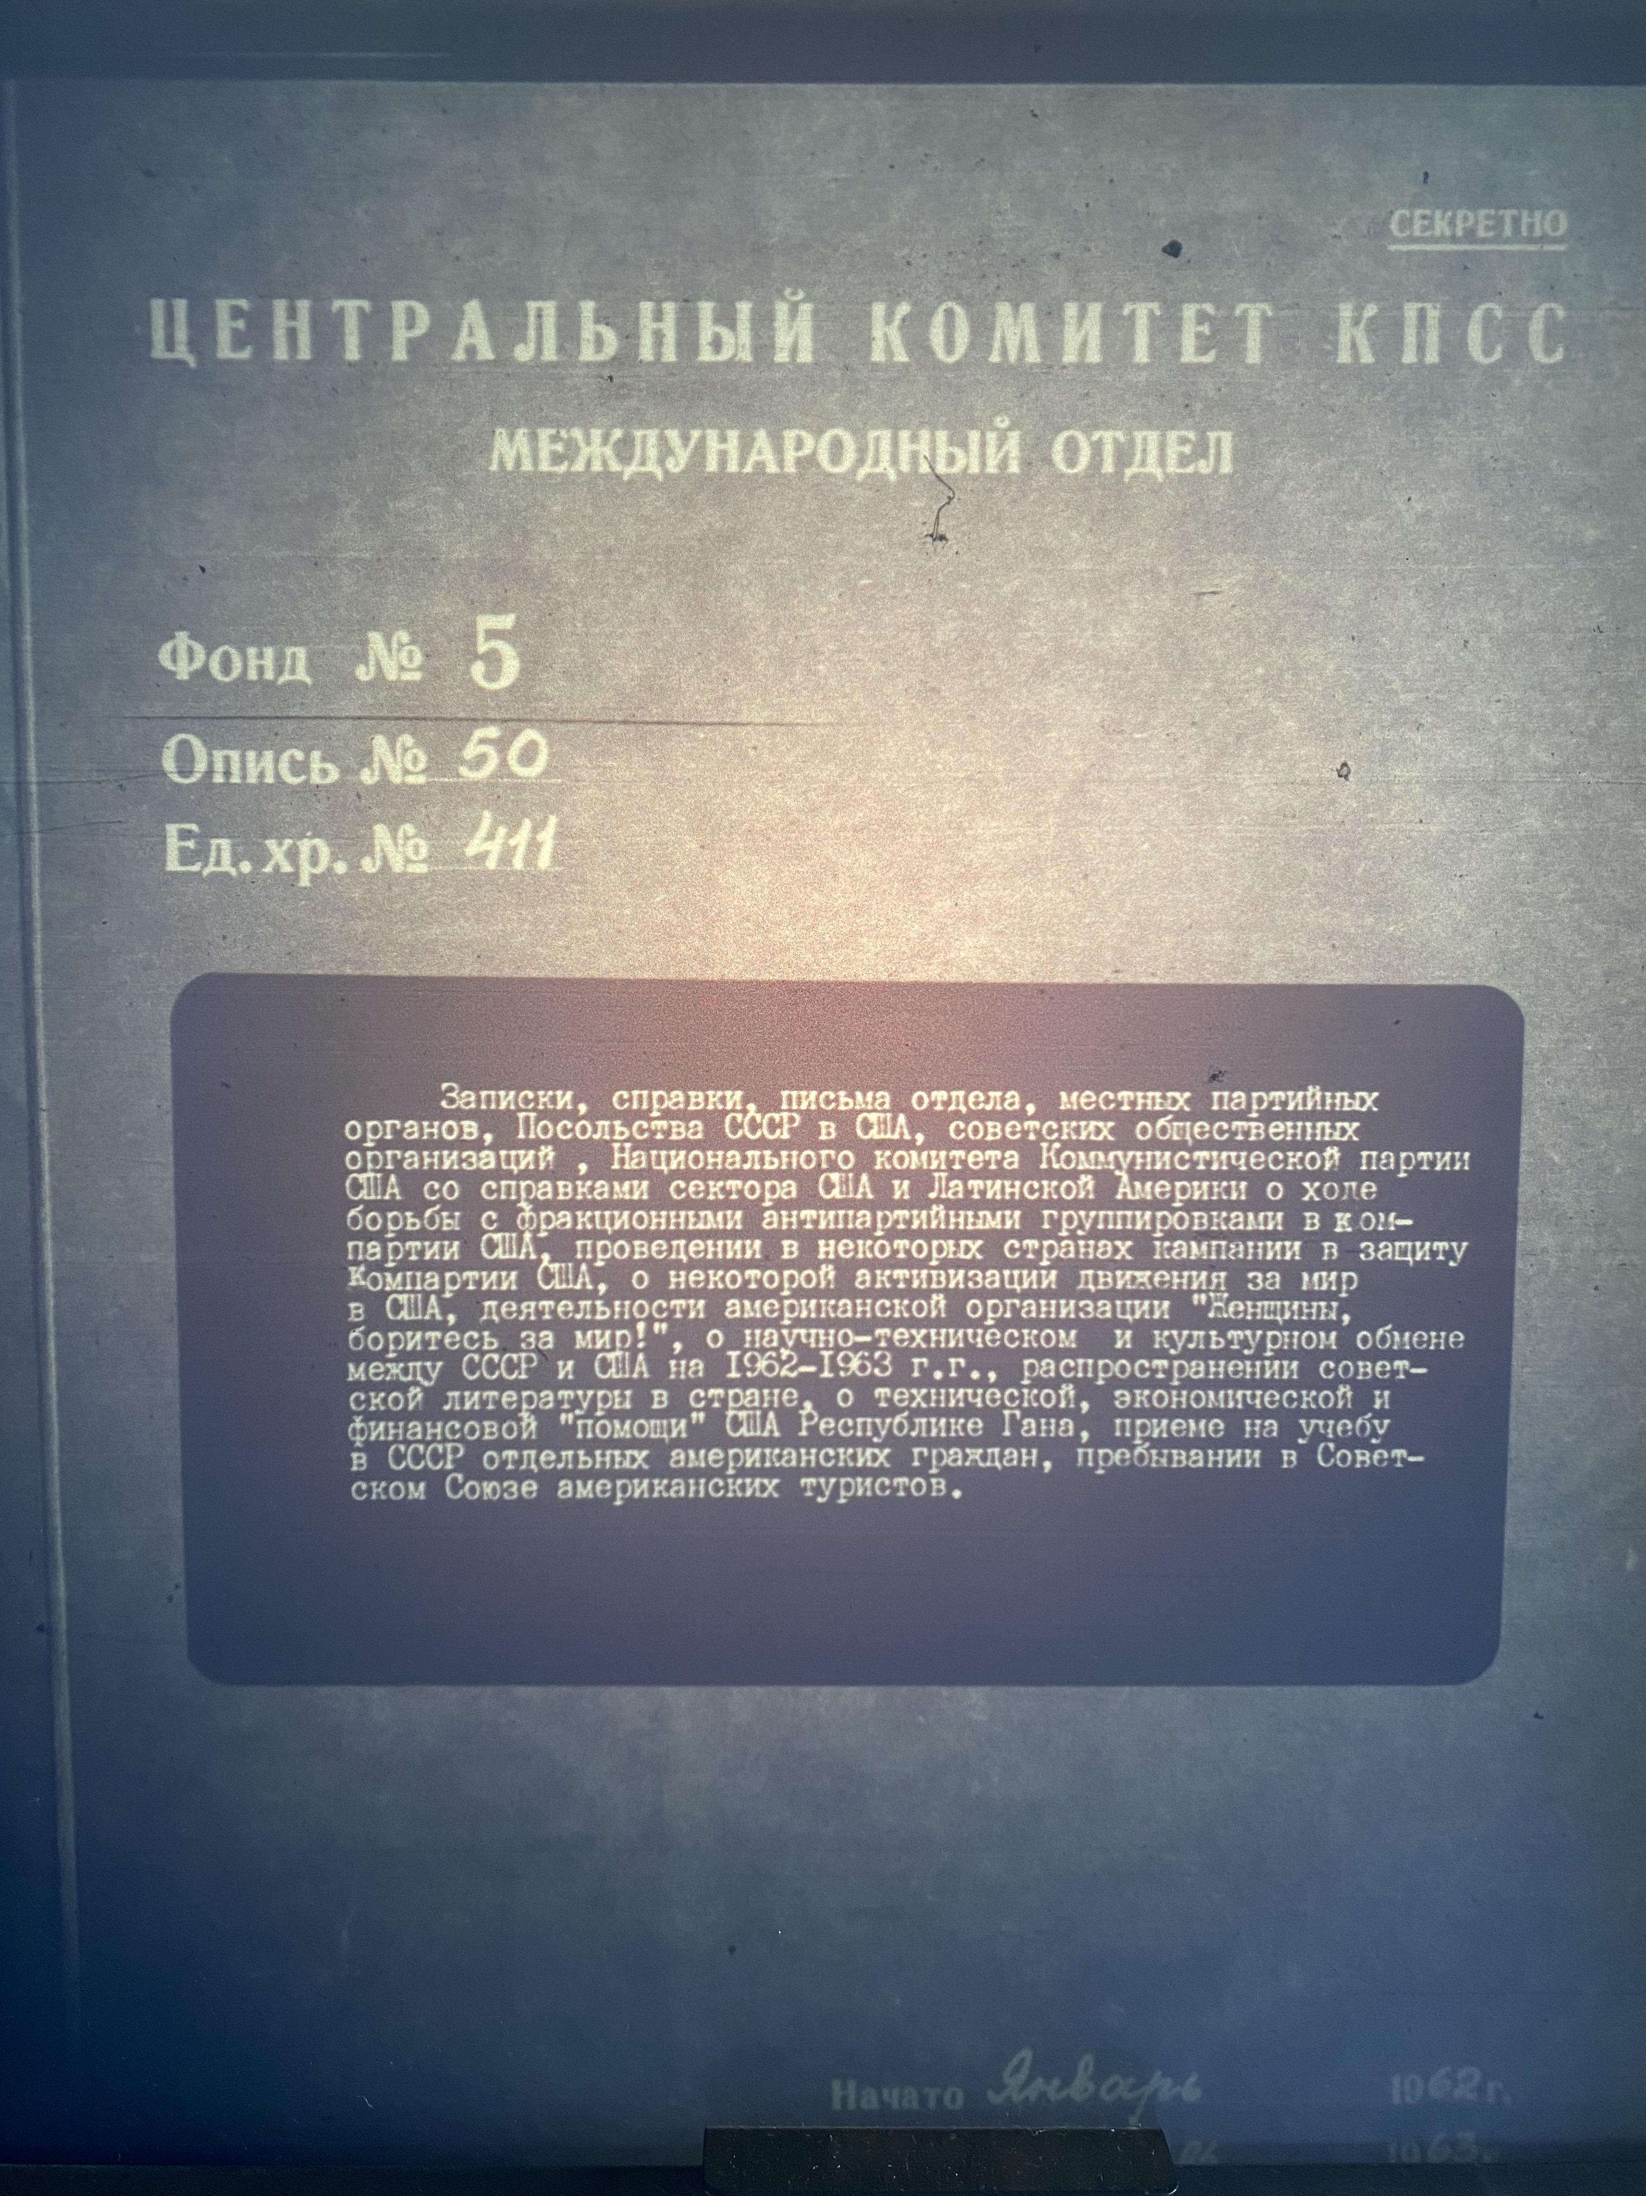
The International Department
Founded in 1943 after the Communist International (Comintern) was liquidated
At the beginning, headed by A. Zhdanov, G. Dimitrov; the first deputy chief – B. Ponomarev (1955-’86) and M. Suslov
At the outset, primarily formulated foreign policy toward Communist parties abroad
Later, participated in the decision-making in other areas
Communicated extensively with the Academy of Sciences, ministries, the KGB, embassies, conference committees, editorial boards, and regional party organs

Slide 7
Changes in Soviet Domestic and Foreign Policies (1950-s) | Changes in Policy Analysis Institutions (1950-s)
Stalin’s death in 1953 and the subsequent domestic political changes The USSR changes its attitude toward international organizations, diplomatic and cultural relations with other countries (Germany, Israel, etc.) Premier and first secretary of the CP Malenkov offers the U.S. to settle tensions by peaceful means In 1954, USSR issues a collective security proposal to a few countries, including the U.S. The Hungarian revolution in 1956 | a shift from ideological propaganda toward policy analysis + the number of discussed countries and issues increased Institutions analyze the Geneva summit of 1955, the XX Congress of the CPSU, and the Moscow Declaration of 1957, the Academy of Science comments on cultural ties Changes in policies and recommendations to journals and other institutions The U.S. served as an important point of comparison for the Soviet Union, despite criticism The ID branch responsible for dealing with foreign Communist parties split off to prevent similar events in the future

Slide 8
The question of influence
In policymaking toward the NATO countries, the ID primarily maintained connections with Communist parties
However, it received materials and commented on other issues (i.e. Soviet relations with Western Europe and U.S. politics)
However, although the ID had the decision-making power and contributed to constructing images of foreign countries, it often received and generated reports after the political events took place
Although under B. Ponomarev the ID’s role increased among the Third World countries, he never became a member of Politburo, a factor most often linked to policy influence in USSR

Slide 9
New institutional shifts: Creation of the first Soviet “think tank”
In 1956, the Institute of World Economy and International Relations was established
It soon became an important center of socio-economic, political, and policy-oriented research
Soviet ”non-state” experts had similar career paths in state institutions (the ID) and academic journals, yet often called themselves “Children of the XX Congress”
Its experts established extensive international academic contacts

Slide 10
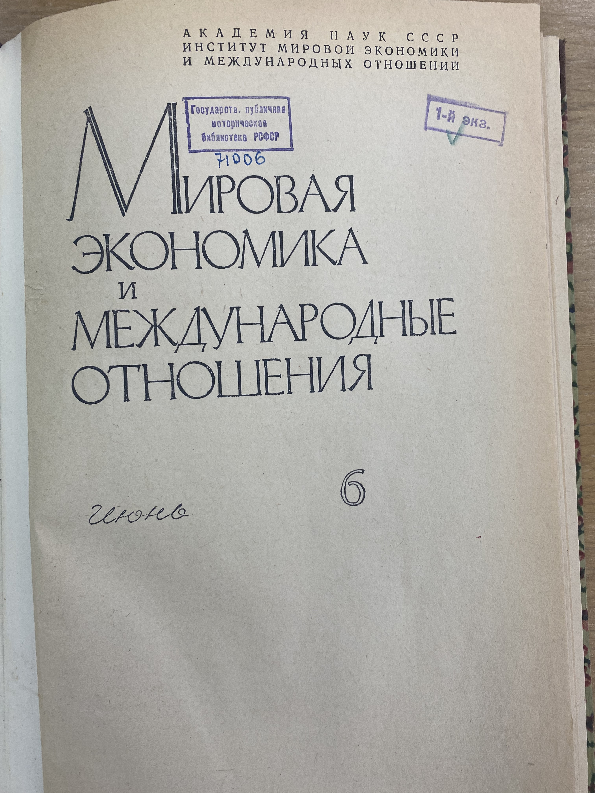
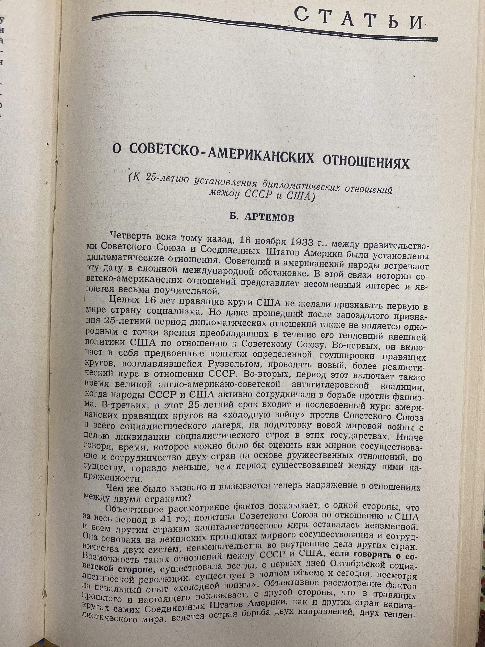
The discrepancy between the Institute’s policy memos and its “public” expertise – a “binary socialism”?

Slide 11
Conclusions
Between 1950-s and 1960-s the Soviet Union had a multi-faceted network of foreign policy knowledge-generating institutions that regularly interacted with each other
They constructed policy discourses and commented on each other’s decision, yet their policy influence was indirect and often limited
The institutional landscape and their discourses changed under domestic shifts and the subsequent changes in foreign policy goals
There was a discrepancy between policy analysis for state institutions and “public” foreign policy expertise

