Slide 1

Collaborative Chemical Information Literacy: Is it "scholarly?"
Barbara Harvey, Science Liaison Librarian

Slide 2
Socrative live polling:
URL: m.socrative.com
Room #: lib001

Slide 3
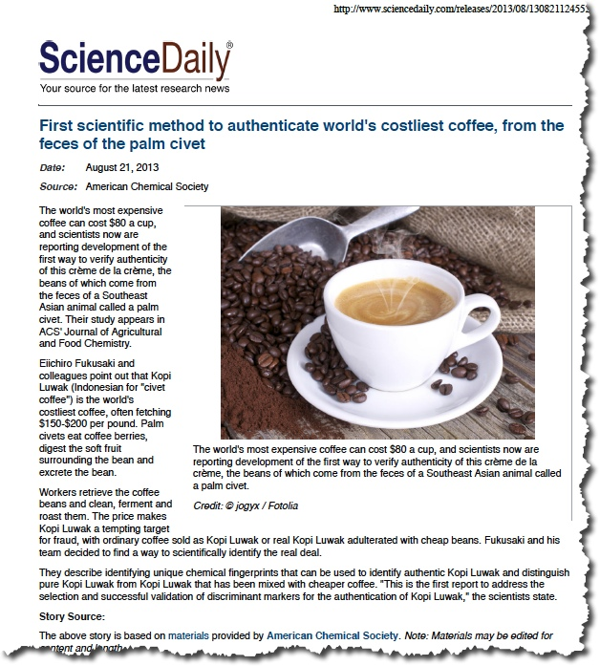
Is this article “scholarly?”
“Science Daily” article on civet poop coffee:
Locate an interesting/timely/humorous article in the discipline.
Determine the original study and confirm access.
Provide students either print or electronic version of article.
Have students read article, and with a partner, decide if article is “scholarly.”

Slide 4
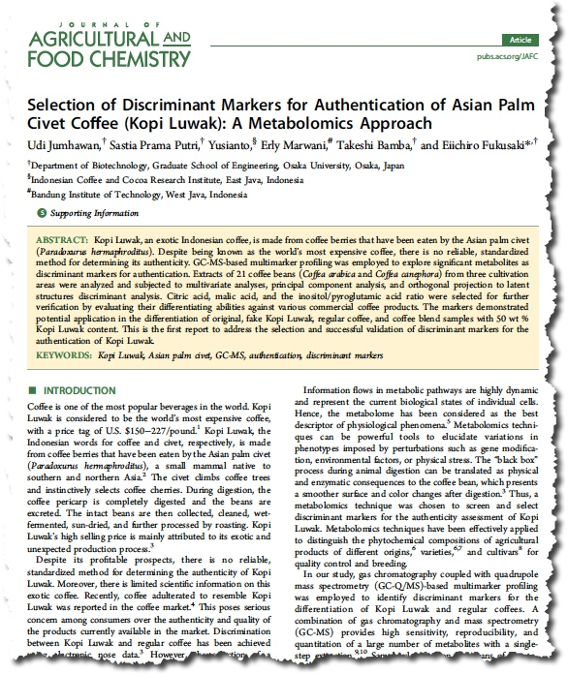
Original Study:
Original study available through ACS Publications.
There are multiple ways to access this article through GVSU.

Slide 5
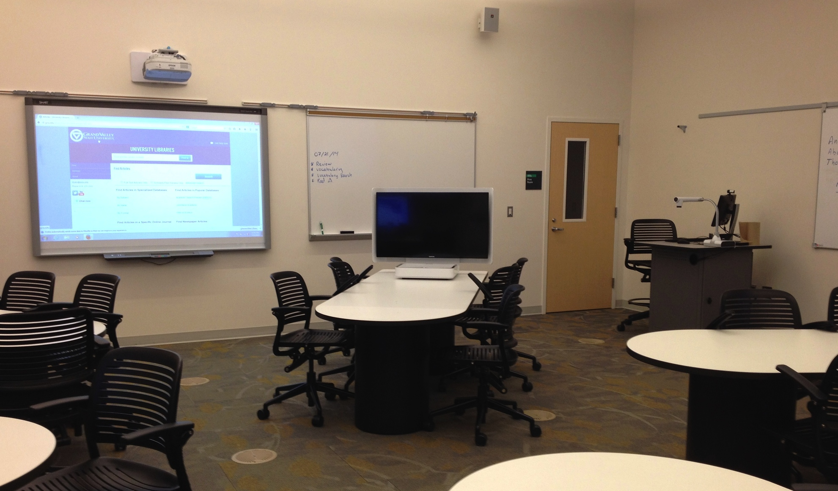
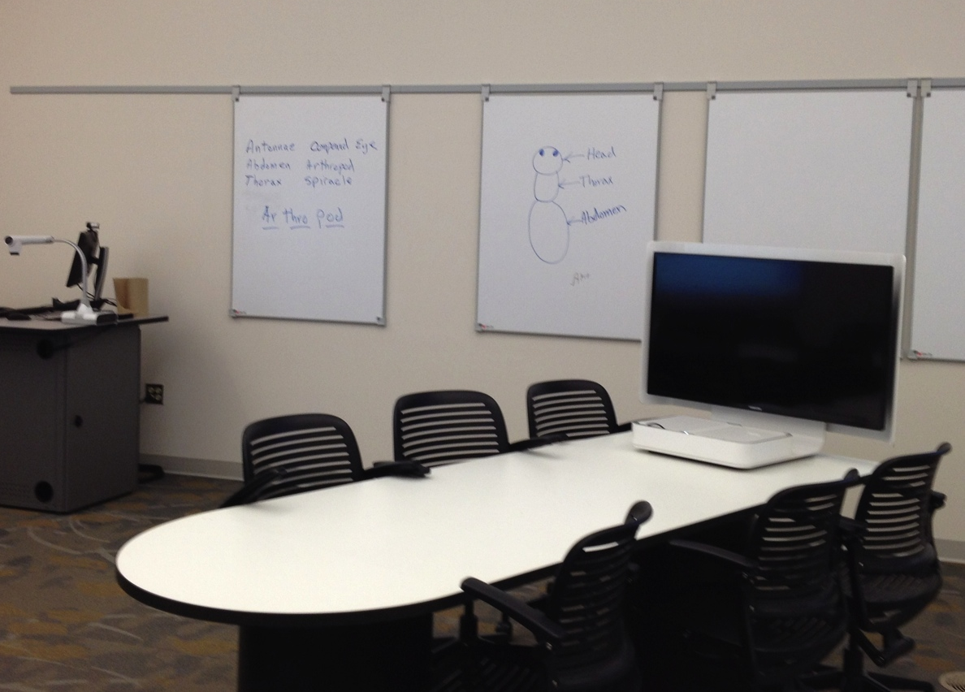
Collaborative Learning Lab
@ GVSU:
Mediascape Tables, SMART Board, Whiteboards

Slide 6
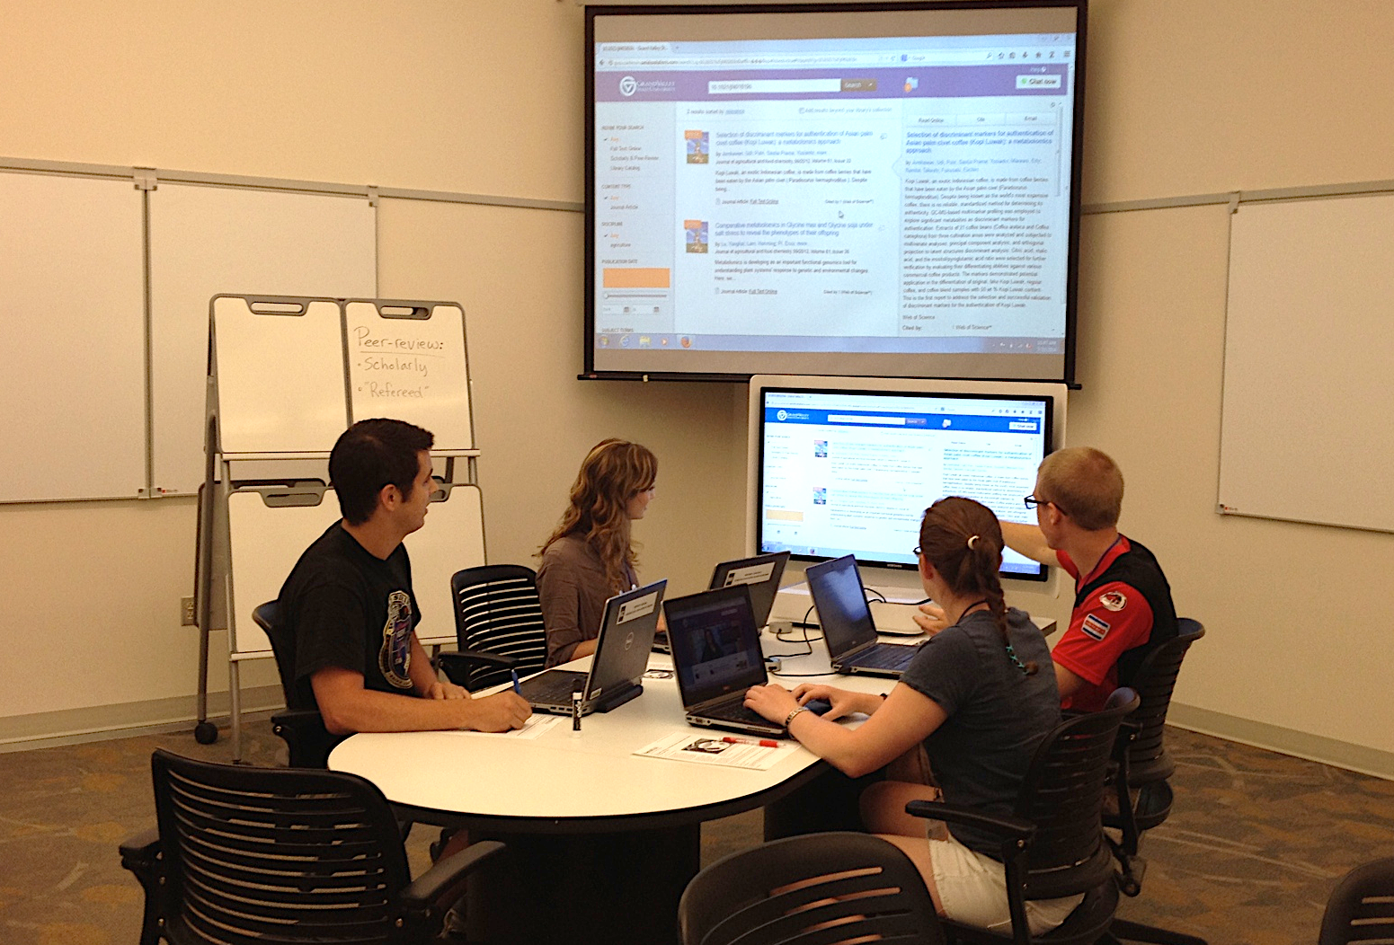
Library Lab 2: Collaborative space

Slide 7
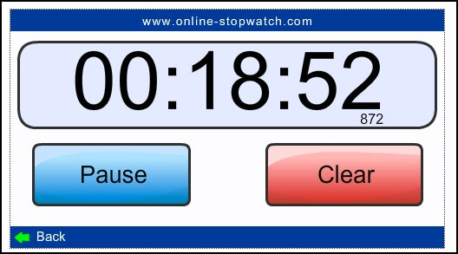
Give limited time for searching

Slide 8
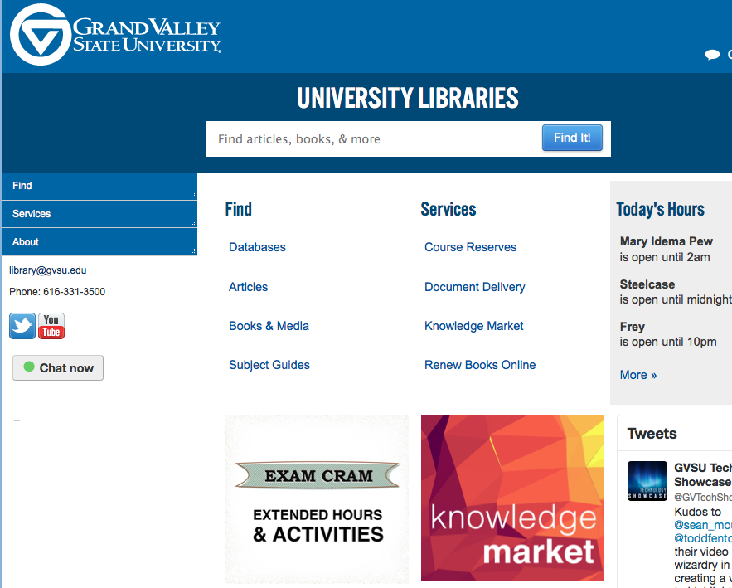
Multiple ways to access a known journal article:
Summon search from library homepage:

Slide 9
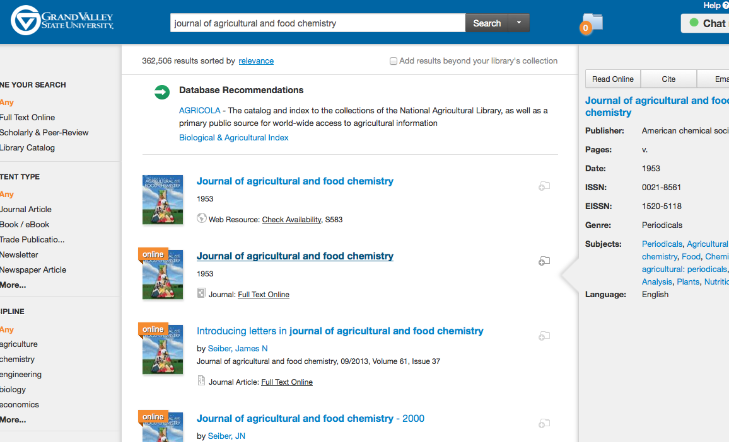
Multiple ways to access a known journal article:
Summon search from library homepage:
  Summon journal title search

Slide 10
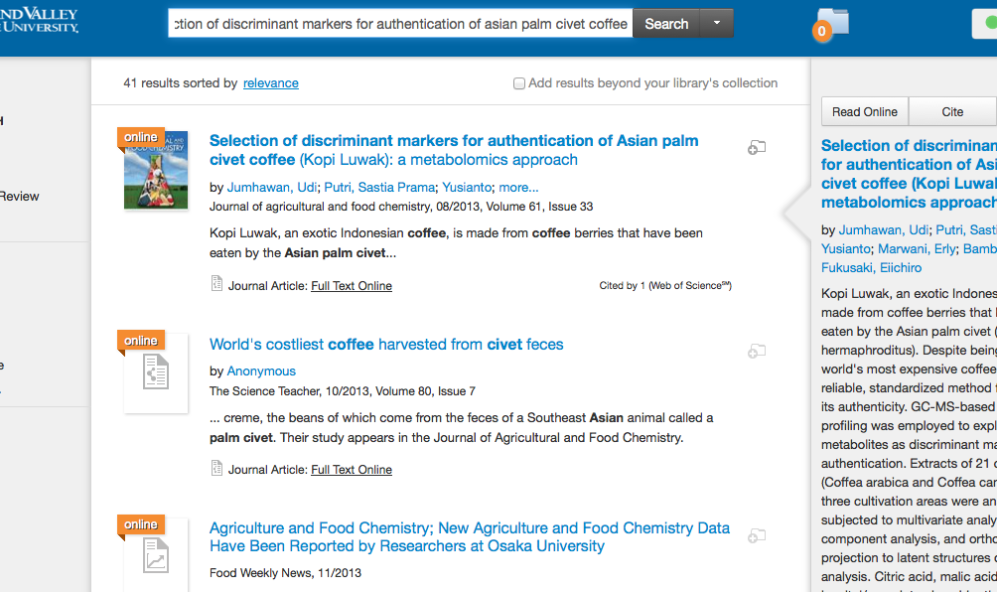
Multiple ways to access a known journal article:
Summon search from library homepage:
  Summon journal title search
  Summon article title search/DOI

Slide 11
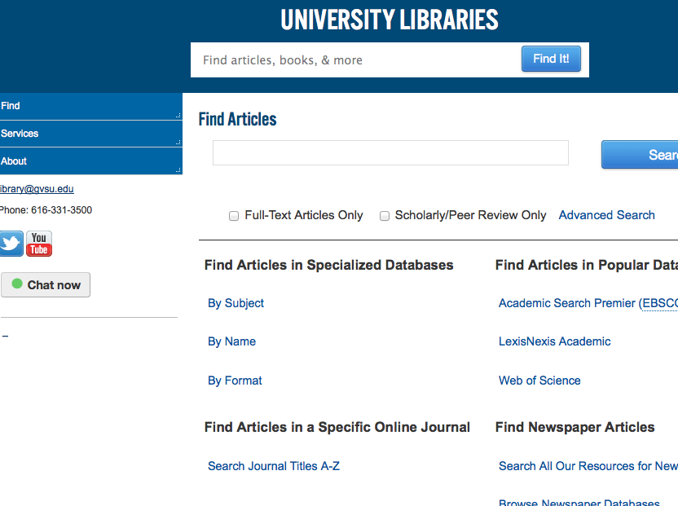
Multiple ways to access a known journal article:
Summon search from library homepage:
  Summon journal title search
  Summon article title search
Journal title search (not Summon)

Slide 12
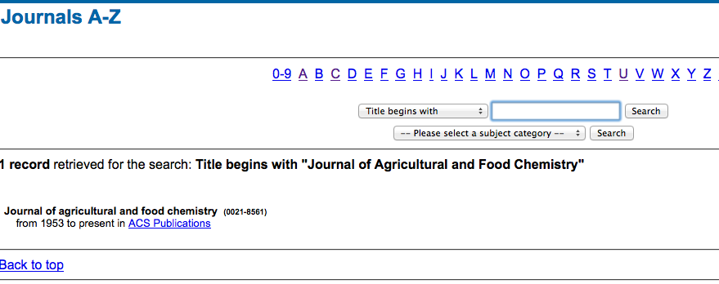
Multiple ways to access a known journal article:
Summon search from library homepage:
  Summon journal title search
  Summon article title search
Journal title search (not Summon)
  Journals A-Z

Slide 13

Multiple ways to access a known journal article:
Summon search from library homepage:
  Summon journal title search
  Summon article title search
Journal title search (not Summon)
  Journals A-Z
Google/Google Scholar search

Slide 14
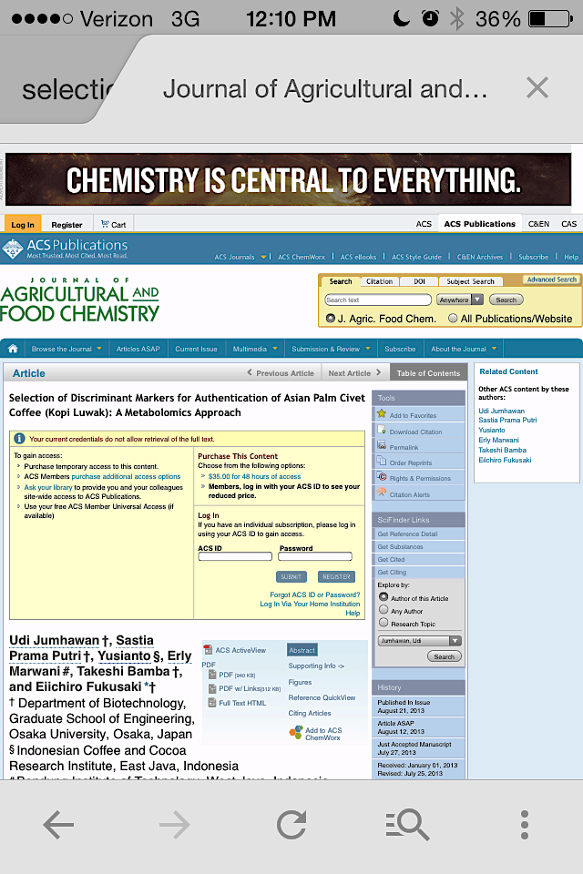
Multiple ways to access a known journal article:
Summon search from library homepage:
  Summon journal title search
  Summon article title search
Journal title search (not Summon)
  Journals A-Z
Google/Google Scholar search
  Paywall if off campus

Slide 15
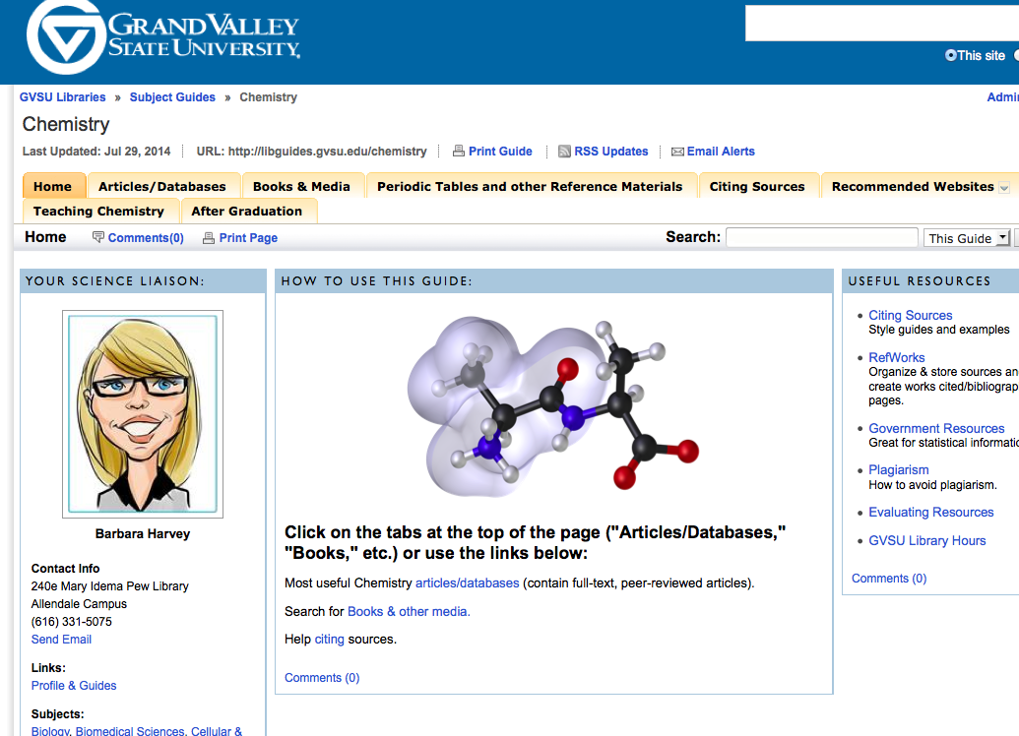
Multiple ways to access a known journal article:
Summon search from library homepage:
  Summon journal title search
  Summon article title search
Journal title search (not Summon)
  Journals A-Z
Google/Google Scholar search
Chemistry subject guide (LibGuide)

Slide 16
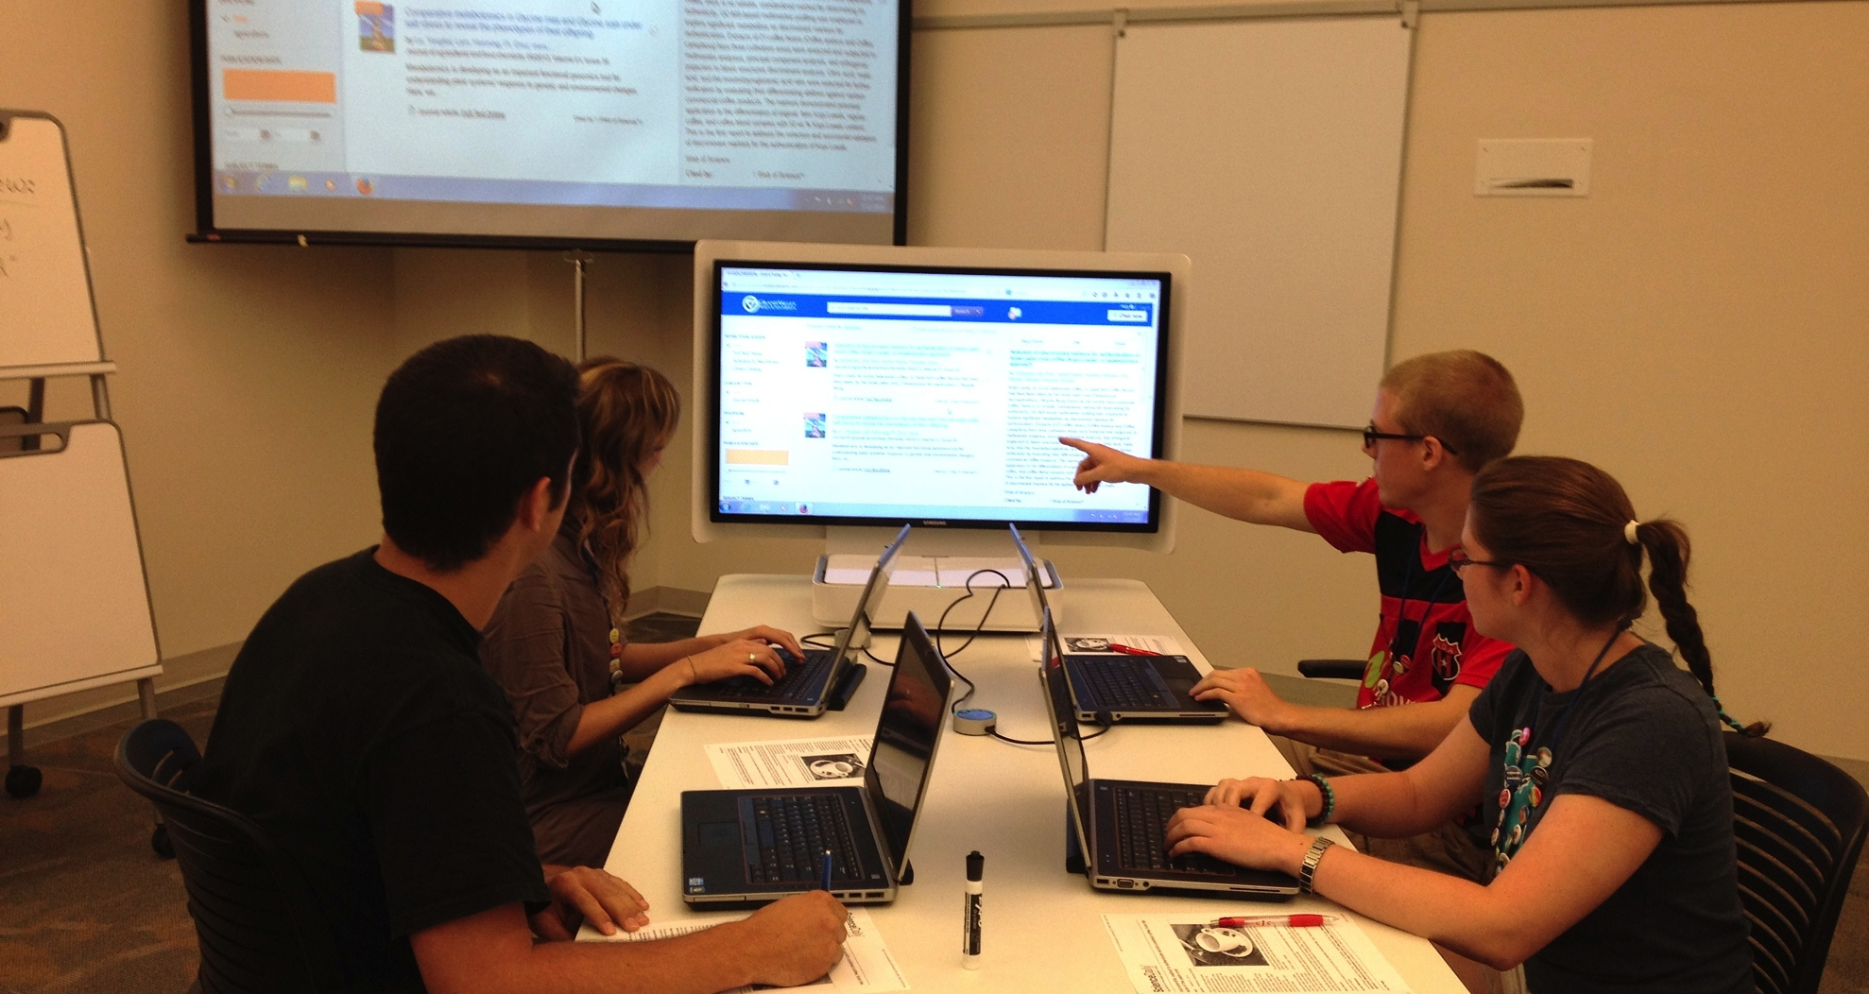
Students work together to find access

Slide 17
Compare/contrast the two articles

Slide 18
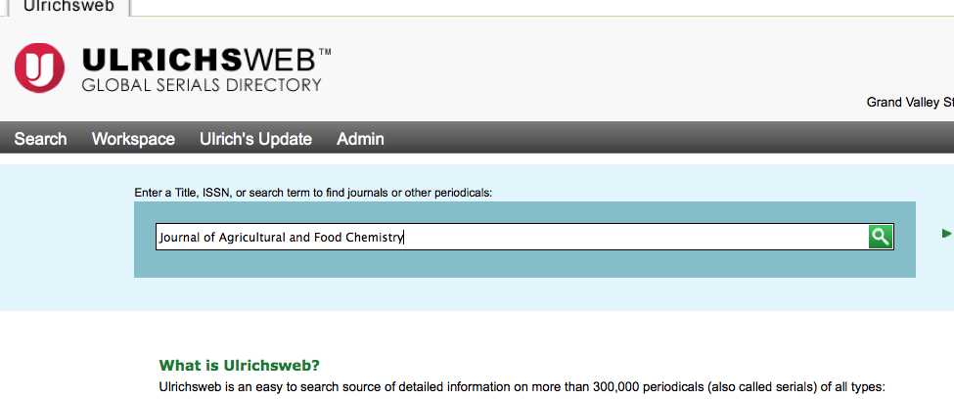
Is it peer-reviewed?
Go to journal home page, click “About us,” or “Submissions.”
Use Ulrichsweb database:

Slide 19
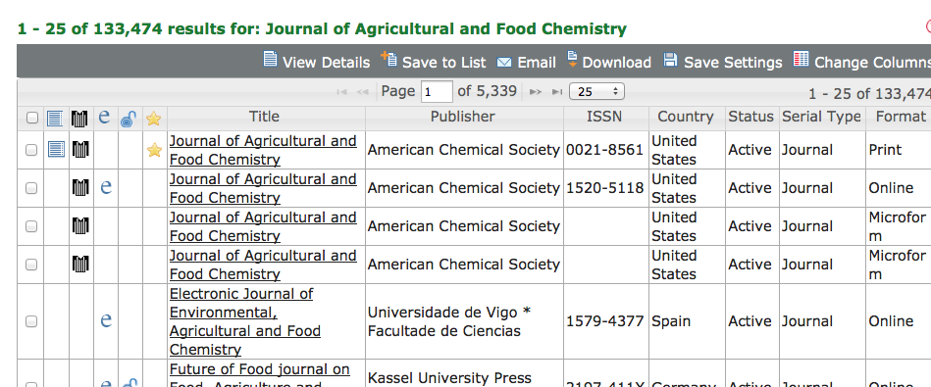
Ulrichsweb results:

Slide 20
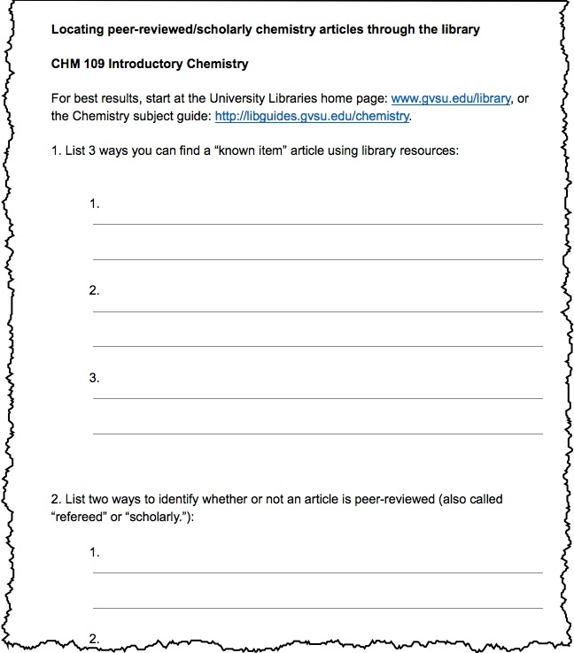
Student Handout:

Slide 21
Acknowledgements:
Charity Lovitt & Kristen Schuyler, Co-Chairs, Integrating Library and Information Resources into Chemistry Curricula Symposium for the 2014 BCCE.
University Libraries User Experience Team, GVSU

