Slide 1
Engaging Undergraduate Students in Planetary Science Research for Parabolic Flights
Gillian Gomer, Adrienne Dove, Seamus Anderson, Jeffery Jorges, Alexandra Yates
Center for Microgravity Research
Department of Physics
University of Central Florida

Slide 2
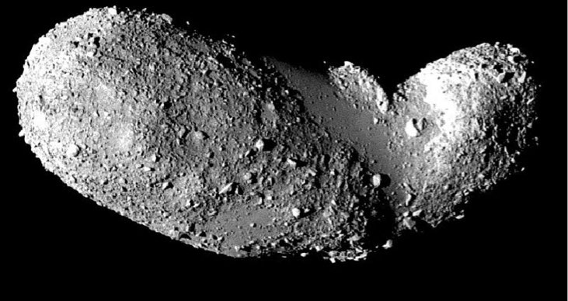
What is SLOPE?
JAXA
SLOPE = Simulating LOw-gravity Planetary Environments
Study the effects of slopes on mass movement of granular material, like planetary surfaces
Provide students an opportunity to participate in the full life cycle of a planetary science space experiment.

Slide 3
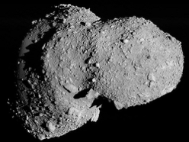
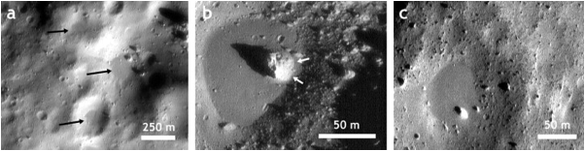
Experiments compliment observational data
Observations of regolith distribution on asteroidal and small moon surfaces
Optical, spectral, thermal measurements used to determine particle sizes on surfaces
Cratering observations and modeling can be used to make predictions about regolith depths
Without sampling, difficult to determine size distribution, distribution with depth
JAXA
JAXA
Dombard et al. 2010

Slide 4
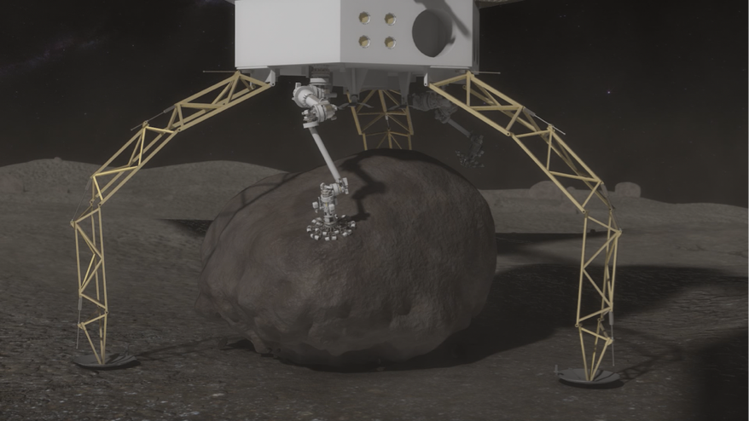
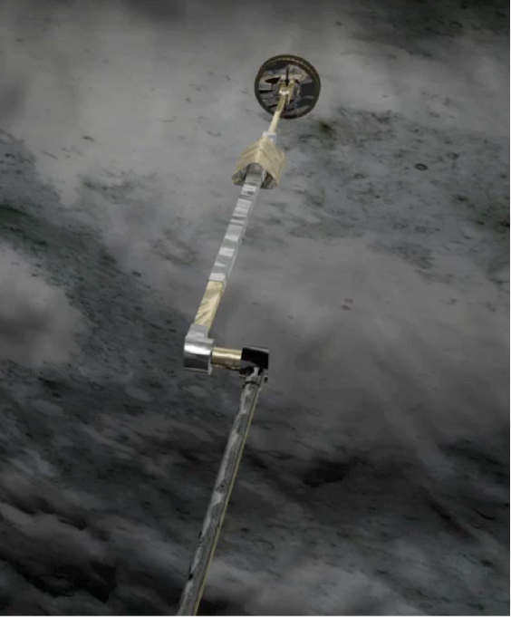
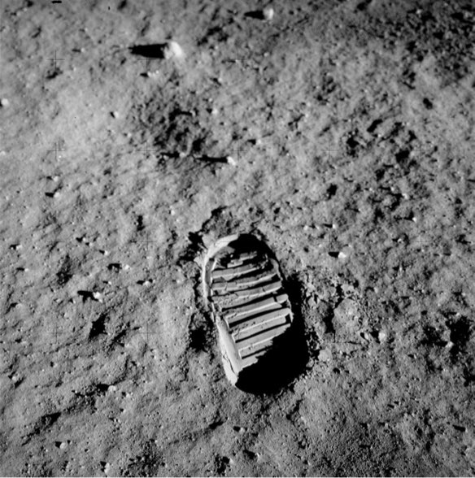
and can be used to drive exploration constraints
Photo Credit: NASA

Slide 5
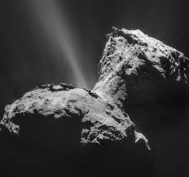
Experiment Plan and Overview
SLOPE will utilize variable gravity environments available on parabolic flights to simulate microgravity environments found on asteroids
We will explore the outcome of a variety of regolith disturbance mechanisms on slope failure in different gravity regimes.
  the flow behavior of granular material along slopes (landslides and avalanches) under reduced-gravity conditions;
  the displacement of granular matter in response to impact-induced seismic vibrations; and
  the responses of regolith to subsurface “jets” or gaseous outflow features, such as those seen on comets and due to rocket exhaust from rendezvous spacecraft.
JAXA
ESA/Rosetta

Slide 6
Organizational Chart
Principal Investigator
Adrienne Dove
Student majors:
Aerospace Engineering
Mechanical Engineering
Physics
Mathematics
Botany
Co-Investigators
Julie Brisset
Joshua Colwell
Graduate Student
Wesley Chambers
Experiment Storage Unit
Jacob Kirstein
Experiment Chambers
Alexandra Yates
Seamus Anderson
Data Collection and Analysis
Jeffery Jorges
Gillian Gomer
Social Media and Outreach
Rachel Hayden

Slide 7
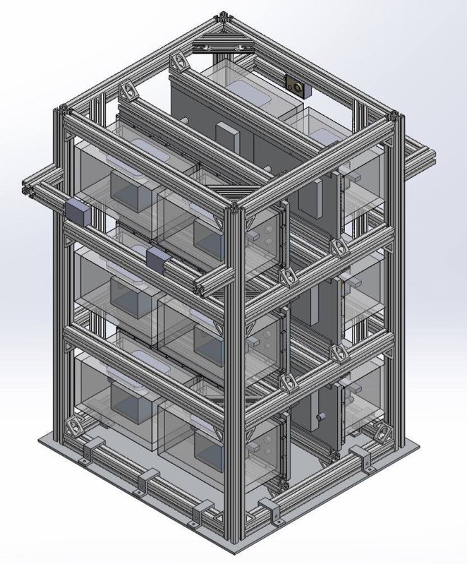
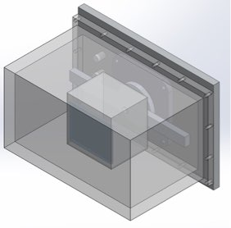
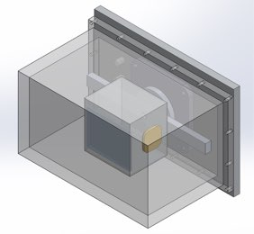
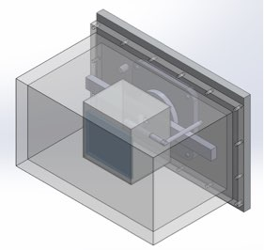
Experiment Design
regolith chambers
avalanche
mechanism
+vibration
+gas injection

Slide 8
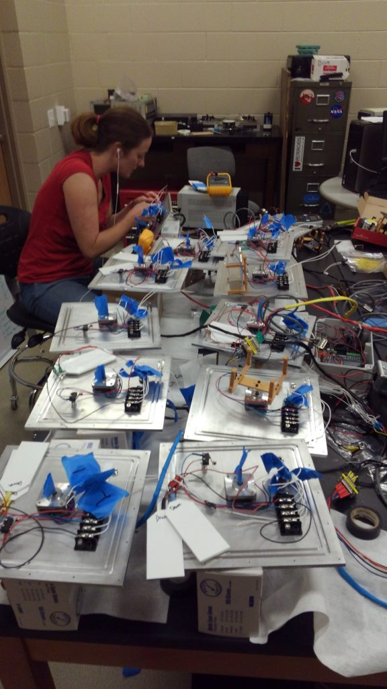
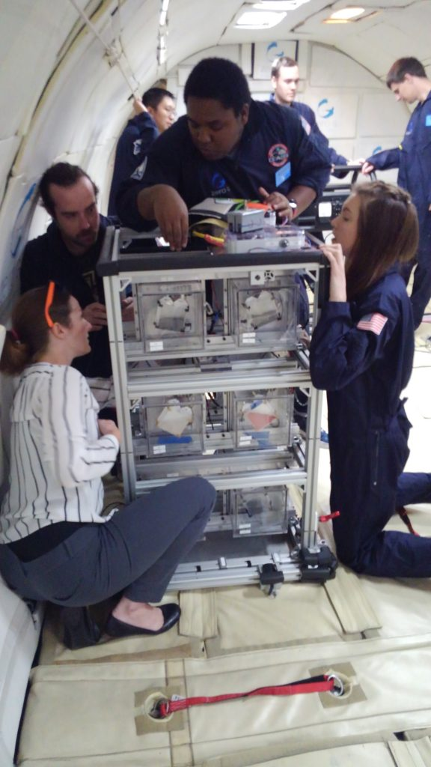
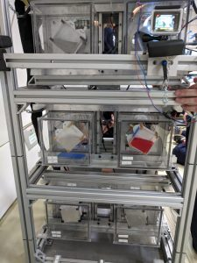
Experiment

Slide 9
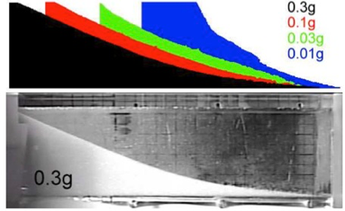
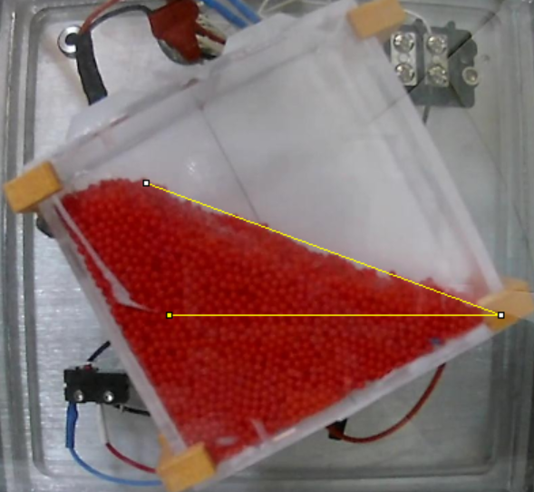
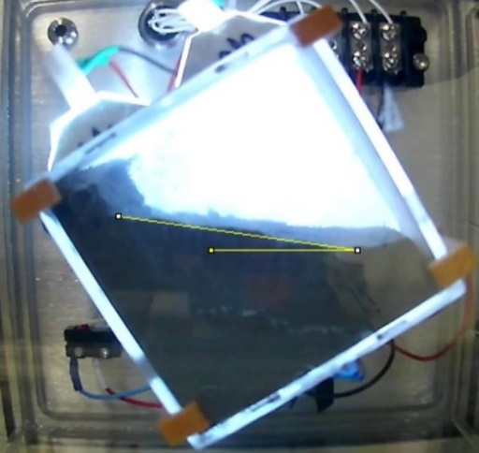
Data and analysis - Background
Previous work indicated that avalanche behavior showed a dependence on g-level
We can use variable g-levels to look at regolith motion due to change in slope, vibration (seismic) effects, and jetting effects.
Hofmeister et al., 2009
Current Slope measurements

Slide 10
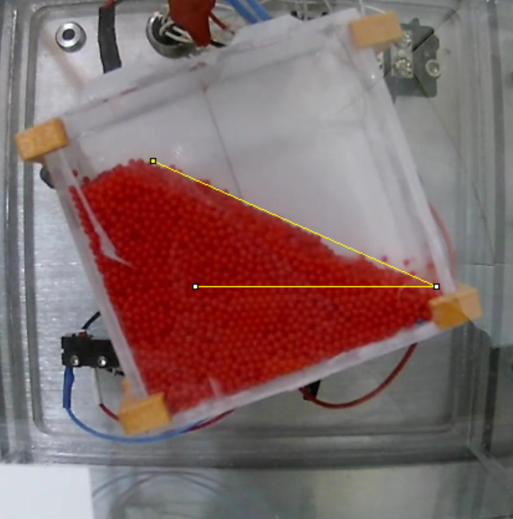
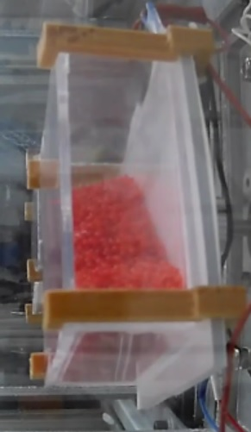
Data Analysis: Slope Detection
Spherical Particles
Image Analysis
  ImageJ (current)
  Python: edge detection after thresholding into B&W images
Front view and side view
Average main slope: 23.923º
Presence of different slopes at top

Slide 11

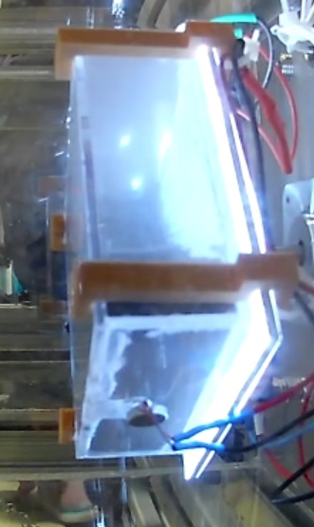
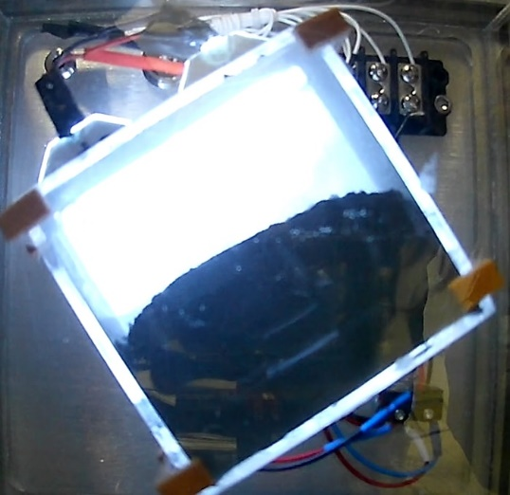
Data Analysis: Slope Detection
Exolith Lab CI Simulant
Slopes seem to maintain through rotation
Presence of different slopes at top and bottom
Blocky feature at top
Incline against white background with different slopes

Slide 12
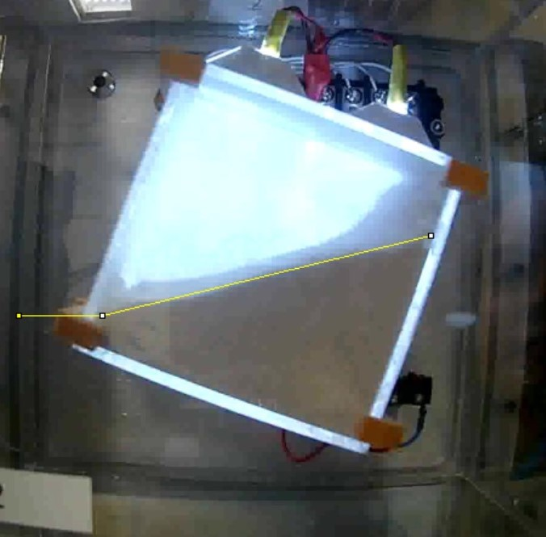
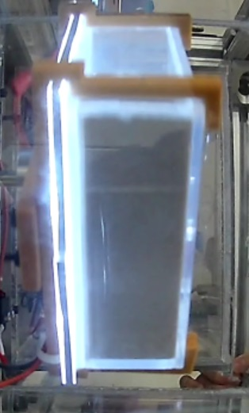
Data Analysis: Slope Detection
Sand
Edge Effect
  No presence of slopes against front face of box
  Incline against white background with different slopes

Slide 13
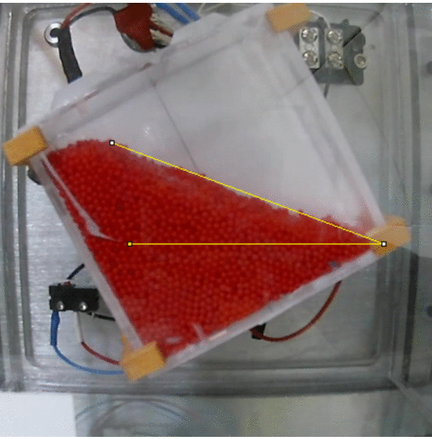
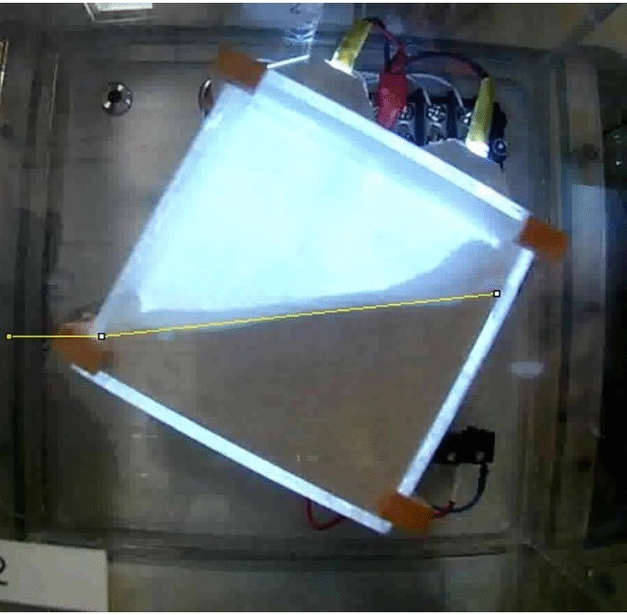
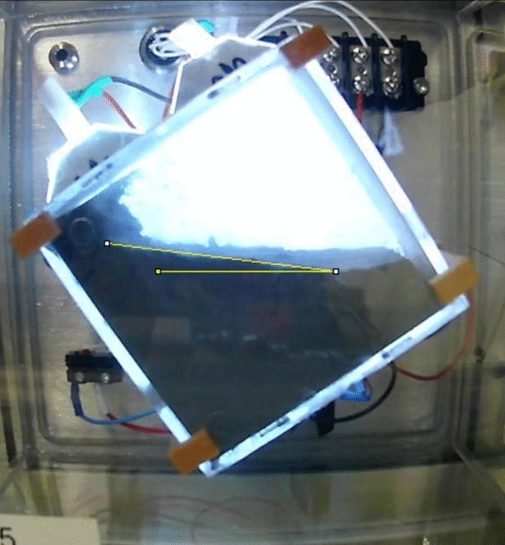
Data Analysis: Slope Comparison

Slide 14
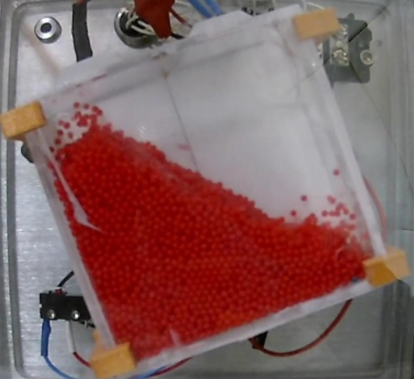
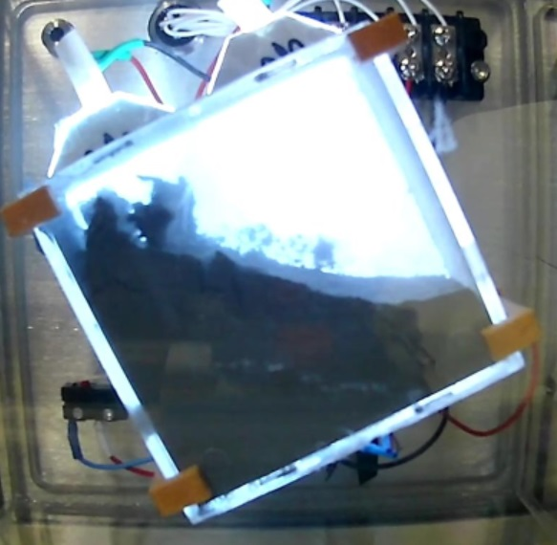
Data Analysis: Negative G
Jumping Beads
Peeling Regolith

Slide 15
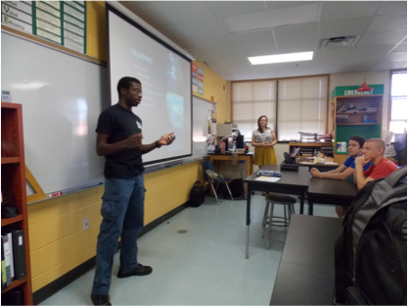
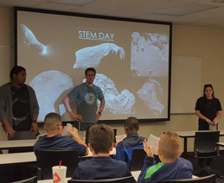
Social Media, Outreach, and Engagement
physics.cos.ucf.edu/microgravity/SLOPE
Blog, Twitter, Instagram, Facebook used to document experiment development.
Presentations to high schools, middle schools, and local clubs.

Slide 16
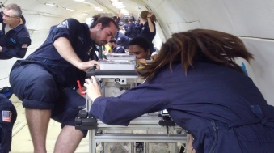
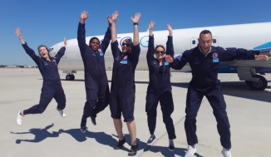
Lessons Learned from This USIP Experience
Students were motivated by sense of ownership of the project - it’s important to (re-)emphasize this throughout
Students were motivated by being able to see project through from start to finish
Students were motivated by unique opportunity.
Interdisciplinary team paid unanticipated dividends.
Student-led experiments can be highly successful, and lead to future flight experiments!

