Slide 1
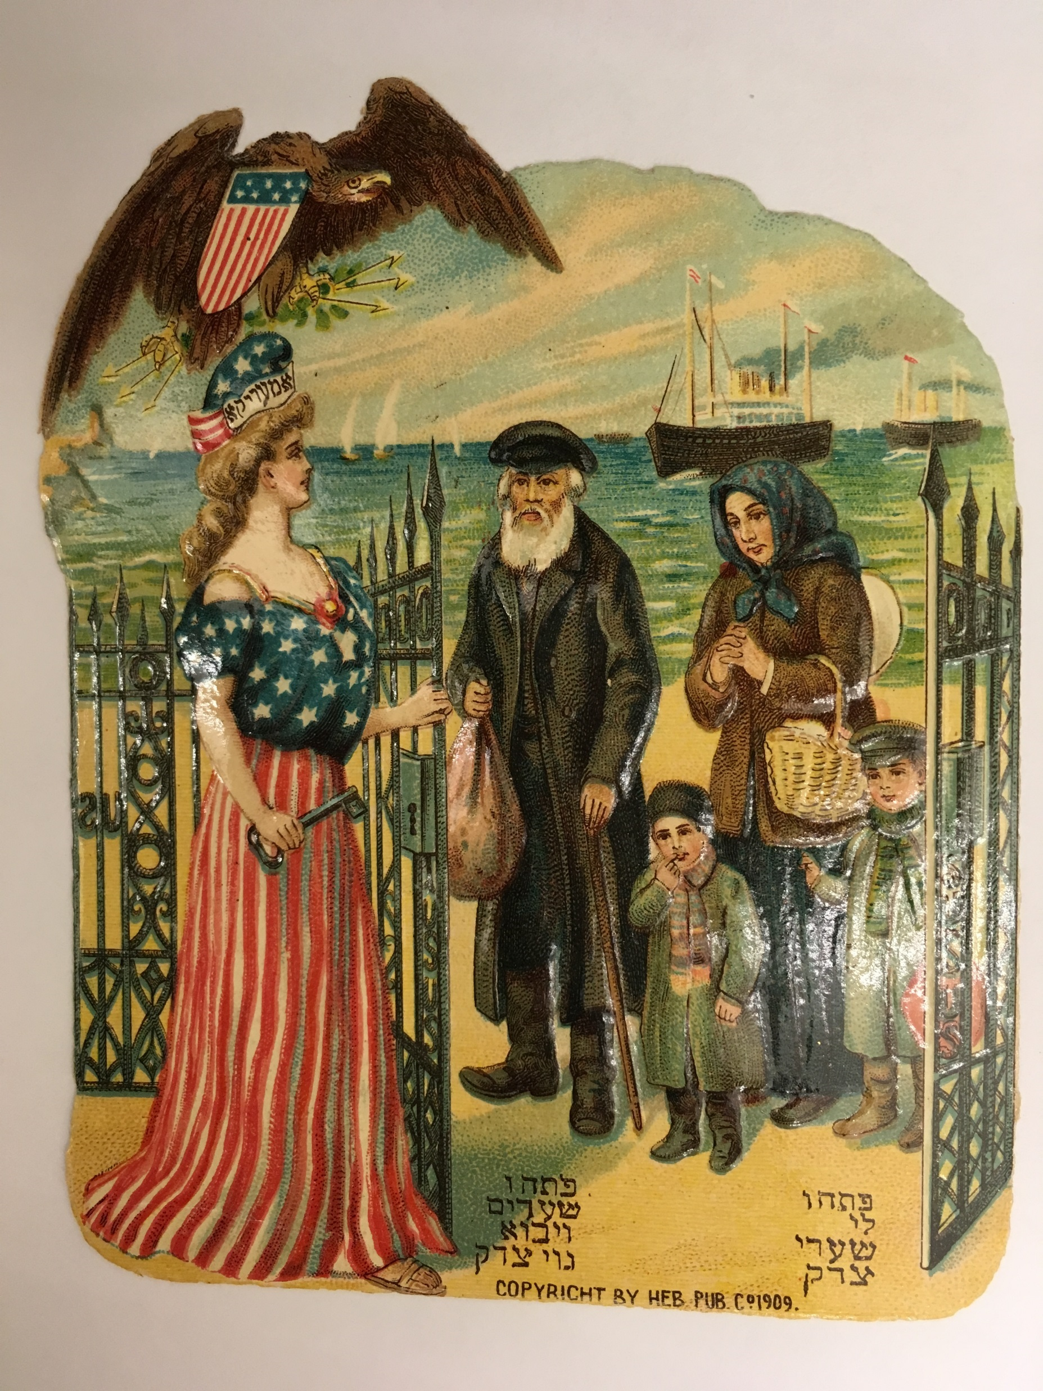
Collection Highlights: American Jewish Immigration Collection
AJL: The Sky’s the Limit
June 21, 2017
Jerry Anne Dickel
Hebraica Catalog Librarian, Yale University
Notes:
The collection was purchased in 2010.
Card (one of 4 from the collection):
Copyright by Heb. Pub. 1909
פִּתְחוּ לִי שַׁעֲרֵי צֶדֶק Psalm 118:19 "Open the gates of righteousness for me"
פִּתְחוּ שְׁעָרִים וְיָבֹא גוֹי צַדִּיק Isaiah 26:2 "Open the gates and let a righteous nation enter"
Very similar picture, published by the Hebrew Immigrant Aid Society, New York, 1909, front page of The Jewish Immigrant, vol. 11. No. 1, January, 1909, with the same biblical quotes

Slide 2
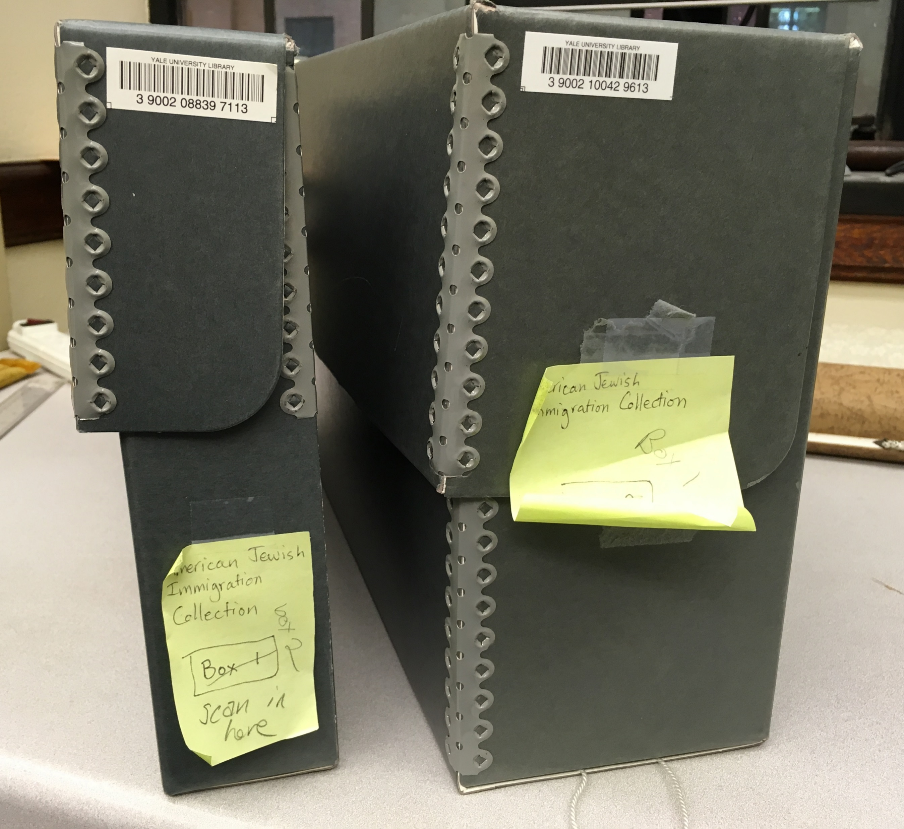
American Jewish Immigration Collection
Correspondence, reports, and other documents concerning Jewish immigration from Eastern Europe and Russia into the United States
  Archives of Louis Levy, President of the Association of Jewish Immigrants in Philadelphia; Joseph Ehrlich, agent for the Association of Jewish Immigrants
Dates covered: 1888-1938
  Bulk of the collection 1888-1918
2 boxes (300+ items)
  Organized chronologically
Notes:
Languages: mostly English, some French, German, and Yiddish, Purchased 2010.
Louis Edward Levy (1846-1919): Chemist, inventor, newspaper editor, published and edited the Philadelphia Evening Herald, the Sunday Mercury and the Jewish Year. With Moses Aaron Dropsie, founded the Association for the Protection of Jewish Immigrants, now HIAS (Hebrew Immigrant Aid Society).
Joseph Ehrlich (1861-): Interpreter in the Immigration Service (1889), agent (1890/91) the Association of Jewish Immigrants / the Protection of Jewish Immigrants, assistant immigrant inspector, (1891), Inspector of Immigrants (1904), Philadelphia
Charitable organizations, such as The United Hebrew Charities of New York (1874 – coordinate relief and charitable work of several independent groups in NYC), the Hebrew Emigrant Aid Society (1881, NYC ) received financial support from the Baron de Hirsch Fund.
The peak years of Jewish migration lie between 1881 and 1914, when approximately 2 ½ million Jews crossed national borders. The mass immigration was ended by the adoption of restrictive quota legislation by the American government in 1921 and, with greater stringency, 1924.

Slide 3
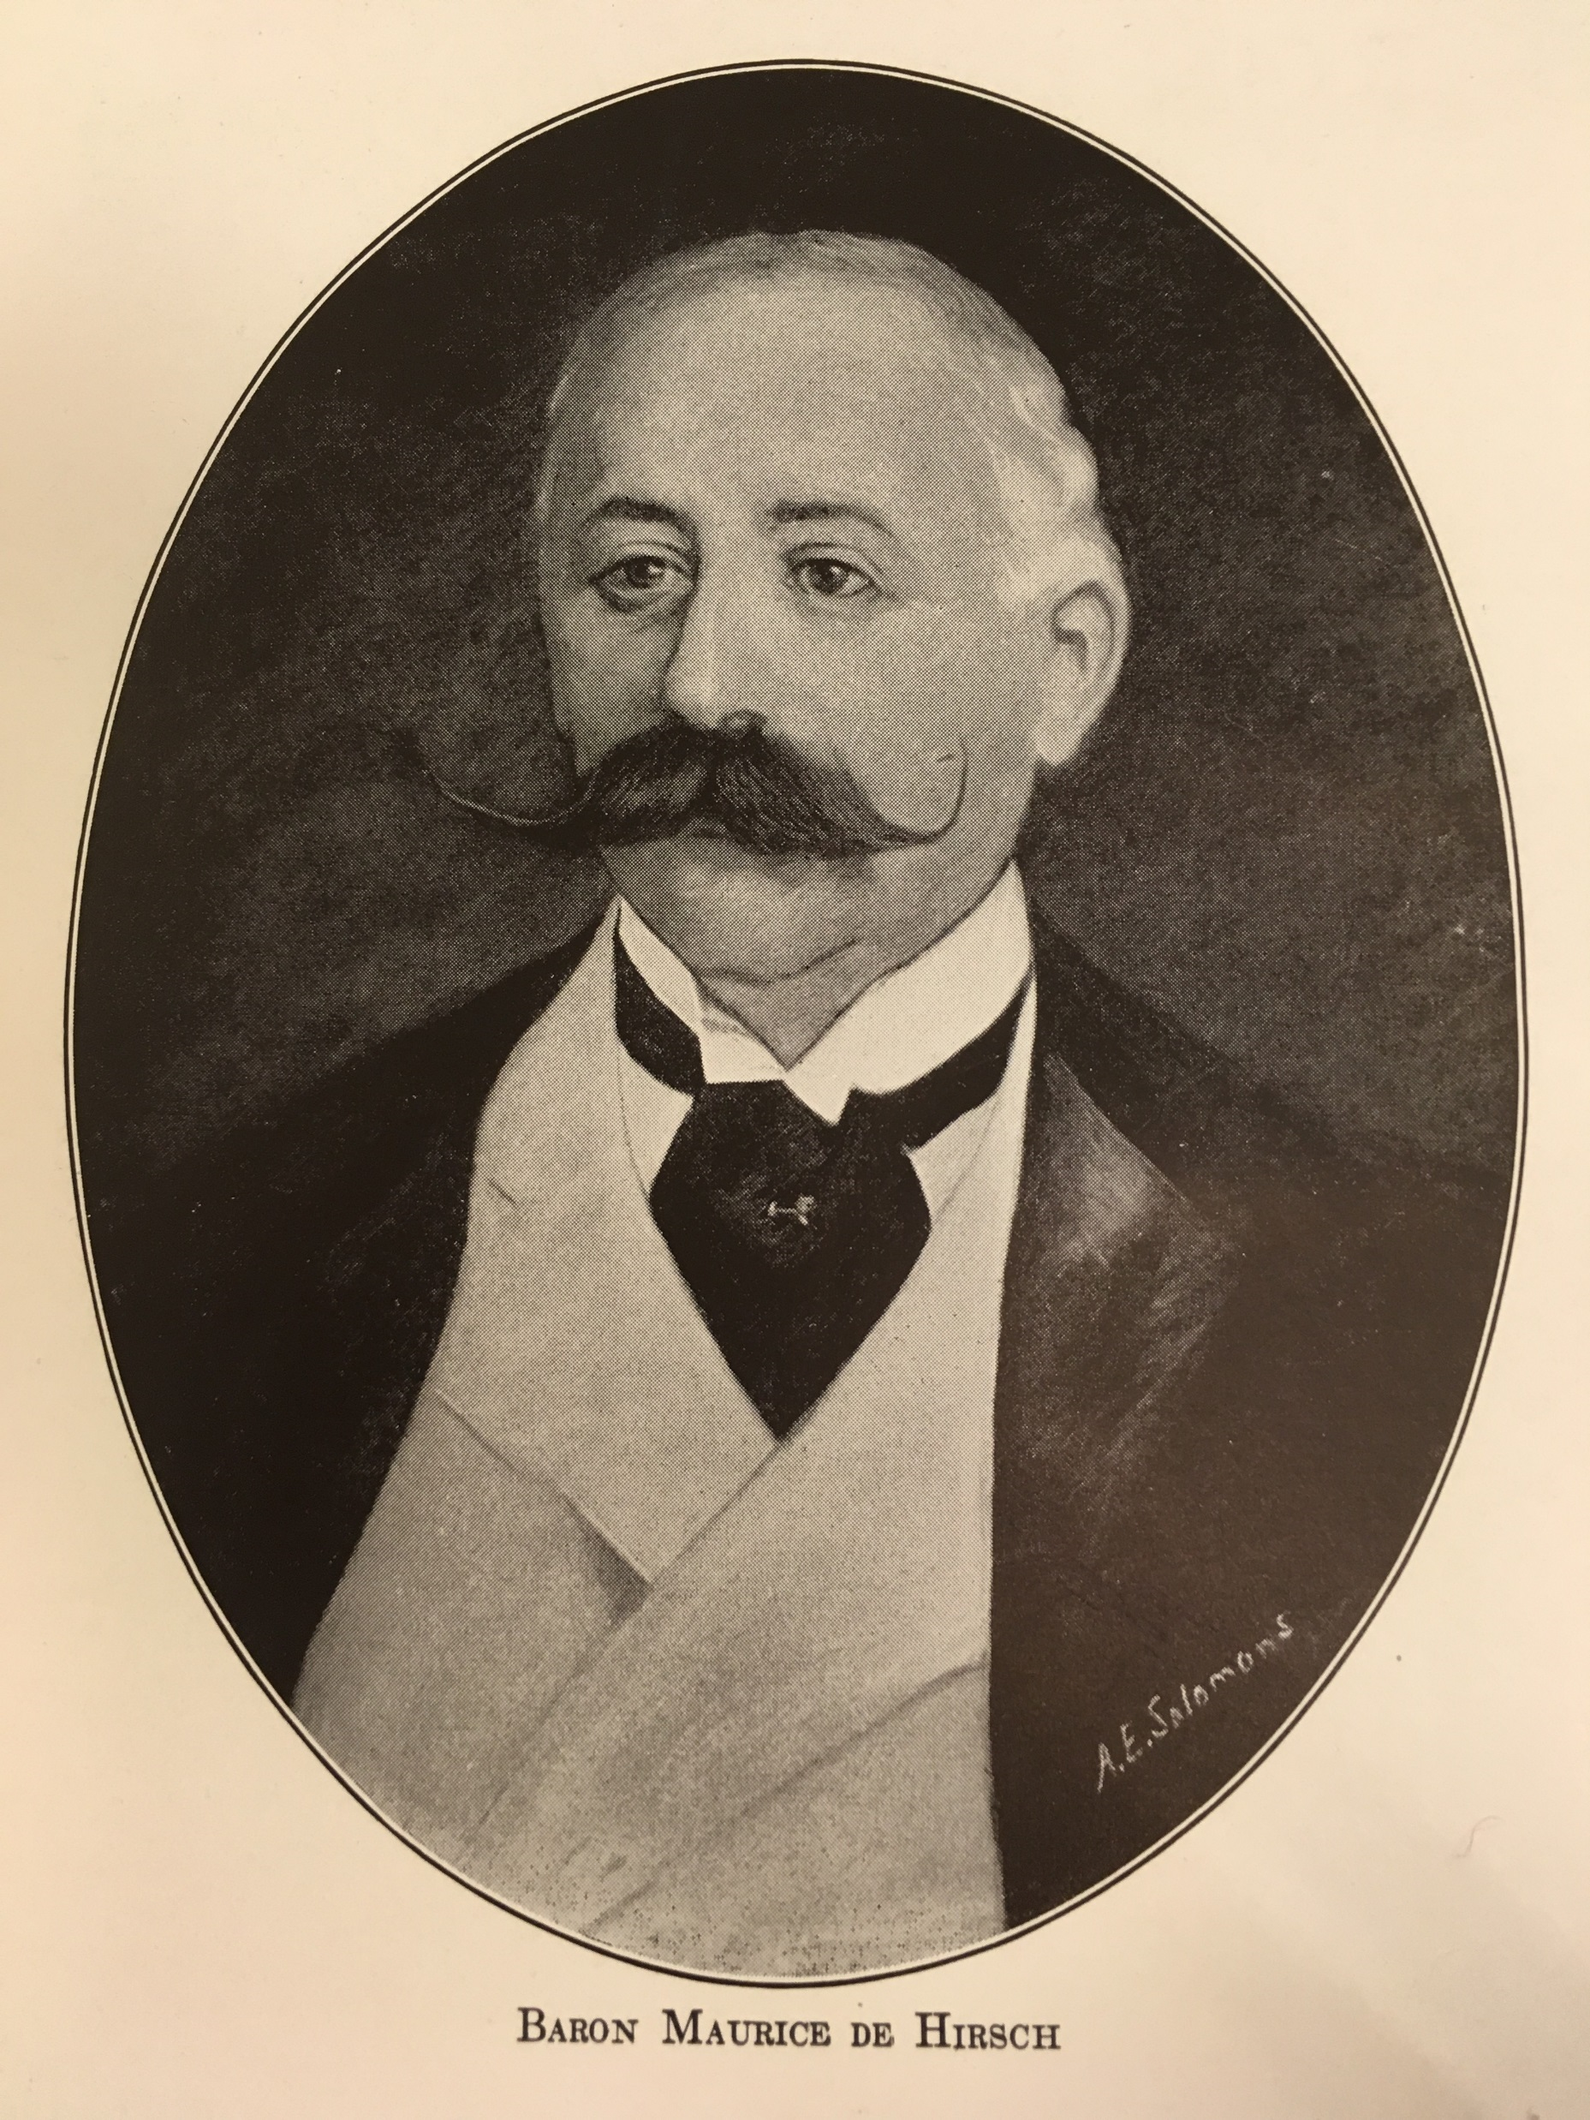
Baron de Hirsch (1831-1896)
The solution to Jewish oppression in Russia was emigration.
  Pogroms (1881 and following)
  "Temporary Laws" of May 1882, and other oppressive measures
  Conscription
The Baron de Hirsch Fund
  Incorporation, 1891, NYC.
  $2.4 million capital
Notes:
Documents relating to the establishing of the Baron de Hirsch Fund.
Image from History of the Baron de Hirsch Fund: the Americanization of the Jewish Immigrant, by Samuel Joseph, 1935.
Baron Maurice de Hirsch, a Jewish-German financier and philanthropist dedicated his fortune to the welfare of Eastern European Jews at a time when worsening conditions in Russia made mass emigration a necessity. Hirsch's estate, estimated at $100 million by 1890, resulted from his pioneer enterprises in the sugar and copper industries and management of the Turkish railway, which linked Constantinople to Europe.
He envisioned an organized, orderly transplantation of Russian Jews, who would become “farmers and also as handicraftsmen, in those lands where the laws and religious tolerance permit them to carry on the struggle for existence as noble and responsible subjects of a humane government.”—”My Views on Philanthropy”, Baron de Hirsch, North American Review, No. 416, July 1891. [History of the Baron de Hirsch Fund: the Americanization of the Jewish Immigrant / Samuel Joseph. Baron de Hirsch Fund, c1935.
On March 13, 1890, the formal meeting of the organization took place, 9 men were chosen as the Central Committee and as Trustees of the Baron de Hirsch Fund. The Baron sent $10,000 monthly until March 1891 when the capital of the Fund would be made available.

Slide 4
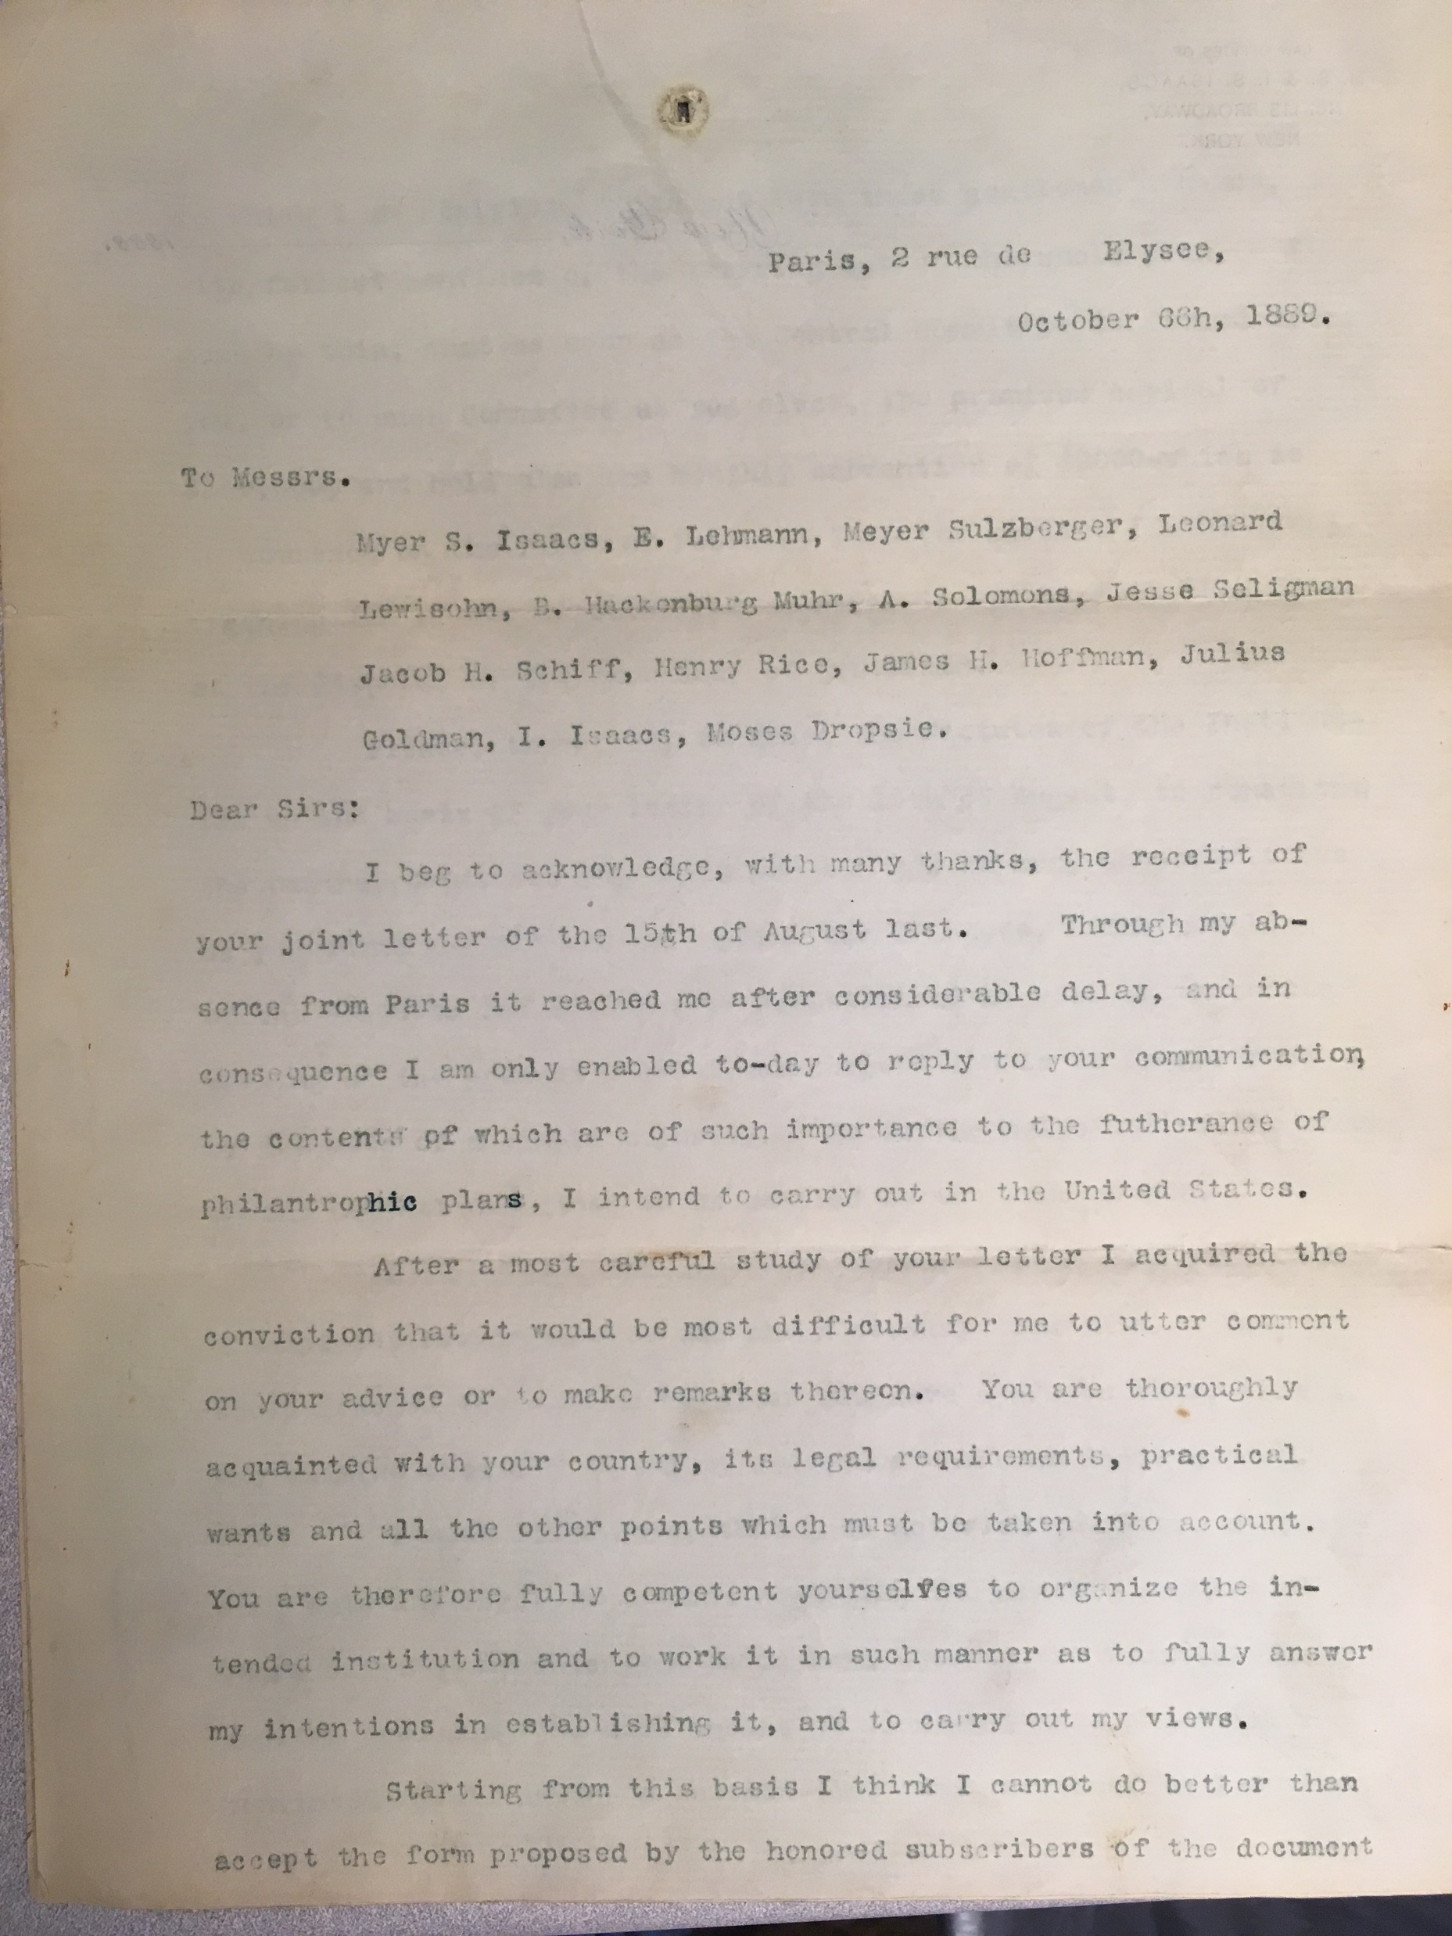
Letter from Hirsch dated 1889
Post scriptum:
I make no doubt that you understood from the outset that my trust is exclusively for the benefit of the Russian Jews in the first place, and of the Roumanian Jews in the second, and that you took this point into account, as I never had any other object in view. … My point of view will be, I am sure, quite inteligible to you, Gentlemen. It is the very poorest of our brethren which I wish to benefit and there cannot be any doubt that the misery of the Jews in both Russia and Roumania is the most cruel, and there they cannot fight for their existence under the hard special laws in those countries. While in other parts of Europe they are not so hardly oppressed.
Notes:
Addressed to Myer S. Isaacs, E. Lehmann, Meyer Sulzberger, Leonard Lewisohn, B. Hackenburg, [S.] Muhr, A. Solomons, Jesse Seligman, Jacob H. Schiff, Henry Rice, James H. Hoffman, Julius Goldman, I. Isaacs, Moses Dropsie
-- Jewish leaders who met together to plan how such a fund could best be used.
The letter has hand written corrections and so appears to be a draft, or a copy of a draft.

Slide 5
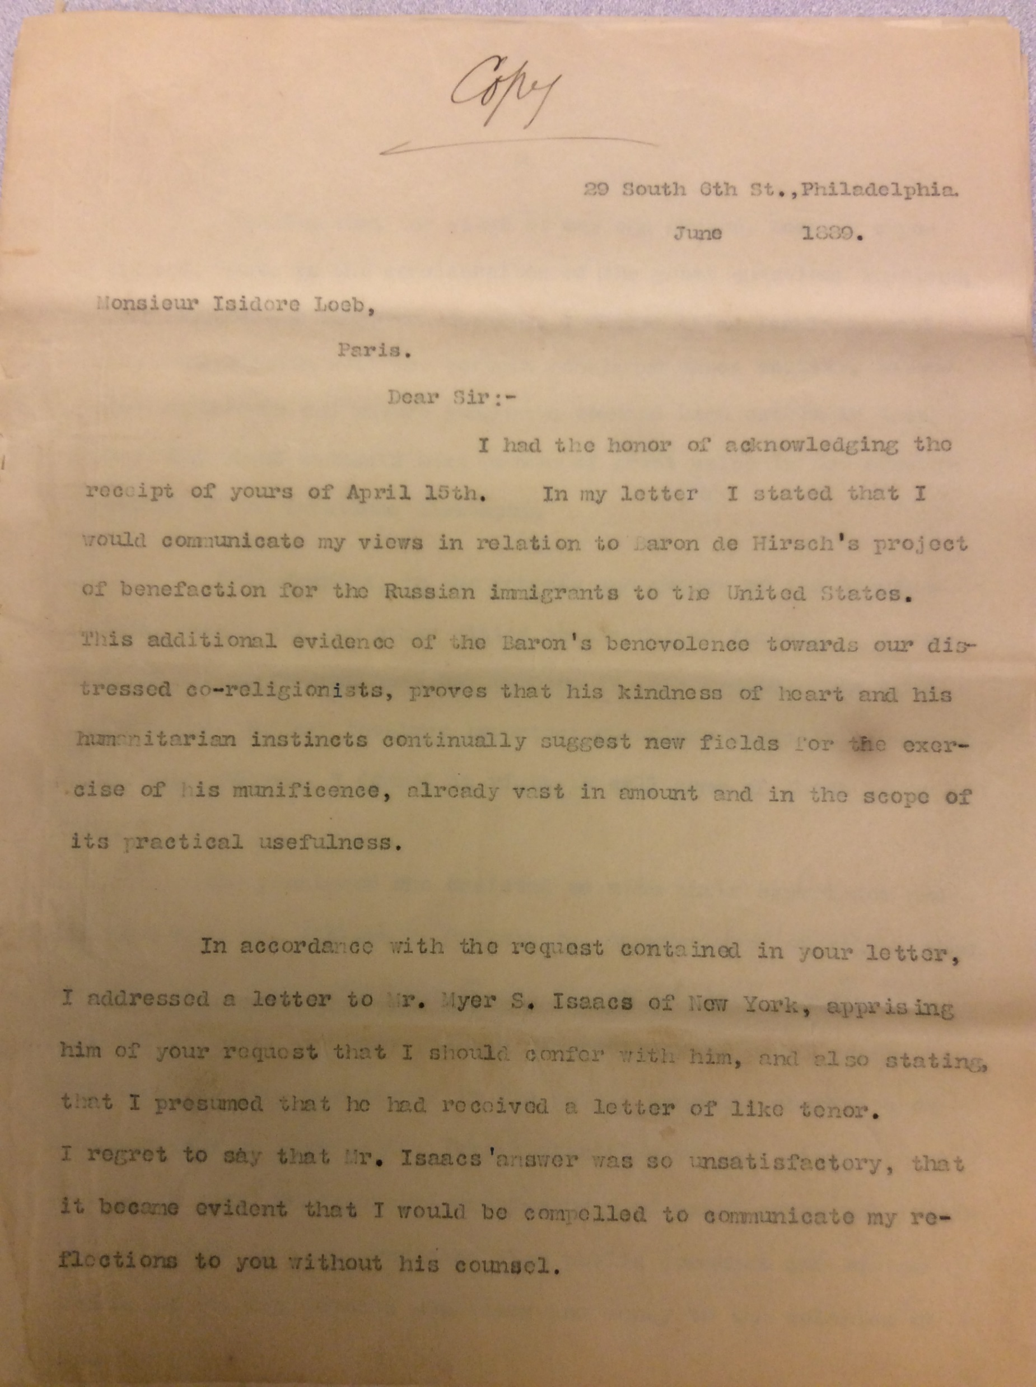
Letter from Moses A. Dropsie to Isidore Loeb, 1889
Suggestions on how the Baron de Hirsch fund should be utilized:
  The objects of such help should be:
  To give to certain worthy persons enough to commence a little business or trade, or to help them and their children to learn trades.
  To aid other persons of the same kind by loans to effect the same purpose.
  To help persons who are capable of only the simpler and ill-paid forms of labor to become fitted for better paid employments.
  To help children of such persons to learn trades for which they are adapted.
  To give to working immigrants and their children opportunities to learn the English language and other necessary elementary subjects at times after their labor ceases- so that they may add to their earning powers by increased adaptation to environing circumstances.
  To help persons already established in agricultural, mechanical or other labor by loans or gifts so as to convert their struggling existence into one of permanent success.
Opposition to using the fund to establish exclusively Jewish agricultural colonies or Jewish manufacturing enterprises.
Notes:
The letter is a copy, with some hand written editing.
Moses Aaron Dropsie (1821-1905), was a lawyer, charter member and an officer of the Hebrew Education Society of Philadelphia. He was president in 1889 when this letter was written.
Isidore Loeb (1839-: secretary of the Alliance Israelite Universelle (כל ישראל חברים), founded in 1860, by Adolphe Crémieux.
South NJ Colonies: Alliance (1882-1883), Rosenhayn and Carmel (1882), Woodbine (1891). By the 1890s, the colonies were funded substantially by Baron de Hirsch.
the Woodbine Colony in southern New Jersey (1891-1940)

Slide 6
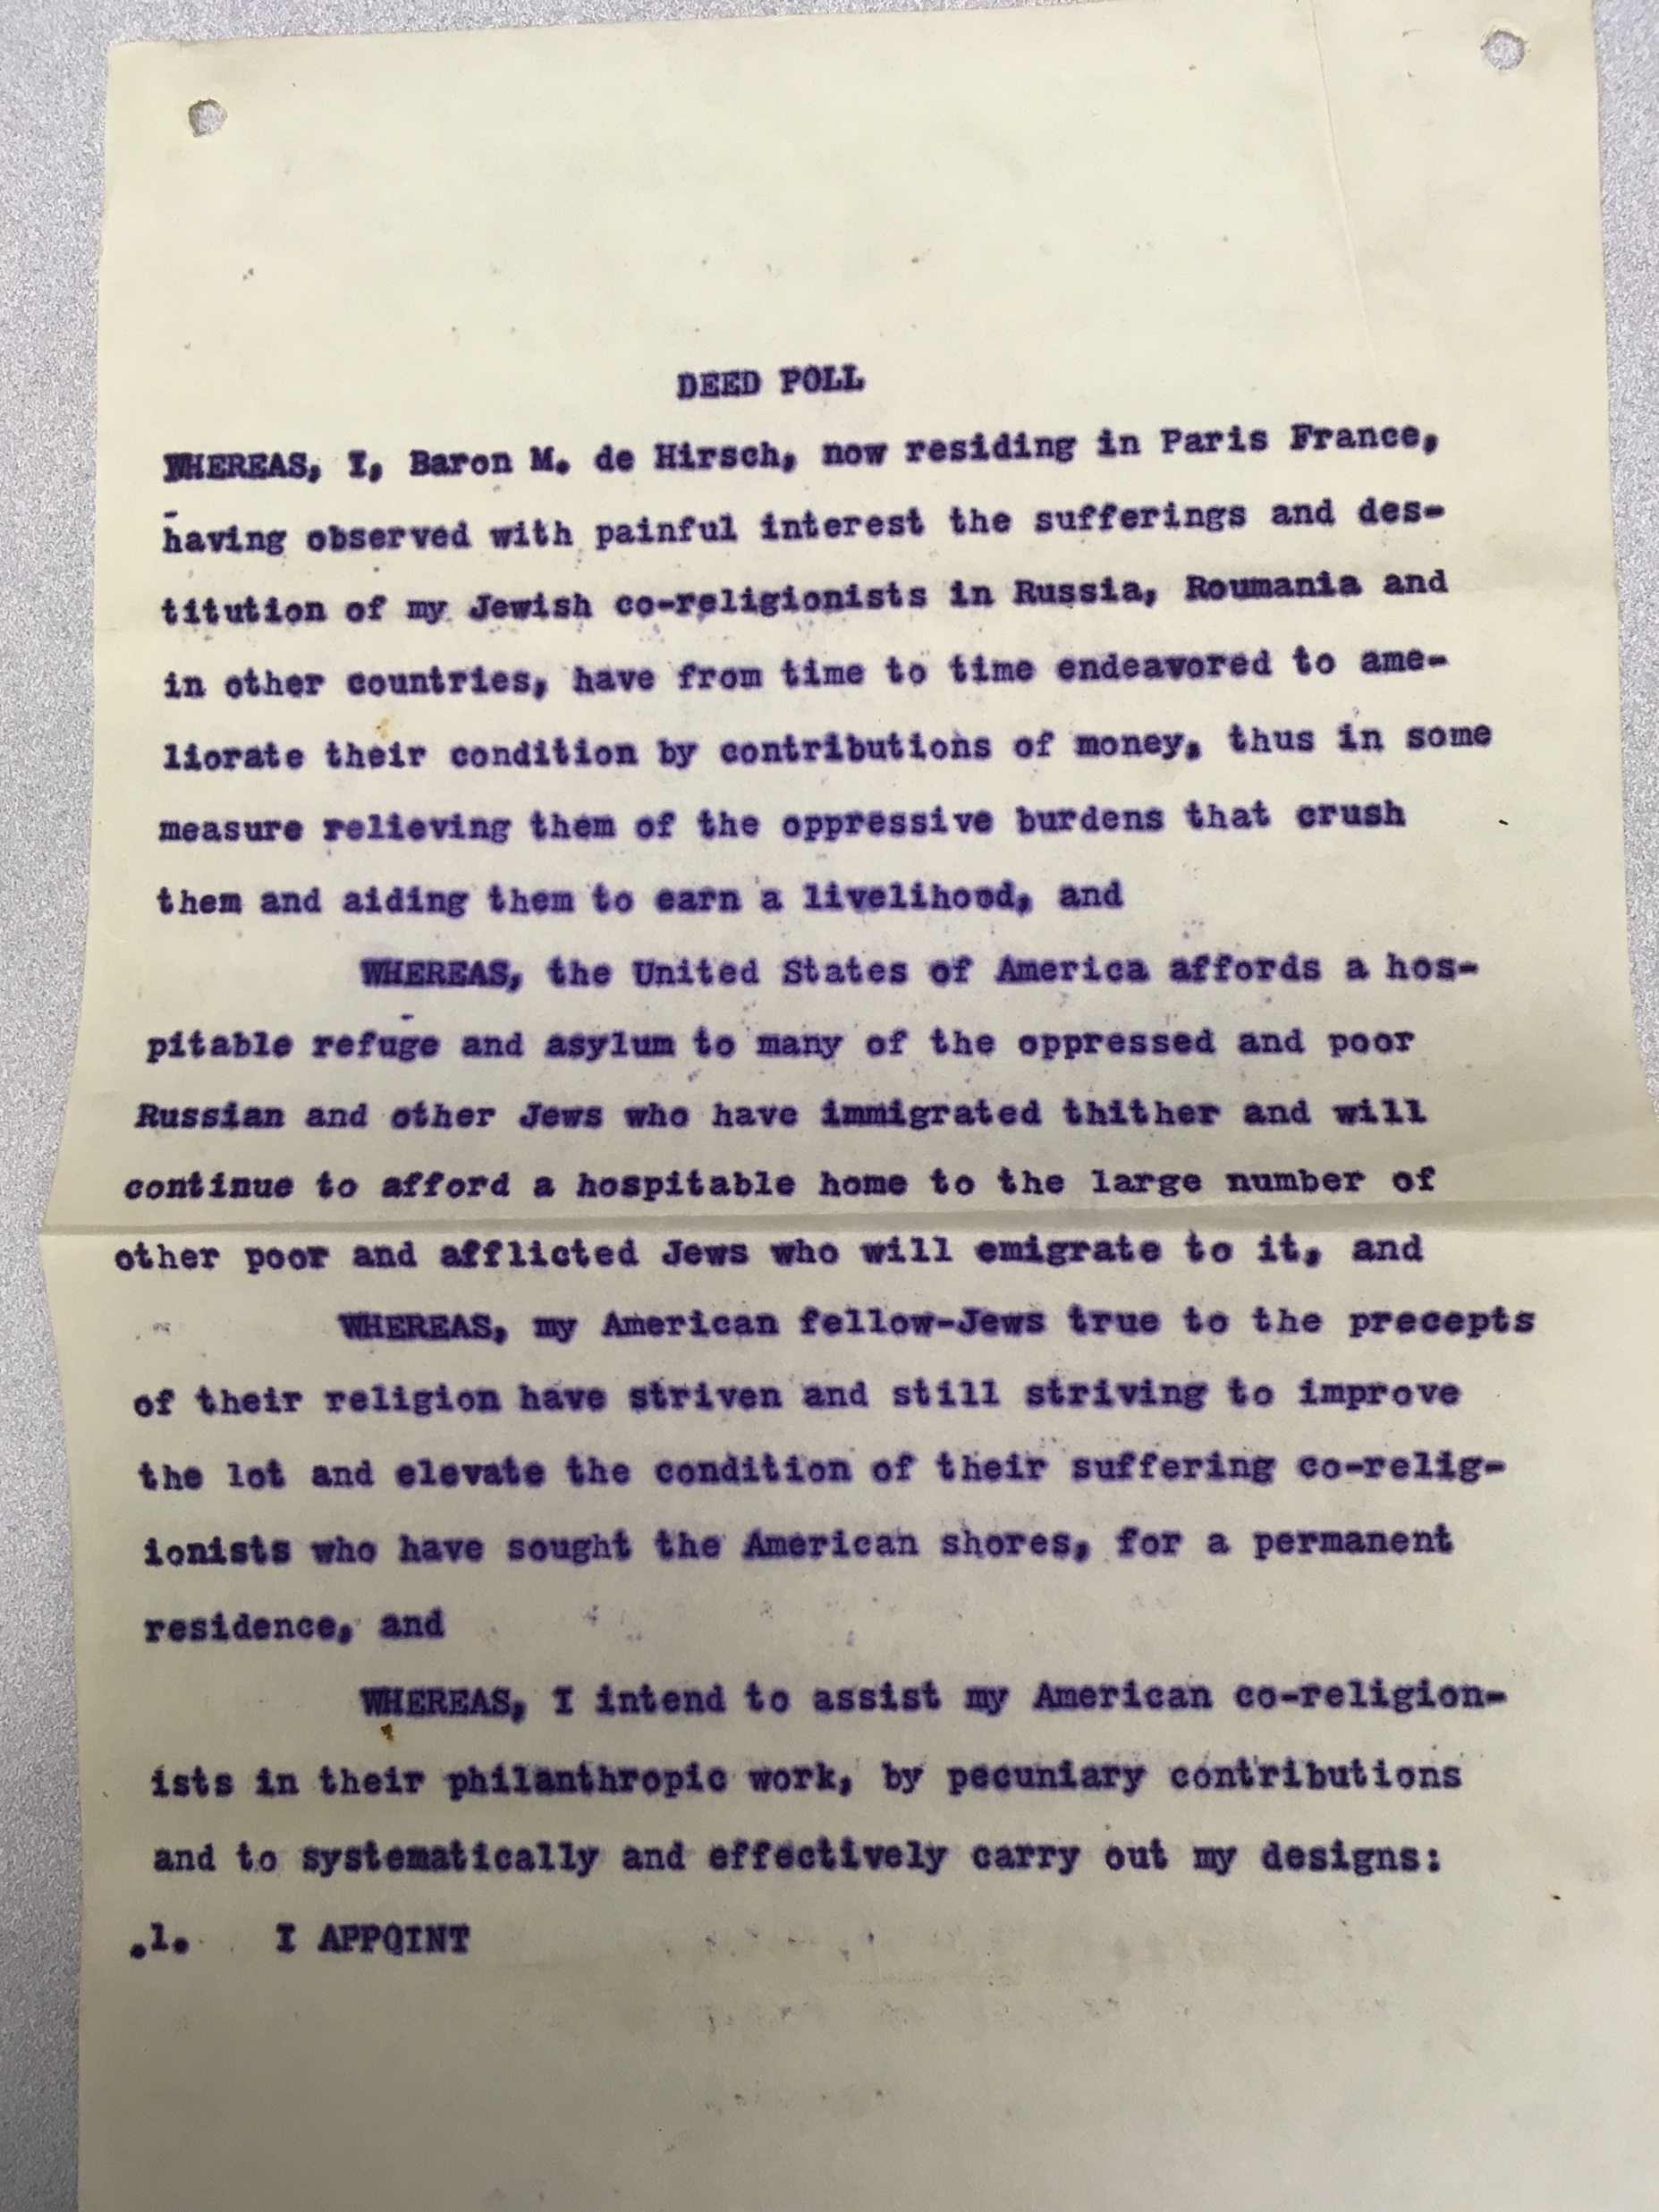
Notes:
Copy of the Deed of Trust of the Baron de Hirsch Fund, [incorporated 1891]
the Jewish Colonization Association, 1891 (J.C.A.) -- secured concession from the Russian government legalizing the departure of Jews from the country.

Slide 7
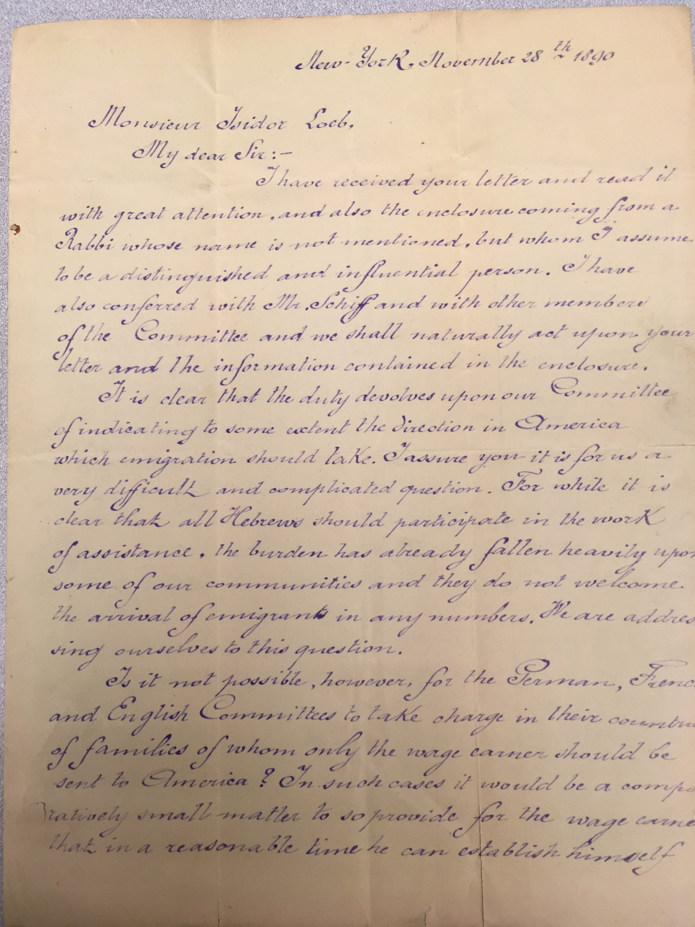
Letter from Myer S. Isaacs to Isidor Loeb, 1890
“Is it not possible for the German, French, and English Committees to take charge in their countries of families of whom only the wage earner should be sent to America?
“The classes recommended will include: 1st: -Skilled laborers. 2nd:-Young men able and willing to endure the struggles of life until they can accumulate savings. 3rd:-Fathers of small families who understand farming or have trade, and who can, if practicable, leave their families in Europe until they have located in America and saved something with which to bring out their families.”
Notes:
New York, November 28th 1890
Myer S. Isaacs: a judge, conducted negotiations with the European committees on behalf of the American committee
Attempt to decrease the numbers of immigrants to a more manageable size – so that the available funds could help more individuals; so that large numbers of Jewish immigrants unable to support themselves would not lead to an increase in anti-immigration agitation or anti-Semitism in the US

Slide 8
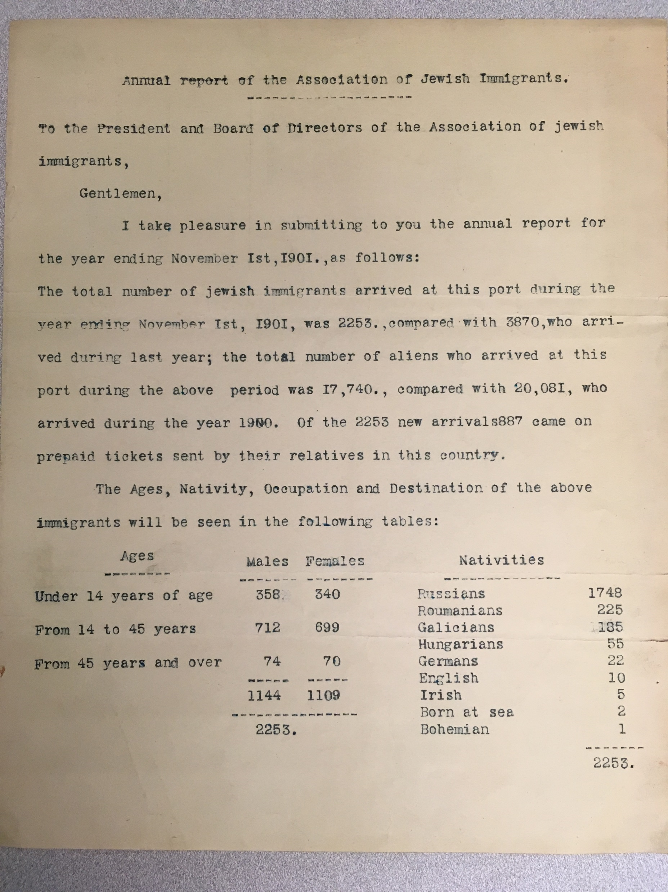
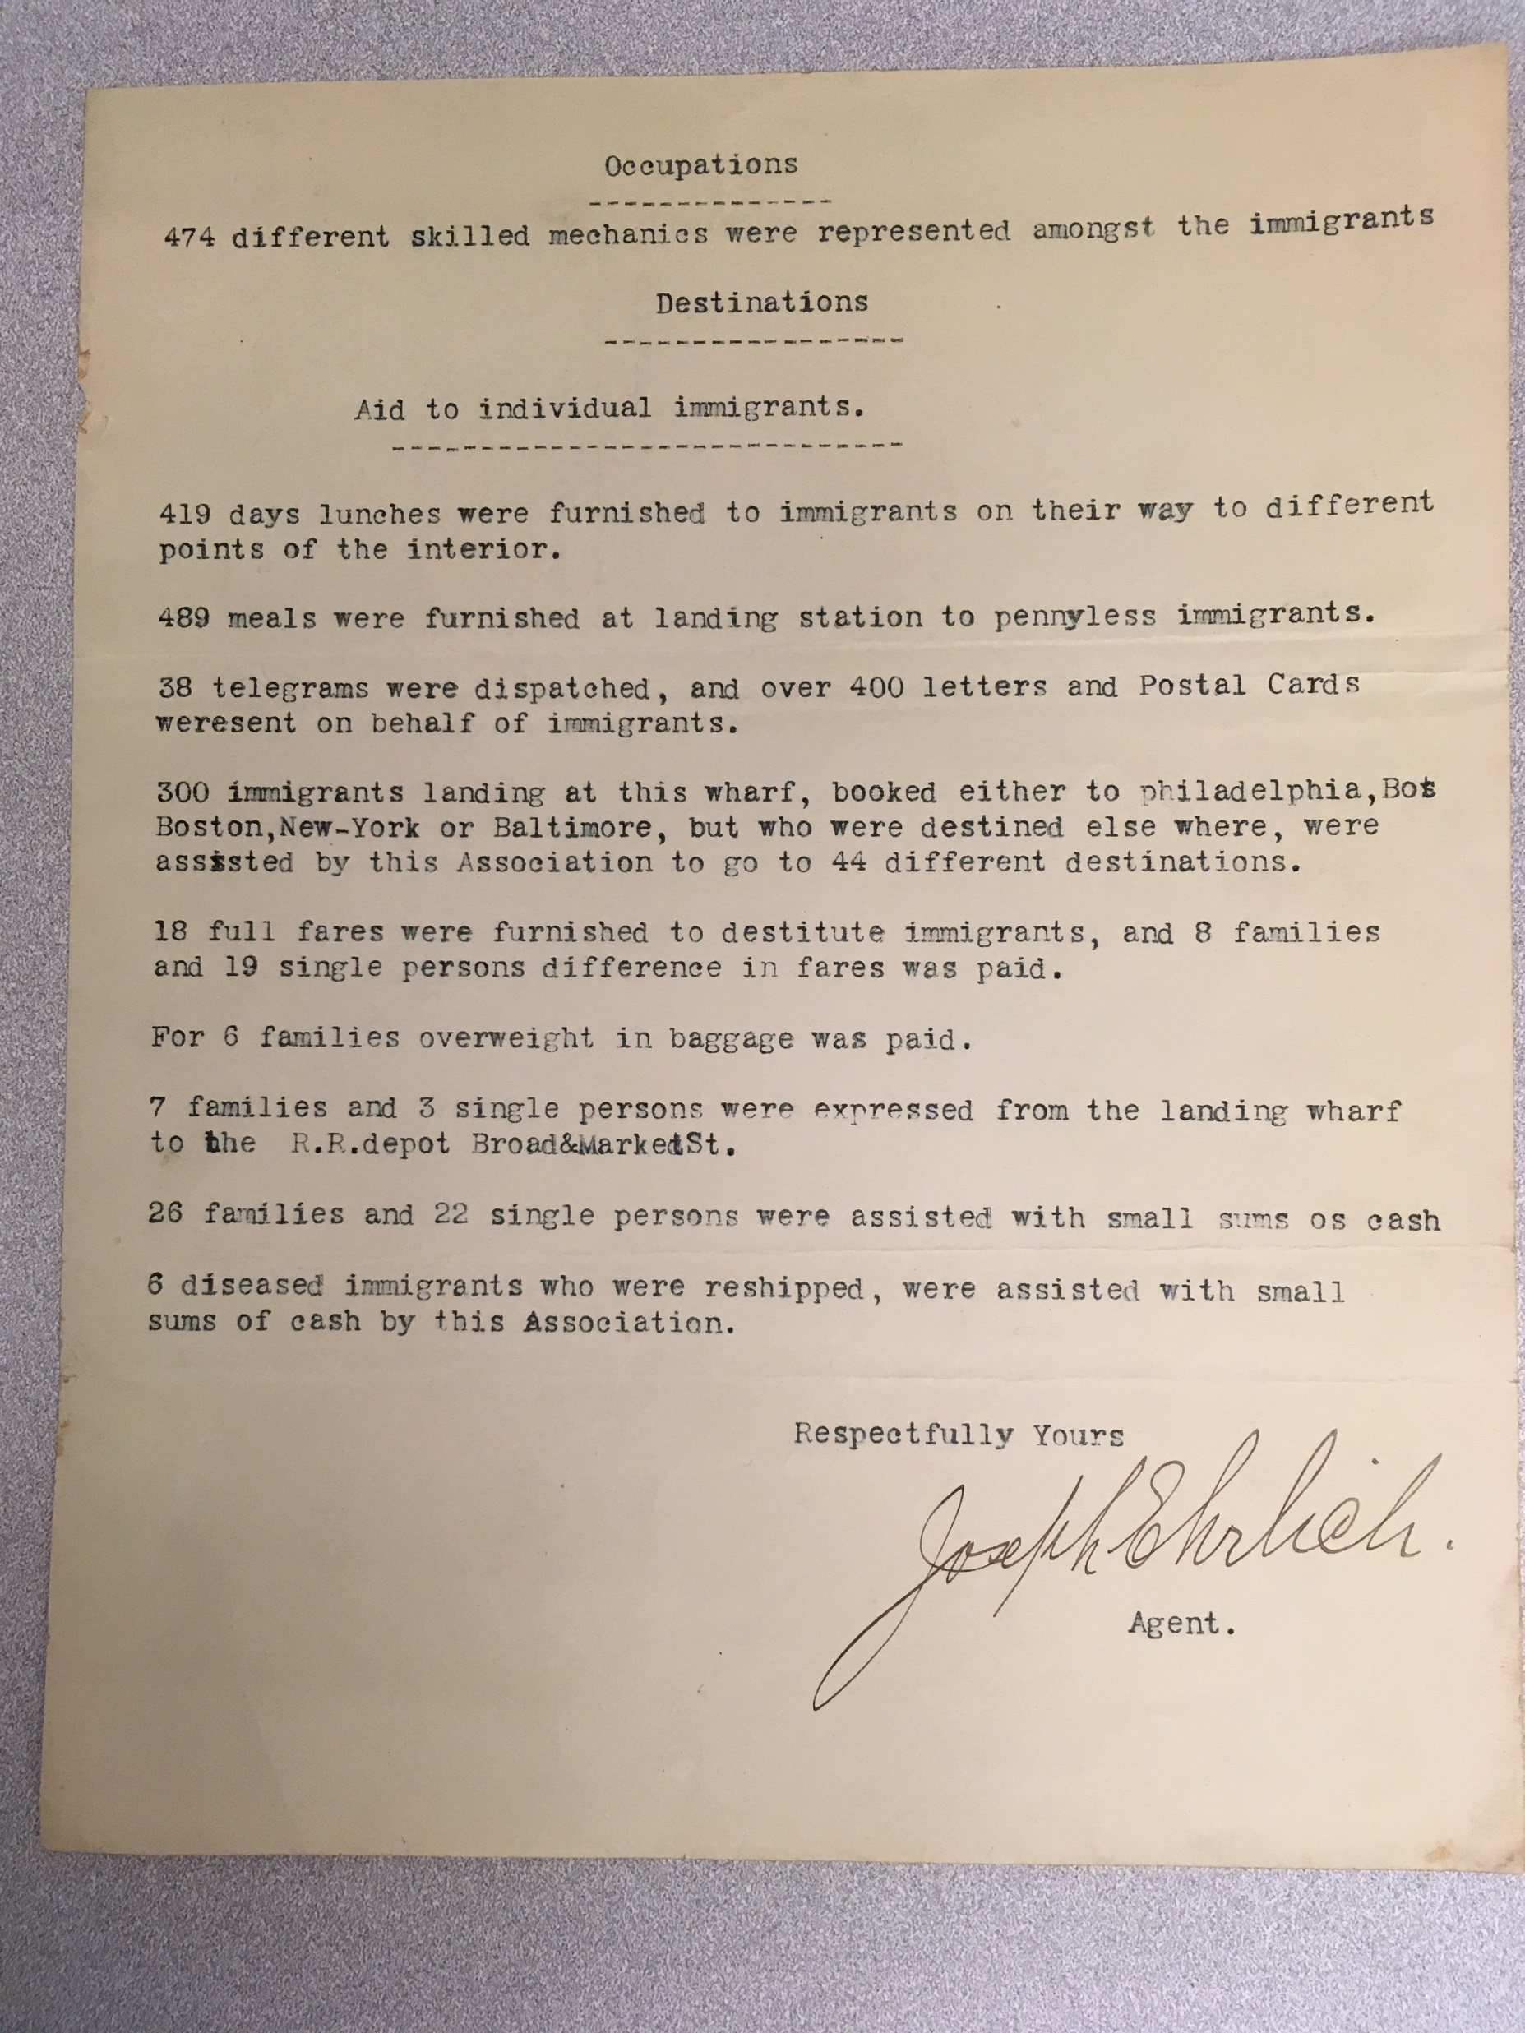
Annual report of the Association of Jewish Immigrants, by Joseph Erhlich, 1901
Notes:
The collection includes many reports on the activities of charitable organizations, and on immigration statistics – numbers of immigrants, countries of origin, sometimes occupations.

Slide 9
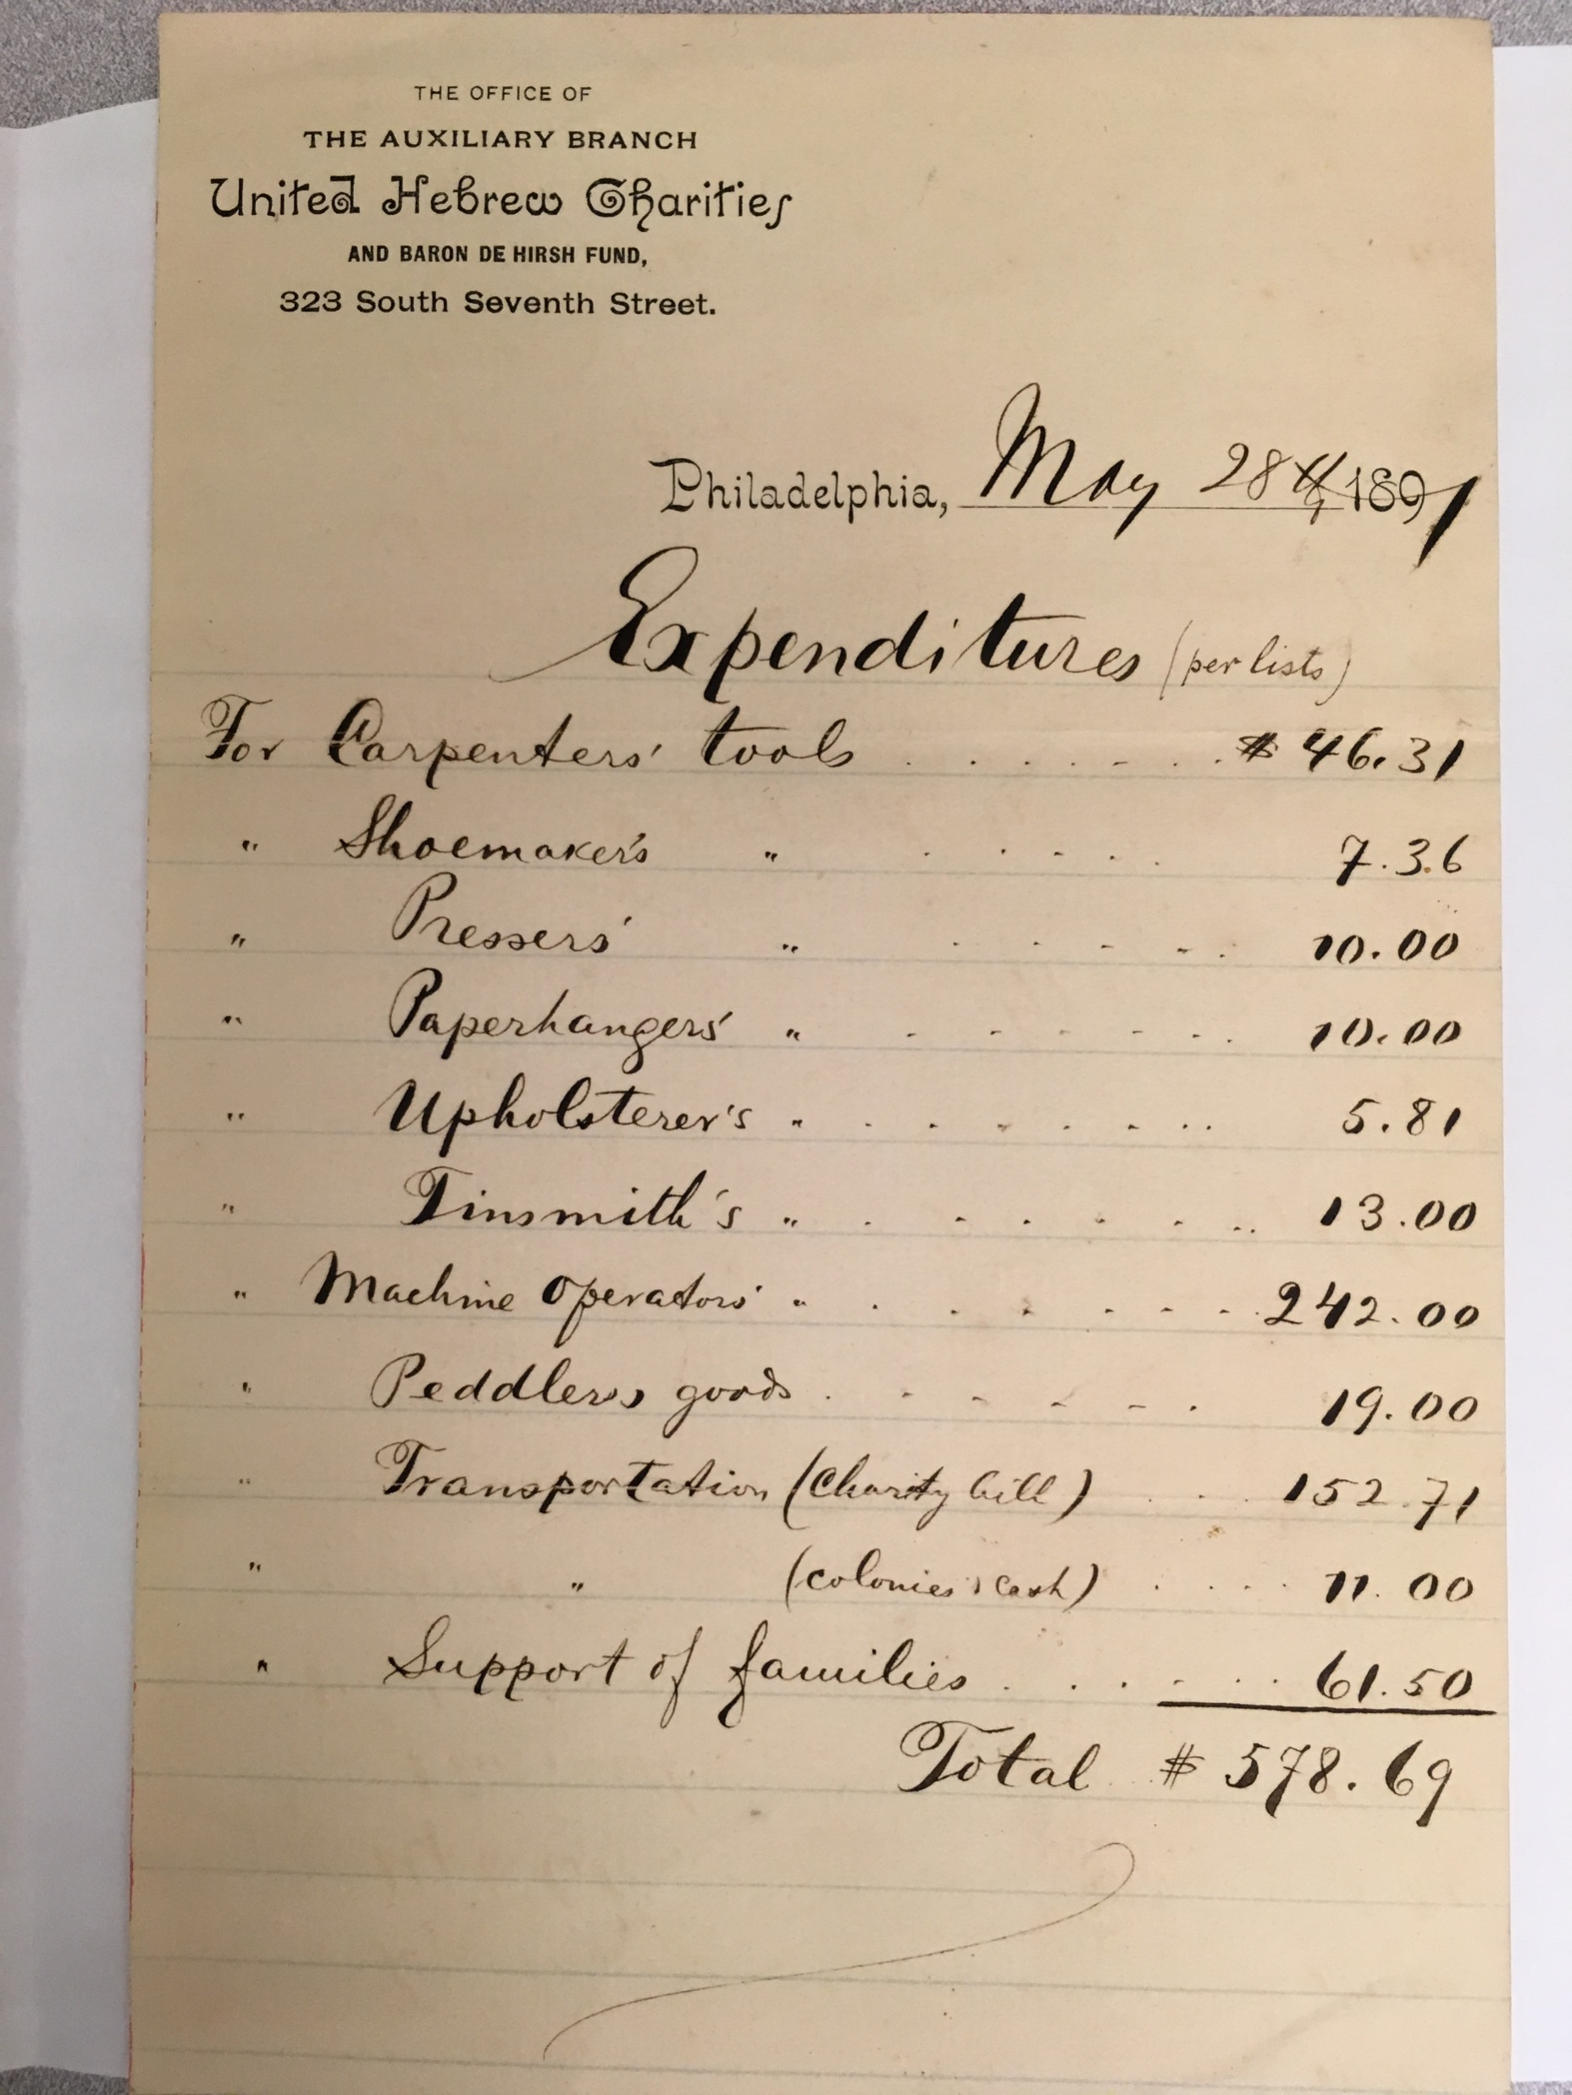
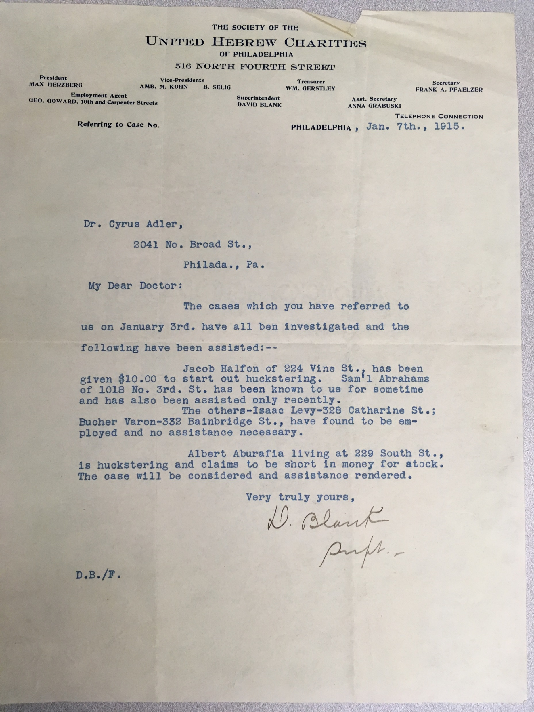
Notes:
Expenditures to aid immigrants (1891):
Tools for various trades
Peddler’s Goods
Transportation
Financial support
1915: Jacob Halfon, $10.00 to start out huckstering …
Services provided by the organizations included translation services, guidance, advocacy to prevent deportations at Castle Garden, then Ellis Island, and other ports of entry (agents), obtaining bonds to guarantee employable status, lending money for the landing fee, finding relatives of detained immigrants. Transportation to areas with better employment opportunities or to where relatives where living who were willing to help the new immigrant.
LPC likely to become a public charge

Slide 10
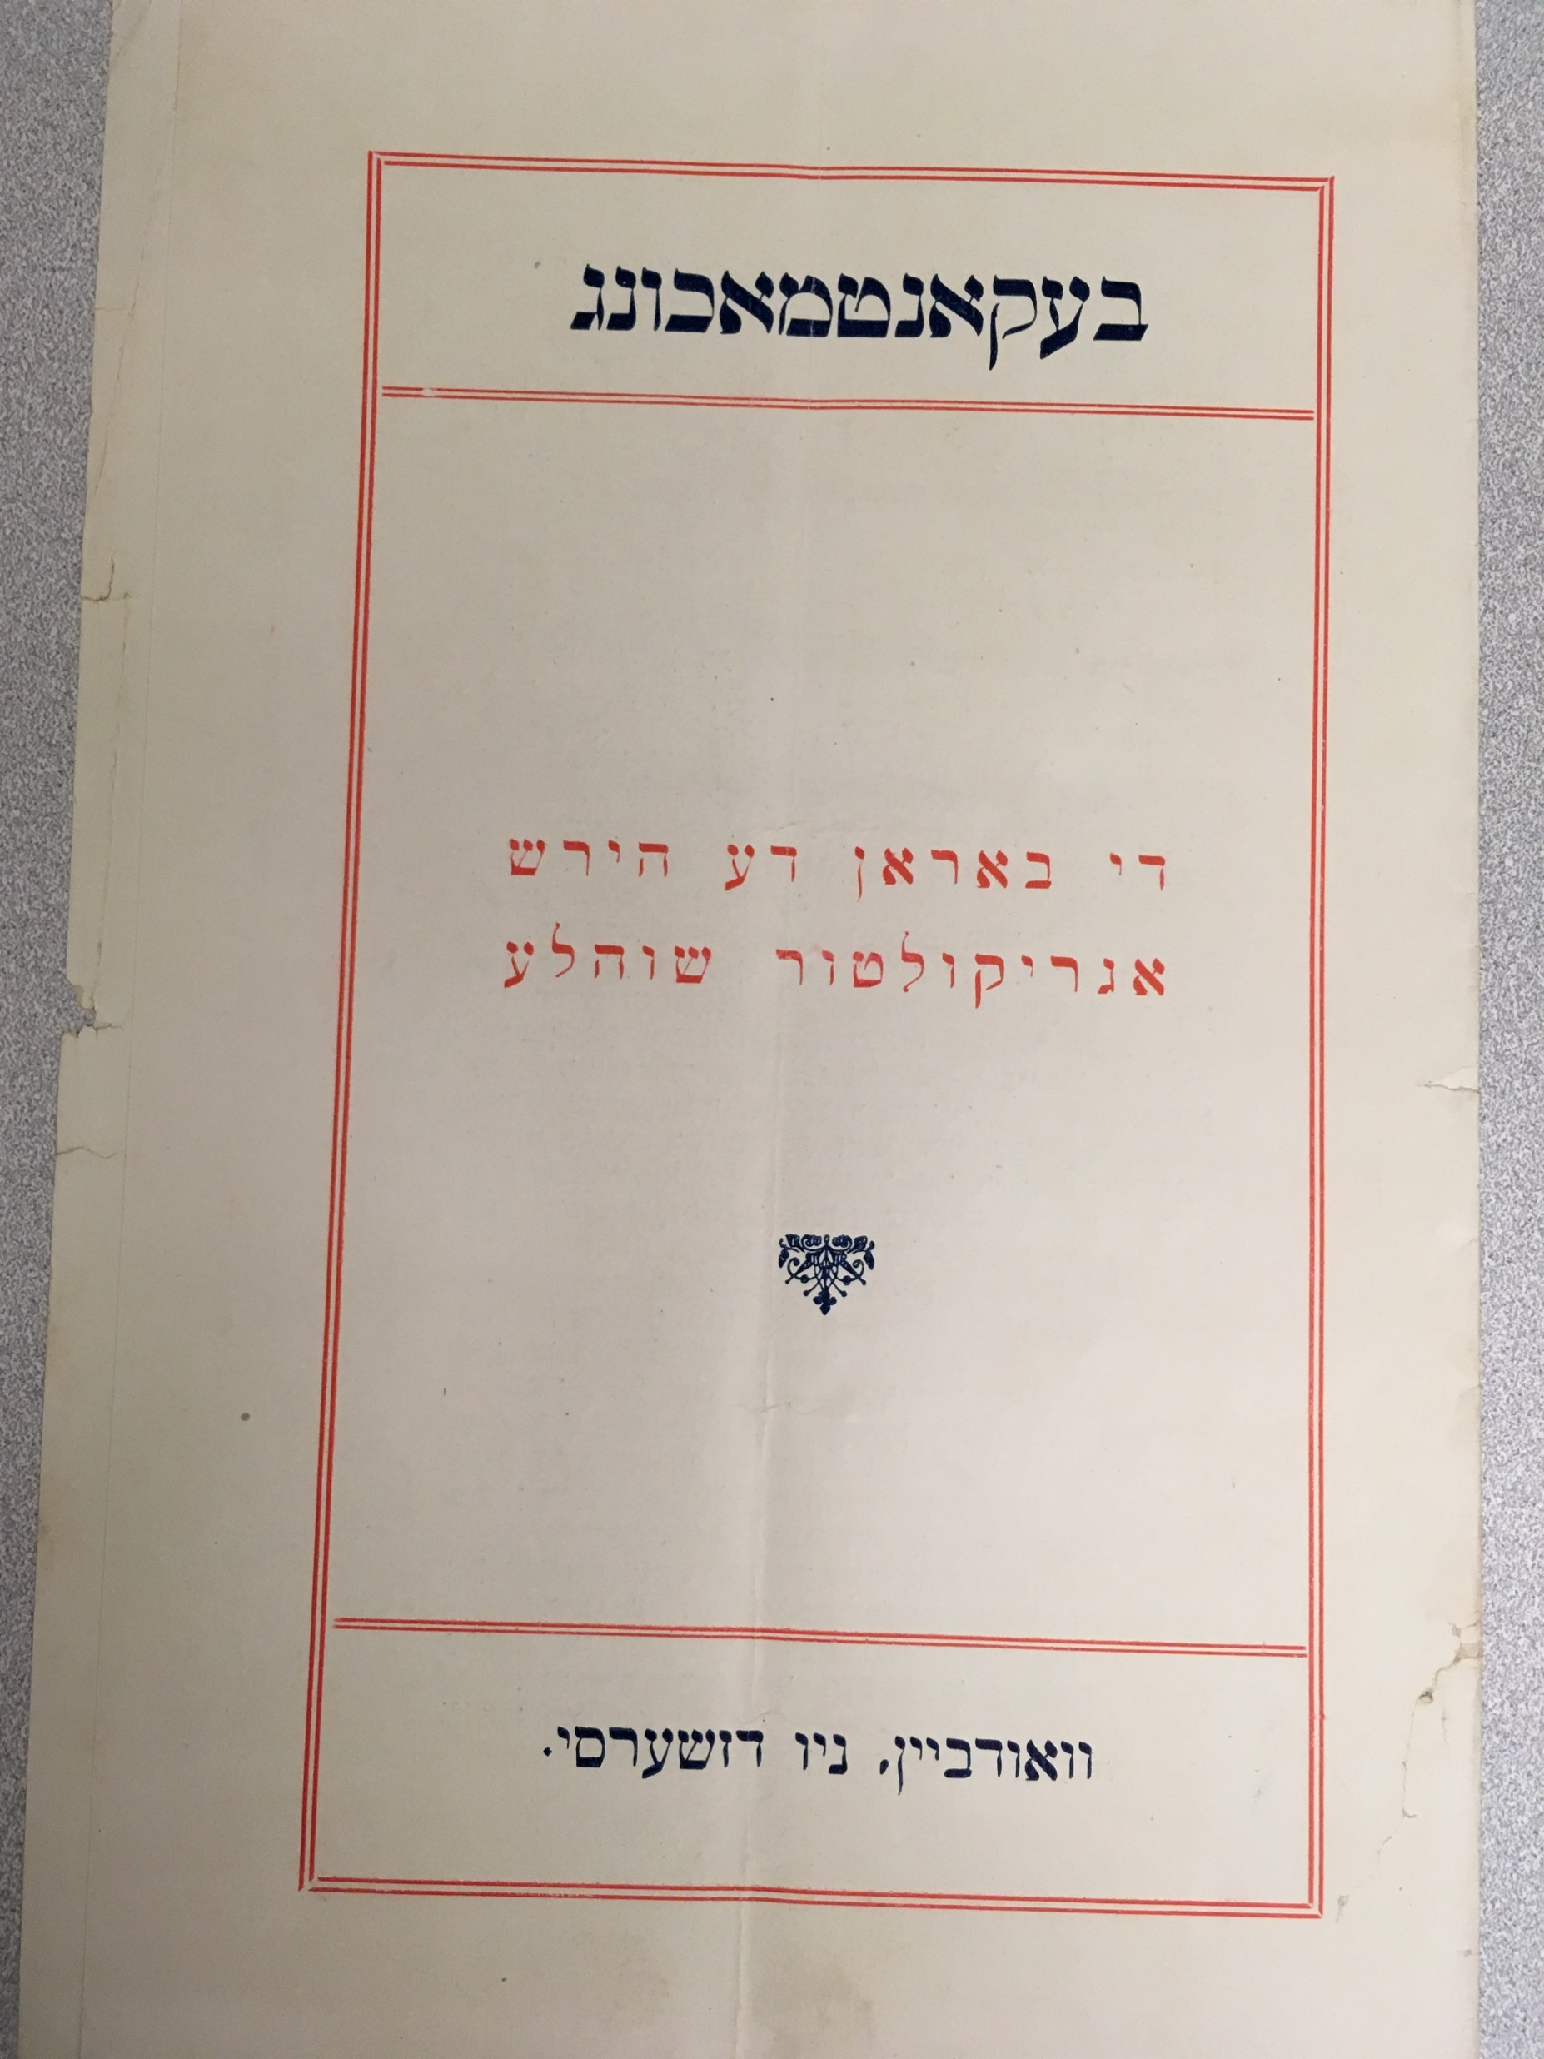
Education
the Woodbine Agricultural School (1893-1917) NJ
Baron De Hirsch Trade School (1895) NYC
  East 64th street, between Second and Third avenues
  carpentry, house- and sign-painting, plumbing, and the machinist's and electrician's trades
English classes
Notes:
Pamphlet, in Yiddish, for prospective students of the Woodbine Agricultural School
the Woodbine Colony in southern New Jersey (1891-1940)
Jewish Agricultural Society (JAS) (Jewish Agricultural and Industrial Aid Society) (1900) NYC
loans to farmers and providing agricultural instruction on an extension basis
The Baron de Hirsch Trade-School was established for the purpose of providing free instruction in the mechanical trades to immigrants from Russia and Rumania. For a time the school was conducted in a leased building; but later a new school building was erected on East Sixty-fourth street, between Second and Third avenues, at a cost of $150,000, which sum was given by the Baroness de Hirsch for the purpose in the summer of 1897.
With the exception of a short time during which wood-carving was taught, the same trades as those taught at the present time, namely, carpentry, house- and sign-painting, plumbing, and the machinist's and electrician's trades, have been the subjects of instruction. The Baron de Hirsch Trade-School does not attempt to turn out skilled mechanics, for pupils receive instruction during five and one-half months only. The aim is, by a good elementary training to make them intelligent apprentices or helpers, and to afford them the opportunity to enter profitable trades under the most favorable conditions.

Slide 11
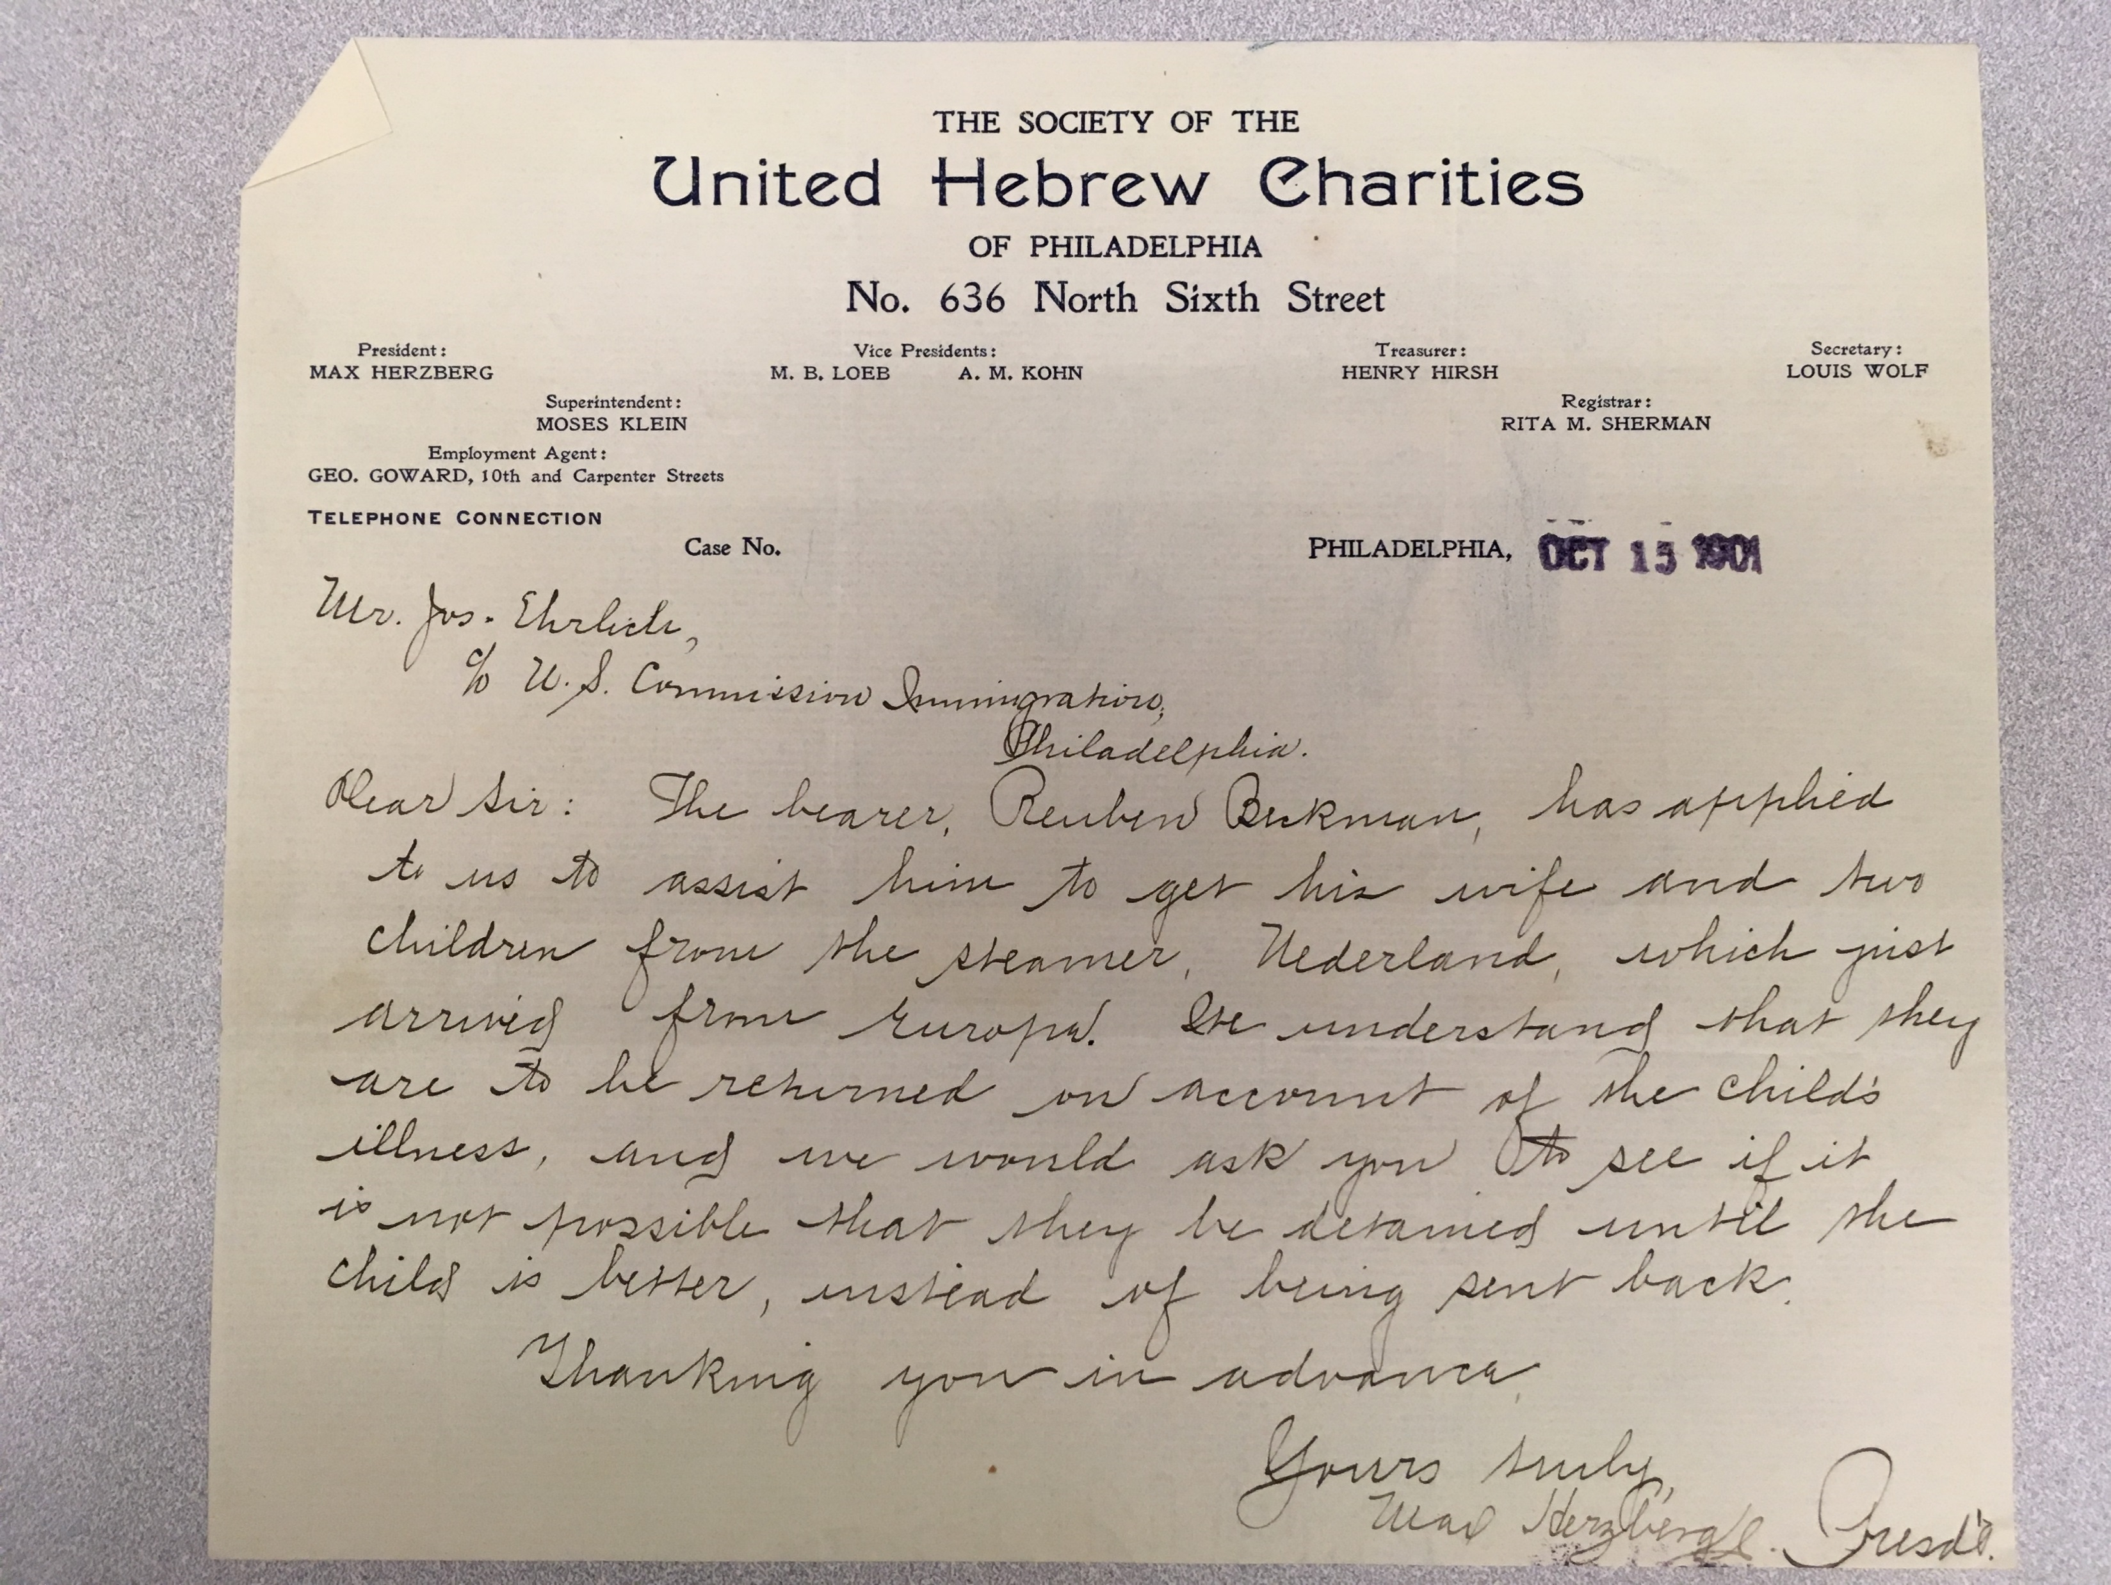
Ruben Bickman (1901)
The bearer, Reuben Berkman, has applied to us to assist him to get his wife and two children from the steamer, Nederland, which just arrived from Europe. We understand that they are to be returned on account of the child’s illness, and we would ask you to see if it is not possible that they be detained until the child is better, instead of being sent back.
Notes:
Ruben Bickman: needs assistance to get his wife and two children, one child is ill. – Problem of illness
Addressed to Joseph Ehrlich, dated Oct 15, 1901
Dear Sir: The bearer, Reuben Berkman, has applied to us to assist him to get his wife and two children from the steamer, Nederland, which just arrived from Europe. We understand that they are to be returned on account of the child’s illness, and we would ask you to see if it is not possible that they be detained until the child is better, instead of being sent back. Thanking you in advance, Yours truly, Max Herzberg, (President)
Rosa Goldberg: “infantile paralysis”, need to have a surety bond (1909). – problem of LPC

Slide 12
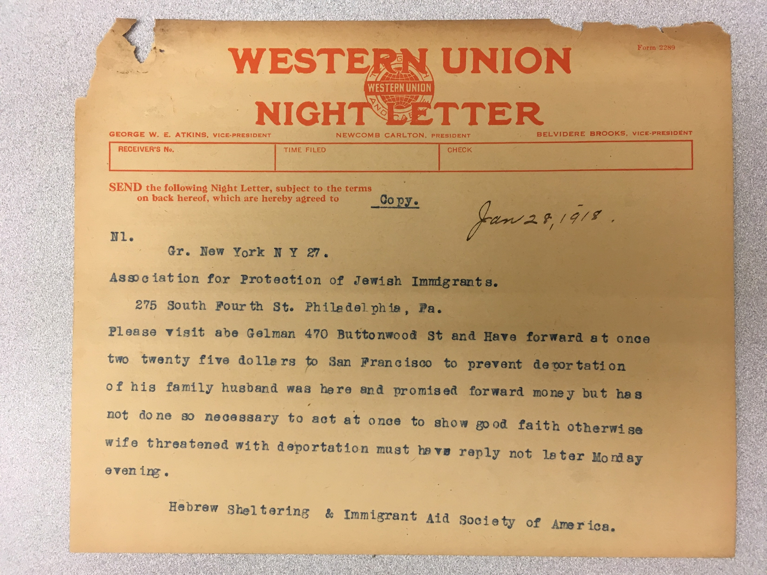
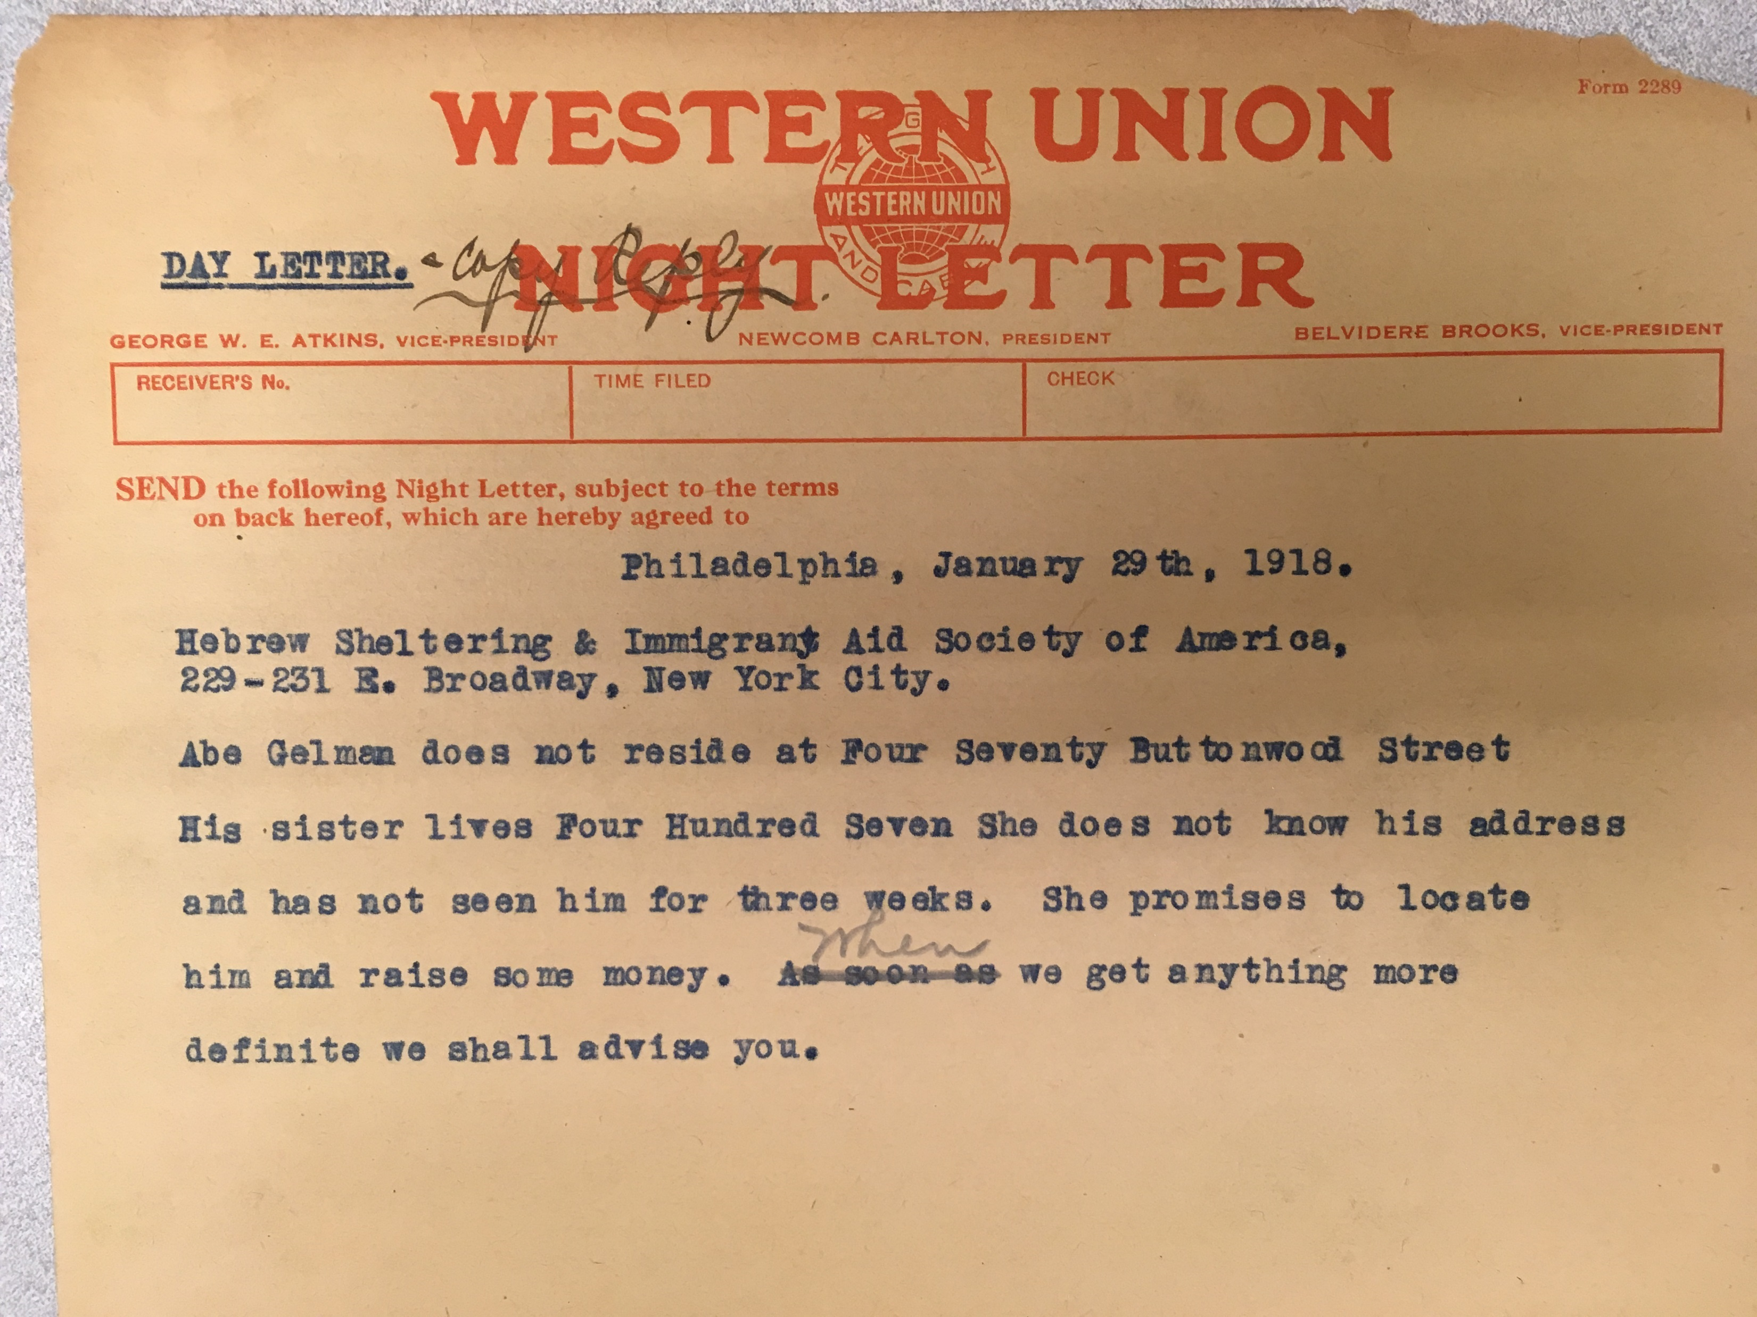
Perla Gelman and 3 children (1918)
Notes:
NYC: Wife and family of Abe Gelman need $225.00 for transportation, to prevent deportation.
Philadelphia: Where is Abe Gelman? Not in Philadelphia, but in NYC, his sister will locate him and try to raise some money.
Citizens of the Russian Empire caught in the turmoil of advancing and retreating armies on the eastern front of the war made their way to the West Coast by way of Siberia, Manchuria, Japan, and the Pacific. Between 1915 and 1919, Russian Jewish men, escaping conscription or deserting the army, and later mothers, children, and other relatives of American residents, constituted a large share of the non–Asians arriving at Angel Island.

Slide 13
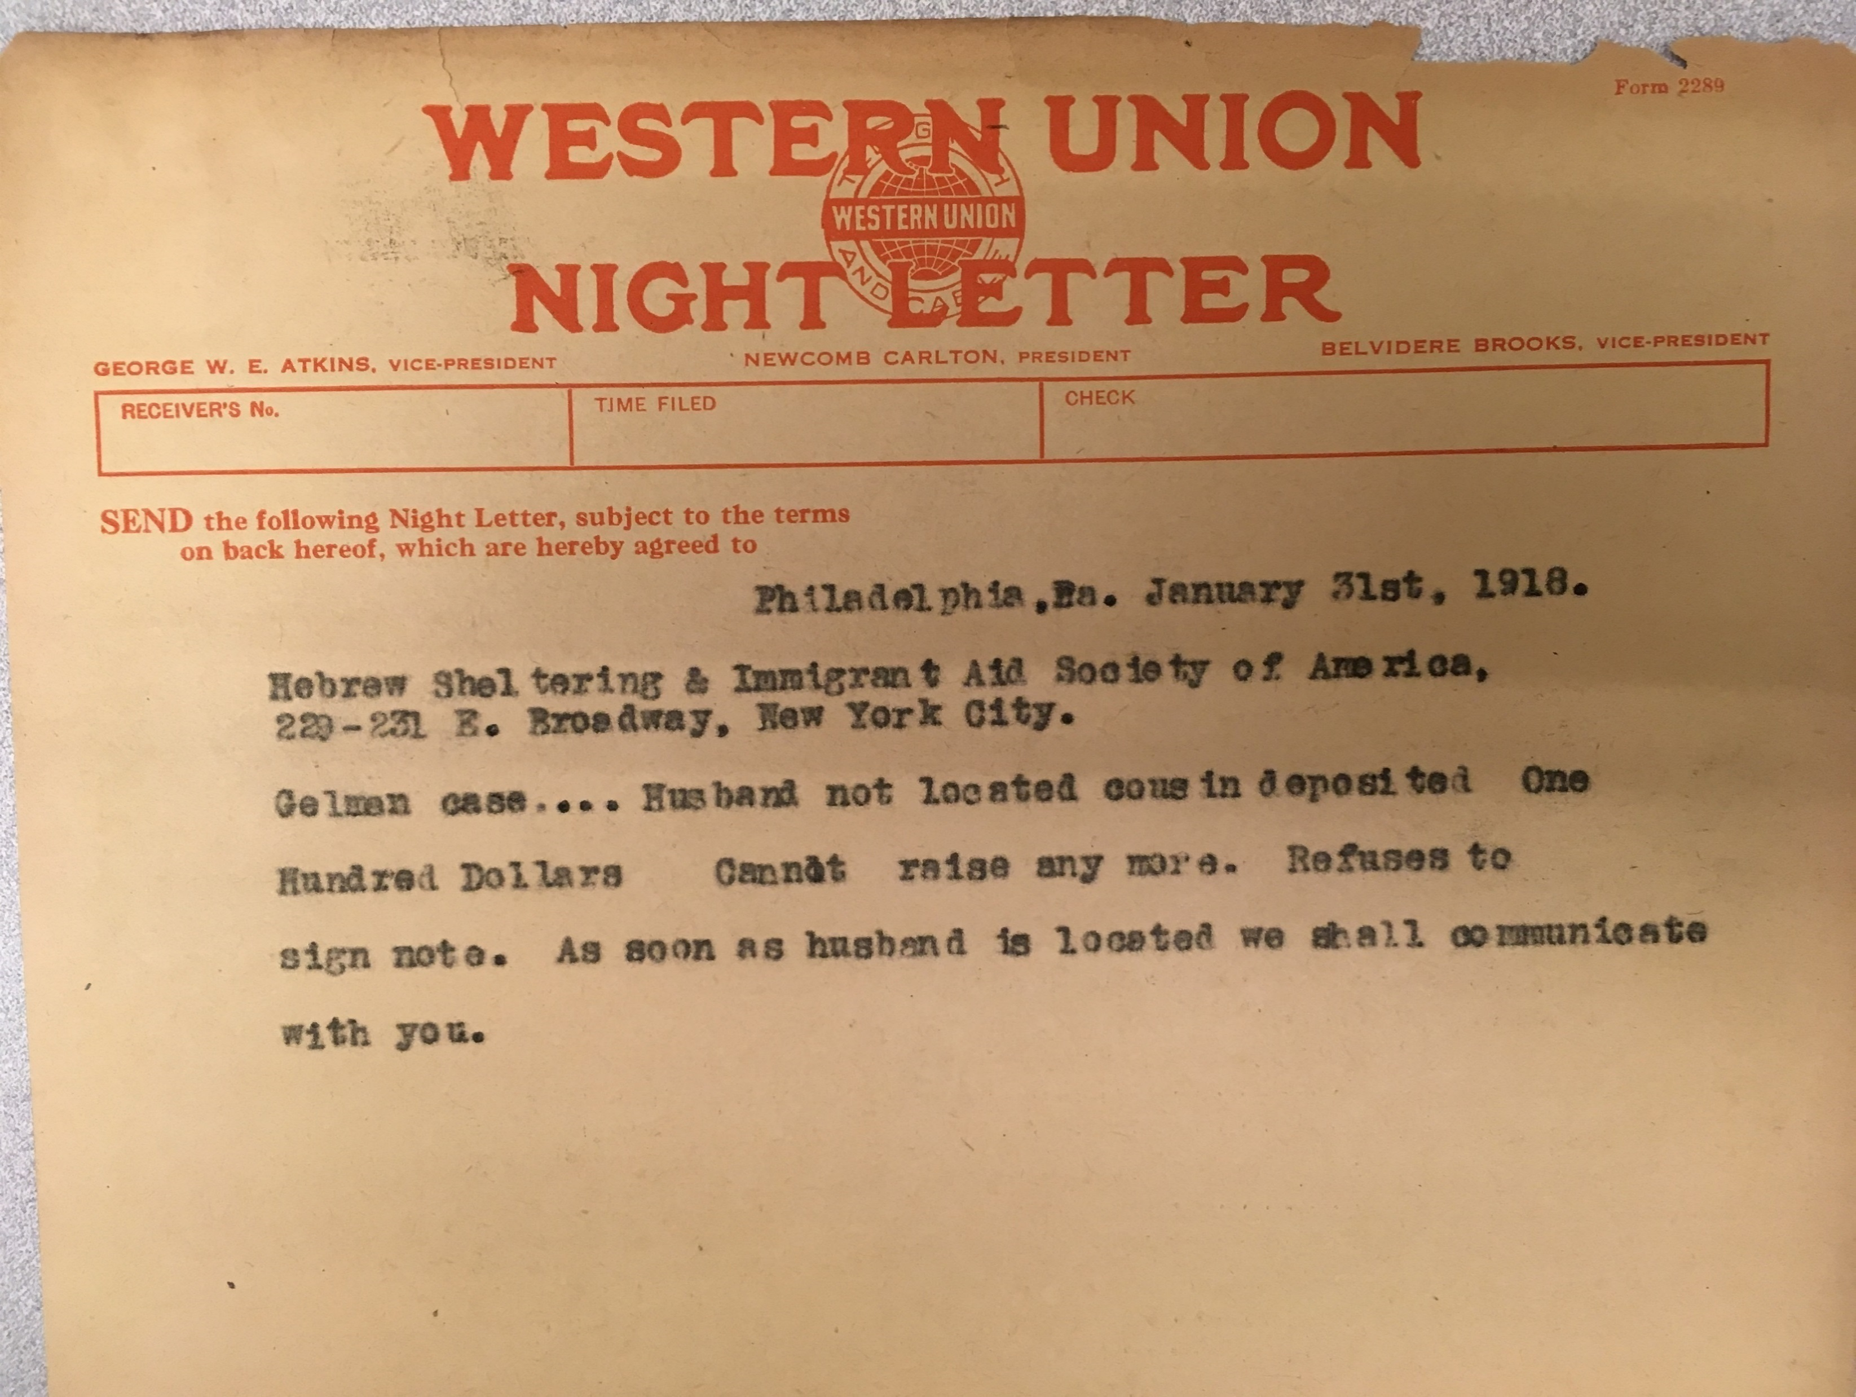
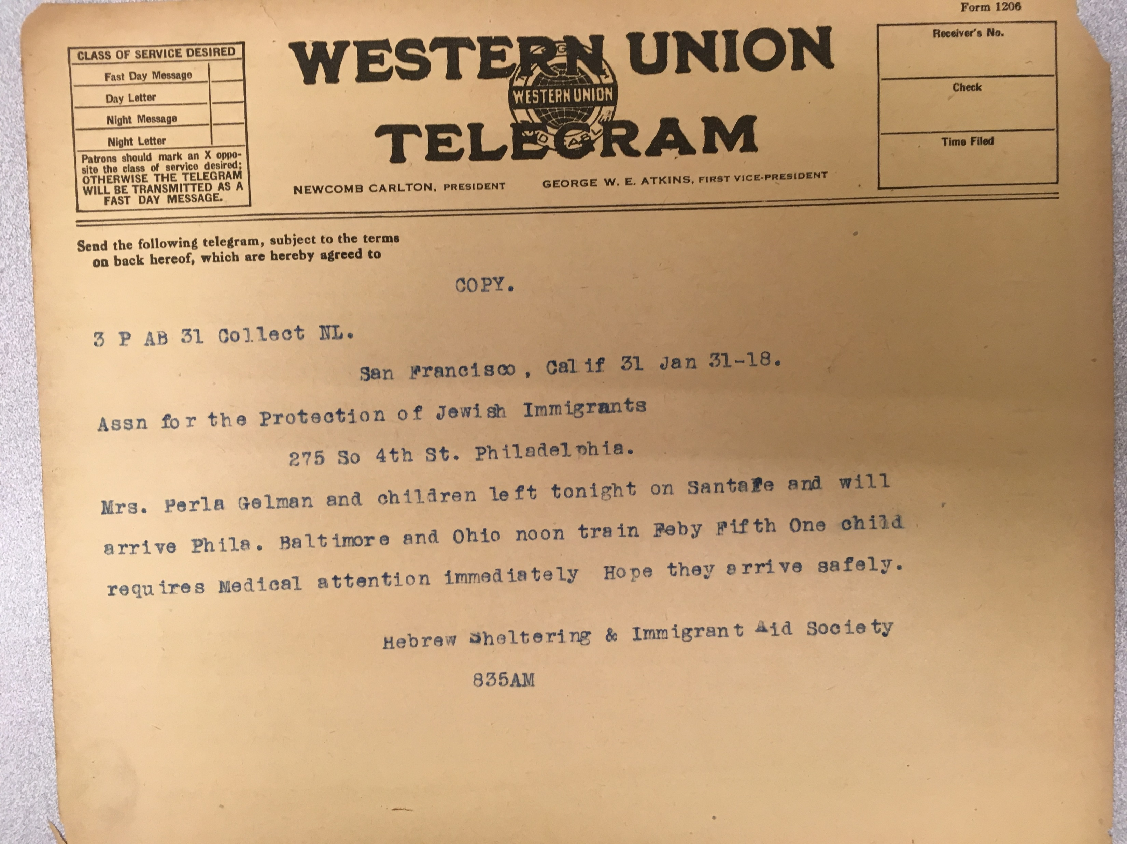
Notes:
(Philadelphia) Husband not located, a cousin deposited $100.00
(San Francisco): Mrs. Perla Gelman and children left – 1 child needs medical attention. (now we know her name)

Slide 14
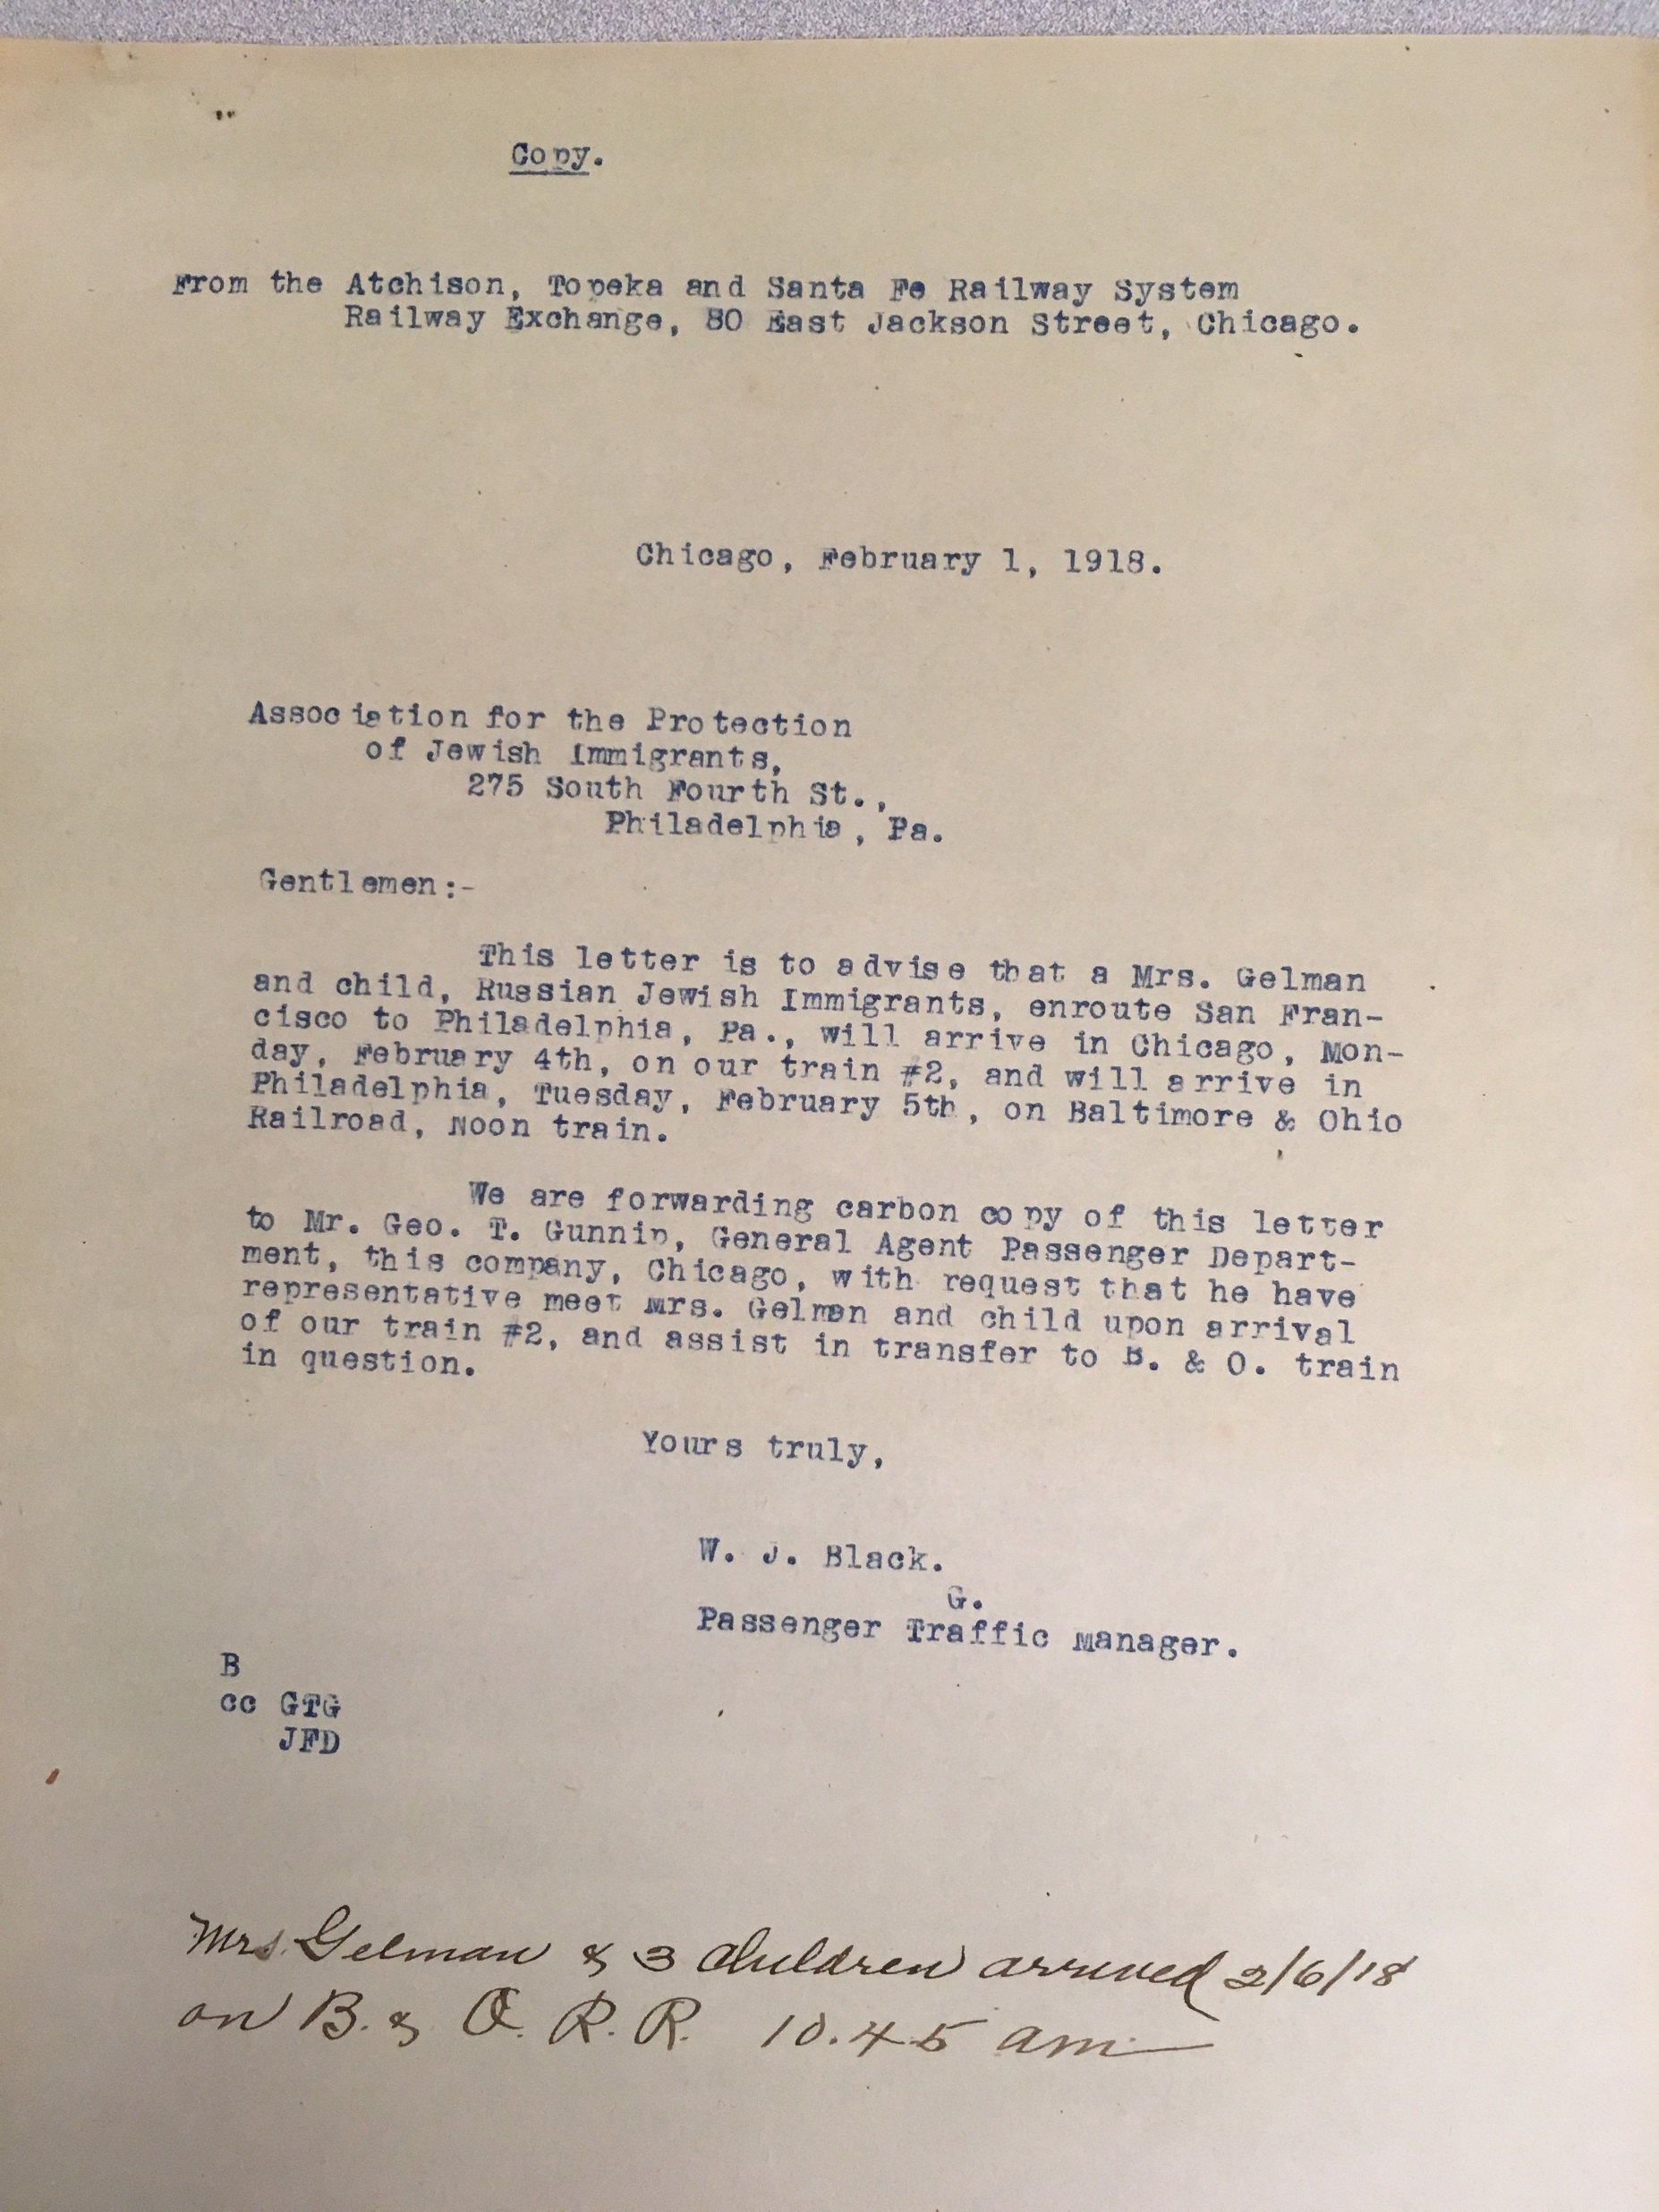
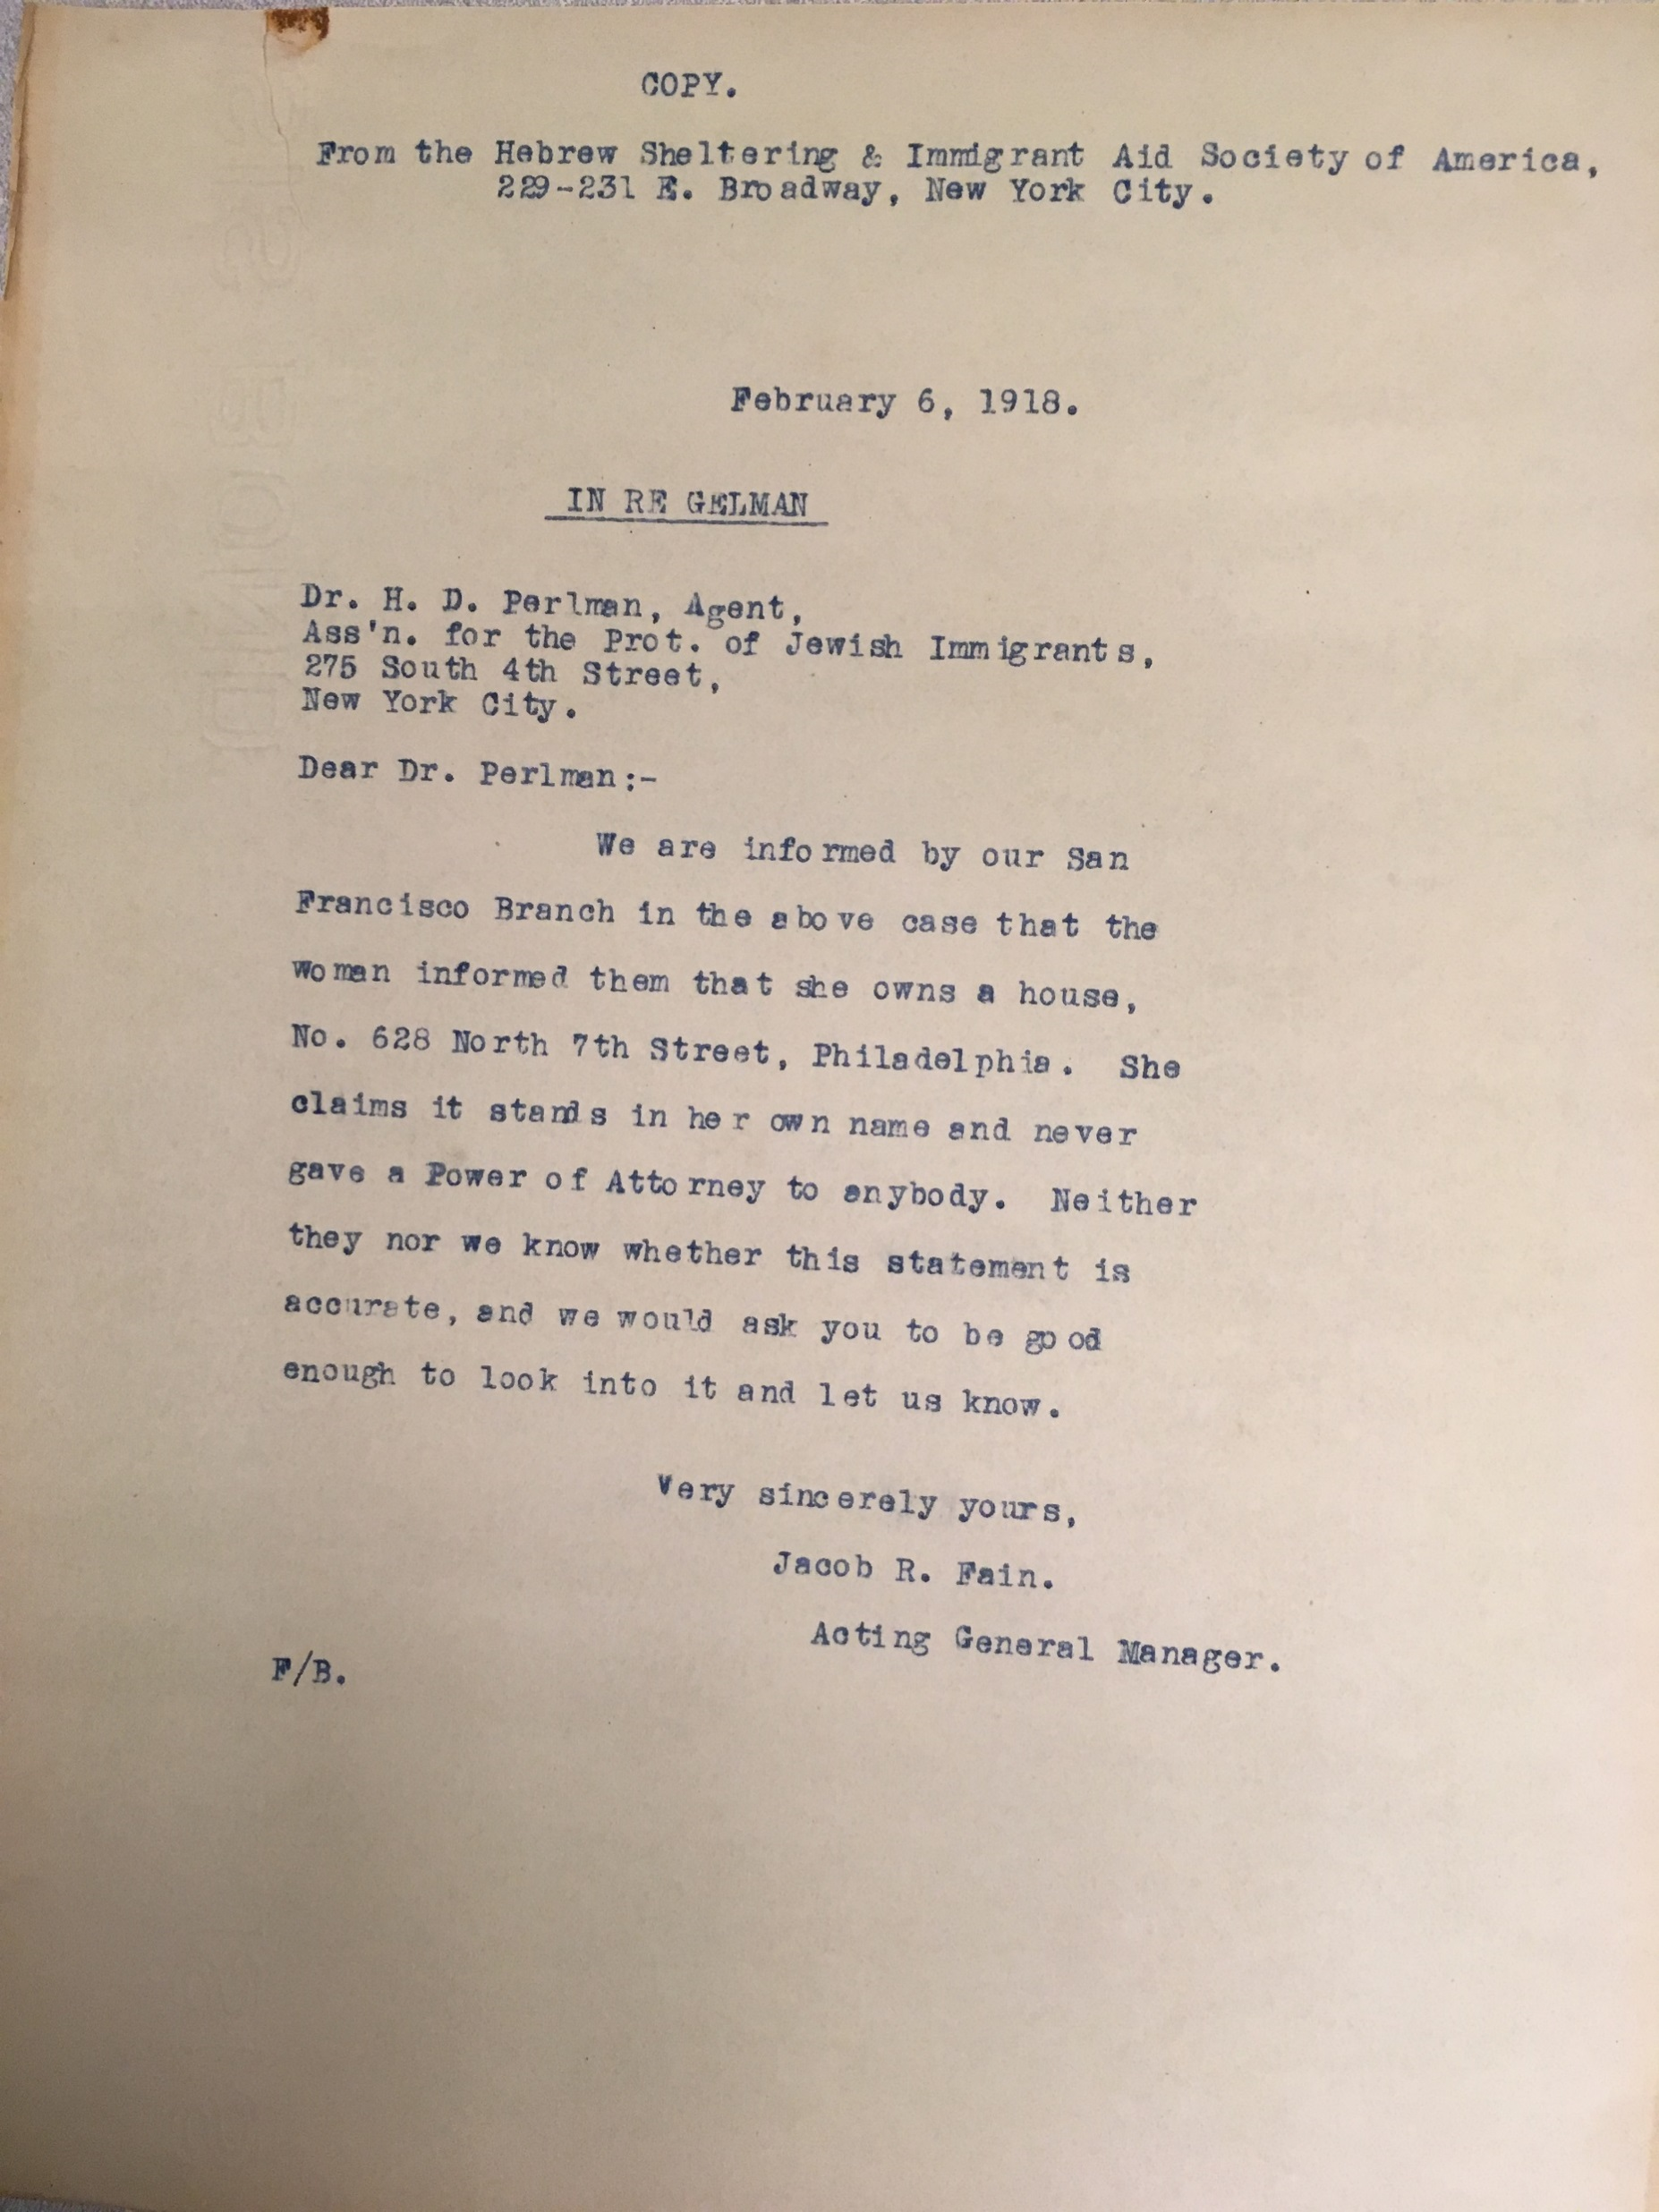
Notes:
Handwritten note – acknowledge arrival of Mrs. Gelmen and 3 children.
She claims to own a house in Philadelphia

Slide 15
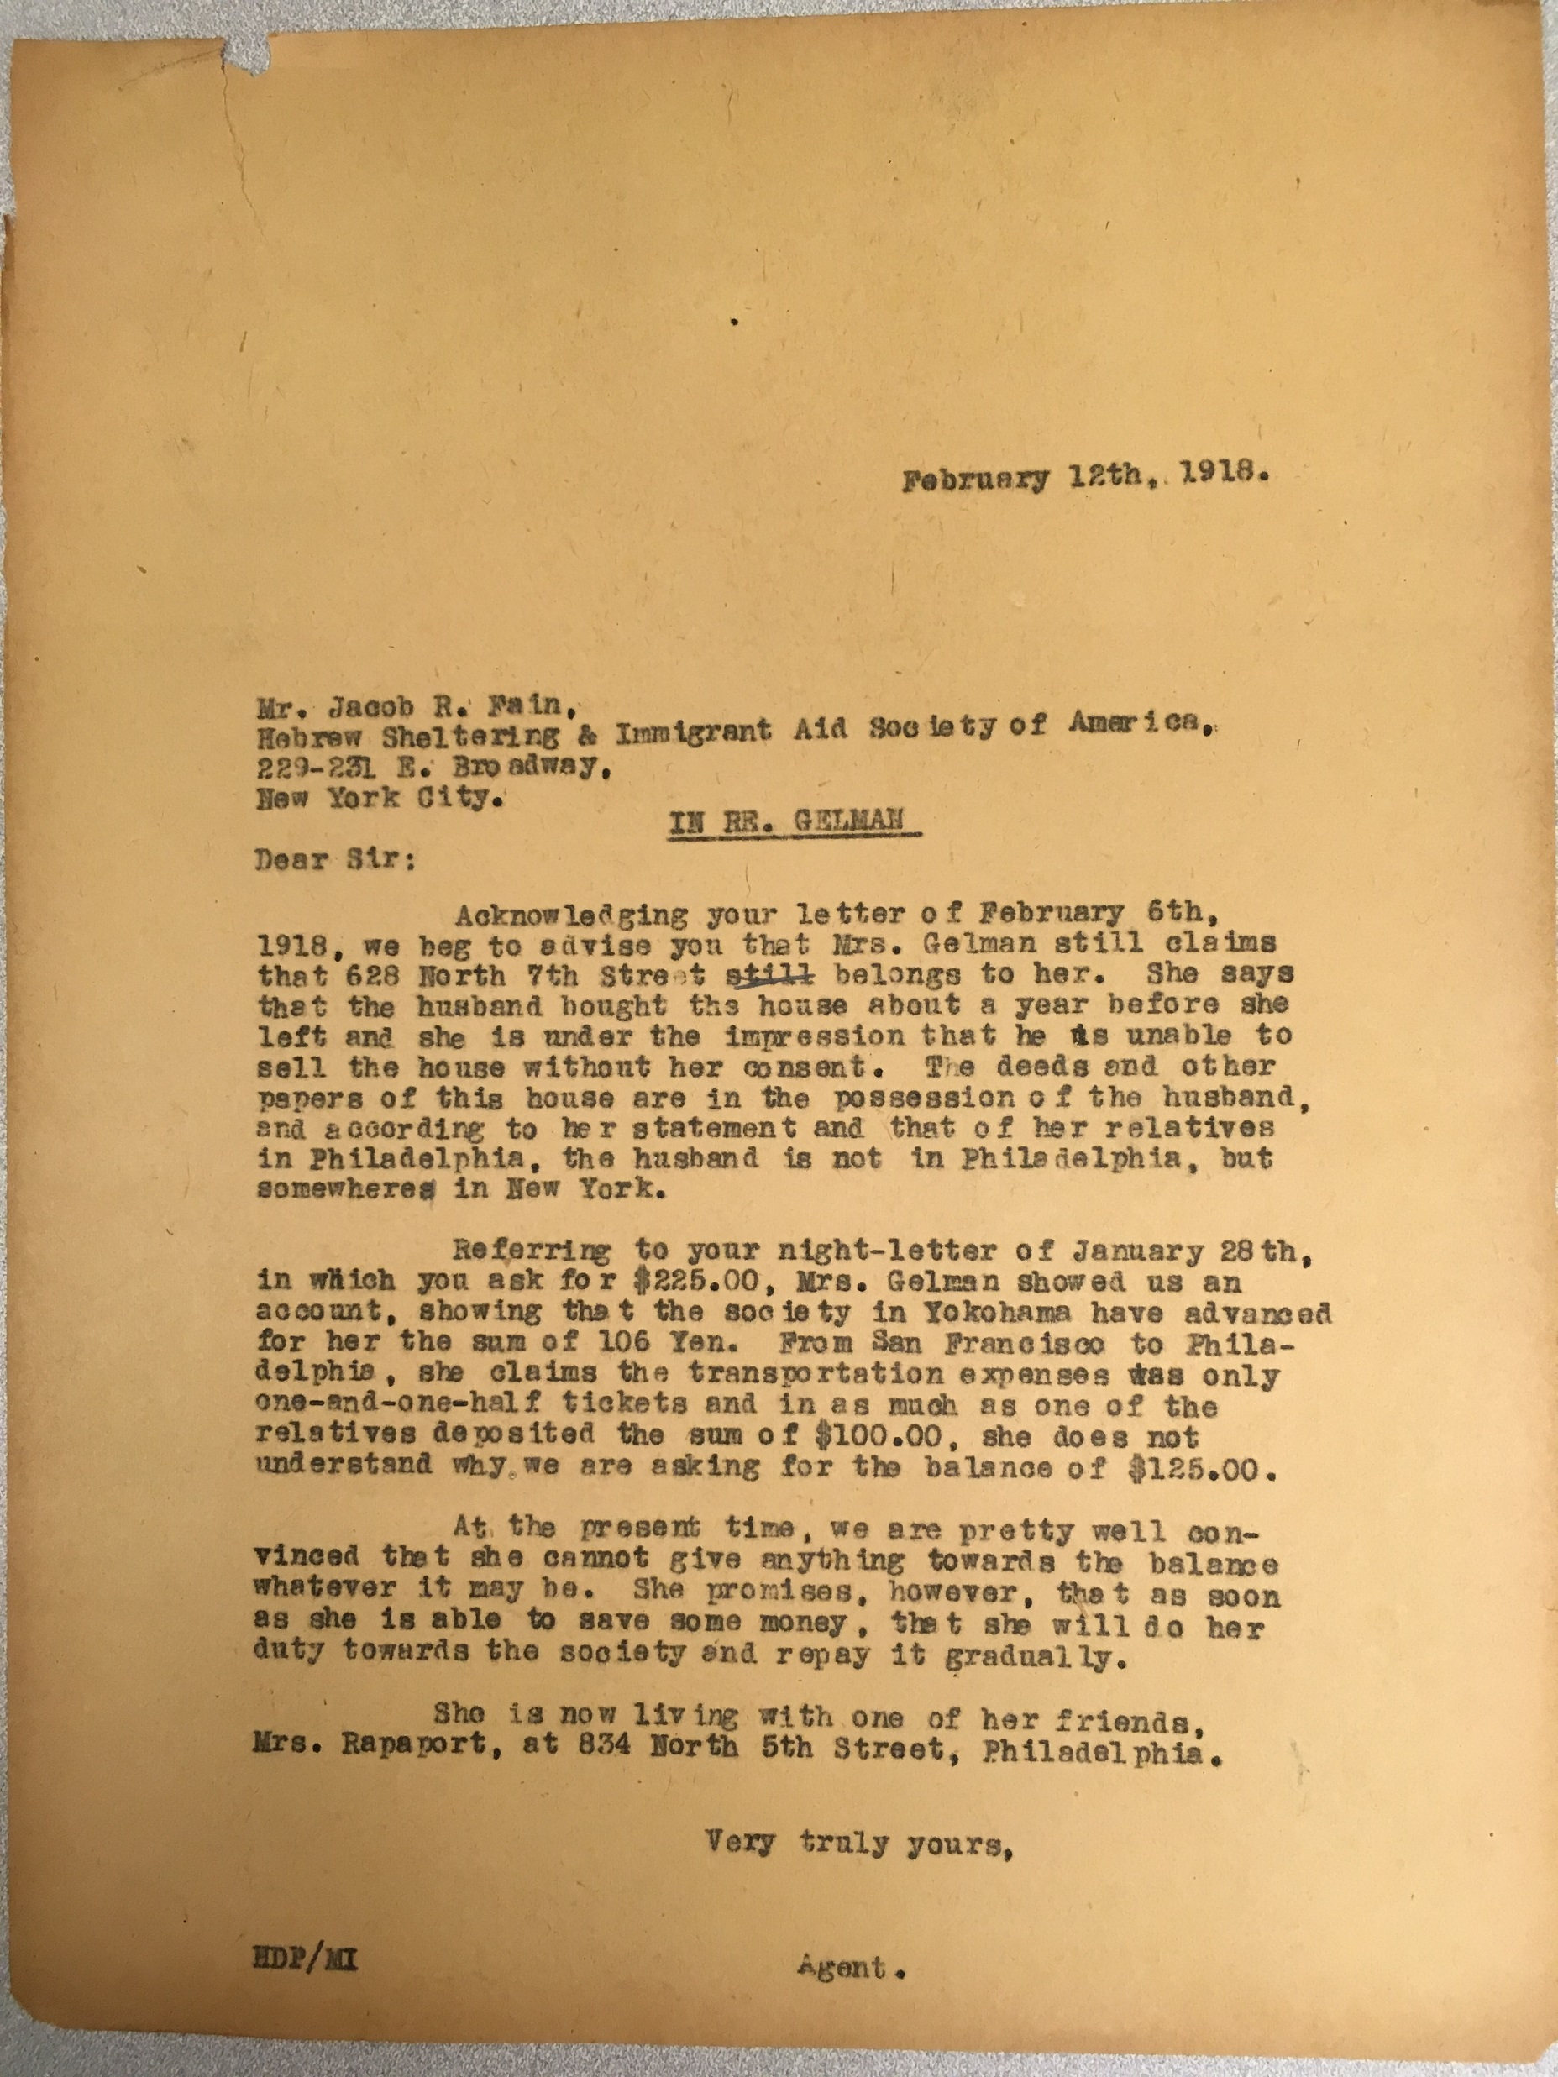
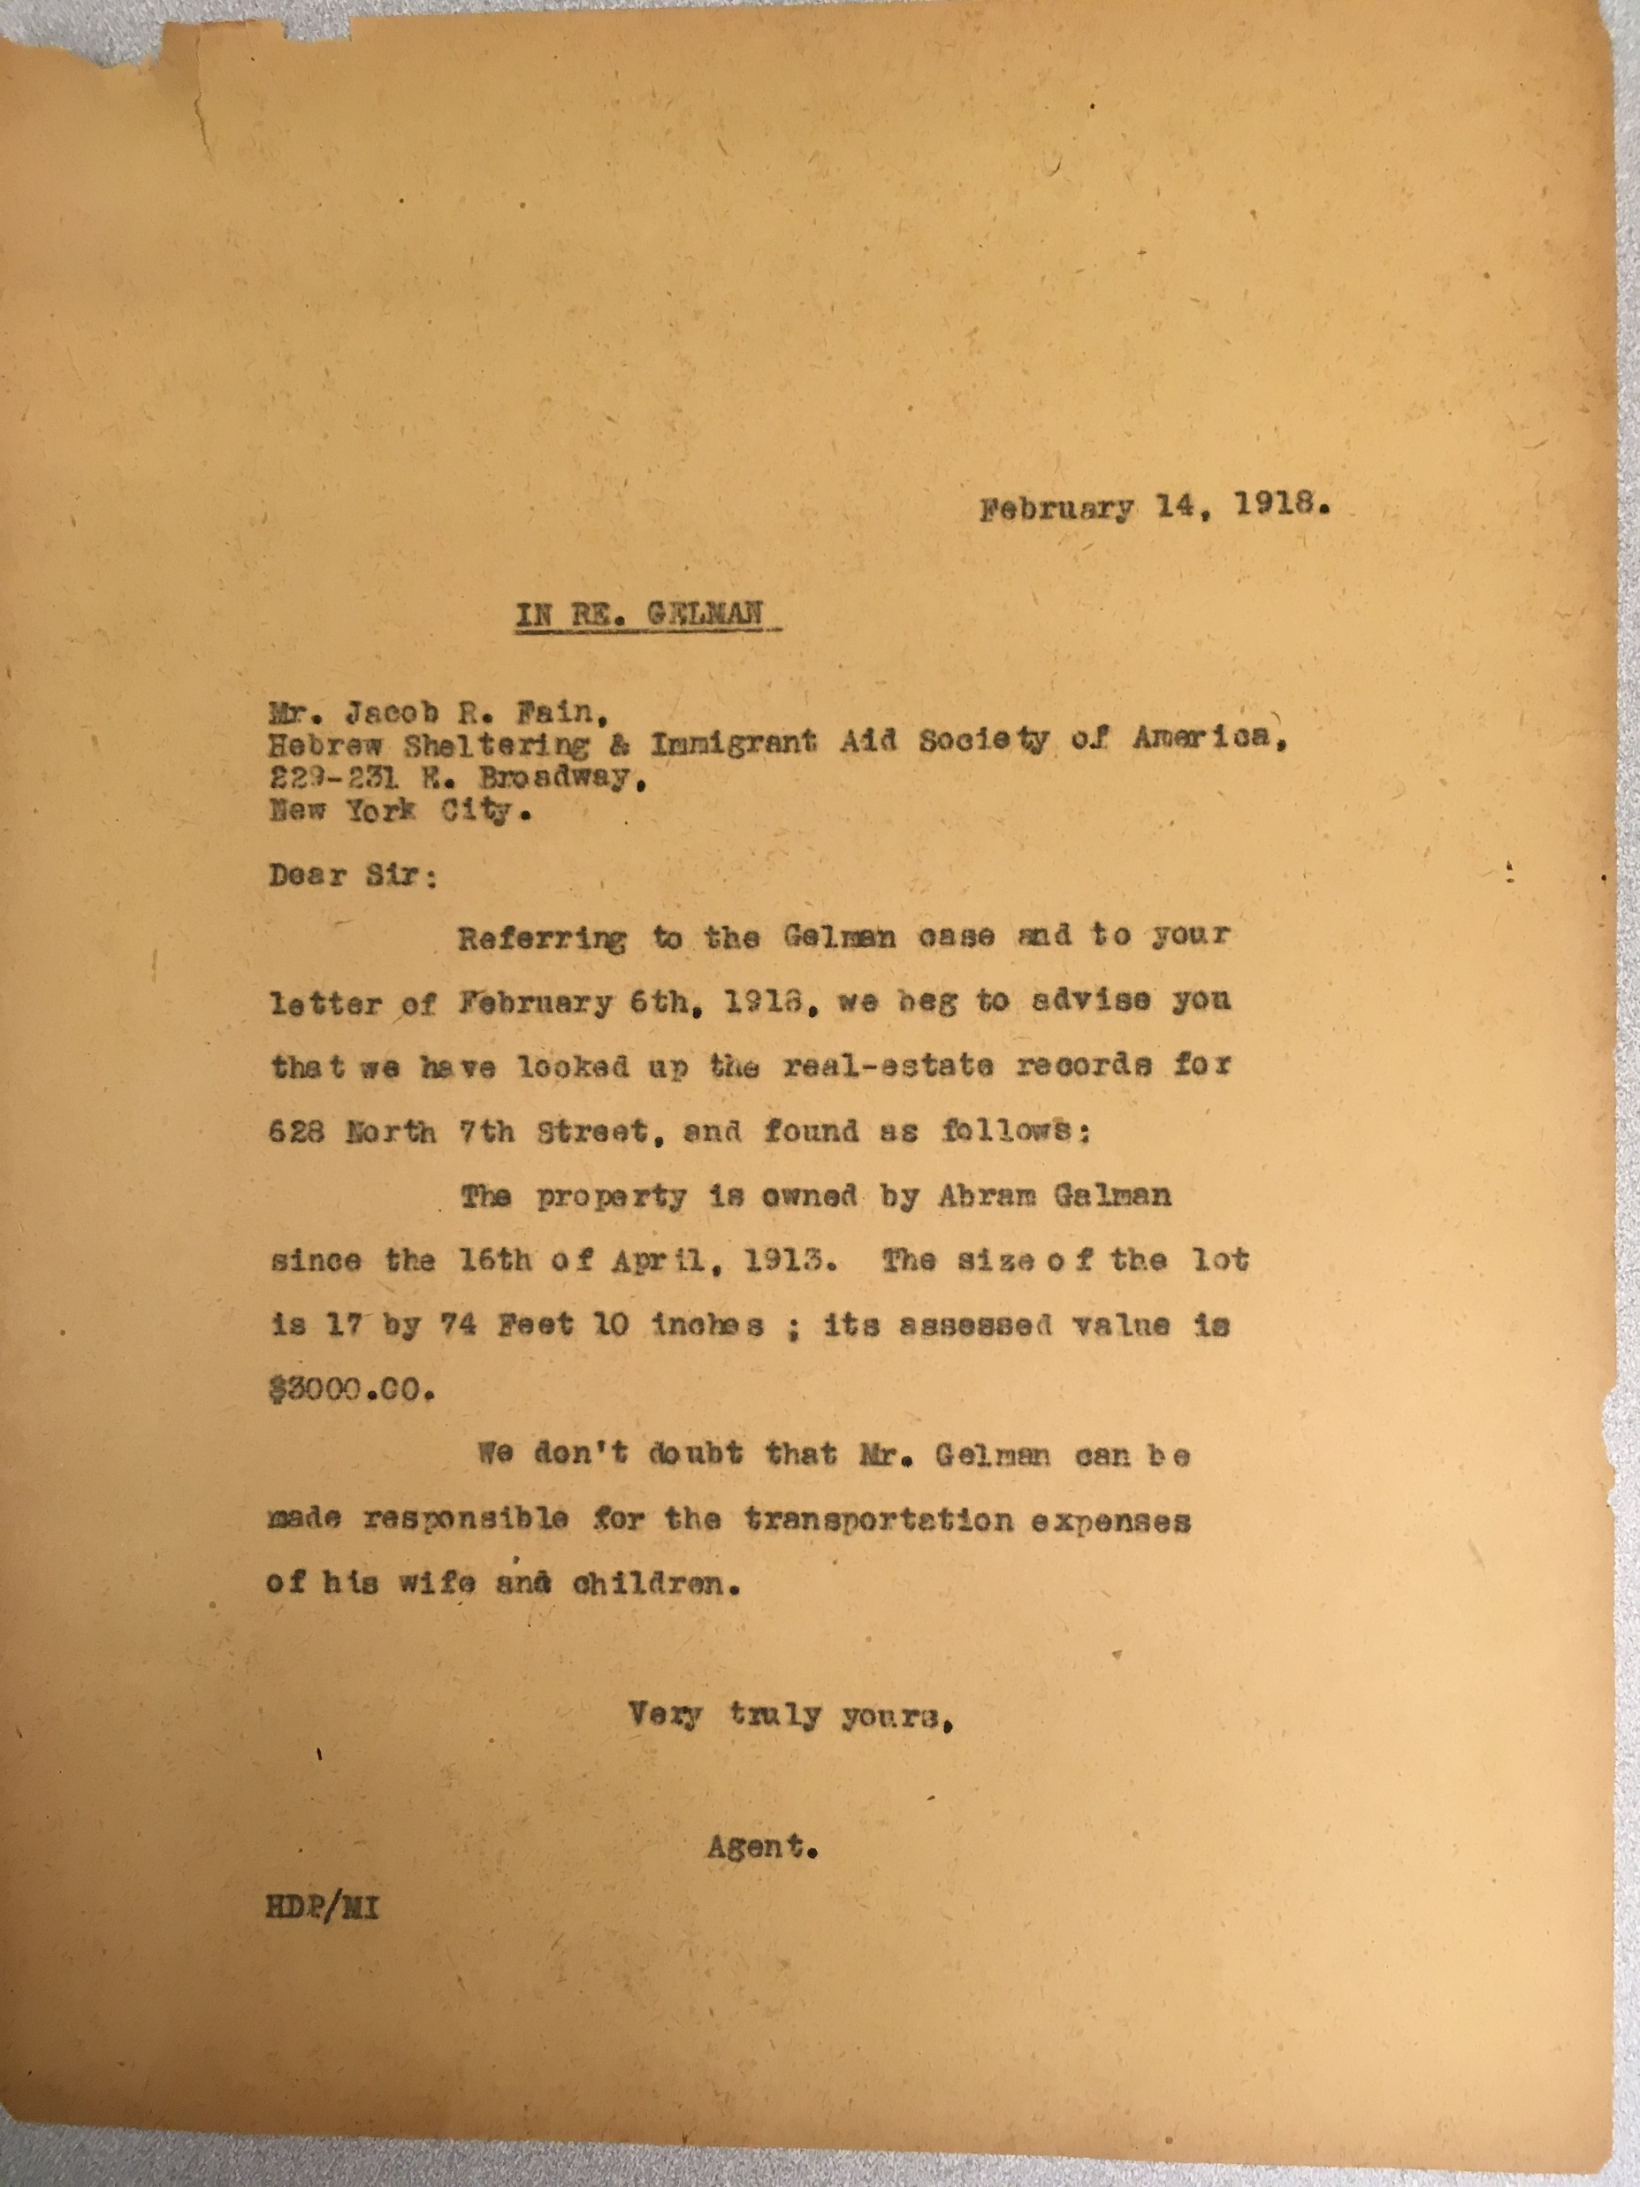
Notes:
Her husband bought the house a year before she came. Question about how much she owes. 106 Yen from the Yokohama office. She is living with a friend in Philadelphia
Abe Gelman owns the house, valued at $3000.00. He can be made responsible for the transportation costs.

Slide 16
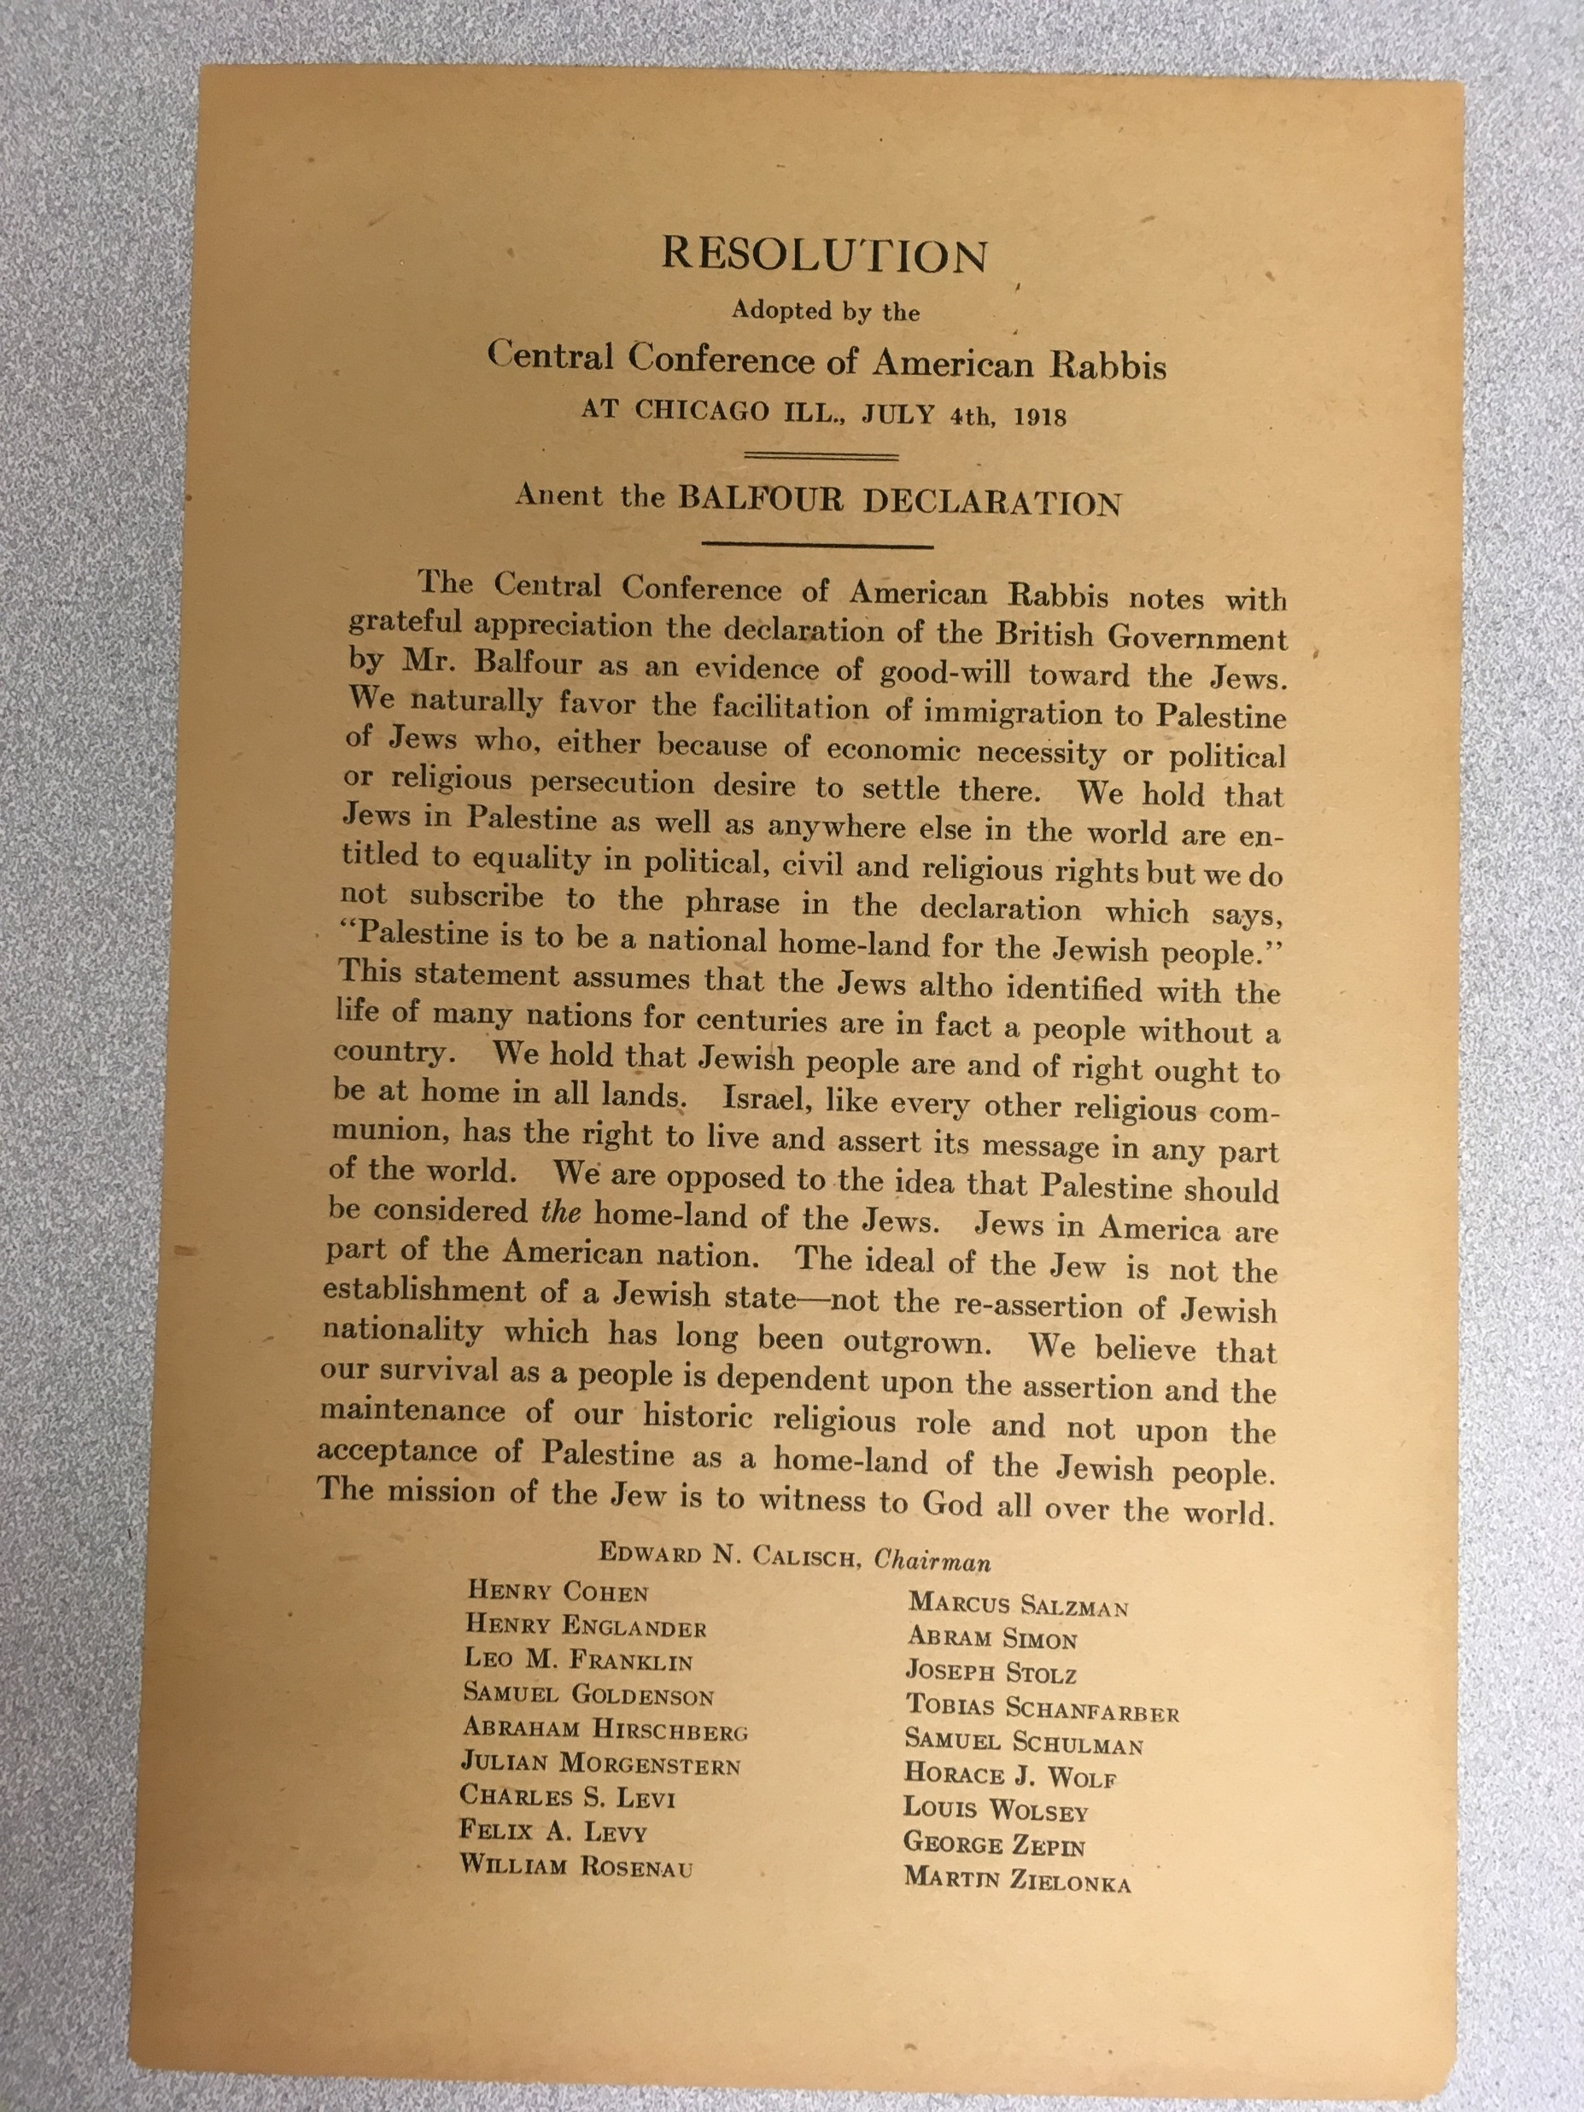
A Response to the Balfour Declaration by the Central Conference of American Rabbis
“We hold that Jews in Palestine as well as anywhere else in the world are entitled to equality in political, civil and religious rights but we do not subscribe to the phrase in the declaration which says , ‘Palestine is to be a national home-land for the Jewish people.’ … We hold that Jewish people are and of right ought to be at home in all lands.”

Slide 17
Related Collections:
American Jewish Historical Society: Baron de Hirsch Fund Records (109 linear feet)
YIVO: HIAS Archive; United Hebrew Charities (1849-1916)

