Slide 1
Interpersonal Neurobiology, Counseling, Psychotherapy, and Spiritual Transformation
Gary Sibcy, II, Ph.D.
Licensed Clinical Psychologist, Piedmont Psychiatric Center
Director, PhD Program in Professional Counseling
Liberty University
Lynchburg, Virginia
Tim Clinton, EdD, LPC, LMFT
President, AACC
Executive Director, Liberty University Center for Counseling and Family Studies

Slide 2
Descartes’ Error
The Mind and the Brain are completely separate from each other

Slide 3
Interpersonal Neurobiology
Seigel’s Triangle of Well-Being
Mind
Relationships
Brain

Slide 4
Mind
The embodied process that regulates the flow of energy and information
  Energy→ the physical properties that propel us to take action
  Information→ is the representation of something other than itself (e.g., words and ideas)

Slide 5
Brain
The neuro-circuitry through which energy and information flow—
  Concentrated primarily in the head, but extends through the entire body

Slide 6
Relationships
How energy and information is shared as we connect and communicate with one another
Relationships are co-regulators of energy and information
I Corinthians 12: 12ff
Notes:
Hierarchical regulation, where higher order (more complex and sophisticated) systems regulate lower ordered ones

Slide 7
Core Principles of Neurobiology
General Systems Theory—how complex systems develop
  Undifferentiated
  Differentiated—separate/individuated with specialized functions and sovereignty
  Integration—linked together but retains separateness in specialized functions
The whole is greater than sum of parts
Disintegration and Fragmentation
Notes:
Too much sovereignty for any one system can potentially be debilitating, e.g, being ruled by the amagdala
Amygdala highjacking

Slide 8
Undifferentiated

Slide 9
Properties of well-functioning systems
The brain is open system-
  Open systems of capable of being influenced by external factors
  Dynamic, nonlinear, complex systems
  When integrated, this type of system is most flexible and adaptive

Slide 10
Characteristics of well-functioning systems (FACES flow)
Flexible
Adaptive
Coherent
Energized
Stable
Notes:
Complexity theory
Central channel is the ever changing flow of integration and harmony (harmony is perfect example of integrated system)
Also, chaos theory--jazz

Slide 11
Siegel’s River of Integration
A river, with an ever changing central channel of integration and harmony
On one bank is Rigidity--
On the other bank is Chaos—

Slide 12
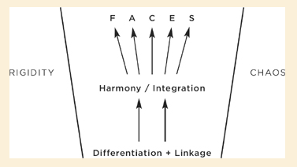
Screen clipping taken: Siegel, Mindsight

Slide 13
Mental Health/ Spiritual Health
Psychospiritual health is the function of integration
Psychopathology is a deviation from integration
  Rigidity
  Chaos
Notes:
Depression is largely rigidity—shut down, stopping, withdrawing
Addictions--chaos

Slide 14
Example: PTSD
Re-experiencing Symptoms
Hyperactivation
Avoidance/numbing/Dissociation
Associated Tension Reduction Behaviors
  Alcohol, drugs, other addictions
  Cutting
  Suicide Rehersal

Slide 15
Neurobiology and the Brain
By Age Three, 9/10th of brain develops
First year: high neuronal growth, many connections →then a “pruning” (“use it or lose it” based on stimulation and use)
Differentiation—developing specialized systems
Then linkages of various systems
Trauma → inhibits cell growth or may even cause cell death

Slide 16
Brain paradox
As we grow older the number of neurons decrease but the brain actually grow larger

Slide 17
Pathways to Brain Growth
How the brain grows
  Bottom to top; right to left
Integrated, regulated brain
  Top to bottom; left and right
Finding the Zone—
  Support—safe, regulated
  Challenge—emotional activation
  Think—label, communicate, problem solve
  Relate—attend, back-and-forth, collaborative

Slide 18
The Role of Experience
Brain wires itself based on experience
Asks several questions:
  Is the world a safe place?
  Can I count on my caregiver’s to help me in time of need?
  Can I get the care I need when I need it?

Slide 19
Our two hemispheres (Horizontal Integration)
Right Hemisphere==
  Develops first
  Imagery, emotional, holistic thinking, nonverbal language, autobiographical memory
Left Hemisphere
  Develop later, logic, verbal, linear
Horizontal Integration is linking these two sides of the brain

Slide 20
From head to gut (Vertical Integration)
Nervous system ascends from bottom (our bodies and gut) to top (brain stem, limbic system, prefrontal cortex)
Vertical integration is about linking these different areas together, bringing bodily sensation up into awareness
Notes:
Knowing what and why your body feels

Slide 21
Brain Stem
Autonomic Nervous System
  Two Branches
    Sympathetic—Gas pedal
      Fight
      Flight
    Parasympathetic—Break
      Freeze

Slide 22
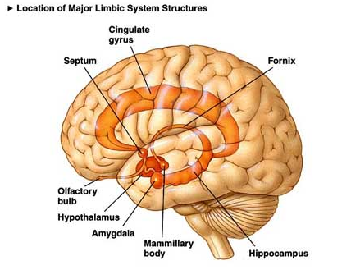
Limbic System
http://brainandgender.files.wordpress.com/2011/03/limbsys2.jpg
Screen clipping taken: 9/26/2011 11:57 AM

Slide 23
Limbic System
Emotional Control Center in Brain
encodes emotionally charged experiences
Forming of key mental models/schemas about
  Self
  Others
  World
Conditioned Emotional Responses
Associative learning
Notes:
Amygdala
Septum
Locus coereleus
Hippocampus

Slide 24
Prefrontal Cortex
The middle prefrontal cortex
  Anterior cingulate
  Orbital prefrontal cortex
  The mediate prefrontal
  Ventral lateral
  All work together as a team

Slide 26
Nine Functions of Middle Prefrontal Cortex
Body regulation--
Attuned communication--
Emotional balance--
Response Flexibility--
Insight—
Empathy
      Theory of mind
    Mindsight--mentalization
Fear modulation
Accessing intuition
Morality

Slide 27
Kinds of Memory
Implicit Memory—
  Present at birth
  Includes behavioral, emotional, perceptual, body
  Mental models—states become traits
  Conscious attention not required for encoding
  No sense of recollection when memories recalled
  Does not involve hippocampus—mostly amygdala

Slide 28
Kinds of Memory
Explicit Memory
  Emerges in second year of life
  Sense of recollection when recalled
  If autobiographical, sense of self and time present
  Includes semantic (factual) and episodic (autobiographical)
  Requires conscious attention
  Involves hippocampus—converts to context
  If autobiographical—involves prefrontal cortex
Notes:
Hippocampus can be blocked by traumatic stress for two reasons
Corticotrophin stress hormone turns off hypocampus and higher brain circuits—keeps brain in the flight, fight, modes of processing, which is quicker and more efficient
During traumatic stress, attention can become divided away from the traumatic event—dissociation—thus inhibiting the hippocampus which requires conscious, direct attention for processing.
When implicit memories are triggered without conscious processing—experienced as flashback, conditioned emotional response (extreme cases) or trigger rigid, implicit mental models that block parents ability to remain open and flexibly attuned to their child

Slide 29
Mind
Mind is the container/organizer/regulator of content, but is not the same things as the content itself

Slide 30
Thoughts
You are not your thoughts!
Just because you have a thought doesn’t mean its true
Just because you think a thought doesn’t mean you believe it
Notes:
We don’t confuse ourselves with any other organ in our bodied---”oh I have gas…I must be a really crappy person”

Slide 31
Capacities of the Mind
Intentionality/Volition/Agency
Focused attention
Belief—epistemic evaluation
Endorse/promote
Entertain
Notes:
Use the metaphor of the personal computer—there is the computer—both hardware, software, and the computer user//hardward influences what the computer can and can’t do. Software is similar to implicit memory—certain programs work like operating system—implicit memory—they influence what kinds of programs can be loaded and how the programs work. Software is loaded on by user—like experiences—used to influence and guide what the use is able to do

Slide 32
Mindsight
Wheel of Awareness

Slide 33
Sensation
thoughts
Hub
images
feelings

Slide 34
Relationships
Attachment Relationships

Slide 35
Attachment Relationships and
Neurobiology
Sensitive, timely responses to child’s distress
Enhance regulation, brain stem, limbic system
  Stimulate integration of these systems
  ultimately through integration of these systems with the middle prefrontal cortex

Slide 36
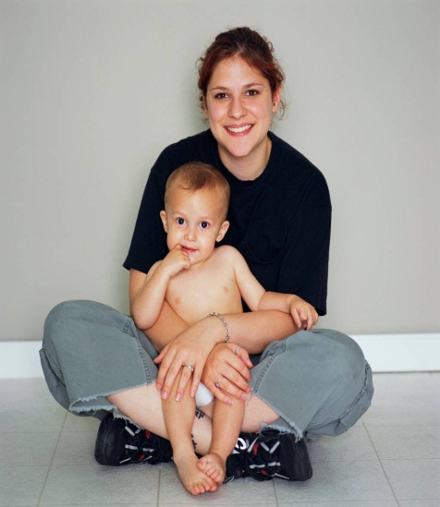

Self-Confidence/Exploration
Felt security
Secure Base
Caregiver’s
Signal detection
Perceived Threat
Safe Haven
Attachment System
Signaling
Proximity Seeking

Slide 37
Sense of Self
Felt security
Balancing
Secure Base
Caregiver’s
Signal detection
Perceived Threat
Safe Haven
Attachment System
Signaling
Sense of Other

Slide 38
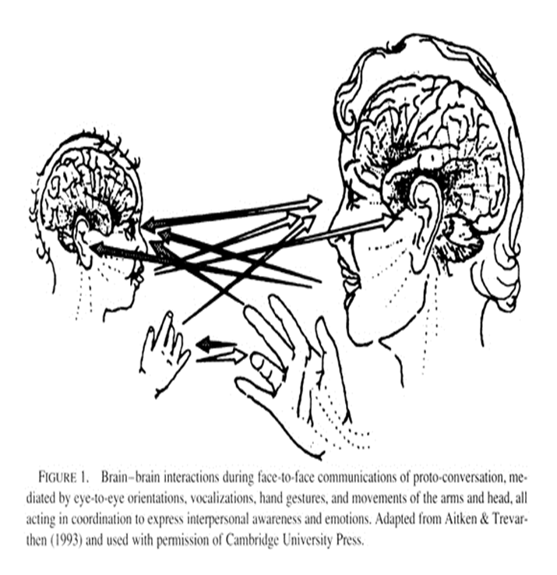

Slide 39
MARY AINSWORTH
· Developed the Strange Situation Procedure
· Three Attachment Categories: A,B,C
Type A - Avoidance
Type B - Secure
Type C - Ambivalent
· A Fourth Category, D, Was Developed Later by Main & Solomon

Slide 40
Attachment Styles and Parent
Responsiveness
Parent Responses Themes
Attachment Style
Responsive/Attuned
Secure
Rejecting/disengaged/overly Intrusive
Avoidant
Inconsistent/Role reversal
Ambivalent
Frightening/
Threatening/
Dissociated
Disorganized

Slide 41
MARY MAIN
· A Student of Mary Ainsworth
· “State of Mind With Respect to Attachment”
Study of Parent Autobiographical Narratives of Childhood and Correlated Them With Child Strange Situation Classifications
· Emphasis on Both Content (What) and Process (How) “Shock the Unconscious”
· Transgenerational Transmission Process
Notes:
Main’s basic methodolgy—how to create anxiety about attachment—use of interview—shock unconscious
Gave strange situation to kids, then interviewed parents, was blind to kids classification. High accuracy==left open question of the chicken or egg
Van izzendorn use of prospective design

Slide 42
TRANSGENERATIONAL PROCESS
AND THE ADULT ATTACHMENT INTERVIEW
AAI Classifications of Pre-term Mothers in Third Trimester of Pregnancy
Child Strange Situation Classification At Twelve –Months
70% ACCURACY
AAI Classification 16 To 20 Years Later
75% TO 78% ACCURACY

Slide 43
AAI: ADULT SECURE ATTACHMENT
Category F: (Continued)
Continuous-
Secure Attachment
Earned-
Secure Attachment
Passing on “the Blessing”
Breaking the Cycle of Abuse

Slide 44
Core Beliefs
Relationship Rules
Self
Other
Are you trustworthy?
Are accessible?
Are you capable?
Are you willing?
Am I worthy?
Am I capable?
Am I willing?

Slide 45
IWM’s: Relationship Rules
+
Other
__
Secure Attachment Self Dimension I’m worthy of love I’m capable of getting the love I need Other Dimension Others are willing and able to love me I can count on you to be there for me | Avoidant Attachment Self Dimension I’m worthy of love (false pride) I’m capable of getting love I want and need (false sense of mastery) Other Dimension Others are incompetent Others are untrustworthy
Ambivalent Attachment Self Dimension I am not worth of love (I feel flawed) I’m not able to get love I need without being angry or clingy Other Dimension Capable but unwilling (bc my flaws) May abandon me (bc my flaws) | Fearful Attachment Self Dimension I’m not worthy of love I’m unable to get the love I need Other Dimension Others are unwilling Others are unable Others are abusive, I deserve it
+
Self
_

Slide 46
Attachment and Feelings
Secure Attachment Full range Good control Self-soothes Shares feelings Ok with others’ feelings Capable of accurate empathy | Avoidant Attachment Restricted Range Too much control Uses things to soothe self, prone to addictions Keeps feelings at a distance Doesn’t share feelings Restricted empathy
Ambivalent Attachment Full range Poor control Can’t self soothe Shares Feelings too much Overwhelms others with their feelings Uses feelings instrumentally to gain proximity | Disorganized Attachment Full Range, but few positive feelings Poor control Can’t self-soothe Can’t really share with others Overwhelmed by others feelings Dissociates when in face of strong emotion
Notes:
Emotions are gas with a purpose
Drives behavior, organizes behavior
Adaptive, God given

Slide 47
Attachment and Intimacy
Secure Attachment Comfortable with closeness Shares feelings and dreams Willing to commit Balances closeness and distance | Avoidant Attachment Not comfortable with closeness Withholds feelings and dreams Difficulty with commitment Distances
Ambivalent Attachment Desires closeness, but never seems to have enough Wants to merge with other Preoccupied with abandonment Clings and criticizes Crisis→attachment | Disorganized Attachment Desires closeness, but fears and avoids it Wants to merge, then wants to distance Terrified of abandonment Sabotages closeness Attracted to people who victimize
Notes:
Emotions are gas with a purpose
Drives behavior, organizes behavior
Adaptive, God given

Slide 48
God and You:
Attachment and Spirituality
Kirkpatric
  Reframes attachment within religious context
Christian conception of God satisfies Ainsworth’s attachment criteria:
  Seeks closeness in times of trouble
  Safe Haven
  Exploration
  Separation→anxiety/anger
  Loss→Grief

Slide 49
Scriptural Bases
Philippians 4:4-7
Rejoice in the Lord always. I will say it again: Rejoice! Let your gentleness be evident to all. The Lord is near. Do not be anxious about anything, but in everything, by prayer and petition, with thanksgiving, present your requests to God. And the peace of God, which transcends all understanding, will guard your hearts and your minds in Christ Jesus.(NIV)
Ps 17:6-10
I call on you, O God, for you will answer me; give ear to me and hear my prayer. Show the wonder of your great love, you who save by your right hand those who take refuge in you from their foes. Keep me as the apple of your eye; hide me in the shadow of your wings from the wicked who assail me, from my mortal enemies who surround me. They close up their callous hearts, and their mouths speak with arrogance.(NIV)

Slide 50
Scriptural Bases
Ps 46:1-4
God is our refuge and strength, an ever-present help in trouble. Therefore we will not fear, though the earth give way and the mountains fall into the heart of the sea, though its waters roar and foam and the mountains quake with their surging. Selah

Slide 51
Attachment and Spirituality
Attachment style impacts how God is viewed
  Secure: He is there, I can count on Him. He will accepts me, in spite of my flaws
  Avoidant: He isn’t there for me when I need Him. I will have to go at life alone. I don’t really need Him.
  Ambivalent: I’m too flawed; God is sure to reject me. I probably committed the unpardonable sin
  Disorganized: I’m flawed, beyond repair. God will strike me down if I turn toward Him. He will surely reject or punish me.
Notes:
Story of the mom, avoidant style, who talked about God in the most glowing terms, yet had a fairly rigid and unrefelctively global view of God, discovers that her father in law was a child molester/ also a pastor---she felt that God had abandoned her.

Slide 52
Helping People Change six essential ingredient
The “Secure” Model of Change
Notes:
Each ingredient is multifaceted and has various layers

Slide 53
Six Ingredient
Art and Science
Cooking a good soup
  Know the essential ingredients
  How the ingredients interact with other, compliment each other
  How they may behave differently, each time you use them
  A good soup—I love chili—is more than the sum of its parts//tomatoes, onions, meat, beans, seasoning, etc.

Slide 54
The work of Holy Spirit
Are you called to do this work
God uses those who have been wounded
You must come to terms with what has happened to you—
God will work all things to the good of those who are called according to his purposes
Your reliance on God and sensitivity to the Spirit is essential
Take care of yourself—this is hard work

Slide 55
Safety—
Fostering therapeutic alliance
Nurturing collaboration—exploring the story of “why are you here?”
Create a “safety zone” (McCallough)
Information gathering, assessment, diagnosis, goal-setting
Structuring sessions—agenda setting, specificity, secure commitment
Instilling hope
Notes:
We are imitators of Christ
Different terms—secure base (bowlby), container (bion), holding environment (Winnocot)
Moving from global, transituational descriptions of problems to specific problems that occur in actual space and time

Slide 56
Education
More than just Psychoeducation—conveying relevant information—Key to Alliance
Learning new skills—distress tolerance, emotion regulation, interpersonal effectiveness, problem solving, impulse control, behavior activation
Spiritual disciplines—mindfulness--
Neuroempathy—understand problems in light of underlying neurocircuitry

Slide 57
neuroempathy
  Your mind and brain are different. You are not your brain
  You are not your thoughts
  Your thoughts are produced automatically by your brain.
  Your mind can chose to believe them or to engage in brooding

Slide 58
Containment
Extends the safety construct
Creating a balance between emotional activation and emotion regulation
The therapeutic window
  When in this window—
    Teaching skills in context of emotion
    Modify old schema
      Implicit beliefs about self and others
      About how to deal with strong emotions
      Breaks patterns of avoidance

Slide 59
Therapeutic Window (see John Briere)
Too much support, not enough challenge
10
Emotion Activation
8
6
4
2
15
30
45
Length of session

Slide 60
Therapeutic Window
Too much challenge, not enough support
10
Emotion Activation
8
6
4
2
15
30
45
Length of session

Slide 61
Therapeutic Window
Balance of challenge and support
10
Emotion Activation
8
6
4
2
15
30
45
Length of session

Slide 62
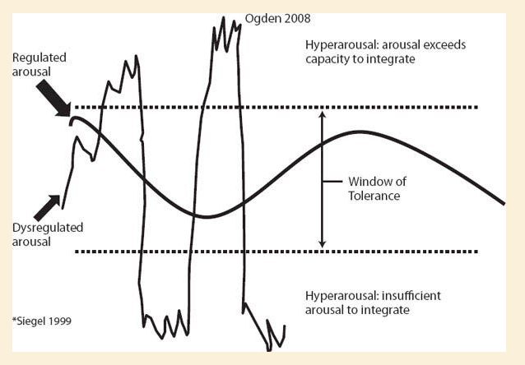
Ogden’s Modulation Model

Slide 63
Containment
Dealing with treatment relationship ruptures
Helping desensitize toxic implicit relational beliefs that are activated by emotional activation

Slide 64
Understanding
Helping clients engage in narrative repair—
Telling their stories, linking current patterns of thinking, feeling relating, and communicating with previous relationship experience
How relationships are two way transactions (especially therapy relationship)
How old patterns of relating were healthy at the time, but maladaptive now…
Appreciate the consequence of their interpersonal and intrapersonal behavior
They create much of the pain they experience now
Differentiating between toxic others of past and current therapeutic relationship
Notes:
Tried to compliment a pt who told me I was saying that because I was being paid by him…link to his parents hiring a nanny who took care of him (because she was being paid--

Slide 65
Examples of Procedures
Significant Other History
Transference Hypothesis
Identification of transference hot spots
Interpersonal Discrimination Exercises

Slide 66
Restructuring
Schema reconstruction—highly intentional process—understanding personal narrative in light of God’s redemptive story in their lives
Modifying maladaptive, self-defeating patterns of thinking, feeling, behaving—cognitive restructuring, problem-solving skills
Learn to engage in personal experiments that can generate new “data” that may unfreeze negative, rigid, globally negative beliefs—both in and out of session
Practice new patterns of relating to others and giving up old patterns of avoidance, blame, and defensiveness
Fostering forgiveness—self-others

Slide 67
Engagement
Dealing with resistance and therapeutic ruptures
Begin differentiating between old, toxic relationships and therapy relationship (Interpersonal Discrimination Exercises)
Fostering generalization from safety of therapy office to other context
Anticipating and dealing with relapse prevention

Slide 68
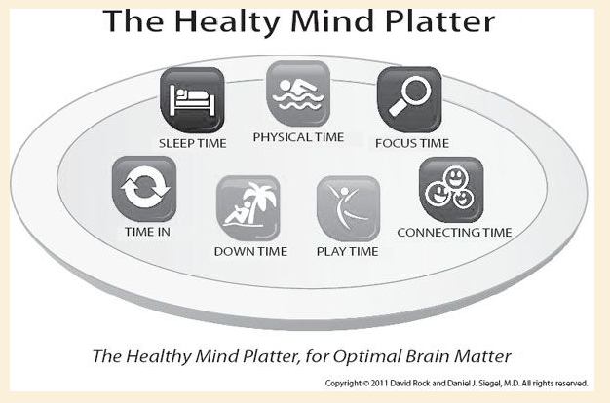
Essential Activities

