Slide 1
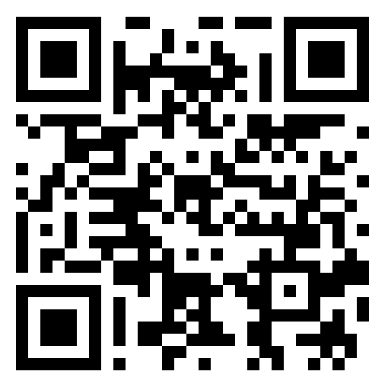
Policies for our people
Student Employment Practices Responding to Pandemic and Climate Disasters
Gabe Gossett, Head of the Hacherl Research & Writing Studio
Western Washington University
Presentation and policy examples at QR code or https://bit.ly/PolicyPeopleIWCA

Slide 2
Ugh . . . Policies boring
Why should I focus on student employee policies?
Enhances employee agency
Provides for equitable and transparent decision-making
Time spent on a good policy saves the time and effort of everyone many times over
The nature of work and labor rights are changing
A less predictable climate means we can’t keep doing teaching and learning as usual

Slide 3
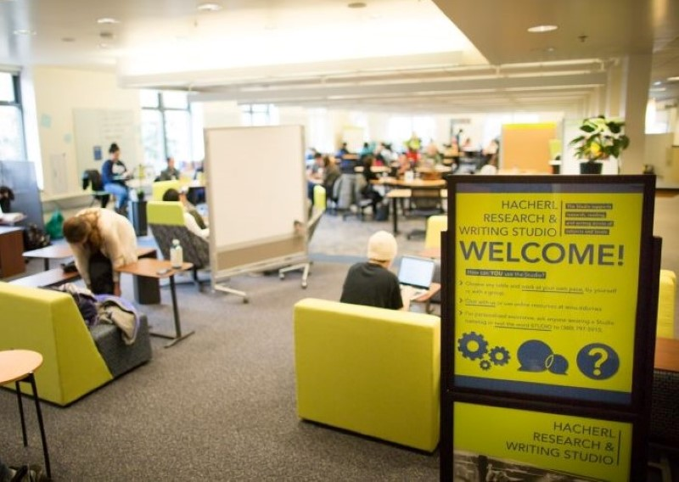
Context
Western Washington University—mid-sized masters granting institution in Bellingham, Washington
Hacherl Research & Writing Studio (Studio) employs student and fulltime staff to support writing, reading, and research
The Studio has long provided consults through many modalities—in-person, draft response, online chat, online meeting, and text message
Chat, online meetings, and text message consults are provided by the same staff who consult in-person
Bellingham has a fast-rising cost of living

Slide 4
There must be something positive we can glean from this pandemic . . .

Slide 5
Hybrid work
Disruptions forced a new way to think about the primacy of in-person work
Many fulltime staff moved from online to hybrid work
Can be used to support a healthy work environment through reduced transmission
What about student employees?
Notes:
There has to be something positive we can glean from this pandemic . . .
The disruptions forced new ways to think about work and the centrality of the physical workspace
From working all-online, it became easier to see how a hybrid work format can not only be beneficial, but actually enhance productivity and employee wellbeing.
But what about student employees?

Slide 6
The Problem
How do we realistically make it so that student employees won’t come in when sick or exposed to COVID, while not causing financial harm? How do we do this while still covering shifts for basic operations?
We know some student staff are paycheck-to-paycheck or going into debt
Washington State has a parttime sick leave law, though it is inadequate
How do we cultivate a work environment with less chance for virus transmission?
Notes:
One conundrum was how to make it possible for employees to not come into work if they had been exposed to Covid or were presenting with symptoms.
We know many students need the income from their shifts. Many are scraping by paycheck to paycheck to make rent and pay for food, while often still going into debt.
While Washington State has introduced mandatory sick leave it takes a long time to accrue.
How might we make it possible for them to take advantage of hybrid work, just like full time employees could, to support everyone’s wellbeing?

Slide 7
The Precautionary Online Shift Option Key Elements
Studio employees presenting with COVID symptoms or with a recent exposure can opt for an online shift
Employee choice: It does not supplant using sick leave or leave without pay
Online shifts are for illness only, not being busy or stressed
Clear communication steps are outlined
Online-only staff are first up for any online interactions
Employees can initiate an online shift without prior approval
After one year of working well the policy was extended to flu and colds
Notes:
If employees were presenting with symptoms for Covid as described on the CDC website, or if they had recent exposure to someone who has tested positive, they could opt for an online shift.
The option is not there to supplant using accrued sick leave or taking leave without pay.
Online shifts through this procedure cannot be for feeling stressed out or busy, only for illness.
Steps are outlined for communicating with the Studio Leadership Team and others sharing a shift with them.
When doing an online shift, that person is first up to take any online consultations in case in-person staff are busy.
Given how well it has worked, we have extended the policy to explicitly include flu and colds.

Slide 8
That’s great, but what about this other thing I have going on?
Notes:
Last October, around the time of IWCA in Vancouver Bellingham was experiencing many weeks of wildfire smoke, an unfortunately annual event now, though usually in summer.

Slide 9
A more complex need
Wildfires, floods, heat domes . . . in addition to all the other things that come up in life.
Initially it was daunting to write a policy that can provide guidance on all the situations that may arise much less the many ways those situations might be managed
An accommodations framework brought it into focus
With advice from the Director of Disability Access Services some basic principles were outlined to devise an “unpolicy”
Notes:
Last October, around the time of IWCA in Vancouver Bellingham was experiencing many weeks of wildfire smoke, an unfortunately annual event now, though usually in summer.
An employee inquired with me about using the online shift option due to a respiratory condition, which I declined because of my focus on making sure the policy stay focused so higher ups wouldn’t start looking askance at it.
That call didn’t sit right, so I started discussing whether we might be able to be more inclusive of these kinds of requests with Shevell Thibou, the Director of the Teaching & Learning Division that our Studio is situated within, and Brian Davidson, the new at that time Head of the Tutoring Center, also in the Teaching & Learning Division.
Brian and I were tasked with attempting to devise a policy that could be used for both of our units.
At first it was daunting, because of all the possible scenarios that we might encounter, but what really brought it into focus was an accommodations framework.
We sought the advice of the director of the Disability Access Center regarding the use of accommodations language for a policy of this kind and any suggestions on how to implement it.
The result, as Brian would put it, was something that was more of an “un-policy.” While many policies set out to prescribe and restrict actions, this one is about expanding those options.

Slide 10
Temporary accommodations procedure Key Elements
Acknowledges the financially precarious situation of student employees
Recognizes there are many unforeseeable situations that arise that can be addressed through a temporary accommodation
A description of some types of disruptive events
An outline of the accommodation request process, including how to establish the specifics of the accommodation (and encouraging employee ideas)
Accommodations are documented in a secure form
Supervisors will not disclose health information with other staff when communicating with them about accommodations

Slide 11
Where we are now
Supervisors are better equipped to work with student employees on collaborative solutions
Aside from some minor issues, both policies have been working well (no understaffed shifts due to illness outbreaks feels like a success!)
Student employees at Western just voted overwhelmingly to form a union to represent the 1,100 student workers and are bargaining now
We have heard overwhelmingly from student staff during quarterly conferences that they feel like they are part of a supportive community

Slide 12
What kinds of policies would enhance employee agency in your program?
Presentation and policy examples at QR code or https://bit.ly/PolicyPeopleIWCA

