Slide 1
Why big data needs the virtues
Frances S. Grodzinsky, PH.d
Professor Computer Science and Information Technology
C0-Director Hersher Institute of Ethics
Sacred Heart University
Visiting Scholar RC VEST SCSU
Notes:
In 1997 a younger and rather naïve professor of Computer Science stood in front of a room of rather senior and well-respected philosophers and explained why Virtue ethics should be revisited in the teaching and study of Computer Ethics ( as the new field was identified). Not used to the gentle ways philosophers have of sharing their comments, she was shocked at the total and vociferous rejection of her ideas. Of course, being strong willed, not easily discouraged and convinced by the evidence coming out of her classes, she pushed on in Virtue ethics for the next 18 years. So it is encouraging to see others using virtue theory in their analyses of technology and its artefacts. In this talk, I will make some observations about Big Data through the lens of the virtues.

Slide 2
Outline
Introduction : Virtue Ethics , Virtue Epistemology and Pluralistic models
Characteristics of Big Data: Volume, Velocity, Variety, and Validity
          Ethical Issues raised by these characteristics
    Big Data : Why is it valuable?
The Big Data Scientist
          Responsibility
Why Big Data needs the virtues
Conclusion

Slide 3
Introduction
      Bernard Williams said:
          If there is such a thing as the truth about the subject matter of ethics…why is there any expectation that it should be simple. In particular, why should it be conceptually simple, using only one or two ethical concepts, such as duty or good state of affairs rather than many? Perhaps we need as many concepts to describe it as we find, we need and no fewer (Williams,1985:17).
Others who have embraced Pluralistic models
        Robert Louden
        Nancy Sherman
        Catherine Elgin
        James Moor

Slide 4
Introduction
Given the increasing complexity of our data driven world, it seems as if we need all the ammunition in our philosophic arsenal to make sense of and to create good policies for the “infosphere”
  where :
      agents are both human and non-human,
      where technology often trumps social values,
      where patterns based solely on correlations are used to predict events that affect us all,
      where scientific method gives way to purely inductive reasoning and
      where experience is ignored or not consulted because of the belief that “more data is necessarily good data”.
Notes:
Term coined by Floridi. This complex infosphere requires attention to both virtue ethics and virtue epistemology to untangle it.

Slide 5
Characteristics of Big data
The central characteristics of Big Data are often referred to as the 3 v’s :
volume (The quantity of data generated),
velocity (speed of generation and analysis)
variety (of sources), (traditional 3 v’s) and a 4th,
veracity (quality)
They raise a number ethical issues concerning its generation, collection and use.

Slide 6
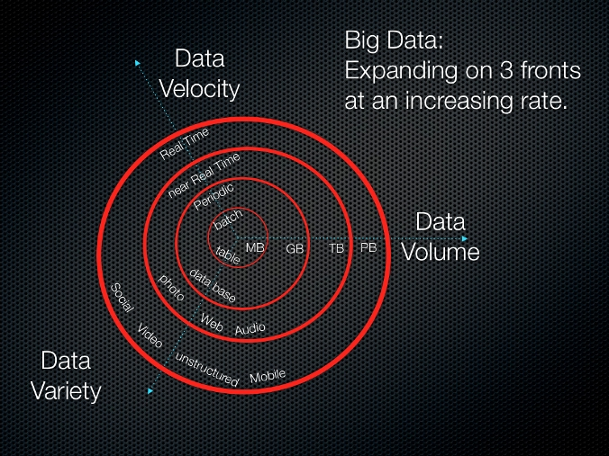
3 V’s: Volume, Velocity, variety
http://whatis.techtarget.com/definition/3Vs

Slide 7
Volume
Is Big Data just doing our old data mining on a larger scale with bigger data sets or do we have a real shift in the way we analyze data to inform our understanding of the world. Kitchen writes “Big Data and new data analytics enable new approaches to data generation and analyses to be implemented that make it possible to ask and answer questions in new ways.
Rather than seeking to extract insights from datasets limited by scope, temporality and size, Big Data provides the counter problem of handling and analyzing enormous, dynamic, and varied datasets.” (Kitchen, 2014:10)
The use of social graphs is such an approach. According to Facebook executives the “social graph” is the most innovative feature of their enterprise because it can be plumbed for social data. Facebook processes 2.7 billion “Likes”, 300 million photo uploads, 2.5 billion status uploads and other data daily in order to determine which ads to send out to its users. In essence it has become the world’s largest data crunching machine (Vance, 2012:67).

Slide 8
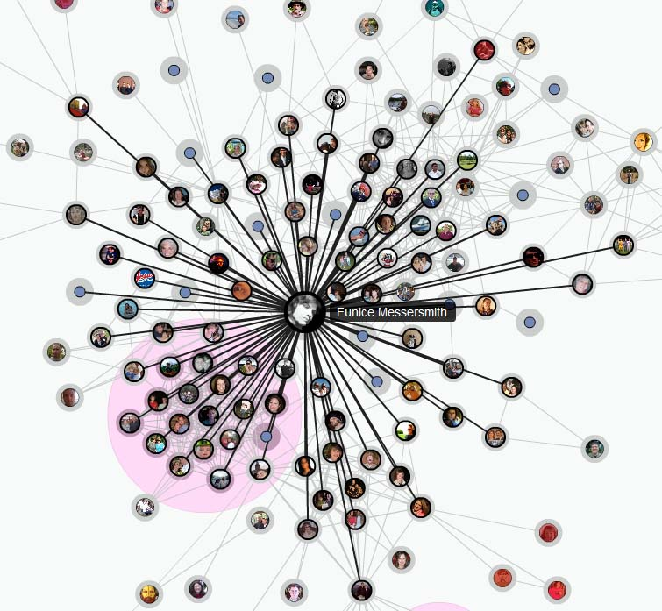
The Social Graph
Actors are nodes; Lines are ties

Slide 9
Volume
How much is necessary to retain for future use?
      The sheer quantity of produced data has given rise to an industry of companies that will help you make sense of analysis results.
      They have become adept at selective data crunching and have uncovered all kinds of patterns and correlations. For example, do we care that that smokers tend to suffer less from carpal tunnel syndrome and vegetarians miss fewer flights. Who knows? But these companies are willing to tell us why this information may be useful in maximizing value for our business venture.
Those who encourage us to believe that correlations are infallible may be ignoring the fact that their use in particular contexts may be dangerous.
For example, some results may give rise to the possibility of profiling based on age, race, sexual orientation or other characteristics and behaviors which when correlated could lead to discriminatory practices
For example, there is nothing to stop employers with access to data from determining the probability of illness or disease based on health and eating habits. These employees could then be viewed as expensive, a potential insurance risk and therefore non-desirable to the company. Furthermore, when correlations lead to policy based on profiled categories the possibility for discrimination exists (See Grodzinsky et al, 2013).
The analytics resulting from the volume of data should not preclude the data scientist from asking the ethical questions and interpreting and re-contextualizing the data in a beneficial rather than harmful way.

Slide 10
Velocity
Velocity refers to the speed and the ability to gather massive amounts of data, ingest it, and spit out analysis in near real time. It also refers to the accelerating rate of data creation and growth provided by the Internet of Things.
“Social media and genetic sequencing are among the fastest growing sources of Big Data used for analysis” (EMC, 2015:3).
The shift to Big Data analytics has moved so fast and gotten so powerful that many in business, a driving force behind the use of Big Data, believe that modern economic activity is dependent on Big Data for the functioning of our global economy.
“The ability to “now cast” using real time data enables prediction and theory testing never before possible in applications in the public sector and in personal location data”.
Carrying smart phones provides a constant stream of incoming data. The speed coupled with the volume, creates patterns and correlations at a rate that no human can compete with.
The machine is trying to make sense of our world at an alarming rate because the rate at which data flows into an organization impacts decision making and return to the customer. The faster the feedback loop, the more value for the company. Should we leave the interpretation of these patterns to a machine alone?

Slide 11
variety
Variety means bringing together pools of data from various sources (sensors, smart devices, databases), either explicitly or gleaned from information passively supplied by human generators, to analyze patterns and make informed decisions.
The amassing and business analysis of this data is the basis for competition and growth, enhanced productivity and value creation in business.
While marketers see this as a win-win situation, ethical analysis of issues such as social engineering, lack of informed consent with human subjects, and discriminatory practices falls by the wayside.
Data generators (those who data is about) are at a disadvantage by not knowing who is collecting and using their data.
Power inequality exists between the generator and the collector and utilizer, both of whom have greater power than the generator. The IoT and global data exacerbate the power imbalance benefitting corporate entities who know how to generate intelligence from data (Zwitter, 2014).

Slide 12
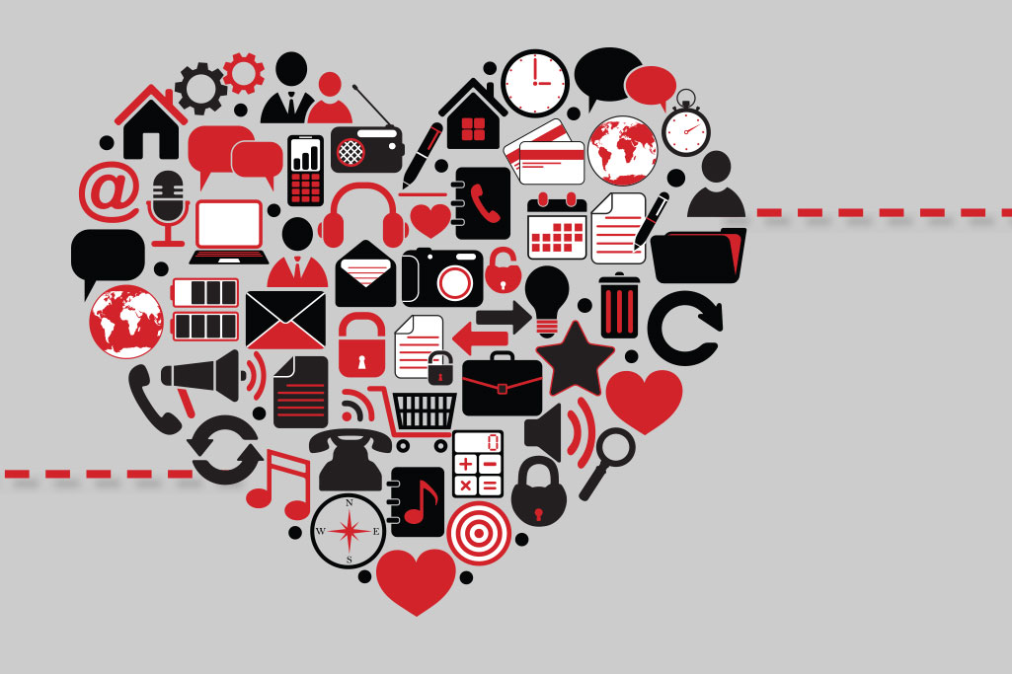
Big Data Sources

Slide 13
Variety (continued)
Statistical discrimination is made possible by modern data collection methods and statistical analysis. Much of the problem of discriminatory practice has to do with how the results of Big Data analysis are interpreted and used. The variety of sources including social media and smart phones provide an unending stream of behavioral patterns that make it easy to identify race or ethnicity.
Media buyers may very well attend to the same sets of privileged consumers based on social affiliation.
Analysts derive population means and other statistics from information gathered from members of various groups of interest on such variables as household income, default rate on loans, and monthly food budget.
These averages are then used to determine if members of a social group will be offered a good or service and at what price. As a result, disparate impact or unequal treatment of an identified class compared to similar groups could result from data analytics (Grodzinsky et al, 2013).

Slide 14
Veracity
Veracity can refer to the quality of the data.
An ethical problem with the preparation is making sure the data is clean data, to avoid any biases. Once the initial data feeds are identified, test data can be run to look for interdependencies among attributes, data quality and the limitations of data. Big Data is not all unilaterally good or valuable. We might want to hold onto raw data to check for any nuances that might not be obvious in the clean data. We are looking for consistency, data ranges, time related variables, consistency of abbreviations, scales and normalization.
Critical evaluation is needed when measuring results.
Are our results meaningful given the context?
    Are we tweaking algorithms? And if so, are we being transparent about how the tweaking affects the results both positively and negatively?
    Are we communicating results in terms that the users can understand? What exactly does it mean to say that results are 90% correct? What happens with the other 10% and how does this translate into meaningful information for the users?
Veracity can also refer to the consistency of the model’s predictions. How will we know which models to trust with our future decisions? This is an issue for the virtue reliabilists and beyond the scope of this talk.

Slide 15
The value of Big data
We live in a world of data collection where organizations and marketers know our income, our credit rating and history, our love life, race, ethnicity, religion, interests, travel history and plans, hobbies, health concerns, spending habits and millions of other data points about our private lives. Butcha refers to the mining of our behaviors, habits, likes and dislikes as the “creep factor” of big data (Buchta, 2014).
It is estimated that data generated worldwide (volume) will be 13 zettabytes (ZB) [1 ZB=10²¹ ] by 2016 and 44ZB by 2020. The rise of computational power (velocity) plus cheaper and faster devices to capture, collect, store and process data, translates into what Mayer-Schonberg and Cukier (2013) calls the datafication of society.
Big Data is data which: “exceed(s) the capacity or capability of current or conventional methods and systems” (MIT, 2013).

Slide 16
The value of big data: ethics gap
According to proponents of Big Data:
    Pentland: A quantitative measure of human behavior that can be used to solve human problems
    The past is history; the future a mystery that Big Data can unlock
        with a shift from causation to correlation
        from old knowledge-based searches to predictive analytics
        from small data sets used to answer specific questions to massive amounts of data analyzed without specific direction
  Rather than processing data into information, we are now “transforming information about all things into a data format to make it quantified (Mayer-Schonberger, Cukier)
  The claim is that that data’s value needs to be evaluated in terms of all the possible ways it can be used in the future, not simply in the present.

Slide 17
Imperatives that drive big data
Mayer-Schonberger and Cukier cite three new imperatives to drive the Big Data process(M_S Cukier, 2013:12-15):
        use all data,
        accept messiness and
        embrace correlation.
    Their claim is that these drive a shift in the way we analyze information that in turn transforms how we understand and organize society. As a result, we can unlock the implicit, latent value of the information (Mayer-Schonberger, Cukier, 2013:15).
  Clearly there is a shift in methodology, in the way we approach and quantify data.
  Yes there are insights that emerge from the patterns of predictive analytics.
  However, I do not share their optimistic belief that correlation is sufficient.
  We need experts and context to unlock the value of Big Data in useful and ethical ways.

Slide 18
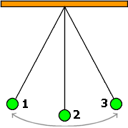
Pendulum
The pendulum swings far beyond accepted norms with claims that Big Data is the next big paradigm shift or even revolutionary. How do we distinguish hype from reality in an attempt to find the appropriate mean? Look to the virtues!

Slide 19
The Virtues
Virtue theory moves us away from only looking at business value and productivity as the end goal of Big Data, but also examining how it can contribute to our well-being
  The changing role and influence of data, the distributed locus of control, the global effect of decisions and wide reaching consequences that affect both the individual and society require thoughtful analysis as we push ahead in our data driven world.
It is my modest claim that combining
      virtue ethics and
      virtue epistemology (“virtue epistemologists hold that knowledge results from the display of epistemic virtues – open-mindedness, rigor, sensitivity to evidence, and the like” (Elgin, 2013, p. 135)).
  will help us build a framework to analyze the process of creating
  and using Big Data in an ethically consistent manner.
  Thinking in terms of the virtues will help us in analyzing Big Data.

Slide 20
The virtues
I advance the following thesis:
      When a Data Scientist habitually acts in accordance with the virtues, she will be better able to cope with the messiness and dynamic flux of Big Data with humility, open-mindedness and intellectual courage.

Slide 21
Big data science
Chris Anderson, former editor-in-chief at Wired magazine, and others argue that ‘the data deluge makes the scientific method obsolete’; that the patterns and relationships contained within Big Data inherently produce meaningful and insightful knowledge about complex phenomena and that we can analyze the data without hypotheses about what it might show.
I disagree with this “theory-free view” of Big Data and want to debunk the claim that useful conclusions can always be read straight out of the data sets without the help of Data Scientists and experts.
While statistical correlations serve us well in producing patterns that can be analyzed, they need not be the epistemic end of the analysis. Correlation can lead to new hypotheses and new and deeper understanding of what we know and what we still need to know.
Experience and expertise in the humanities and social sciences are devalued if the task of understanding the nuances emerging from analytics is just left to statisticians.
Notes:
Place of values in science and scientific experimentation: see work of the Philosophers of Science Helen Longino, Eric Winsberg and Heather Douglas.

Slide 22
Big Data Science
While Big Data enthusiasts might not see this as a problem, as they can access correlations directly and more efficiently, I claim that the role of the humanities and social scientists is to augment this process as interpreters of how best to use these correlations to benefit society.

Slide 23
The role of Big Data Scientists
The Data Scientist who approaches the ethical issues (those touched on in the previous slides, using her intellectual virtues, will be well-equipped to deal with them .
The role of the Data Scientist is to reframe social, medical, business challenges as analytics challenges.
S/he investigates what kind of analytics we need to explore a problem. In order to make these analytics valuable to the interested parties, the Data Scientist has to have the insight and skills to communicate effectively.
Along with quantitative and technical skills, data scientists embrace the intellectual virtues of creativity, curiosity, critical thinking. They should be able to work collaboratively with quants and stakeholders alike to explain what they are doing and why.
It is critical that they honestly define the key questions that analytics can and cannot answer for their stakeholders. Communication is the key. The lack of communication between those at the bottom and those at the top of the Big Data chain is a problem. The Data Scientist can serve as the effective interface in the solution to this problem.

Slide 24
The role of big data scientists
In the context of discovery, exploring patterns that emerge from Big Data may lead to understanding of how and when they should be used. They do not merit blind acceptance.
Understanding is critical in the view of Zagzebski, a Virtue responsibilist. (Zagzebski 2001, 242).
The Data Scientist who approaches Big Data with the virtues of humility, open-mindedness, creativity, prudence , rigor and intellectual courage contributes to this understanding by recognizing the limitations of the analytics and reaching out to experts to broaden the understanding contextually.
Including experts provides a richer and more robust epistemic community in which to explore the complexities of Big Data.
Notes:
It could still be future oriented , but also context driven.

Slide 25
the computing context gap
Steve Lohr, in his book Dataism (2015:3), cites the example of Google Flu Trends that is illustrative of the strengths and weaknesses of the Big Data approach (Lohr, 2015:107).
In 2011, the algorithm stumbled consistently overestimating the number of flu cases. Despite that, Lohr points out, Flu Trends is still regarded as a triumph because Google algorithms did their job; they identified correlations and quantified them.
However , things turned out to be complicated and more nuanced than the algorithms could see. They missed context—some missing pieces of the large picture which gave the data meaning. Lohr refers to this as the computing context gap (Lohr,2015:111),
I claim that this gap could be closed by Data Scientists working with experts.
Getting to the why of thing requires understanding. That is why we should give more authority to experts from a plurality of domains.
Notes:
He reports, in 2011, the algorithm stumbles; in 2013 google updated its code; in 2014 four quantitative social scientist found that Google’s flu tracking service had consistently overestimated the number of flu cases…a period of 2 years, and declared Google guilty of big data hubris which the authors defined as the implicit assumption that big data sets trump traditional data collection and analysis. Although Google made more tweaks to its algorithms, they still over shot by 30 percent.
I claim…..“Big data is good at interpolation—figuring out what happens next when the outcome is, most likely, a continuation of the current trend. It is far less good at extrapolation—figuring out what happens next when the trend line of the future is less clear. In short, big data stumbles when a decision requires an intuitive step outside the data sandbox—beyond the range of data” (Lohr, 2015:53).

Slide 26
responsibility
The power of Big Data derives from how it is used in a social context. If we are to flourish in the era of Big Data we need transparency: hidden assumptions, biases and motivations need to be unveiled, and the limitations of Data Science revealed.
The responsibility of the Data Scientist is to create the best product possible. But this is a shared responsibility
Falling under the excitement of developing new models and algorithms, does not remove computing developers, experts and users from the responsibility of ascertaining how to use results in a manner that benefits society and not simply one that is expedient for corporate or governmental interests.
Approaching Big Data with humility is at step in that direction.
Notes:
Financial crisis 2008: Financial economics is young and suffers the same growing pains as Big Data. It uses predictive analytics to forecast the performance of financial markets.
In 200 , world govts, bankers etc did not see the financial collapse on Wall st until it was too late. Only a few experts emerged with credible early warnings but they were ignored and dismissed. (The models contradicted them). Joe Weizenbaum would call this the ‘hubris’ of the predictors that prevented them from recognizing the limitations of the models. People suffered huge losses.

Slide 27
responsibility
Data scientists experts and users are interdependent.
Teams of responsible Data Scientists, users and experts can work together to realize the same epistemic goal of creating the best models and tools to be used for prediction.
Although expertise is distributed across the epistemic community, the individual epistemic agent’s responsibility is not undermined. This theme is seen in the work of Miller, Wolf and Grodzinsky on responsibility in software development and is a response to Helen Nissenbaum’s account of the problem of many hands.
Notes:
1-- In order to critically assess the process, we need access and transparency.
2– According to Cahterine Elgin– epistemic agents should think of themselves as and act as legislating members of a realm of epistemic ends. They make the rules, devise the methods and set the standards that bind them. The epistemic virtues are the traits of intellectual character that equip them to do so.

Slide 28
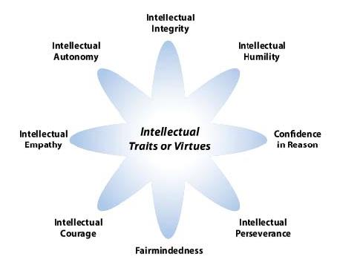
Intellectual virtues

Slide 29
Using the virtues
Knowledge results from the display of epistemic virtues such open-mindedness, rigor, sensitivity to evidence, intellectual courage . Zagzebski argues that intellectual virtues must be reliable. So not only do they just require epistemic motivation, but also reliable success in attaining their ends such as truth, knowledge and understanding.
Virtue responsibilists conceive of the virtues as acquired character traits—habits that a responsible inquirer would have. They are modeled on Aristotle’s study of moral virtues.
An attractive feature of epistemic virtue theory is that it can both acknowledge, and explain why, virtuous epistemic agents are cognitively admirable even in epistemi­cally hostile environments.” (Elgin,2013)
A Data Scientist who “makes the best use of available resources” and gives attention to context is demonstrating what a responsible epistemic agent should do, whether the envi­ronment is hostile or auspicious or something in between. “Open-mindedness and sensitivity to relevant detail qualify as responsibilist virtues”.
There is a plurality of intellectual virtues, and their successful exercise gives rise to a plurality of epistemic goods that may contribute to flourishing in society.
Notes:
To attain these ends, intellectual skills and the knowledge that they provide are necessary for without them virtuously motivated agents would not be reliably successful. The motivational piece of Zagzebski makes her concept of the intellectual virtues different from Aristotle’s: there are no motivations in Aristotle’s contemplative virtues. Unlike Aristotle, these virtue responsibilists focus on desires and motivations that are specifically epistemic
According to Elgin:
An attractive feature of epistemic virtue theory is that it can both acknowledge, and explain why, virtuous epistemic agents are cognitively admirable even in epistemi­cally hostile environments.” (Elgin,2013)

Slide 30
Using the virtues
Ideally, the Data Scientist should take on the role of epistemic agent. I claim that if we are going to use Big Data for predictive analytics, Data Scientists, have the obligation to set goals of transparency that will increase the ethically responsible use of the data.
The Data Scientist, as an epistemic agent, working within an epistemic community could develop and deploy a variety of methods, mech­anisms, heuristics and habits that enable her to credit or discredit wide swaths of inputs efficiently. The critical point is that her beliefs are products of her reflective endorse­ment.
As a member of a “realm of ends”, the agent realizes that the exercise of epistemic virtues leads to these beliefs. “What makes the epistemic agent responsible for her beliefs is that she takes responsibility for them and makes a case for them”(Elgin, 2013).
Being able to respond to the dynamism, the flux and flow, of Big Data projects suggests that the Data Scientist not suppose in advance or be bound by one approach.
Using the virtues such as intellectual courage and open-mindedness enables her to respond better to the flux and flow of the Big Data projects. Working through the messiness guided by the virtues, she should reach an understanding of how the emergent patterns and predictions might affect individuals and society within given contexts. These she should communicate to others in her epistemic community.
Notes:
“Open-mindedness and sensitivity to relevant detail qualify as responsibilist virtues”. For Elgin, this suggests that there is a plurality of intellectual virtues, and their successful exercise gives rise to a plurality of epistemic goods.
Ideally, the Data Scientist should take on the role of virtuous epistemic agent. If we are going to use Big Data for predictive analytics, Data Scientists have the obligation to set goals of transparency that will increase the ethically responsible use of the data. Elgin contends that “an epistemic agent should believe only considerations that she could advocate and accept as a legislating member of a realm of epistemic ends. The ends may be non-truths (perhaps non-propositional representations, effective models, informative idealizations or illuminating fictions) that she takes to yield information or insight about the topic that concerns her. The critical point is that agents set their ends” (Elgin, 2013:144).

Slide 31
Epistemic communities of big data
In Big Data, there can be overlapping communities of ethicists, social scientists, statisticians, economists and the wisdom of crowds who will put forth differing perspectives.
They may not all share the same beliefs
Different stakeholders bring different epistemic goals to the table. The predictive analytics used might be comparable, but how they are interpreted and their context is quite different if you are predicting what shoes to buy or where the next famine will strike because the consequences are less harmful in the former.
These teams produce epistemic content . To turn that content into knowledge requires “effective transformative criticism by differently situated epistemic agents who share epistemic standards” according to Helen Longino, a Philosopher of Science.
Notes:
These teams produce epistemic content
We can be informed by the Philosophers of Science such as Helen Longino , who believes in the context of science that knowledge productive practices and their modes of justification vary in different contexts. Knowledge as content depends on effective trasformative criticism by differently situated epistemic agents who share epistemic standards. Eric Winsberg and Heather Douglas also take stands on the place of values in scientific judgment.

Slide 32
Concluding remarks
I have grounded my discussion of Big Data in the virtues in order to demonstrate that epistemic communities led by virtuous Data Scientists will bring us one step closer to integrating non-epistemic and epistemic values with the goal of doing what is good and right and responsible.
Catherine Elgin (2013:145) reminds us that some virtues are vindicated by what we have come to understand about our epistemic situation because as we learn more about topics, we learn more about how to learn about them .
As we discover biases and limitations in old methods, we turn to new ones. In our attempt to advance our understanding and correct perceived weaknesses in old methods, we must not blindly rush to the other extreme without careful analysis.

Slide 33
Concluding remarks
The science of Big Data is relatively immature compared to that of atomic energy or climate control, for example.
The mature sciences that are as data driven as Big Data already incorporate experts and take a stand on ethical issues for the good of society.
Organizations such as the Union of Concerned Scientists form part of a professional community that serves to give scientists the clout they need to refute politicians and others who are trying to make decisions based on their own agendas.
In this immature science, because the predictions can be somewhat uncertain, Data Scientists are needed to help users understand what the data is, and is not contributing, to their particular context.

Slide 34
Concluding Remarks
Hopefully working within a community of virtuous epistemic agents with common goals, quants, Data Scientists, experts and users, will be able to:
Exhibit open-mindedness-- take the generated patterns and predictions and put them into context, even if they seem counterintuitive at the time;
Exhibit rigor-- validate the evidence to see if the predications have been true or are true. The reliability of the predictions may lead to trust;
Exhibit honesty-- document and communicate to insure transparency of the process, distributed responsibility and the concept of open data.
Using the virtues will be a significant step forward in unpacking and mitigating the ethical issues arising out of the development and use of Big Data.

Slide 35
References
Buchta, Heather. (Nov 25, 2014) How Did Data Get to Be So Big? Inside Counsel. Breaking News. http://www.insidecounsel.com/2014/11/25/how-did-data-get-to-be-so-big Accessed 6/1/15.
Elgin, Catherine Z. (2013) “Epistemic Agency” in Theory and Research in Education 11(2) Sage Publishing Comapany: pp. 135–152 . DOI: 10.1177/1477878513485173.
EMC (2015) Data Science and Big Data Analytics: Discovering, analyzing, Visualizing and Presenting Data. New York: Wiley.
Grodzinsky, Gumbus, Lilley, (2013) Will “smarter” marketing end social discrimination? A critical review, Journal of Information, Communication and Ethics in Society, vol 11. Issue 3, pp. 132-143.
Kitchin, Rob (2014) “Big Data, new epistemologies and paradigm shifts”. Big Data and Society, Sage Publishing Co. April-June pp. 1-12. DOI: 10.1177/2053951714528481.
Lohr, Steve (2015) Dataism. New York: Harper Collins.
Mayer-Schonberger, V. and Cukier, K. ( 2013) Big Data: A revolution that will transform how we live, work and think. Houghton Mifflin Harcourt, Boston, NY
MIT Technology Review, (2013), http://www.technologyreview.com/view/519851/the-big-data-conundrum-how-to-define-it/ Accessed 10/3/13.
Shirky, Clay (2009), Algorithmic Authority,http://p2pfoundation.net/Algorithmic_Authority, accessed 6/15/15.
Simon, Judith (2010), entanglement of trust and knowledge on the Web, Ethics Inf Technology, 12:343–355.DOI10.1007/s10676-010-9243-5.
Vance, Ashlee ( 2012 ) The Making of 1 Billion. Bloomberg Business Week. October 10, 2012
Williams, Bernard (1985). Ethics and the Limits of Philosophy. Cambridge MA: Harvard University Press.
Zwitter, Andrej ( 2014 ) Big Data Ethics. Big Data & Society July – December, 2014: 1 – 6.

