Slide 1
Parkland College’s PMGE Developmental Redesign
Erin Wilding-Martin

Slide 2
Algebra at Parkland
Approximately 67-75% of incoming freshmen place into developmental math
Success rates of about 50% in beginning, intermediate, and college algebra
Approximately 75% of developmental math students are on a non-STEM path!

Slide 3
Old Course Sequence
Pre-Algebra
Beginning Algebra
Intermediate Algebra
Gen Ed Math or Intro to Stat
College Algebra or Pre-Calculus

Slide 4

Redesign Goals
Make the track for college algebra-bound students better
  More rigor, attention to concepts that sabotage algebra skills
Create a new track for gen-ed bound students
  Keep core algebra content, add data literacy
  De-emphasize by-hand algebraic simplification
  Add more applications, exploration, and writing
  Use technology

Slide 5
Course Sequence – First Revision
Math
Literacy
Intro to Statistics or Gen Ed Math
Beginning Algebra
College Algebra or Pre-Calculus
Pre-Algebra
Intermediate
Algebra

Slide 6
Course Sequence – Current Version
Math
Literacy
Intro to Statistics or Gen Ed Math
College Algebra or Pre-Calculus
Pre-Algebra
Intermediate
Algebra

Slide 7
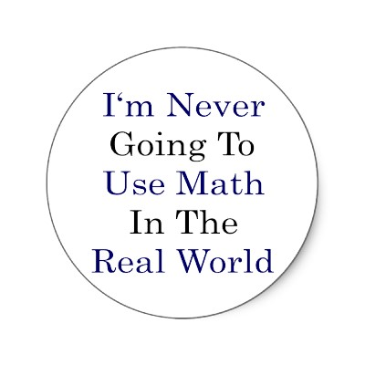
Math Literacy
Design
Alternate but still challenging path
Math in context, focus on numeracy, data analysis, and functions
Develop critical thinking and conceptual understanding

Slide 8
Productive Struggle
Real problems don’t follow cookie-cutter patterns; they take work
Take responsibility
Persistence will pay off

Slide 9

This Class is Different!
Little to no lecture
Group work, active participation required
Reading, writing, technology
Online skills work outside of class

Slide 10
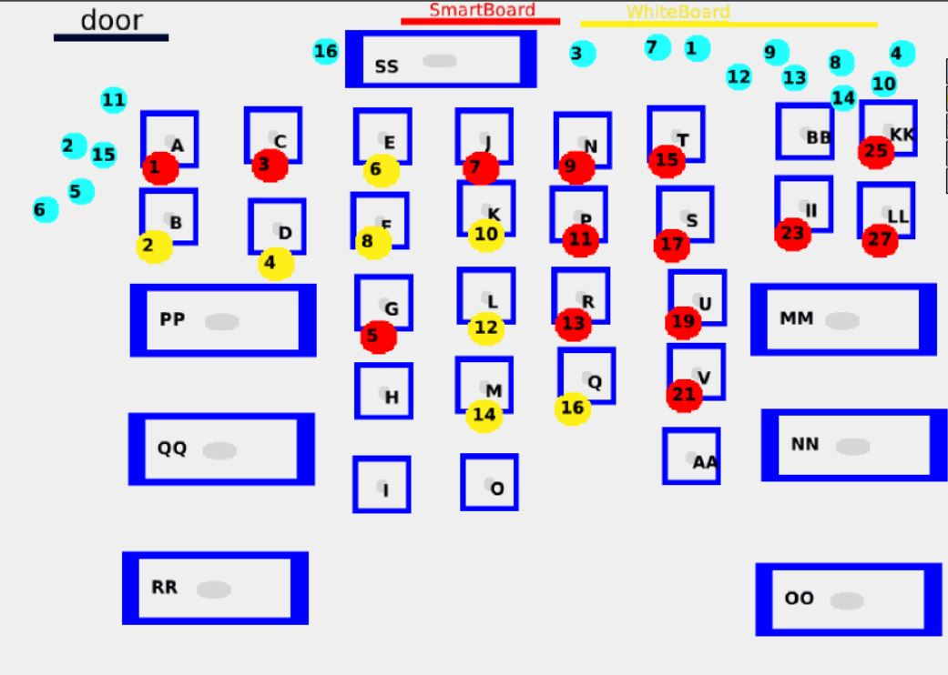
A Traditional Classroom

Slide 11
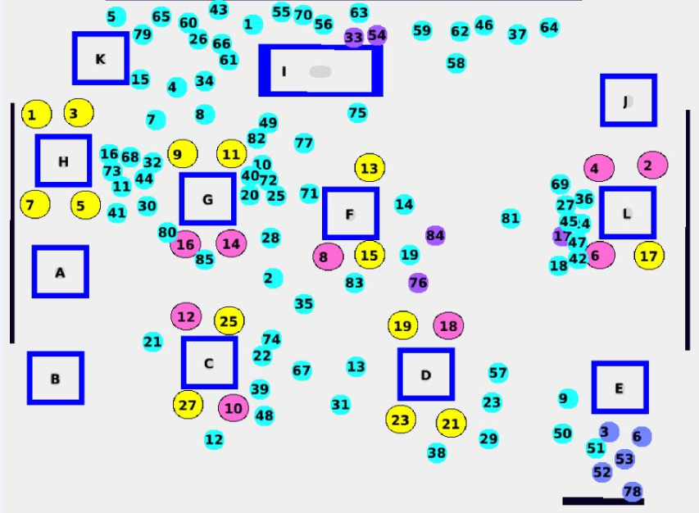
A Math Lit Classroom

Slide 12

Student Feedback
(Survey of 127 students)
Group work – students were split
  Many loved working in groups instead of lecture
    “Much better [than other math classes]. Less intimidating. Much more relaxed and more comfortable.”
    “More teacher/student interaction as opposed to a 2-hour lecture.”
  Many hated the groups
    Feel that “the teacher doesn’t teach,” and you have to “teach yourself”

Slide 13
Setting Expectations
Collaboration as a tool for problem solving and thinking.
Keep calm and carry on: Mathematicians don’t know how to solve every problem immediately. They just know how to start thinking about it.

Slide 14

Our Experience
Has changed our whole philosophy about teaching
Most fun we’ve had since we started teaching
Get to know students much better
We can’t go back

Slide 15

The Data so Far:
Fall 2013-Spring 2015
Success rates (completed Math Lit, C or better)
  53% successfully completed Math Literacy
  Compared to historical average in traditional track of approximately 50% in Beg Alg and 50% in Int Alg
Success in subsequent courses on first attempt
  Students completing Math Literacy had 52% success in Intro to Statistics and General Education Math on first attempt
  Compared to historical average of 66% after Beginning-Intermediate Algebra

Slide 16
The Data so Far:
Fall 2013-Spring 2015
Time to Completion
  WAY too soon for data to be meaningful. But…
  Of students who have gone on to enroll in a college-level course so far, 86% got there in one semester

Slide 17

Challenges
Student expectations and buy-in
  Better explain the course philosophy
  Work on developing “grit”
Instructor training
  Technology skills
  Pedagogy buy-in and comfort
    Philosophy and rationale for the pedagogy
    Importance of setting the right tone and “selling” the course
    Managing group dynamics
    Balance between giving students room to think and providing help

Slide 18
Considerations for Implementing a Redesign
Faculty buy-in
College buy-in and support
Educating advisors and other departments
Training instructors – confidence!
  Sell the course philosophy
  Manage group dynamics
Marketing to students – expectations!
Details, details

