Slide 1
Parkland College Developmental Math Redesign
What Have We Learned?
Brian Mercer and Erin Wilding-Martin

Slide 2

INTEGRATING 21ST CENTURY SKILLS
Topics chosen to prepare students for General Education Mathematics and Statistics, and Life
  Algebra addressed in context, focus on numeracy and functions
  Data analysis and modeling integrated throughout
  Incorporate reading, writing, technology

Slide 3

COLLABORATIVE PEDAGOGY
Group-based problem-solving pedagogy
  Use an online homework system for more skill practice outside of class
  Work on problem-solving, critical thinking, and conceptual understanding in class
  Look at real data, explore patterns, create models, solve problems, have fun

Slide 4
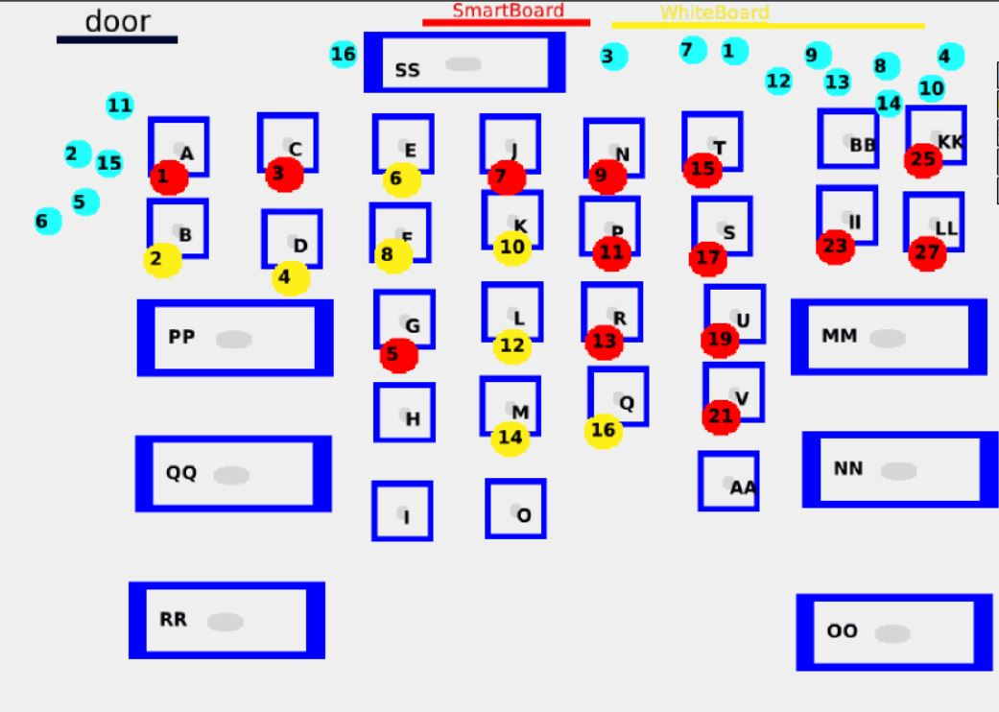
A Traditional Classroom

Slide 5
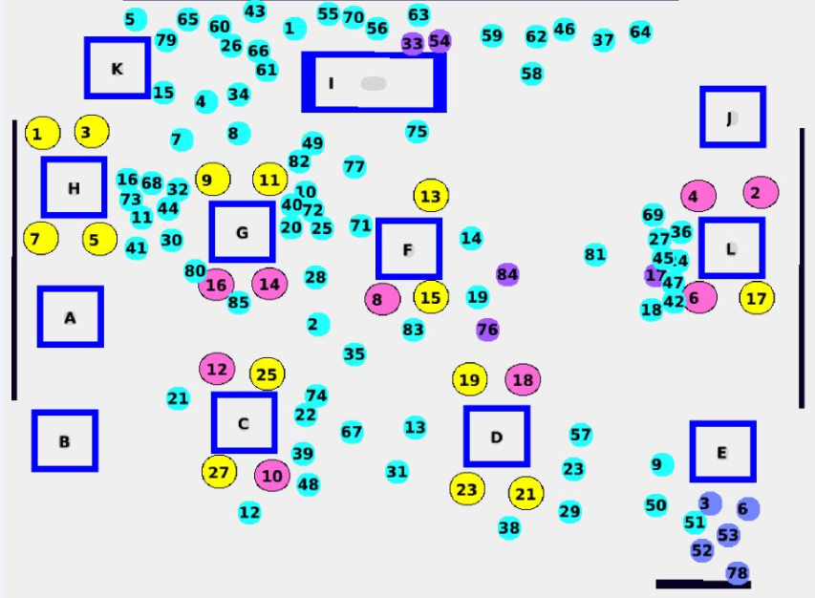
A Math Lit Classroom

Slide 6

The Data so Far
Success rates for Fall 2013 (C or better)
  73% in Math Lit A and 76% in Math Lit B
  55% successfully completed the entire Math Lit sequence
  Compared to historical average in traditional track of approximately 50% in Beg Alg and 50% in Int Alg
Success in subsequent courses
  Pilot students completing Math Literacy in Spring 2013 had 75% success in Intro to Statistics and Liberal Arts Math on first attempt
  Compared to 69% success on any attempt in same courses for traditional track students over years 2008-2012

Slide 7
Student Feedback
(Survey of 127 students)
Content
  Most found at least some of the content to be relevant
  Some even listed specific topics such as compound interest
Assignments
  Many complaints about Excel assignments
  Several commented that they didn’t see the point of the Reflections
  Mixed review of ALEKS skills assignments
    Some love the independent practice
    Some do not see the connection to classroom topics

Slide 8
Student Feedback
(Survey of 127 students)
Group work – students were split
  Many loved working in groups instead of lecture
    “Working in groups was informative—gave more information than I would have expected.”
    “Much better [than other math classes]. Less intimidating. Much more relaxed and more comfortable.”
    “More teacher/student interaction as opposed to a 2-hour lecture.”
  Many hated the groups
    Prefer lecture
    Feel that “the teacher doesn’t teach,” and you have to “teach yourself”
Overall opinions of the course
  52 liked it better than other math courses
  38 thought it was worse than other math courses
  37 were neutral or had a mixed review

Slide 9
Instructor Feedback
(Survey of 10 Instructors)
Most (8) said they definitely enjoyed teaching the class; All said they would request it again
  Fun, closer interaction with students
  “The interaction with the students is exhausting and exciting at the same time.”
  “I get to know the students as people earlier on during the semester-- faster than I would be able to with a lecture course.”
Challenges
  Group dynamics, facilitating good group work
  Explaining to students the reason for discovery learning
  Making sure group work doesn’t “pad” the grade
  Technology skills

Slide 10

Plans for Improvement
STUDENTS
Student expectations and buy-in
  Make the course philosophy more transparent
  Work on developing “grit”
Technology skills
  Work with students on technology skills in class
Group dynamics
  Get ideas for better group facilitation like assigning roles
Individual accountability
  Individual homework quizzes

Slide 11
Plans for Improvement
INSTRUCTORS
Technology skills
  Require instructors to have some tech comfort before teaching the course
  Work with instructors on skills specific to the course
Pedagogy buy-in and comfort
  More informal classroom visits, conversations, and support
    Philosophy and rationale for the pedagogy
    Importance of setting the right tone and “selling” the course to students
    Managing group dynamics
    Balance between giving students room to think and providing help

Slide 12
Contact info
Erin Wilding-Martin
emartin@parkland.edu
Brian Mercer
bmercer@parkland.edu

