Slide 1
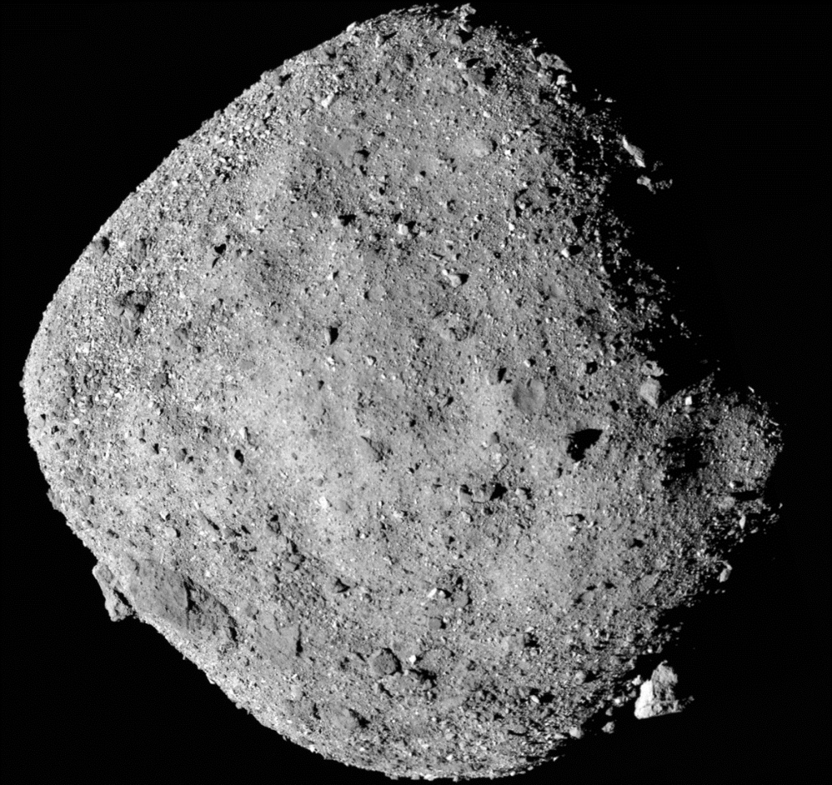
Economics and Policy of Space Resources
SAMPLE SLIDES FOR A LESSON ON SPACE RESOURCES IN AN UNDERGRADUATE ENVIRONMENTAL ECONOMICS OR POLICY CLASS
Erik Nordman, Ph.D.
Professor
Natural Resources Management Program
Grand Valley State University
Allendale, Michigan

Slide 2



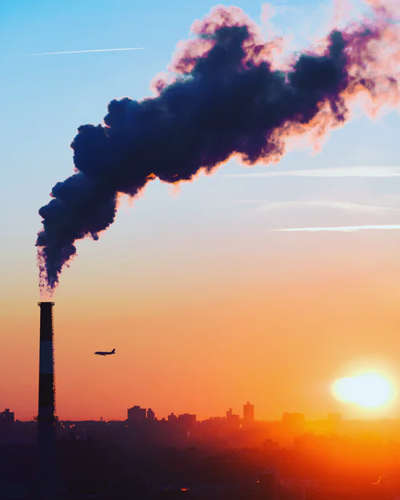
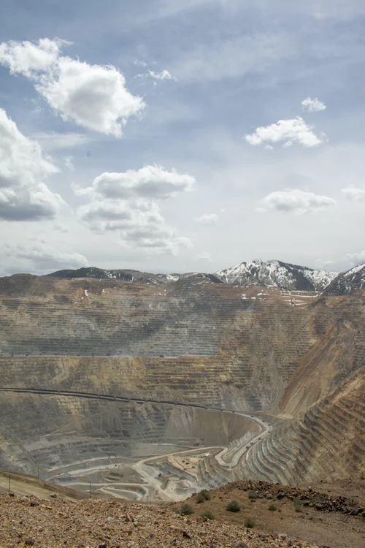
Environmental and resource economics historically focused on terrestrial and marine resources.
Forests
Water
Energy
Pollution
Minerals

Slide 3




Many of these resources can be described as “commons.”
 | Rival (depletable) | Non-rival (non-depletable)
Exclusive | Private goods | Club goods
Non-exclusive | Commons or open access | Public goods
Many resources in space fall into these categories as well.
Notes:
Private goods: most things you buy at the store, like the bag of onions in the picture
Club goods: Cable TV is a club good – pay the monthly fee and get access, doesn’t get used up or depleted. Don’t pay – get cut off
Commons: A common pasture, open all (as Hardin described it). Open access is an unmanaged system. Prone to over exploitation if unmanaged or poorly managed
Public good: PBS – people can watch it without depleting it, but PBS does not exclude people who don’t donate during the pledge drive. Prone to under provision – government often provides

Slide 4
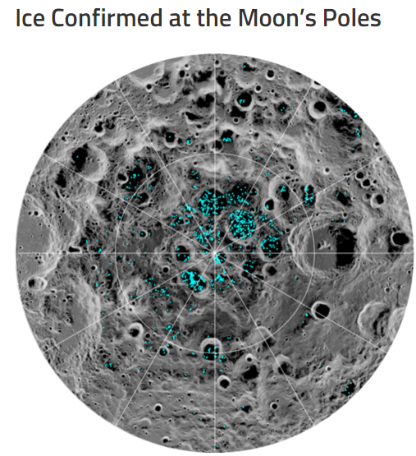
Some space resources will be essentially private goods.
Rival or depletable
Exclusive – if property right clearly defined
Economics of mineral resources – Hotelling rule?
Source: NASA/Goddard/University of Arizona
Source: NASA

Slide 5

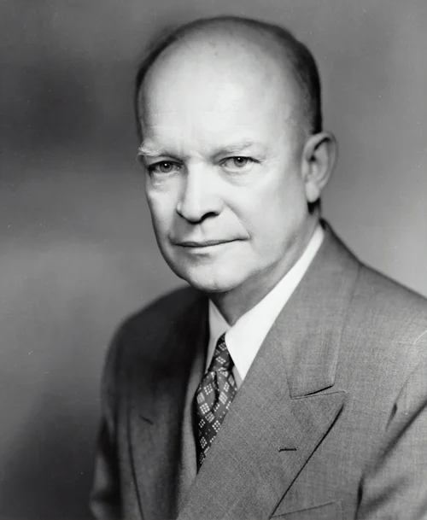
Property rights for space resources are complicated!
Outer Space Treaty
Treaty on Principles Governing the Activities of States in the Exploration and Use of Outer Space, Including the Moon and Other Celestial Bodies
Antarctic Treaty System – 1959
Signatories shall not assert territorial claims or sovereignty in Antarctica
A place for peaceful and scientific purposes
Prevent "a new form of colonial competition" in space
No nation can assert territorial claims on Moon, other resources
Notes:
President Eisenhower encouraged the adoption of the Antarctic Treaty System model to outer space resources.

Slide 6
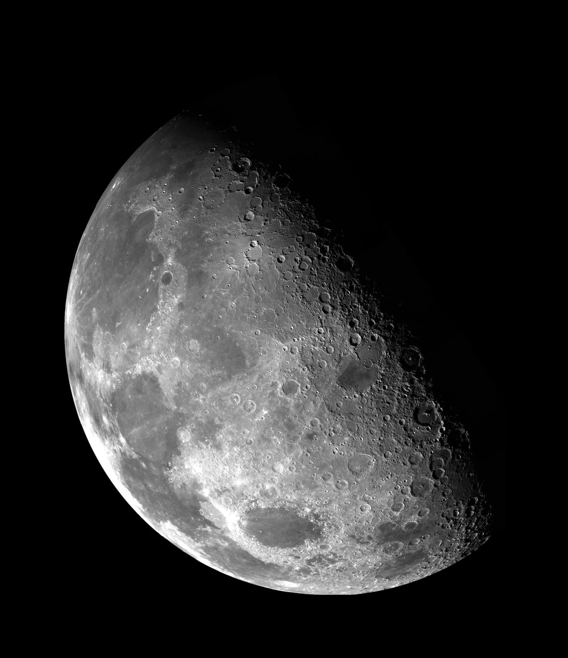

The Moon Agreement is contentious.
Most space powers are not signatories.
“Moon and its natural resources are the common heritage of mankind…”
“common heritage” ≠ commons
Moon’s natural resources shall not “become the property of any State, international intergovernmental or non-governmental organization, national organization or non-governmental entity or of any natural person.”

Slide 7
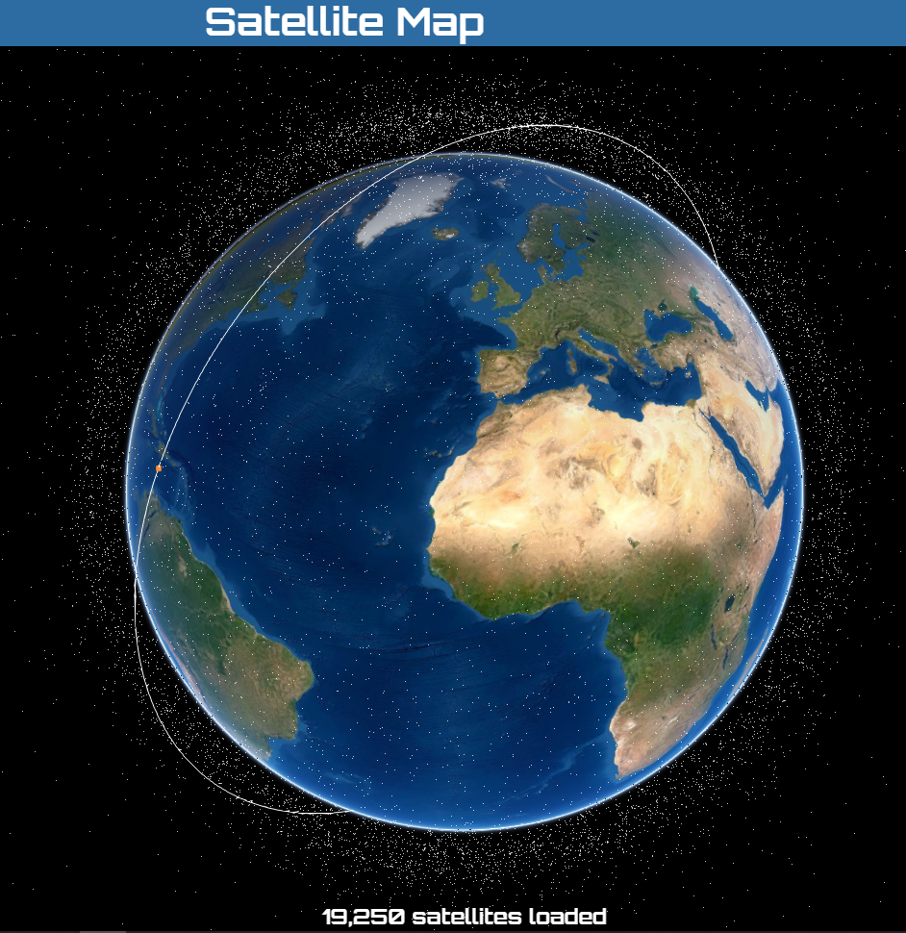
Other space resources may be commons.
Low Earth orbit
Rival (depletable)
Non-exclusive
Commons or open access
Many objects in orbit
Active satellites
Defunct satellites
Debris (space junk)
HOWEVER
Space resources are not common property in the legal sense
https://maps.esri.com/rc/sat2/index.html

Slide 8

Space junk is a form of pollution.
Few incentives to de-orbit defunct satellites or remove debris
Voluntary compliance?
Prescriptive regulations?
Market-based approaches?

Slide 9
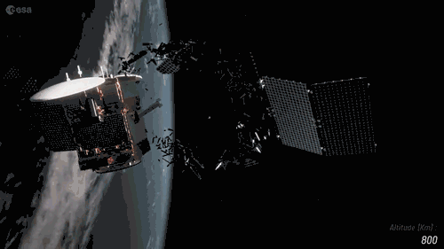
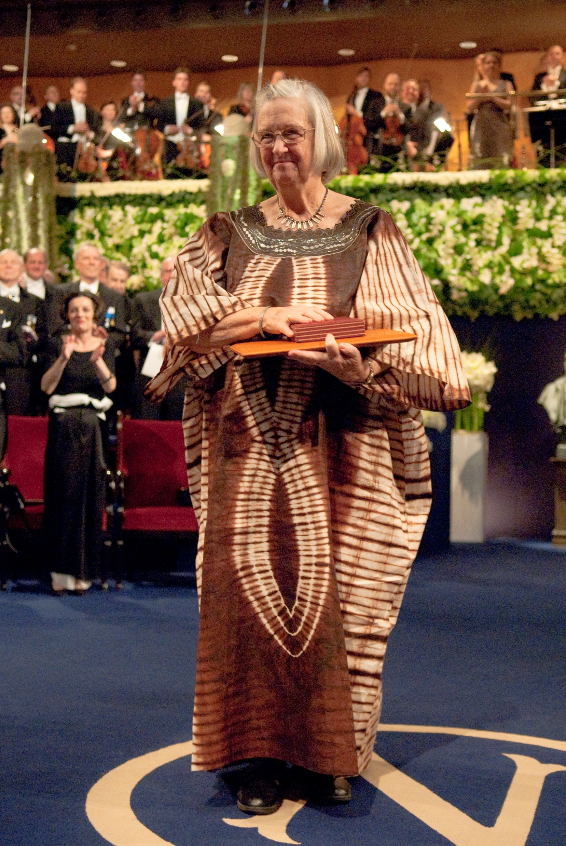
Collaboration is critical to managing a space commons.
Collisions happen!
Collisions make more debris
Cascading collisions → Kessler syndrome
Must coordinate launches, orbits
Ostrom’s ideas for governing commons may apply

Slide 10


Collision monitoring is analogous to a space lighthouse.
Lighthouse
Classic public good
Non-rival (non-depletable) and non-exclusive
Collision monitoring
Threat to one object is a threat to all
Difficult to exclude users
“Space situational awareness”

Slide 11
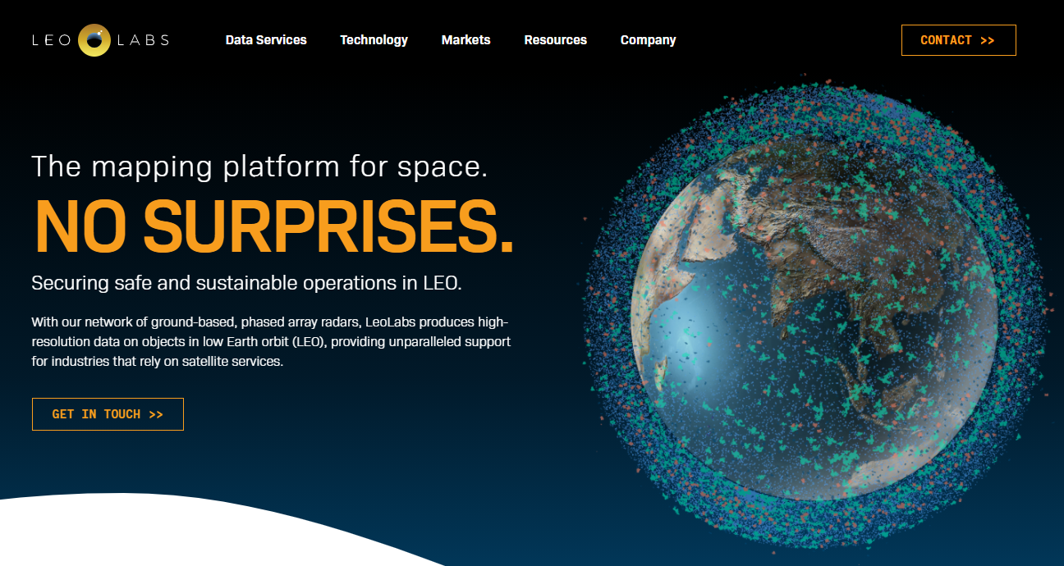
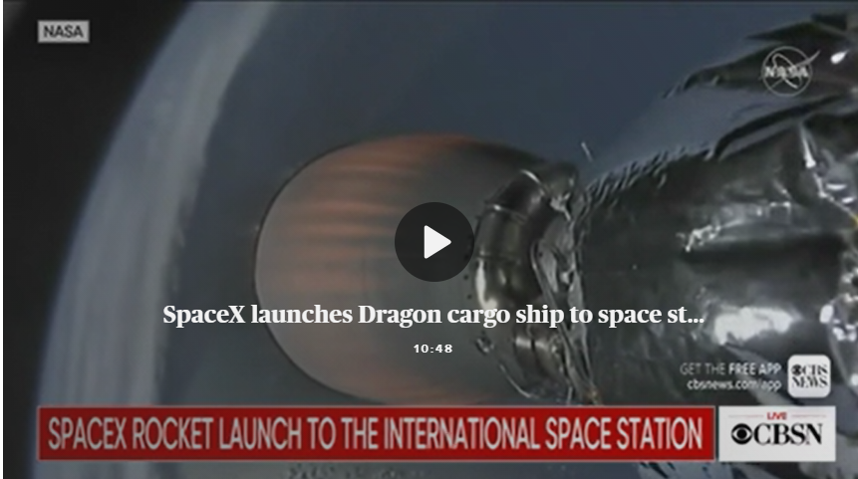
Governments still play a major role, but the private sector is increasingly active.
Orbital debris monitoring
Satellites for
Communication
Observation
Transporting cargo to ISS

Slide 12
Concepts from environmental economics and policy can help inform and manage space resources.
Non-renewable minerals
Commons
Public goods
Markets, treaties, regulations – it’s all here!

